Slide 1
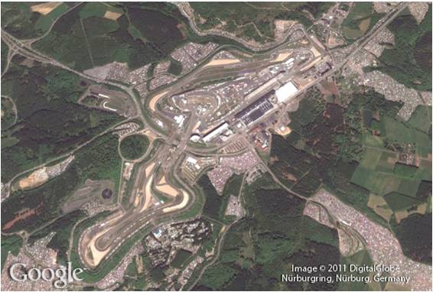
Rational Expressions
7
Copyright © Cengage Learning. All rights reserved.

Slide 2
SECTION 7.4
Equations Involving Rational
Expressions
Copyright © Cengage Learning. All rights reserved.

Slide 3
Objective
A
Solve equations that contain rational expressions.

Slide 4
Solving Rational Equations
A

Slide 5
Solving Rational Equations
The first step in solving an equation that contains one or more rational expressions is to find the LCD for all denominators in the equation. Once the LCD has been found, we multiply both sides of the equation by it.
The resulting equation should be equivalent to the original one (unless we inadvertently multiplied by zero) and free from any denominators except the number 1.

Slide 6
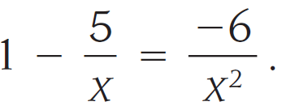
Example 3
Solve
Solution:
The LCD is x². Multiplying both sides by x², we have

Slide 7
Example 3 – Solution
cont’d
We have a quadratic equation, which we write in standard form, factor, and solve.
The two possible solutions are 2 and 3.

Slide 8
Example 3 – Solution
cont’d
Checking each in the original equation, we find they both give true statements. They are both solutions to the original equation.

Slide 9
Example 5
Solve
Solution:
We begin by multiplying each term on both sides of the equation by the LCD, 2(x – 3).

Slide 10
Example 5 – Solution
cont’d
Our only possible solution is x = 3. If we substitute x = 3 into our original equation, we get

Slide 11
Example 5 – Solution
cont’d
Two of the terms are undefined, so the equation is meaningless. What has happened is that we have multiplied both sides of the original equation by zero.
The equation produced by doing this is not equivalent to our original equation.
We always must check our solution when we multiply both sides of an equation by an expression containing the variable to make sure we have not multiplied both sides by zero.

Slide 12
Example 5 – Solution
cont’d
Our original equation has no solution; that is, there is no real number x such that
The solution set is Ø.

Slide 13
Example 6
Solve $\frac{a+4}{a^{2}+5a}=\frac{−2}{a^{2}−25}$
Solution:
Factorize each denominator, we have
$\frac{a+4}{a(a+5)}=\frac{−2}{(a+5)(a−5)}$
The LCD is $a(a+5)(a−5)$.
Multiply both sides of the equation by the LCD,
$$a(a+5)(a−5)\frac{a+4}{a\left(a+5\right)}=\frac{−2}{\left(a+5\right)\left(a−5\right)}a(a+5)(a−5)$$

Slide 14
Example 6 – Solution
cont’d
$\left(a−5\right)\left(a+4\right)=−2a$
$a^{2}−a−20=−2a$
$a^{2}+a−20=0$
Factoring the left side, we have
$\left(a+5\right)\left(a−4\right)=0$
Therefore either a = -5 or a = 4
The solution a = 4 checks. But if we put a = -5 ,
$\frac{(−5)+4}{{(−5)}^{2}+5(−5)}=\frac{−2}{{(−5)}^{2}−25}$
$\frac{−1}{0}=\frac{−2}{0}$
This indicates that a = -5 is not a solution.
?
?
False statement.

