Slide 1
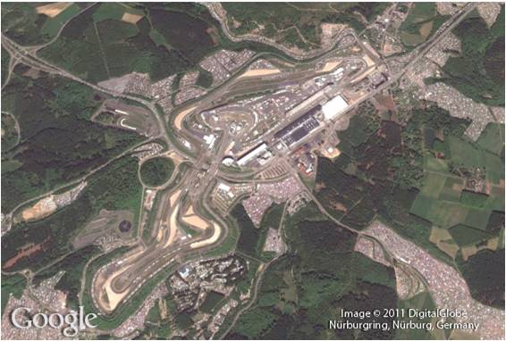
Rational Expressions
7
Copyright © Cengage Learning. All rights reserved.

Slide 2
SECTION 7.5
Applications of Rational Expressions
Copyright © Cengage Learning. All rights reserved.

Slide 3
Objectives
A
Solve applications whose solutions depend on solving an equation containing rational expressions.
Graph an equation involving a rational expression.
B

Slide 4
Applications Involving Rational Expressions
A

Slide 5
Example 1
One number is twice another. The sum of their reciprocals is $\frac{9}{2}$ . Find the two numbers.
Solution
Let x = the smaller number . The larger number then must be 2x.
Their reciprocals are $\frac{1}{x}$ and $\frac{1}{2x}$ respectively.
Equation: $\frac{1}{x}+\frac{1}{2x}=\frac{9}{2}$

Slide 6
Example 1 – Solution
cont’d
We can multiply both sides by the LCD, which is 2x, and then solve the resulting equation.
$2x\left(\frac{1}{x}\right)+2x\left(\frac{1}{2x}\right)=2x\left(\frac{9}{2}\right)$
$2+1=9x$
$3=9x$
$x=\frac{3}{9}=\frac{1}{3}$
The smaller number is $\frac{1}{3}$ and the larger number is twice as large, hence it must be $\frac{2}{3}$.

Slide 7
Applications Involving Rational Expressions
Let us have a rate equation application.
For example, if you travelled 120 miles in 2 hours, then your rate (speed) is
120 mi / 2 hr = 60mph
distance
Rate =
time

Slide 8
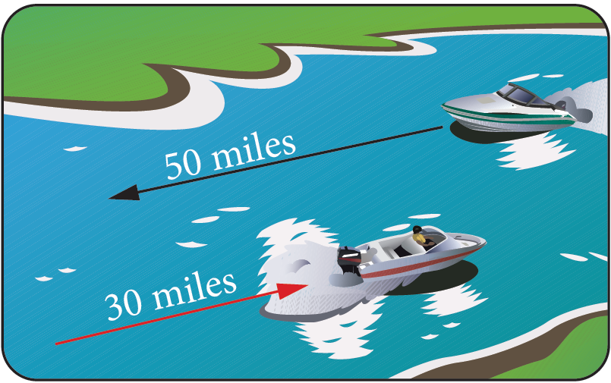
Example 2
A boat travels 30 miles up a river in the same amount of time it takes to travel 50 miles down the same river.
If the current is 5 miles per hour, what is the speed of the boat in still water?

Slide 9
Example 2 – Solution
The easiest way to work a problem like this is with a table. The top row of the table is labeled with d for distance, r for rate, and t for time.
The left column of the table is labeled with the two trips: upstream and downstream. Here is what the table looks like:
The next step is to read the problem over again and fill in as much of the table as we can with the information in the problem.

Slide 10
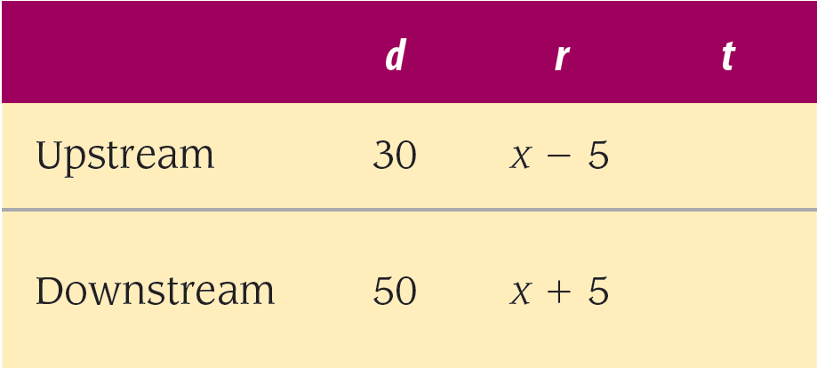
Example 2 – Solution
cont’d
The distance the boat travels upstream is 30 miles and the distance downstream is 50 miles. Since we are asked for the speed of the boat in still water, we will let that be x.
If the speed of the boat in still water is x, then its speed upstream (against the current) must be x – 5, and its speed downstream (with the current) must be x + 5.
Putting these four quantities into the appropriate positions in the table, we have

Slide 11
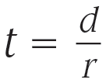
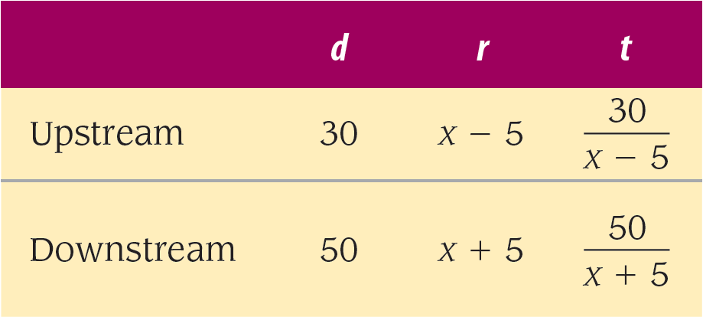
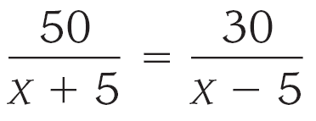
Example 2 – Solution
cont’d
The last positions in the table are filled in by using an equivalent form of the rate equation .
Reading the problem again, we find that the time for the trip upstream is equal to the time for the trip downstream. Setting these two quantities equal to each other, we have our equation:

Slide 12
Example 2 – Solution
cont’d
The LCD is
We multiply both sides of the equation by the LCD to clear it of all denominators. Here is the solution:
The speed of the boat in still water is 20 miles per hour.

Slide 13
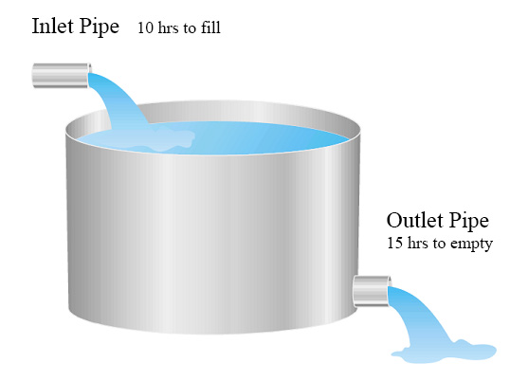
Example 4
A inlet pipe can fill a water tank in 10 hours, while an outlet pipe can empty the same tank in 15 hours. By mistake, both pipes are left open in the beginning when the tank is empty. How long will it take to fill the water tank?

Slide 14
Example 4 – Solution
cont’d
Solution
Let x = number of hours to fill the tank with both pipes open.
In one hour, the inlet pipe can fill 1/10 of the tank.
In one hour, the outlet pipe can empty 1/15 of the tank.
With both pipes open, they can fill $\frac{1}{10}−\frac{1}{15}$ of the tank.
Equation $\frac{1}{10}−\frac{1}{15}=\frac{1}{x}$
The LCD of the equation is 30x. So we multiply 30x on each term. $30x\left(\frac{1}{10}\right)−3x\left(\frac{1}{15}\right)=30x\left(\frac{1}{x}\right)$
$3x −2x=30$
$x=30$

Slide 15
Graphing Rational Equations
B

Slide 16
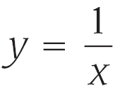
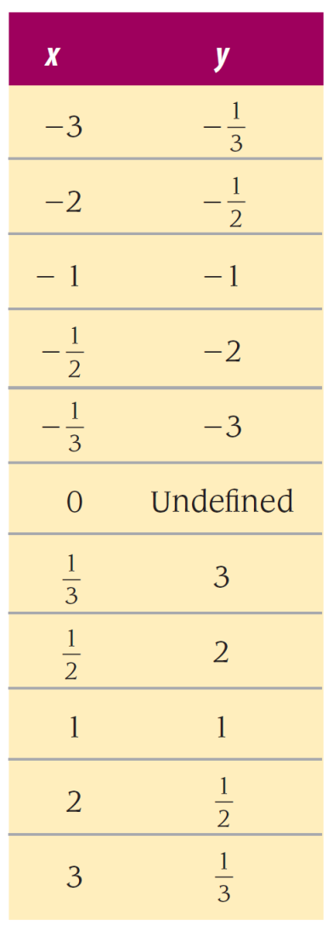
Example 5
Graph the equation .
Solution:
Since this is the first time we have graphed an equation of this form, we will make a table of values for x and y that satisfy the equation.

Slide 17
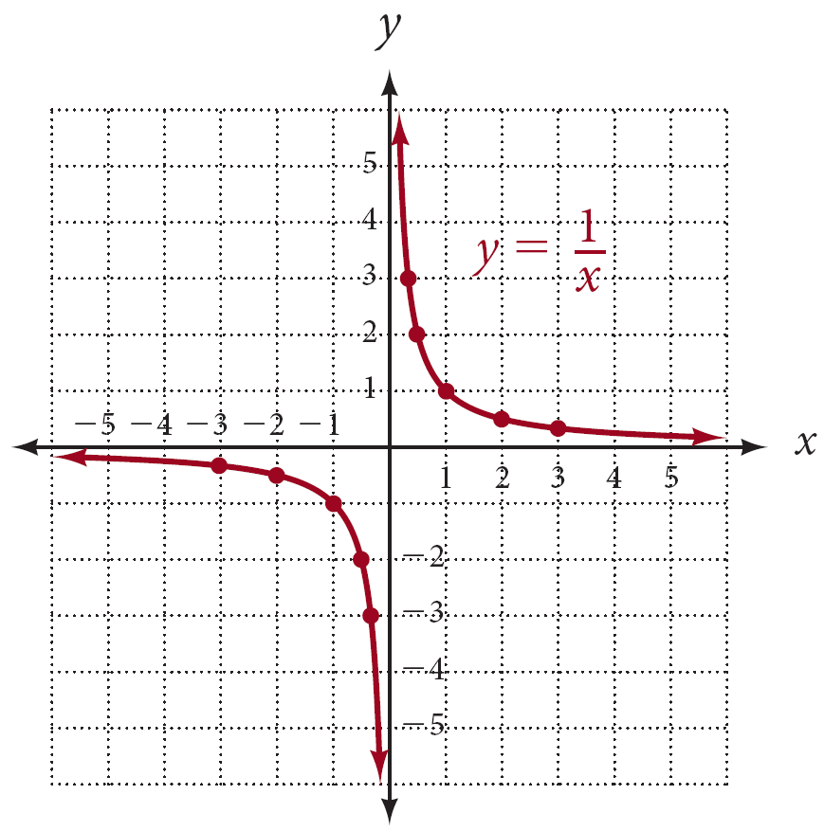
Example 5 – Solution
cont’d
Before we do, let’s make some generalizations about the graph (Figure 1).
First, notice that since y is equal to 1 divided by x, y will be positive when x is positive. (The quotient of two positive numbers is a positive number.)
Figure 1

Slide 18
Example 5 – Solution
cont’d
Likewise, when x is negative, y will be negative. In other words, x and y always will have the same sign.
Thus, our graph will appear in quadrants I and III only because in those quadrants x and y have the same sign.
Next, notice that the expression will be undefined when x is 0, meaning that there is no value of y corresponding to x = 0. Because of this, the graph will not cross the y-axis.

Slide 19
Example 5 – Solution
cont’d
Further, the graph will not cross the x-axis either. If we try to find the x-intercept by letting y = 0, we have
But there is no value of x to divide into 1 to obtain 0.
Therefore, since there is no solution to this equation, our graph will not cross the x-axis.
To summarize, we can expect to find the graph in quadrants I and III only, and the graph will cross neither axis.

