Slide 1

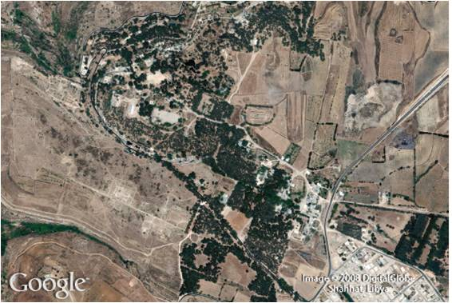
Roots and Radicals
8
Copyright © Cengage Learning. All rights reserved.

Slide 2
SECTION 8.3
Simplified Form for Radicals
Copyright © Cengage Learning. All rights reserved.

Slide 3
Objectives
A
Use properties of radicals to write a radical
expression in simplified form.
Rationalize the denominator in a radical
expression that contains only one term in the
denominator.
B

Slide 4
Simplified Form for Radicals
A

Slide 5
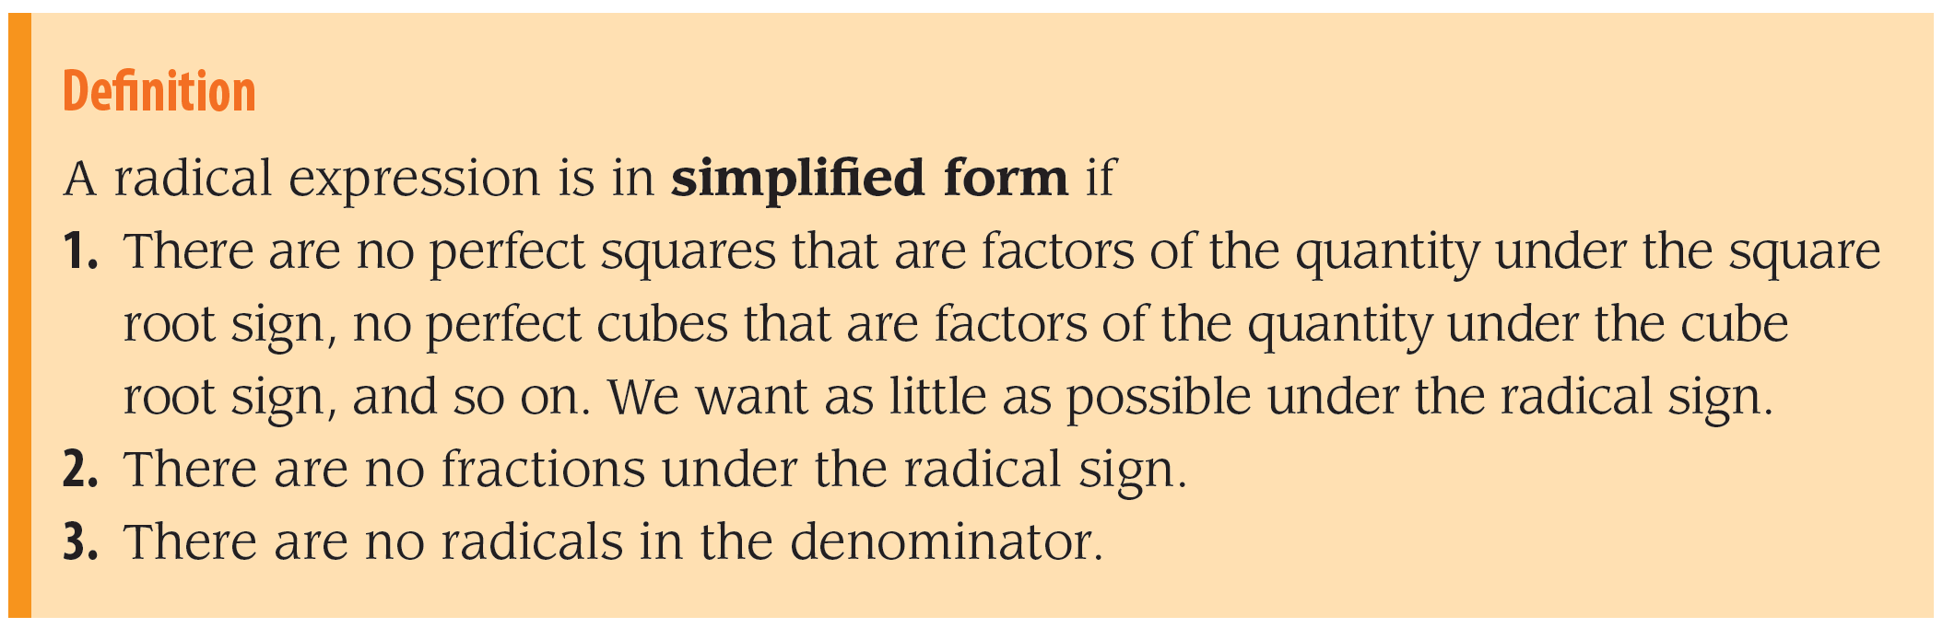
Simplified Form for Radicals
Radical expressions that are in simplified form are generally easier to work with.
A radical expression is in simplified form if it has three special characteristics.

Slide 6
Simplified Form for Radicals
The tools we will use to put radical expressions into simplified form are the properties of radicals. We list the properties as follows:

Slide 7
Simplified Form for Radicals
The next examples illustrate how we put a radical expression into simplified form using the three properties of radicals.
Although the properties are stated for square roots only, they hold for all roots.

Slide 8
Rationalizing the Denominator
B

Slide 9

Example 1
Put into simplified form.
Solution:
The expression is not in simplified form because there is a fraction under the radical sign.
We can change this by applying the quotient property for
radicals.

Slide 10

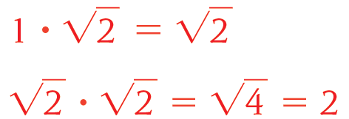
Example 1 – Solution
cont’d
The expression is not in simplified form because there is a radical sign in the denominator.
If we multiply the numerator and denominator of by
the denominator becomes

Slide 11
Rationalizing the Denominator
If we check the expression against our definition of simplified form for radicals, we find that all three rules hold.
There are no perfect squares that are factors of 2. There are no fractions under the radical sign. No radicals appear
in the denominator.
The expression, therefore, must be in simplified form.

Slide 12
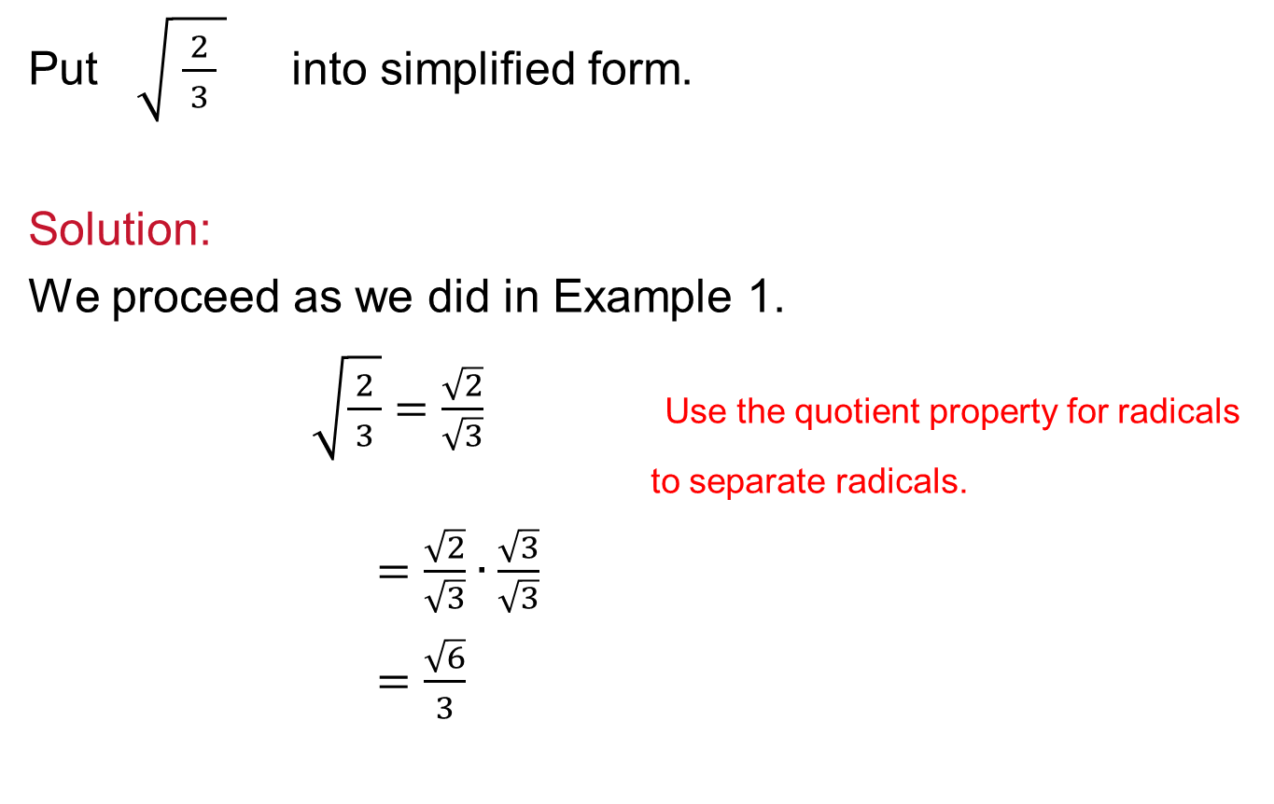
Example 2
Put $\sqrt{ \frac{ 2 }{ 3 } }$ into simplified form.
Solution:
We proceed as we did in Example 1.
$\sqrt{\frac{ 2 }{ 3 }}=\frac{\sqrt{2}}{\sqrt{3}}$ Use the quotient property for radicals
to separate radicals.
$=\frac{\sqrt{2}}{\sqrt{3}}∙\frac{\sqrt{3}}{\sqrt{3}}$
$=\frac{\sqrt{6}}{3}$

Slide 13
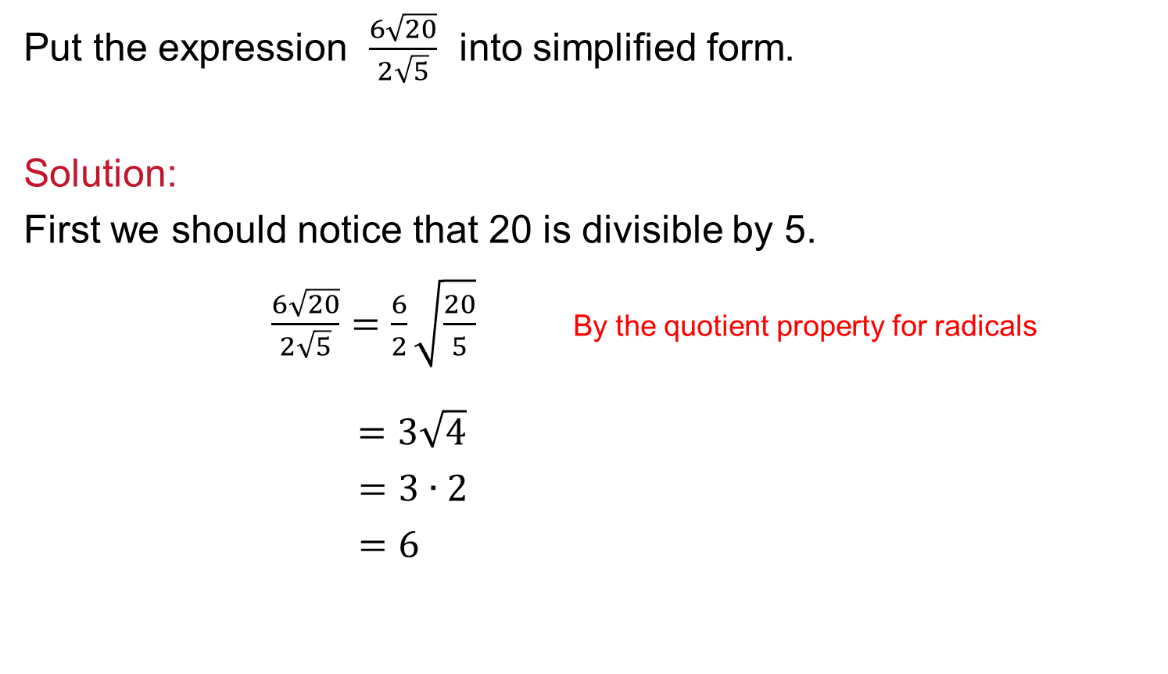
Example 3
Put the expression $\frac{6\sqrt{20}}{2\sqrt{5}}$ into simplified form.
Solution:
First we should notice that 20 is divisible by 5.
$\frac{6\sqrt{20}}{2\sqrt{5}}=\frac{6}{2}\sqrt{\frac{20}{5}}$ By the quotient property for radicals
$=3\sqrt{4}$
$=3∙2$
$=6$

Slide 14
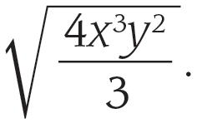
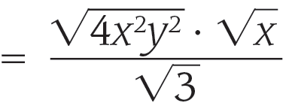
Example 4
Simplify
Solution:
We begin by separating the numerator and denominator and then taking the perfect squares out of the numerator.

Slide 15
Example 4 – Solution
cont’d
The only thing keeping our expression from being in simplified form is the in the denominator.
We can take care of this by multiplying the numerator and
denominator by

Slide 16
Rationalizing the Denominator
Although the final expression in Example 4 may look more complicated than the original expression, it is in simplified form.
The last step is called rationalizing the denominator. We have taken the radical out of the denominator and replaced it with a rational number.

Slide 17
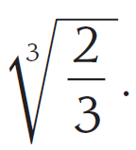
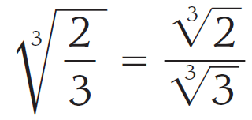
Example 5
Simplify
Solution:
We can apply the quotient property first to separate the cube roots.
To write this expression in simplified form, we must remove the radical from the denominator.
Since the radical is a cube root, we will need to multiply it
by an expression that will give us a perfect cube under that cube root.

Slide 18

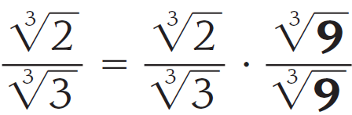
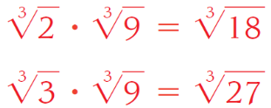
Example 5 – Solution
cont’d
We can accomplish this by multiplying the numerator and denominator by .
Here is what it looks like:

Slide 19
Example 5 – Solution
cont’d
To see why multiplying the numerator and denominator by
works in this example, you first must convince yourself that multiplying the numerator and denominator by would not have worked.

Slide 20
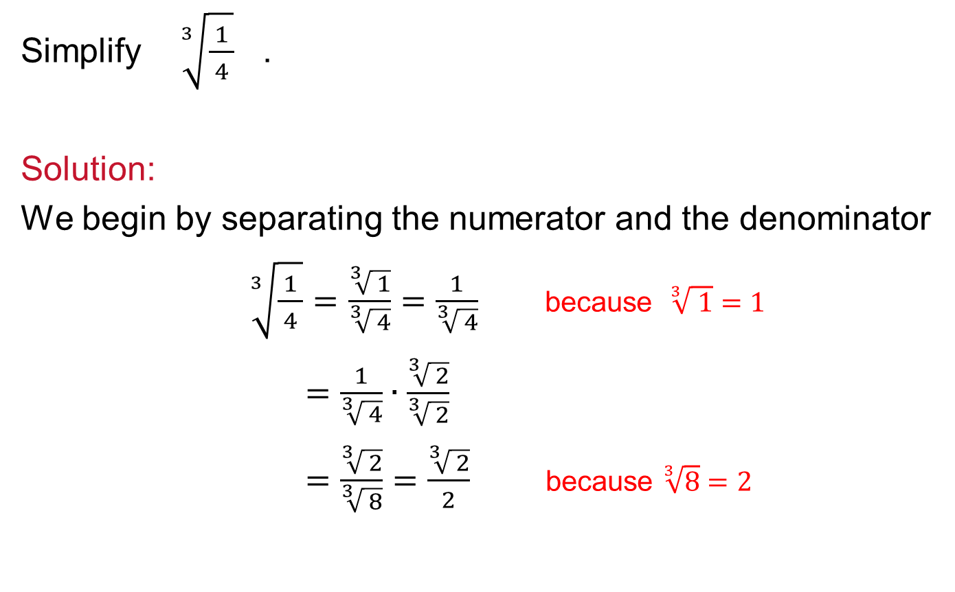
Example 6
Simplify $\sqrt[3]{\frac{ 1 }{ 4 }}$ .
Solution:
We begin by separating the numerator and the denominator
$\sqrt[3]{\frac{ 1 }{ 4 }}=\frac{\sqrt[3]{ 1}}{\sqrt[3]{ 4}}=\frac{1}{\sqrt[3]{ 4}}$ because $\sqrt[3]{ 1}=1$
$=\frac{1}{\sqrt[3]{ 4}}∙\frac{\sqrt[3]{ 2}}{\sqrt[3]{ 2}}$
$=\frac{\sqrt[3]{ 2}}{\sqrt[3]{ 8}}=\frac{\sqrt[3]{ 2}}{2}$ because $\sqrt[3]{8}=2$

