Slide 1
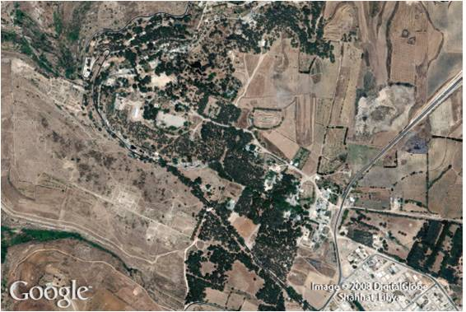
Roots and Radicals
8
Copyright © Cengage Learning. All rights reserved.

Slide 2
SECTION 8.4
Addition and Subtraction of Radical Expressions
Copyright © Cengage Learning. All rights reserved.

Slide 3
Addition and Subtraction of Radical Expressions
A

Slide 4
Addition and Subtraction of Radical Expressions
To add two or more radical expressions, we apply the distributive property.
Adding radical expressions is similar to adding similar terms of polynomials.

Slide 5
Example 2
Combine terms in the expression
Solution:

Slide 6
Addition and Subtraction of Radical Expressions
In Example 2, each term was a radical expression in simplified form. If one or more terms are not in simplified form, we must put them into simplified form and then combine terms, if possible.
The most time-consuming part of combining most radical expressions is simplifying each term in the expression.
Once this has been done, applying the distributive property is simple and fast.

Slide 7
Example 4
Combine terms in the expression $5\sqrt{75}+\sqrt{27}−\sqrt{3}$
Solution:
$5\sqrt{75}+\sqrt{27}−\sqrt{3}=5\sqrt{25}\sqrt{3}+\sqrt{9}\sqrt{3}−\sqrt{3}$
$=5∙5\sqrt{3}+3\sqrt{3}−\sqrt{3}$
$=25\sqrt{3}+3\sqrt{3}−\sqrt{3}$
$=(25+3−1)\sqrt{3}$
$=27\sqrt{3}$

Slide 8
Example 5
Simplify
Solution: We must assume that a represents a positive number. Then we simplify each term in the expression by putting it in simplified form for radicals.

Slide 9
Example 5 – Solution
cont’d

Slide 10
Example 6
Combine terms in the expression.
(Assume x is a positive real number.)
Solution:

Slide 11
Example 6 – Solution
cont’d
Each term is now in simplified form. The best we can do next is to combine the first two terms. The last term does not have the common radical
We have, in any case, succeeded in reducing the number of terms in our original problem.

