Slide 1
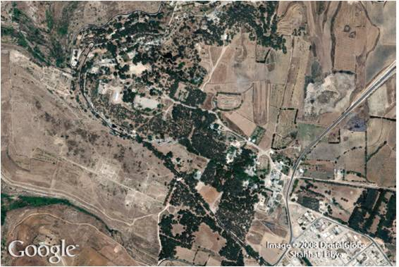
Roots and Radicals
8
Copyright © Cengage Learning. All rights reserved.

Slide 2
SECTION 8.5
Multiplication and Division of Radicals
Copyright © Cengage Learning. All rights reserved.

Slide 3
Objectives
A
Multiply radical expressions.
Rationalize the denominator in a radical expression that contains two terms in the denominator.
B

Slide 4
Multiplication and Division of Radicals
In this section, we will look at multiplication and division of expressions that contain radicals.
As you will see, multiplication of expressions that contain radicals is very similar to multiplication of polynomials.

Slide 5
Multiplying Radical Expressions
A

Slide 6
Example 1
Multiply .
Solution:
We can rearrange the order and grouping of the numbers in this product by applying the commutative and associative properties.
Following that, we apply the product property for radicals and multiply.

Slide 7
Example 1 – Solution
cont’d
In actual practice, it is not necessary to show either of the first two steps, although you may want to show them on the first few problems you work, just to be sure you understand them.

Slide 8
Example 3
Multiply $3\sqrt{2}(2\sqrt{5}+5\sqrt{3}$ ) .
Solution:
$3\sqrt{2}\left(2\sqrt{5}+5\sqrt{3}\right)=3\sqrt{2}∙2\sqrt{5}+3\sqrt{2}∙2\sqrt{5}$
$=3∙2∙\sqrt{2}∙\sqrt{5}+3∙5∙\sqrt{2}∙\sqrt{3}$
$=6\sqrt{10}+15\sqrt{6}$
Each term in the last line is in simplified form, so that problem is complete.

Slide 9
Example 4
Multiply .
Solution:
We multiply using the FOIL method that we used to multiply binomials.

Slide 10
Example 4 – Solution
cont’d
We must be careful not to simplify further by adding 19 and 9. We can add only radical expressions that have a common radical part; 19 and are not similar.

Slide 11
Example 6
Expand and simplify .
Solution:
Multiplying times itself, we have

Slide 12
Example 7
Multiply .
Solution:
We can apply the formula (x + y)(x − y) = x² − y² to obtain
We also could have multiplied the two expressions using the FOIL method.

Slide 13
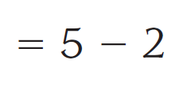
Example 7 – Solution
cont’d
If we were to do so, the work would look like this:
In either case, the product is 3. Also, the expressions and are called conjugates of each other.

Slide 14
Multiplying Radical Expressions

Slide 15
Rationalizing the Denominator
B

Slide 16
Example 9
Rationalize the denominator in the expression $\frac{\sqrt{3}}{\sqrt{3}−\sqrt{2} }$ .
Solution:
To remove the radical in the denominator, we must multiply the numerator and denominator by the conjugate of the denominator, which is $\sqrt{3}+\sqrt{2}$ .
$\frac{\sqrt{3}}{\sqrt{3}−\sqrt{2}}=\frac{\sqrt{3}}{\sqrt{3}−\sqrt{2}}∙\frac{\sqrt{3}+\sqrt{2}}{\sqrt{3}+\sqrt{2}}$
$=\frac{\sqrt{3}∙\sqrt{3}+\sqrt{3}∙\sqrt{2}}{{\left(\sqrt{3}\right)}^{2}−{\left(\sqrt{2}\right)}^{2}}=\frac{3+\sqrt{6}}{3−2}=\frac{3+\sqrt{6}}{1}$

Slide 17
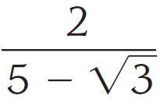
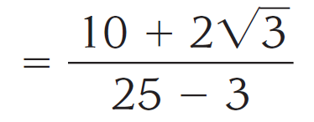
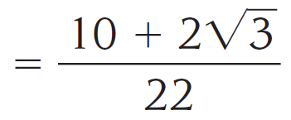
Example 10
Rationalize the denominator in the expression .
Solution:
To remove the radical in the denominator, we must multiply the numerator and denominator by the conjugate of the denominator, which is .

Slide 18
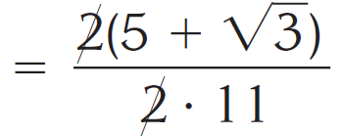
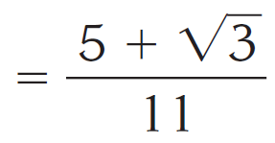
Example 10 – Solution
cont’d
The numerator and denominator of this last expression have a factor of 2 in common.
We can reduce to lowest terms by dividing out the common factor 2. Continuing, we have
The final expression is in simplified form.

Slide 19
Example 11
Rationalize the denominator in the expression $\frac{\sqrt{2}+\sqrt{3} }{\sqrt{2}−\sqrt{3} }$ .
Solution:
To remove the radical in the denominator, we must multiply the numerator and denominator by the conjugate of the denominator, which is $\sqrt{2}+\sqrt{3}$ .
$\frac{\sqrt{2}+\sqrt{3} }{\sqrt{2}−\sqrt{3} }=\frac{\sqrt{2}+\sqrt{3} }{\sqrt{2}−\sqrt{3} }∙\frac{\sqrt{2}+\sqrt{3}}{\sqrt{2}+\sqrt{3}}=\frac{\sqrt{2}∙\sqrt{2}+\sqrt{2}∙\sqrt{3}+\sqrt{3}∙\sqrt{2}+\sqrt{3}∙\sqrt{3}}{{\left(\sqrt{2}\right)}^{2}−{\left(\sqrt{3}\right)}^{2}}$
$=\frac{2+\sqrt{6}+\sqrt{6}+3}{2−3}$
$=\frac{5+2\sqrt{6}}{−1}=−5−2\sqrt{6}$

