Slide 1
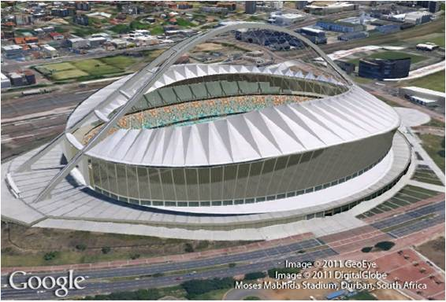
Quadratic Equations
9
Copyright © Cengage Learning. All rights reserved.

Slide 2
SECTION 9.3
The Quadratic Formula
Copyright © Cengage Learning. All rights reserved.

Slide 3
Objective
A
Solve a quadratic equation by using the quadratic formula.

Slide 4
The Quadratic Formula
A

Slide 5
The Quadratic Formula

Slide 6
Example 1
Solve x² – 5x – 6 = 0 by using the quadratic formula.
Solution:
To use the quadratic formula, we must make sure the equation is in standard form; identify a, b, and c; substitute them into the formula; and work out the arithmetic.
For the equation x² – 5x – 6 = 0, a = 1, b = –5, and c = –6.

Slide 7
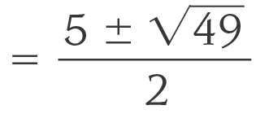
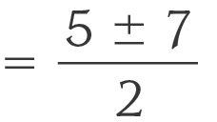
Example 1 – Solution
cont’d

Slide 8
Example 1 – Solution
cont’d
The two solutions are 6 and –1.

Slide 9
Example 4
Solve x² – 6x = –7.
Solution:
We begin by writing the equation in standard form.
Using, a = 1, b = –6, and c = 7 in the quadratic formula

Slide 10
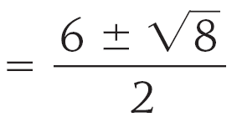
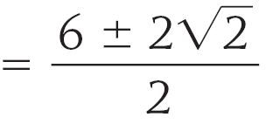
Example 4 – Solution
cont’d
We have,

Slide 11
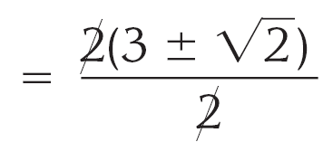
Example 4 – Solution
cont’d
The two terms in the numerator have a 2 in common.
We reduce to lowest terms by factoring the 2 from the numerator and then dividing numerator and denominator by 2.
x
The two solutions are and .

Slide 12
Example 5
Solve 2x² + 5x – 8 = 0.
Solution:
We first set, a = 2, b = 5, and c = -8 in the quadratic formula
We then have $x=\frac{−5±\sqrt{25−4(2)(−8)}}{2(2)}$
$x=\frac{−5±\sqrt{25 + 64 }}{4}=\frac{−5±\sqrt{89}}{4}$

