Slide 1
MA180 Introduction
“Calculus” is a Latin word, which literally means “small pebble”; and these pebbles are used for counting or calculations.
In mathematics, Calculus is a relatively new field developed during the second half of the 17th century (1670 to 1700). During that time, many new problems surfaced due to the advancements in physics, engineering, and mathematics.
However, those problems cannot be solved by existing algebraic and geometric methods because they will take an infinite number of steps to do so. Therefore a new kind of mathematics, now called Calculus, must be invented to solve those problems (in a finite number of steps).
The two most notable founding fathers of calculus are Sir Isaac Newton in England, and Gottfried Leibniz from Germany. Later on, many brilliant minds in mathematics such as Gauss, Euler, Riemann, and Weierstrass helped to shape and improve this subject to the almost perfect state it is in today.

Slide 2
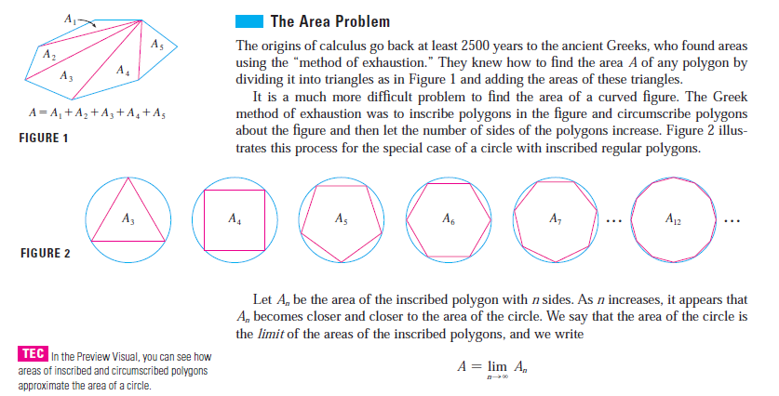
Famous mathematical problems that cannot be solved by traditional methods (in a finite number of steps)

Slide 4
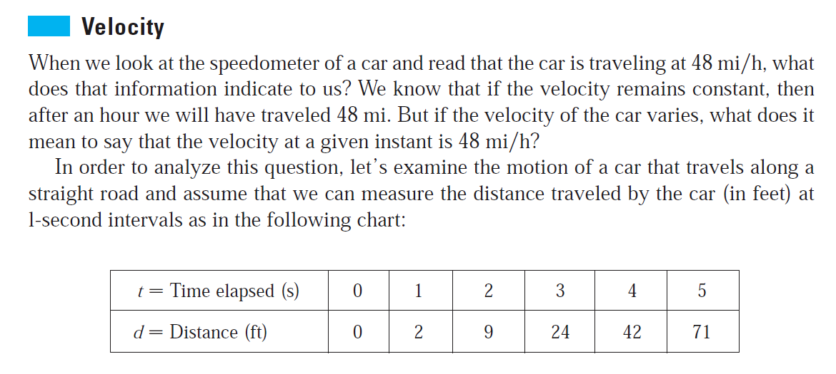

Slide 5
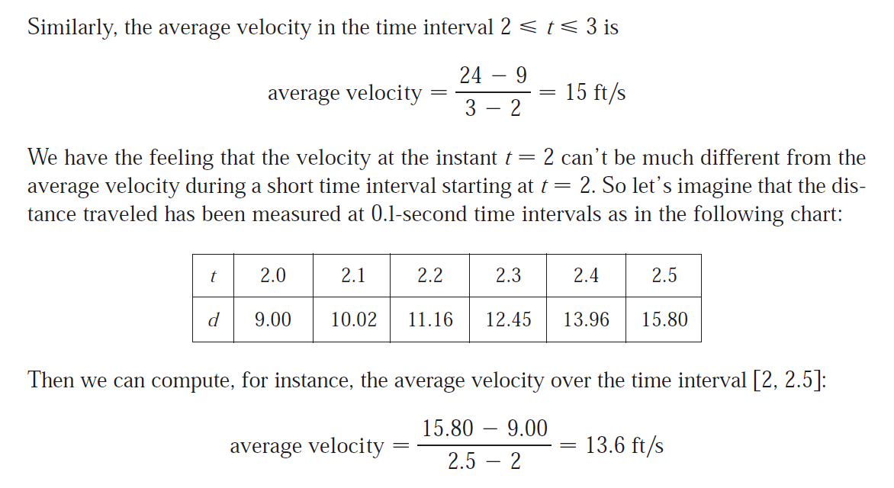

Slide 6
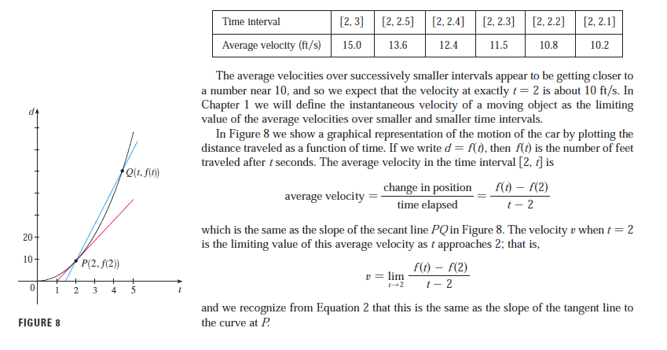

Slide 7
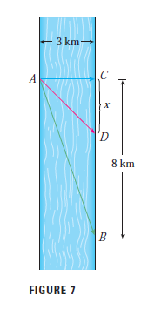

Slide 9
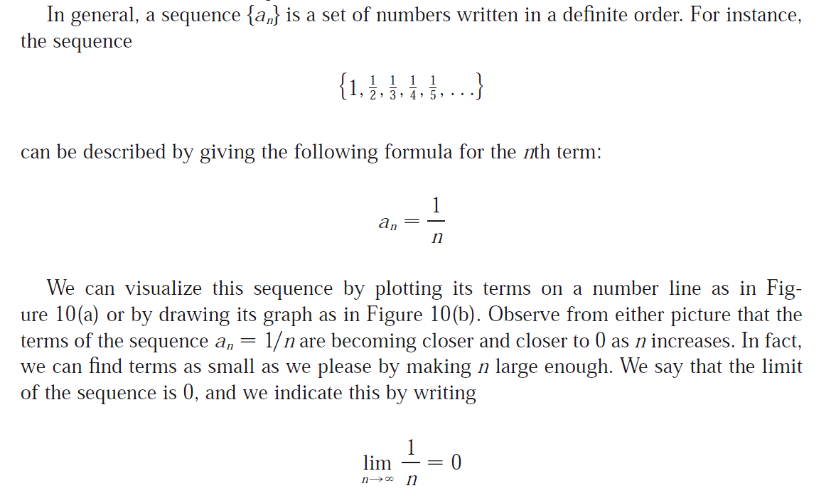
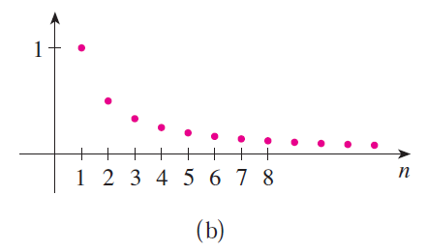
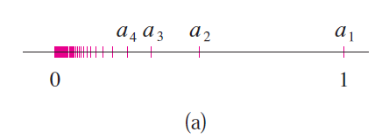

Slide 10
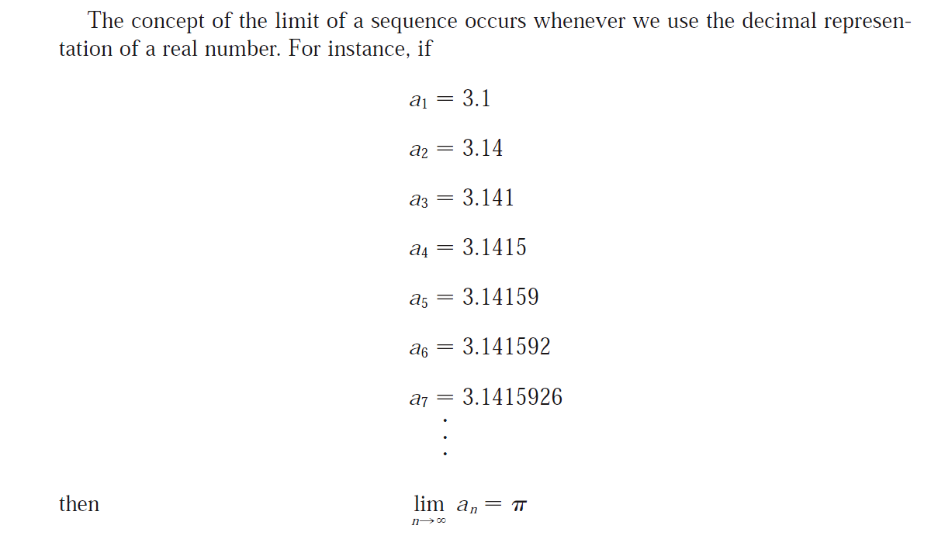

Slide 11
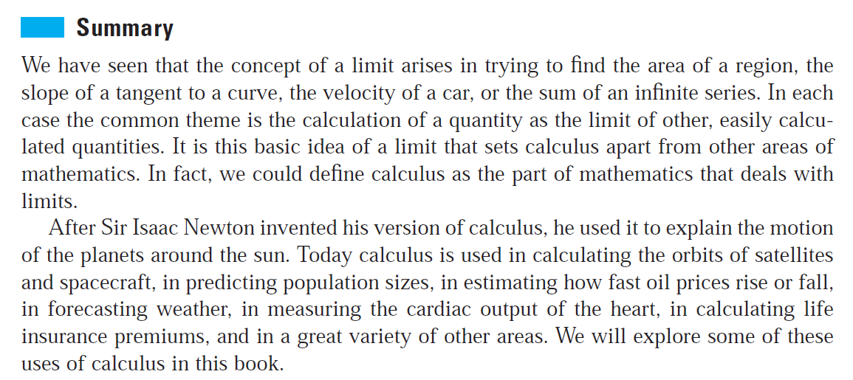

Slide 12
Limits of some simple sequences
We are going to see how we can calculate the limit of some simple sequences using only the fact that
$$\lim_{n→∞}{\frac{1}{n}}=0$$
Example 1. Calculate
$$\lim_{n→∞}{\frac{4}{n}}$$
Example 2. Calculate
$$\lim_{n→∞}{\frac{3}{n+5}}$$
Example 3. Calculate
$$\lim_{n→∞}{\frac{1−3n}{2+n}}$$
Example 4. Calculate
$$\lim_{n→∞}{\frac{6n+11}{n^{2}+3n−7}}$$

Slide 13
Important formulas for sum of n-th powers
$$1+2+3+⋯+n=\frac{n(n+1)}{2}$$
1.
2.
3.
$$1^{2}+2^{2}+3^{2}+⋯+n^{2}=\frac{n(n+1)(2n+1)}{6}$$
$$1^{3}+2^{3}+3^{3}+⋯+n^{3}=\frac{n^{2}{(n+1)}^{2}}{4}$$
Example:
Find the sum of squares
$${24}^{2}+{25}^{2}+{26}^{2}+⋯+{83}^{2}$$

