Slide 1
Early Atomic Theory and Structure
Chapter 5
Outline
Models of the Atom
Dalton’s Atomic Theory
Thomson’s Plum-Pudding Model
Rutherford’s Gold Foil Experiment
Nuclear Model of the Atom
Subatomic particles
Electrons
Protons
Neutrons
Atomic Notation
Isotopes
Atomic Mass

Slide 2
Dalton’s Atomic Theory
Elements (matter) is composed of small, indivisible particles called atoms.
Atoms of a given element are identical in mass and behavior.
Atoms of different elements differ in mass and behavior.
Chemical combination of elements to make different substances occurs when atoms join together in small whole number ratios.
Chemical reactions only rearrange the way the atoms are combined; the atoms themselves are not changed.

Slide 3
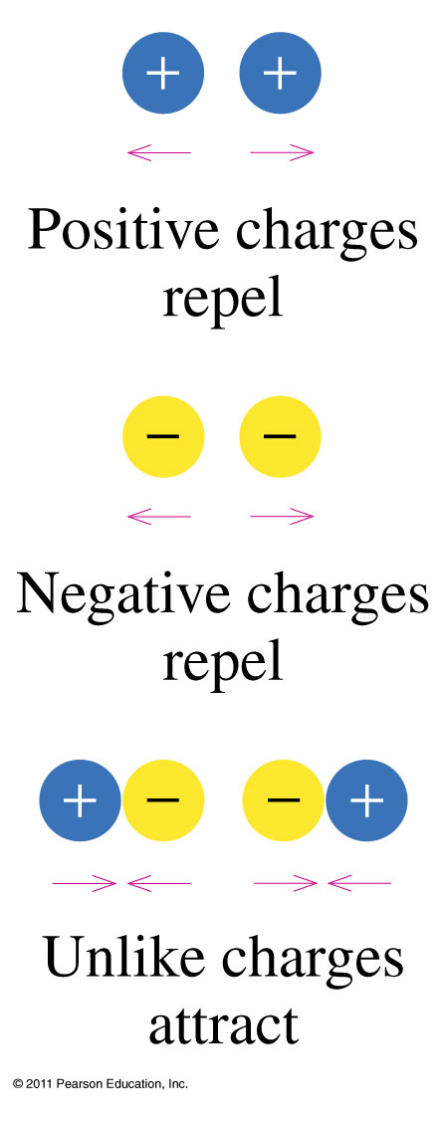
How do charges interact?

Slide 4
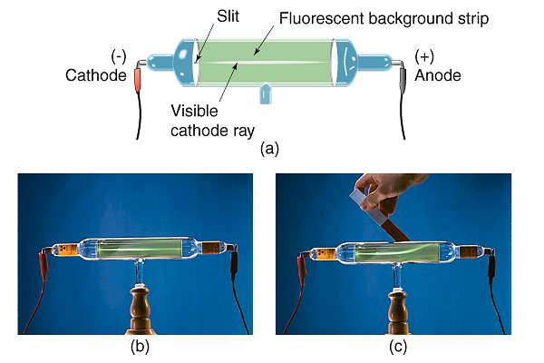
What does Crookes’ tube tell us about cathode rays?

Slide 5
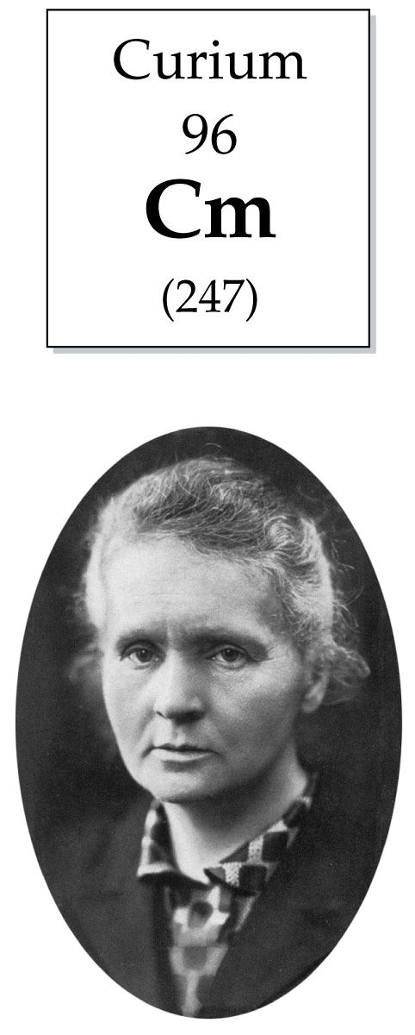

Slide 6
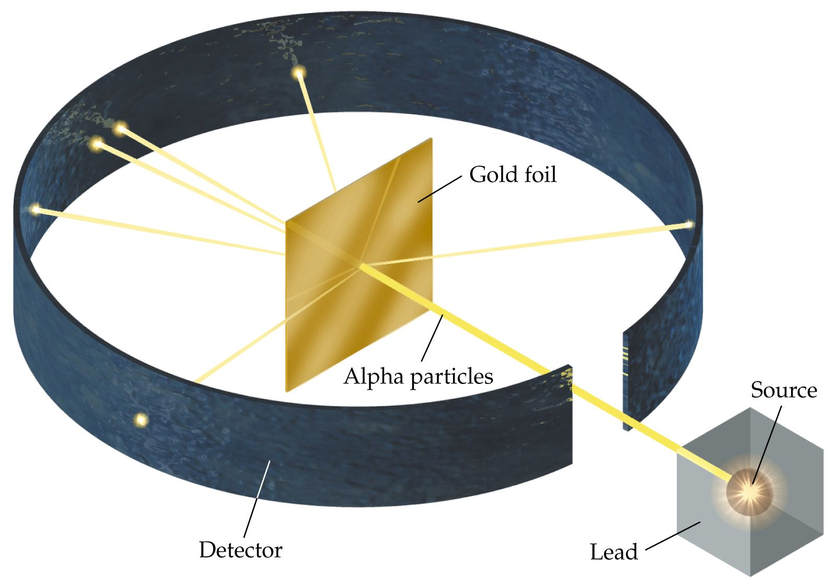
What does the gold foil experiment show us about the structure of the atom?

Slide 7
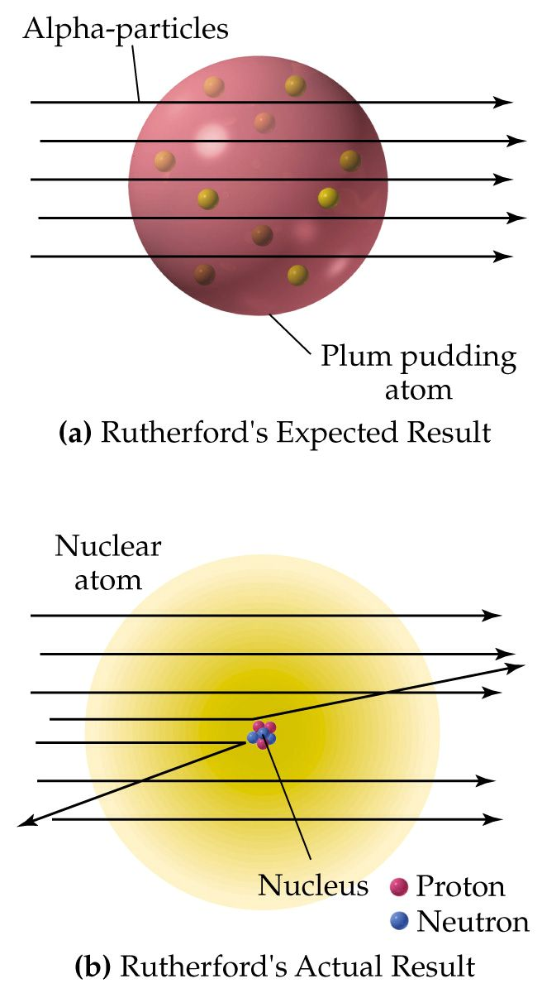
How does the Plum Pudding Model differ from the Nuclear Model of the atom?

Slide 8
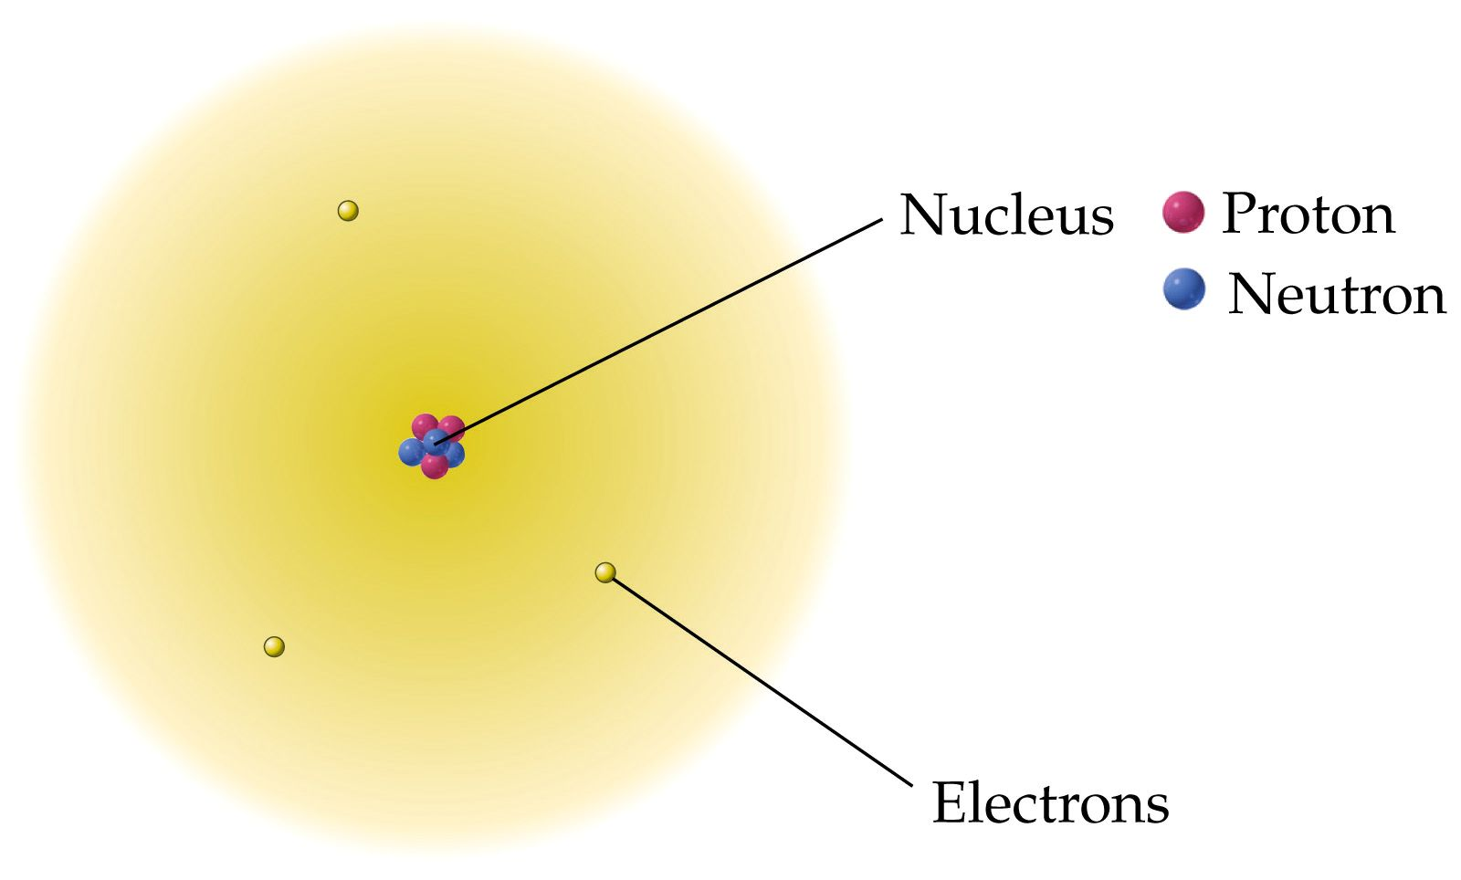
How are the subatomic particles distributed in the atom?

Slide 10
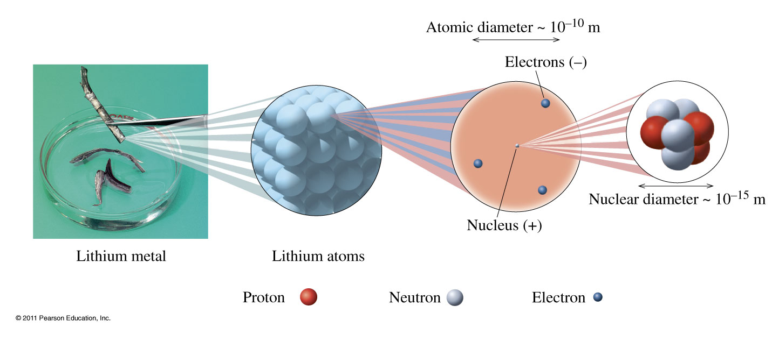
Notes:
Chapter 4, Figure 4.10
In an atom, the protons (positive charge) and neutrons (neutral) that make up almost all the mass of the atom are packed into the tiny volume of the nucleus. The rapidly moving electrons (negative charge) surround the nucleus and account for the large volume of the atom.

Slide 11
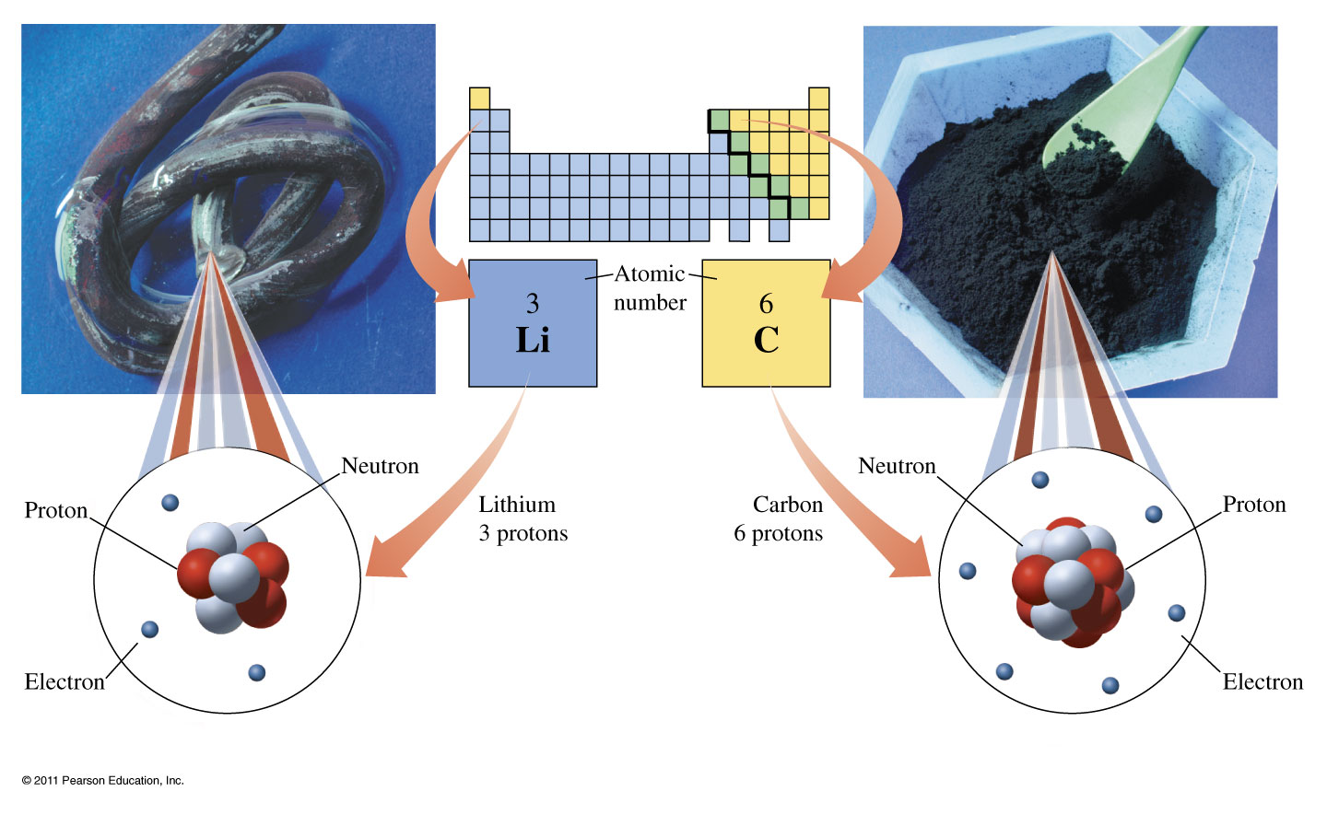
Notes:
Chapter 4, Unnumbered Figure, Page 109
All atoms of lithium (left) contain three protons, and all atoms of carbon (right) contain six protons.

Slide 12
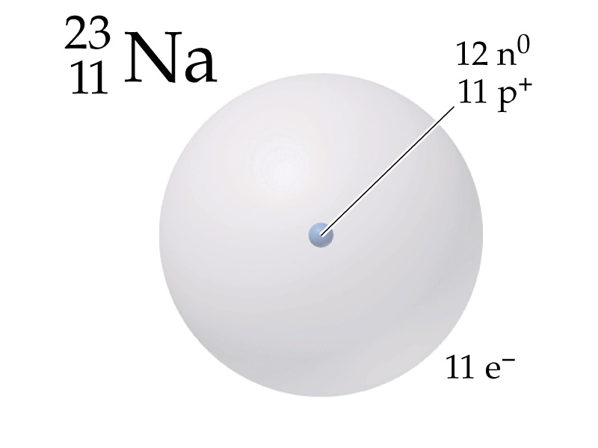
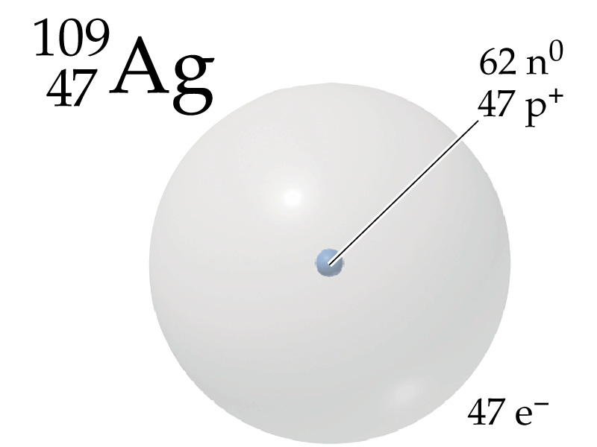

Slide 13
Example – Atomic Notation
Thallium-201, Tl-201, is used for heart imaging.
What is the mass number?
What is the atomic number?
How many protons are there?
How many neutrons are there?
How many electrons are there?

Slide 14
Example – Atomic Notation
Thallium-201, Tl-201, is used for heart imaging.
What is the mass number?
What is the atomic number?
How many protons are there?
How many neutrons are there?
How many electrons are there?

Slide 15
Example – Atomic Notation
Thallium-201, Tl-201, is used for heart imaging.
What is the mass number?
What is the atomic number?
How many protons are there?
How many neutrons are there?
How many electrons are there?

Slide 16
Example – Atomic Notation
Thallium-201, Tl-201, is used for heart imaging.
What is the mass number?
What is the atomic number?
How many protons are there?
How many neutrons are there?
How many electrons are there?

Slide 17
Example – Atomic Notation
Thallium-201, Tl-201, is used for heart imaging.
What is the mass number?
What is the atomic number?
How many protons are there?
How many neutrons are there?
How many electrons are there?

Slide 18
Example – Chemical Symbols
What is the atomic notation for an atom that has 15 protons, 16 neutrons, and 18 electrons?

Slide 19
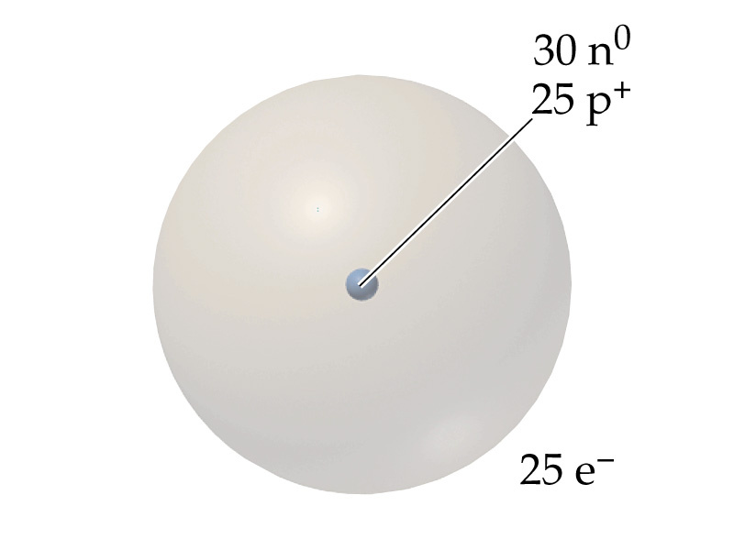
Example – Elements
What element is represented by:
Manganese, Mn
Zinc, Zn
Terbium, Tb
Tin, Sn
Mercury, Hg

Slide 20
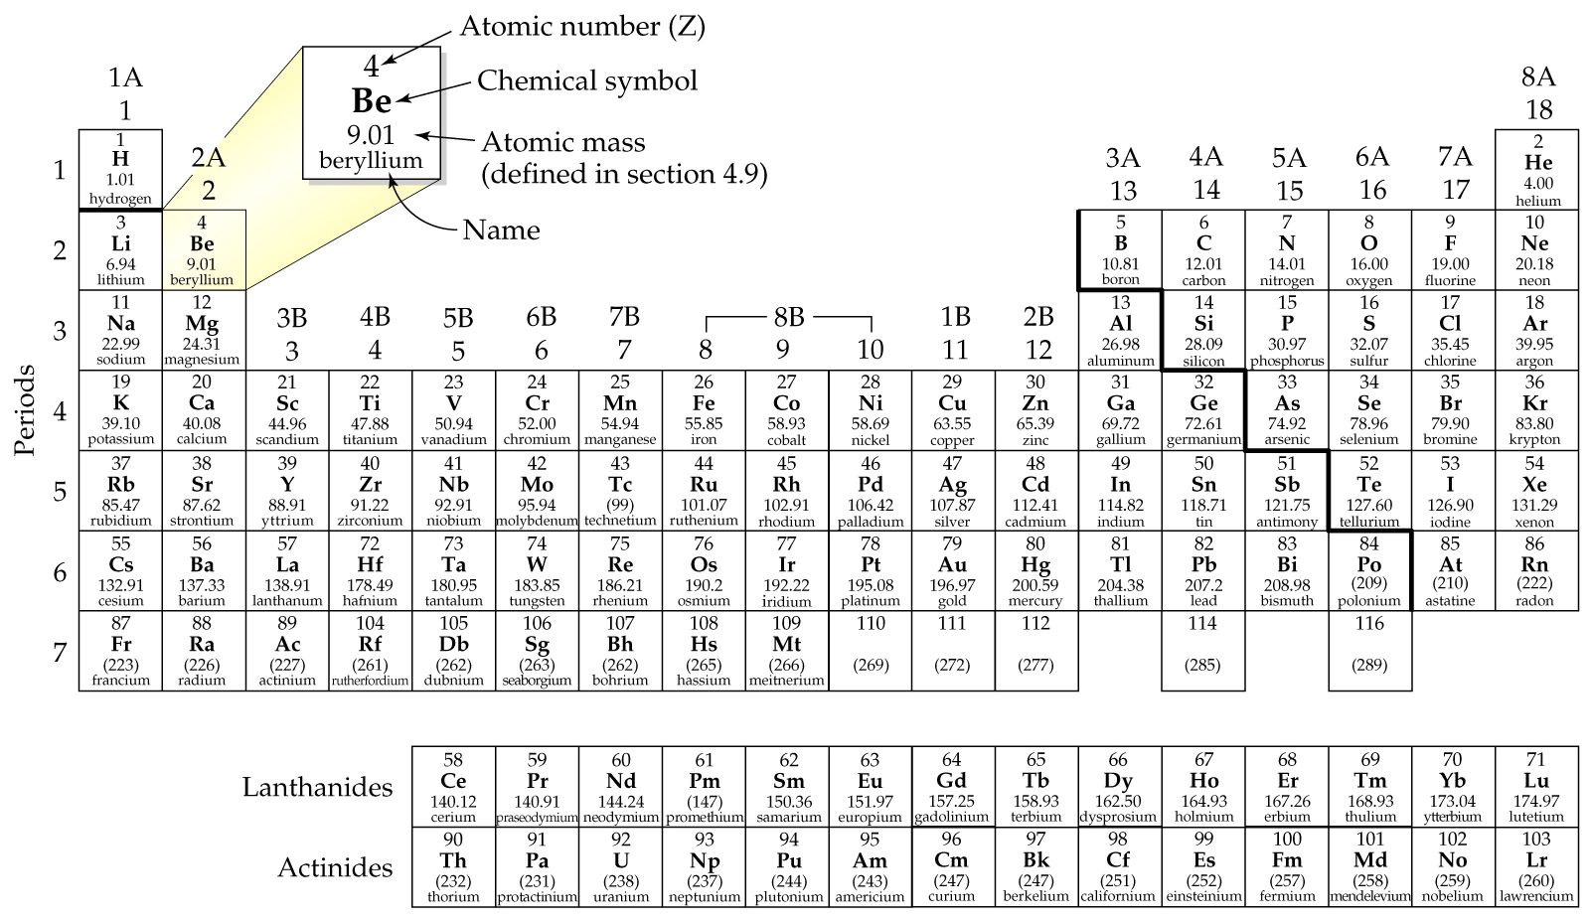

Slide 21
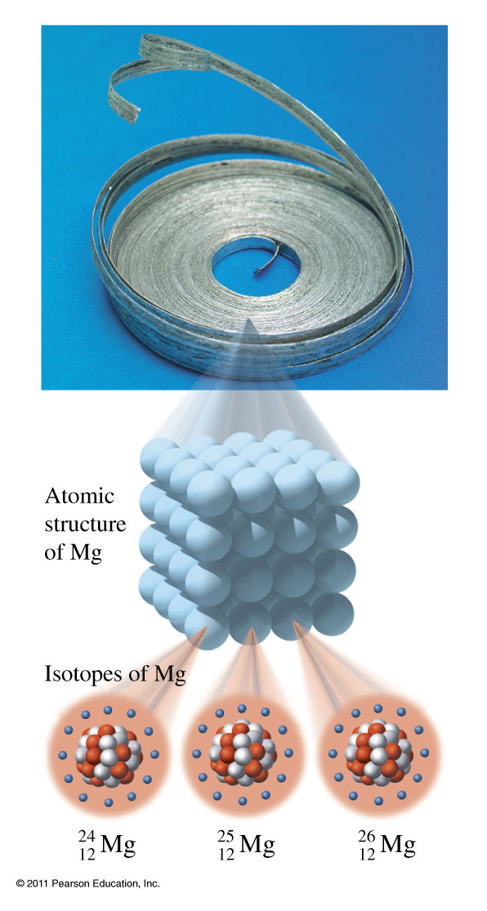
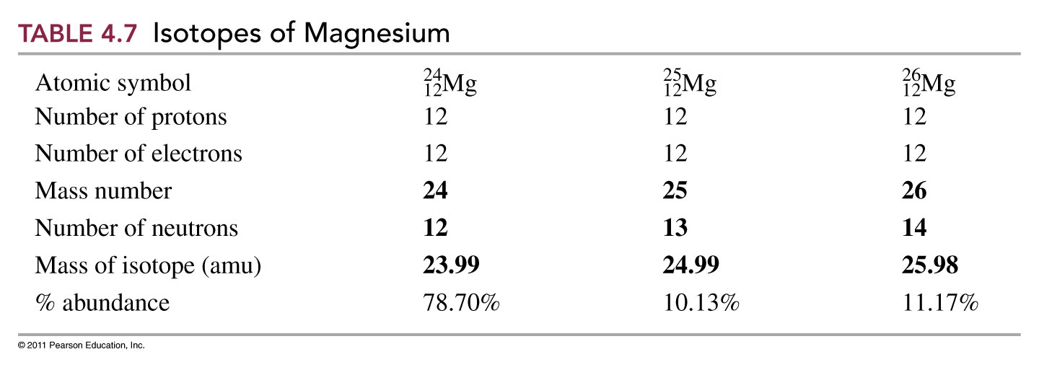
Isotopes of Magnesium
In naturally occurring magnesium, there are three isotopes:
Basic Chemistry Copyright © 2011 Pearson Education, Inc.

Slide 22
¹H | ²H | ³H

Slide 23
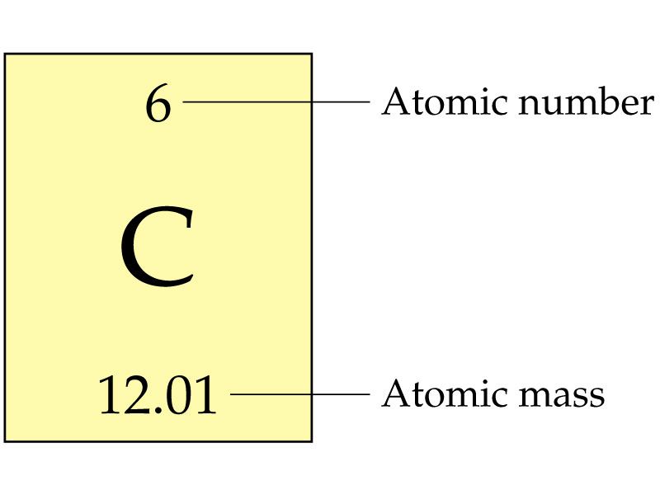
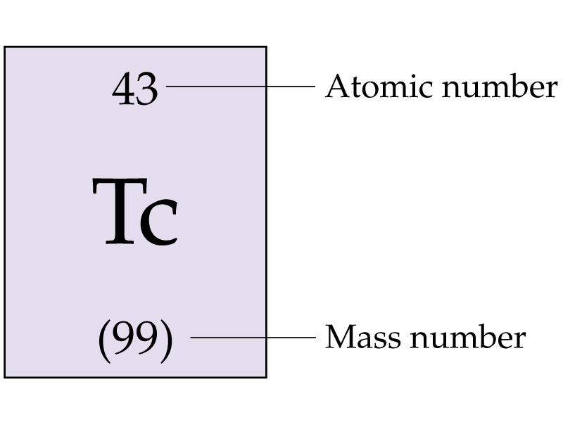

Slide 24
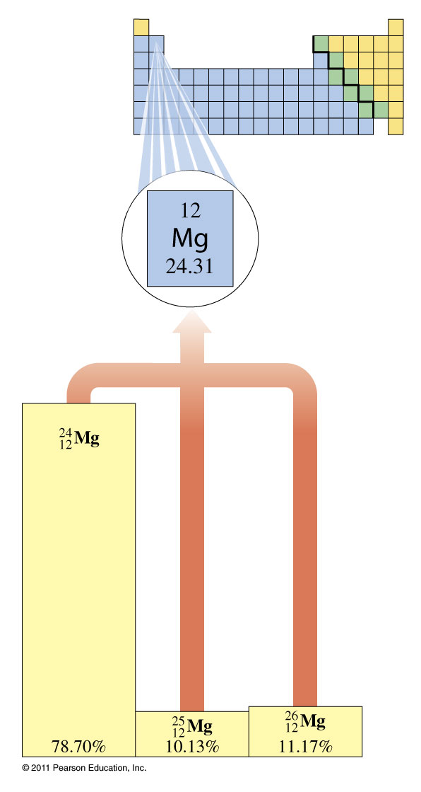
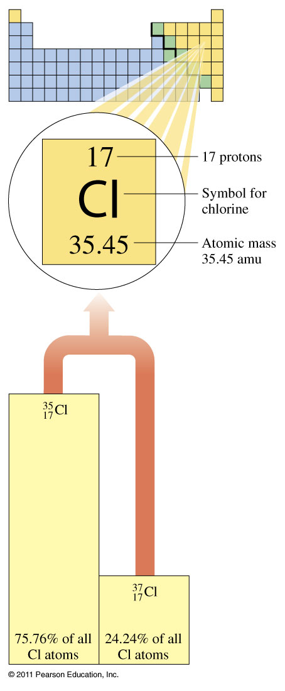

Slide 25
Example - Isotopes of Neon What is the atomic mass of neon?

Slide 26
Example – Atomic Mass
Lithium has two isotopes: lithium-6 at 7.420% and lithium-7 at 92.58%. If the atomic mass of lithium is 6.941 amu and the mass of lithium-6 is 6.0151 amu, what is the mass of lithium-7?

