Slide 1
Nomenclature of Inorganic Compounds
Chapter 6
Outline
Octet Rule
Ionic Compounds
Binary Nomenclature
Polyatomic Nomenclature
Covalent Compounds
Binary Nomenclature
Acids
Binary Nomenclature
Ternary Nomenclature (Oxyacids)
Hydrates

Slide 2
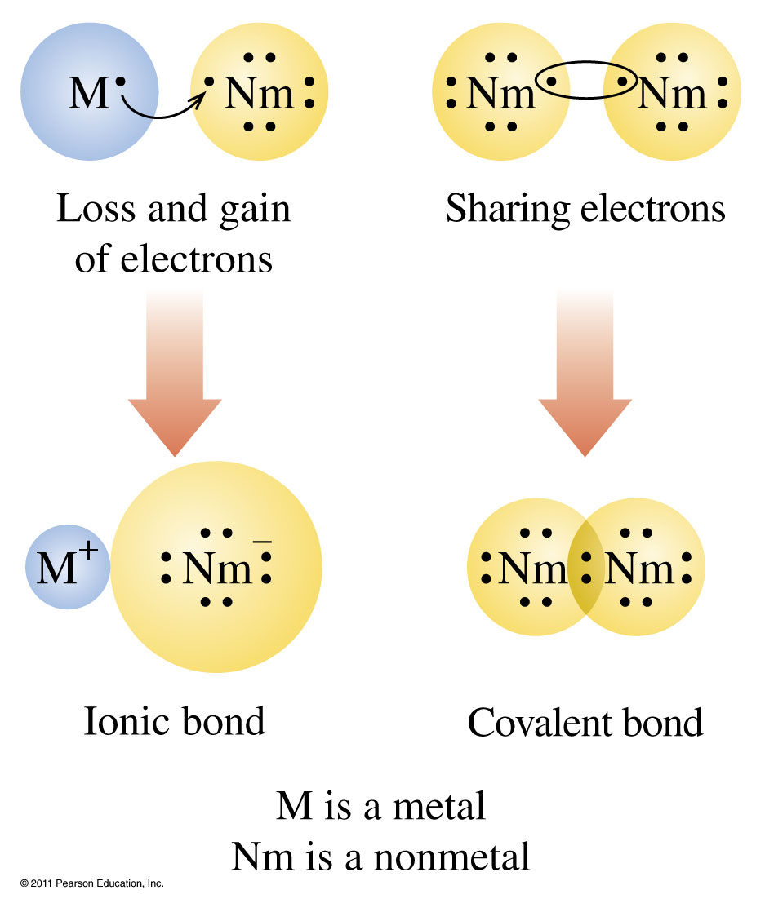

Slide 3
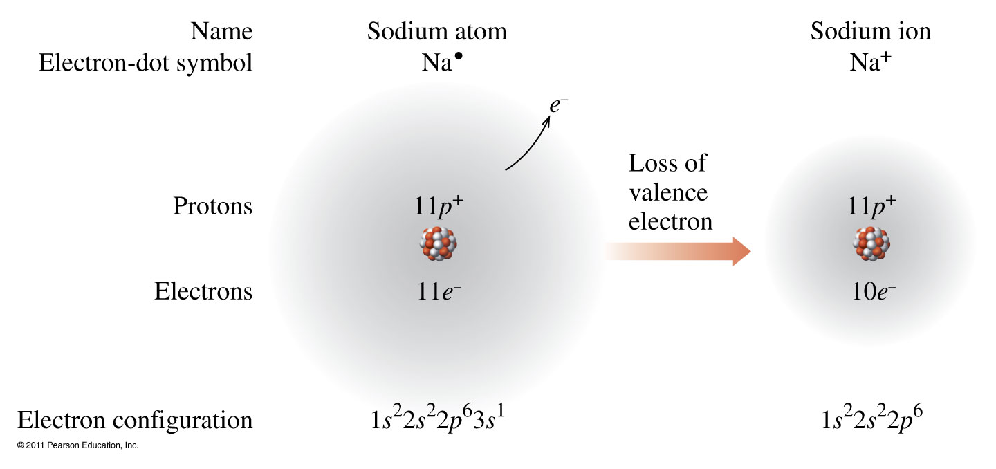
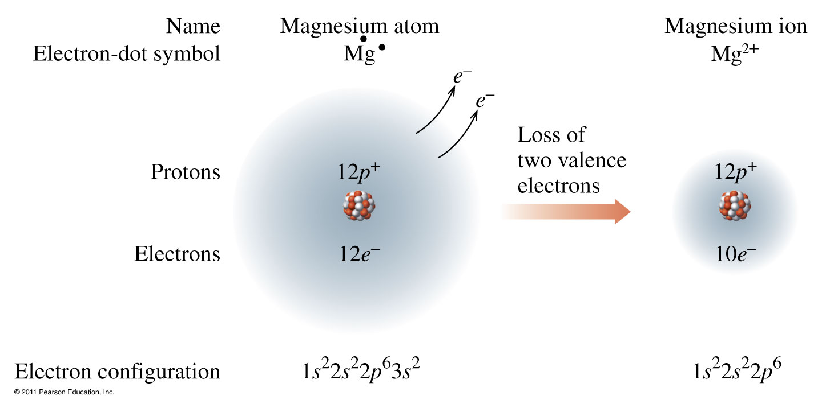
Metals lose electrons.

Slide 4
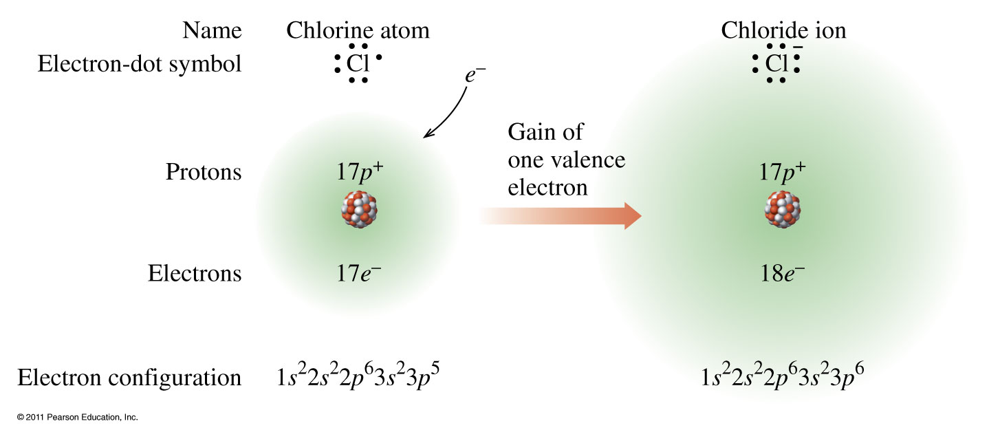
Nonmetals gain electrons.

Slide 5
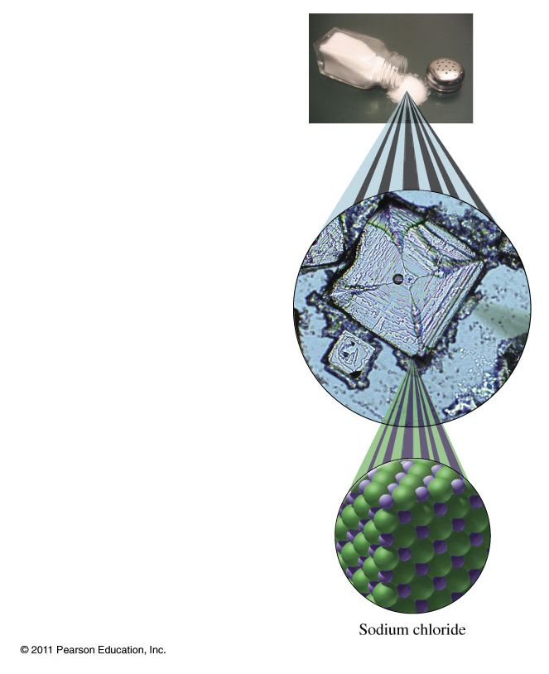
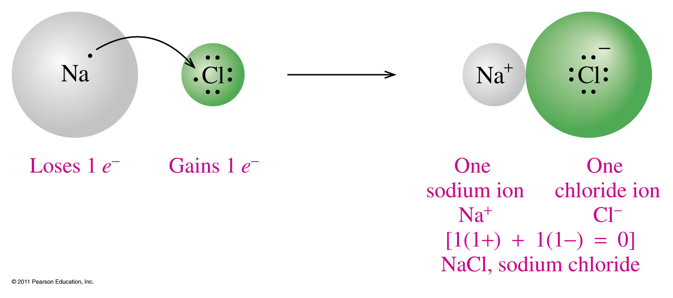
Sodium Chloride, NaCl

Slide 6
Chemical Formulas
AxByCz
Elemental Symbol
Number of atoms

Slide 9
Inorganic Nomenclature

Slide 10
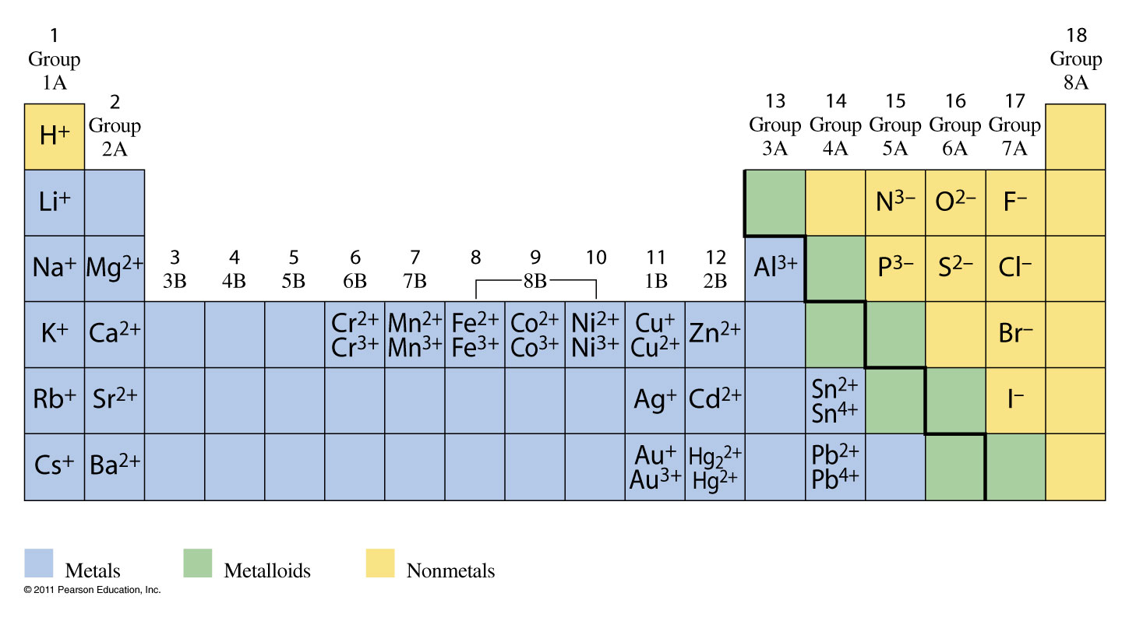
Periodic Table and Common Ions

Slide 11
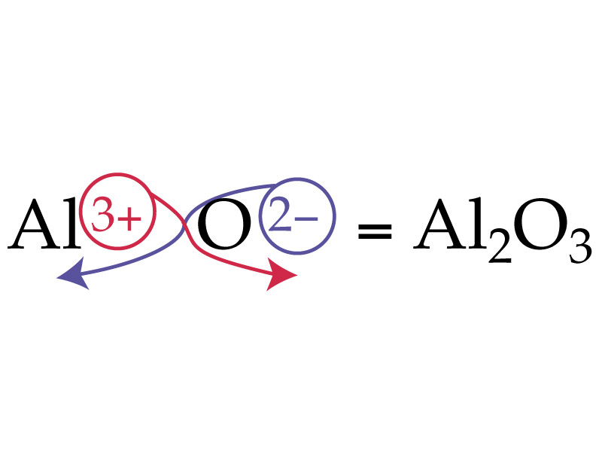

Slide 12
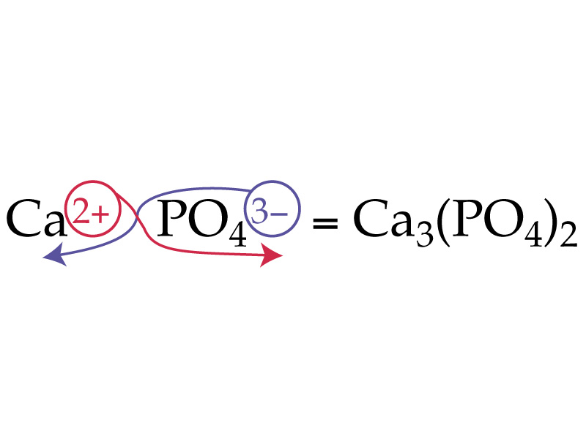

Slide 13
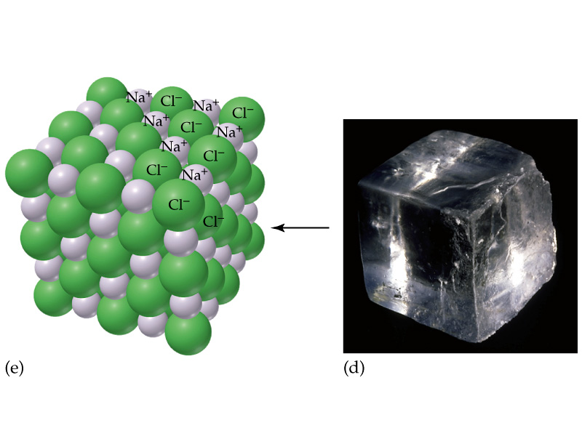

Slide 15
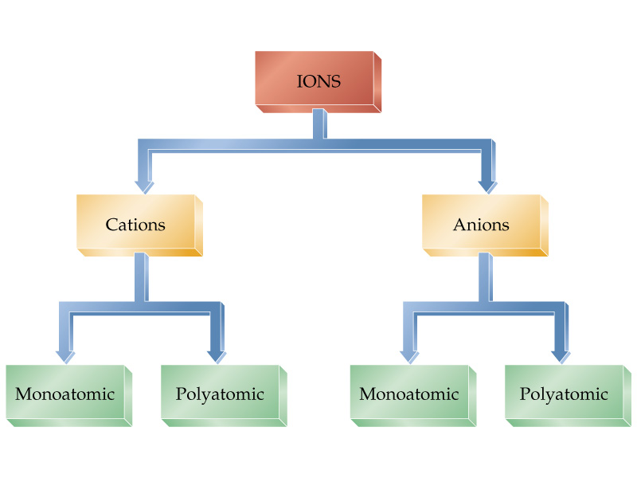

Slide 17
Latin names for cations
Copper(I) = cuprous = Cu⁺
Copper(II) = cupric = Cu²⁺
Iron(II) = ferrous = Fe²⁺
Iron(III) = ferric Fe³⁺
Tin(II) = stannous = Sn²⁺
Tin(IV) = stannic = Sn⁴⁺

Slide 18
Mercury
Remember—
Mercury(I) exists only as Hg₂²⁺
Mercury(II) is Hg²⁺

Slide 19
Example – Binary Nomenclature
What is the name for Ca₃N₂?
Tricalcium dinitride
Calcium nitride
Calcium nitrogen
Calcium nitrate
Calcium nitrite

Slide 20
Example – Binary Nomenclature
What is the formula for potassium phosphide?
KP
PP
K₃P
KP₃
K₃PO₄

Slide 21
Binary Covalent Nomenclature

Slide 22
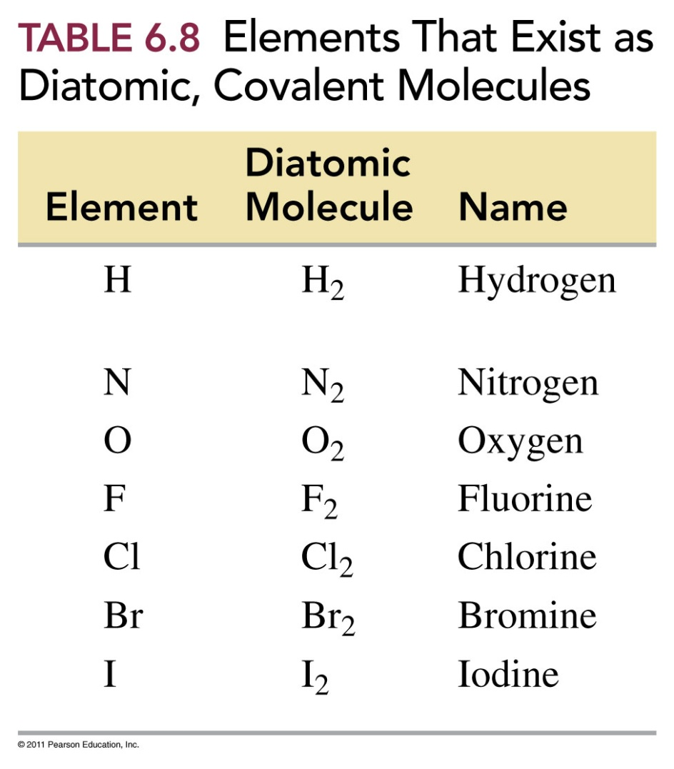
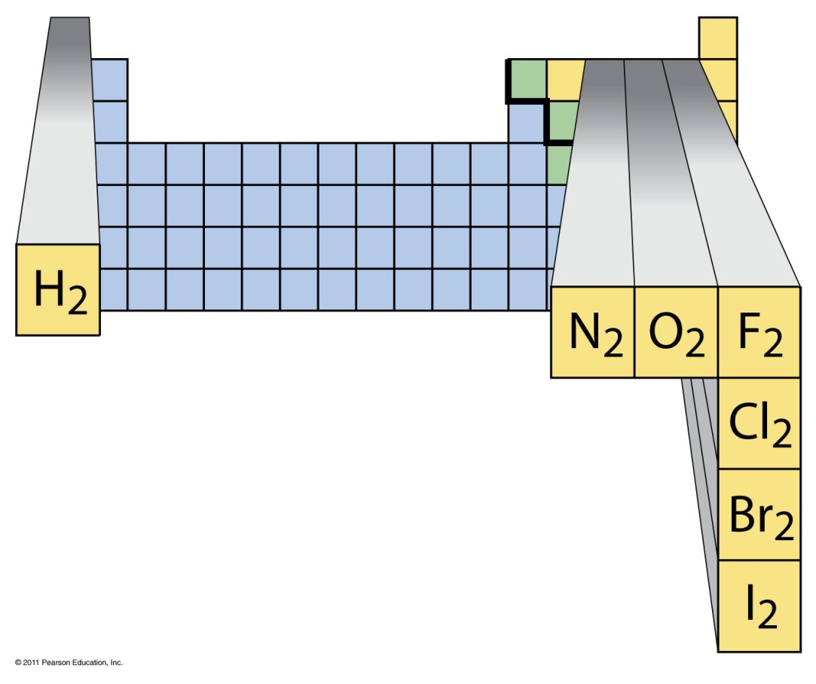
7 Diatomic Molecules

Slide 23
Name as
_____ element 1 _____ element 2 ide
↑ ↑
prefix telling number of each type of atom at arrows
Generally more metallic atom listed first
CO₂ carbon dioxide
Br₃O₈ tribromine octaoxide

Slide 24
Prefixes
mono 1
di 2
tri 3
tetra 4
penta 5
hexa 6
hepta 7
octa 8
nona 9
deca 10

Slide 25
Example – Binary Nomenclature
What is the formula for dinitrogen monoxide?
2NO
N₂O
NO₂
N₂O₂
NO

Slide 26
Example – Binary Nomenclature
What is the name for P₄O₁₀
Phosphorus oxide
Phosphorus decaoxide
Tetraphosphorus decaoxide
Phosphorus oxygen
Decaphosphorus tetraoxide

Slide 27
Example – Binary Nomenclature
What is the name for Fe₂O₃
Iron oxide
Iron(III) oxide
Ferric oxide
Iron(II) oxide
B and C

Slide 28
Example – Binary Nomenclature
What is the formula for lead(IV) oxide?
Pb₂O₄
PbO₂
PbO
LbO₂
Plumbic oxide

Slide 29
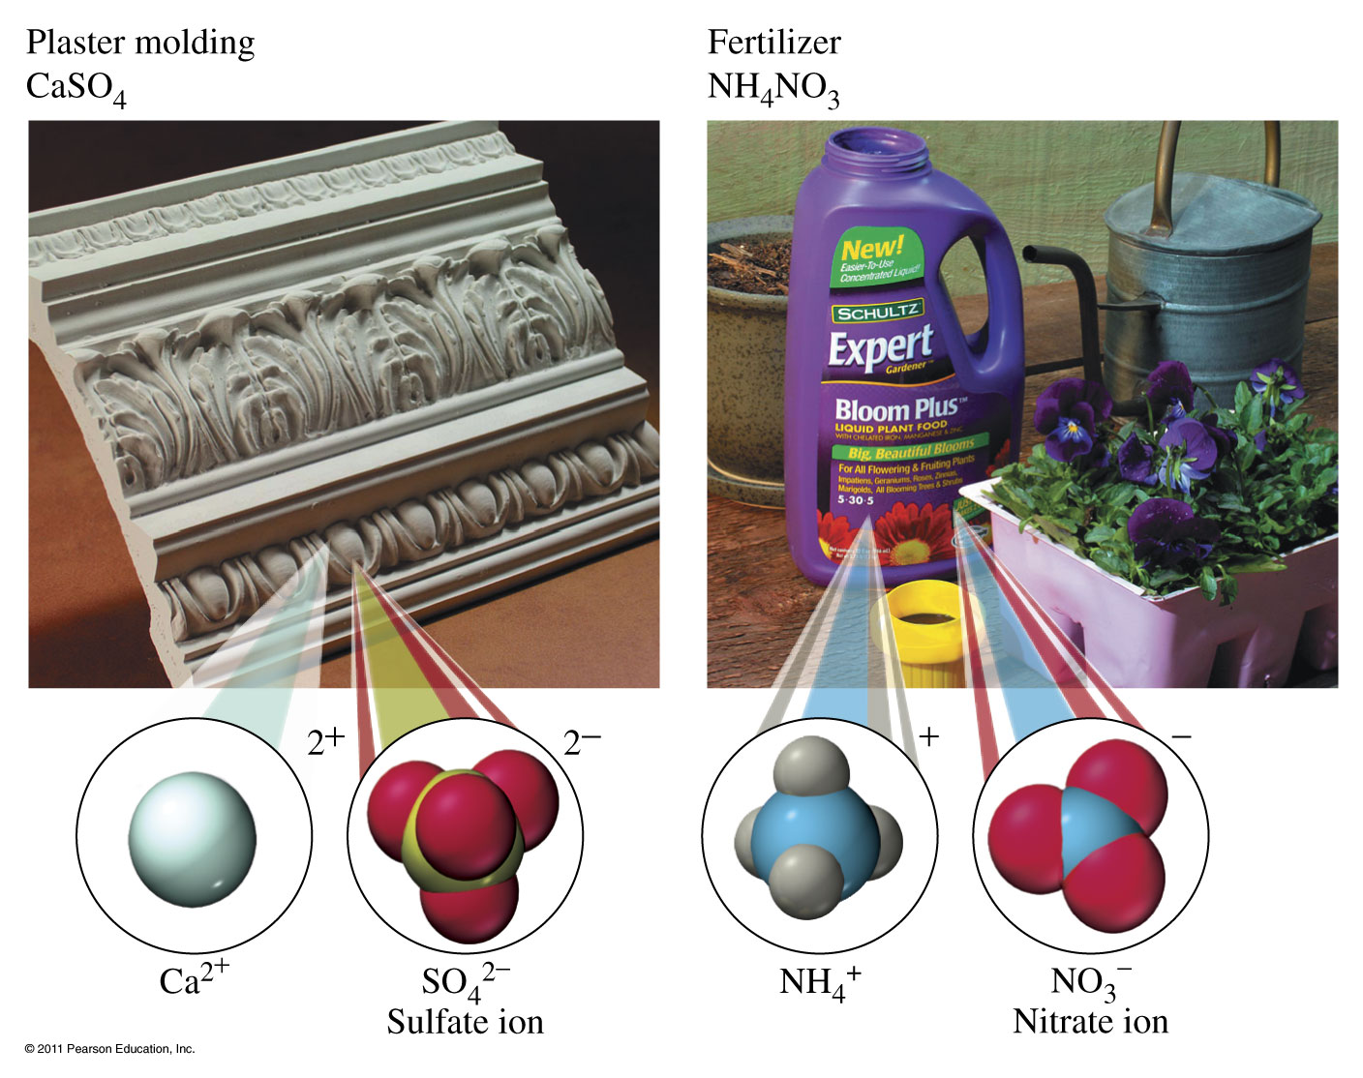

Slide 30
Group III (-3) | Group IV (-2) | Group V (-3 except N) | Group VI (-2) | Group VII (-1)
Borate BO₃³⁻ | Carbonate CO₃²⁻ | Nitrate NO₃¹⁻ Nitrite NO₂¹⁻
 |  | Phosphate PO₄³⁻ Phosphite PO₃³⁻ | Sulfate SO₄²⁻ Sulfite SO₃²⁻ | Chlorate ClO₃¹⁻ Chlorite ClO₂¹⁻
 |  | Arsenate AsO₄³⁻ Arsenite AsO₃³⁻ | Selenate SeO₄²⁻ Selenite SeO₃²⁻ | Bromate BrO₃¹⁻ Bromite BrO₂¹⁻
 |  |  | Tellurate TeO₄²⁻ Tellurite TeO₃²⁻ | Iodate IO₃¹⁻ Iodite IO₂¹⁻

Slide 31
Group III (-3) | Group IV (-2) | Group V (-3 except N) | Group VI (-2) | Group VII (-1)
Borate BO₃³⁻ | Carbonate CO₃²⁻ | Nitrate NO₃¹⁻ Nitrite NO₂¹⁻
 |  | Phosphate PO₄³⁻ Phosphite PO₃³⁻ | Sulfate SO₄²⁻ Sulfite SO₃²⁻ | Chlorate ClO₃¹⁻ Chlorite ClO₂¹⁻
 |  | Arsenate AsO₄³⁻ Arsenite AsO₃³⁻ | Selenate SeO₄²⁻ Selenite SeO₃²⁻ | Bromate BrO₃¹⁻ Bromite BrO₂¹⁻
 |  |  | Tellurate TeO₄²⁻ Tellurite TeO₃²⁻ | Iodate IO₃¹⁻ Iodite IO₂¹⁻

Slide 32
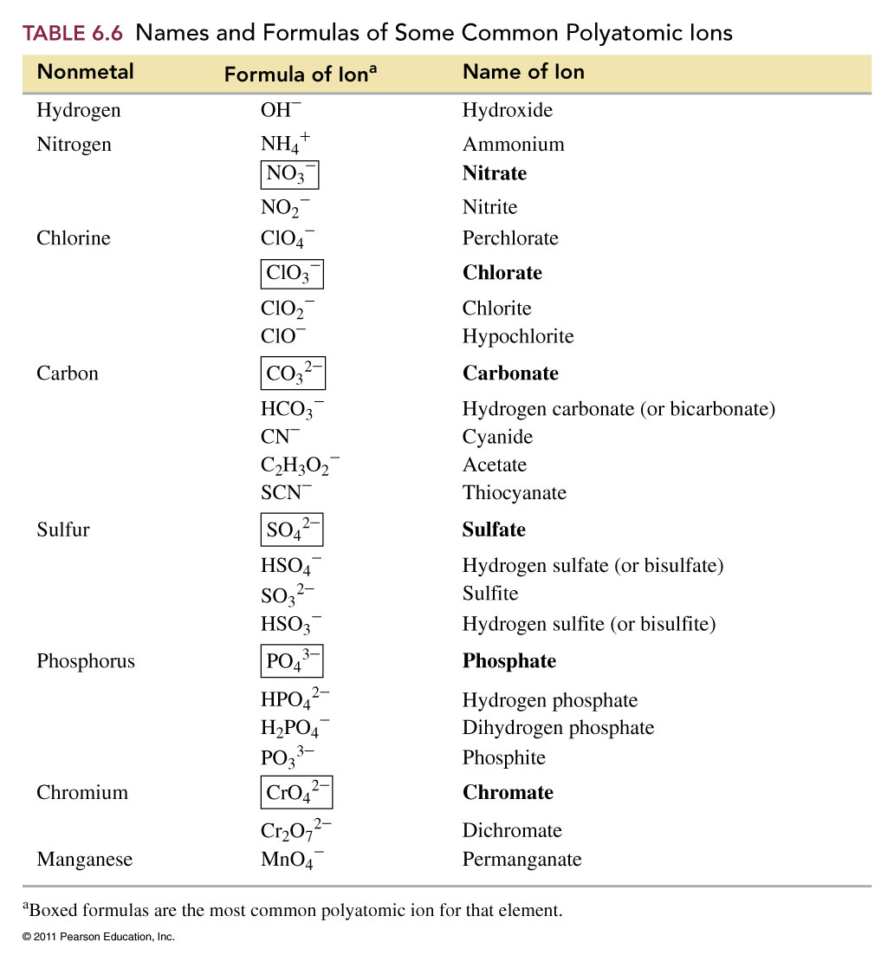

Slide 33
Ions to Memorize
NH₄¹⁺ ammonium ion
OCN¹⁻ cyanate ion
CrO₄²⁻ chromate ion
Cr₂O₇²⁻ dichromate ion
MnO₄¹⁻ permanganate ion
NO₃¹⁻ nitrate ion
CN¹⁻ cyanide ion
C₂H₃O₂¹⁻ acetate ion
C₂O₄²⁻ oxalate ion
OH¹⁻ hydroxide ion
O₂²⁻ peroxide ion

Slide 34
Sulfur compounds
When an oxygen atom in an ion is replaced by a sulfur atom the prefix thio is added to the name.
OCN¹⁻ cyanate SCN¹⁻ thiocyanate
SO₄²⁻ sulfate S₂O₃²⁻ thiosulfate

Slide 35
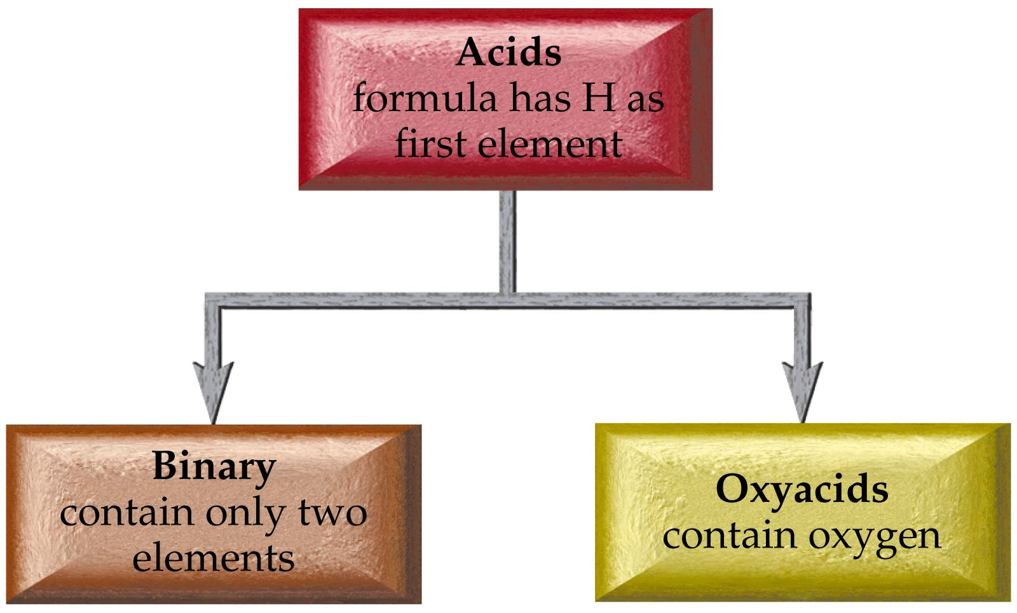

Slide 36
Acid Nomenclature
Binary Acids
HX hydrogen _____ide
becomes
Hydro______ ic acid

Slide 37
HCl(g) hydrogen chloride
HCl (aq) hydrochloric acid
H₂S(g) hydrogen sulfide
H₂S(aq) hydrosulfuric acid
HCN(g) hydrogen cyanide
HCN(aq) hydrocyanic acid

Slide 39
Oxyacid Nomenclature
Hydrogen ___ate → ___ic acid
Hydrogen ___ite → ___ous acid
Hydrogen per __ate → per__ic acid
Hydrogen hypo__ite →hypo__ous acid

Slide 40
Acid salt nomenclature
HX-? Hydrogen anion name
H₂X-? Dihydrogen anion name
Sometimes use the prefix bi to indicate the presence of one H attached to an anion

Slide 41
HCO₃¹⁻ hydrogen carbonate or bicarbonate
HS¹⁻ hydrogen sulfide or bisulfide
HSO₄¹⁻ hydrogen sulfate or bisulfate

Slide 42
HPO₄²⁻ hydrogen phosphate
H₂PO₃¹⁻ dihydrogen phosphite

Slide 43
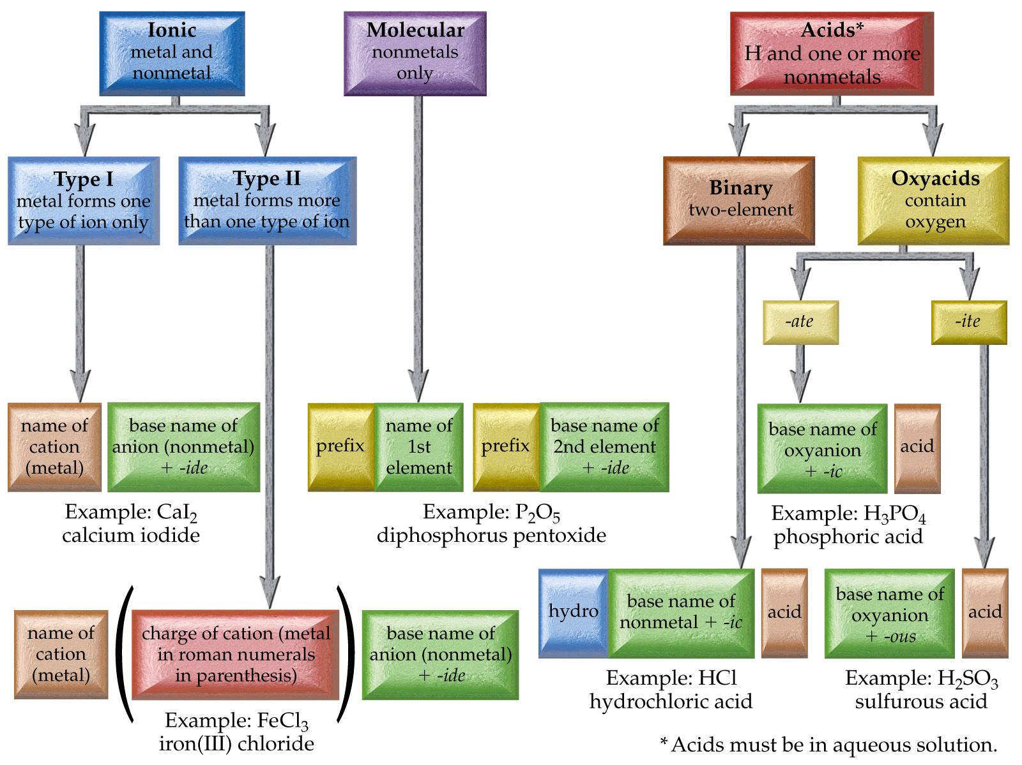

Slide 44
Example – Ternary and Quaternary Nomenclature
What is the name of NaNO₃?
Sodium nitrite
Sodium nitride
Sodium nitrogen trioxide
Sodium nitrate
Sodium nitrogen oxide

Slide 45
Example – Ternary and Quaternary Nomenclature
What is the name of Cr₂(CO₃)₃?
Chromium carbonate
Chromium(II) carbonate
Chromium(II) carbonate(III)
Chromium(III) carbon trioxide
Chromium(III) carbonate

Slide 46
Example – Acid Nomenclature
What is the name of HCl _{(aq)}?
Chloric acid
Hydrochloric acid
Hydrogen chloride
Hydrochlorous acid
B and C

Slide 47
Example – Acid Nomenclature
What is the name of HClO_{3 (aq)}?
Chloric acid
Hydrochloric acid
Hydrogen chlorate
chlorous acid
Perchloric acid

Slide 48
Example – Acid Nomenclature
What is the formula for phosphorous acid?
H₃PO_{3 (aq)}
H₃P _{(aq)}
H₃PO_{4 (aq)}
PO_{3 (aq)}
H₂PO_{3 (aq)}

Slide 49
Example – Hydrate Nomenclature
What is the formula of cupric chloride dihydrate?
CuCl • H₂O
CuCl₂ • 2 H₂O
H₂CuCl₂O
CuCl₂
B and C

Slide 50
Example – Hydrate Nomenclature
What is the name of MgSO₄ • 7 H₂O?
Magnesium sulfate heptahydrate
Manganese(II) sulfate hexahydrate
Magnesium sulfate hydrate
Magnesium(II) sulfate heptahydrate
Magnesium(II) sulfite hexahydrate

Slide 51
Hydrate Nomenclature
NaNO₃·4 H₂O sodium nitrate tetrahydrate
K₃PO₄·7 H₂O potassium phosphate heptahydrate
MgO·5 H₂O magnesium oxide pentahydrate

