Slide 1
Chemistry 120
Chapter 12: Chemical Bonding
Chapter 13: Structure and Shape
Outline
Types of Bonds
Ionic
Metallic
Covalent
Electronegativity
Bond Polarity
Bonding
Lewis Electron-Dot Structures
VSEPR Theory
Molecule Polarity

Slide 2
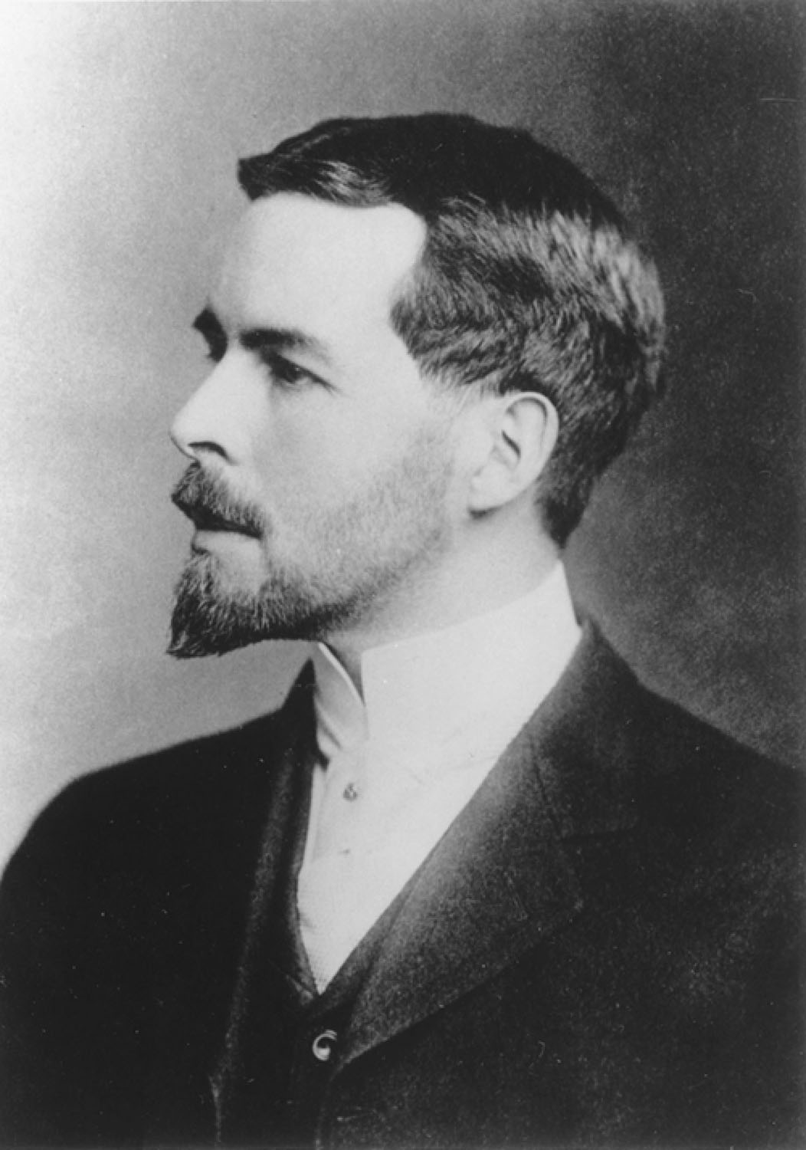
Gilbert N. Lewis
p356
Notes:
Gilbert N. Lewis (1875–1946). Elec-tron dot structures are called Lewis diagrams in his honor.

Slide 3
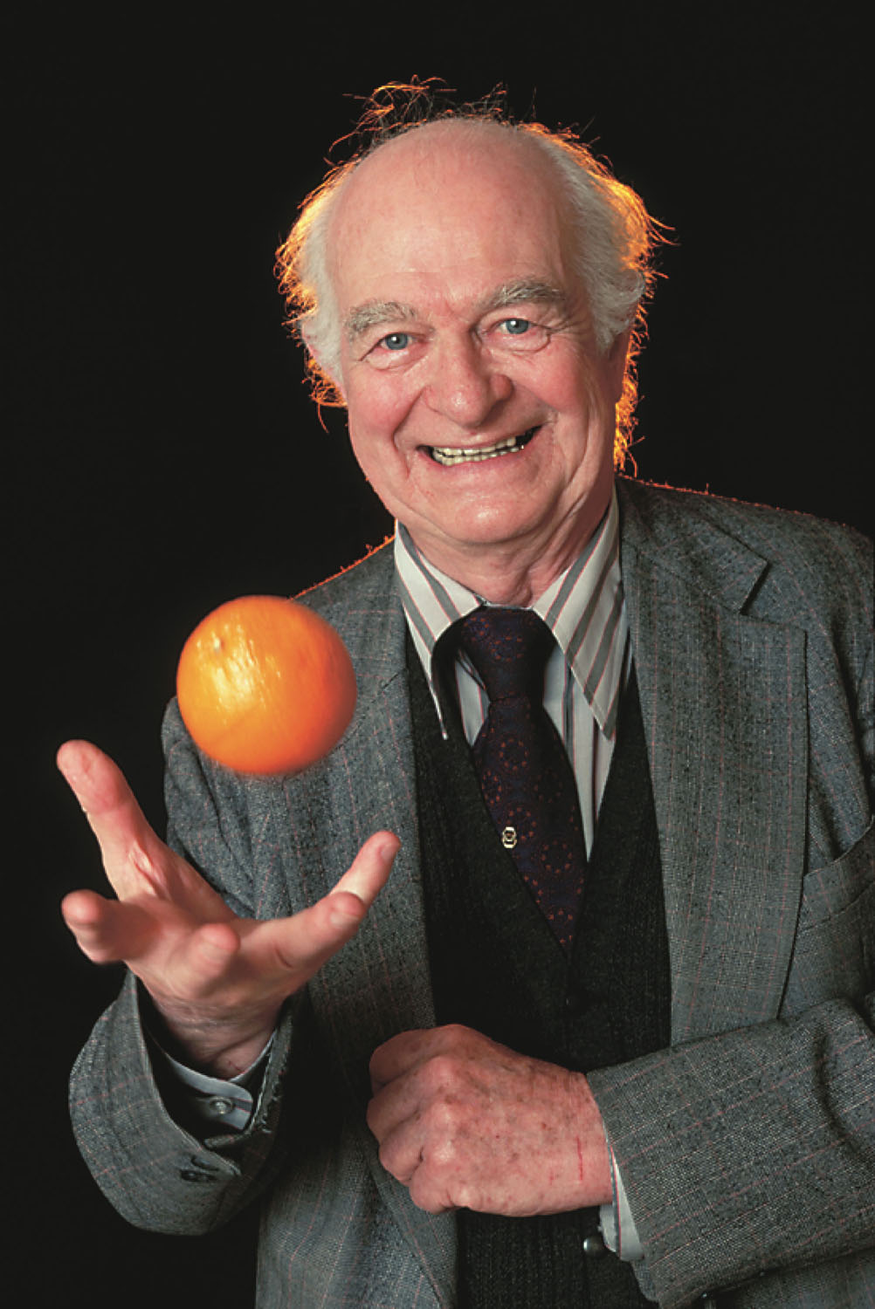
Linus Pauling
p358
Notes:
Linus Pauling (1901–1994). The concept of electronegativity was proposed by Pauling, who was awarded the 1954 Nobel Prize in Chemistry and the 1963 Nobel Peace Prize.

Slide 4
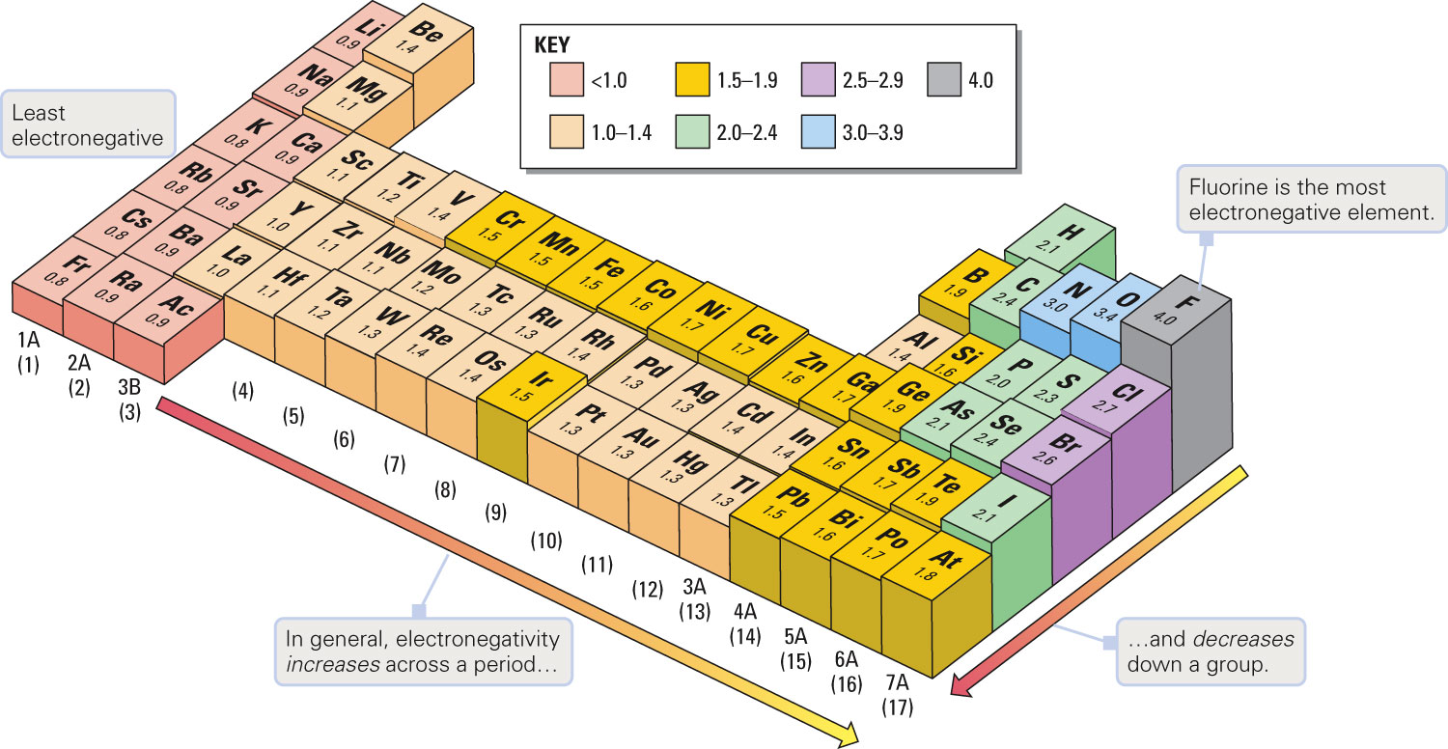
What are the trends for electronegativity?
Figure 12-11 p359
Notes:
Figure 12.11 Periodic trends in electronegativity values. Electronegativity values generally increase from left to right across any period of the table, and they decrease from the top to the bottom of any group.

Slide 5
Example – Electronegativity
Rank the following in order of increasing electronegativity: F, Ga, K, Rb, and V.
F < Ga < K < Rb < V
Rb < K < V < Ga < F
V < Rb < Ga < K < F
F < Ga < Rb < V < K
Rb < F < K < V < Ga

Slide 6
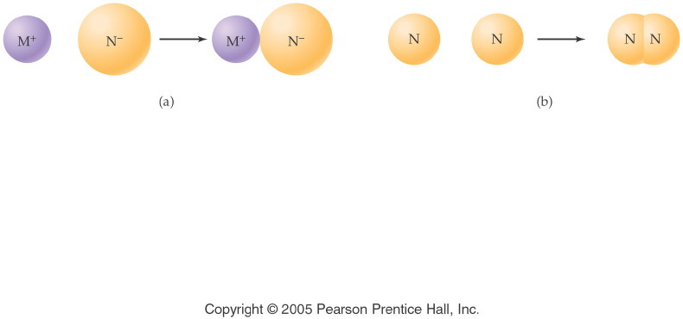
How do atoms bond?
Notes:
Figure: 12-01
Title:
Chemical Bonds
Caption:
An ionic bond forms between a metal and nonmetal. Two nonmetal atoms form a covalent bond.
Notes:
In each compound, all atoms have filled their valence shell. It is only the method of filling (ion formation vs. electron sharing) that differs.

Slide 7
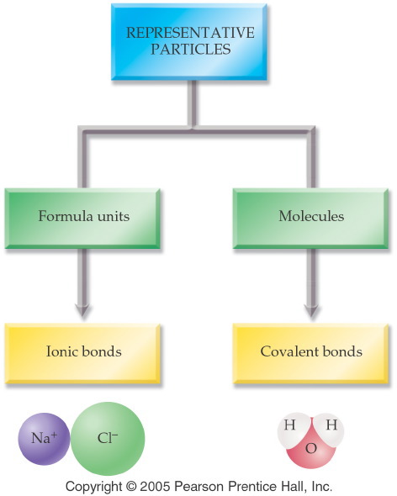
Notes:
Figure: 12-02
Title:
Representative Particles
Caption:
Particles can be formula units held together by ionic bonds, or molecules held by covalent bonds.
Notes:
This classification is also made in Ch. 7 (Nomenclature) between salts and binary molecules.

Slide 8
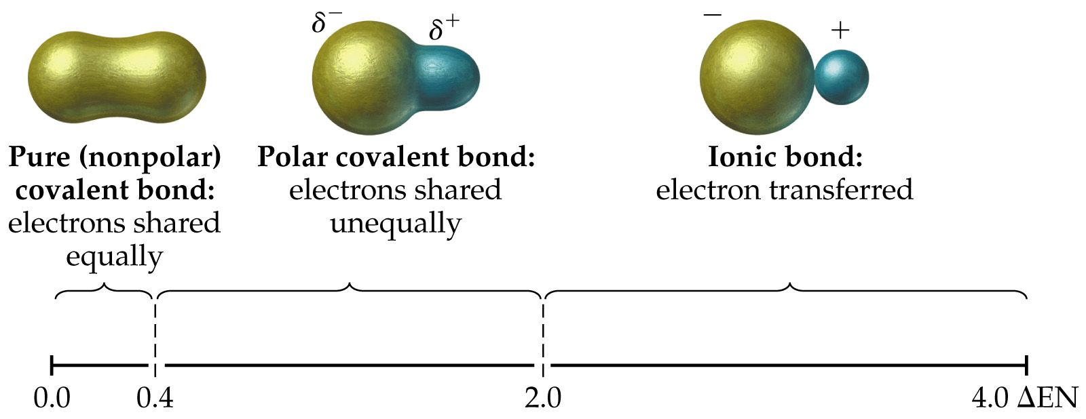
How do bonds differ?

Slide 9
What does the bonding in H₂ look like?
+
1s¹
1s¹

Slide 10
How does Cl₂ bond?
+
[Ne]3s²3p⁵
[Ne]3s²3p⁵

Slide 11
What orbital(s) does Cl₂ use to bond?
Cl:[Ne]3s²3p⁵

Slide 12
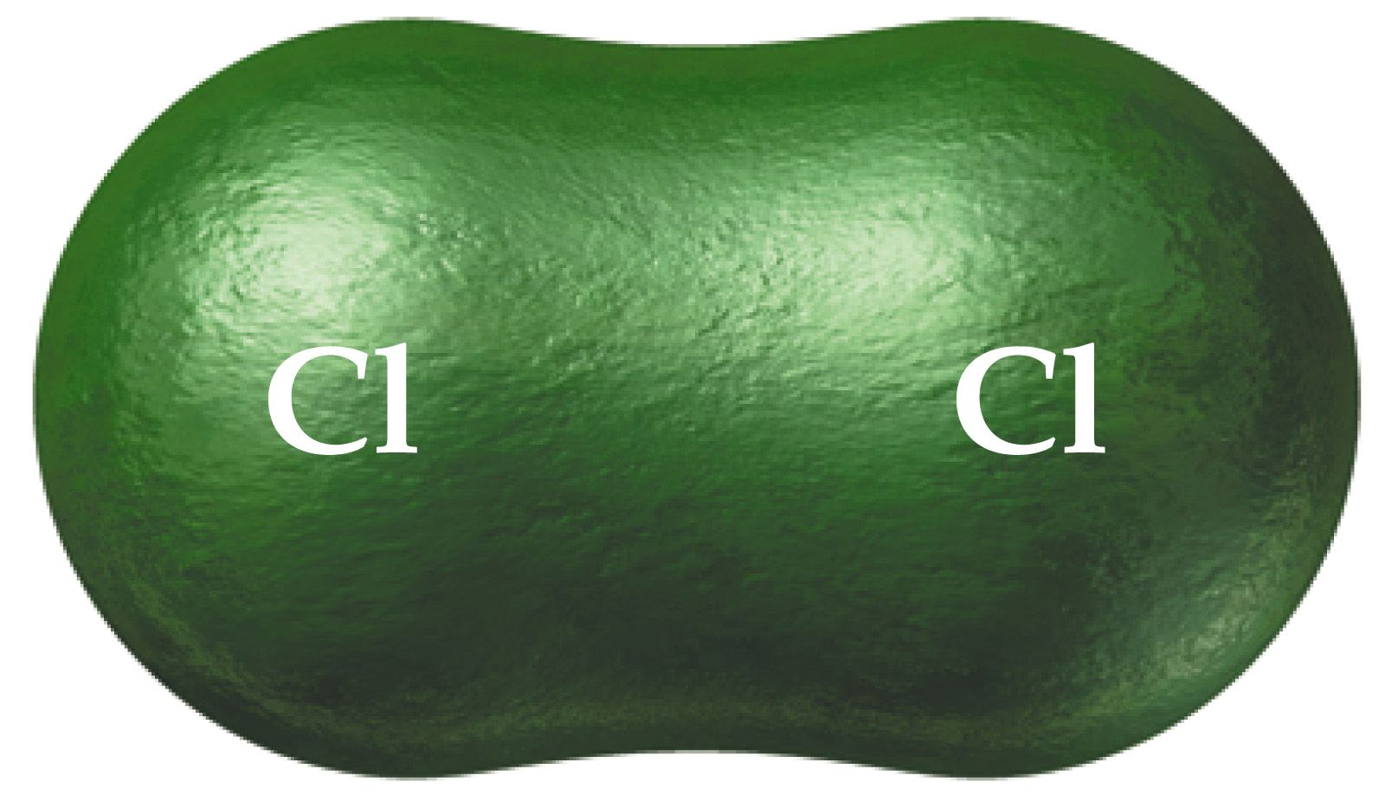
How are electrons shared in Cl₂?

Slide 13
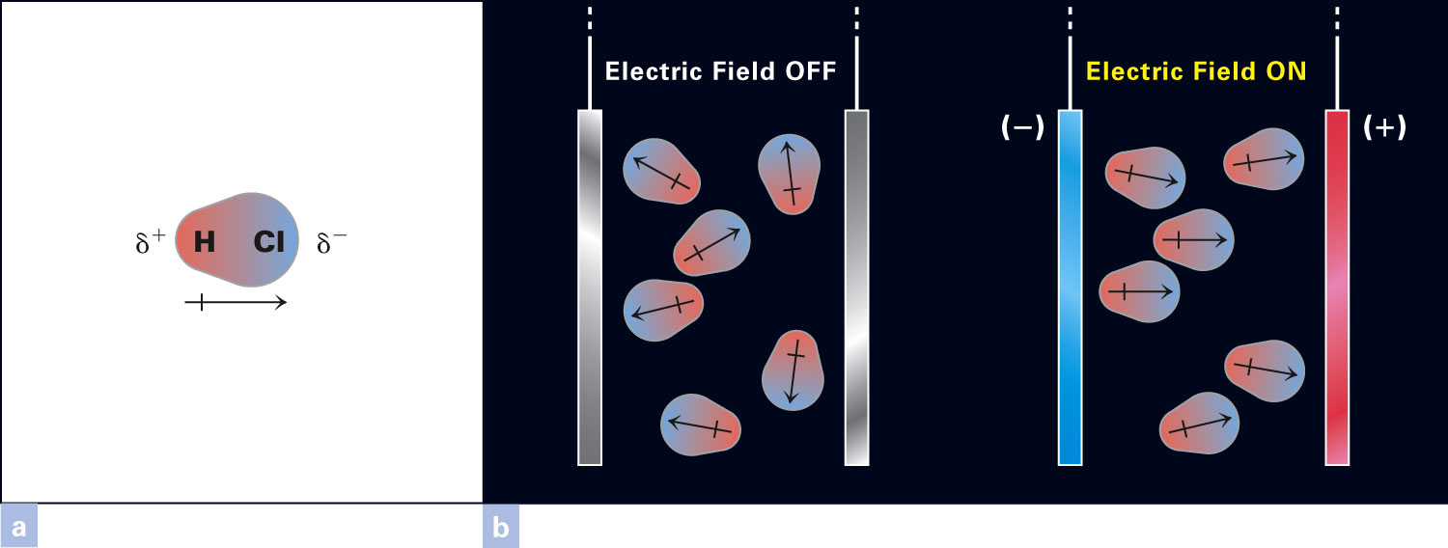
How does an electric field affect a polar molecule?
Figure 13-9 p392
Notes:
Figure 13.9 Orientation of polar molecules in an electric field. (a) HCl is an example of a polar molecule. The partially posi-tive end is shaded in red, and the partially negative side is blue. The arrow is drawn with a plus sign at the positive end and an arrowhead at the negative end. The arrow points in the direction of greatest charge density for the bonding electrons. (b) Two plates are connected through a switch to a source of an electric field. With the switch open, the orientation of the molecules is random (left). When the switch is closed (right), the molecules line up with the positive end (red) toward the negative plate and the negative pole (blue) toward the positive plate.

Slide 14
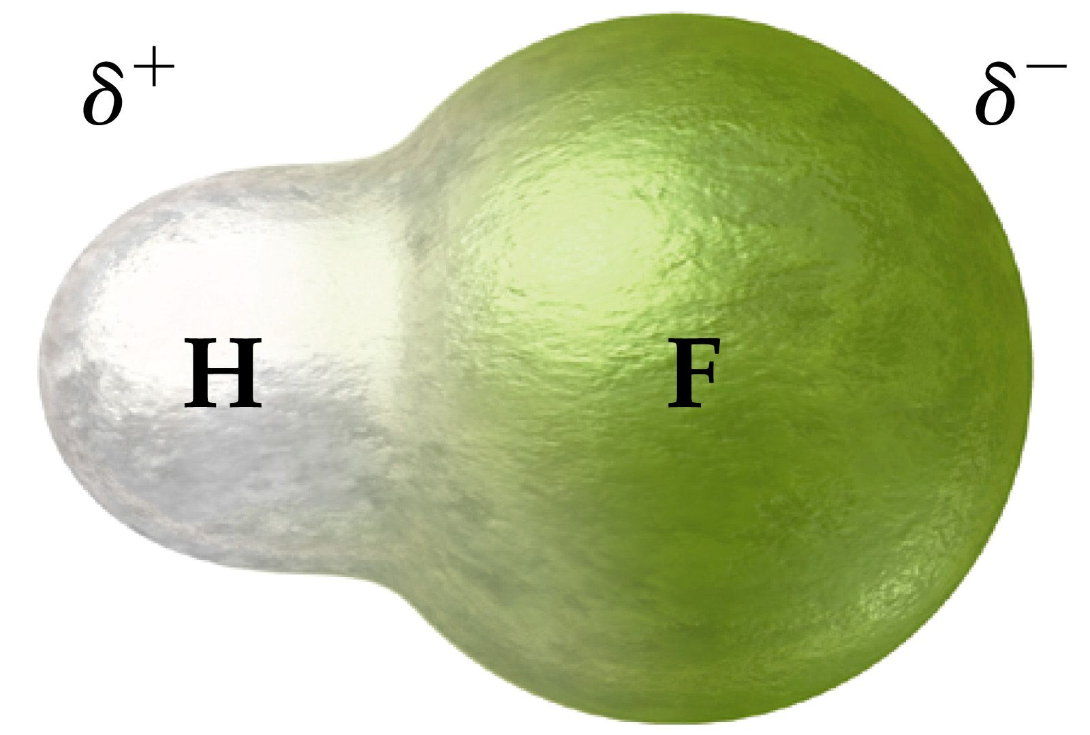
How are electrons shared in HF?

Slide 15
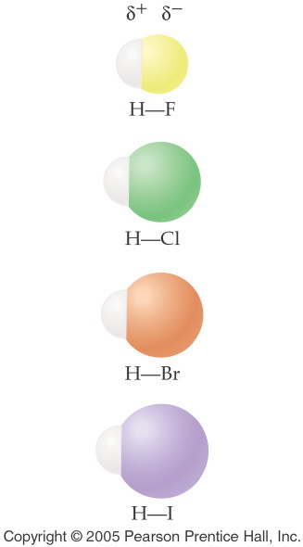
Notes:
Figure: 12-09-01UN
Title:
Hydrogen Halides
Caption:
The two atoms in each hydrogen halide molecule are joined by a polar covalent bond.
Notes:
The electrons in a polar covalent bond are pulled closer to the nucleus of the most electronegative element. This leads to bond polarity. In each of these molecules the halogen atom is more electronegative than the hydrogen atom.

Slide 16
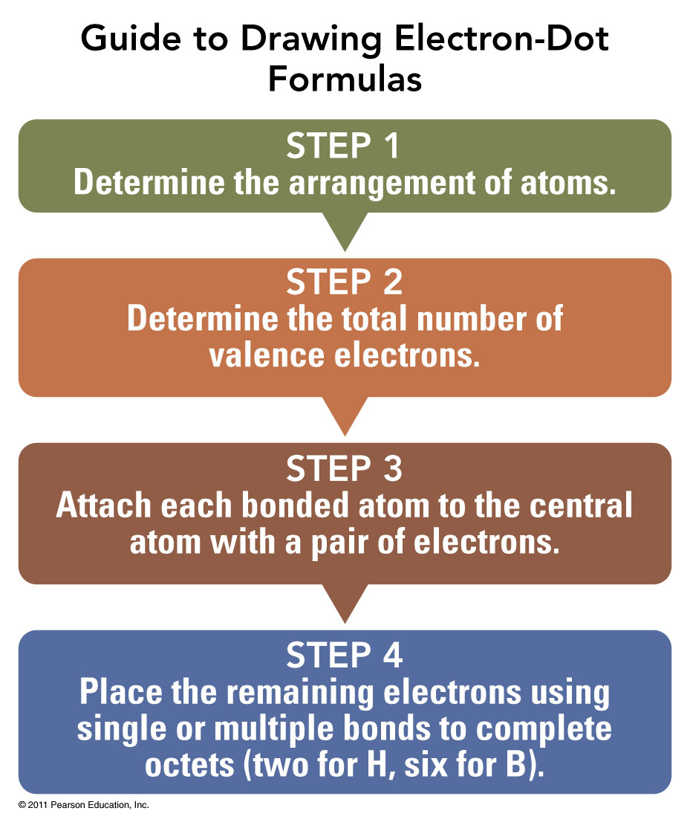

Slide 17
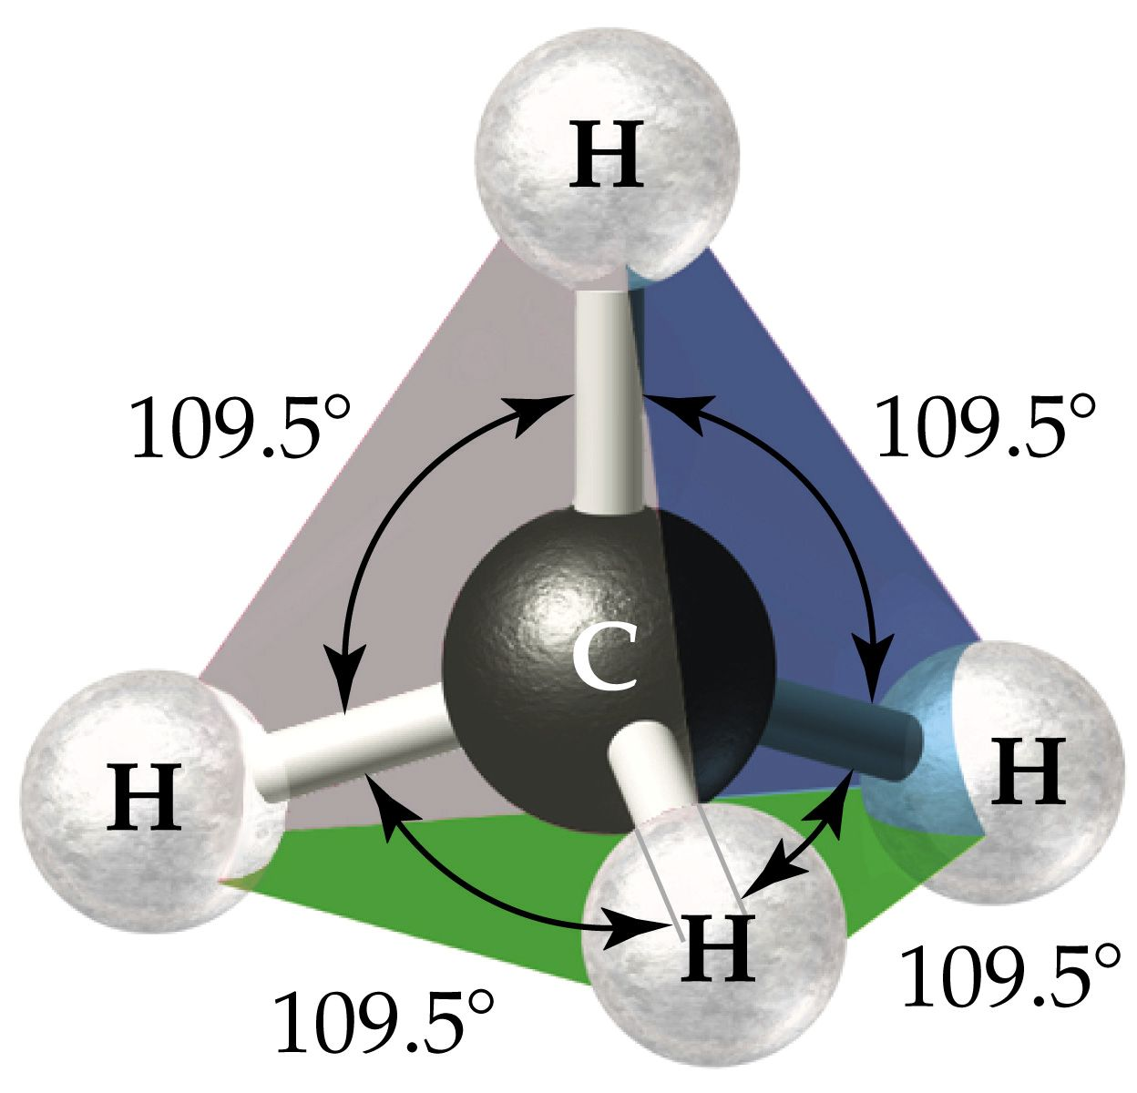
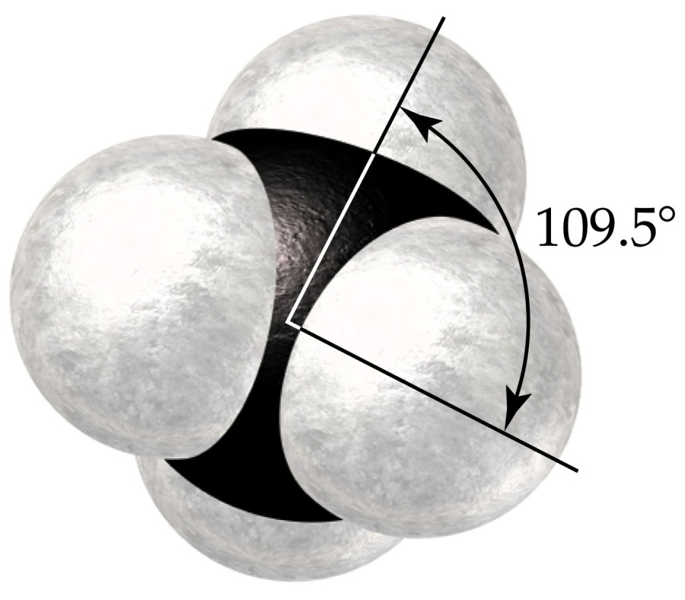
What is the shape when 4 atoms are attached to the central atom?

Slide 18
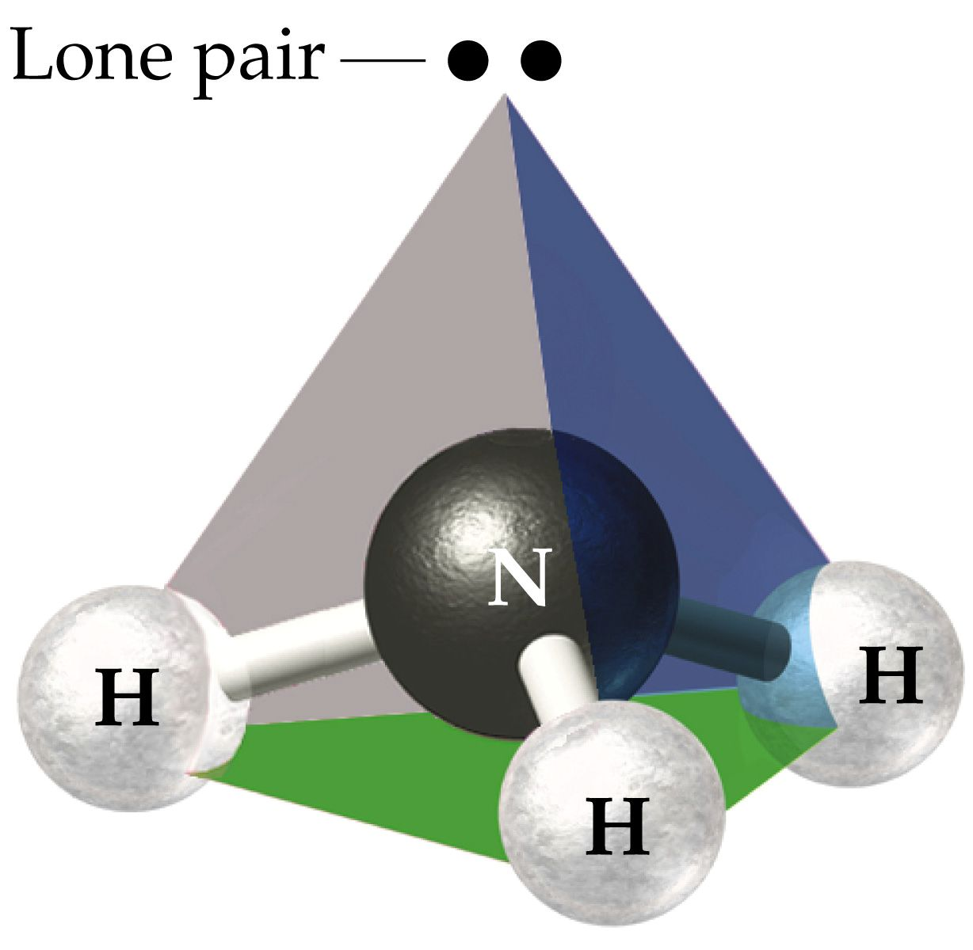
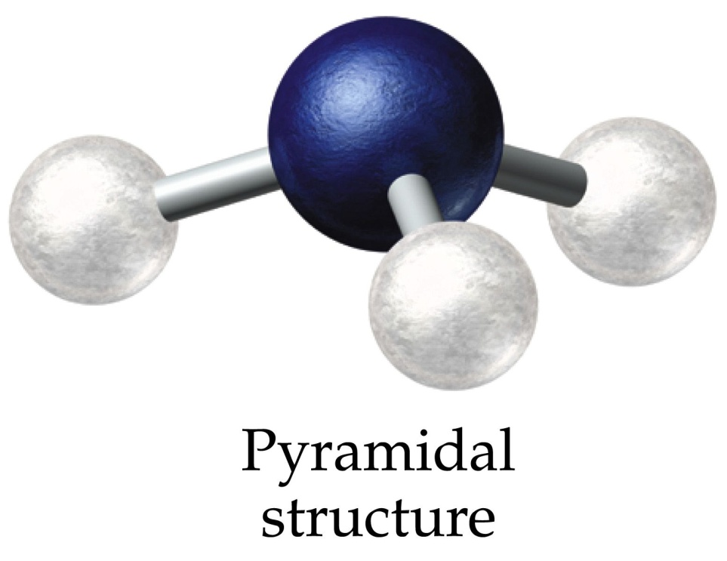
What is the shape when 3 atoms + lone pair are attached to the central atom?

Slide 19
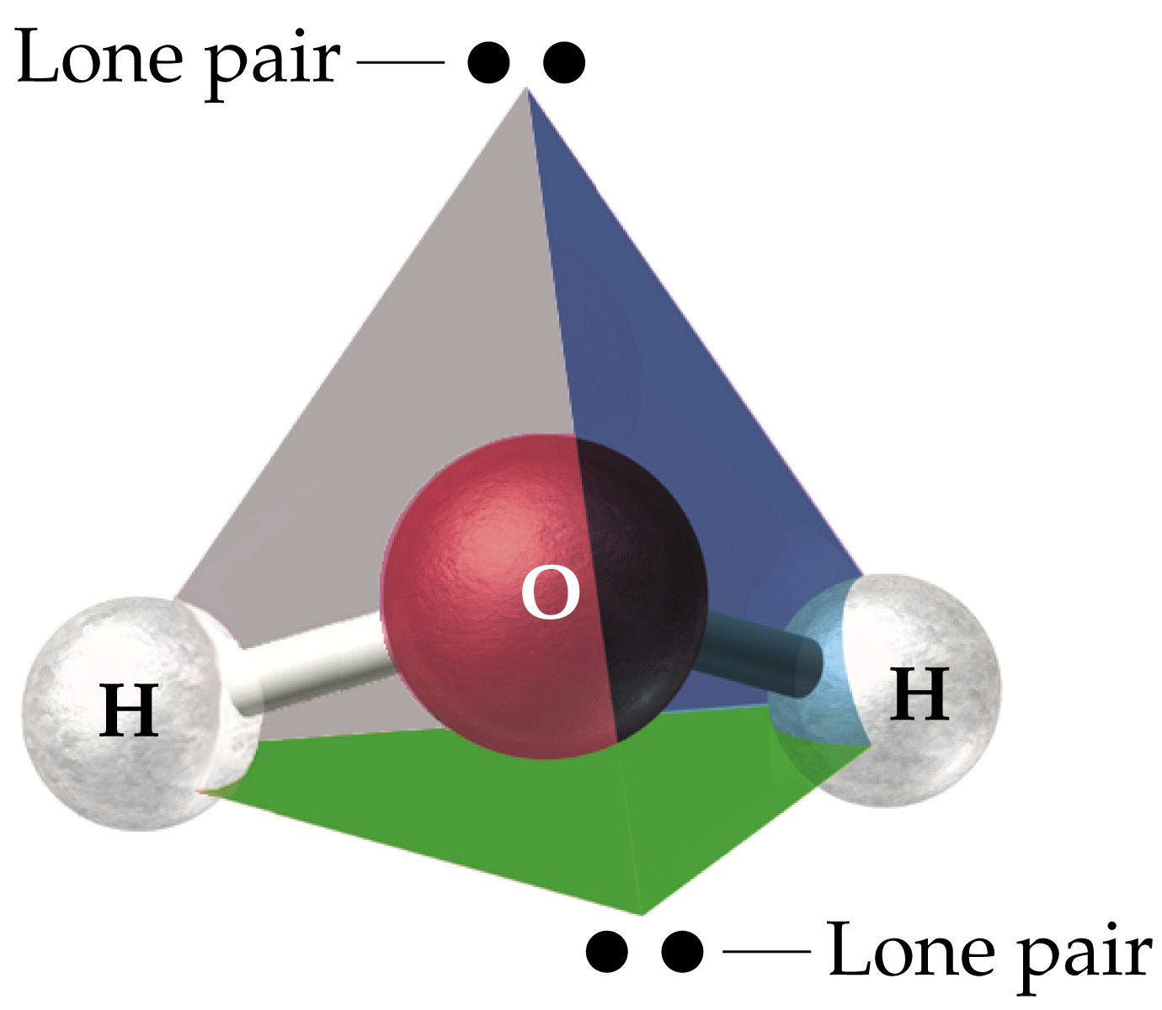
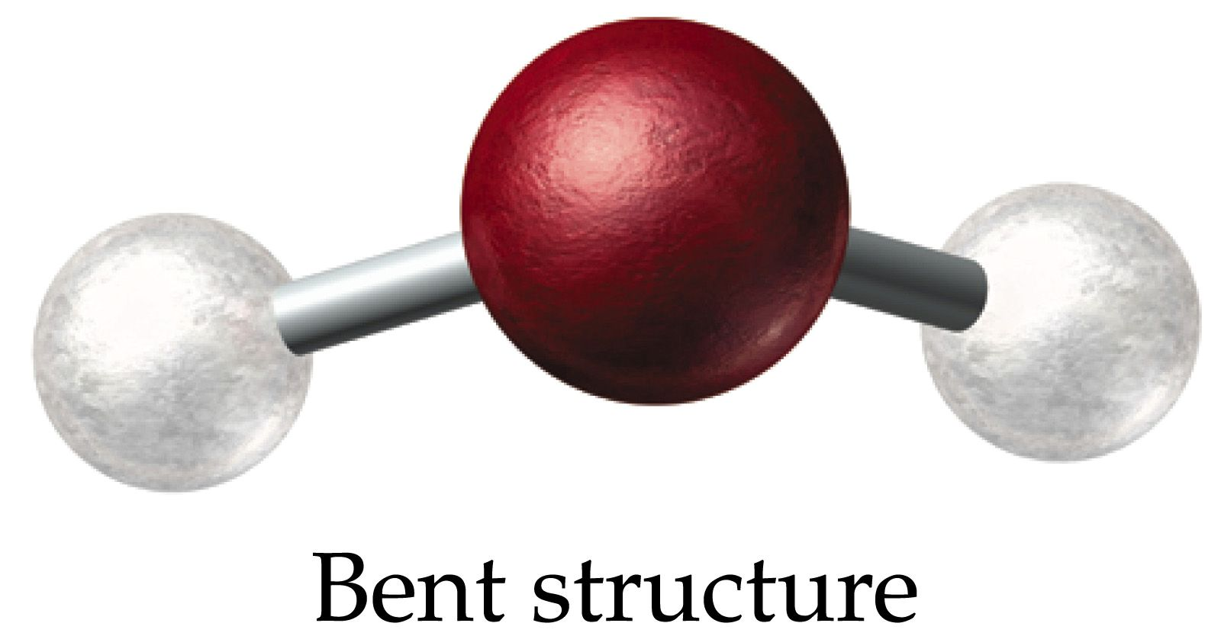
What is the shape when 2 atoms + 2 lone pairs are attached to the central atom?

Slide 20
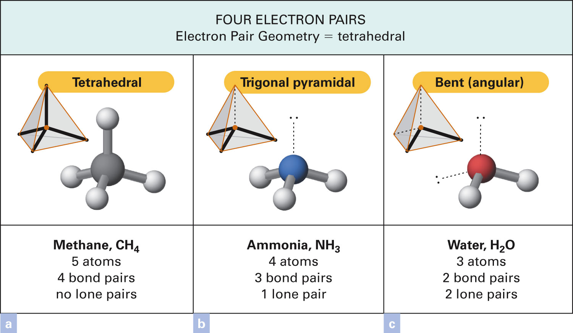
Figure 13-5 p384
Notes:
Figure 13.5 Molecular geometries based on four electron pairs around the central atom. (a) In methane, CH4, the four hydrogen atoms are at the corners of a tetrahedron, and the carbon atom is at its center. If the top hydrogen atom and the carbon atom are in the plane of the page, the front hydrogen atom in the base is in front of the page and the other two hydrogen atoms are behind the page. (b) Ammonia, NH3 has the shape of a pyramid with a triangular base. The nitro-gen atom is in the plane of the page, the front hydrogen atom is in front of the page, and the other two hydrogen atoms are behind the page. Like the carbon atom in methane, the nitrogen atom in ammonia is surrounded by four electron pairs. (c) Water, H2O has a bent (angular) shape. With only three atoms, the bond angle of the water molecule lies in two dimensions. The oxygen atom in water is surrounded by four electron pairs. These pairs are not in the same plane as the three atoms; one pair is above that plane and the other is beneath it.

Slide 21
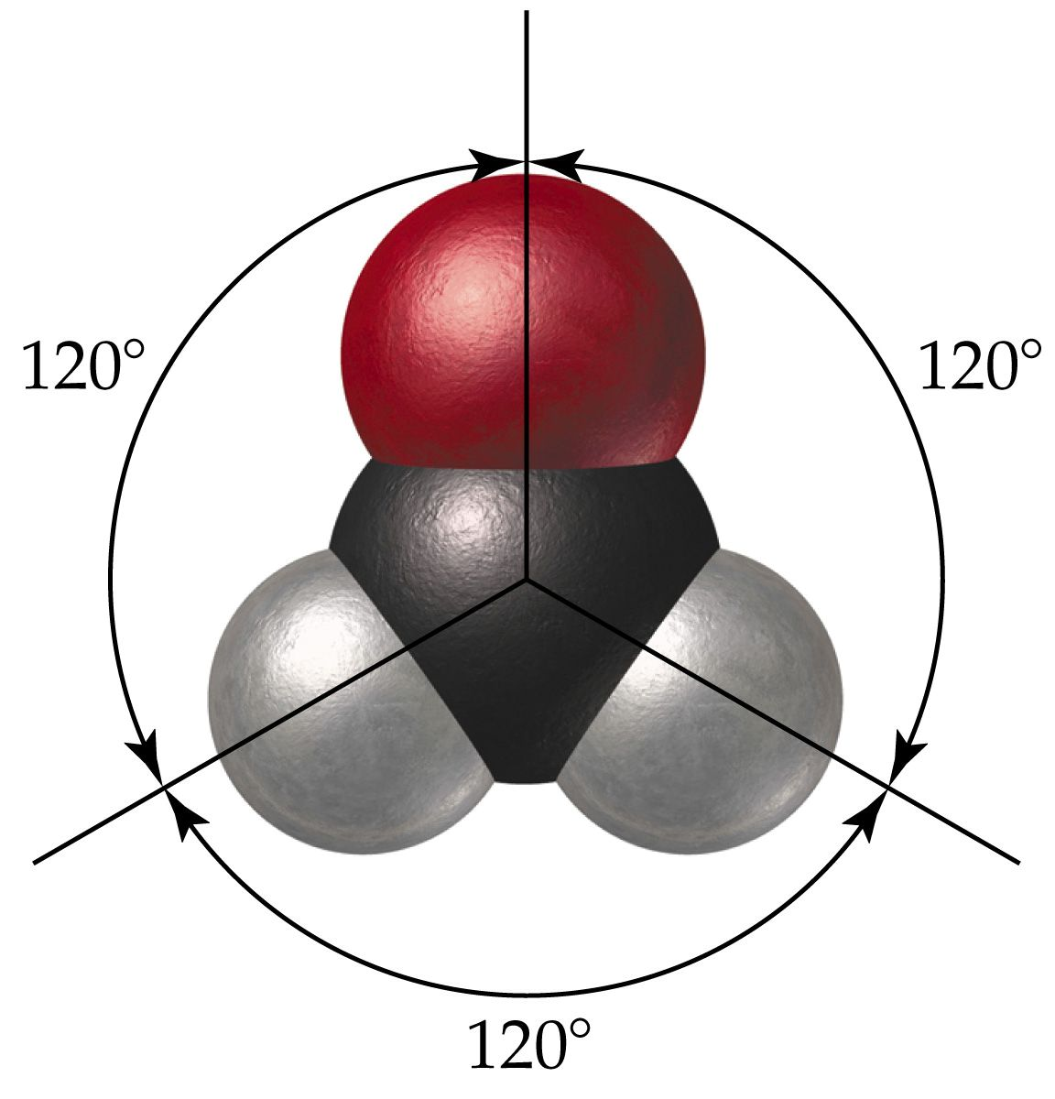
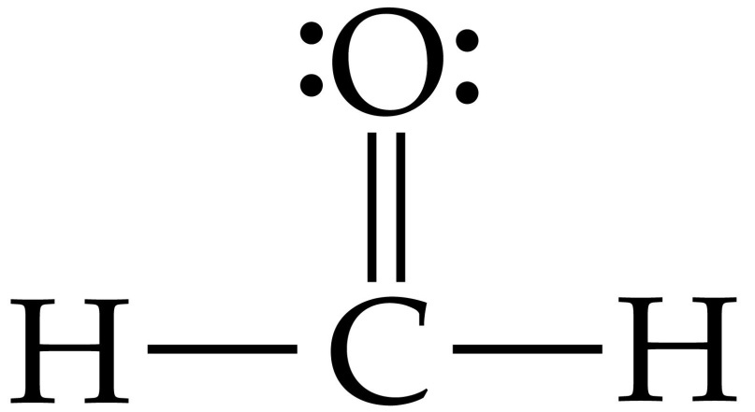
What is the shape when 3 atoms are attached to the central atom?

Slide 22
Example – Covalent Bonding
What is the Lewis structure for formaldehyde, CH₂O?

Slide 23
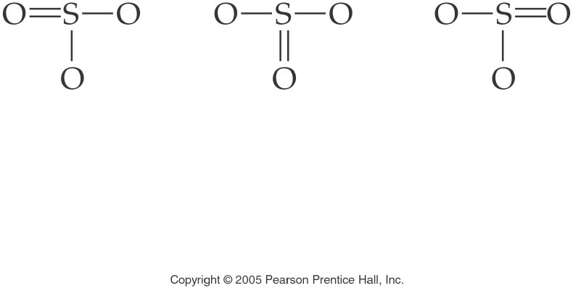
How are these structures different?
Notes:
Figure: 12-08-09UN
Title:
SO₃ Structural Formula
Caption:
This is the structural formula for the resonance structures of sulfur trioxide.
Notes:
This diagram is part of an in-text example for drawing Electron Dot Formulas and Structural Formulas. The three structures are equivalent and are known as resonance structures.

Slide 24
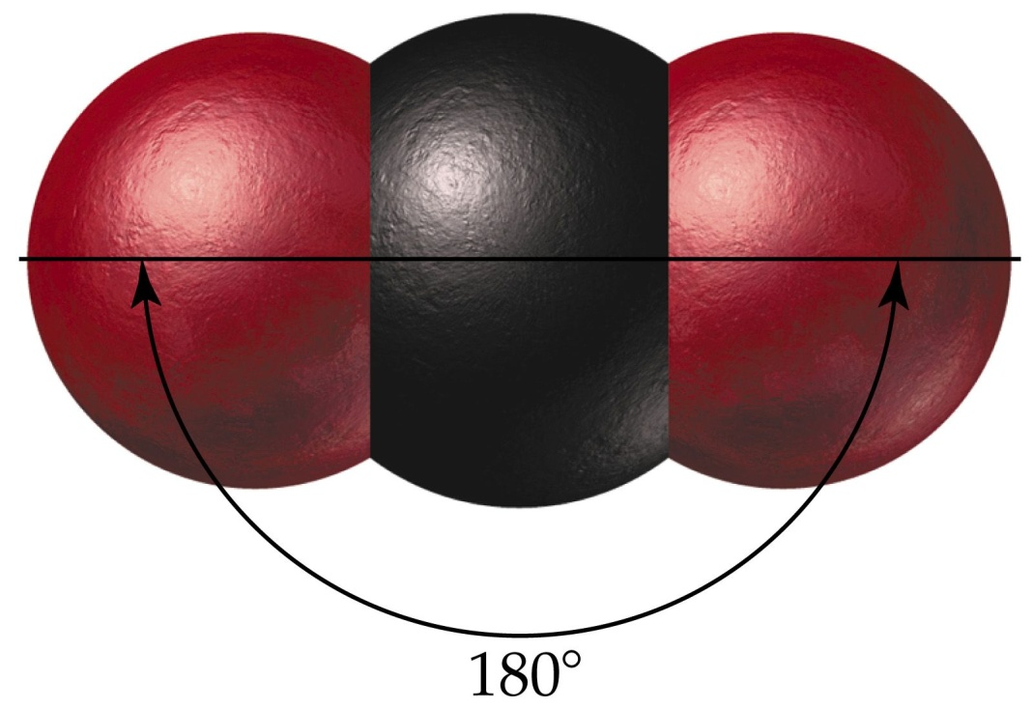
What is the shape when 2 atoms are attached to the central atom?

Slide 25
Notes:
Figure: 12-09-09UNa
Title:
Carbon Dioxide
Caption:
The electron pair geometry in carbon dioxide, CO₂, is linear. The molecular shape of CO₂ is linear; the bond angle is 180¡.
Notes:
The 4 electron pairs are all bonding and form bonds to only two atoms. Thus the angle between the bonds is 180¡.

Slide 26
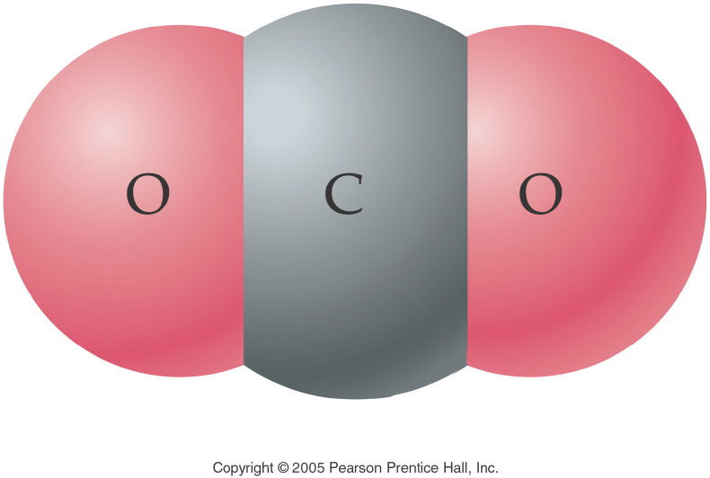
Notes:
Figure: 12-08-20UN
Title:
Carbon Dioxide Molecule
Caption:
This is a 3-D representation of carbon dioxide, CO₂.
Notes:
This 3-D representation depicts an accurate model of the electron shell in each atom of a carbon dioxide molecule.

Slide 27
Table 13-1 p380

Slide 28
What are the basic shapes around a central atom?
Figure 13-1 p381
Notes:
Figure 13.1 Electron-pair geometry. Ball-and-stick models show the arrangement of two, three, and four electron pairs (sticks) around a central atom (ball). (a) According to the electron-pair repulsion principle, two sticks are as far from each other as possible when they are diametri-cally opposite each other. The geometry is linear, and the angle formed is 180°. (b) Three sticks are as far from one another as possible when equally spaced on a circumference of the ball. The sticks and the center of the ball are in the same plane and the angles are 120°. The geometry is trigonal (triangular) planar. (c) Four electron pairs are as far from one another as possible when arranged to form a tetrahedron. Each angle is 109.5°, which is called the tetrahedral angle.

Slide 29
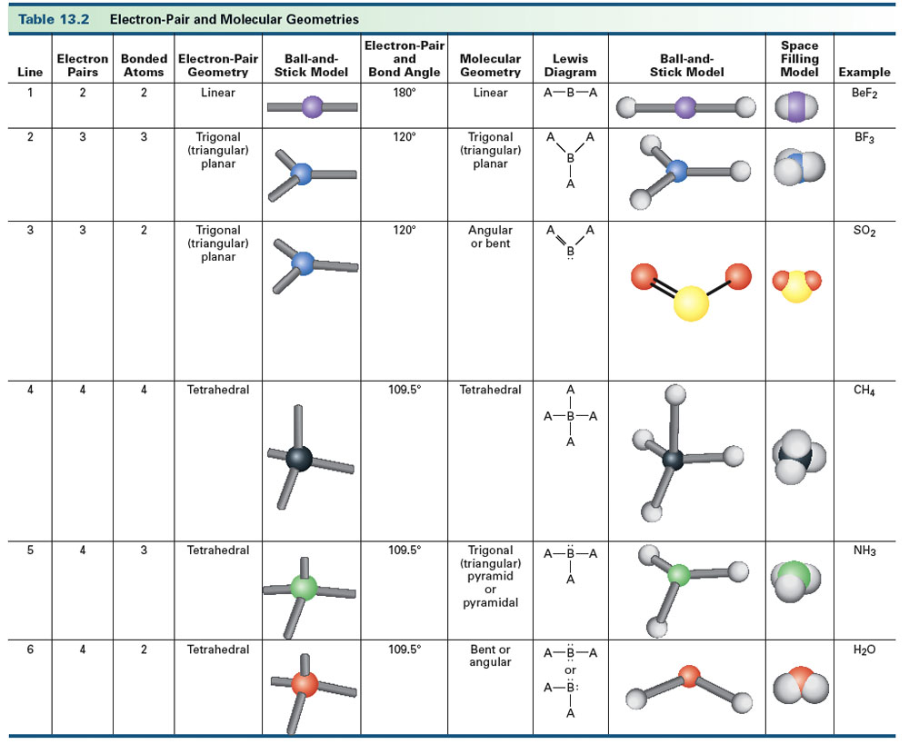
Table 13-2, p. 377

Slide 30
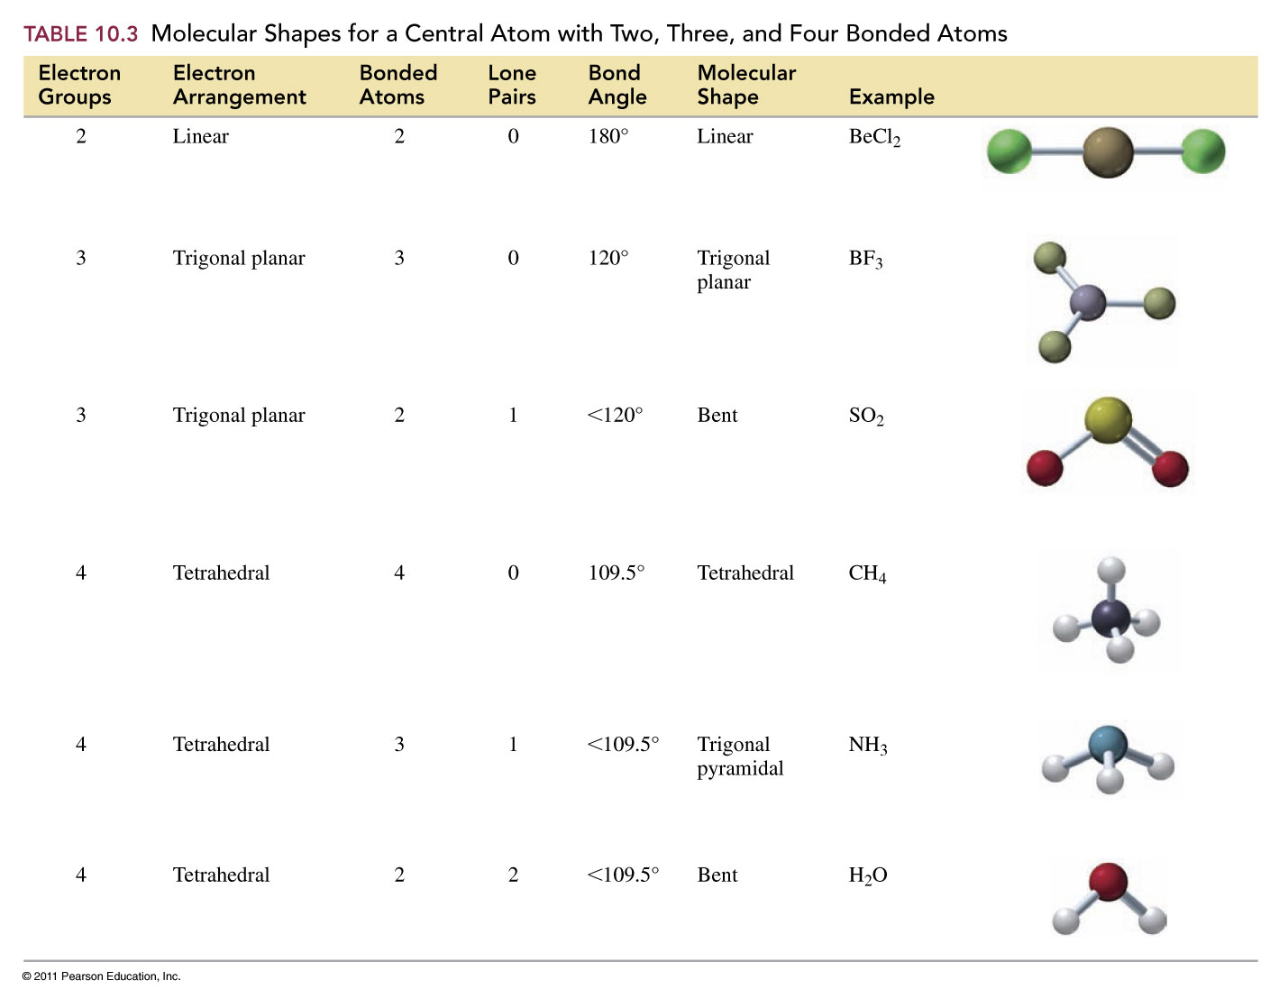

Slide 31
Example – VSEPR Theory
What is the molecular geometry for hydrogen sulfide?
tetrahedral
trigonal planar
trigonal pyramidal
bent
linear

Slide 32
Example – VSEPR Theory
What is the bond angle for the thiocyanate ion, SCN⁻?
109.5°
107°
180°
104.5°
120°

Slide 33
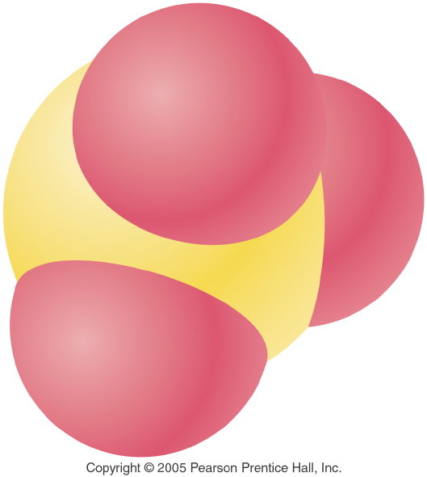
Notes:
Figure: 12-08-04UNa
Title:
Sulfur Trioxide
Caption:
Sulfur trioxide, SO₃
Notes:
This is a representation of sulfur trioxide, SO₃ showing the shape of the molecule and the relative sizes of the sulfur and oxygen atoms.

Slide 34
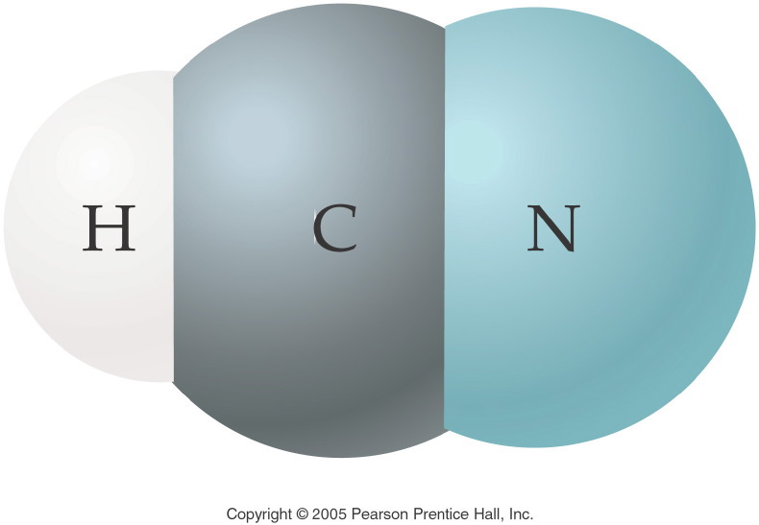
Notes:
Figure: 12-08-10UN
Title:
Hydrogen Cyanide Molecule
Caption:
This is a 3-D representation of hydrogen cyanide, HCN.
Notes:
This 3-D representation depicts an accurate model of the electron shell in each atom of a hydrogen cyanide molecule.

Slide 35
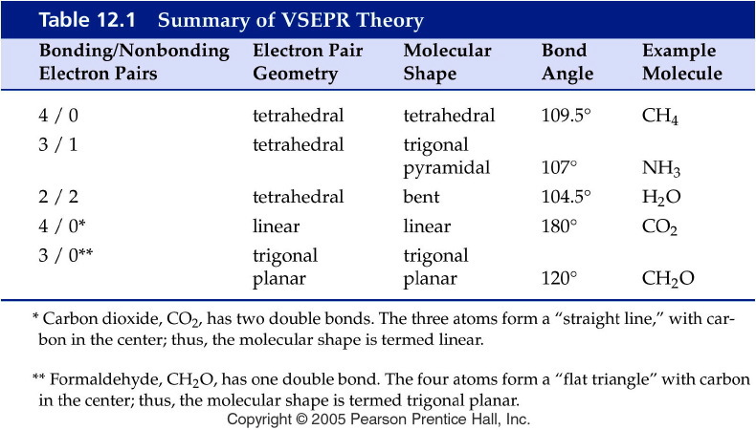
Notes:
Figure: 12-T01
Title:
Table 12.1
Caption:
Summary of VSEPR Theory
Notes:
The major molecular shapes from VSEPR are summarized. The number of bonding pairs and lone pairs determine the molecular shape.

Slide 36
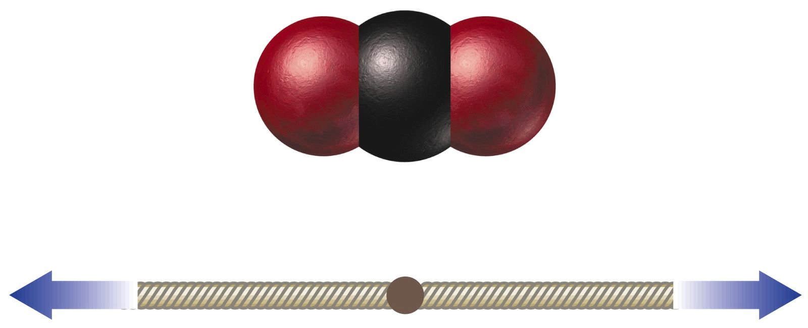
Is CO₂ a polar or nonpolar molecule?

Slide 37
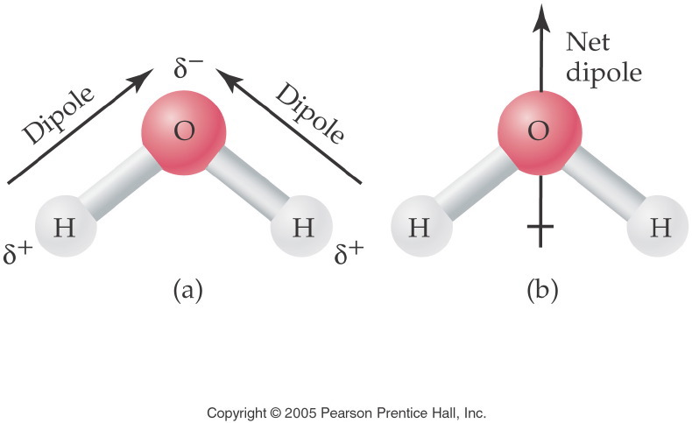
Notes:
Figure: 14-01
Title:
The Polar Water Molecule
Caption:
The two dipoles produce a net dipole for the entire water molecule.
Notes:
The high degree of polarity in water makes it an excellent solvent for the solvation of ionic compounds and other polar molecules.

Slide 38
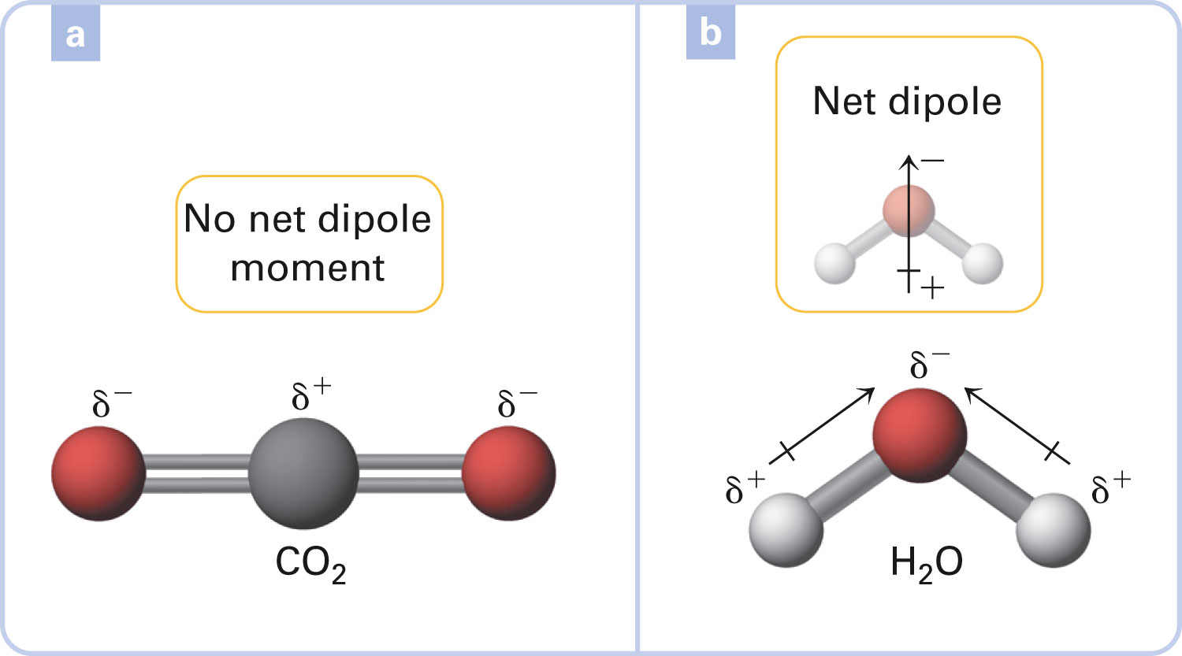
Figure 13-10 p392
Notes:
Figure 13.10 Polarity of tri-atomic molecules. Molecular polar-ity depends on both bond polarity and molecular geometry.

Slide 39
Can a nonpolar molecule have polar bonds?

Slide 40
What is the direction of the net dipole?

Slide 41
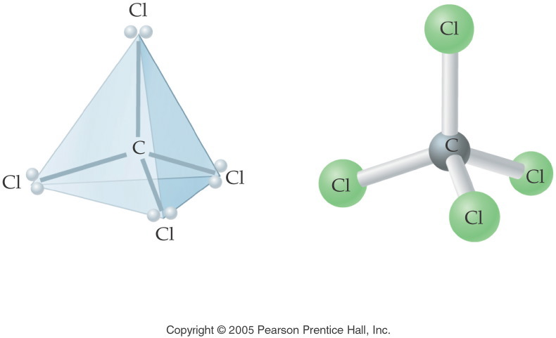
Notes:
Figure: 12-09-10UN
Title:
CCl₄ Molecular Shape
Caption:
This is the electron pair geometry and molecular shape of carbon tetrachloride.
Notes:
This diagram is part of an in-text example of electron pair geometry and molecular shape. In this example, carbon tetrachloride has 4 electron pairs and a tetrahedral molecular shape.

Slide 42
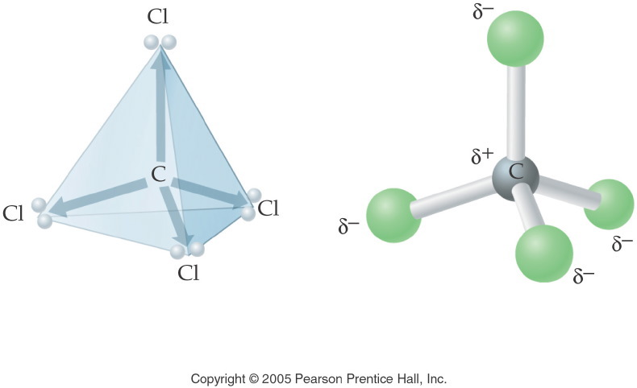
Notes:
Figure: 12-09-11UN
Title:
CCl₄ Polarity
Caption:
This is the electron pair geometry and molecular shape of carbon tetrachloride.
Notes:
This diagram is part of an in-text example of electron pair geometry and polarity. In this example, carbon tetrachloride is non-polar, although each bond is polar covalent. The carbon tetrachloride molecule contains polar bonds but is nonpolar as a molecule because the opposing directions of the attractive forces "cancel out".

Slide 43
Figure 13-11 p393
Notes:
Figure 13.11 Polar and nonpolar molecules. The carbon–chlorine bond is polar, with chlo-rine as the end toward which bonding electrons are displaced. The carbon–hydrogen bond is also polar, with carbon at the more negative end. CCl4 and CH4 are nonpolar because the dipoles from the polar bonds cancel due to the molecular symmetry. CHCl3, CH2Cl2, and CH3Cl are polar because the dipoles from the polar bonds do not cancel.

Slide 44
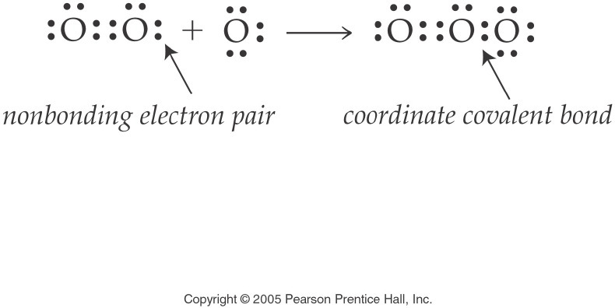
How are coordinate covalent bonds different from other covalent bonds?
Notes:
Figure: 12-09-04UN
Title:
O₃ Electron Dot Formula
Caption:
This is the electron dot formula for ozone. The coordinate covalent bond is clearly noted.
Notes:
This diagram is part of an in-text example for drawing electron dot formulas and structural formulas. The coordinate covalent bond is formed by the O₂ molecule donating a pair of electrons to form a bond to an O atom.

Slide 45
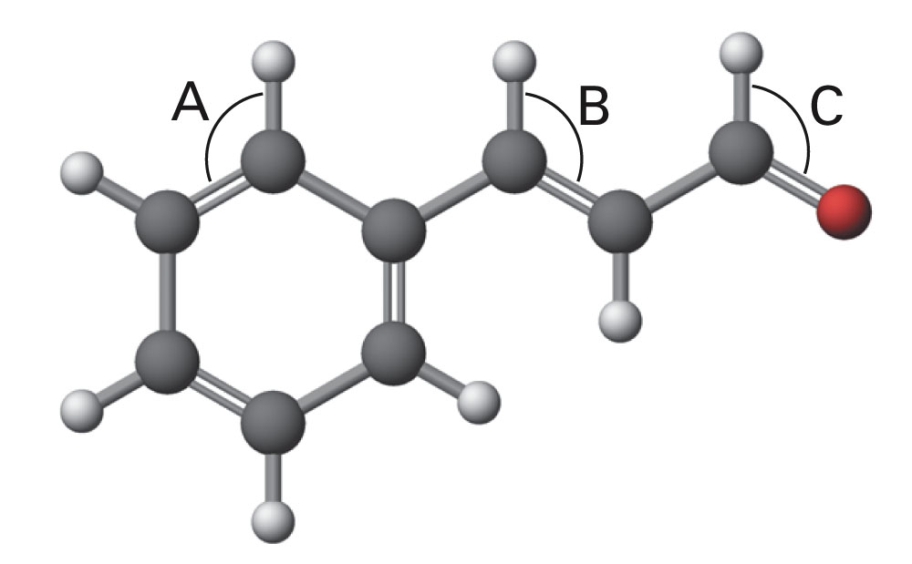
p. 397

Slide 46
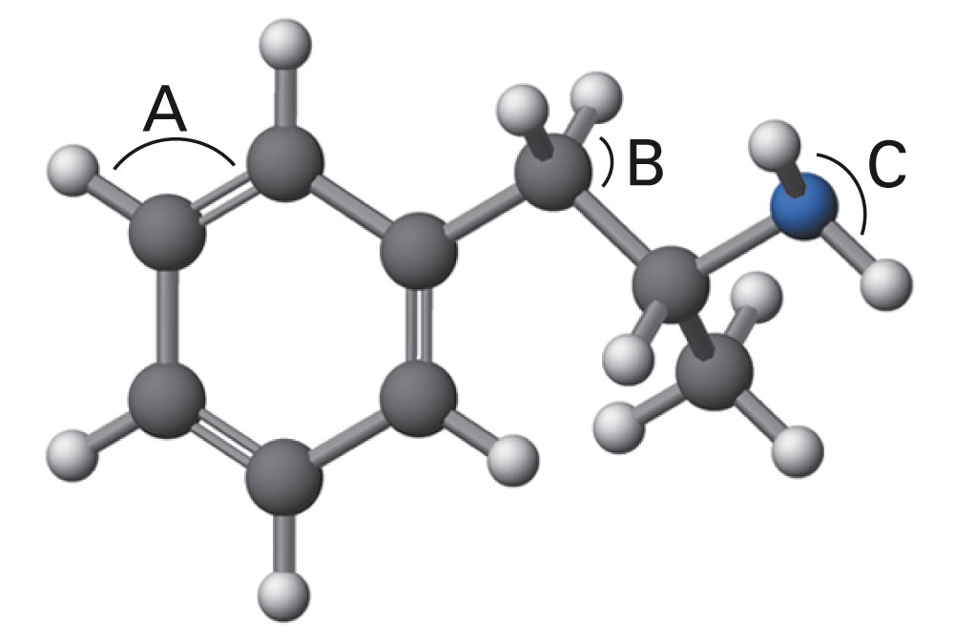
p. 397

Slide 47
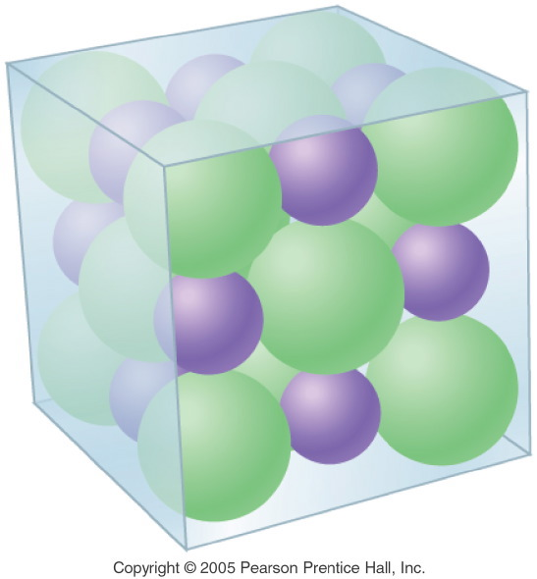
What does a formula unit look like?
Notes:
Figure: 12-04
Title:
Crystalline Structure of NaCl
Caption:
A crystal of NaCl is composed of sodium and chloride ions which repeat regularly.
Notes:
This regulated, alternating pattern of ions is the reason that NaCl crystallizes in a cubic shape. Note that each cation is attracted to several anions and vice versa.

Slide 48
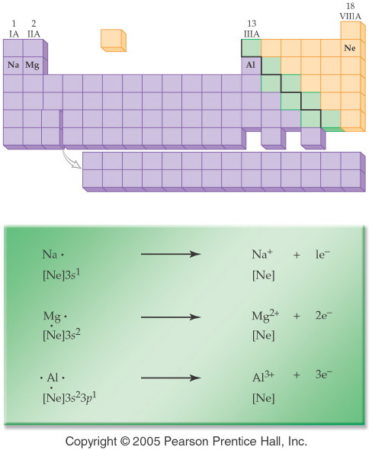
What is one way that a metal obtains an octet?
Notes:
Figure: 12-05
Title:
Formation of Metal Ions
Caption:
The atoms of the metals in Period 3 form cations by losing 1, 2, or 3 electrons, respectively.
Notes:
With all three metals, the stable cation formed is isoelectronic with neon, a noble gas with a filled valence shell.

Slide 49
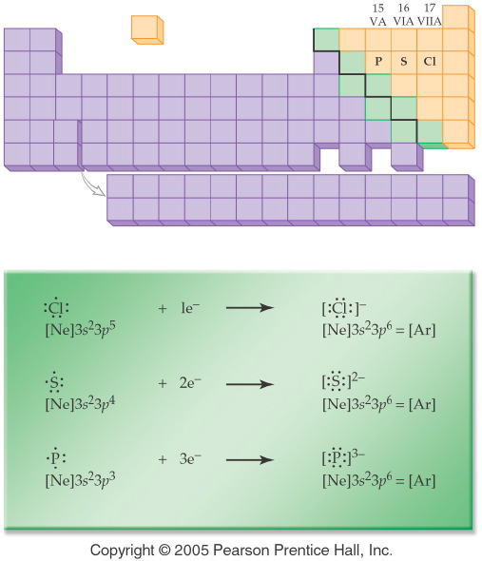
What is one way that a nonmetal obtains an octet?
Notes:
Figure: 12-06
Title:
Formation of Nonmetal Ions
Caption:
The nonmetals in Period 3 gain 1, 2, or 3 electrons, respectively.
Notes:
With all three nonmetals, the stable anion formed is isoelectronic with argon, a noble gas with a filled valence shell.

Slide 50
Example – Ionic Bonding
What is the Lewis structure when aluminum and chlorine form an ionic compound?

Slide 51
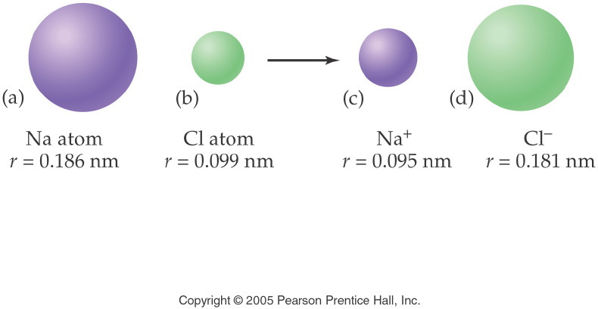
How are the sizes of species related?
Notes:
Figure: 12-07
Title:
Formation of Na+ and Cl- Ions
Caption:
The radius of the sodium atom decreases, while the chloride atom increases when ionized.
Notes:
Losing an electron means that the positive nucleus can pull the other electrons in more strongly. Gaining an electron means that the positive nucleus is less effective in pulling the electrons in.

Slide 52
Figure 12-7 p356
Notes:
Figure 12.7 Conductivity of solutions. Ions are held together by ionic bonds in salt, but another type of bonding must be responsible for the properties of sugar.

Slide 53
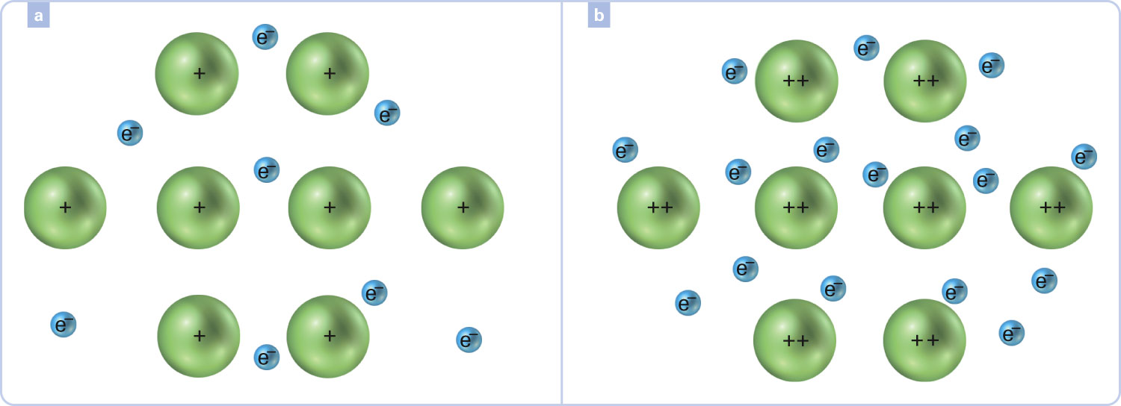
How do metals bond?
Figure 12-17 p366
Notes:
Figure 12.17 The electron-sea model of a metallic crystal. The monatomic ions formed by the metal remain fixed in a definite crystal pattern, but the highest-energy valence electrons are relatively free to move, which explains the high electrical conductivity of metals. (a) This might represent metallic sodium, or another Group 1A/1 element, with its highest-energy ns1 electrons, and (b) might represent magnesium, or another Group 2A/2 element, with its highest-energy ns2 electrons.

Slide 54
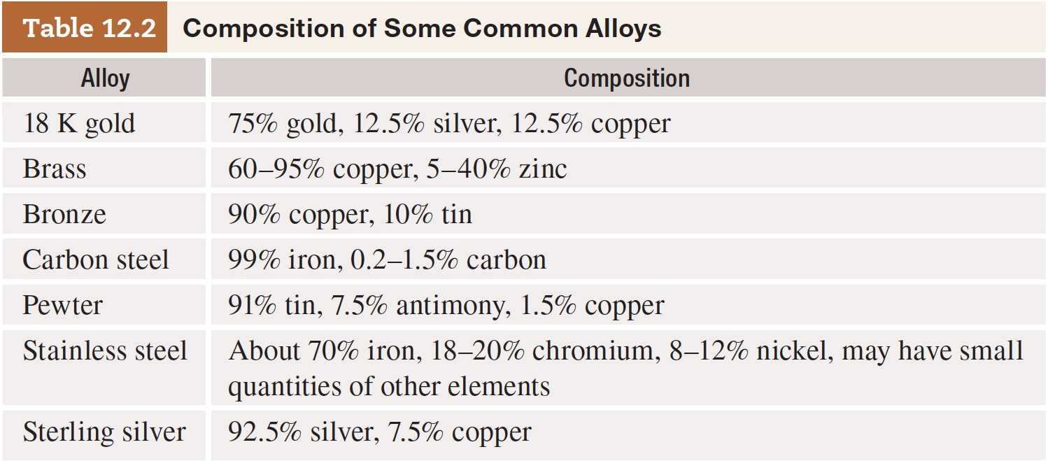
Table 12-2 p366

