Slide 1
Chemistry 142
Review

Slide 2
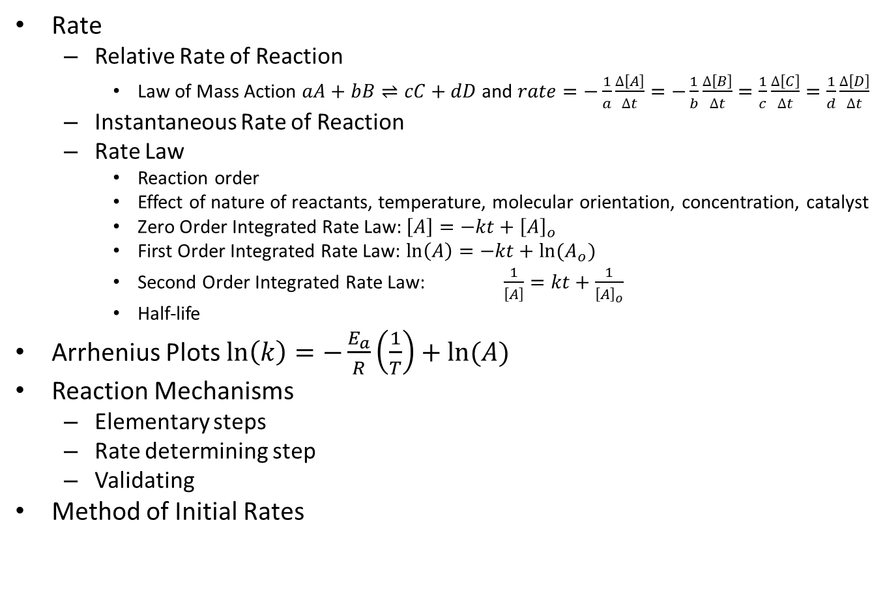
Chapter 14: Chemical Kinetics
Rate
Relative Rate of Reaction
Law of Mass Action $aA+bB⇌cC+dD$ and $rate=−\frac{1}{a}\frac{∆\left[A\right]}{∆t}=−\frac{1}{b}\frac{∆\left[B\right]}{∆t}=\frac{1}{c}\frac{∆\left[C\right]}{∆t}=\frac{1}{d}\frac{∆\left[D\right]}{∆t}$
Instantaneous Rate of Reaction
Rate Law
Reaction order
Effect of nature of reactants, temperature, molecular orientation, concentration, catalyst
Zero Order Integrated Rate Law: $\left[A\right]=−kt+{\left[A\right]}_{o}$
First Order Integrated Rate Law: $\ln\left(A\right)=−kt+ln⁡(A_{o})$
Second Order Integrated Rate Law: $\frac{1}{\left[A\right]}=kt+\frac{1}{{\left[A\right]}_{o}}$
Half-life
Arrhenius Plots $\ln\left(k\right)=−\frac{E_{a}}{R}\left(\frac{1}{T}\right)+ln⁡(A)$
Reaction Mechanisms
Elementary steps
Rate determining step
Validating
Method of Initial Rates

Slide 3
Chapter 15: Chemical Equilibrium
Reversibility of Reactions
Equilibrium constants
Law of Mass Action $aA+bB⇌cC+dD$
Concentration $K_{c}=\frac{{\left[C\right]}^{c}{\left[D\right]}^{d}}{{\left[A\right]}^{a}{\left[B\right]}^{b}}$
Temperature dependent
Pressure $K_{p}=K_{c}{\left(RT\right)}^{∆n}$
Reaction Quotient, Q
Relationships
Multiplying a reaction by a factor n $K_{n}={K_{1}}^{n}$
Reversing a reaction $K_{forward}=\frac{1}{K_{reverse}}$
Adding reactions together $K_{Σrxn}=K_{1}×K_{2}×…$
Le Châtelier’s Principle
Effect of concentration changes
Effect of volume changes
Effect of temperature changes
Effect of a catalyst
Approximations

Slide 4
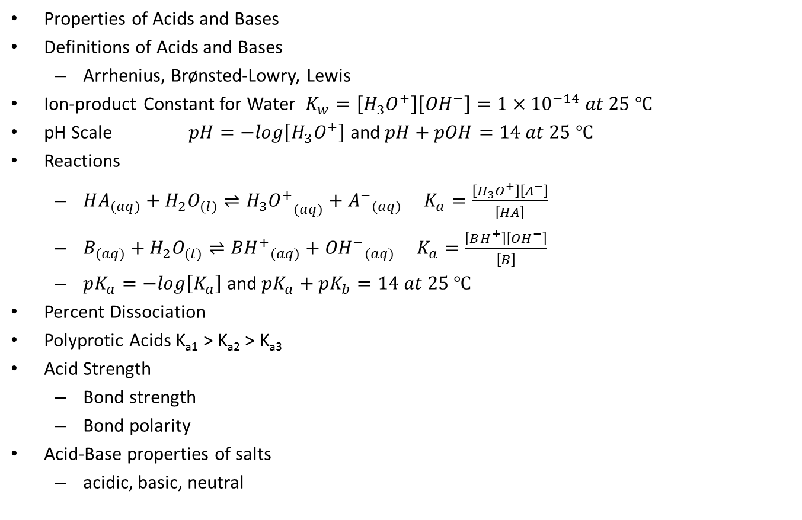
Chapter 16: Acids and Bases
Properties of Acids and Bases
Definitions of Acids and Bases
Arrhenius, Brønsted-Lowry, Lewis
Ion-product Constant for Water $K_{w}=\left[H_{3}O^{+}\right]\left[{OH}^{−}\right]=1×{10}^{−14} at 25 ℃$
pH Scale $pH=−log\left[H_{3}O^{+}\right]$ and $pH+pOH=14 at 25 ℃$
Reactions
$HA_{(aq)}+H_{2}O_{(l)}⇌{H_{3}O^{+}}_{(aq)}+{A^{−}}_{(aq)} K_{a}=\frac{\left[H_{3}O^{+}\right]\left[A^{−}\right]}{\left[HA\right]}$
$B_{(aq)}+H_{2}O_{(l)}⇌{BH^{+}}_{(aq)}+{{OH}^{−}}_{(aq)} K_{a}=\frac{\left[BH^{+}\right]\left[{OH}^{−}\right]}{\left[B\right]}$
$pK_{a}=−log\left[K_{a}\right]$ and $pK_{a}+pK_{b}=14 at 25 ℃$
Percent Dissociation
Polyprotic Acids K_{a1} > K_{a2} > K_{a3}
Acid Strength
Bond strength
Bond polarity
Acid-Base properties of salts
acidic, basic, neutral

Slide 5
Chapter 17: Aqueous Ionic Equilibrium
Common Ion
Buffers
Henderson-Hasselbach equation : $pH=pK_{a}+log\left(\frac{\left[base\right]}{\left[acid\right]}\right)$
Titration Curves
Strong acid-strong base
Stoichiometric point $\left[H_{3}O^{+}\right]=\left[{OH}^{−}\right]$ and pH = 7
Weak acid-strong base
Half-neutralization $pH=pK_{a}$ and $\left[acid\right]=\left[conjugate base\right]$
Equivalence point pH > 7
Weak base-strong acid
Half-neutralization $pOH=pK_{b}$ and $\left[base\right]=\left[conjugate acid\right]$
Equivalence point pH < 7
Acid-Base Indicators
Complex Ion Equilibrium
Solubility Equilibrium, K_{sp}
Effect of common ion, pH, formation of a complex ion
Precipitation
Qualitative Analysis

Slide 6
Chapter 18: Free Energy and Thermodynamics
First Law of Thermodynamics $∆E=q+w=∆H+P∆V$
Entropy $S=k\ln\left(W\right)$
effect of state, molar mass, allotropes, molecular complexity, and dissolution
$∆S^{°}=\sum{n_{p}{S_{p}}^{°}−\sum{n_{r}{S_{r}}^{°}}}$
ΔS > 0 system is more disordered, ΔS < 0 system is more ordered
Second Law of Thermodynamics
$∆S_{universe}=∆S_{system}+∆S_{surroundings}$
$∆S_{surrounding }=−\frac{∆H_{system}}{T}$
Third Law of Thermodynamics (W = 1, S = 0)
Gibbs Free Energy $∆G=∆H−T∆S$
exergonic (ΔG < 0), endergonic (ΔG > 0), equilibrium (ΔG = 0)
$∆G^{°}=\sum{n_{p}{G_{p}}^{°}−\sum{n_{r}{G_{r}}^{°}}}$
$∆G=∆G^{°}+RTln\left(Q\right)$
van’t Hoff equation $\ln\left(K\right)=−\frac{∆H^{°}}{R}\left(\frac{1}{T}\right)+\frac{∆S^{°}}{R}$

Slide 7
Chapter 19: Electrochemistry
Oxidation-Reduction Reactions
Oxidation vs. reduction
Oxidizing agent vs. reducing agent
Oxidation numbers
Balancing redox reactions
Electrodes: anode vs. cathode
Voltaic (or Galvanic) Cells (spontaneous)
Cell notation
Cell potential ${E_{cell}}^{°}={E_{cathode}}^{°}−{E_{anode}}^{°}$
$∆G=−nFE_{cell}$ where $F=96485\frac{C}{mol e^{−}}$
The Nernst Equation: $E=E^{°}−\frac{RT}{nF}ln⁡(Q)$
Batteries
Electrolysis (nonspontaneous)
Corrosion

Slide 8
Chapter 25: Transition Metals and Coordination Compounds
Properties of Transition Metals
Coordination Compounds
Ligands: monodentate vs. bidentate vs. polydentate
Complex ions
Primary valence (oxidation number)
Secondary valence (coordination number)
Nomenclature
Structure and Isomers
Structural isomers: coordination isomers vs. linkage isomers
Stereoisomers
Geometric isomers (diastereomers): cis-trans vs. mer-fac
Optical isomers (enantiomers)
Bonding
Valence Bond Theory: hybridization
Crystal Field Theory
Applications

Slide 9
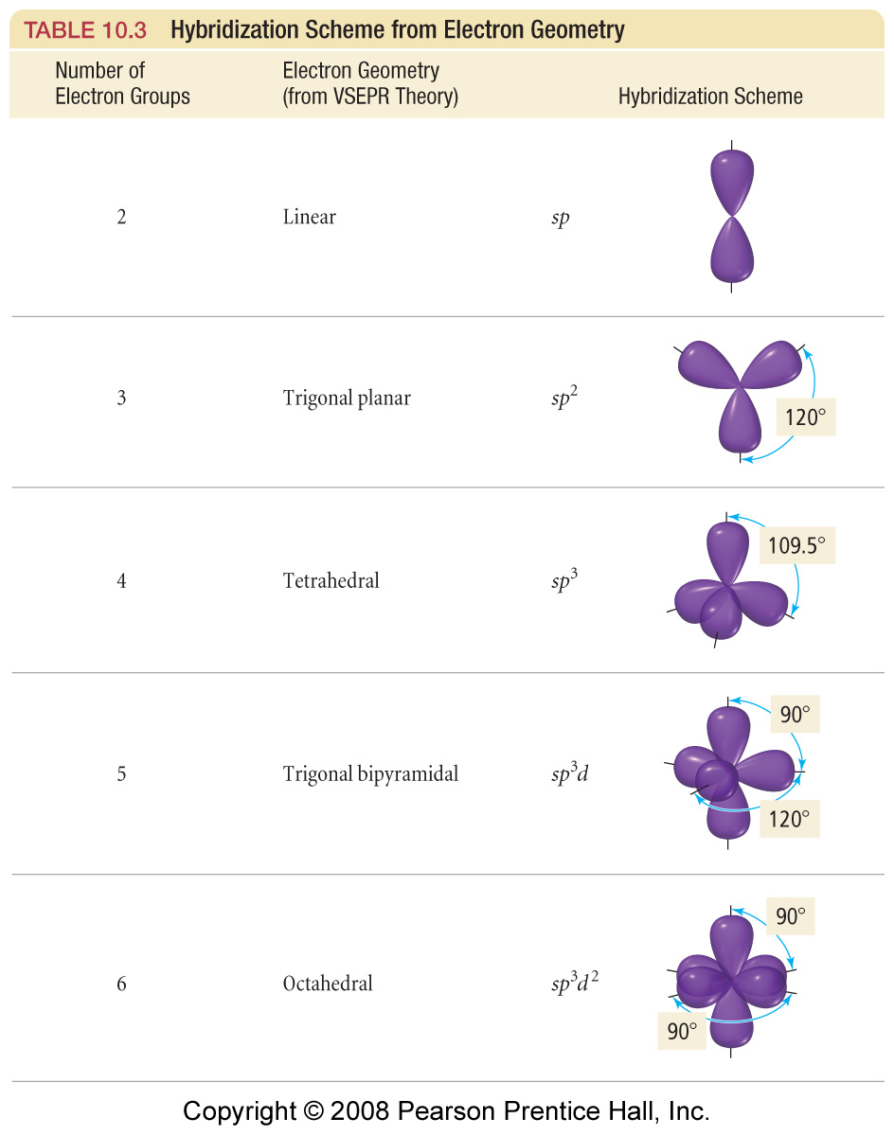

Slide 10
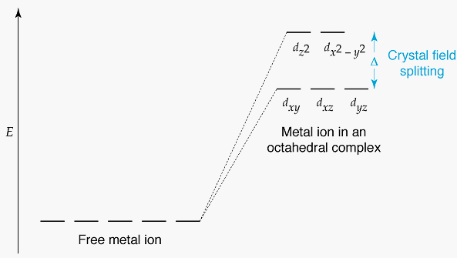
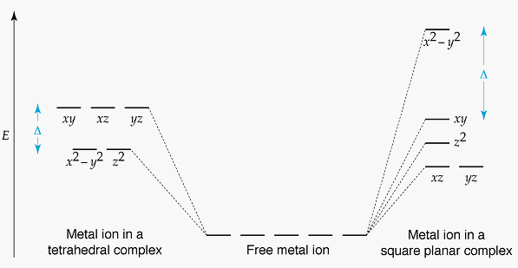
Crystal Field Theory
Notes:
Tetrahedral Complexes
Only high spin known because Δ small
[NiCl₄]^{2–}, [FeCl₄]–
Square Planar
Most common for d⁸
[Ni(CN)₄]^{2–}, [PdCl₄]^{2–}, Pt(NH₃)₂Cl₂

Slide 11
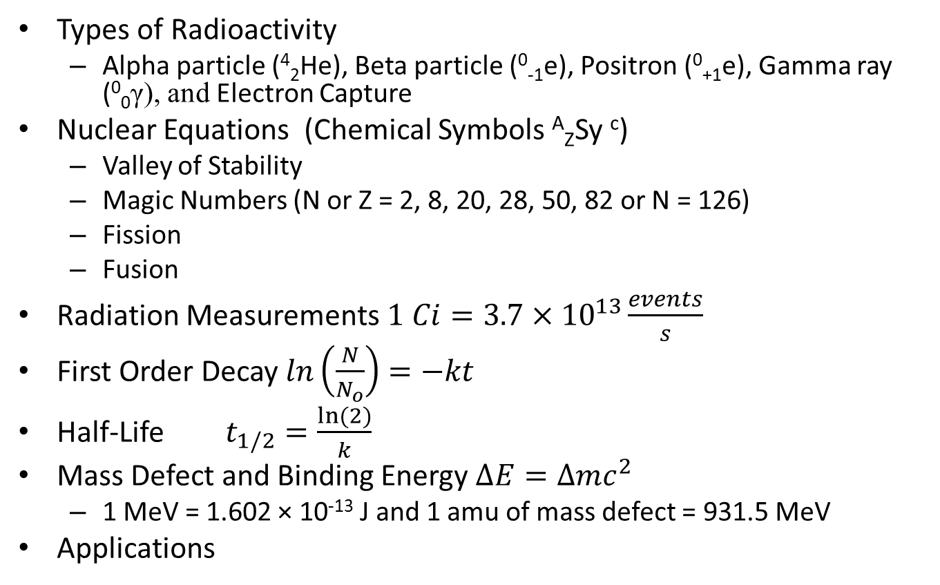
Chapter 20: Radioactivity and Nuclear Chemistry
Types of Radioactivity
Alpha particle (⁴₂He), Beta particle (⁰₋₁e), Positron (⁰₊₁e), Gamma ray (⁰₀γ), and Electron Capture
Nuclear Equations (Chemical Symbols ^{A}_{Z}Sy ^{c})
Valley of Stability
Magic Numbers (N or Z = 2, 8, 20, 28, 50, 82 or N = 126)
Fission
Fusion
Radiation Measurements $1 Ci=3.7×{10}^{13}\frac{events}{s}$
First Order Decay $ln\left(\frac{N}{N_{o}}\right)=−kt$
Half-Life $t_{1/2}=\frac{ln⁡(2)}{k}$
Mass Defect and Binding Energy $∆E=∆mc^{2}$
1 MeV = 1.602 × 10⁻¹³ J and 1 amu of mass defect = 931.5 MeV
Applications

Slide 12
Chapter 21: Organic Chemistry
Organic Compounds
Hydrocarbons
alkanes, alkenes, alkynes, arenes
Functional Groups
organic halide, alcohol, phenol, aldehyde, ketone, carboxylic acid, ester, amine, amide, ether
Organic Chemistry Nomenclature
Polymers
Properties of Organic Compounds
Reactions
Combustion
Addition
Substitution
Neutralization
Dehydration
Oxidation
Reduction
Condensation Reactions
Esterification
Amidation

Slide 13
How does the functional group change the suffix?
Functional Group | Condensed Formula | Suffix
Alkane | -C-C- | -ane
Alkene | -C=C- | -ene
Alkyne | -C≡C- | -yne
Alcohol | R-OH | -ol
Ether | R-O-R | -ether
Aldehyde | R-CHO | -al
Ketone | R-CO-R | -one
Carboxylic Acid | R-CO₂H or R-COOH | -ic acid
Ester | R-COOR | -oate
Amine | R-NH₂; R₂-NH; R₃-N 1° 2° 3° | -amine
Amide | R-CONH₂; R-CONHR; R-CONR₂ 1° 2° 3° | -amide

Slide 14
How do organic functional groups compare?
Functional Group | Condensed Formula | Major Intermolecular Force | Polar when side chain is small? | Boiling Point | Water Soluble | Similar to
Organic Halide | R-X | Dipole | Mostly nonpolar | Low | Insoluble
Alcohol | R-OH | Hydrogen Bonding | Polar | High | Soluble
Ether | R-O-R | Dipole (h-bond acceptor) | Mostly nonpolar | Low | Insoluble
Aldehyde | R-CHO | Dipole (h-bond acceptor) | Mostly nonpolar | Lower than similar alcohols | Not very soluble
Ketone | R-CO-R | Dipole (h-bond acceptor) | Nonpolar unless ketone is small | Lower than similar alcohols | Not very soluble
Carboxylic acid | R-COOH | Hydrogen Bonding | Polar | High | Soluble | Alcohols
Ester | R-COO-R | Dipole (h-bond acceptor) | Slightly polar | Lower than similar alcohols | Insoluble
Amine | R-NH₂ (1°) R₂NH (2°) R₃N (3°) | 1° hydrogen bonding 2° hydrogen bonding 3° Dipole (h-bond acceptor) | Polar | High | Soluble | Alcohols
Amide | R-CO-NH₂ (1°) R-CO-NHR (2°) R-CO-NR₂ (3°) | 1° hydrogen bonding 2° hydrogen bonding 3° Dipole (h-bond acceptor) | Polar | High | Soluble | Carboxylic acids

Slide 15
Lab Techniques
Basic glass working
Proper use of standard equipment
Balances
Electronic and quad-beam
Volumetric equipment
Beakers, graduated cylinders, Erlenmeyer flasks
Volumetric flasks and pipets, burets
Use equipment to collect, organize and evaluate experimental data
Observe physical and chemical changes
Interpret qualitative (non-numerical) and quantitative (numerical) data
Use CRC Handbook to look up information
Make linear graphs using data

