Slide 1
Chemistry 142 Chapter 16: Acids and Bases
Outline
Definitions
Ion-product Constant for Water
pH Scale
Percent Dissociation
Polyprotic Acids
Salts of Acid-Base Reactions
Acid Strength

Slide 2
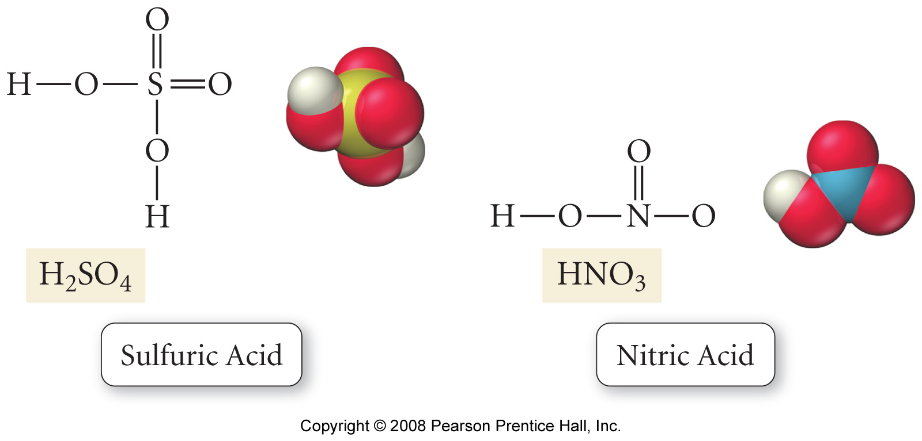
What are the structures of acids?

Slide 3
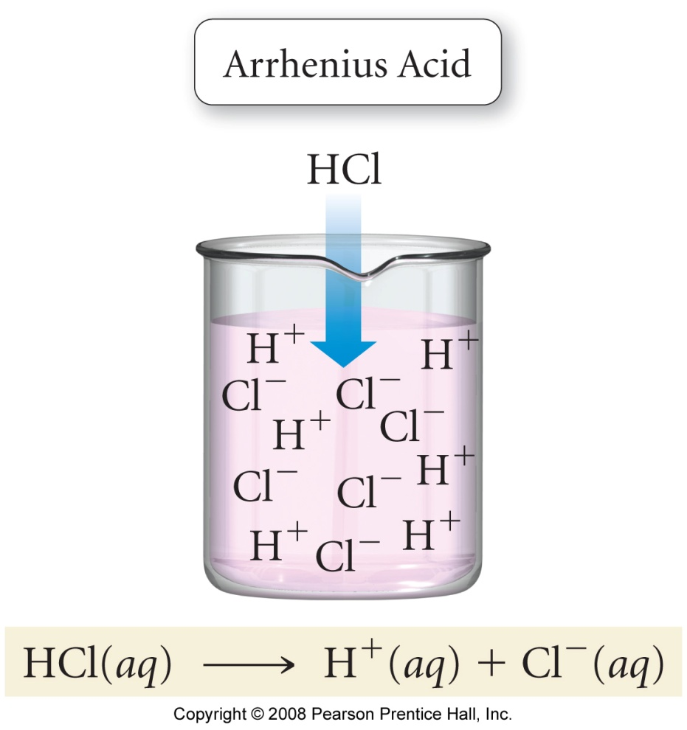
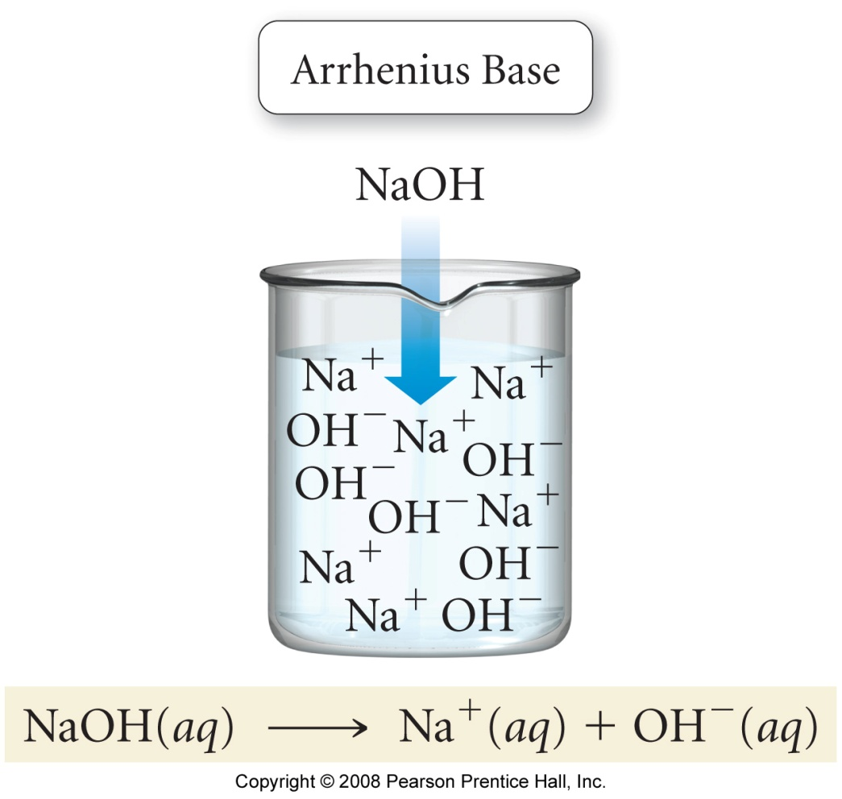
What is Arrhenius Theory?
HCl ionizes in water,
producing H⁺ and Cl– ions
NaOH dissociates in water,
producing Na⁺ and OH– ions

Slide 4
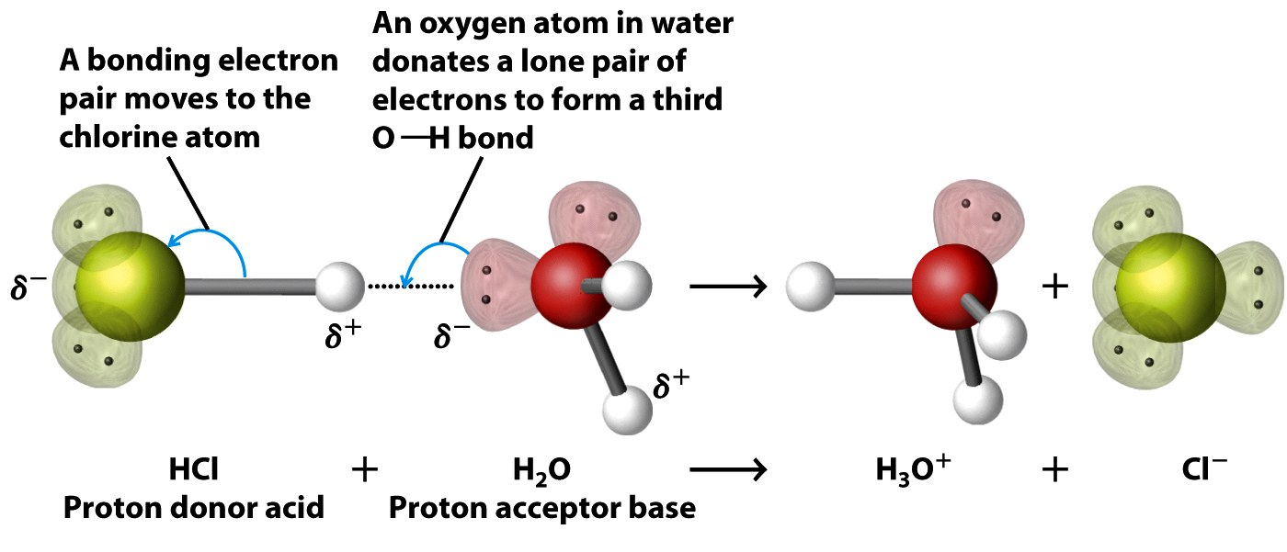
What is Brønsted-Lowry Theory?

Slide 5
What are Lewis acids and bases?

Slide 6
How does water Autoionize?

Slide 7
How does a hydronium ion form in water?

Slide 8
Acids and Bases Example – Ion Product
What are the equilibrium concentrations of hydronium and hydroxide ions at 25 ˚C?

Slide 9
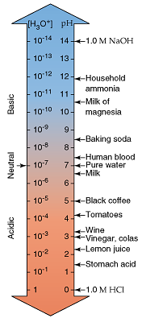
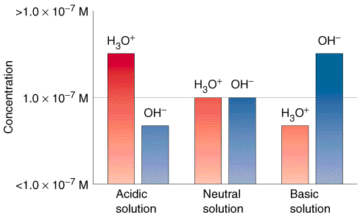
What is the pH Scale?

Slide 11
Increasing Basicity
Increasing Acidity

Slide 13
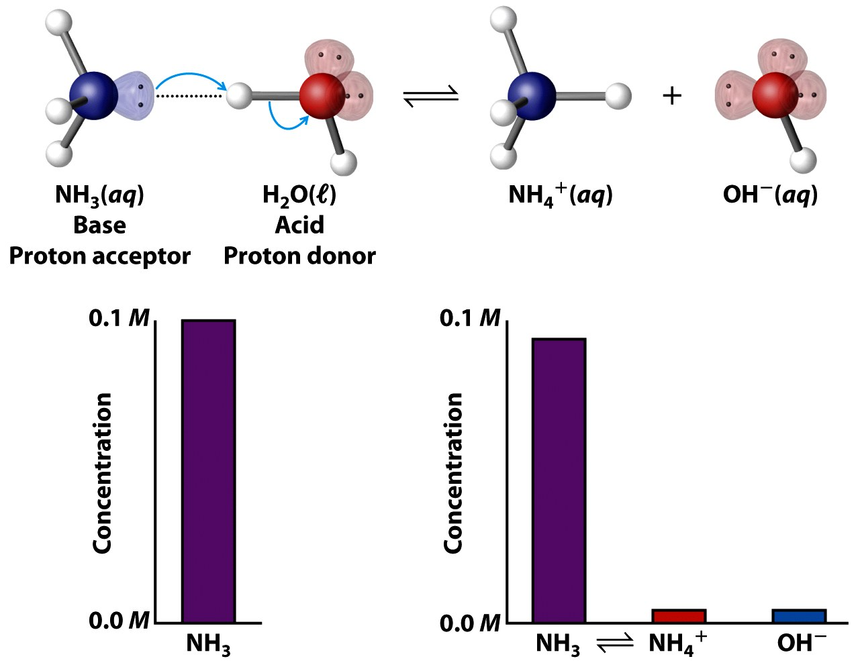
What is a weak base?

Slide 14
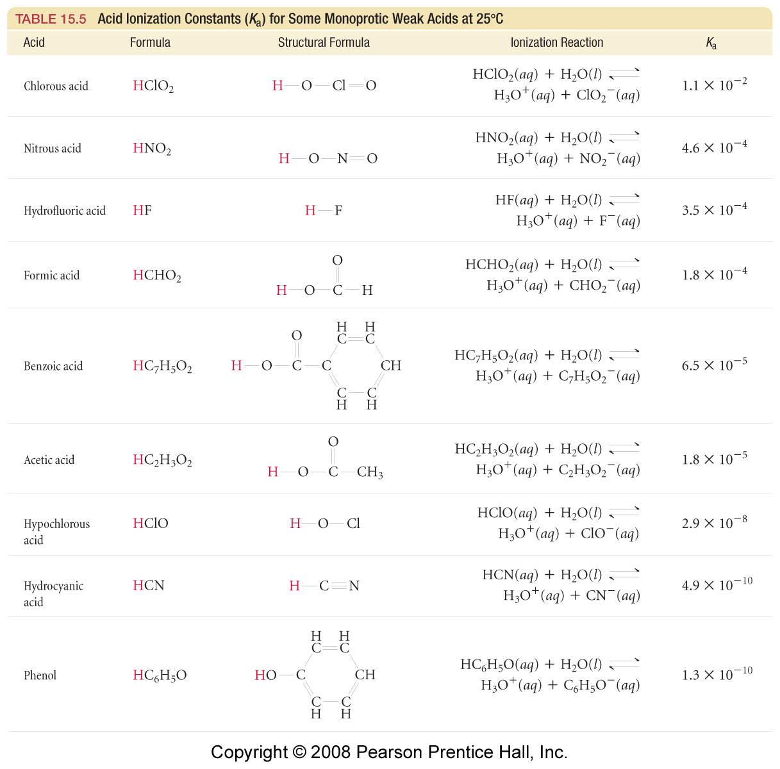

Slide 15
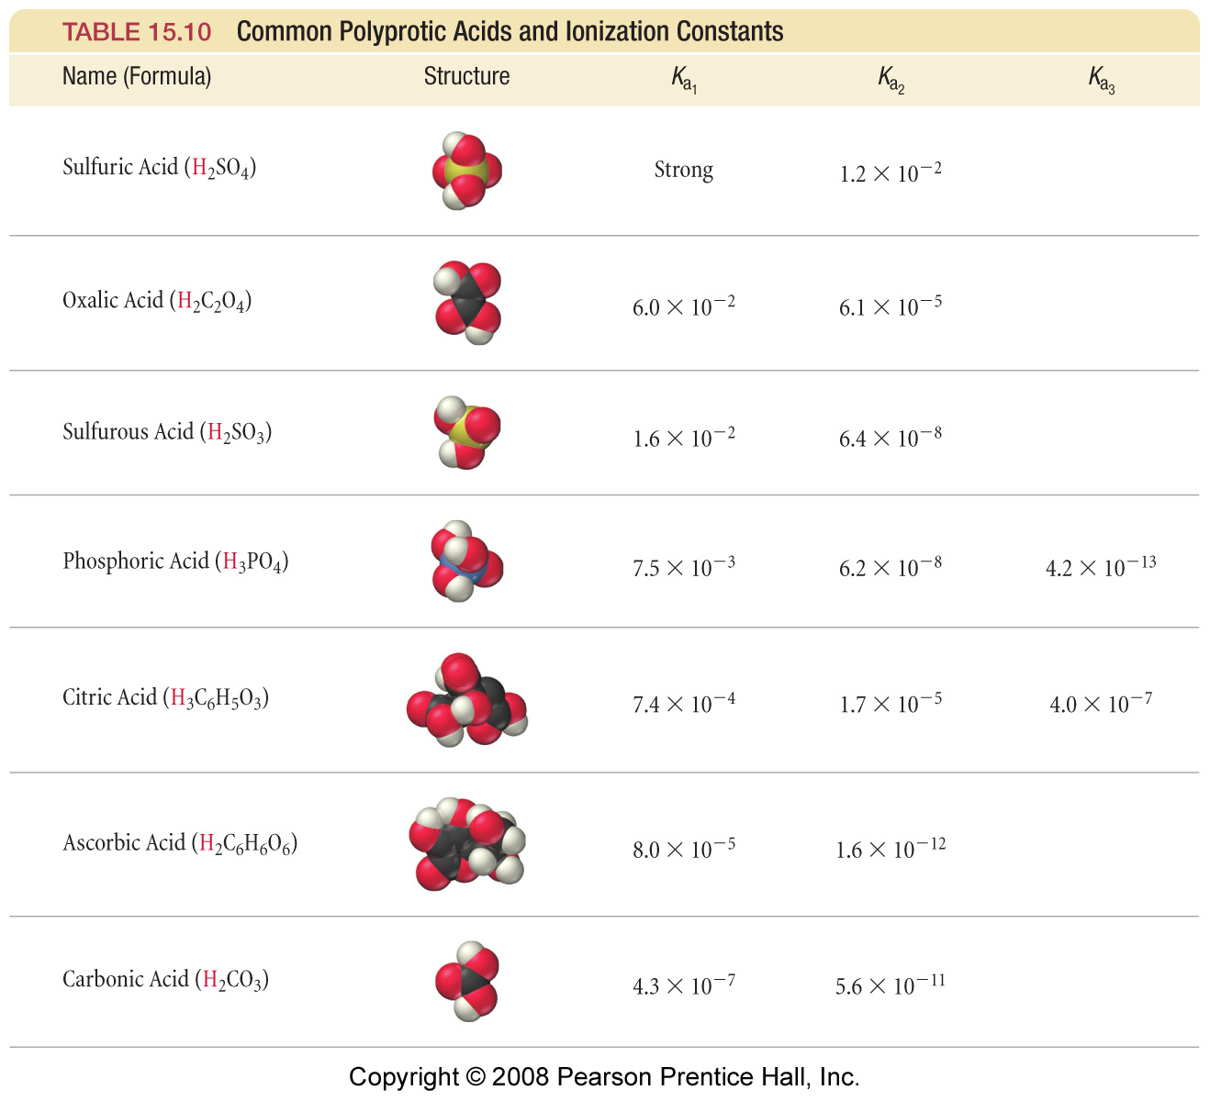

Slide 16
Acids and Bases Example – pH, pOH, pK_{a}
Calculate the pH and pOH of a 1.73 x 10⁻³ M barium hydroxide solution.

Slide 17
Acids and Bases Example – pH, pOH, pK_{a}
If 250.0 mL of 0.1520 M sulfuric acid is mixed with 150.0 mL of 0.2601 M sodium hydroxide, what is the pH of the resulting solution?

Slide 18
Acids and Bases Example – Percent Dissociation
For a 1.00 M hydrofluoric acid solution, the hydronium ion concentration was found to be 2.7 x 10⁻² M. What is the percent dissociation of the solution?

Slide 19
What are the trends in acid strength?

Slide 20
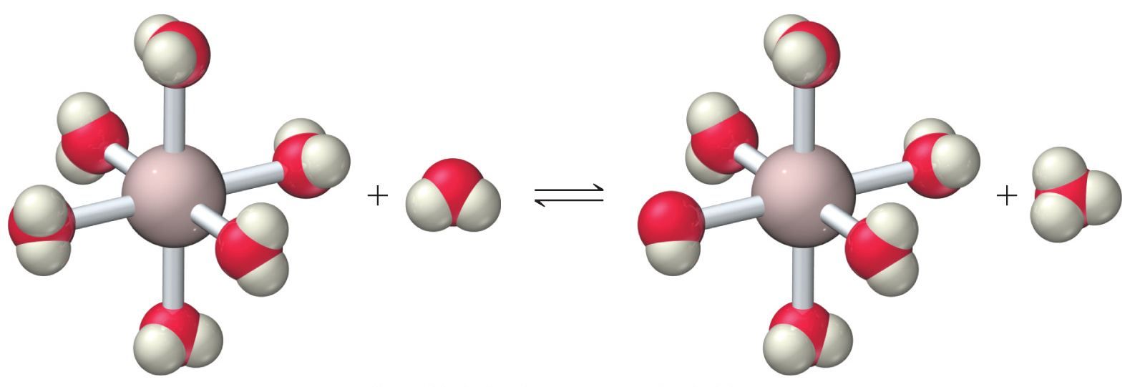
Why are metal cations weak acids?
Al(H₂O)₆³⁺(aq) + H₂O(l) ⇔ Al(H₂O)₅(OH)²⁺ (aq) + H₃O⁺(aq)

Slide 22
Acids and Bases Example – Salts
Determine whether the following aqueous solutions of salts have a pH equal to, greater than, or less than 7. If pH > 7 or pH < 7, write a chemical equation to justify your answer.
ammonium bromide
sodium carbonate
potassium fluoride
potassium bromide
aluminum chloride
copper(II) nitrate

Slide 23
Acids and Bases Example – pH, pOH, pK_{a}
Calculate the pH of a 0.20 M lactic acid, CH₃CH(OH)COOH, solution. K_{a} = 8.4 x 10⁻⁴

Slide 24
Acids and Bases Example – pH, pOH, pK_{a}
Calculate the pH and percent protonation of a 0.20 M aqueous solution of methylamine, CH₃NH₂. The K_{a} of methylamine is
2.78 x 10⁻¹¹.

Slide 25
Acids and Bases Example – pH, pOH, pK_{a}
Calculate the pH of a 0.010 M sulfuric acid solution at 25 ˚C. K_{a1} is strong and K_{a2} is
1.2 x 10⁻².

Slide 26
Acids and Bases Example – pH, pOH, pK_{a}
The pH of a 0.025 M aqueous solution of a base was 11.6. What is the pK_{b} of the base?

Slide 27
Acids and Bases Example – pH, pOH, pK_{a}
Calculate the molarities of sulfurous acid, bisulfite ion, sulfite ion, hydronium ion and hydroxide ion in a 0.10 M sulfurous acid solution. K_{a1} = 1.5 x 10⁻² and K_{a2} = 1.2 x 10⁻⁷ .

Slide 28
Acids and Bases Example – pH, pOH, pK_{a}
A 42.07 mL sample of 0.255 M sulfuric acid is mixed 68.01 mL of 0.555 M potassium hydroxide. Determine the concentration of all of the ions in solution, the pH, and pOH.

Slide 29
Acids and Bases Example – pH, pOH, pK_{a}
Calculate the pH of a solution that contains 1.00 M hydrocyanic acid (K_{a} = 6.2 x 10⁻¹⁰) and 5.00 M nitrous acid (K_{a} = 4.0 x 10⁻⁴). In addition calculate the concentration of cyanide ions at equilibrium.

Slide 30
Acids and Bases Example – K_{a}
When 2.55 g of an unknown weak acid (HA) with a molar mass of 85.0 g/mol is dissolved in 250.0 g of water, the freezing point of the resulting solution is -0.257 °C. Calculate the acid equilibrium constant, K_{a}, for the unknown weak acid (K_{f} for water is 1.86 °C/m)

