Slide 1
Chemistry 142 Chapter 17: Aqueous Ionic Equilibrium
Outline
Common Ion
Buffers
Titration Curves
Acid-Base Indicators
Solubility Equilibrium
Precipitation
Qualitative Analysis
Complex Ion Equilibrium

Slide 2
Aqueous Ionic Equilibrium Example – Common Ion
What effect does the presence of dissolved sodium fluoride have on the equilibrium of hydrofluoric acid? Compare the dissociation of 1.0 M HF (K_{a} = 7.2 x 10⁻⁴) and a solution of 1.0 M HF and 1.0 M NaF.

Slide 3
Aqueous Ionic Equilibrium Example – Common Ion
The equilibrium concentration of hydrogen ions in a 1.0 M hydrofluoric acid solution is 2.7 x 10⁻² M and the percent dissociation of 2.7%. Calculate the hydrogen ion concentration and the percent dissociation of a hydrofluoric acid solution (K_{a} = 7.2 x 10⁻⁴) in a solution of 1.0 M HF and 1.0 M NaF.

Slide 4
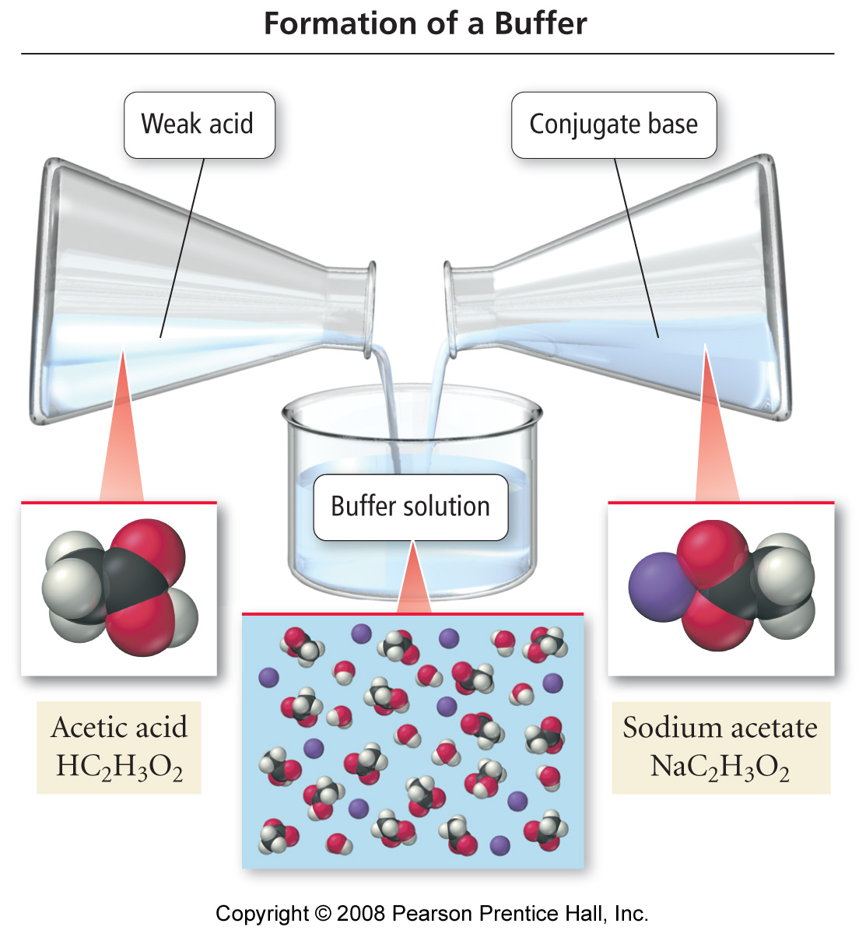
How is an acid buffer made?

Slide 5
How do buffers work?
Notes:
Buffers are solutions that resist change in pH.
Buffers are solutions that can be prepared by mixing weak acid solutions and solutions of their conjugate base. Bases too.
Talk about shifts in equilibrium and how it effects buffer
Buffer capacity

Slide 6
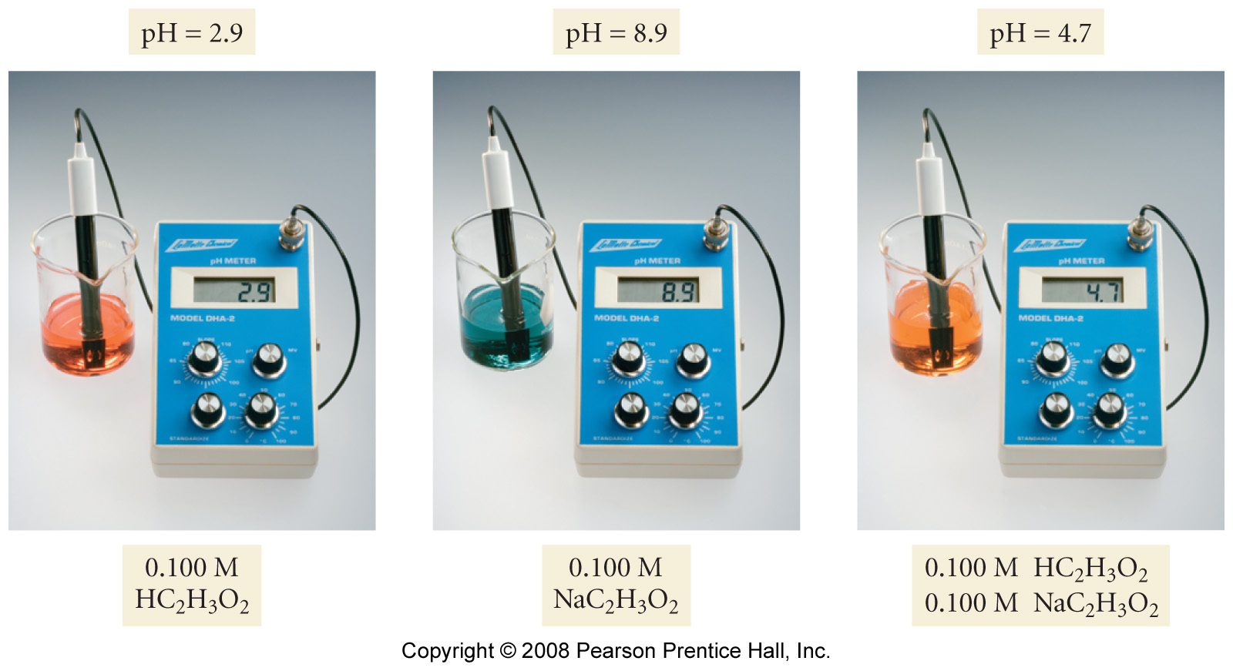
What is the common ion effect?

Slide 7
Aqueous Ionic Equilibrium Example – Common Ion
Calculate the pH of a solution containing 0.75 M lactic acid (HC₃H₅O₃, K_{a} = 1.4 x 10⁻⁴) and 0.25 M sodium lactate (NaC₃H₅O₃).

Slide 8
Aqueous Ionic Equilibrium Example – Common Ion
A buffered solution contains 0.50 M acetic acid (K_{a} = 1.8 x 10⁻⁵) and 0.50 M sodium acetate. Calculate the pH of this solution.

Slide 9
Aqueous Ionic Equilibrium Example – Common Ion
Calculate the change in pH that occurs when 0.010 mol of solid sodium hydroxide is added to 1.0 L of the buffered sodium acetate/acetic acid solution (0.50 M acetic acid (K_{a} = 1.8 x 10⁻⁵) and 0.50 M sodium acetate). Then compare the pH change with the one that occurs when 0.010 mol of solid sodium hydroxide is added to 1.0 L of water.

Slide 10
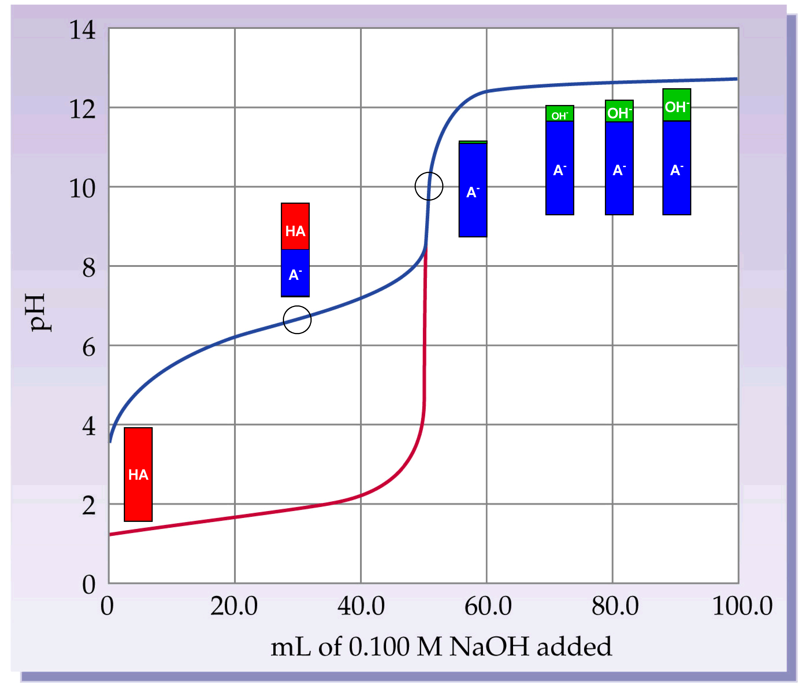

Slide 11
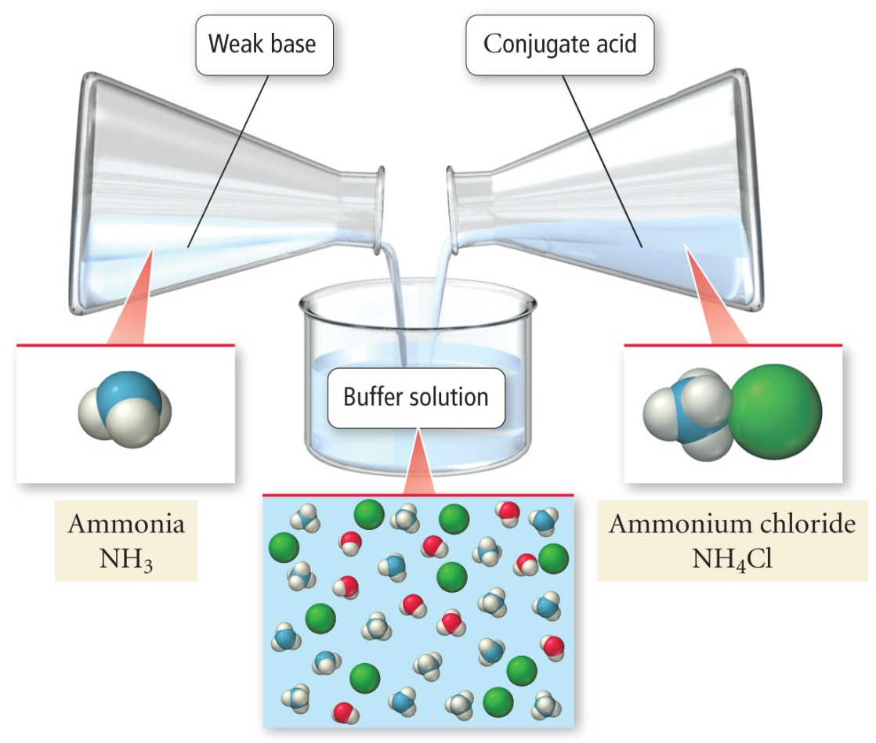
What is a basic buffer? B:_{(aq)} + H₂O_{(l)} ⇔ H:B⁺_{(aq)} + OH⁻_{(aq)}
H₂O_{(l)} + NH₃ _{(aq)} ⇔ NH₄⁺_{(aq)} + OH⁻_{(aq)}

Slide 12
Aqueous Ionic Equilibrium Example – Common Ion
A buffered solution contains 0.25 M ammonia (K_{b} = 1.8 x 10⁻⁵) and 0.40 M ammonium chloride. Calculate the pH of this solution.

Slide 13
Aqueous Ionic Equilibrium Example – Common Ion
Calculate the pH of the solution that results when 0.10 moles of gaseous hydrogen chloride is added to 1.0 L of the buffered solution from the previous example (0.25 M ammonia (K_{b} = 1.8 x 10⁻⁵) and 0.40 M ammonium chloride).

Slide 14
Aqueous Ionic Equilibrium Example – Buffered Solutions
Suppose you need a solution of pH equal to 4.30 and you have the following salts to choose from:
a. chloroacetic acid K_{a} = 1.35 x 10⁻³
b. propanoic acid K_{a} = 1.3 x 10⁻⁵ c. benzoic acid K_{a} = 6.4 x 10⁻⁵ d. hypochlorous acid K_{a} = 3.5 x 10⁻⁸

Slide 15
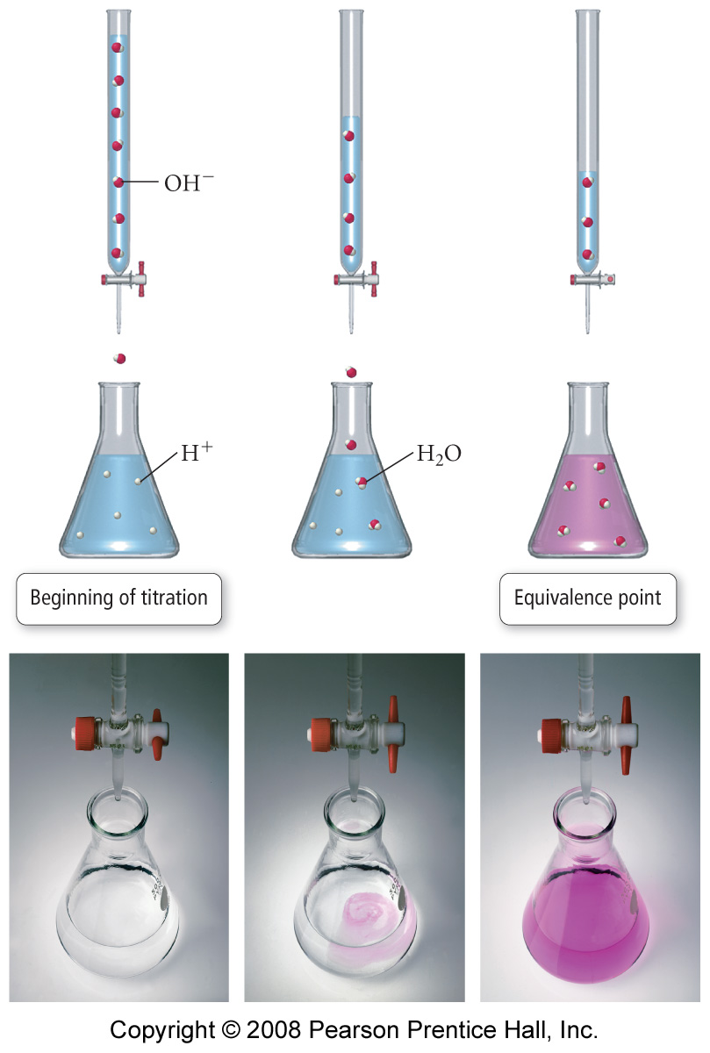
What is an acid-base titration?

Slide 16
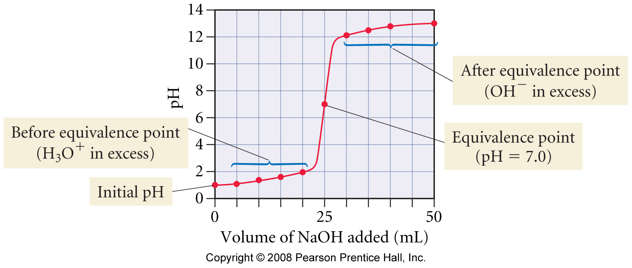
Titration Curve: Unknown Strong Base Added to Strong Acid

Slide 17
Titration of 25.0 mL of 0.100 M HCl with 0.100 M NaOH
The 1st derivative of the curve is maximum at the equivalence point
Since the solutions are equal concentration, the equivalence point is at equal volumes

Slide 18
After about pH 3, there is practically no HCl left, it has all been reacted and become NaCl + H₂O

Slide 19
Aqueous Ionic Equilibrium Example – Titration Curves: Strong Acid-Strong Base
Suppose that 50.00 mL of 0.200 M nitric acid is titrated against 0.100 M sodium hydroxide. What is the pH when:
a. No NaOH is added?
b. 10.0 ml of 0.100 M NaOH is added?
c. 20.0 mL of 0.100 M NaOH is added?
d. 50.0 mL of 0.100 M NaOH is added?
e. 100.0 mL of 0.100 M NaOH is added?
f. 150.0 mL of 0.100 M NaOH is added?
g. 200.0 mL of 0.100 M NaOH is added?

Slide 20
Aqueous Ionic Equilibrium Example – Titration Curves: Strong Acid-Strong Base
Titration of HNO₃ with NaOH
H⁺ _{(aq)} + OH⁻ _{(aq)} → H₂O _{(l)}
V_{NaOH added} (mL) | pH
0.00 | 0.699
10.0
20.0
50.0
100.0
150.0
200.0

Slide 21
Aqueous Ionic Equilibrium Example – Titration Curves: Strong Acid-Strong Base
Titration of HNO₃ with NaOH
H⁺ _{(aq)} + OH⁻ _{(aq)} → H₂O _{(l)}
V_{NaOH added} (mL) | pH
0.00 | 0.699
10.0 | 0.82
20.0
50.0
100.0
150.0
200.0

Slide 22
Aqueous Ionic Equilibrium Example – Titration Curves: Strong Acid-Strong Base
Titration of HNO₃ with NaOH
H⁺ _{(aq)} + OH⁻ _{(aq)} → H₂O _{(l)}
V_{NaOH added} (mL) | pH
0.00 | 0.699
10.0 | 0.82
20.0 | 0.94
50.0
100.0
150.0
200.0

Slide 23
Chapter 16 – Aqueous Ionic Equilibrium Example – Titration Curves: Strong Acid-Strong Base
16.8 Titration of HNO₃ with NaOH
H⁺ _{(aq)} + OH⁻ _{(aq)} → H₂O _{(l)}
V_{NaOH added} (mL) | pH
0.00 | 0.699
10.0 | 0.82
20.0 | 0.94
50.0 | 1.30
100.0
150.0
200.0

Slide 24
Chapter 16 – Aqueous Ionic Equilibrium Example – Titration Curves: Strong Acid-Strong Base
16.8 Titration of HNO₃ with NaOH
H⁺ _{(aq)} + OH⁻ _{(aq)} → H₂O _{(l)}
V_{NaOH added} (mL) | pH
0.00 | 0.699
10.0 | 0.82
20.0 | 0.94
50.0 | 1.30
100.0 | 7.00
150.0
200.0

Slide 25
Aqueous Ionic Equilibrium Example – Titration Curves: Strong Acid-Strong Base
Titration of HNO₃ with NaOH
H⁺ _{(aq)} + OH⁻ _{(aq)} → H₂O _{(l)}
V_{NaOH added} (mL) | pH
0.00 | 0.699
10.0 | 0.82
20.0 | 0.94
50.0 | 1.30
100.0 | 7.00
150.0 | 12.40
200.0

Slide 26
Aqueous Ionic Equilibrium Example – Titration Curves: Strong Acid-Strong Base
Titration of HNO₃ with NaOH
H⁺ _{(aq)} + OH⁻ _{(aq)} → H₂O _{(l)}
V_{NaOH added} (mL) | pH
0.00 | 0.699
10.0 | 0.82
20.0 | 0.94
50.0 | 1.30
100.0 | 7.00
150.0 | 12.40
200.0 | 12.602

Slide 27
Aqueous Ionic Equilibrium Example – Titration Curves: Strong Acid-Strong Base
Titration of HNO₃ with NaOH
H⁺ _{(aq)} + OH⁻ _{(aq)} → H₂O _{(l)}
V_{NaOH added} (mL) | pH
0.00 | 0.699
10.0 | 0.82
20.0 | 0.94
50.0 | 1.30
100.0 | 7.00
150.0 | 12.40
200.0 | 12.602
Major species at half-equivalence point:
H⁺, NO₃⁻, Na⁺
pH = 1.30, V_{NaOH} = 50.0 mL

Slide 29
Titration of 25.0 mL of 0.100 M HCHO₂ with 0.100 M NaOH
The 1st derivative of the curve is maximum at the equivalence point
pH at equivalence = 8.23
Since the solutions are equal concentration, the equivalence point is at equal volumes

Slide 30
at pH 3.74, the [HCHO₂] = [CHO₂⁻]; the acid is half neutralized
half-neutralization occurs when pH = pK_{a}

Slide 31
Aqueous Ionic Equilibrium Example – Titration Curves: Weak Acid-Strong Base
Consider the titration of 50.0 mL of 0.10 M acetic acid (K_{a} = 1.8 x 10⁻⁵) with 0.10 M sodium hydroxide. What is the pH when:
a. No NaOH is added?
b. 10.0 ml of 0.100 M NaOH is added?
c. 25.0 mL of 0.100 M NaOH is added?
d. 40.0 mL of 0.100 M NaOH is added?
e. 50.0 mL of 0.100 M NaOH is added?
f. 60.0 mL of 0.100 M NaOH is added?
g. 75.0 mL of 0.100 M NaOH is added?

Slide 32
Aqueous Ionic Equilibrium Example – Titration Curves: Weak Acid-Strong Base
Titration of HC₂H₃O₂ with NaOH
HC₂H₃O₂ _{(aq)} + OH⁻ _{(aq)} → H₂O _{(l)} + C₂H₃O₂⁻ _{(aq)}
V_{NaOH added} (mL) | pH
0.00 | 2.87
10.0
25.0
40.0
50.0
60.0
75.0

Slide 33
Aqueous Ionic Equilibrium Example – Titration Curves: Weak Acid-Strong Base
Titration of HC₂H₃O₂ with NaOH
HC₂H₃O₂ _{(aq)} + OH⁻ _{(aq)} → H₂O _{(l)} + C₂H₃O₂⁻ _{(aq)}
V_{NaOH added} (mL) | pH
0.00 | 2.87
10.0 | 4.14
25.0
40.0
50.0
60.0
75.0

Slide 34
Aqueous Ionic Equilibrium Example – Titration Curves: Weak Acid-Strong Base
Titration of HC₂H₃O₂ with NaOH
HC₂H₃O₂ _{(aq)} + OH⁻ _{(aq)} → H₂O _{(l)} + C₂H₃O₂⁻ _{(aq)}
V_{NaOH added} (mL) | pH
0.00 | 2.87
10.0 | 4.14
25.0 | 4.74
40.0
50.0
60.0
75.0

Slide 35
Aqueous Ionic Equilibrium Example – Titration Curves: Weak Acid-Strong Base
Titration of HC₂H₃O₂ with NaOH
HC₂H₃O₂ _{(aq)} + OH⁻ _{(aq)} → H₂O _{(l)} + C₂H₃O₂⁻ _{(aq)}
V_{NaOH added} (mL) | pH
0.00 | 2.87
10.0 | 4.14
25.0 | 4.74
40.0 | 5.35
50.0
60.0
75.0

Slide 36
Aqueous Ionic Equilibrium Example – Titration Curves: Weak Acid-Strong Base
Titration of HC₂H₃O₂ with NaOH
HC₂H₃O₂ _{(aq)} + OH⁻ _{(aq)} → H₂O _{(l)} + C₂H₃O₂⁻ _{(aq)}
V_{NaOH added} (mL) | pH
0.00 | 2.87
10.0 | 4.14
25.0 | 4.74
40.0 | 5.35
50.0 | 8.73
60.0
75.0

Slide 37
Aqueous Ionic Equilibrium Example – Titration Curves: Weak Acid-Strong Base
Titration of HC₂H₃O₂ with NaOH
HC₂H₃O₂ _{(aq)} + OH⁻ _{(aq)} → H₂O _{(l)} + C₂H₃O₂⁻ _{(aq)}
V_{NaOH added} (mL) | pH
0.00 | 2.87
10.0 | 4.14
25.0 | 4.74
40.0 | 5.35
50.0 | 8.73
60.0 | 11.96
75.0

Slide 38
Aqueous Ionic Equilibrium Example – Titration Curves: Weak Acid-Strong Base
Titration of HC₂H₃O₂ with NaOH
HC₂H₃O₂ _{(aq)} + OH⁻ _{(aq)} → H₂O _{(l)} + C₂H₃O₂⁻ _{(aq)}
V_{NaOH added} (mL) | pH
0.00 | 2.87
10.0 | 4.14
25.0 | 4.74
40.0 | 5.35
50.0 | 8.73
60.0 | 11.96
75.0 | 12.30

Slide 39
Chapter 16 – Aqueous Ionic Equilibrium Example – Titration Curves: Weak Acid-Strong Base
16.9 Titration of HC₂H₃O₂ with NaOH
HC₂H₃O₂ _{(aq)} + OH⁻ _{(aq)} → H₂O _{(l)} + C₂H₃O₂⁻ _{(aq)}
V_{NaOH added} (mL) | pH
0.00 | 2.87
10.0 | 4.14
25.0 | 4.74
40.0 | 5.35
50.0 | 8.73
60.0 | 11.96
75.0 | 12.30

Slide 40
Aqueous Ionic Equilibrium Example – Titration Curves: Weak Acid-Strong Base
Titration of HC₂H₃O₂ with NaOH
Reaction before equilibrium: HC₂H₃O₂ _{(aq)} + H₂O _{(l)} → H₃O⁺ _{(aq)} + C₂H₃O₂⁻ _{(aq)} $K_{a}=\frac{\left[H_{3}O^{+}\right]\left[{C_{2}H_{3}O_{2}^{}}^{−}\right]}{\left[HC_{2}H_{3}O_{2}\right]}$
Reaction after equilibrium: C₂H₃O₂⁻ _{(aq)} + H₂O _{(l)} → OH⁻ _{(aq)} + HC₂H₃O₂ _{(aq)} $K_{b}=\frac{\left[{OH}^{−}\right]\left[HC_{2}H_{3}O_{2}\right]}{\left[{C_{2}H_{3}O_{2}^{}}^{−}\right]}$

Slide 41
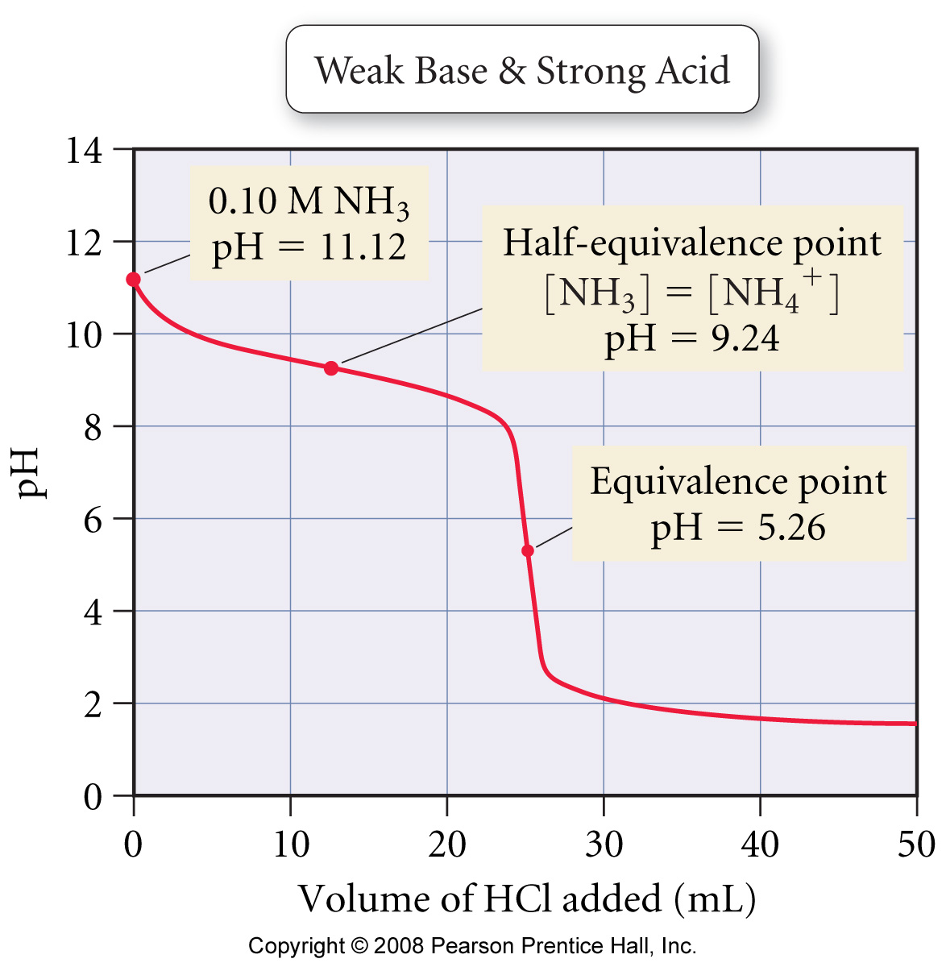
Titration Curve of a Weak Base with a Strong Acid

Slide 42
Aqueous Ionic Equilibrium Example – Titration Curves: Weak Base-Strong Acid
V (mL) | pH
0.00 | 11.86
10.00 | 10.72
15.00 | 10.24
19.00 | 9.44
19.95 | 8.12
20.00 | 5.21
20.05 | 2.30
25.00 | 0.30
25.50 | 0.26
29.00 | 0.05
20.00 mL of triethylamine, (CH₃CH₂)₃N, is titrated with 0.1000 M HCl, which generated the titration curve:
At what pH does the equivalence point occur?
What is the initial concentration of triethylamine?
At what volume does the half-equivalence point occur?
What is the K_{b} of the base?
Identify the major species at the half-equivalence point, equivalence point, and three-halves equivalence point.

Slide 43
Aqueous Ionic Equilibrium Example – Titration Curves: Weak Base-Strong Acid
20.00 mL of triethylamine, (CH₃CH₂)₃N,is titrated with 0.1000 M HCl, which generated the titration curve:
At what pH does the equivalence point occur?
What is the initial concentration of triethylamine?
At what volume does the half-equivalence point occur?
What is the K_{b} of the base?
Identify the major species at the half-equivalence point, equivalence point, and three-halves equivalence point.

Slide 44
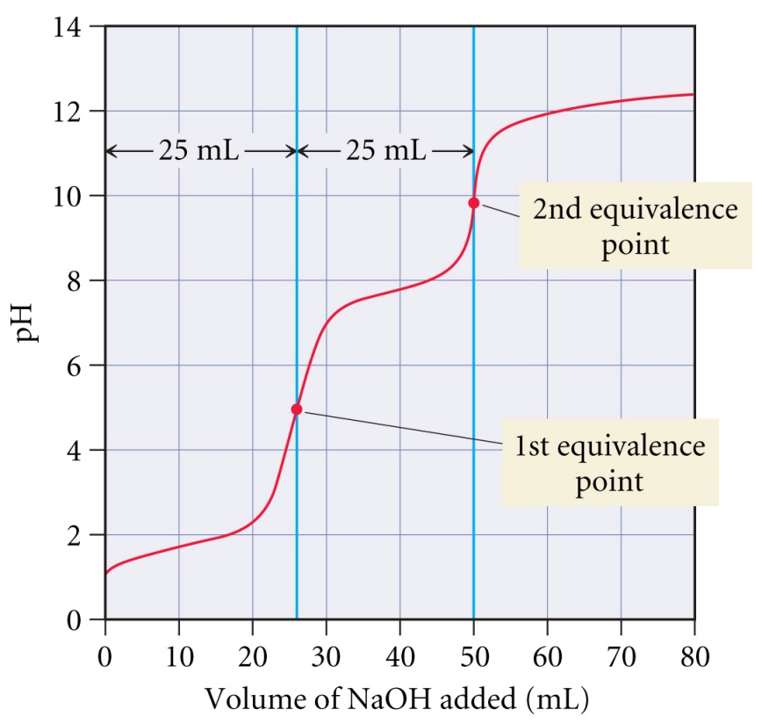
What occurs in the titration of a polyprotic acid?
Titration of 25.0 mL of 0.100 M H₂SO₃ with 0.100 M NaOH
H₂SO_{3 (aq)} + OH⁻ _{(aq)} → HSO₃⁻ _{(aq)} + H₂O _{(l)}
HSO₃⁻ _{(aq)} + OH⁻ _{(aq)} → SO₃²⁻ _{(aq)} + H₂O _{(l)}
Net Rxn: H₂SO_{3 (aq)} + 2 OH⁻ _{(aq)} → SO₃²⁻ _{(aq)} + 2 H₂O _{(l)}

Slide 45
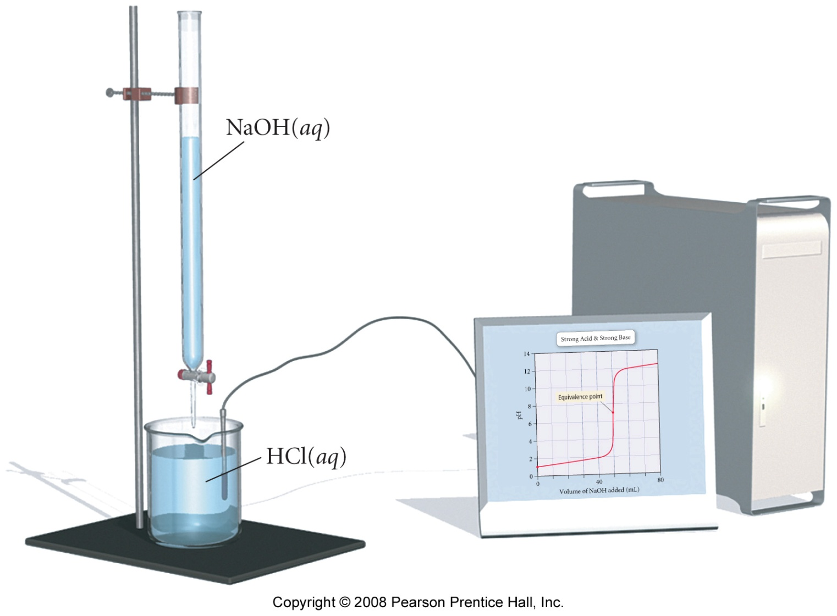
How is pH monitored during a titration?

Slide 46
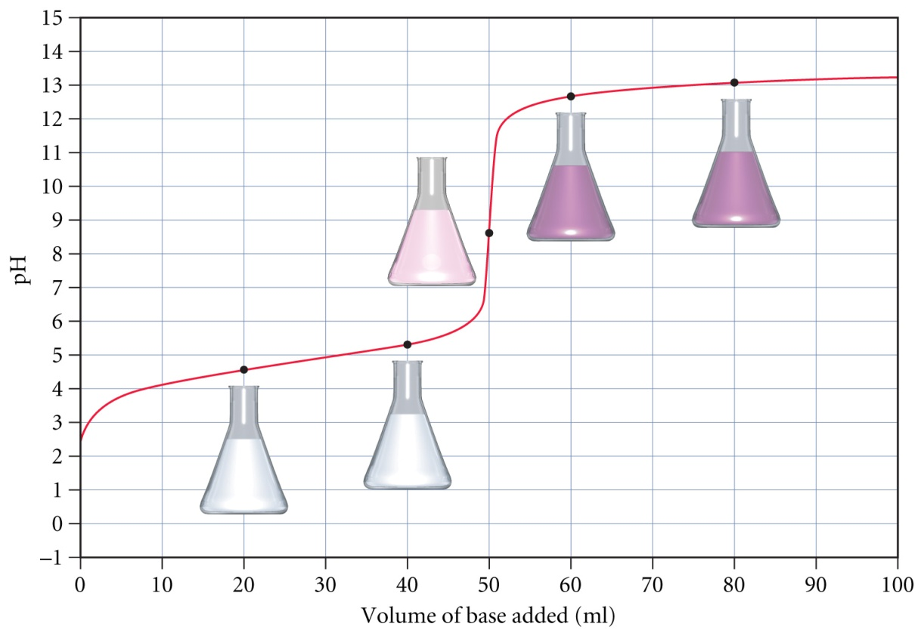
Phenolphthalein

Slide 47
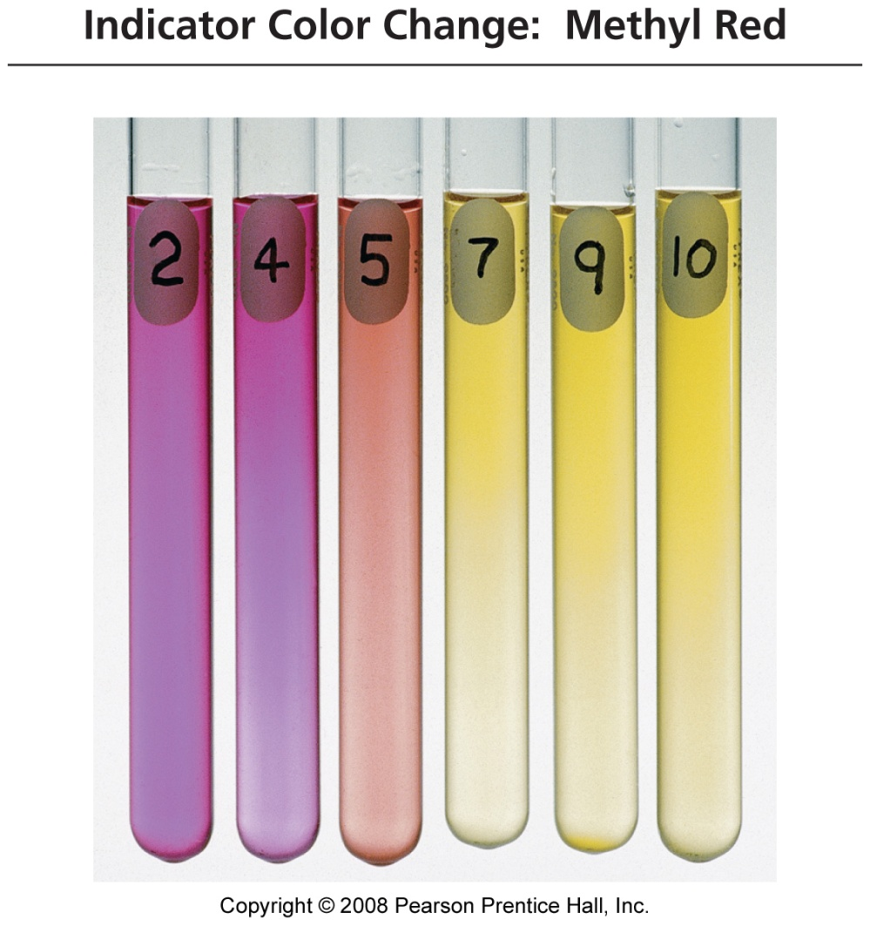
Methyl Red

Slide 48
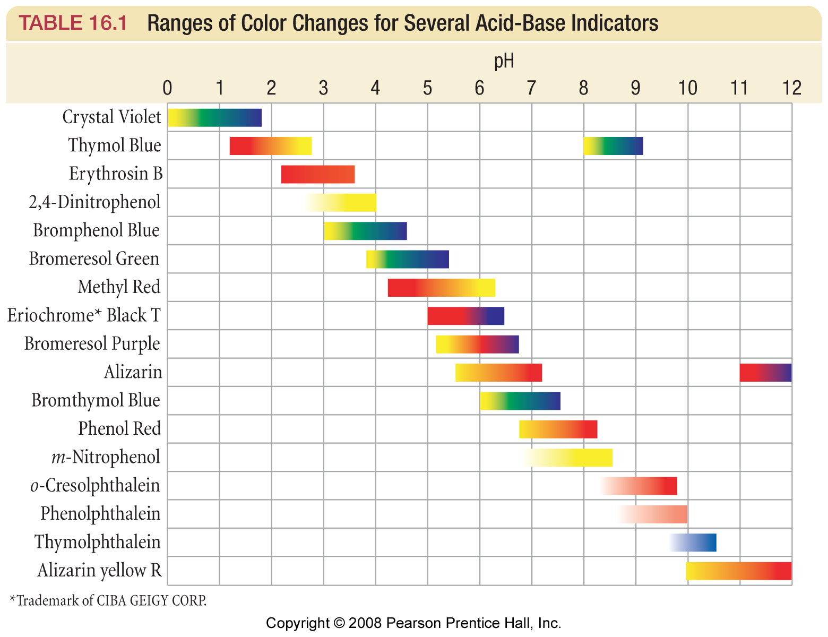
Acid-Base Indicators

Slide 49
Aqueous Ionic Equilibrium Example – Indicator Color Change
Bromthymol blue, an indicator with a K_{a} value of 1.0 x 10⁻⁷, is yellow in its acid, HIn, form and blue in its base, In⁻, form. Suppose that a few drops of this indicator is in a strongly acidic solution. If the solution is then titrated with sodium hydroxide, at what pH will the indicator color change first be visible?

Slide 50
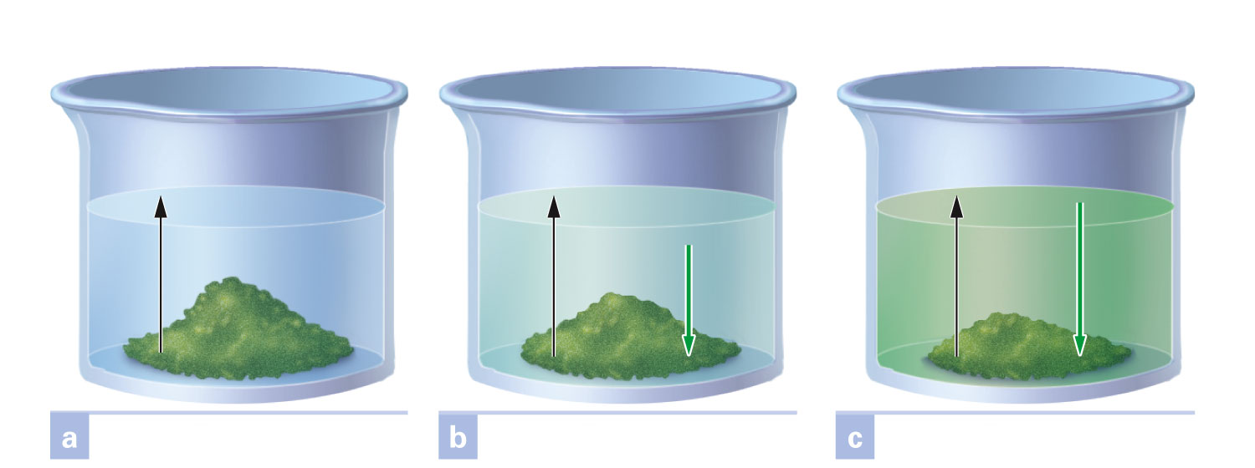
What is a saturated solution?
Figure 16-7 p480
Notes:
Figure 16.7 Development of equilibrium in forming a saturated solution. If temperature is held constant, the rate of dissolving per unit of solute surface area is constant. This is shown by the equal length black arrows in the three views. The crystallization rate per unit of surface area increases as the solution concentration at the surface increases. In (a), when dissolving has just begun, solution concentration is zero, and the crystallization rate is zero. In (b) the solution con-centration has risen to yield a crystallization rate above zero, but less than the dissolving rate. This is shown by the different length arrows. Concentration continues to increase until (c), when the crystallization rate has become equal to the dissolving rate. Equilibrium has been reached, and the solution is saturated.

Slide 51
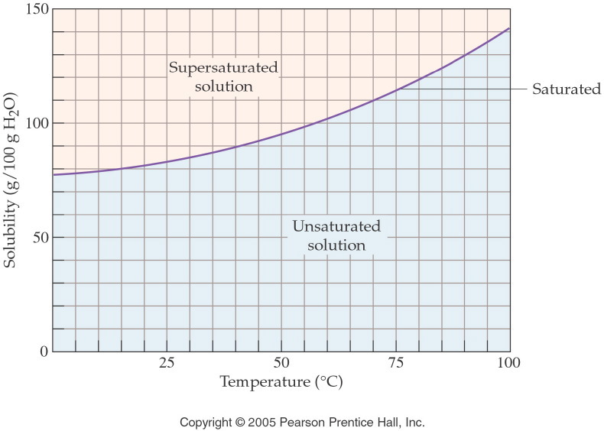
What are the three types of solutions?

Slide 52
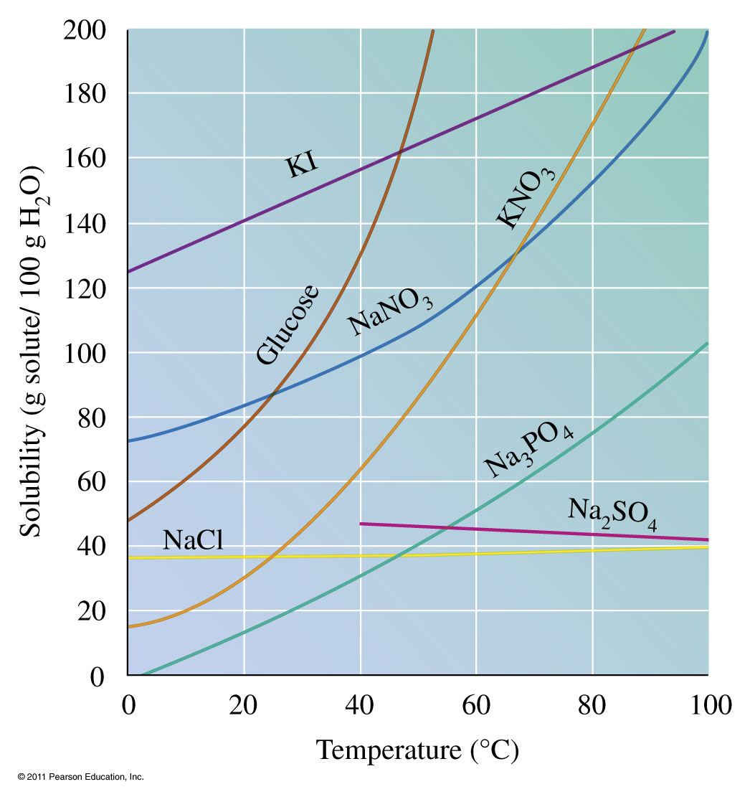
How are solubility and temperature related?

Slide 53
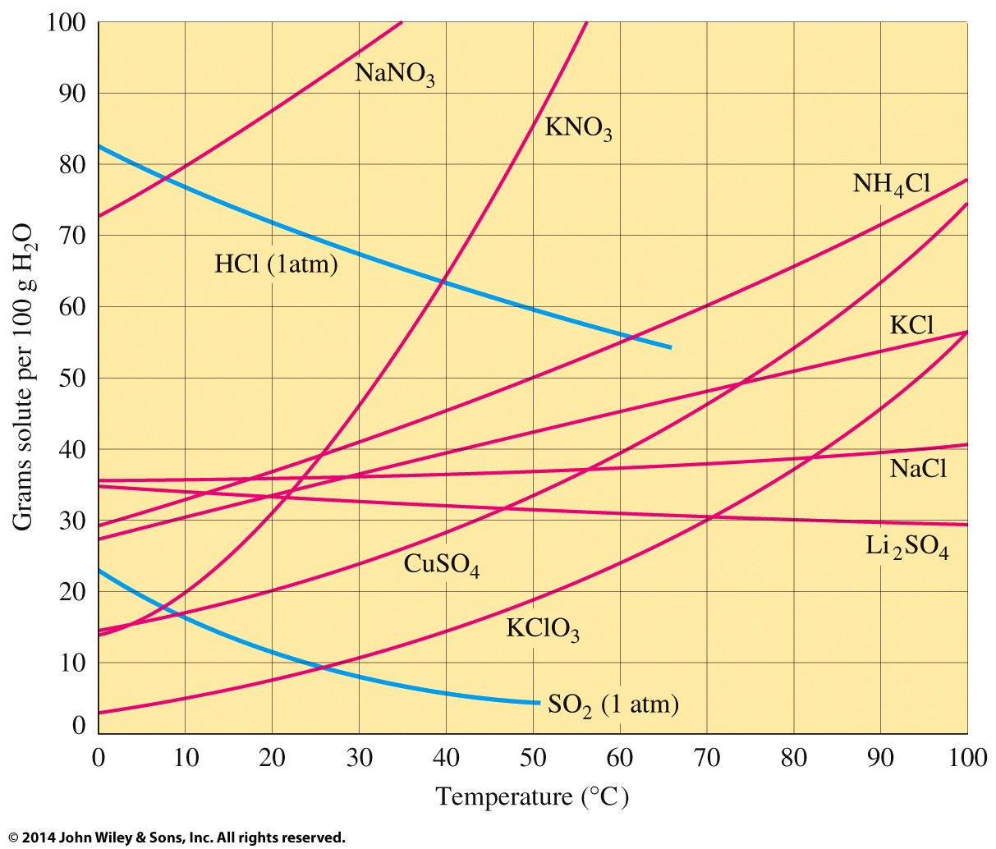
How are solubility and temperature related?

Slide 54
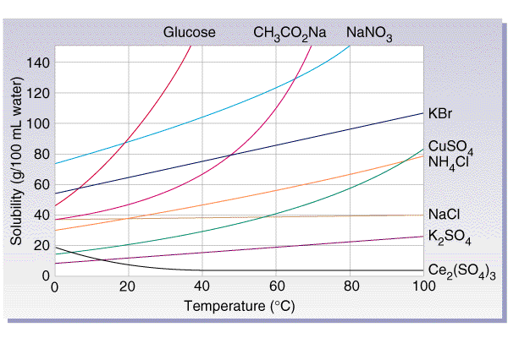
How does the solubility of a solid change with increasing temperature?

Slide 55
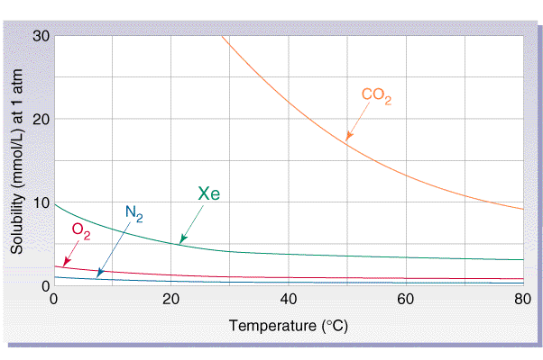
How does gas solubility change with increasing temperature?

Slide 56
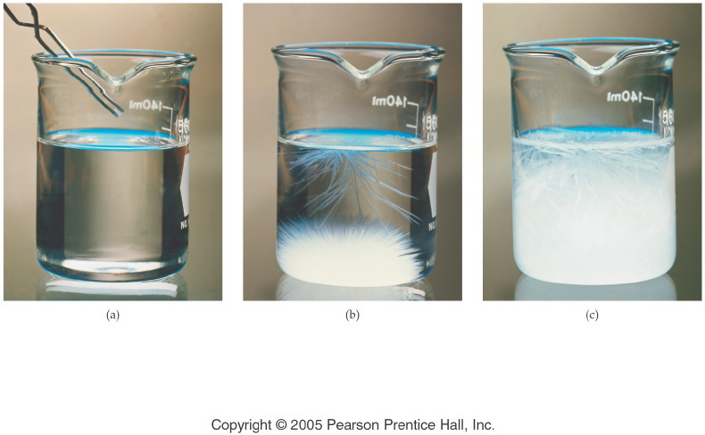
What happens to a supersaturated solution if more solute is added?
Notes:
Figure: 14-06-01UN
Title:
Illustration of Supersaturation
Caption:
(a) A single crystal of sodium acetate, NaC₂H₃O₂, is dropped into a supersaturated solution, (b) the small crystal causes extensive crystallization, and eventually, (c) the solute forms a solid mass of NaC₂H₃O₂.
Notes:
Any remaining sodium acetate solution in the beaker is saturated.

Slide 57
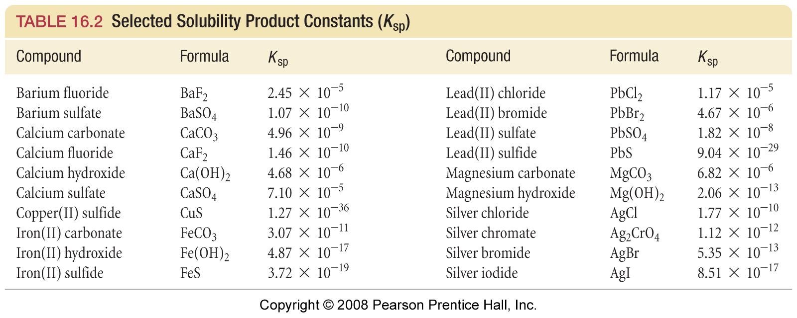

Slide 58
Aqueous Ionic Equilibrium Example – Solubility Equilibria
Copper(I) bromide has a measured solubility of 2.0 x 10⁻⁴ M at 25 ˚C. Calculate the solubility product, K_{sp}, value.

Slide 59
How does a common ion effect solubility?
Notes:
What happens to the extent of ionization when a solution of the salt of the conjugate base of a weak acid is added to a solution of a weak acid?
Le Chatelier’s Principle

Slide 60
Aqueous Ionic Equilibrium Example – Solubility Equilibria
Calculate the solubility product, K_{sp}, value of bismuth(III) sulfide, Bi₂S₃, which has a solubility of 1.0 x 10⁻¹⁵ M at 25 ˚C.

Slide 61
Aqueous Ionic Equilibrium Example – Solubility Equilibria
The solubility product, K_{sp}, for copper(II) iodate is
1.4 x 10⁻⁷ M³ at 25 ˚C. Calculate the solubility of copper(II) iodate at this temperature.

Slide 62
Aqueous Ionic Equilibrium Example – Solubility Equilibria and Titration
A saturated solution of lead(II) hydroxide is filtered and 50.00 mL of this solution is titrated with 2.550 x 10⁻⁵ M hydrochloric acid. The volume required to reach the equivalence point of this solution is 26.24 mL.
Calculate the concentration of lead(II) and hydroxide ions.
Determine the solubility product, K_{sp}, of this saturated solution.

Slide 63
Aqueous Ionic Equilibrium Example – Molar Solubility
Rank the following salts from most soluble to least soluble given:
AgI _{(s)} K_{sp} = 1.5 x 10⁻¹⁶
CuI _{(s)} K_{sp} = 5.0 x 10⁻¹²
CaSO_{4 (s)} K_{sp} = 6.1 x 10⁻⁵

Slide 64
Aqueous Ionic Equilibrium Example – Molar Solubility
Rank the following salts from most soluble to least soluble given:
CuS _{(s)} K_{sp} = 8.5 x 10⁻⁴⁵
Ag₂S _{(s)} K_{sp} = 1.6 x 10⁻⁴⁹
Bi₂S_{3 (s)} K_{sp} = 1.1 x 10⁻⁷³

Slide 65
Aqueous Ionic Equilibrium Example – Common Ions and Solubility
Silver chromate has a K_{sp} = 9.0 x 10⁻¹²:
find the solubility of silver chromate;
find the solubility of silver chromate in a 0.100 M solution of silver nitrate.

Slide 66
Aqueous Ionic Equilibrium Example – Common Ions and Solubility
Calcium fluoride has a K_{sp} = 4.0 x 10⁻¹¹:
calculate the solubility of calcium fluoride;
calculate the solubility of calcium fluoride in a 0.0250 M solution of sodium fluoride.

Slide 67
Aqueous Ionic Equilibrium Example – Common Ion and pH
Consider the two equilibria:
CaF_{2 (s)} $⇌$ Ca²⁺ _{(aq)} + 2 F⁻_{(aq)} K_{sp} = 4.0 x 10⁻¹¹ M³
F⁻ _{(aq)} + H₂O _{(l)} $⇌$ HF _{(aq)} + OH⁻ _{(aq)} K_{b} (F⁻) = 2.9 x 10⁻¹¹ M
Write the chemical equation for the overall equilibrium and determine the corresponding equilibrium constant.
Determine the solubility of calcium fluoride at pH = 7.0.

Slide 68
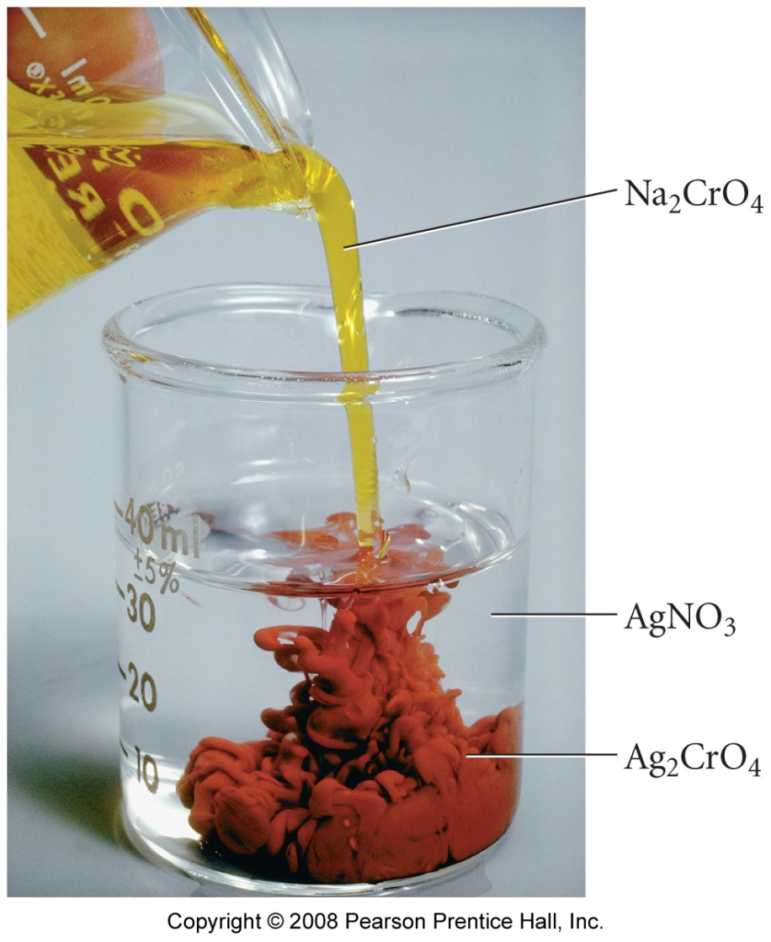
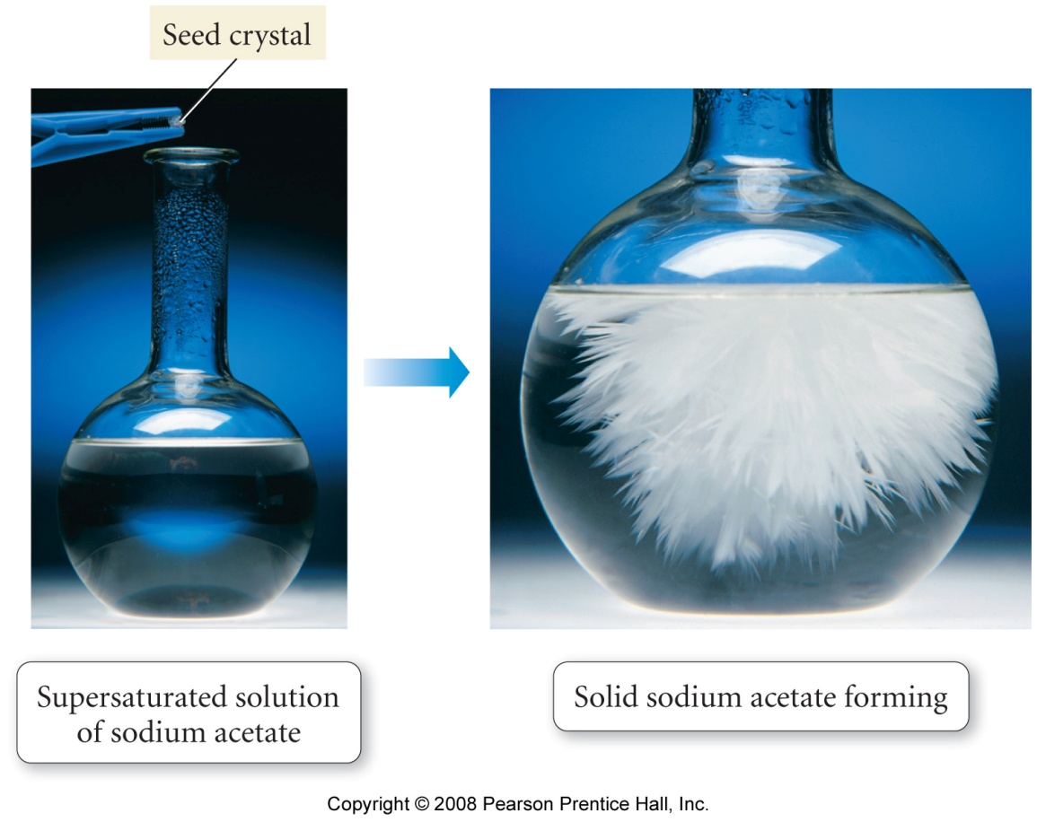
a supersaturated solution will precipitate if a seed crystal is added
precipitation occurs if Q > K_{sp}

Slide 69
Aqueous Ionic Equilibrium Example – Precipitation
A solution is prepared by adding 750.0 mL of 4.00 x 10⁻³ M cerium(III) nitrate to 300.0 mL of 2.00 x 10⁻² M potassium iodate. Will the cerium(III) iodate
(K_{sp} = 1.9 x 10⁻¹⁰) precipitate from this solution?

Slide 70
Aqueous Ionic Equilibrium Example – Precipitation
Calculate the equilibrium concentrations of lead(II) and iodide ions after 100.0 mL of 0.0500 M lead(II) nitrate and 200.0 mL of 0.100 M sodium iodide solutions are mixed. K_{sp} of lead(II) iodide is
1.4 x 10⁻⁸.

Slide 71
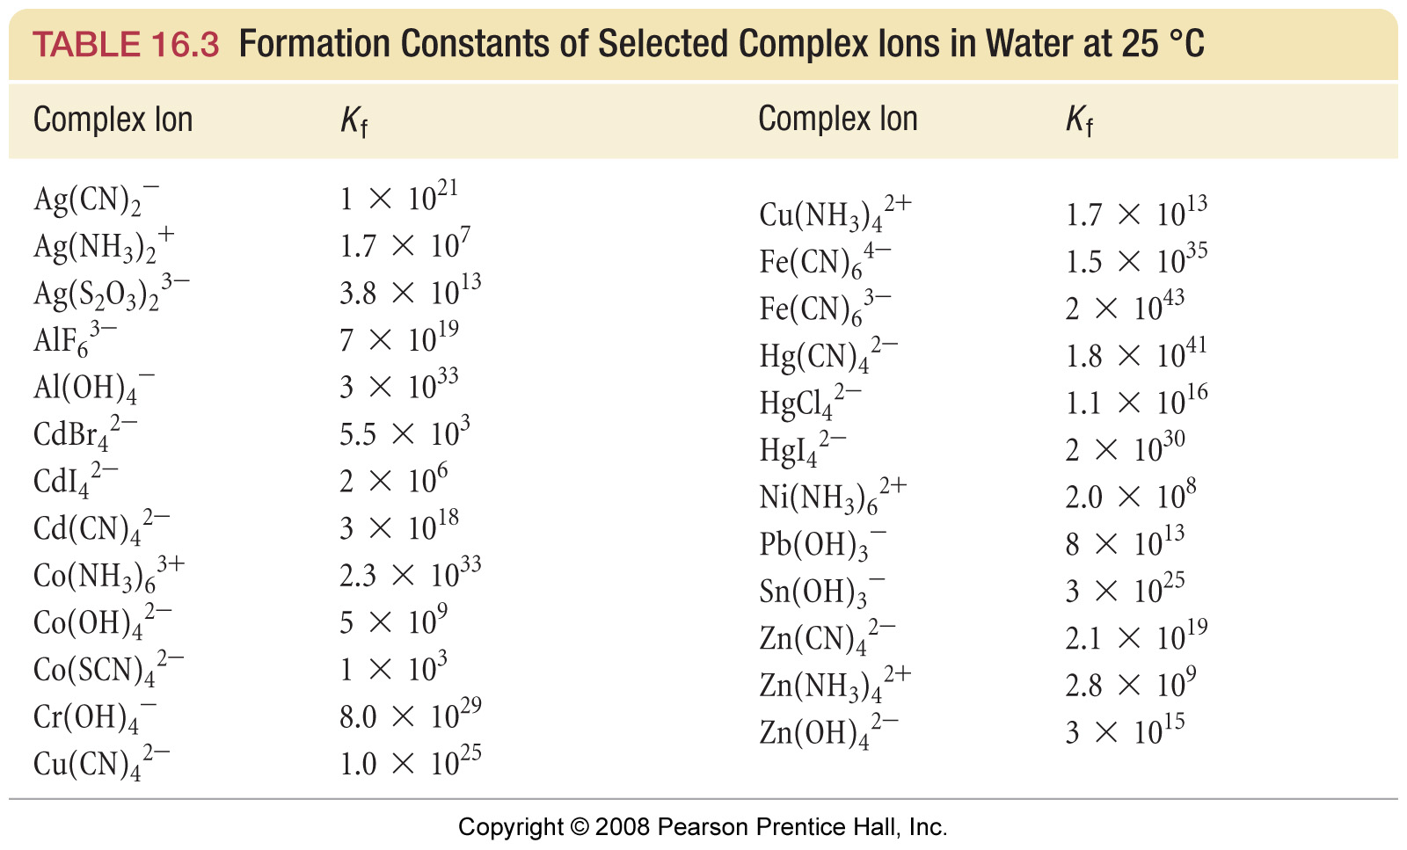
Formation Constants

Slide 72
Aqueous Ionic Equilibrium Example – Complex Ions
Consider a solution prepared by mixing 100.0 mL of 2.0 M ammonia (K_{b} = 1.8 x 10⁻⁵) with 100.0 mL of 0.0010 M silver nitrate.
What reactions occur in the solution?
What are the equilibrium concentrations of Ag⁺, Ag(NH₃)⁺, and Ag(NH₃)₂⁺? Where K₁ = 2.1 x 10³ and K₂ = 8.2 x 10³.
What is the total dissolved silver in the solution?

Slide 73
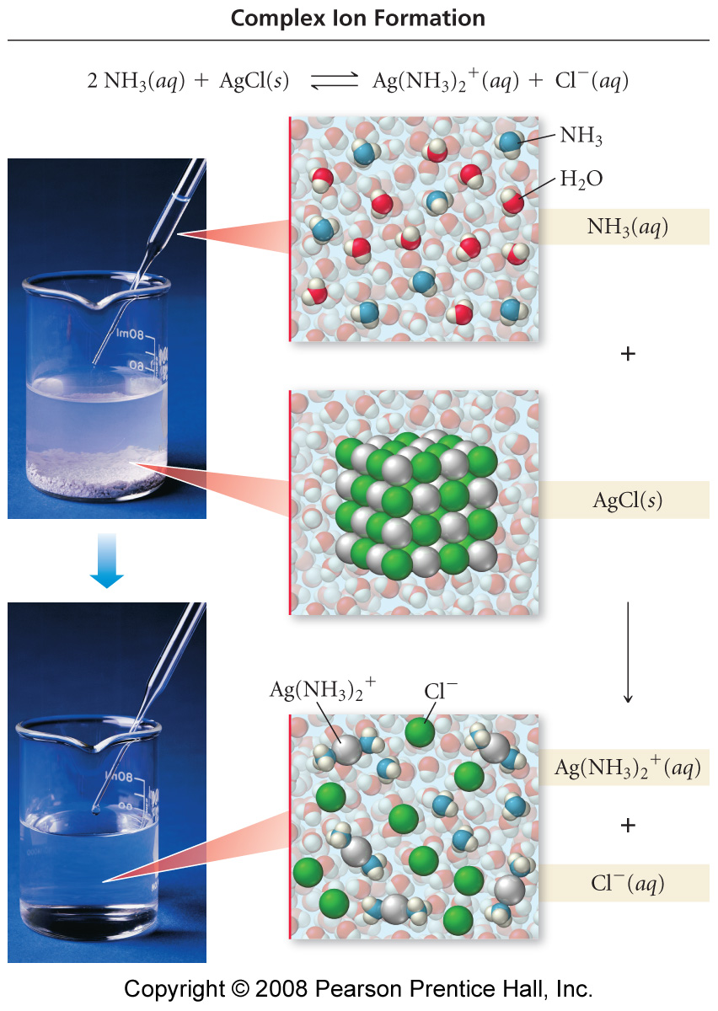

Slide 74
Aqueous Ionic Equilibrium Example – Complex Ions
Consider the solubility of silver chloride
(K_{sp} = 1.8 x 10⁻¹⁰).
a. What is the solubility of silver chloride?
b. What is the solubility of silver chloride in 10.0 M ammonia? K₁ = 2.1 x 10³ and K₂ = 8.2 x 10³ for the complex ion formation of Ag(NH₃)₂⁺. Recall from the previous problem K = 3.1 x 10⁻³.

Slide 75
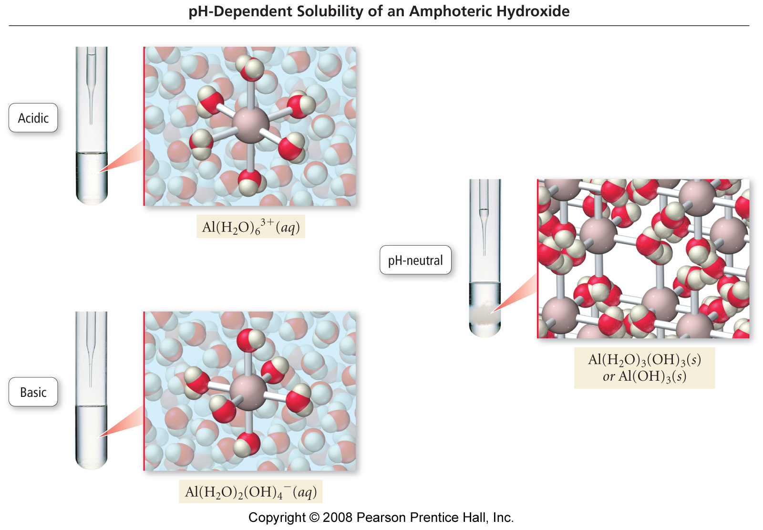

Slide 76
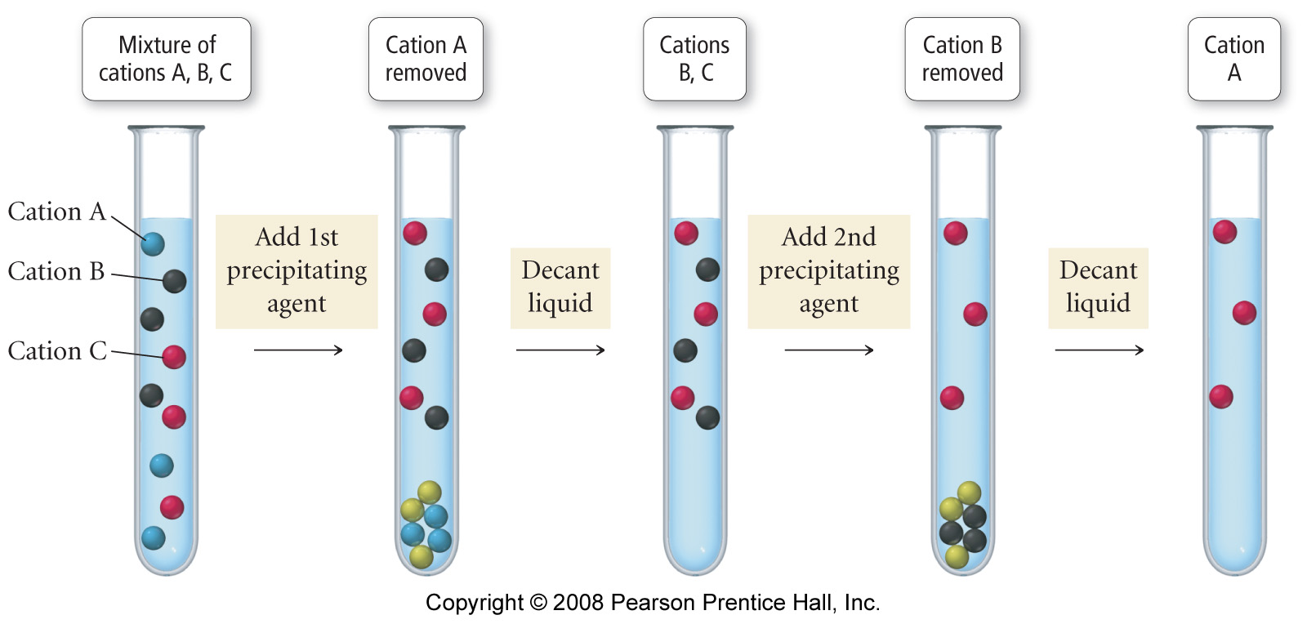
What is qualitative analysis?

Slide 77
