Slide 1
Chemistry 142
Chapter 25:
Transition Metals and Coordination Compounds
Outline
Properties of Transition Metals
Coordination Compounds
Structure and Isomers
Nomenclature
Bonding
Applications

Slide 2
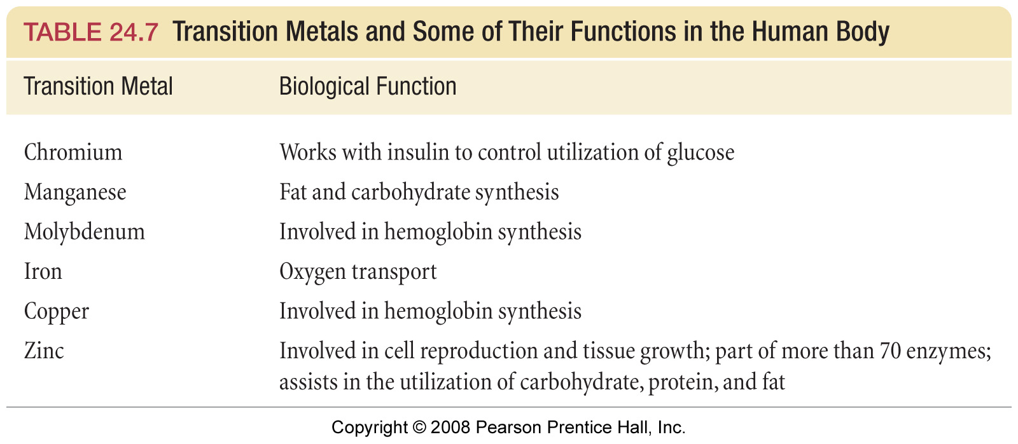

Slide 3
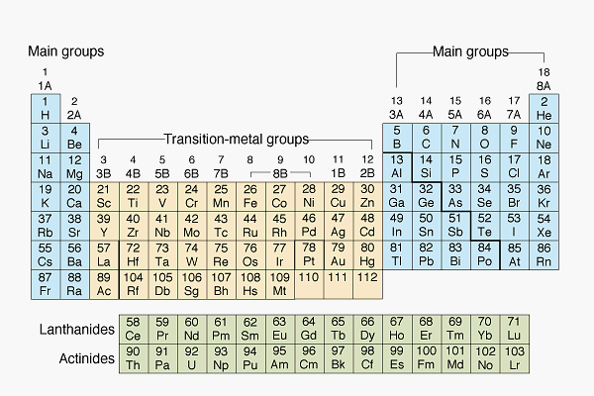
What are some properties of transition metals?

Slide 4
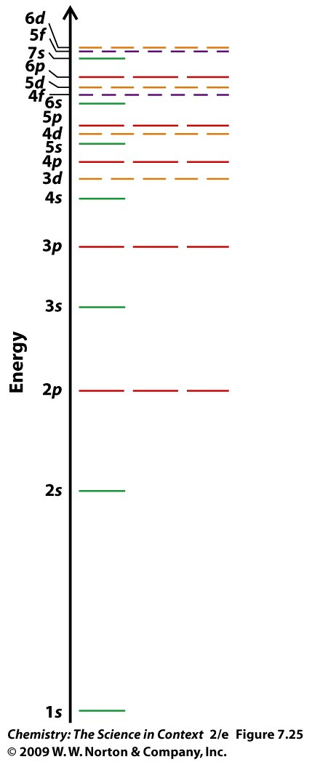

Slide 5
Expanded Periodic Table

Slide 6
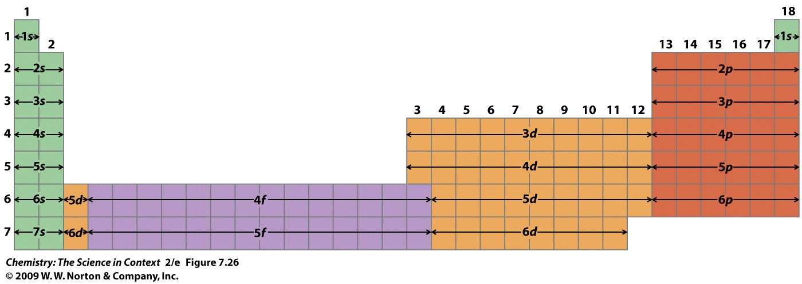

Slide 8
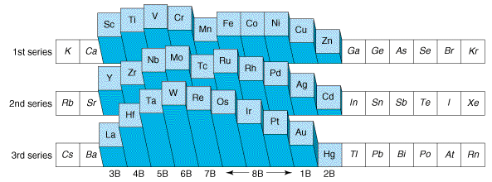
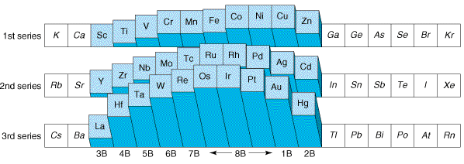
What are the trends in density?
What are the melting point trends?
Notes:
Density & Radius?
Why 3rd series higher?

Slide 9
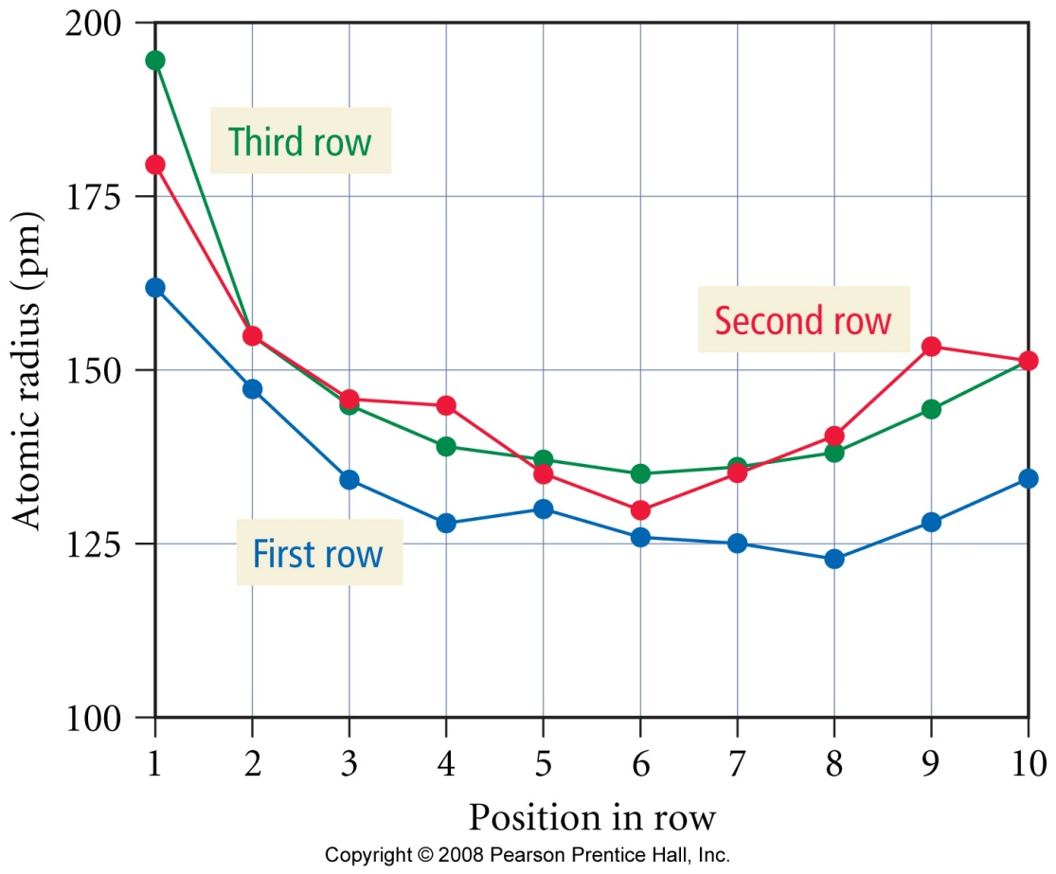
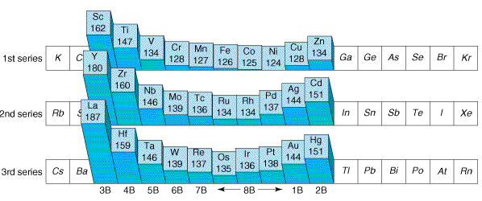
What are the trends in atomic size?

Slide 10
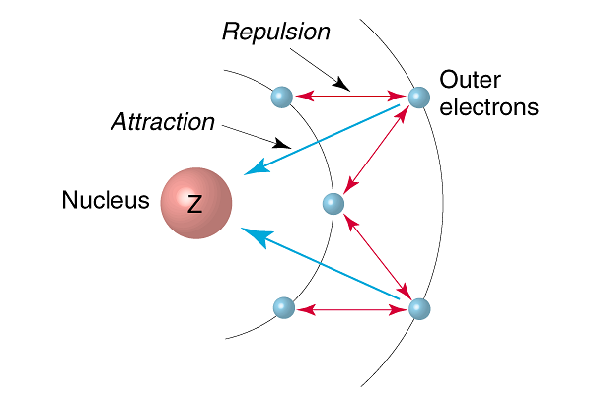
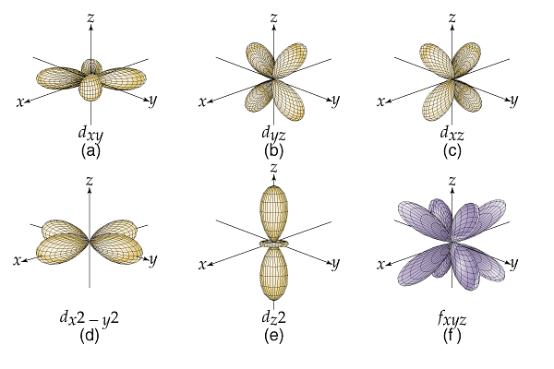

Slide 11
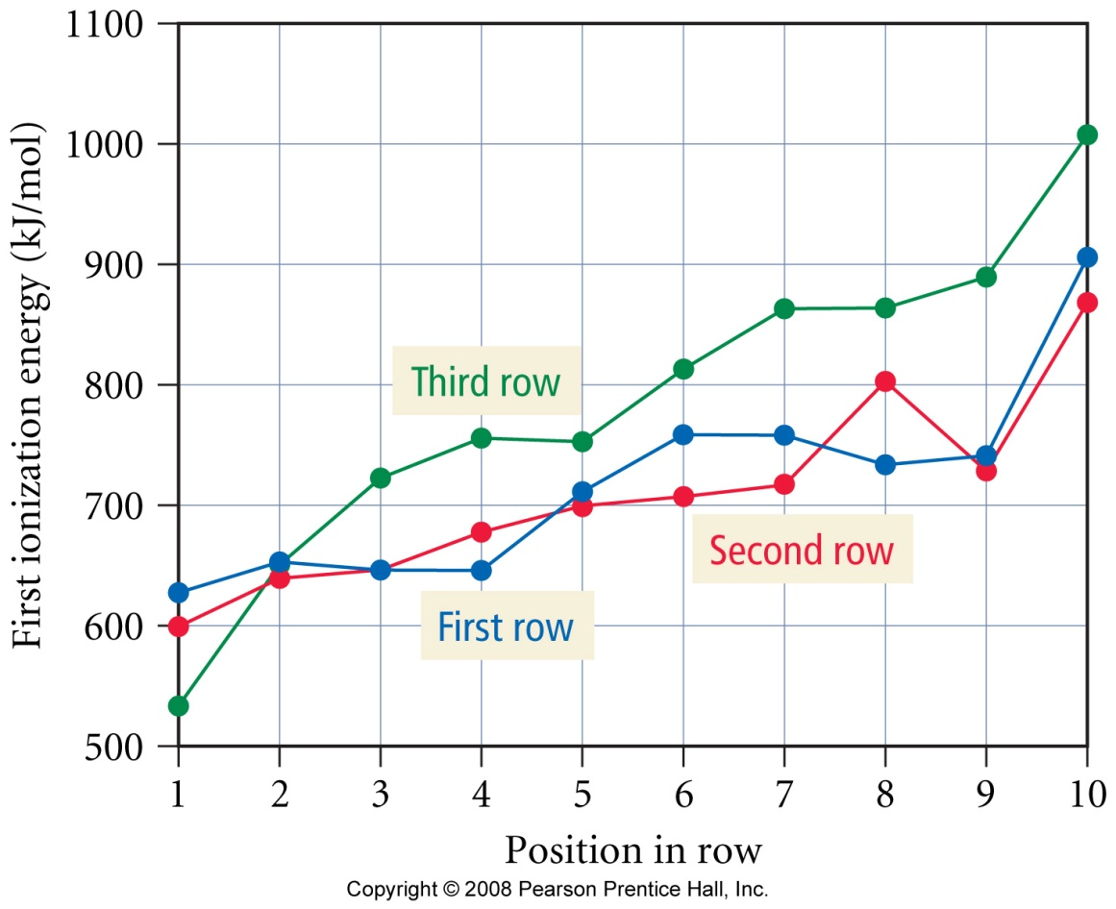
What are the trends in ionization energy?

Slide 12
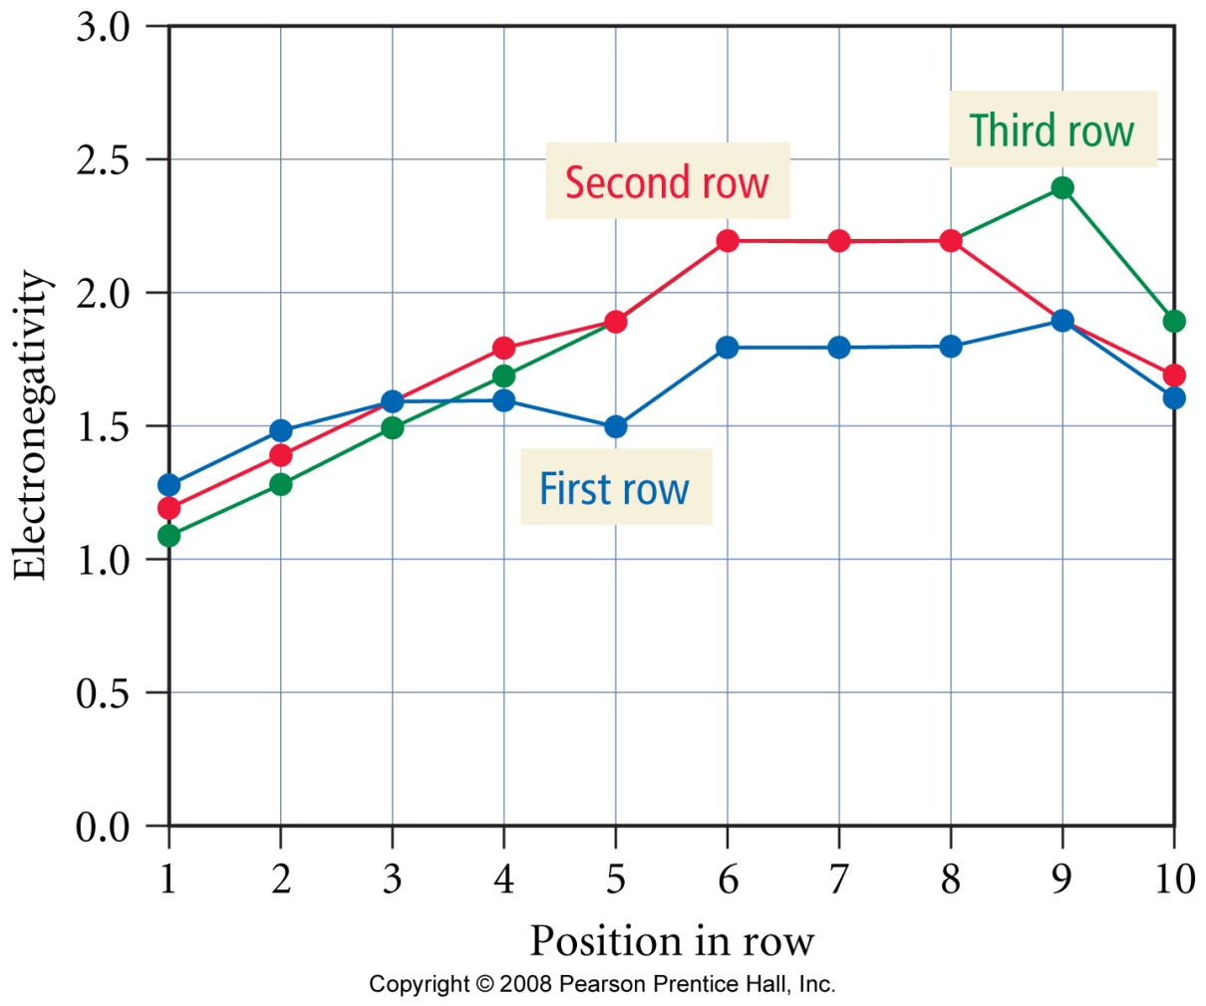
What are the trends in electronegativity?

Slide 13
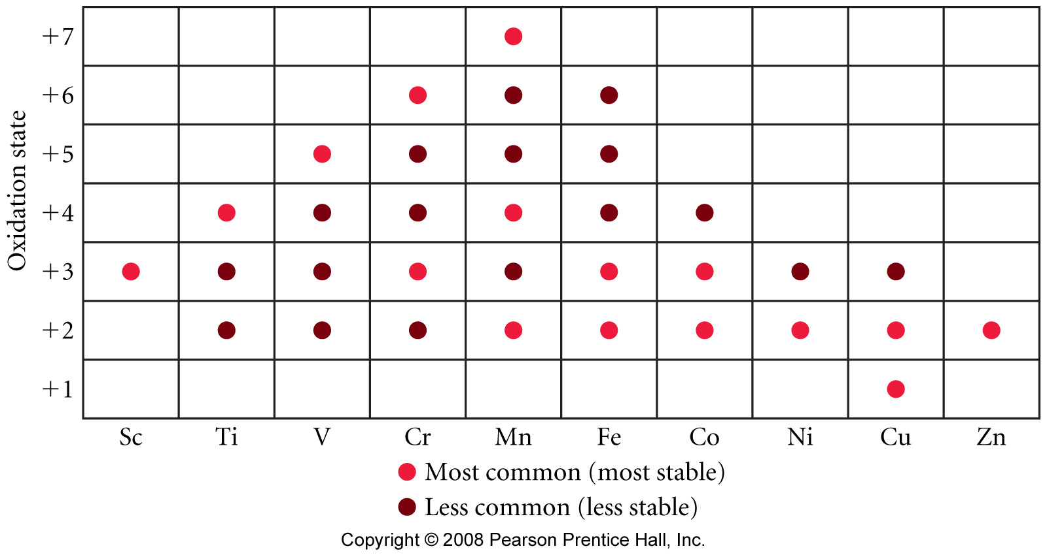
What oxidation states are found in period three transition metals?

Slide 14
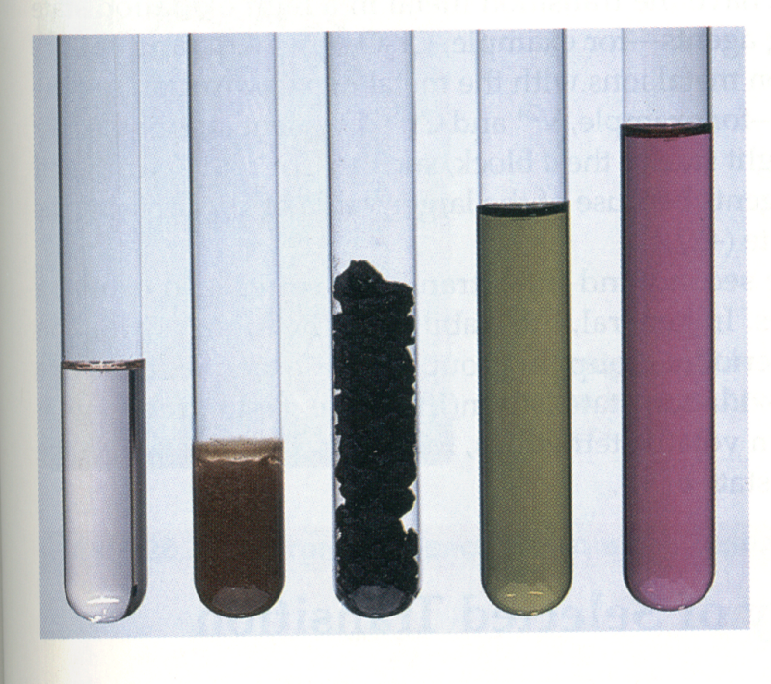
What are do the oxidation states of Mn look like?
Mn²⁺ _{(aq)}, Mn(OH)_{3 (s)}, MnO_{2 (s)}, MnO₄^{2–}_{(aq)}, MnO₄ – _{(aq)}
Notes:
Left to right:
Mn²⁺, Mn(OH)₃(s), MnO₂(s), MnO₄^{2–}(aq), MnO_{4–}(aq)

Slide 15
Relative Reducing Abilities of First Row Transition Metals in Aqueous Solution
Half-Reaction | Potential (V)
Sc _{(s)} → Sc³⁺ _{(aq)} + 3 e⁻ | 2.08
Ti _{(s)} → Ti²⁺ _{(aq)} + 2 e⁻ | 1.63
V _{(s)} → V²⁺ _{(aq)} + 2 e⁻ | 1.20
Mn _{(s)} → Mn²⁺ _{(aq)} + 2 e⁻ | 1.18
Cr _{(s)} → Cr²⁺ _{(aq)} + 2 e⁻ | 0.91
Zn _{(s)} → Zn²⁺ _{(aq)} + 2 e⁻ | 0.76
Fe _{(s)} → Fe²⁺ _{(aq)} + 2 e⁻ | 0.44
Co _{(s)} → Co²⁺ _{(aq)} + 2 e⁻ | 0.28
Ni _{(s)} → Ni²⁺ _{(aq)} + 2 e⁻ | 0.23
Cu _{(s)} → Cu²⁺ _{(aq)} + 2 e⁻ | -0.34
reducing ability

Slide 16
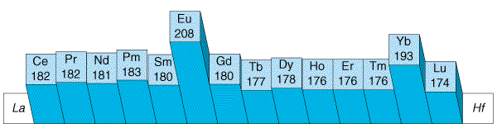
What is the lanthanide contraction?
Notes:
Z_{eff}
_{Similar to previous periods}

Slide 17
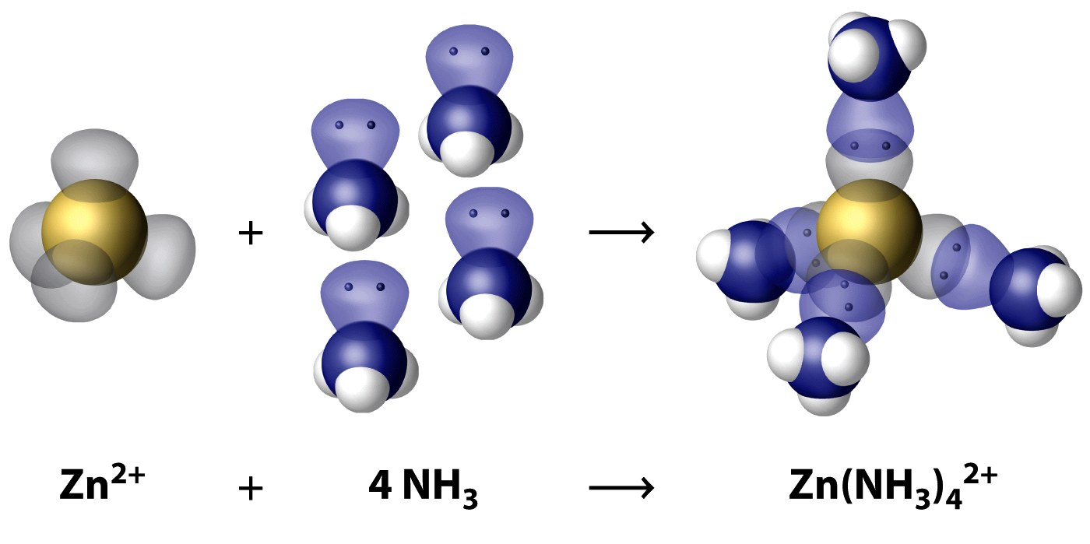
How is a complex ion formed?

Slide 18
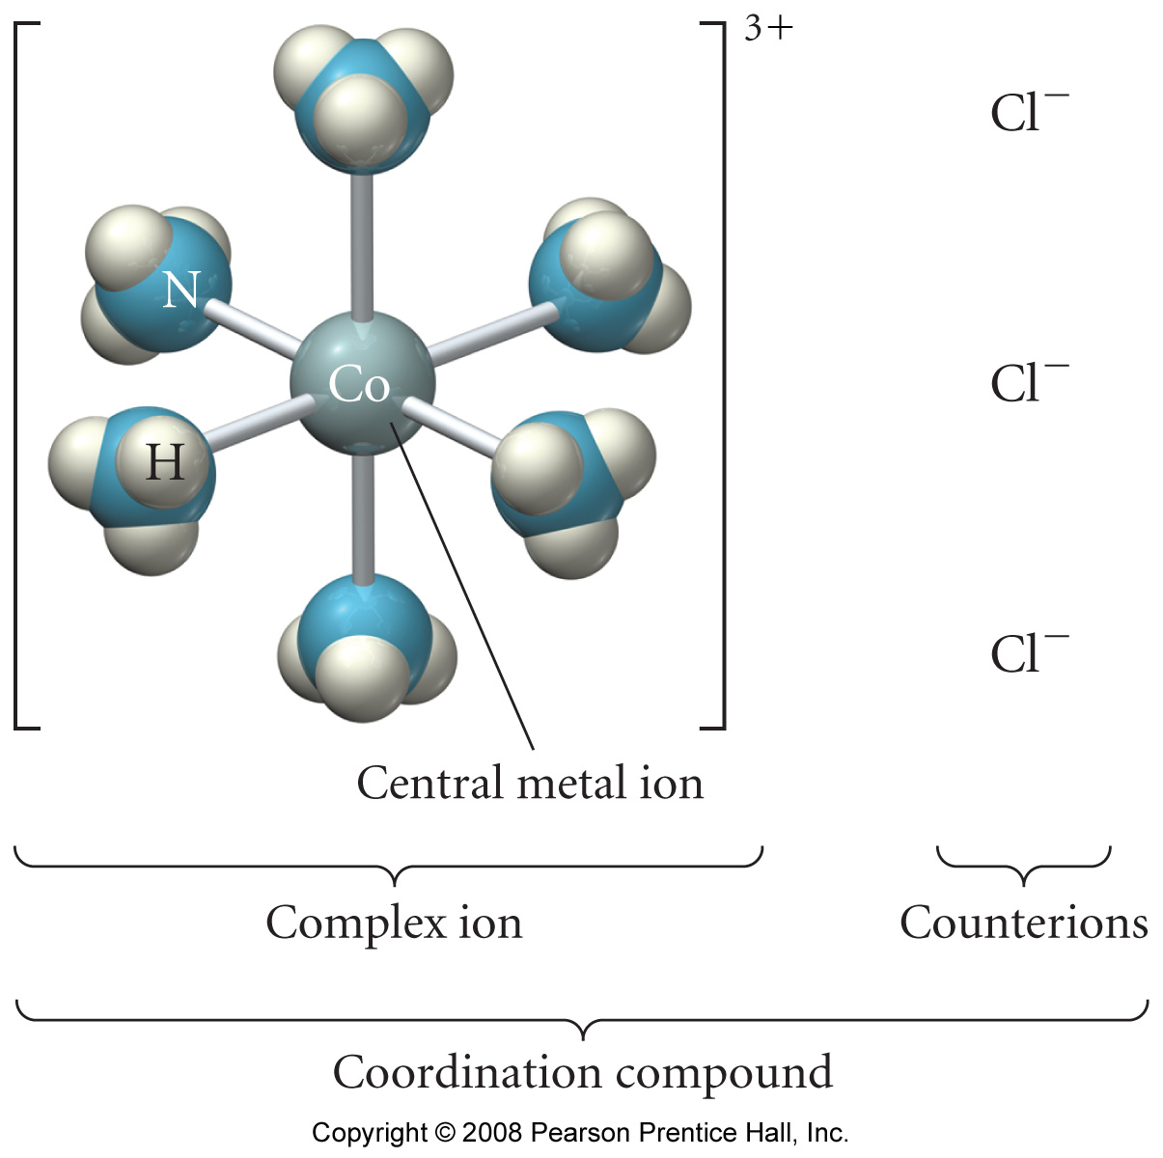
What is a coordination compound?

Slide 19
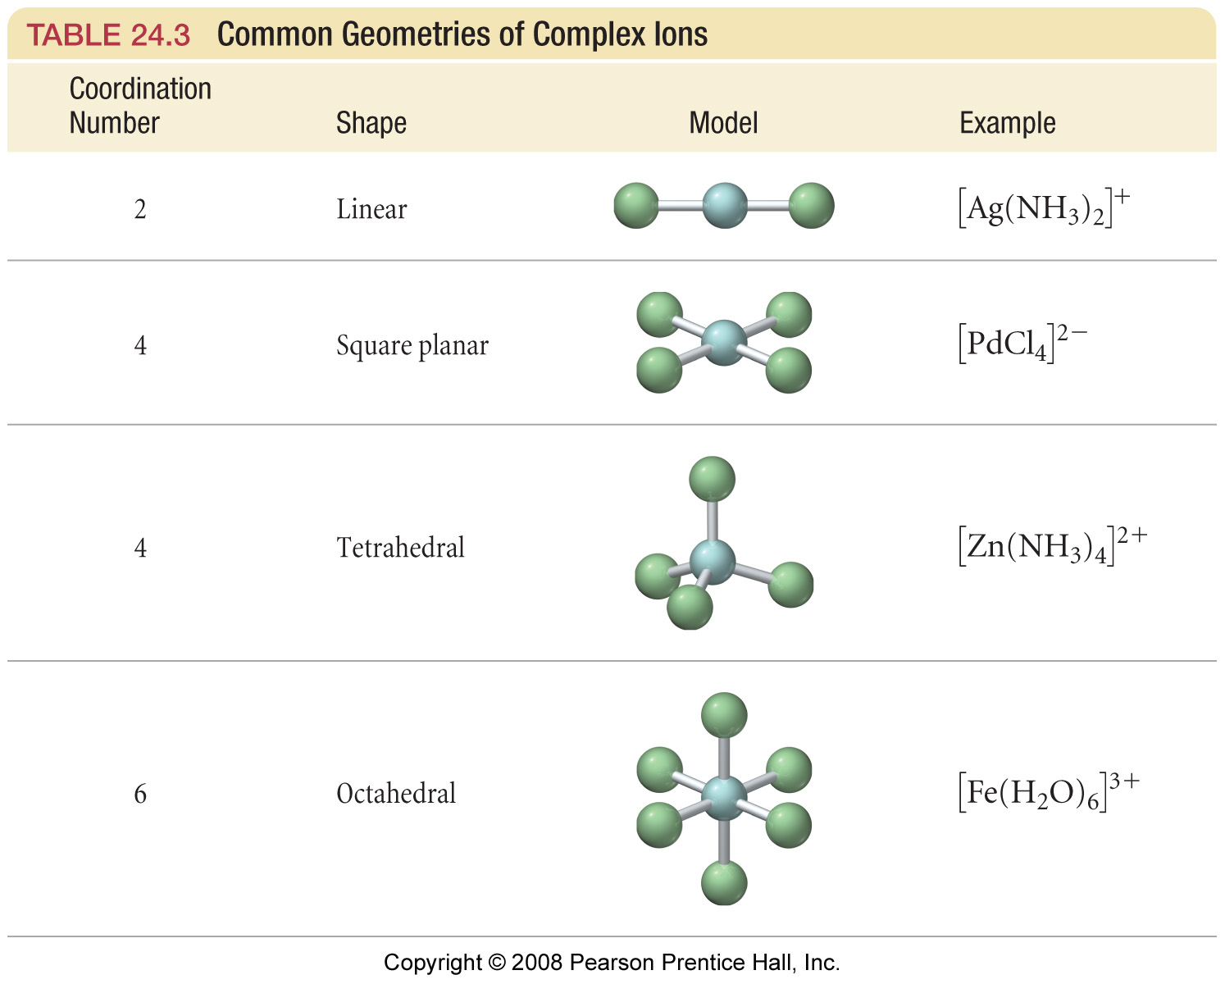
Geometries in Complex Ions

Slide 20
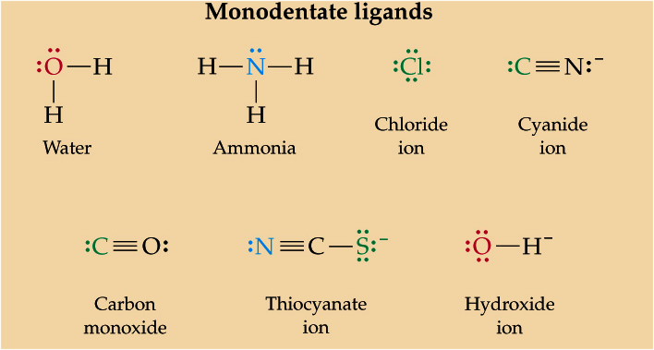
What are some common ligands?

Slide 21
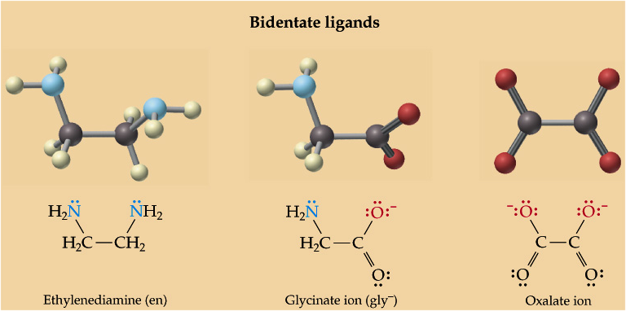
What are some common ligands?

Slide 22
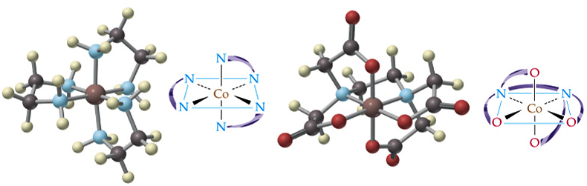
What is a chelate?
[Co(en)₃]³⁺ [Co(EDTA)]⁻
Notes:
EDTA
Ethylenediamine (en)

Slide 23
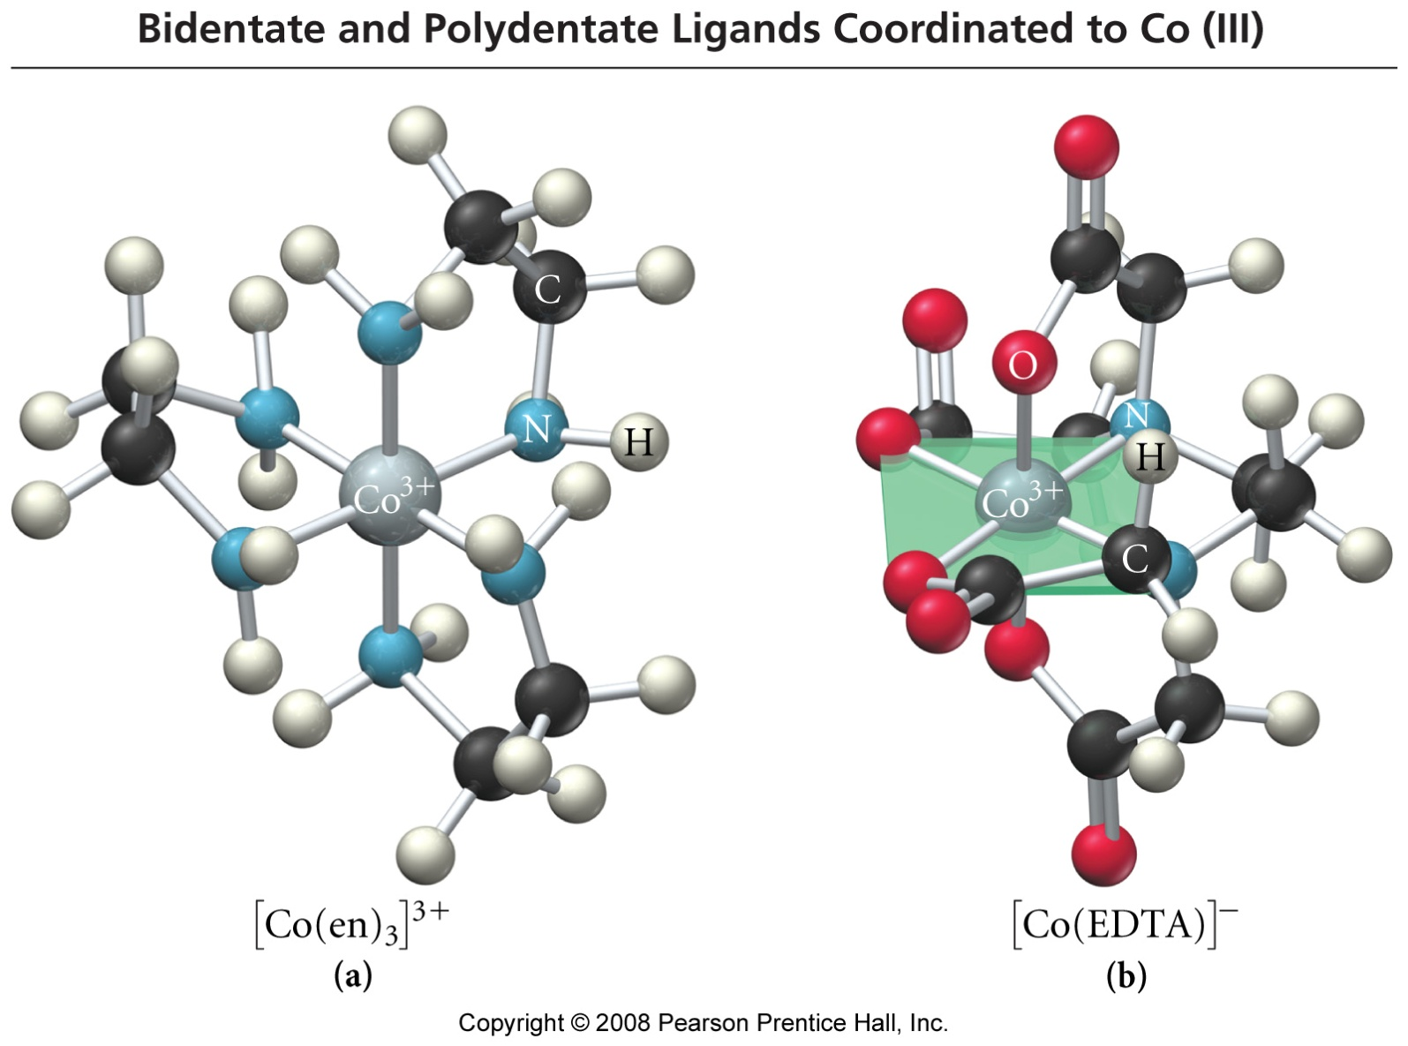
Complex Ions with Polydentate Ligands

Slide 24
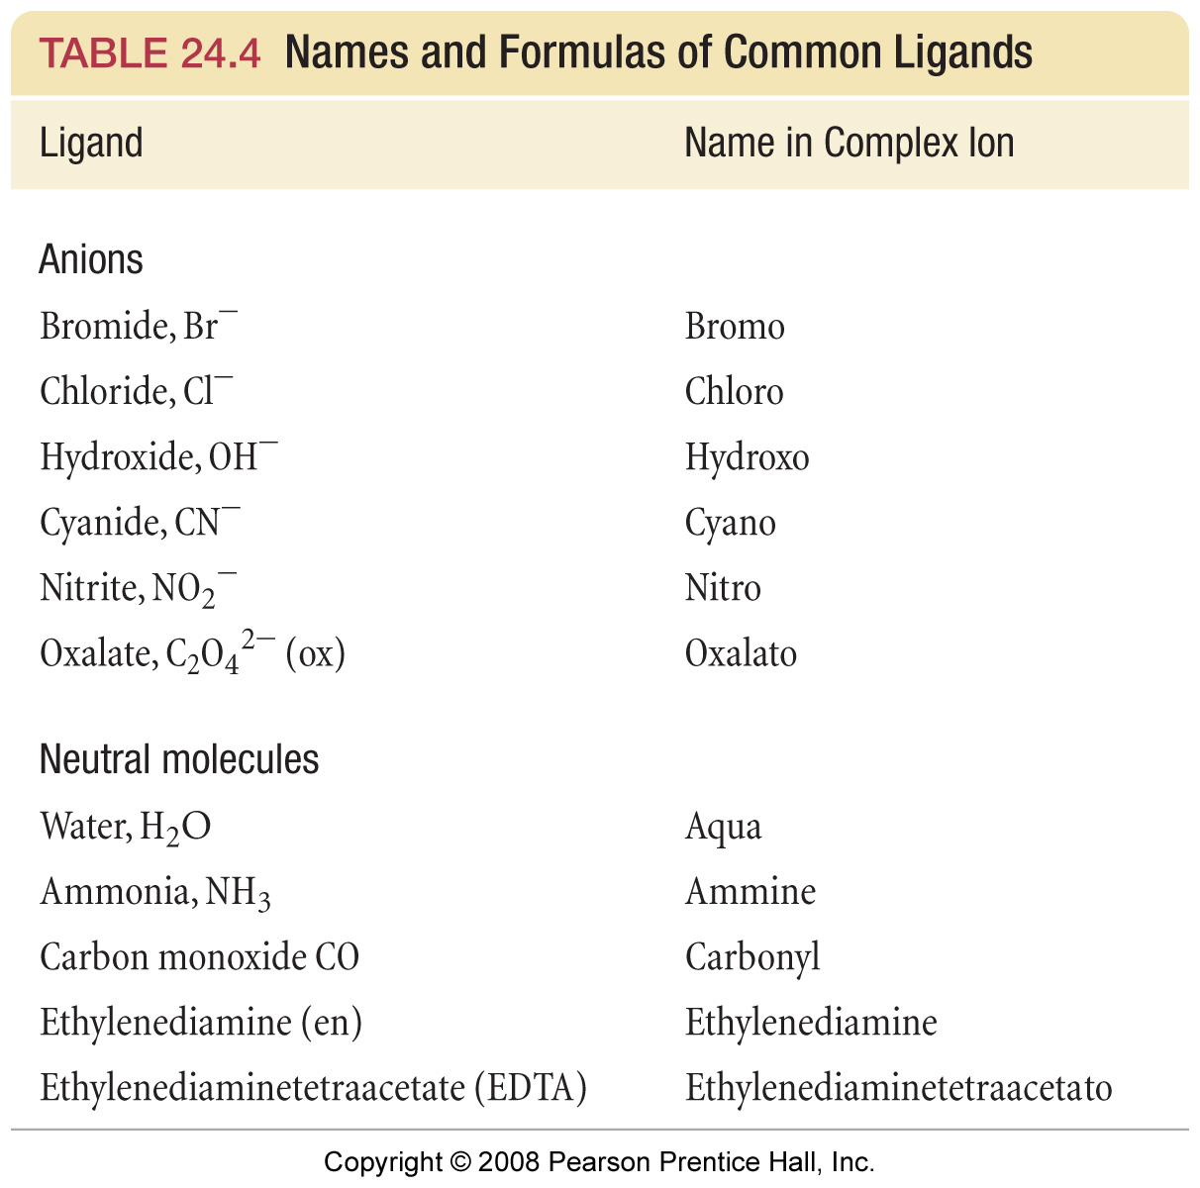

Slide 25
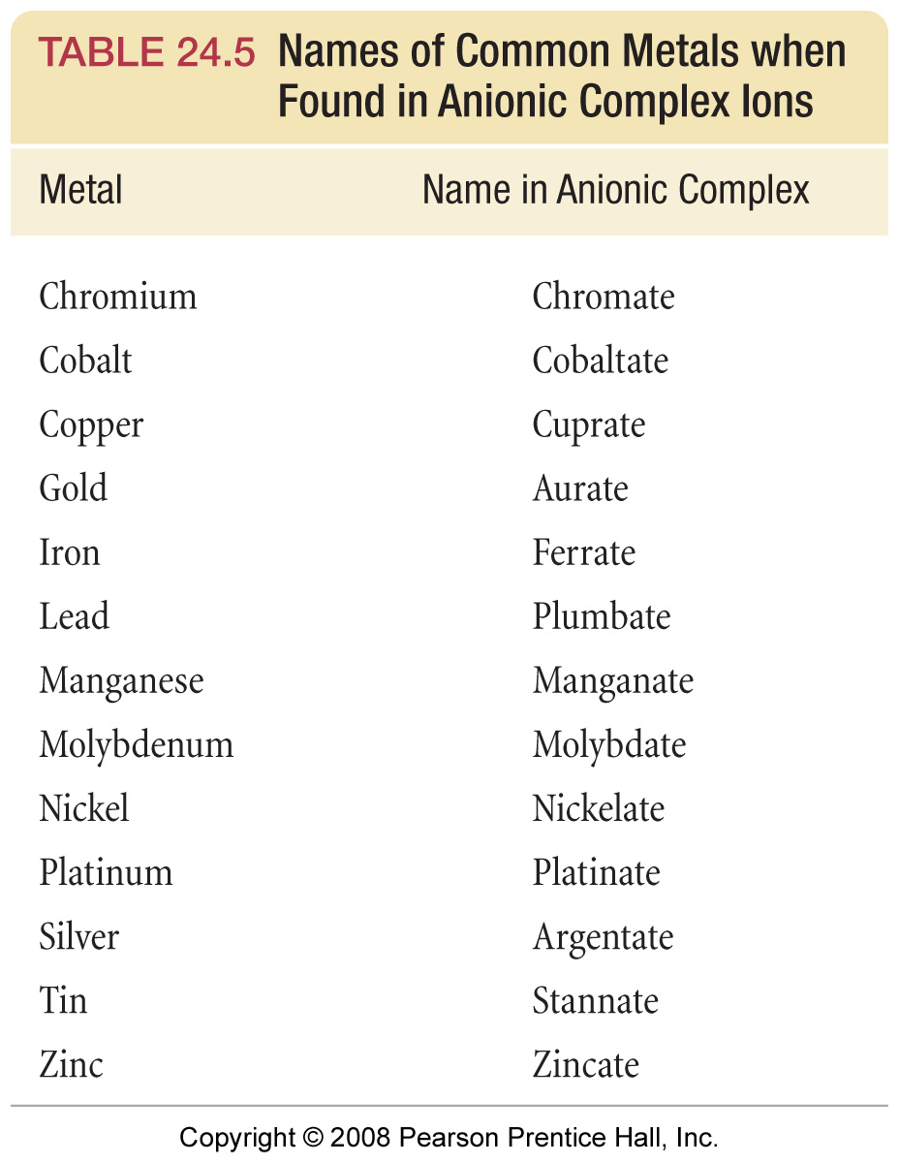

Slide 26
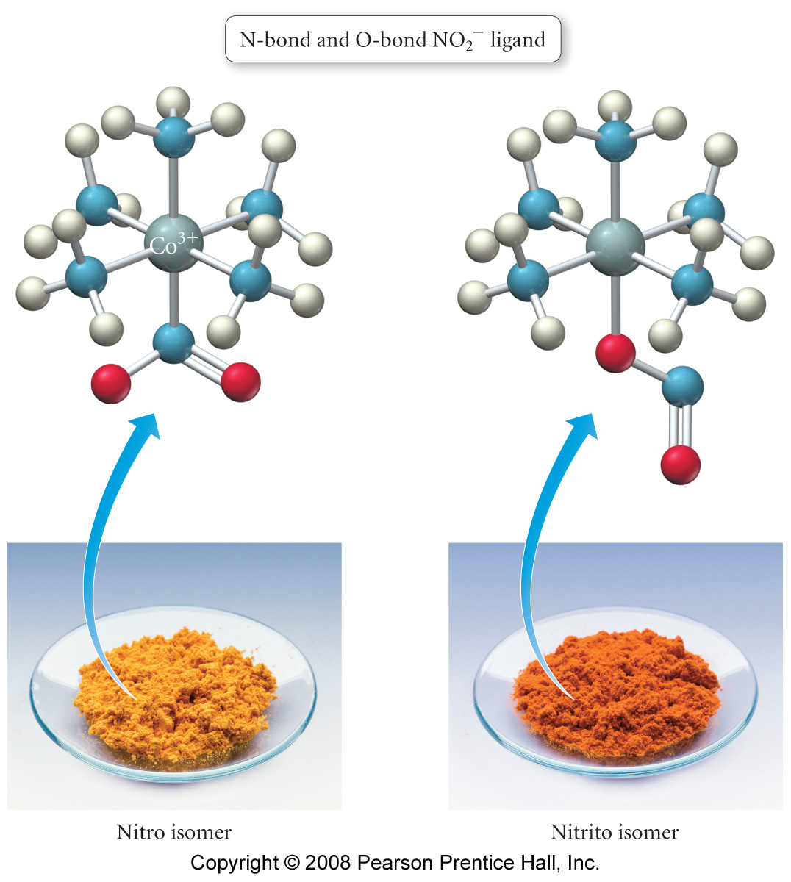
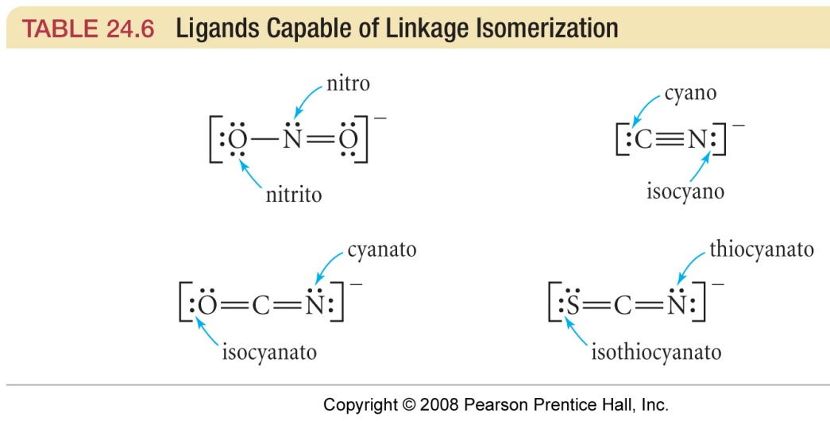
What are linkage isomers?

Slide 27
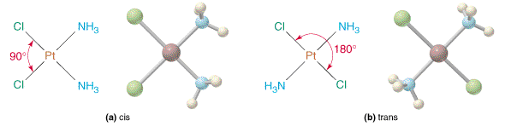
Geometric Isomers: Cis-Trans
Square Planar Complex
[Pt(NH₃)₂Cl₂] diamminedichloroplatinum(II)

Slide 28
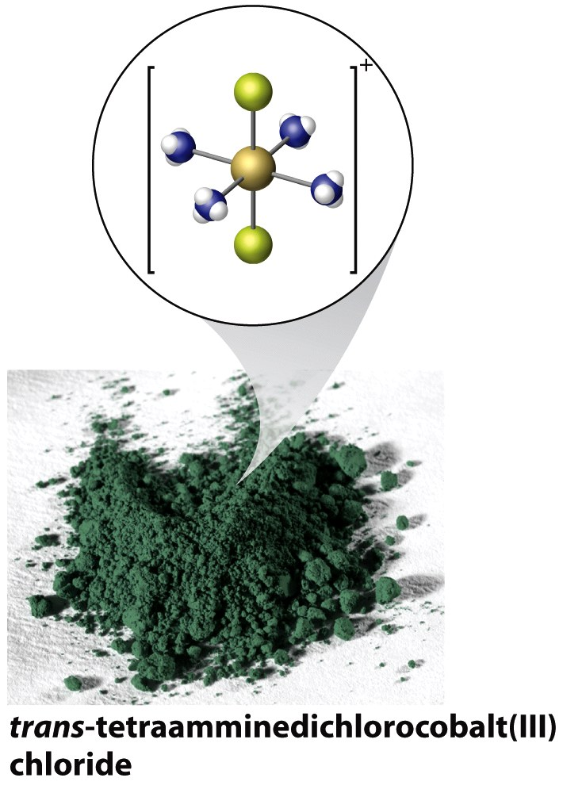
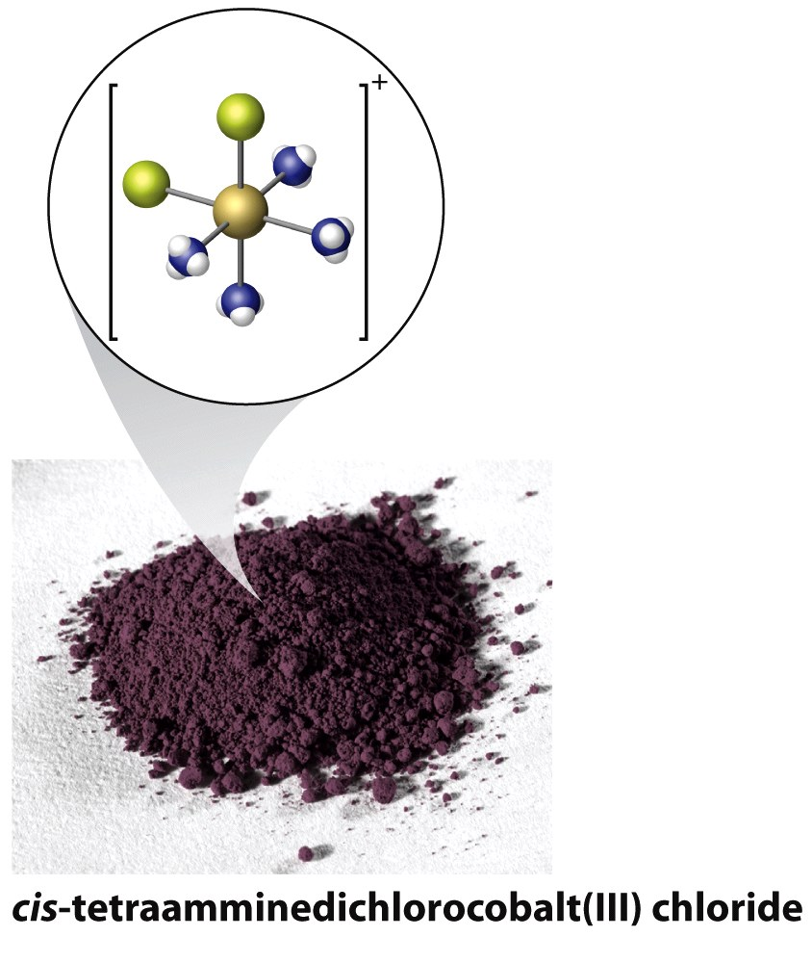
Geometric Isomers: Cis-Trans Octahedral Complexes
[Co(NH₃)₄Cl₂]Cl

Slide 29
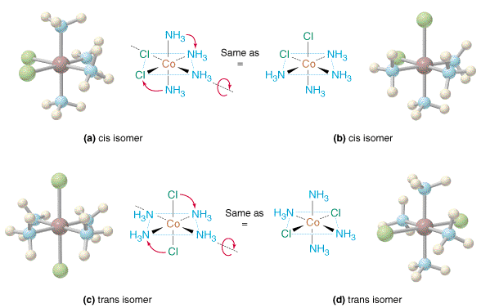
Geometric Isomers: Cis-Trans
Octahedral Complex
[Co(NH₃)₄Cl₂]⁺ tetraamminedichlorocobalt(II)

Slide 30
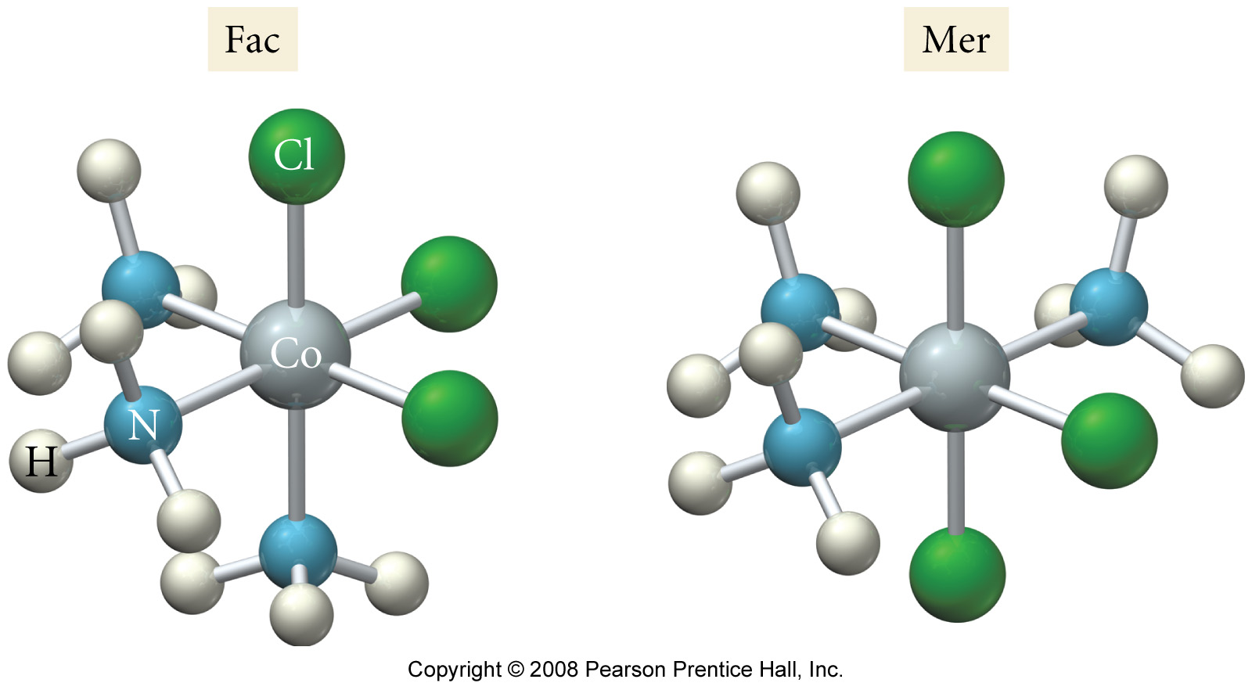
Geometric Isomers: Mer-Fac
Octahedral Complex
[Co(NH₃)₃Cl₃] triamminetrichlorocobalt(II)

Slide 31
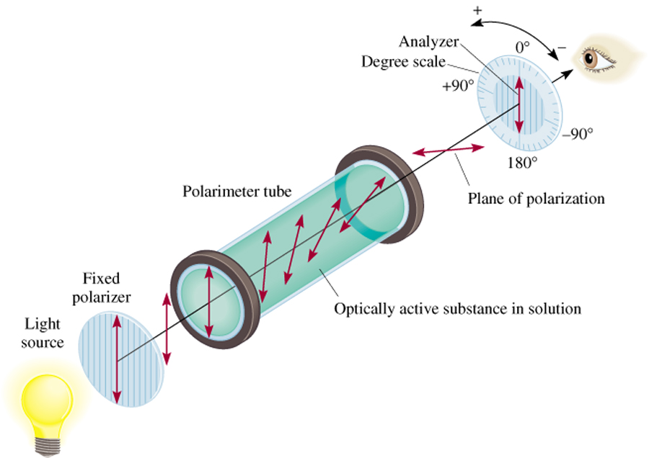
How do optically active substances rotate polarized light?
22.4

Slide 32
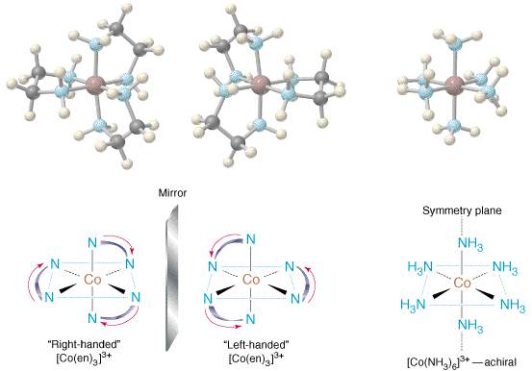
Structures of [Co(en)₃]³⁺ and [Co(NH₃)₆]³⁺

Slide 33
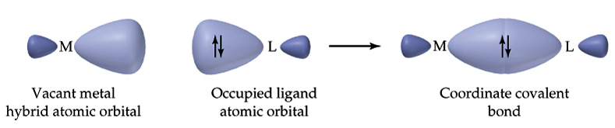
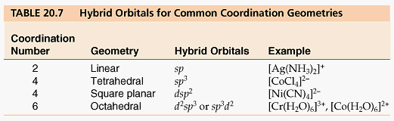
What is Valence Bond Theory?
Notes:
Overlap of empty orbitals
Hybrids derived from geometry
[Cr(NH₃)₆]³⁺, [Ni(CN)₄]^{2–}, [Zn(OH)₄]^{2–}

Slide 34
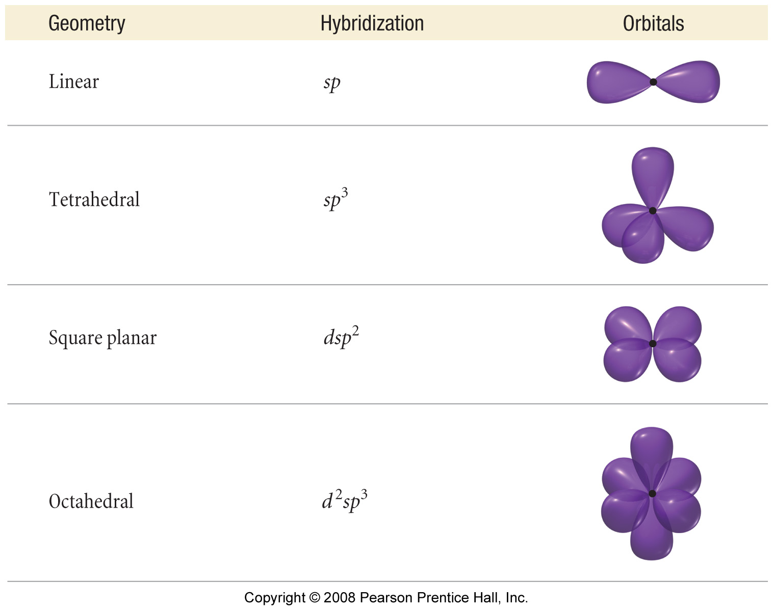

Slide 35
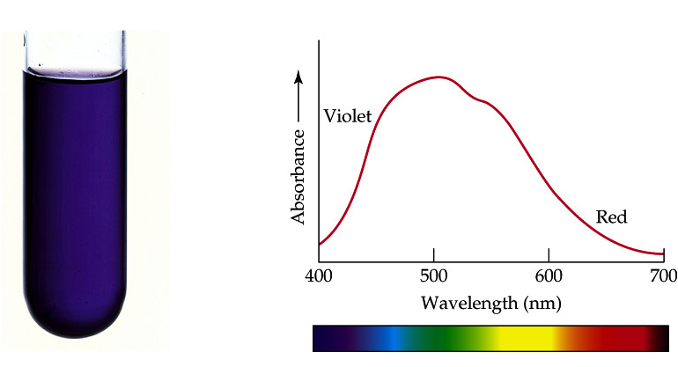
How is solution color related to electrons?
Notes:
[Ti(H₂O)₆]³⁺ is violet. Electron transitions
400nm
800nm
430nm
490nm
560nm
600nm
650nm

Slide 36
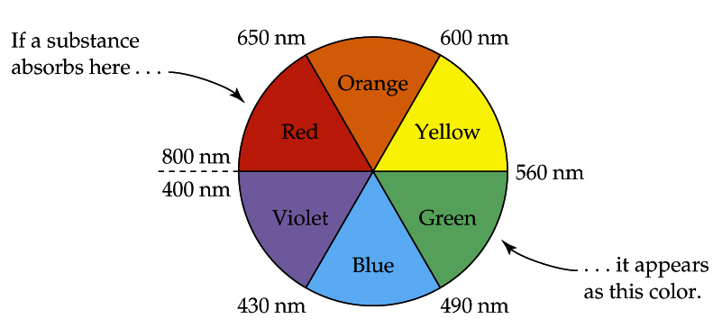

Slide 37
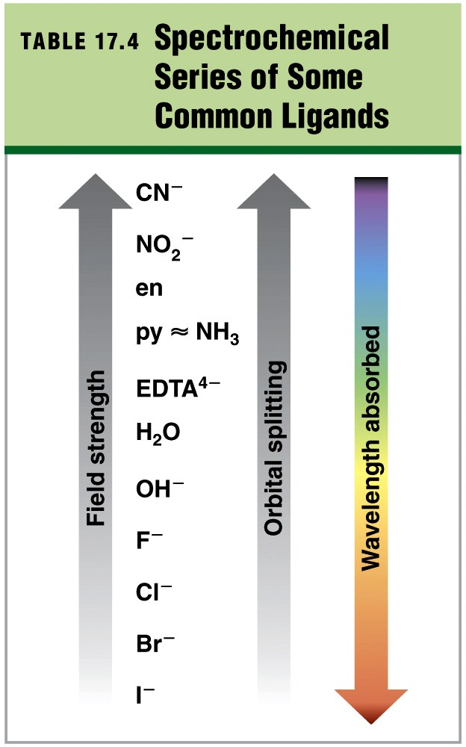

Slide 38
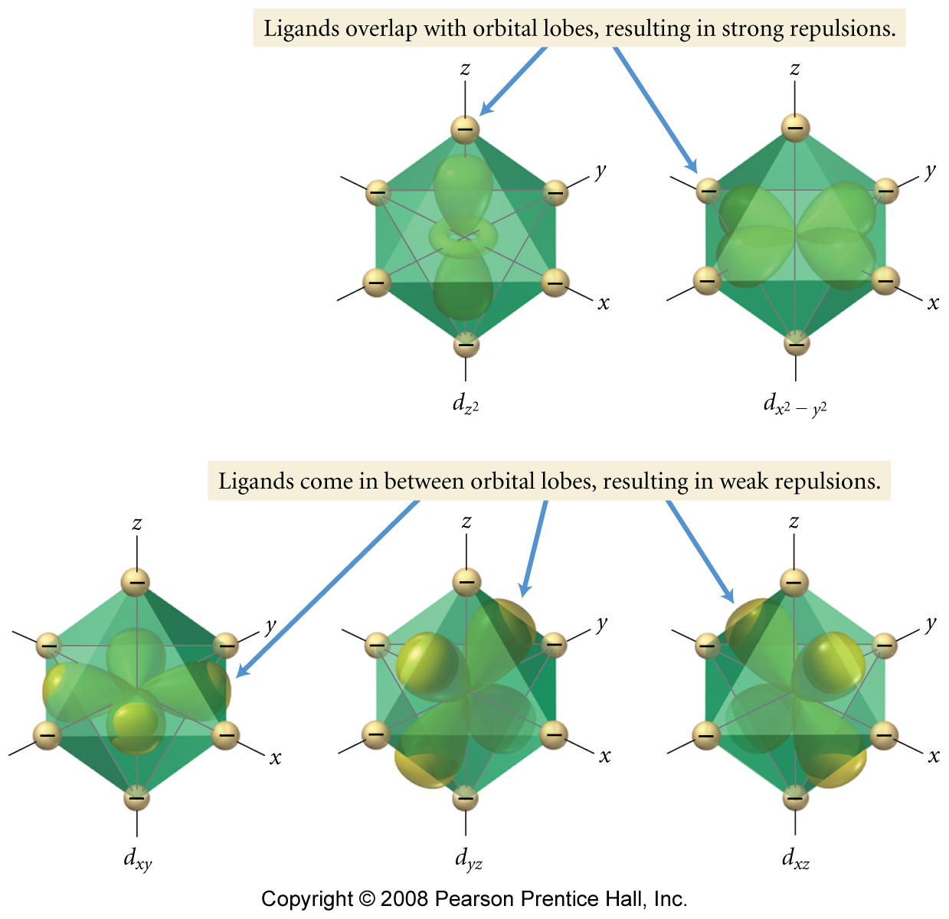
What is strong and weak field splitting?

Slide 39
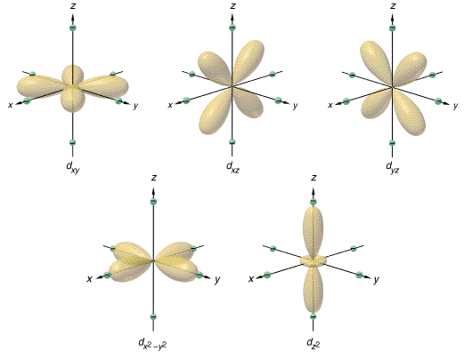
Notes:
d orbitals repelled by ligands (electron pairs or charged ions)
Crystal field splitting
Magnitude of splitting determined by color
Calculate Δ from the absorbed wavelength of light
[Ti(H₂O)₆]³⁺ absorbs blue-green light, but is violet
Spectrochemical series
For a given ligand the color depends on the oxidation state of the metal
For a given metal ion, the color depends on the ligand
Because d⁰ like Ti⁴⁺ and d¹⁰ like Zn²⁺ don’t have partially filled d orbitals there are no transitions and they are colorless
Main group elements are also colorless for same reason
Pairing energy vs. Δ
Weak field = high spin
Strong field = low spin

Slide 40
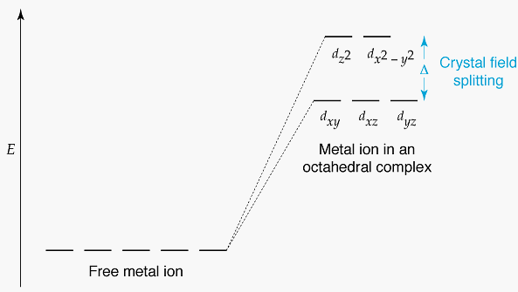
What is Crystal Field Theory?
Octahedral Complexes
Notes:
Magnitude of splitting determined by ligand.
Size of Δ depends on ligand (Weak field vs. Strong Field)
Spectrochemical series:
I–<Br–<Cl–<F–<OH–<H₂O<NH₃<en<NO₂–<CN–<CO
Octahedral Complex
For d^{1–9} high/low spin possible for d^{4–7}
^{d1–3} always high spin (no need to pair)
d^{8–9} always high spin

Slide 41
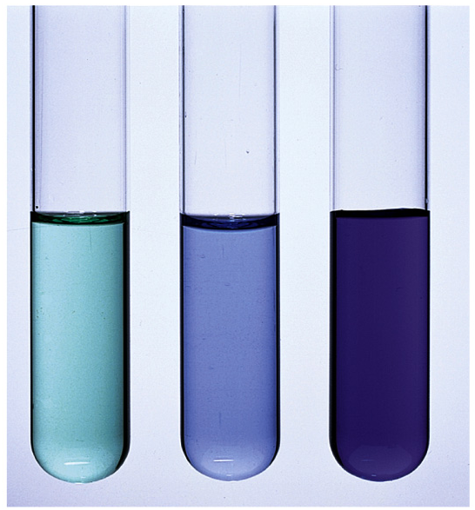
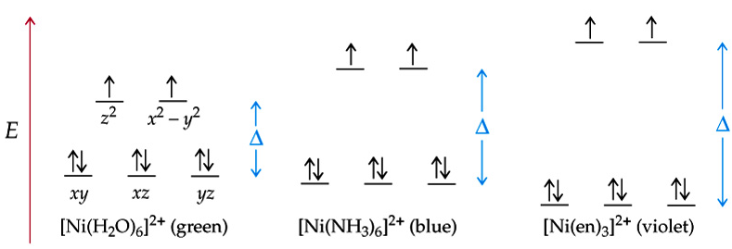

Slide 42
Example – Coordination Chemistry
Compare the strong field case of hexaamminecobalt(III) ion to the weak field case of hexafluorocobaltate(III) ion.
What is the oxidation state of each cobalt?
What do the orbital diagrams look like?
Are they high spin, low spin or neither?
What are the hybridized orbitals?

Slide 43
Example – Coordination Chemistry
The hexacyanoferrate(III) ion is known to have one unpaired electron. Does the cyanide ion produce a strong or weak field?

Slide 44
Example – Coordination Chemistry
Predict the number of unpaired electrons in the complex ion hexacyanochromate(II).

Slide 45
Example – Coordination Chemistry
The complex ion hexaaquatitanium(III) absorbs light of wavelength 510 nm and has a reddish-violet color. What is the ligand field splitting in the complex?

Slide 46
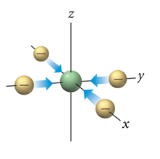
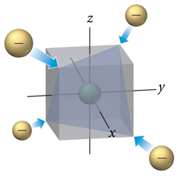
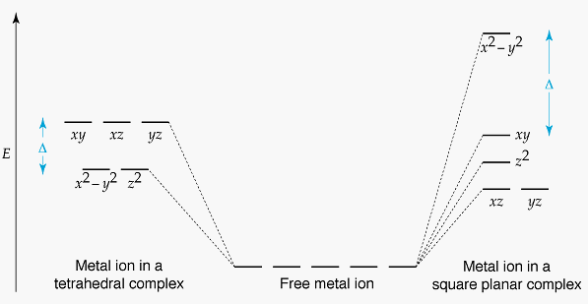
What is Crystal Field Theory?
Tetrahedral and Square Planar Complexes
Notes:
Tetrahedral Complexes
Only high spin known because Δ small
[NiCl₄]^{2–}, [FeCl₄]–
Square Planar
Most common for d⁸
[Ni(CN)₄]^{2–}, [PdCl₄]^{2–}, Pt(NH₃)₂Cl₂

Slide 47
Example – Coordination Chemistry
One method for refining cobalt involves the formation of the complex ion tetrachlorocobaltate(II). This anion is tetrahedral. Is this complex paramagnetic or diamagnetic?

Slide 48
Example – Coordination Chemistry
Why is it that the tetracyanonickelate(II) ion is diamagnetic, but the tetrachloronickelate(II) ion is paramagnetic?

Slide 49
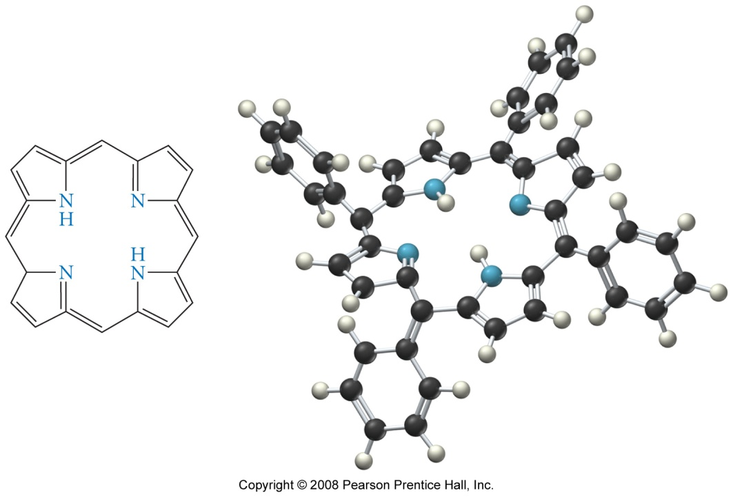
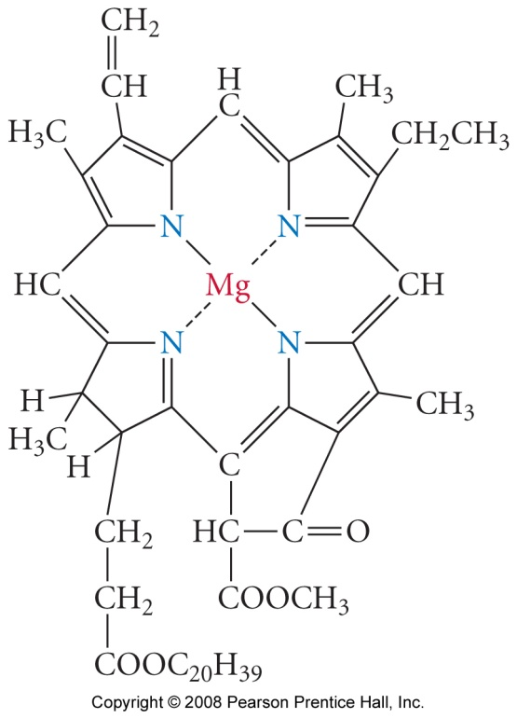
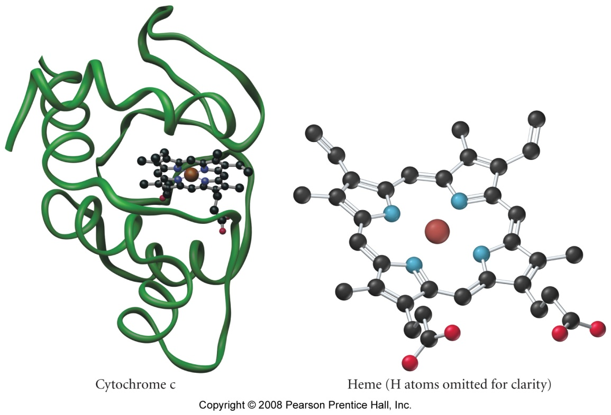

What are some applications of coordination compounds?
chlorophyll
porphryin

Slide 50
What are some applications of coordination compounds?
chlorophyll
porphryin

Slide 51



What are some applications of coordination compounds?
carbonic anhydrase
cisplatin
anticancer drug
carbonic anhydrase
cisplatin
anticancer drug

