Slide 1
Chemistry 142 Chapter 19: Electrochemistry
Outline
Oxidation-Reduction Reactions
Voltaic (or Galvanic) Cells
Electrolysis
Corrosion

Slide 2
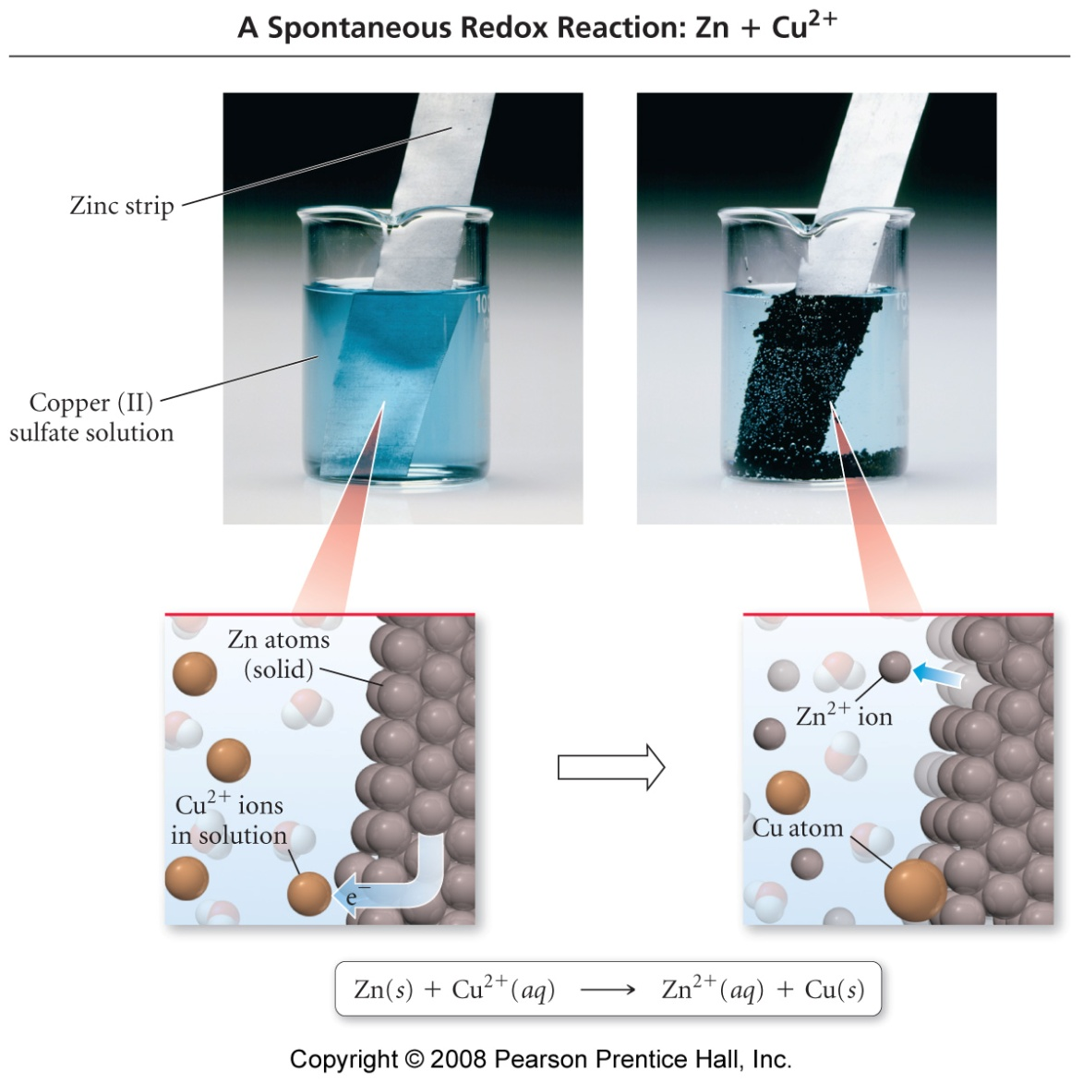
How does electric current flow directly between atoms?

Slide 3
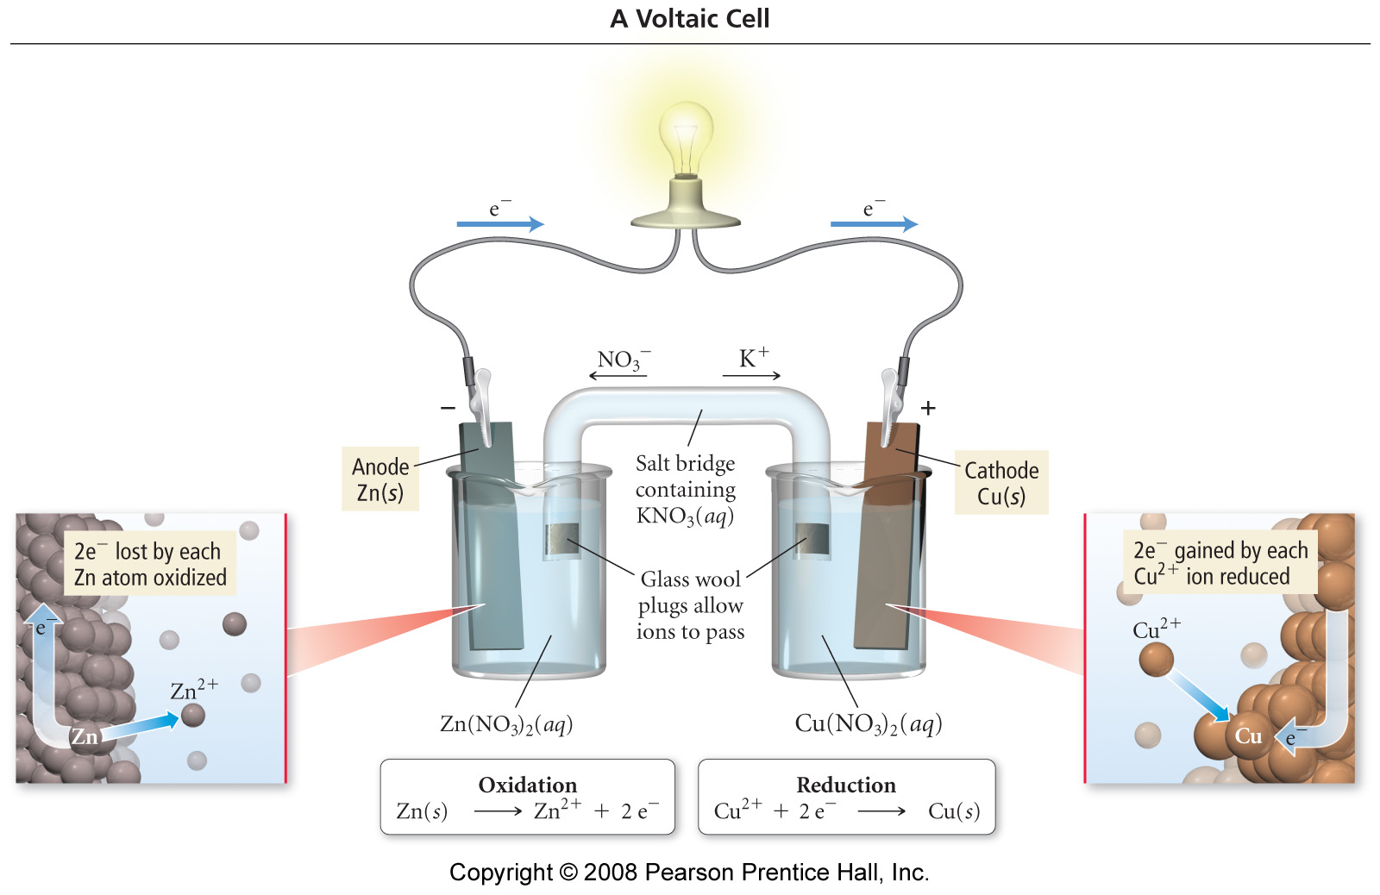
How does electric current flow indirectly between atoms?

Slide 4
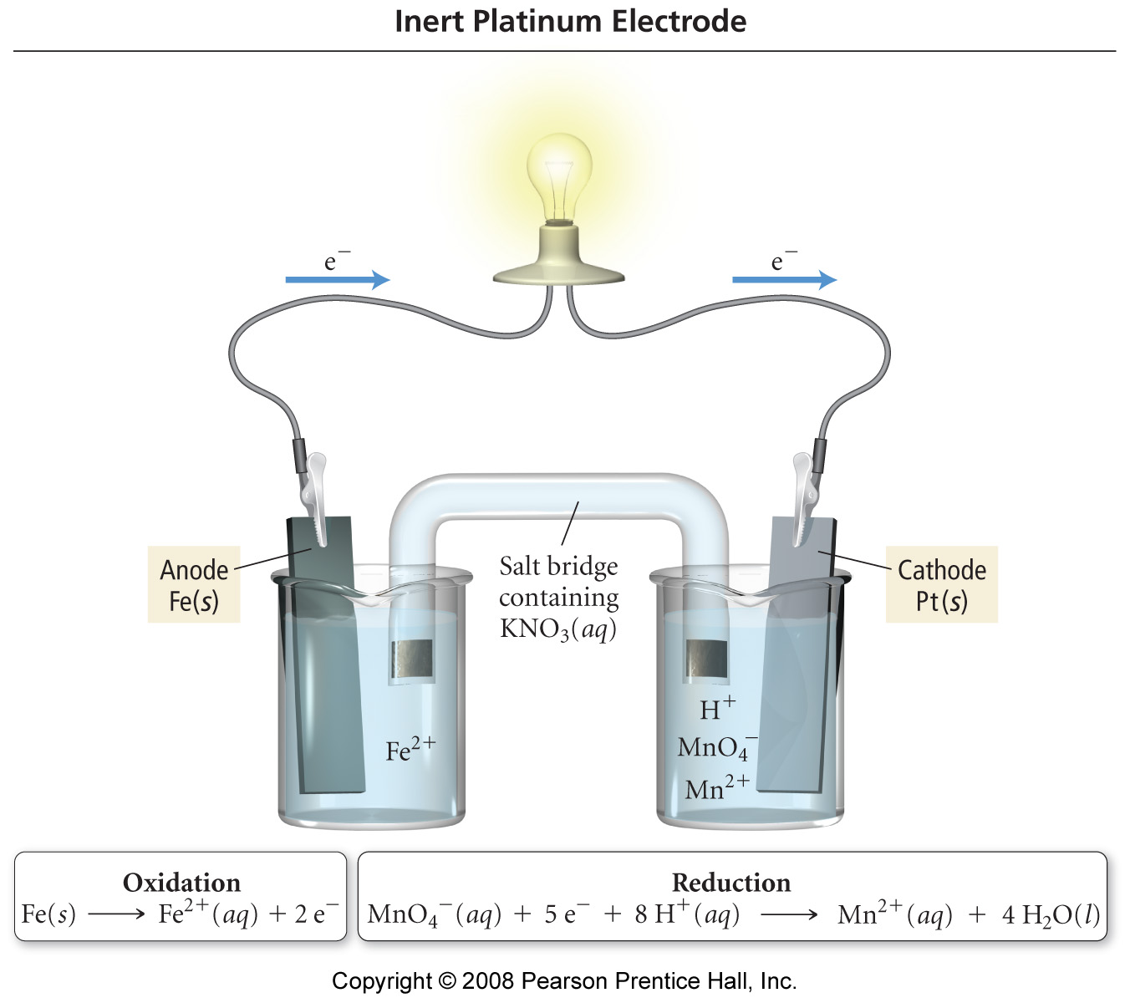
Fe(s) | Fe²⁺(aq) || MnO₄⁻(aq), Mn²⁺(aq), H⁺(aq) | Pt(s)

Slide 5
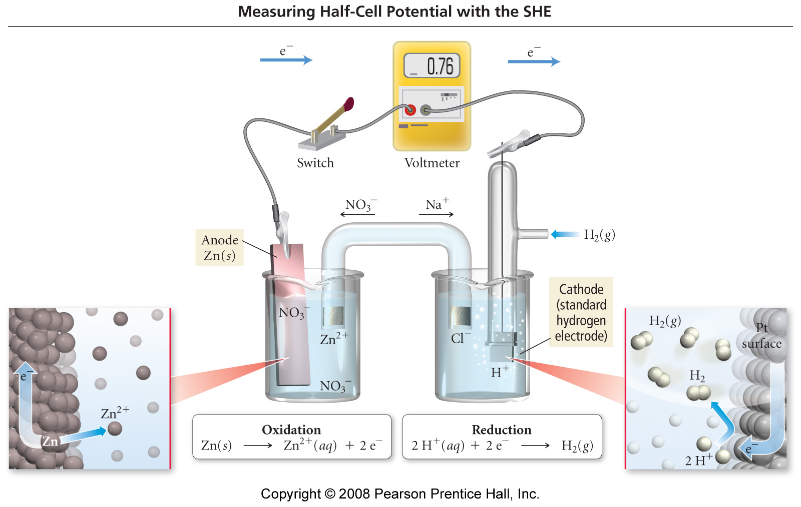

Slide 6
Notes:
Which way for stronger oxidizing agent? Reducing agent?

Slide 7
Activity Series
Notes:
Relative strengths of ox and red agents
The more positive E°, the more the reaction (as written) tends to occur
What does this say about table as ordered by oxidizing agent? Reducing agent?
How does this table compare to an activity series?
Top to Bottom
Oxidizing agents decreasing in strength (reactants)
Reducing agents increasing in strength (products)

Slide 8
Notes:
F = 96,500 C/mol e– = Faraday constant
Since free energy and cell potential are directly proportional a voltmeter can be considered a “free energy meter”
ΔG = -w_{max}
work = (no. of coulombs) × (energy available / coulomb)
no. of coulombs = nF
energy available / coulomb = E (emf)
w_{max} = nFE
joules = (moles of e–) × (coulombs / mole e–) × (joules / coulomb)

Slide 10
Electrochemistry Example – Cell Potential
Consider a Galvanic cell based on the reaction:
Al³⁺ _{(aq)} + Mg _{(s)} → Al _{(s)} + Mg²⁺ _{(aq)}
Given the half reactions:
Al³⁺ _{(aq)} + 3 e⁻ → Al _{(s)} E˚ = -1.66 V
Mg²⁺ _{(aq)} + 2 e⁻ → Mg _{(s)} E˚ = -2.37 V

Slide 11
Electrochemistry Example – Cell Potential
What is the cell potential of the following Galvanic cell?
Pt _{(s)}|ClO₃⁻ _{(aq)}, ClO₄⁻ _{(aq)}, H⁺ _{(aq)}|| H⁺ _{(aq)}, MnO₄⁻ _{(aq)}, Mn²⁺ _{(aq)}|Pt _{(s)}
Given the half-reactions:
MnO₄⁻ _{(aq)} + 8 H⁺ _{(aq)} + 5 e⁻ → Mn²⁺ _{(aq)} + 4 H₂O _{(l)} E˚ = 1.51 V
ClO₄⁻ _{(aq)} + 2 H⁺ _{(aq)} + 2 e⁻ → ClO₃⁻ _{(aq)} + H₂O _{(l)} E˚ = 1.19 V

Slide 12
Electrochemistry Example – Cell Potential
What is the cell potential of the following Galvanic cell?
Pt _{(s)}|ClO₃⁻ _{(aq)}, ClO₄⁻ _{(aq)}, H⁺ _{(aq)}|| H⁺ _{(aq)}, MnO₄⁻ _{(aq)}, Mn²⁺ _{(aq)}|Pt _{(s)}
Given the cell potentials:
E_{oxidation}˚ = 1.19 V
E_{reduction}˚ = 1.51 V

Slide 13
Electrochemistry Example – Cell Potential
Describe completely the Galvanic cell based on the following half-reactions under standard conditions:
Ag⁺ _{(aq)} + e⁻ → Ag _{(s)} E˚ = 0.80 V
Fe³⁺ _{(aq)} + e⁻ → Fe²⁺ _{(aq)} E˚ = 0.77 V

Slide 14
Electrochemistry Example – Cell Potential
Describe completely the Galvanic cell based on the following half-reactions under standard conditions:
Fe²⁺ _{(aq)} + 2 e⁻ → Fe _{(s)} E˚ = -0.44 V
MnO₄⁻ _{(aq)} + 8 H⁺ _{(aq)} + 5 e⁻ → Mn²⁺ _{(aq)} + 4 H₂O _{(l)} E˚ = 1.51 V

Slide 15
Electrochemistry Example – Cell Potential
What is the efficiency of a Galvanic cell that has a maximum potential of 2.50 V, if 1.33 moles of electrons is passed through a cell with an average potential of 2.10 V?

Slide 16
Electrochemistry Example – Cell Potential and Free Energy
The following process is used to deposit copper metal from copper ore, calculate ΔG˚ for:
Cu²⁺ _{(aq)} + Fe _{(s)} → Fe²⁺ _{(aq)} + Cu _{(s)}
Is the reaction spontaneous? Given:
Cu²⁺ _{(aq)} + 2 e⁻ → Cu _{(s)} E˚ = 0.34 V
Fe²⁺ _{(aq)} + 2 e⁻ → Fe _{(s)} E˚ = -0.44 V

Slide 17
What is a concentration cell?
Cu(s)⏐ Cu²⁺_{(aq)} (0.010 M) ⏐⏐ Cu²⁺_{(aq)} (2.0 M)⏐ Cu(s)

Slide 18
Electrochemistry Example – Concentration Cell
For the reaction:
2 Al _{(s)} + 3 Mn²⁺ _{(aq)} → 2 Al³⁺ _{(aq)} + 3 Mn _{(s)} E_{cell}˚ = 0.48 V
Predict the larger or small E_{cell}˚ given :
a. [Al³⁺] = 2.0 M and [Mn²⁺] = 1.0 M
b. [Al³⁺] = 1.0 M and [Mn²⁺] = 3.0 M

Slide 19
Electrochemistry Example – Concentration Cell
E_{cell}˚ is 0.48 V for the Galvanic cell based on the reaction below:
2 Al _{(s)} + 3 Mn²⁺ _{(aq)} → 2 Al³⁺ _{(aq)} + 3 Mn _{(s)}
Consider a cell in which [Al³⁺] = 1.50 M and [Mn²⁺] = 0.50 M. Calculate the cell potential, E_{cell}, at 25 ˚C.

Slide 20
Electrochemistry Example – Concentration Cell
Consider the following Galvanic cell at 25 ˚C with a E_{cell} of 0.58 V:
Zn _{(s)}|Zn²⁺ _{(aq)} (1 M)|| H⁺ _{(aq)} (? M)| H_{2 (g)} (1 atm)|Pt _{(s)}
What is the pH of the solution? Given the two half-reactions:
2 H⁺ _{(aq)} + 2 e⁻ → H_{2 (g)} E˚ = 0 V
Zn²⁺ _{(aq)} + 2 e⁻ → Zn _{(s)} E˚ = -0.76 V

Slide 21
Electrochemistry Example – Concentration Cell
For the unbalanced redox reaction below calculate E° and K at 25 °C.
S₄O₆²⁻ _{(aq)} + Cr²⁺ _{(aq)} → Cr³⁺ _{(aq)} + S₂O₃²⁻ _{(aq)}
Given the half-reactions:
S₄O₆²⁻ _{(aq)} + 2 e⁻ → S₂O₃²⁻ _{(aq)} E˚ = 0.17 V
Cr³⁺ _{(aq)} + e⁻ → Cr²⁺ _{(aq)} E˚ = -0.50 V

Slide 22
How did electrolysis contribute to the discoveries of the elements?
1785 – Martinus van Marum used electrolysis to reduce tin, zinc, and antimony from their salts.
1800 – William Nicholson and Anthony Carlisle decomposed water into its elements.
1807 – Sir Humphrey Davis discovered potassium, barium, sodium, calcium, and magnesium using electrolysis.
1875 – Paul Émile Lecoq de Bolsbaudran discovered gallium using electrolysis.
1886 – Henri Moissan discovered fluorine
1886 – The Hall-Hérolt process developed for making aluminum.

Slide 23
What is neuron potential?
Notes:
E_{ion} = RT/nF ln ([ion]_{outside}/[ion]_{inside)}
Assume n = 1 and 37 °C
E_{ion} = RT/nF ln(0.003/0.135)
The cell has a potential 102 mV more negative on the inside than on the outside due to the much higher K⁺ concentration inside the cell.
Ions on next page all contribute to resting potential of neuron.
Resting potential -60 to -75 mV dpending on type. With the outside more positive.

Slide 24
Ion | Intracellular conc. (mM) | Extracellular conc. (mM) | Potential (mV)
Na⁺ | 18 | 150 | +56
K⁺ | 135 | 3 | -102
Cl– | 7 | 120 | -76
Ca²⁺ | 0.0001 | 1.2 | +125
Notes:
Generator potential vs. postsynaptic potential
Depolarize vs. hyperpolarize
Depolarizing are excitatory
Some inhibitory stimuli are hyperpolarizing
Depolarization (stimulation)—makes membrane more permeable to Na⁺. Inrush of sodium makes potential less negative. Then…
Hyperpolarization—increase permeability to K⁺ allowing potassium to flow out thus increasing negative potential.
Some inhibitory stimuli increase permeability of Cl⁻ which requires more Na⁺ to change the charge ratio thus increasing a required stimulus.

Slide 25
The pH Electrode
Notes:
Could measure pH with electrode, Pt | H₂(1 atm) H⁺ (? M) || Reference cathode
E_{cell} = E_{H2 -> H+} + E_{ref}
H₂ -> 2H⁺ + 2e⁻
E_{H2 -> H+} = Eº_{H2 -> H+} - RT/2F ln([H⁺]²/P_{H2}
E_{H2 -> H+} = -RT/2F ln[H⁺]². Since ln[H⁺]² = 2 ln[H⁺],
E_{H2 -> H+} = RT/F(-ln[H⁺]) = RT/F(pH) + E_{ref}; pH = (E_{cell} - E_{ref})/(RT/F)
Hydrogen electrode is not convenient, so use calomel electrode for reference and glass electrode for measurement.
Glass electrode - Silver wire coated with AgCl that dips into HCl solution that is separated from solution by a thin glass membrane
Calomel electrode - Hg₂Cl₂ in contact with Hg(l) and KCl(aq).
Potential depends on these two electrodes and concentration gradient across glass membrane.

Slide 26
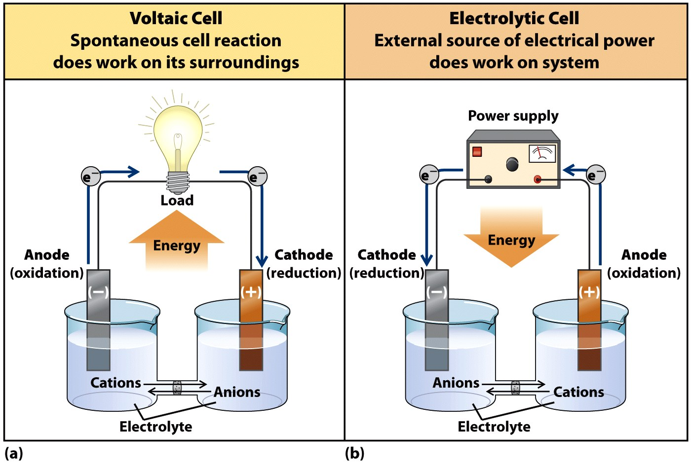
What are the cell types?

Slide 27
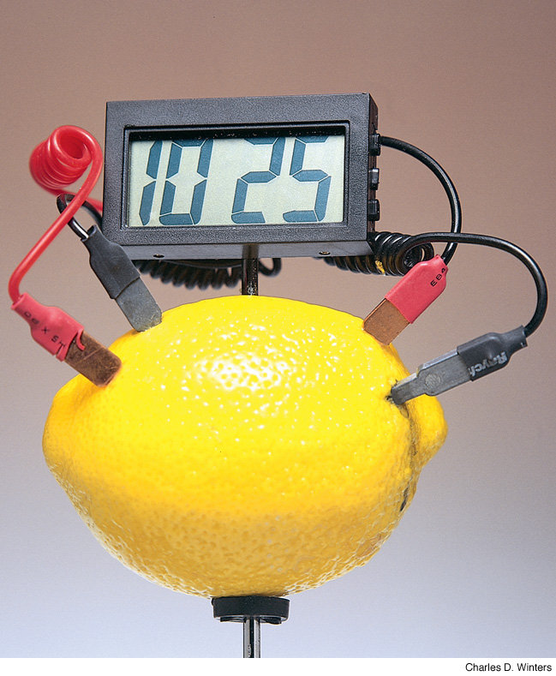
How can a simple battery be made?
Notes:
Page: 553
All common batteries convert chemical energy into electrical energy by means of an oxidation–reduction reaction. A battery can be made by placing a strip of copper and a strip of zinc into a lemon! This lemon battery produces enough current to power a small clock. In this chapter, you will learn how a chemical reaction can generate an electric current.

Slide 28
What are some characteristic voltage of common cells?
Voltaic Cell | Voltage
Common alkaline battery | 1.5V
Lead-acid storage battery (6 cells = 12V) | 2.0V
Mercury calculator battery | 1.3V
Electric eel (5000 cells = 750V) | 0.15V
Nerve of giant squid | 0.070V

Slide 29
LeClanche’ Acidic Dry Cell
electrolyte in paste form
ZnCl₂ + NH₄Cl
or MgBr₂
anode = Zn (or Mg)
Zn(s) → Zn²⁺(aq) + 2 e⁻
cathode = graphite rod
MnO₂ is reduced
2 MnO₂(s) + 2 NH₄⁺(aq) + 2 H₂O(l) + 2 e⁻
→ 2 NH₄OH(aq) + 2 Mn(O)OH(s)
cell voltage = 1.5 v
expensive, nonrechargeable, heavy, easily corroded

Slide 30
Alkaline Dry Cell
same basic cell as acidic dry cell, except electrolyte is alkaline KOH paste
anode = Zn (or Mg)
Zn(s) → Zn²⁺(aq) + 2 e⁻
cathode = brass rod
MnO₂ is reduced
2 MnO₂(s) + 2 NH₄⁺(aq) + 2 H₂O(l) + 2 e⁻ → 2 NH₄OH(aq) + 2 Mn(O)OH(s)
cell voltage = 1.54 v
longer shelf life than acidic dry cells and rechargeable, little corrosion of zinc

Slide 31
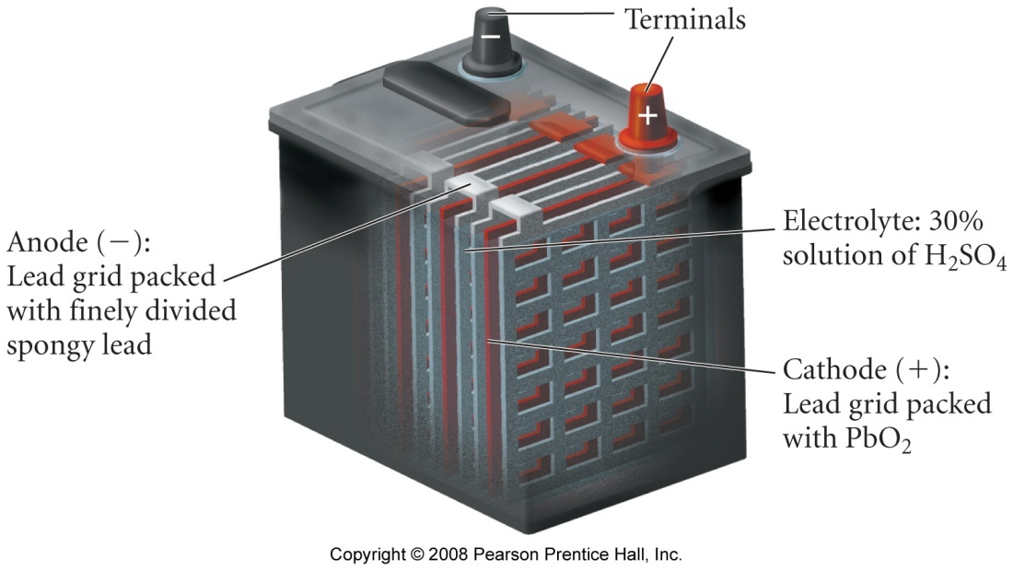
Lead Storage Battery
6 cells in series
electrolyte = 30% H₂SO₄
anode = Pb
Pb(s) + SO₄²⁻(aq) → PbSO₄(s) + 2 e⁻
cathode = Pb coated with PbO₂
PbO₂ is reduced
PbO₂(s) + 4 H⁺(aq) + SO₄²⁻(aq) + 2 e⁻ → PbSO₄(s) + 2 H₂O(l)
cell voltage = 2.09 v
rechargeable, heavy

Slide 32
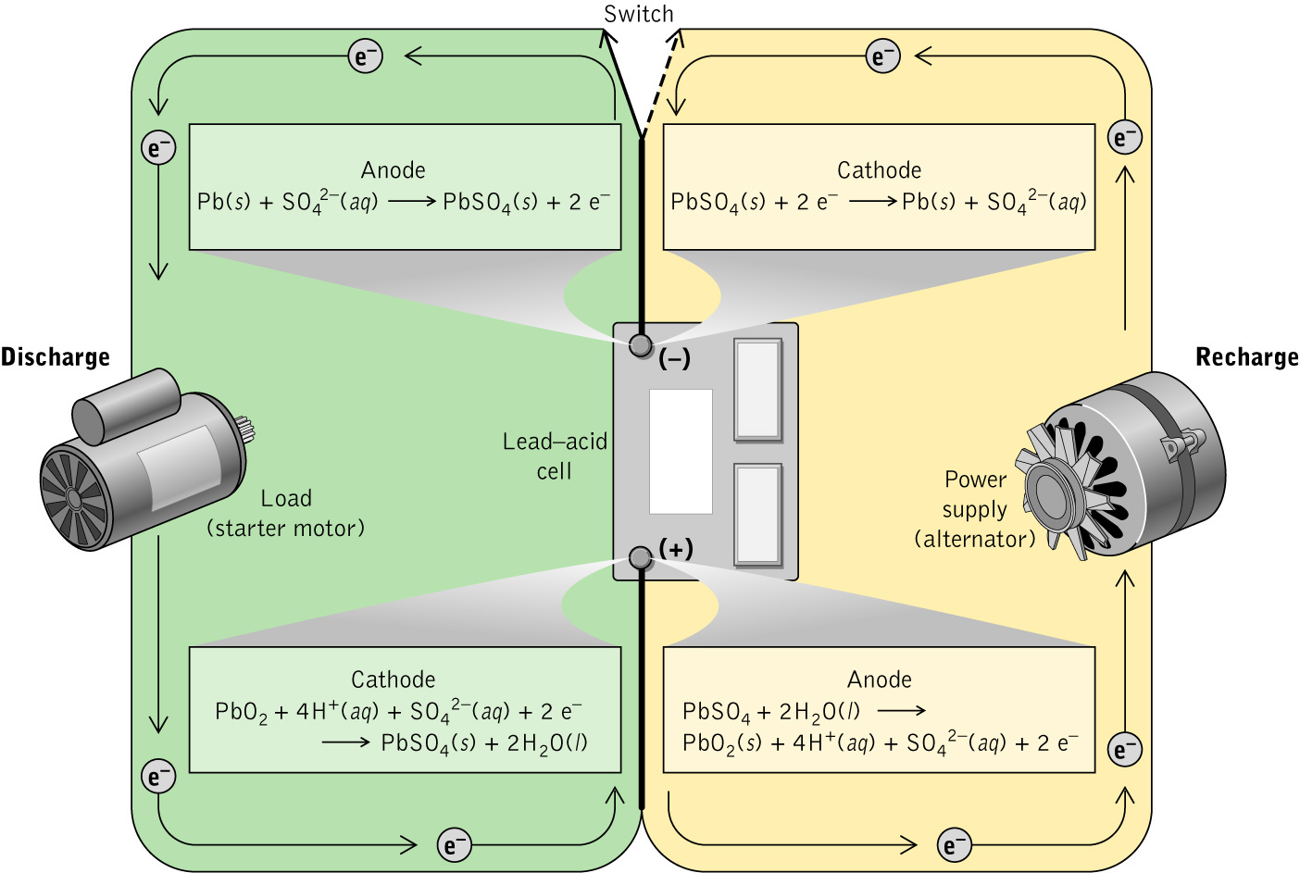
The Lead-acid Battery in Cars

Slide 33
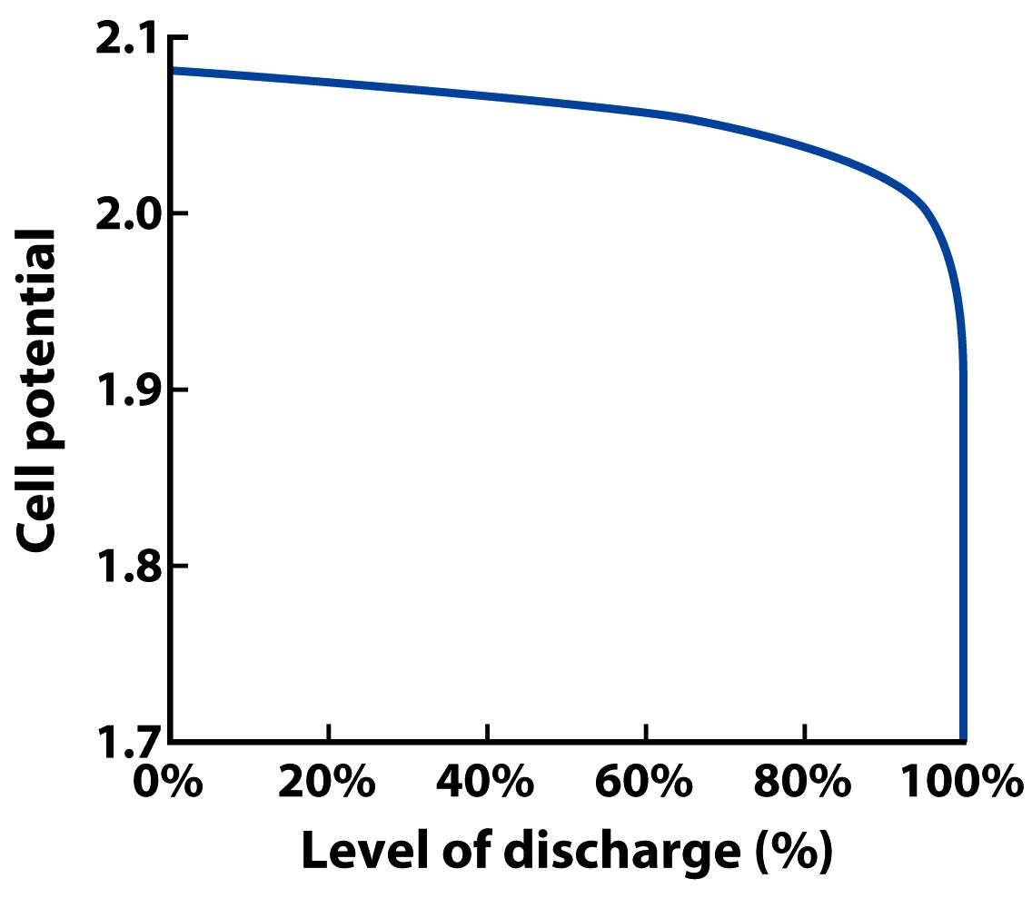
Discharge of a Lead-acid Battery

Slide 34
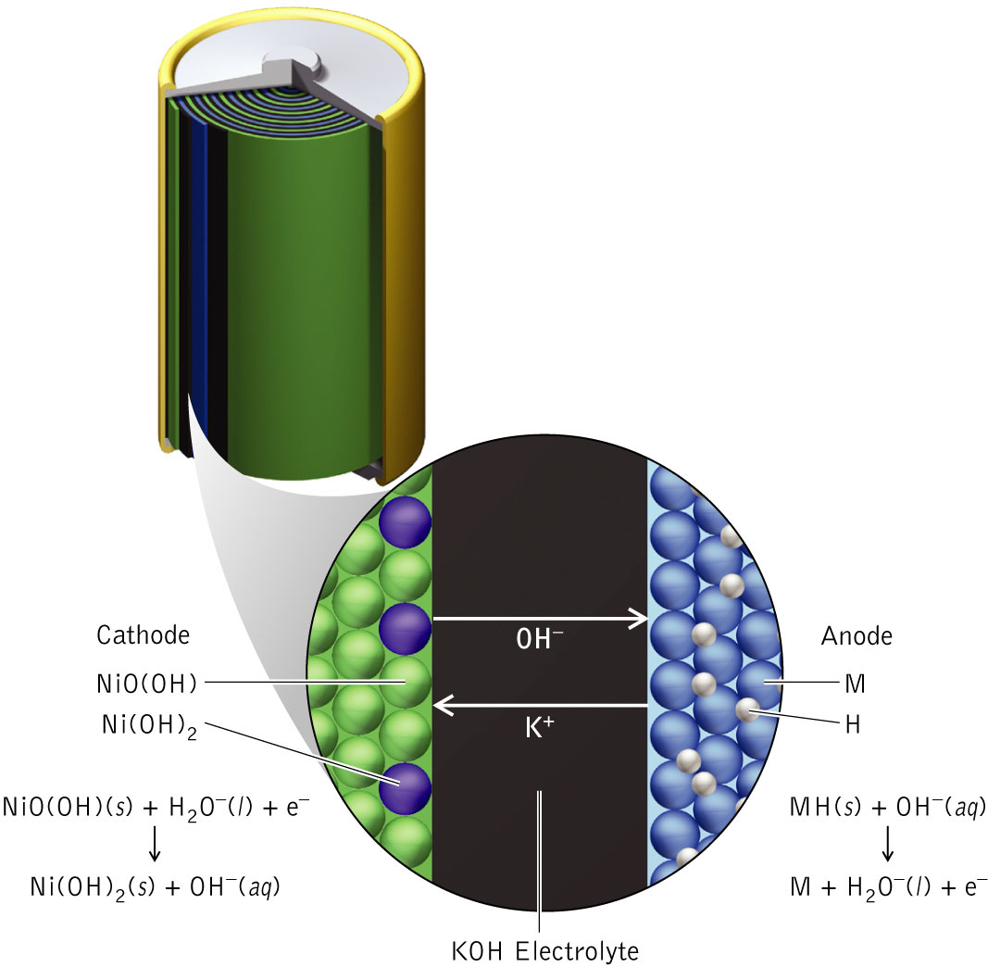
Nickel-metal Hydride Battery

Slide 35
Mercury Button Cell
Notes:
Anode: Zn + 2OH– →ZnO(s) + H₂O(l) + 2e–
HgO(s) + H₂O + 2e– → Hg(l) + 2OH–
Stable voltage (1.3V)
Small w/ large voltage
Also Ag as in,
Cathode: Ag₂O + H₂O_{(l)} + 2e– →2Ag(s) + 2OH–
Ag: cameras, pacemakers, hearing aids
Hg: watched, calculators
Ag more expensive
Hg more toxic

Slide 36
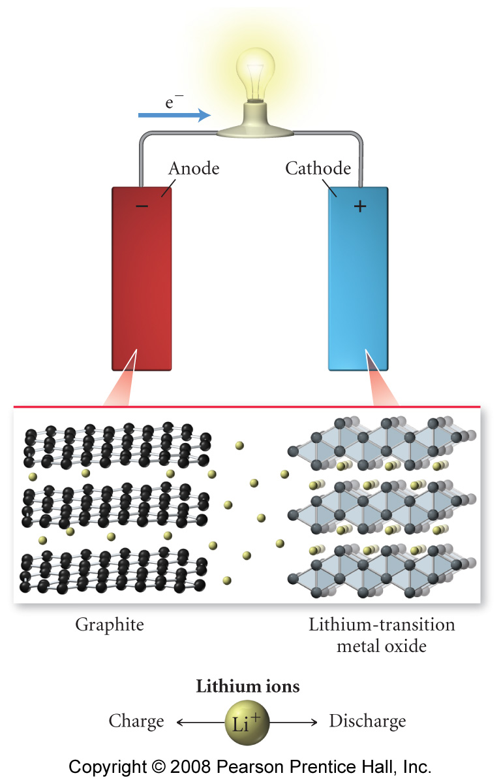
Lithium Ion Battery
electrolyte is concentrated KOH solution
anode = graphite impregnated with Li ions
cathode = Li - transition metal oxide
reduction of transition metal

Slide 37
Lithium-Ion Batteries

Slide 38
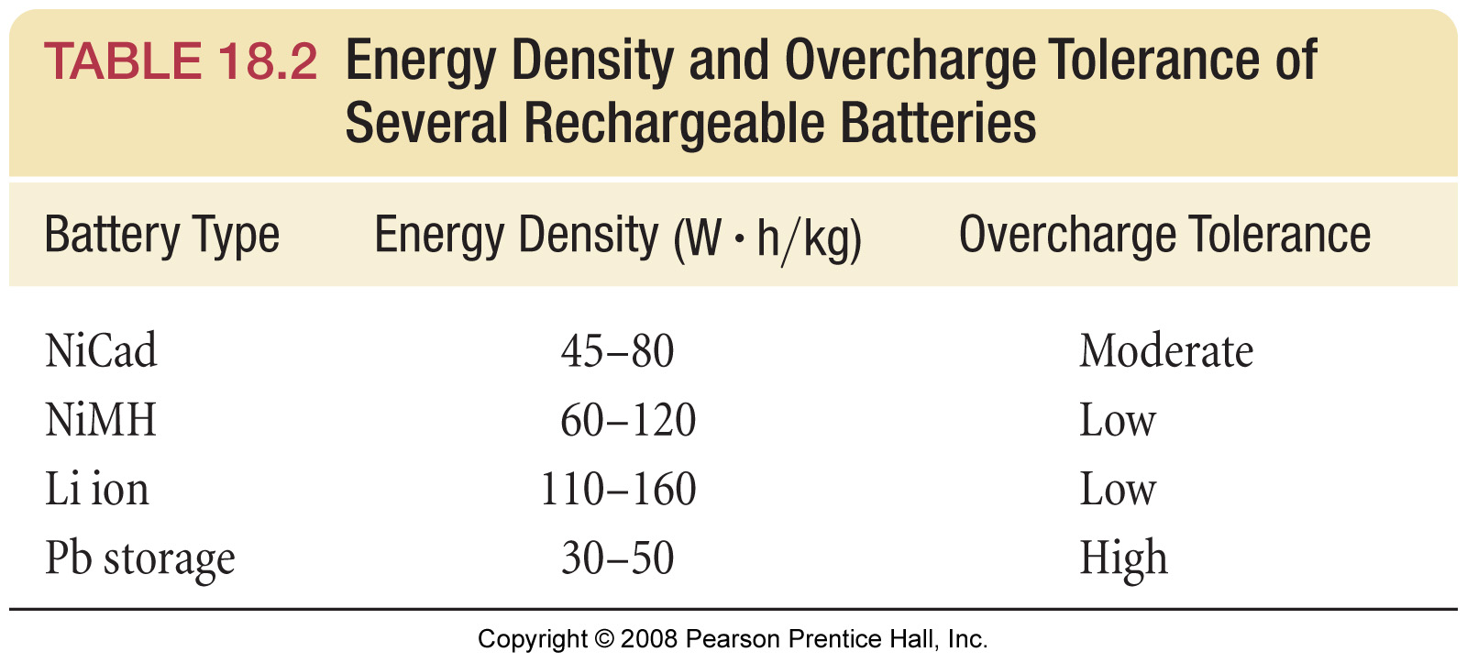

Slide 39
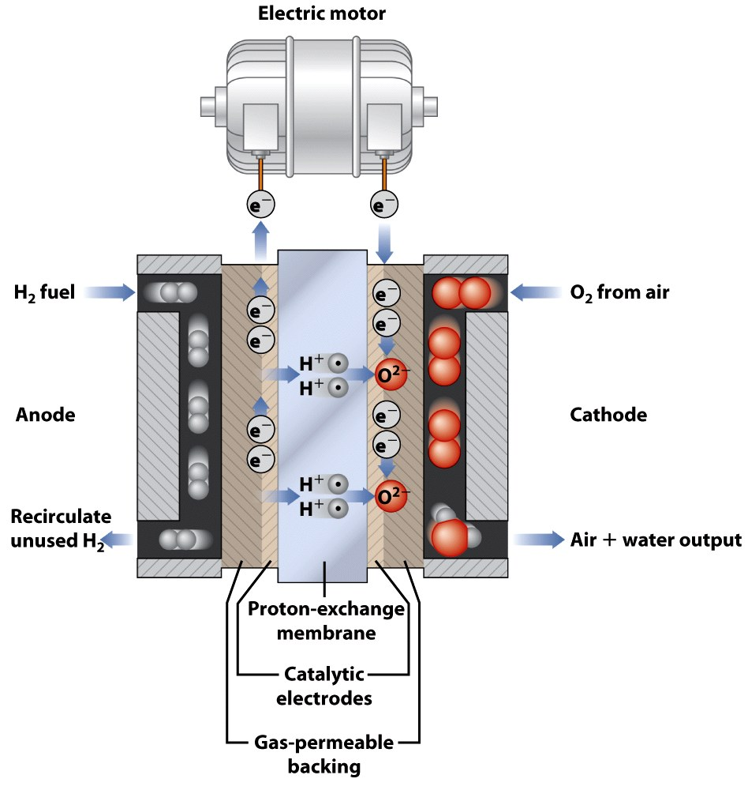
Fuel Cell Example

Slide 40
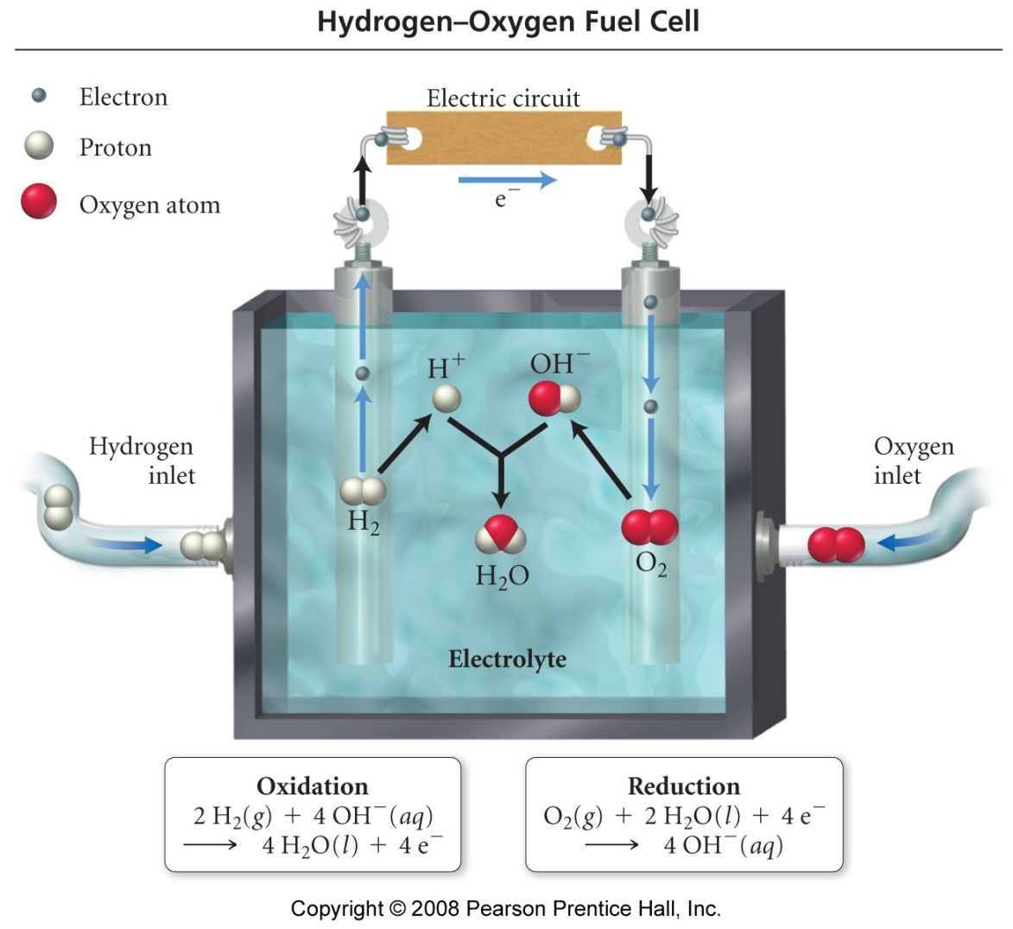
Fuel Cells

Slide 41
Fuel Cell
Notes:
Anode: 2H₂(g) + 4OH– → 4H₂O(l) + 4e–
Cathode: O₂(g) + 2H₂O(l) + 4e– → 4OH–
Reactants must be continuously supplied
Reactants don’t touch
Porous carbon electrodes
Very efficient 75% of bond energy to electricity (power plant 40%)
Most yield no pollutants
Expensive and bulky
Other fuel cells: 2NH₃ + 1/2O₂ → N₂ + 3H₂O
CH₄ + 2O₂ → CO₂ + 2H₂O
N₂H₄ + O₂ → N₂ + 2H₂O

Slide 42
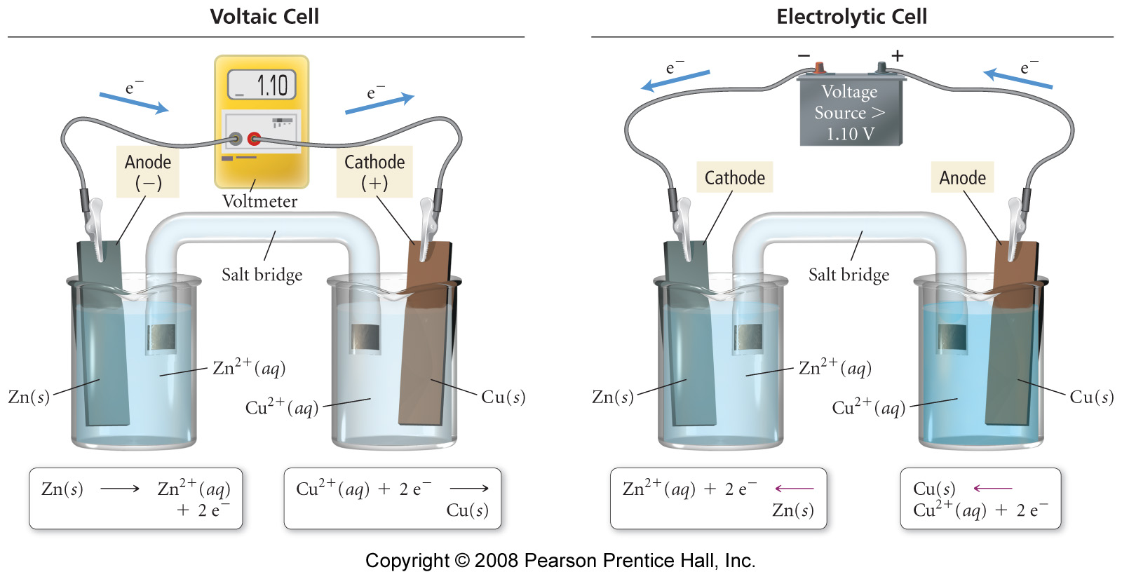

Slide 43
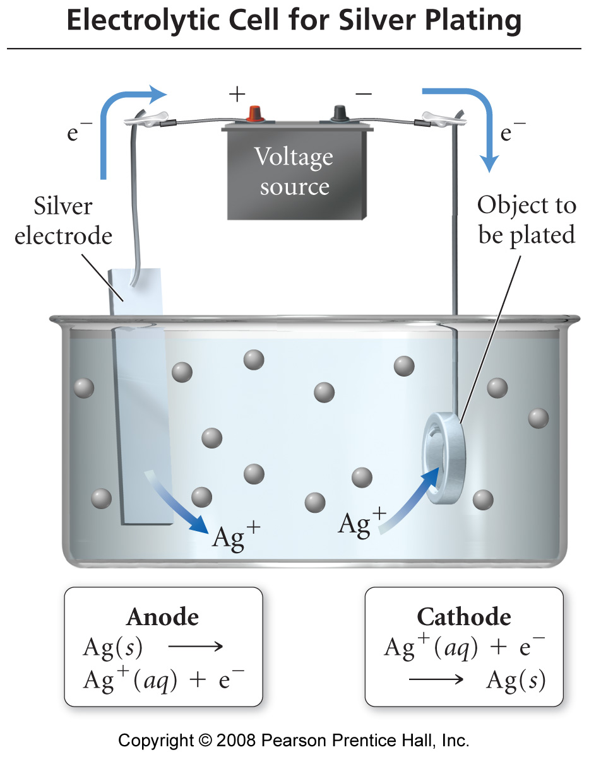
Electroplating

Slide 44
How the Oscar statues platted?
Brittanium, an alloy of tin, copper, and antimony is sequentially electroplated with copper, nickel, silver, and, finally, 24-karat gold.
Notes:
Page: 561
Figure 19-11 Electroplating. An electrolytic cell is used to add a coating of a relatively expensive metal to a less expensive base metal. The base metal for the Oscar statues shown here is brittanium, an alloy (solid solution) of tin, copper, and antimony. They are then sequentially electroplated with copper, nickel, silver, and, finally, 24-karat gold.

Slide 45
Production of Na
Notes:
Downs Cell
Molten mix oc NaCl & CaCl₂ (lowers melting point; 580 vs. 801°C)
Liq Na less dense than molten salt and floats to top where drawn off.
Na and Cl₂ not allowed to contact
Requires 25,000–40,000 A

Slide 46
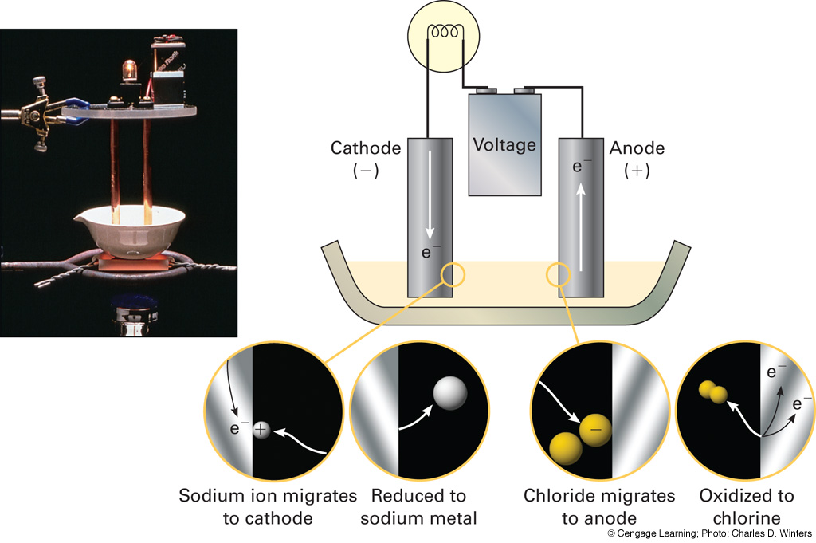
Notes:
Page: 560
Figure 19-10 Electrolysis of sodium chloride. Solid sodium chloride is heated past its melting point. A battery causes a flow of electric current, pumping electrons to the cathode, where sodium ions are reduced to sodium metal. Electrons are pumped from the anode, where chloride ions are oxidized to chlorine gas.

Slide 47
Molten NaCl
Notes:
Overvoltage
If aqueous NaCl then water is reduced as that potential is lower than Na⁺ (–2.71 V –0.83 V)
Likewise Cl is reduced rather than water being oxidized to Cl₂ since water reduction is –1.23 V vs –1.36 V for that of Cl– going to Cl_{2.} Due to overvoltage requirement, the Cl is oxidized rather than water.
When water electolyzes which process occurs at the anode? (2H₂O →O₂ + 4H⁺ + 4e–) Cathode? (4H₂O + 4e– → 2H₂ + 4OH–)

Slide 48
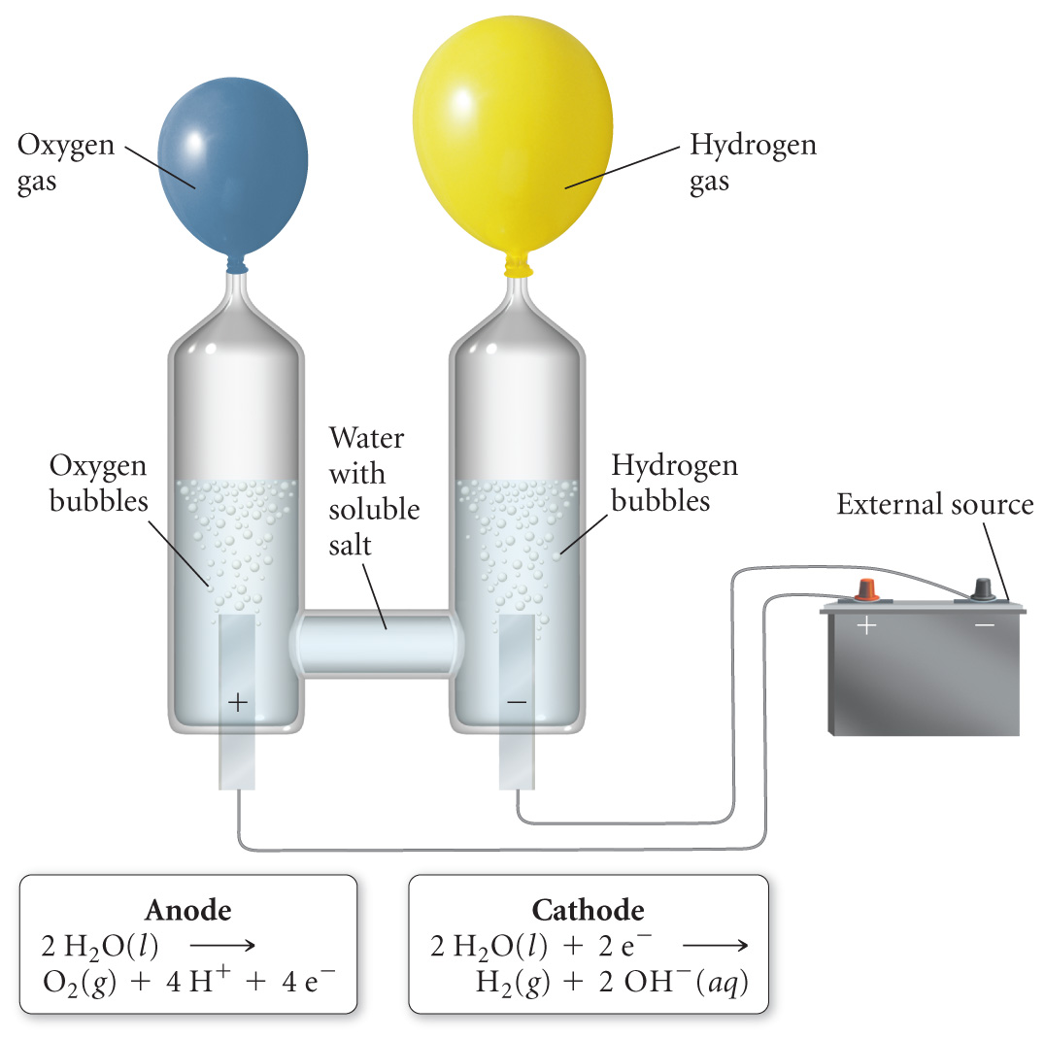
Electrolysis of Water

Slide 49
Production of Cl₂
Notes:
Sat sol’n of NaCl flows into anode compartment where Cl– ox to Cl₂
Water enters cathode compartment where converted to H₂ and OH–
Cation permaeable membrane between compartments allows flow of Na⁺ into cathode compartment

Slide 50
Production of Al
Notes:
1886 Hall & Heroult
electrolysis of molten mix of Al₂O₃ and cryolite (Na₃AlF₆) at 1000°C
Al₂O₃ melts at too high T, and Al³⁺ cannot be reduced due to preference for water.
Electrode reactions are not understood completely
O₂ and Al are produced at carbon anodes. O₂ reacts w/ C to give CO₂, so anodes need to be periodically replaced
5–6 V at 250,000 A. Largest consumer of electricity in US

Slide 51
Electrochemistry Example – Electrolytic Cell
How much copper can plate out when 10.0 amps (1 A = 1 C/s) of current is used over a 30.0 minute period through a solution of 1.00 M cupric ions (cupric sulfate solution) with a power source greater than 1.10 V?
Cu _{(s)} + Zn²⁺ _{(aq)} → Zn _{(s)} + Cu²⁺ _{(aq)}

Slide 52
Electrolytic Cells
Notes:
Run galvanic cell in reverse
Many industrial applications

Slide 53
Electrorefining
Notes:
At impure Cu anode, Cu is oxidized with more easily oxidized impurities (Ag, Au, Pt)
Anode mud
At cathode Cu²⁺ reduced to Cu while less easily reduced ions (Zn², Fe²⁺) remain in sol’n
99.95% pure
Electroplating
Anodizing

Slide 54
Electrochemistry Example – Electrolysis of Ions
If a solution contains Cu²⁺, Ag⁺, and Zn²⁺ and the voltage starts out low and is gradually turned up in which order will the metals plate? Given:
Ag⁺ _{(aq)} + e⁻ → Ag _{(s)} E˚ = 0.80 V
Cu²⁺ _{(aq)} + 2 e⁻ → Cu _{(s)} E˚ = 0.34 V
Zn²⁺ _{(aq)} + 2 e⁻ → Zn _{(s)} E˚ = -0.76 V

Slide 55
Electrochemistry Example – Electrolysis of Ions
To electrodeposit all of the Cu and Cd from a solution of CuSO₄ and CdSO₄ required 1.20 F of electricity (1 F = 1 mol e⁻). The mixture of Cu and Cd that was deposited had a mass of 50.36 g. What mass of CdSO₄ was present in the original mixture?

Slide 56
What causes corrosion?
Notes:
~25% of steel produced for replacement
Rusting causes pitting, but at different location from deposition of rust
Inhomogeneous surface: impurities, mechanical stree, phase boundaries
Fe(s) → Fe²⁺ + 2e– E° = 0.45 V
O₂(g) + 4H⁺ + 4e– → 2H₂O(l) E° = 1.23 V
Actual voltage less because not at std cond. for oxygen reaction. H⁺ not at 1M.
When Fe²⁺ contact O₂ at the surface of droplet
4Fe²⁺ + O₂ + 4H⁺ → 4Fe³⁺ + 2H₂O(l)
2Fe³⁺ + 4H₂O(l) → Fe₂O₃ • H₂O(l) + 6H⁺
Salt on roads accelerate process due to increasing conductivity of water
O₂ / H₂O half-reaction lies above M^{n+} / M half-reaction for nearly all metals
O₂ can oxidize all metals except for Au, Pt
What about Al E° = –1.66 V?

Slide 57
How can rust be prevented?
Notes:
Galvanizing
Fe²⁺ + 2e– →Fe(s) E° = –0.45 V
Zn²⁺ + 2e– → Zn(s) E° = –0.76 V
Cathodic protection
Sacrificial anode
Mg(s) → Mg²⁺ + 2e– E° = 2.37 V
O₂(g) + 4H⁺ + 4e– → 2H₂O(l) E° = 1.23 V
Often used in maritime applications and pipelines.

Slide 58
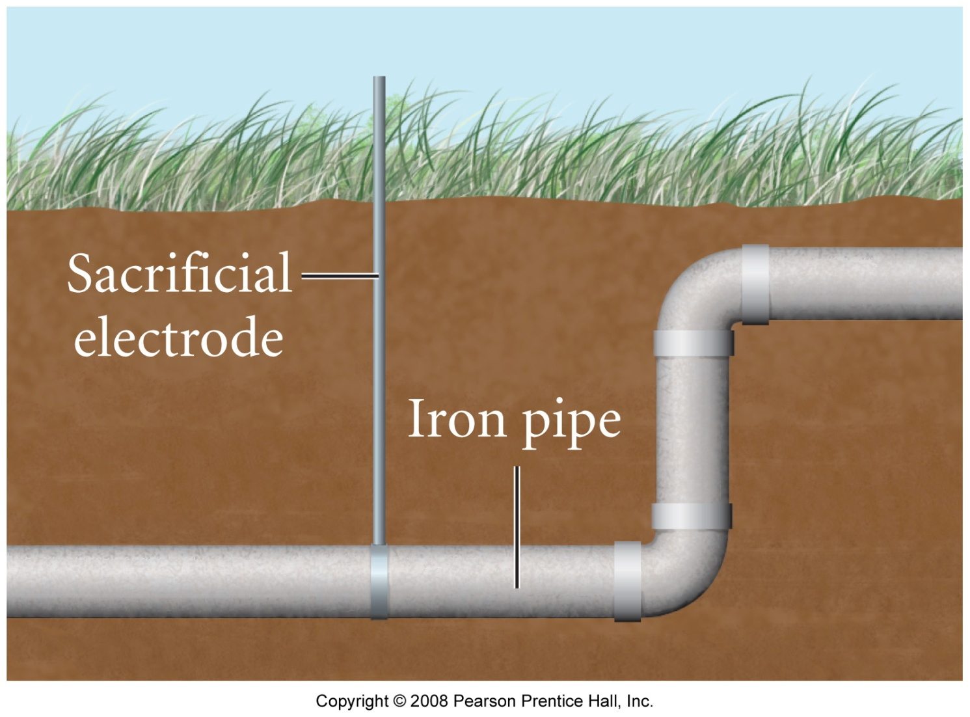
What is a sacrificial anode?

