Slide 1
Chemistry 142 Chapter 20: Radioactivity and Nuclear Chemistry
Outline
Types of Radiation
Nuclear Equations
Radioactive Decay
Applications of Radioactivity

Slide 2
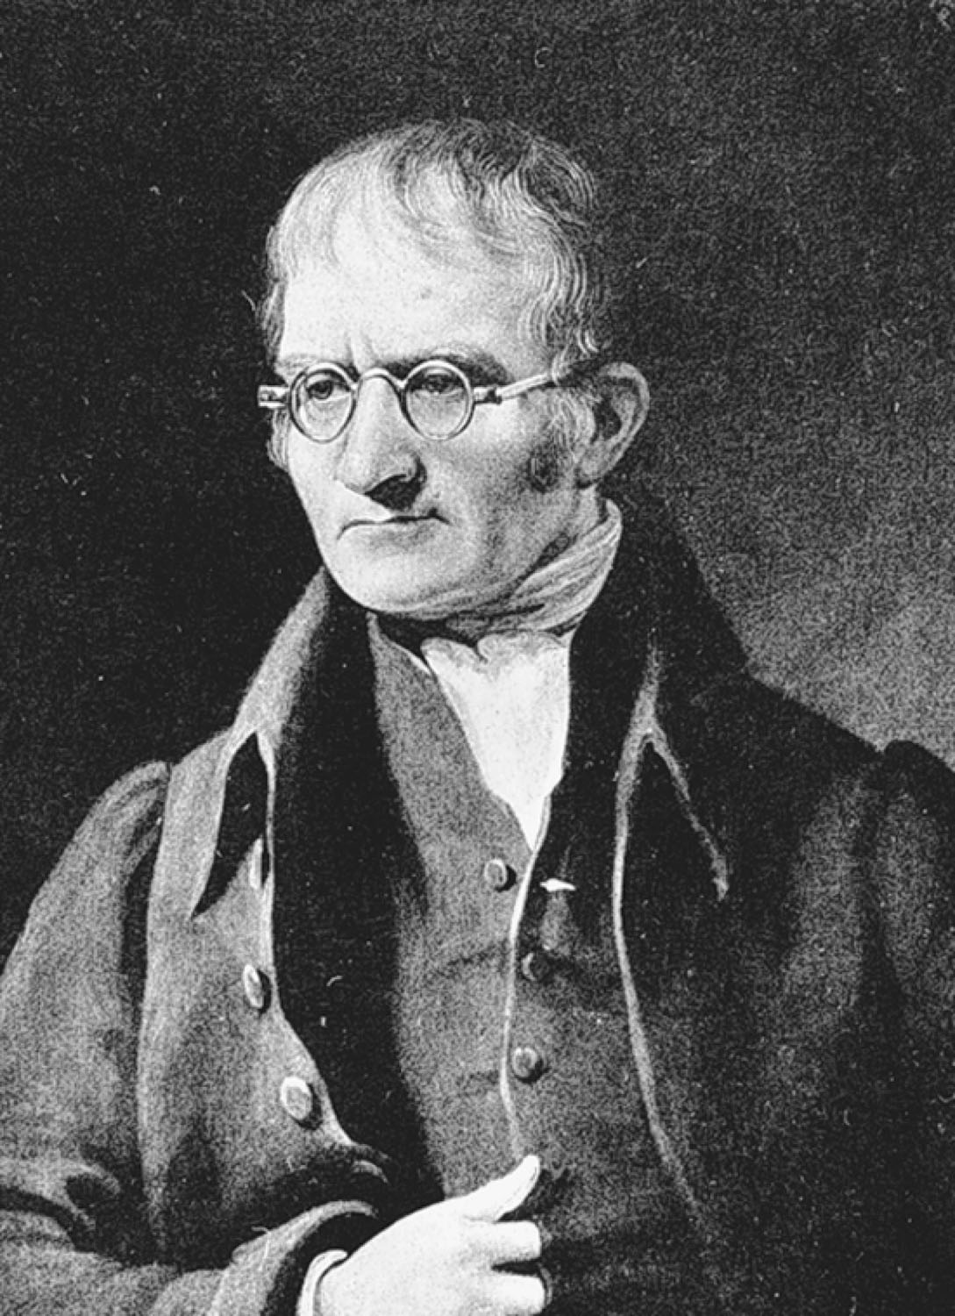
What was John Dalton’s Atomic Theory?
p124
Notes:
John Dalton (1766–1844) devised the atomic theory while trying to formulate a hypothesis to explain the Law of Multiple Proportions

Slide 3
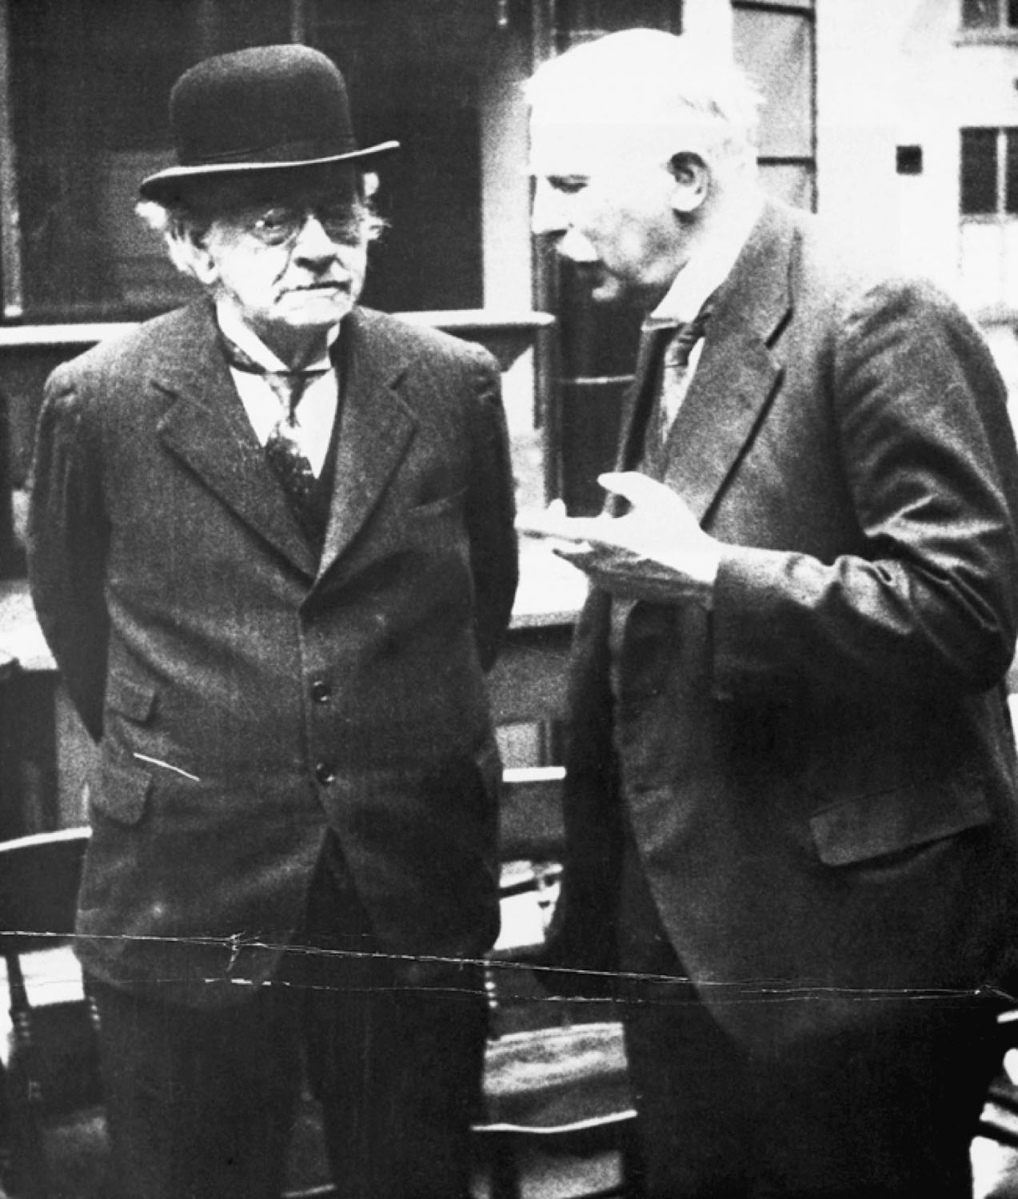
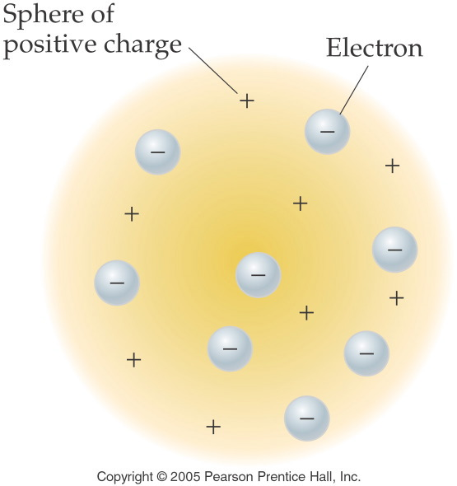
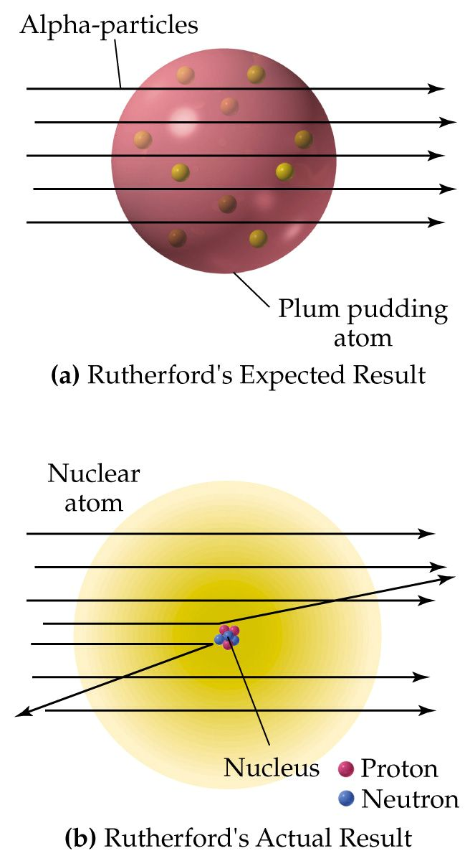
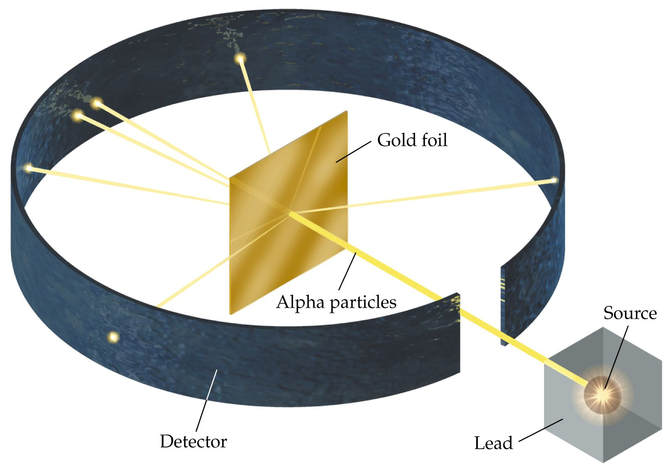
What did J. J. Thomson and Ernest Rutherford contribute to our understanding of the structure of the atom?
p126
Notes:
J. J. Thomson (1856–1940) (left) dis-covered the electron, and Ernest Rutherford (1871–1937) (right) dis-covered the proton

Slide 4
What do we know about atoms so far?
Table 5-1 p126

Slide 5
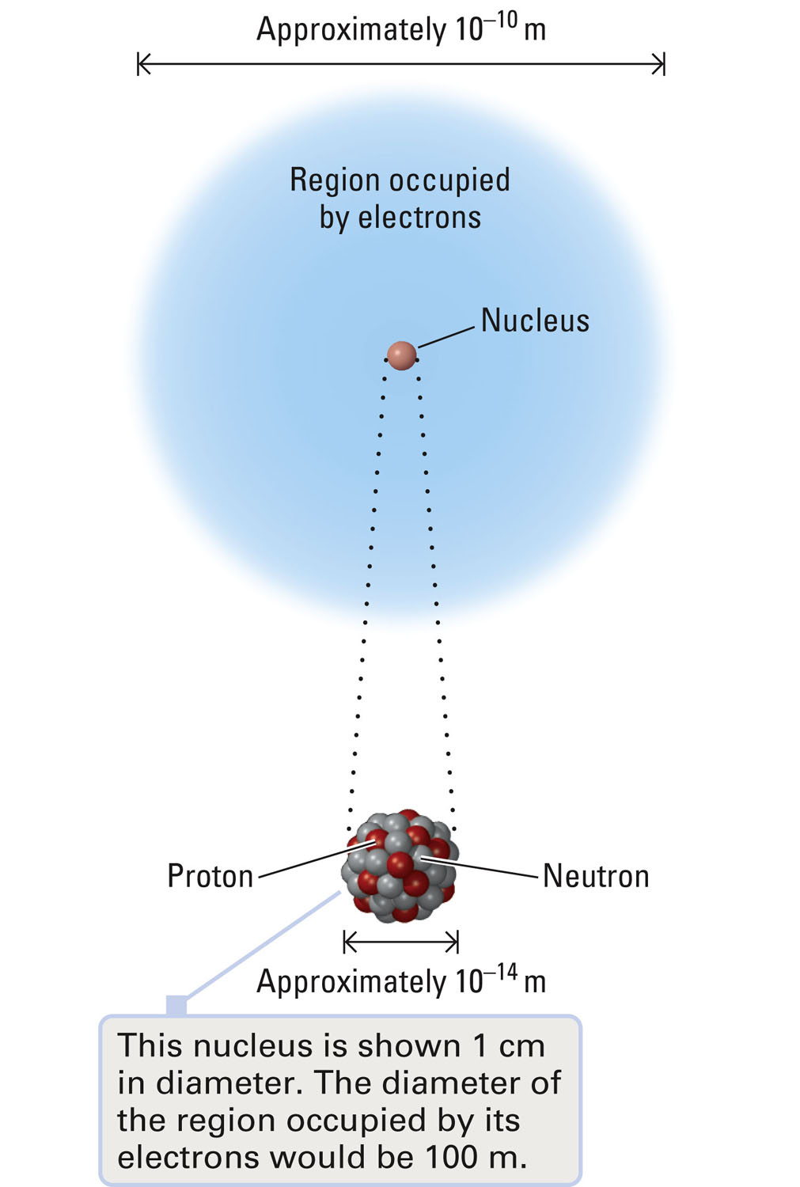
What is the size of an atom versus a nucleus?
Figure 5-4 p127
Notes:
Figure 5.4 Relative sizes of an atom and its nucleus. The diameter of an atom is approximately 10,000 times the diameter of its nucleus.

Slide 6
Atomic Number = Z = number of protons in an atom. = number of electrons in a neutral atom. Mass Number = number protons + number neutrons in an atom
How do we keep track of the subatomic particles?

Slide 7
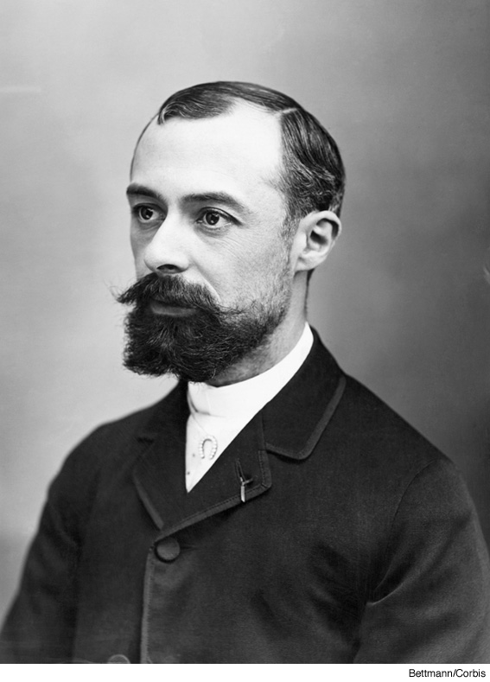
Henri Becquerel

Slide 8
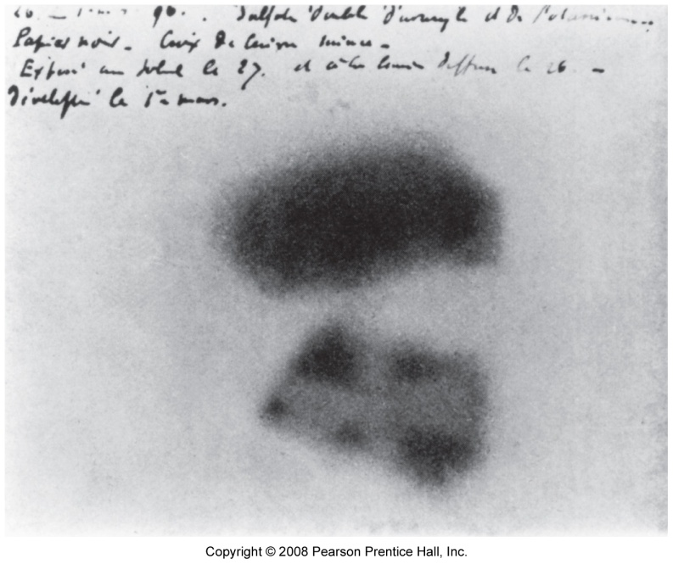
How do uranic rays leave an image?

Slide 9
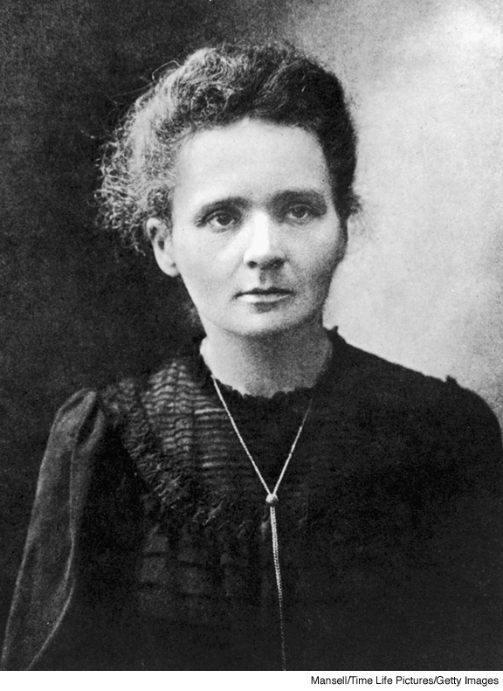
Marie Curie
Notes:
Page: 594
Figure 20-16 Marie Curie (1867–1934), who was awarded the 1903 Nobel Prize in Physics (with husband Pierre and Henri Becquerel) for the discovery of radioactivity and the 1911 Nobel Prize in Chemistry for the isolation of pure radium. She was the mother of Irene and Eve (Irene Curie-Joliot shared with her husband, Frederic, the 1935 Nobel Prize in Chemistry). Marie Curie was the first woman to teach at the Sorbonne (1906) and the first woman to be appointed as a full professor at the Sorbonne (1908).

Slide 10
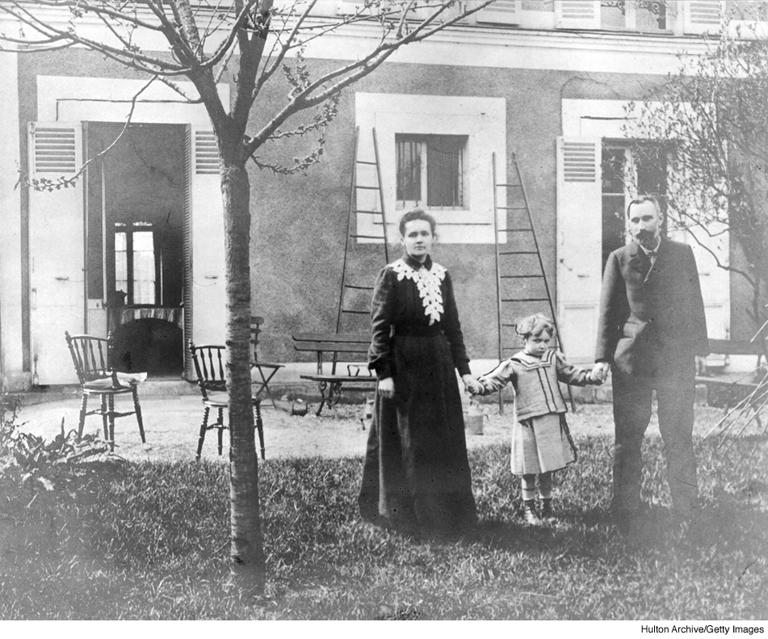
Marie, Irene, and Pierre Curie

Slide 11
What are the types of radiation and their penetrating abilities?
α
γ
β
0.01 mm 1 mm 100 mm
Pieces of Lead
Notes:
Alpha Particle – Identical to He nucleus. Contain 2 protons and 2 neutrons. Travels at 10% of the speed of light. Stopped by paper and clothing.
Beta Particle – Identical to an electron. Travels at approximately 90% of the speed of light. Stopped by aluminum foil, several cm of wood, or ~1 cm of flesh.
Gamma Ray – Similar to X-rays, but more powerful. Travels at the speed of light. Can be stopped by 10 cm of lead or 30 cm of concrete.
Positron Particle – This particle is similar to a beta particle, it is positively charged.

Slide 12
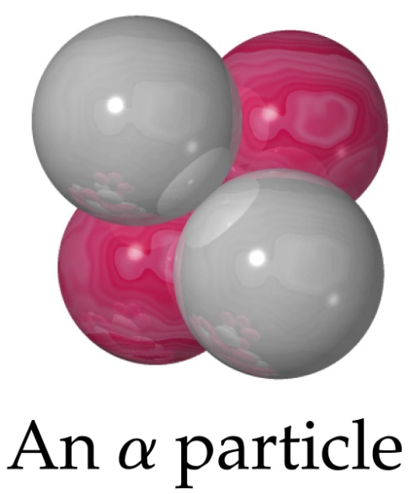
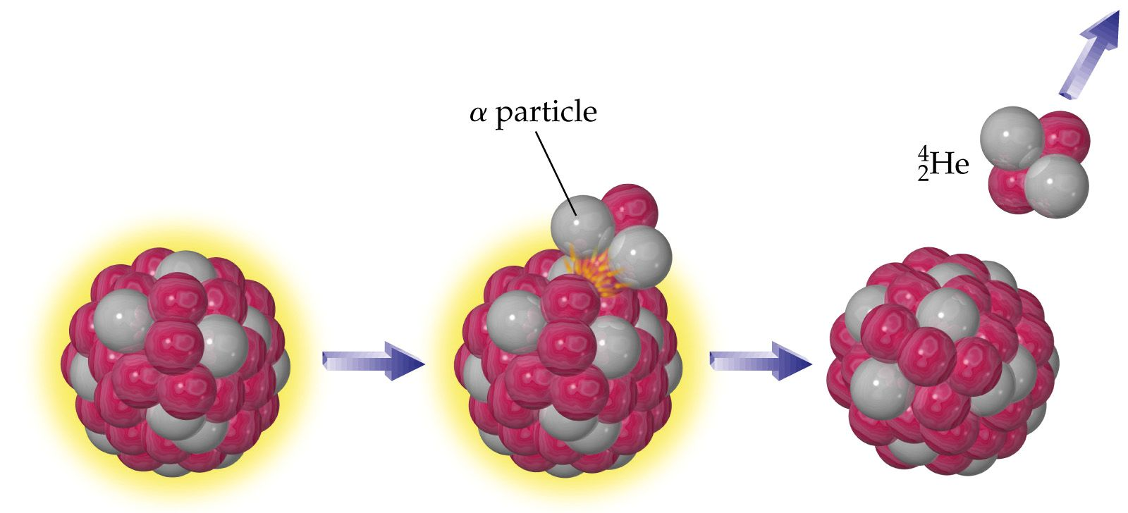
What are the types of radioactive decay?
alpha particle emission

Slide 13
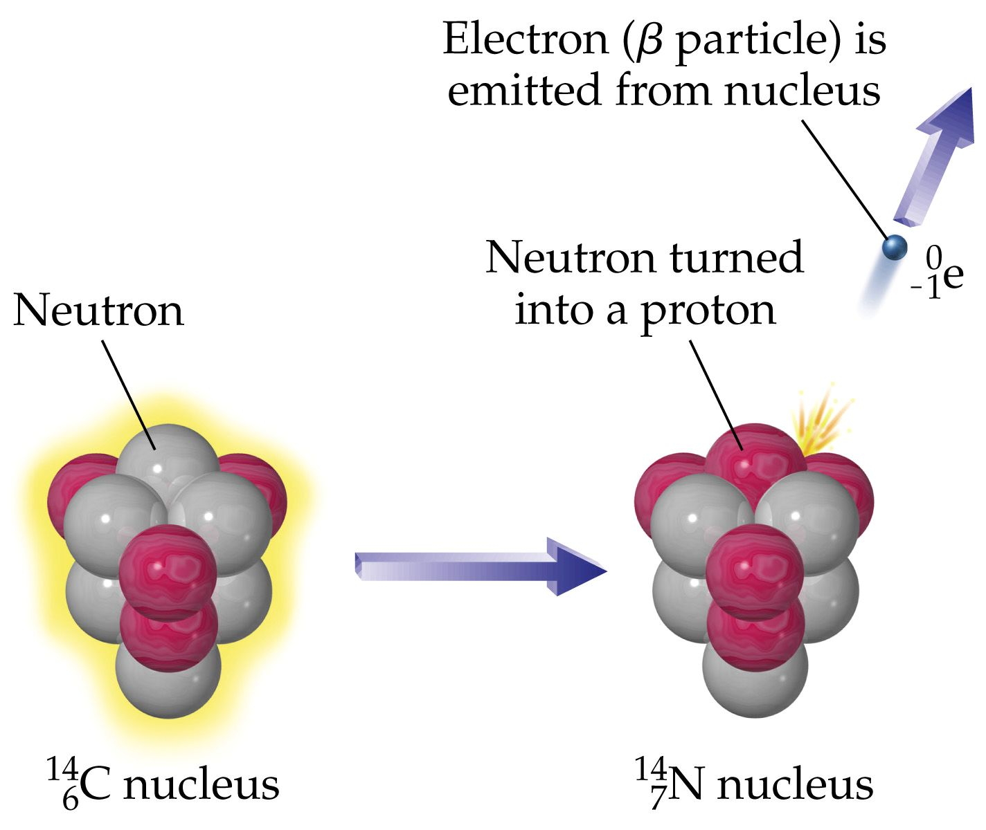
What are the types of radioactive decay?
beta emission

Slide 14
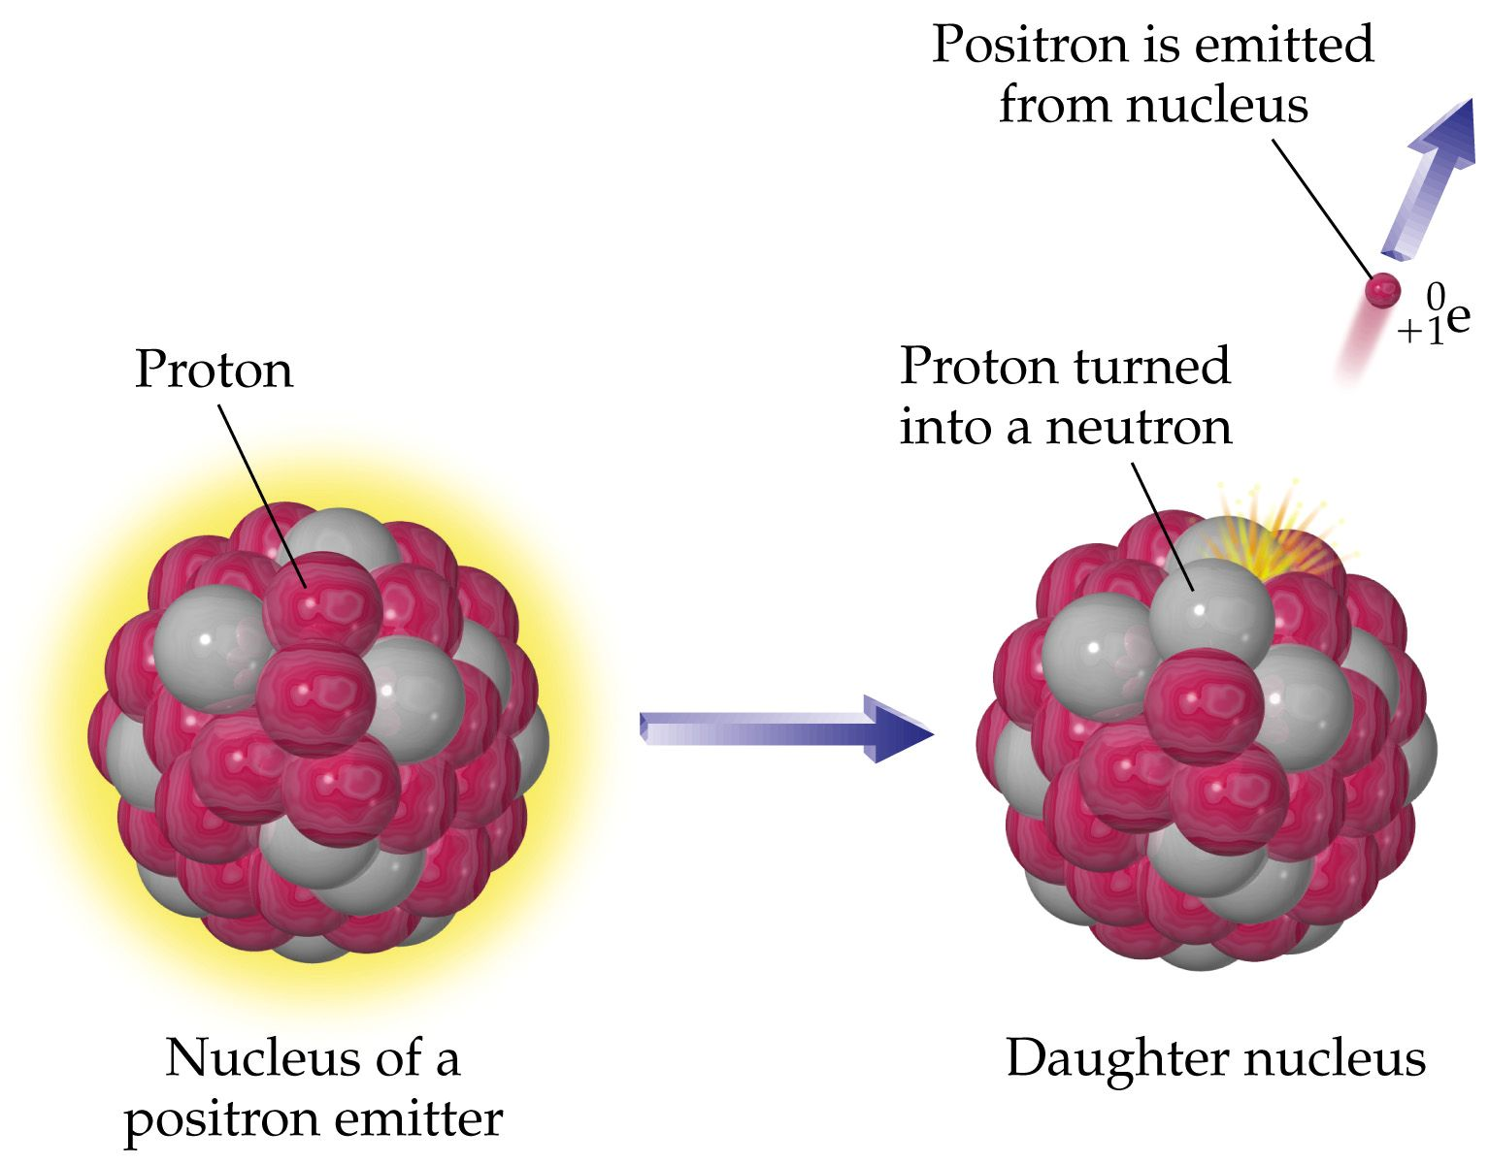
What are the types of radioactive decay?
positron emission

Slide 15
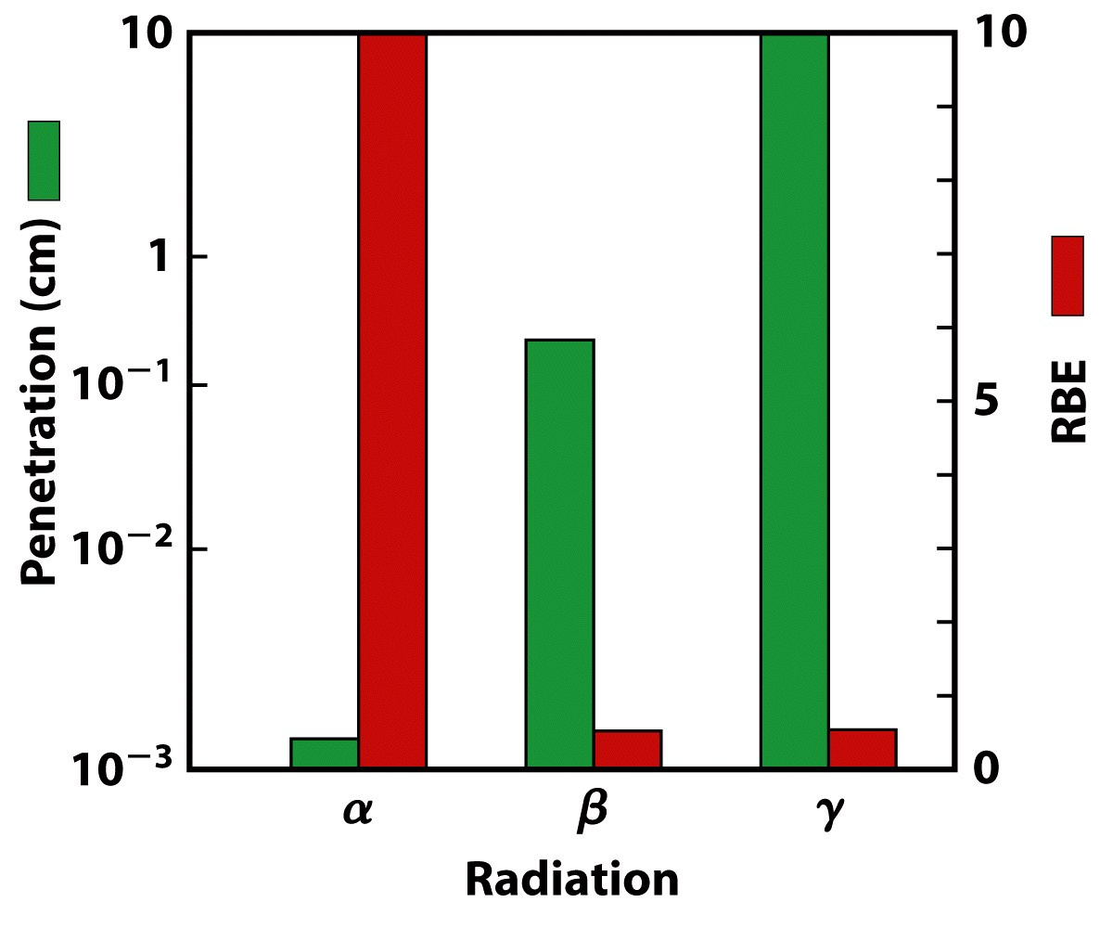
Biological Effect of Radiation

Slide 16
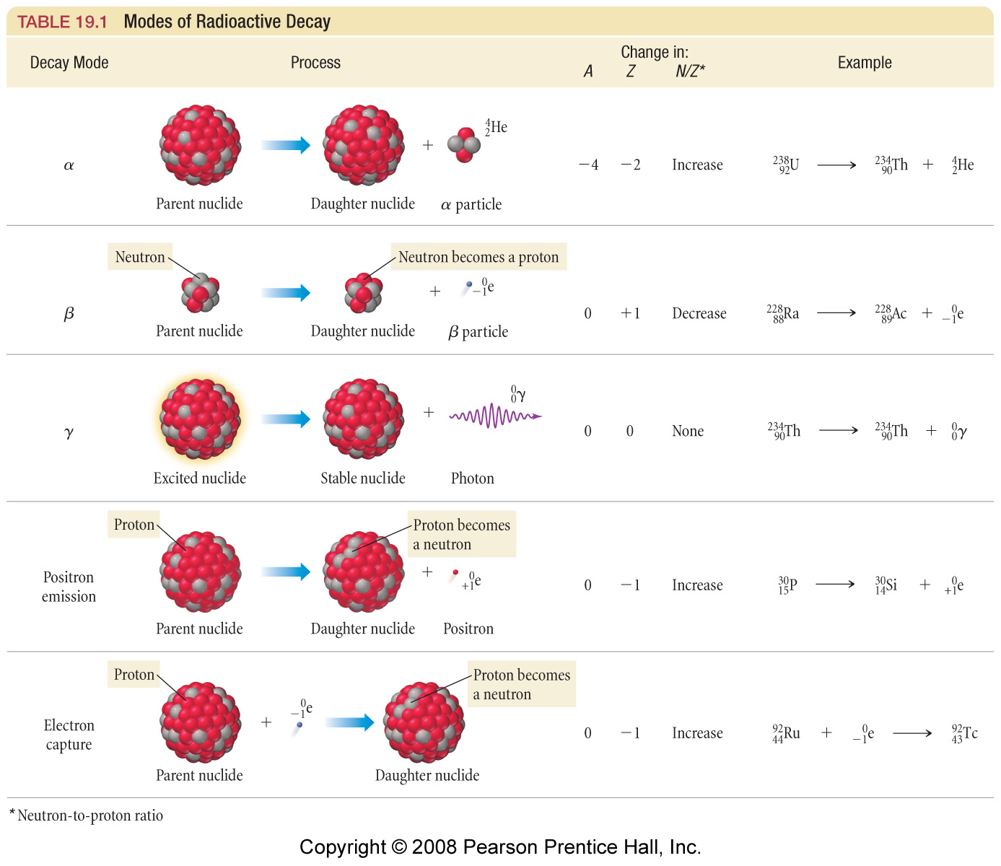

Slide 17
Notes:
α particle decomposition results in a reduction of the mass number by 4 and the atomic number is reduced by 2
β particle decomposition results in an increase in the atomic number and no change in the mass number.
γ rays do not result in any mass changes in the nucleus. They often, however, are accompanied by other forms of nuclear decomposition.
β + (positron) particle decomposition does not result in any mass number change, but the atomic number is decreased by one.

Slide 18
23.1

Slide 19
What causes a nuclide to be stable?
Notes:
Stability means measurable half-life
Nonradioactive = indefinitely stable
When 3000 known are plotted, fall within “band”
Within “band” all but 264 disintegrate spontaneously
Every element has at least 1 radioactive isotope
H is only element whose most abundant isotope contains more protons than neutrons
Ratio of neutrons to protons gradually increases for elements heavier than Ca (curved band)
All isotopes heavier than Bi-209 are radioactive
Of 264 nonradioactive 207 have even number of neutrons. Most have even protons & neutrons (156), 51 have an even number of neutrons but odd number of protons, and only 4 have odd both protons & neutrons

Slide 20
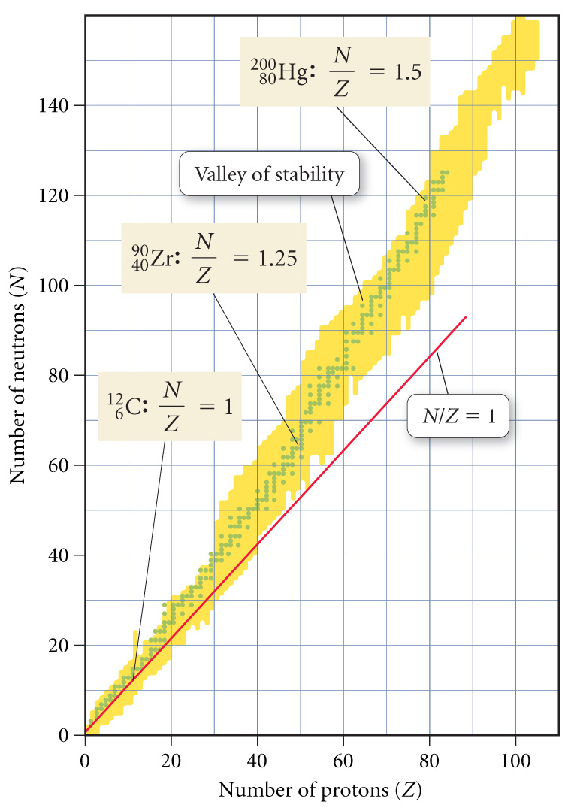
Valley of Stability
for Z = 1 ⇒ 20,
stable N/Z ≈ 1
for Z = 20 ⇒ 40,
stable N/Z approaches 1.25
for Z = 40 ⇒ 80,
stable N/Z approaches 1.5
for Z > 83,
there are no stable nuclei

Slide 21
Notes:
Neutrons are nuclear “glue”. The more protons the more neutrons required
Analogous to octet rule
Radioactive nuclei with higher n / p ratios tend to emit beta particles, while nuclei with lower p / n tend toward positron, EC or alpha emission.

Slide 22
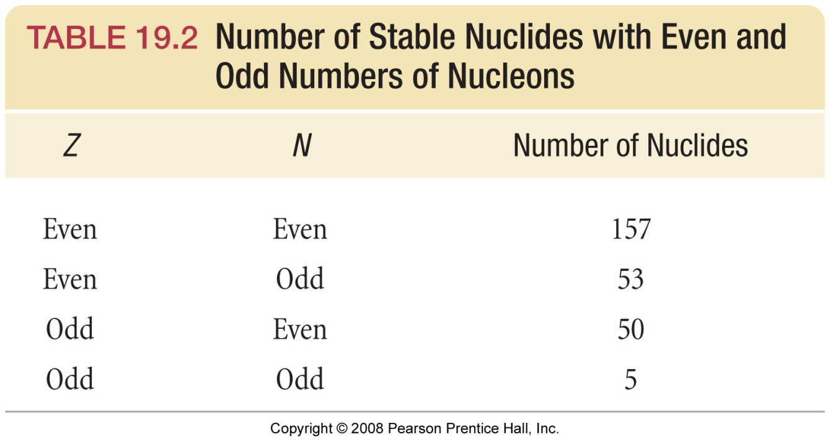

Slide 23
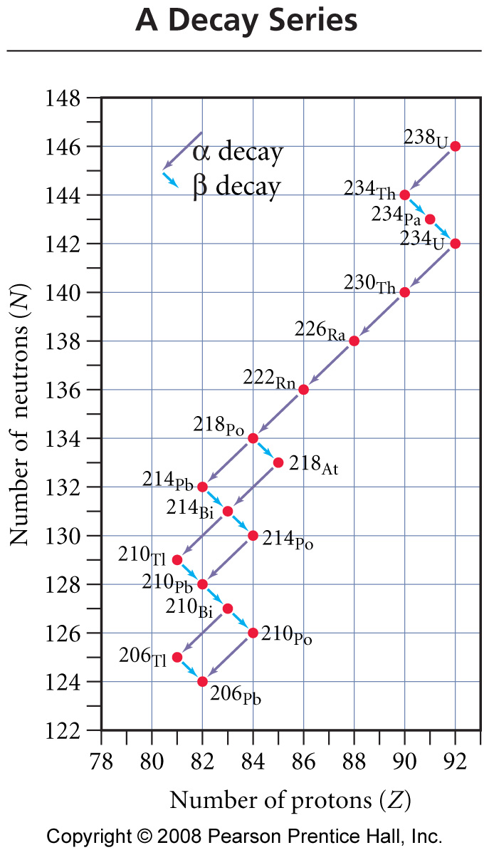
U-238 Decay Series
α
β
β
α
α
α
α
β
α
β
α
β
β
α
or
α
β
α
β
β
α
β
or other combinations

Slide 24
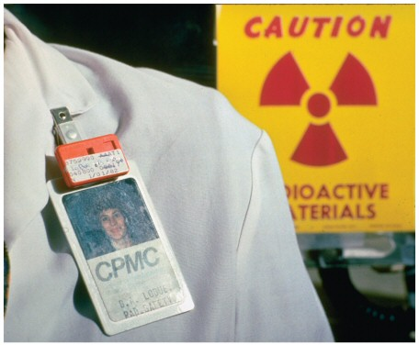
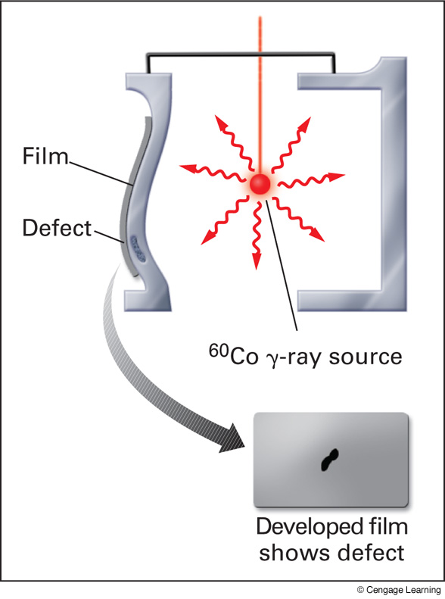
What methods can be used to detect radioactivity? Film Badge Electroscope
+++
+++
Notes:
When charged, the metal foils spread apart due to like charge repulsion
When exposed to ionizing radiation, the radiation knocks electrons off the air molecules, which jump onto the foils and discharge them, causing them to drop down.

Slide 25
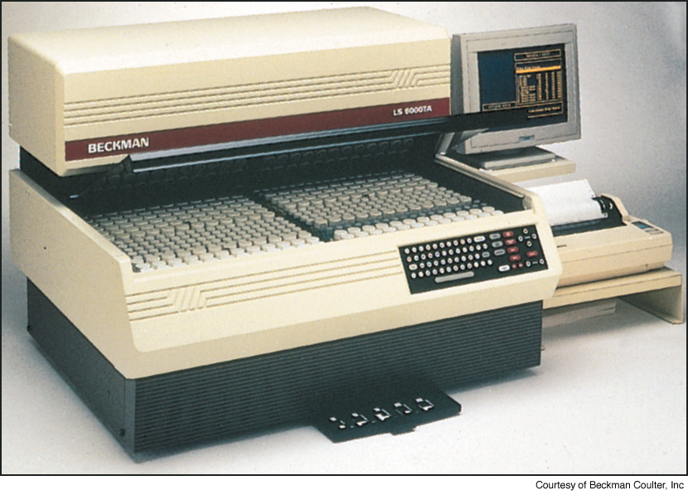
Scintillation Counter
Notes:
Page: 585
Figure 20-6 Scintillation counter. This instrument is especially useful for detecting gamma radiation because it uses a high-density transparent solid, in contrast with the low-density gas in a Geiger counter. Radiation interacts with the solid, resulting in flashes of light, which are counted by a detector.

Slide 26
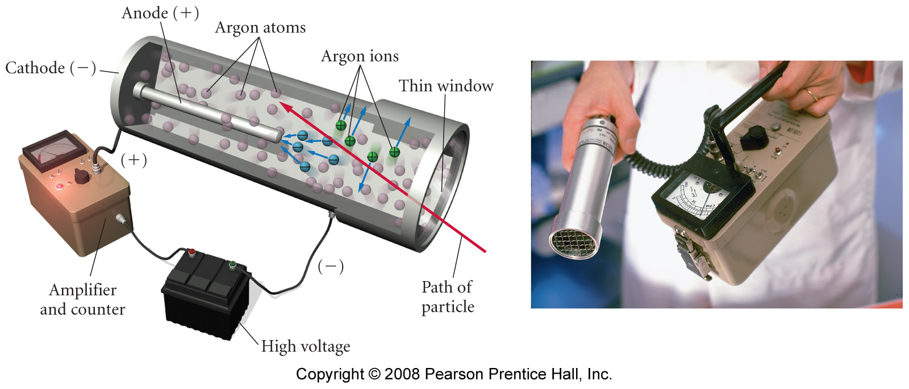
What methods can be used to detect radioactivity? Geiger-Müller Counter (Geiger Counter)

Slide 27
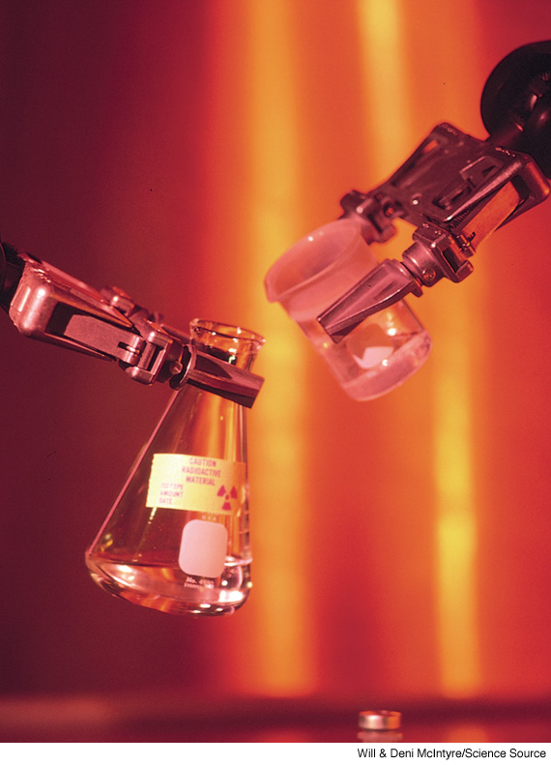
Why are robotic arms used to work with radioactive samples?
Notes:
Page: 606a
Remotely operated robotic arms are used to maneuver dangerously radioactive samples.

Slide 28
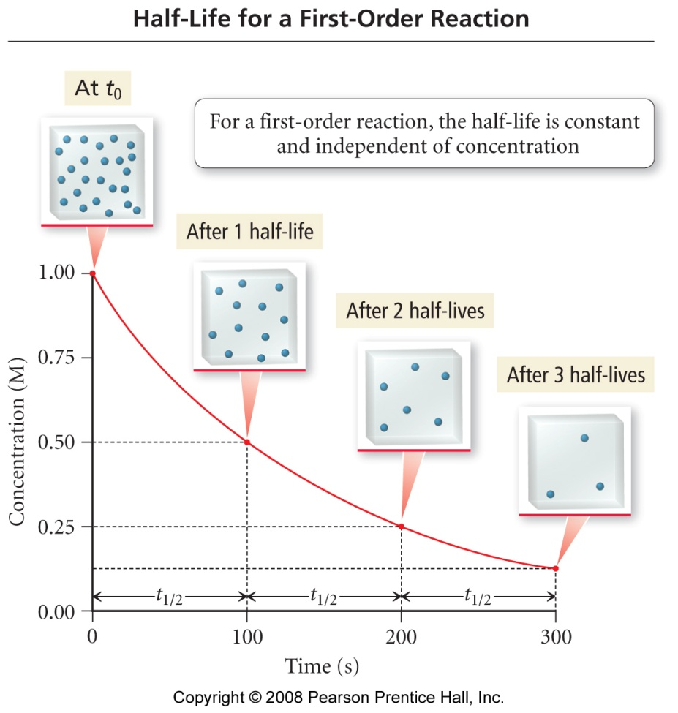
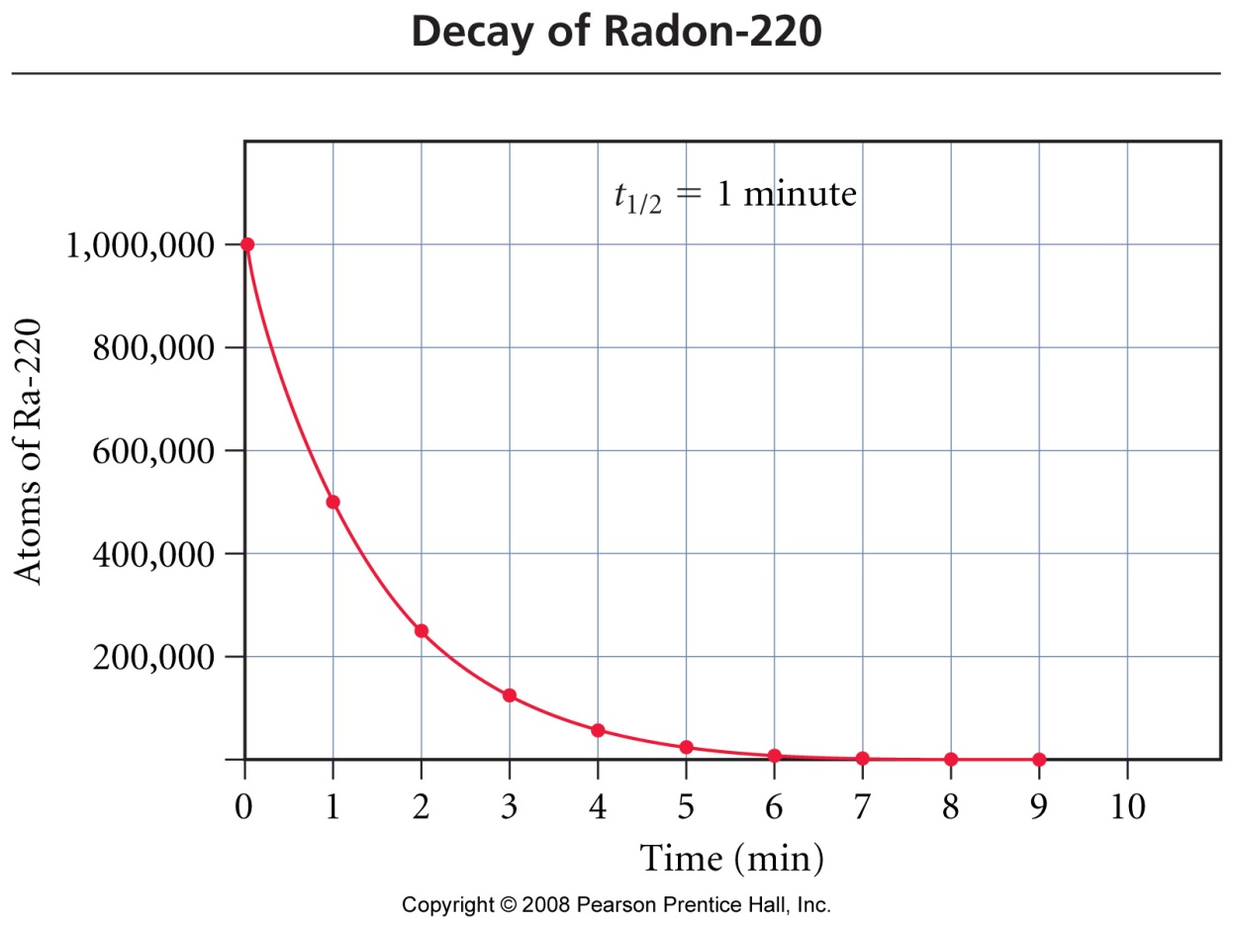
Is the half-life of a first-order reaction constant?

Slide 29
Nuclear Chemistry Example – Half-Life
Technetium-99m is used to form pictures of internal organs in the body; Particularly to assess heart damage. The rate constant, k, for Tc-99m is 1.16 x 10⁻¹ hr⁻¹, what is the half-life?

Slide 30
Nuclear Chemistry Example – Half-Life
The half-life of molybdenum-99 is 67.0 hours. How much of a 1.000 mg sample of Mo-99 is left after 335 hours?

Slide 31
Nuclear Chemistry Example – Half-Life
Sodium-24 decays by positron emission, has a half-life of 60 hours, and an atomic mass of 23.9909633 amu. Suppose that a patient is injected with 80. mg of sodium-24 to measure their sodium electrolyte balance.
How much remains after 75 hours?
How many positron emissions occur in 75 hours?
What dose of radiation (in Ci) is the person exposed to?

Slide 32
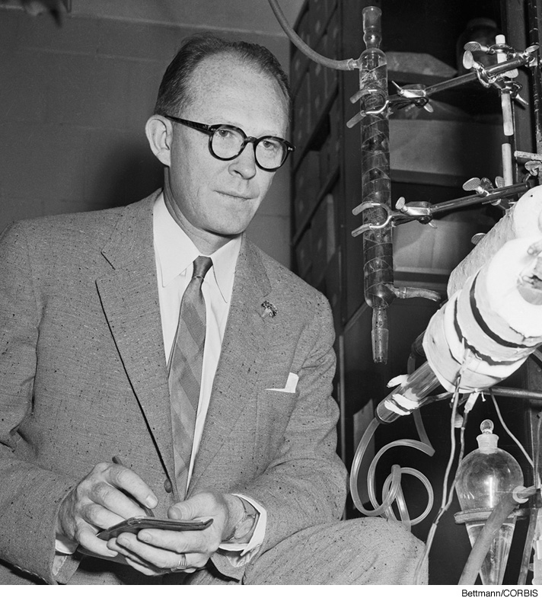
Willard Libby
Notes:
Page: 590
Figure 20-12 Willard Libby (1908–1980) was awarded the 1960 Nobel Prize in Chemistry for leading the team of scientists that developed radiocarbon dating.

Slide 33
Radiocarbon Dating of Artifacts

Slide 34
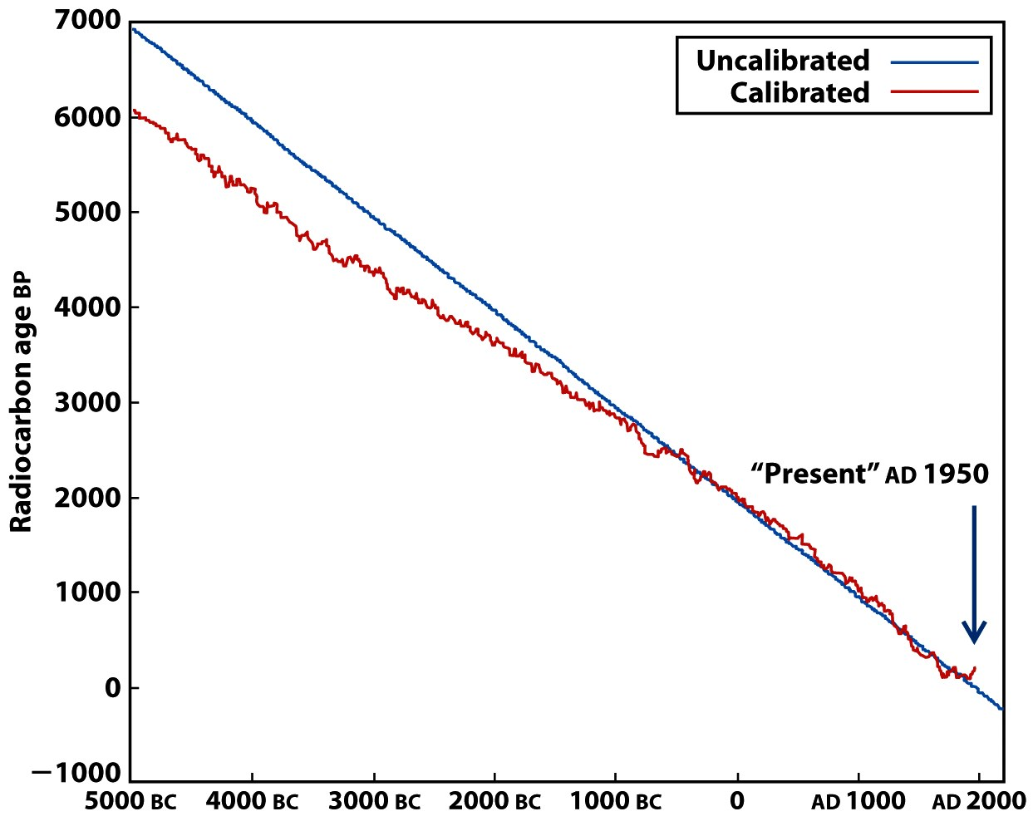
Calibration Curves for Radiocarbon Dating

Slide 35
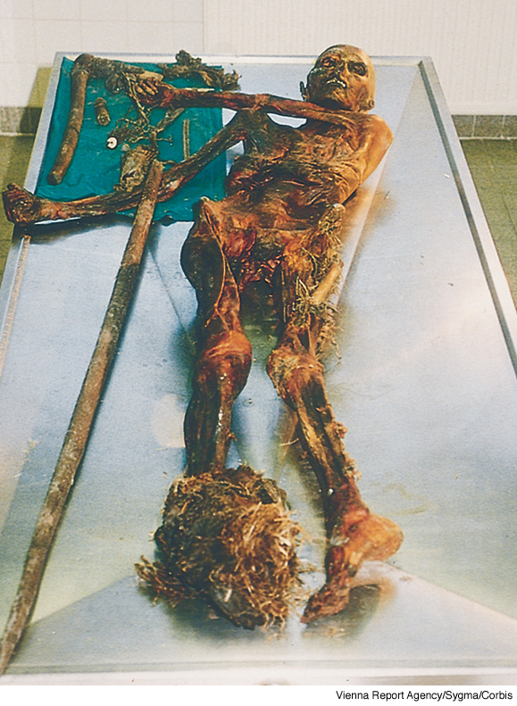
Ötzi the Iceman. He was found in a glacier in the Tyrolean Alps near the Austrian/ Italian border in 1991. He is believed to have lived in about 3300 BCE. He was so well preserved that scientists were able to examine the contents of his digestive system, finding that he was an omnivore.
Notes:
Page: 591
Figure 20-13 Ötzi the Iceman. He was found in a glacier in the Tyrolean Alps near the Austrian/ Italian border in 1991. He is believed to have lived in about 3300 BCE. He was so well preserved that scientists were able to examine the contents of his digestive system, finding that he was an omnivore.

Slide 36
Nuclear Chemistry Example – Radioactive Dating
The remnants of an ancient fire in a cave in Africa showed a carbon-14 decay rate of 3.1 counts per minutes per gram of carbon. Assuming that the decay rate of carbon-14 in freshly cut wood is 13.6 counts per minutes per gram of carbon, calculate the age of the remnants (t_{1/2} C-14 is 5730 years).

Slide 37
Nuclear Chemistry Example – Radioactive Dating
A rock containing uranium-238 and lead-206 was examined to determine its approximate age. Analysis showed the ratio of lead-206 atoms to uranium-238 atoms to be 0.115. Assuming no lead was originally present, that all the lead-206 formed over the years has remained in the rock and that the number of nuclides in intermediate stages of decay between uranium-238 and lead-206 is negligible, calculate the age of the rock
(t_{1/2} U-238 is 4.5 x 10⁹ years).

Slide 38
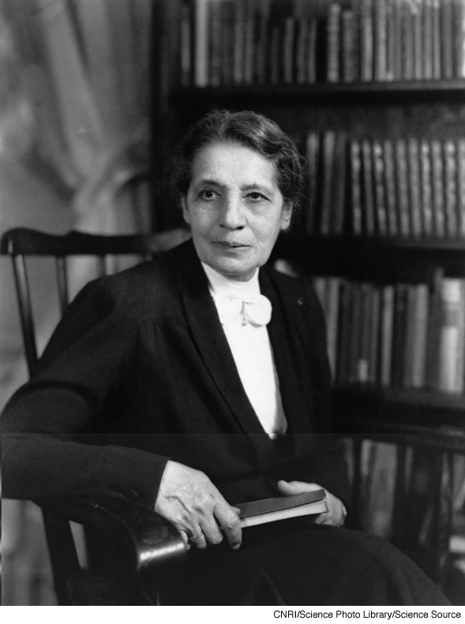
Lise Meitner
Notes:
Page: 599
Figure 20-23 Thyroid gland imaging. (a) A healthy thyroid gland, located in the lower neck, is shaped like a bow tie. This image was produced by injecting the patient with a solution containing technetium-99m and scanning the neck with a gamma camera. (b) Hyperthyroidism, an overactive thyroid gland, is a common disease that has many causes. It can be treated with drugs, radioactive iodine treatment, or surgery.

Slide 39
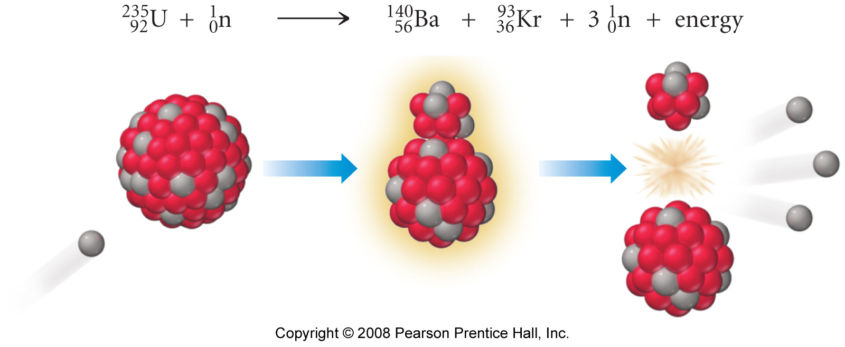
What is fission?

Slide 40
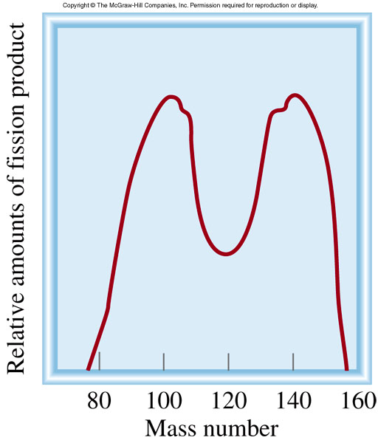
Nuclear Fission
Representative fission reaction
²³⁵U + ¹n ⁹⁰Sr + ¹⁴³Xe + 3¹n + Energy
92
0
38
54
0
23.5

Slide 41
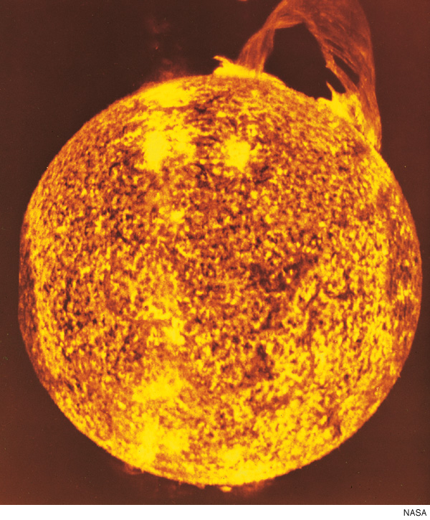
What is nuclear fusion?
Notes:
Page: 603
Figure 20-30 The sun. The fundamental energy source of the sun is a series of reactions that can be summarized as the conversion of hydrogen into helium.

Slide 42
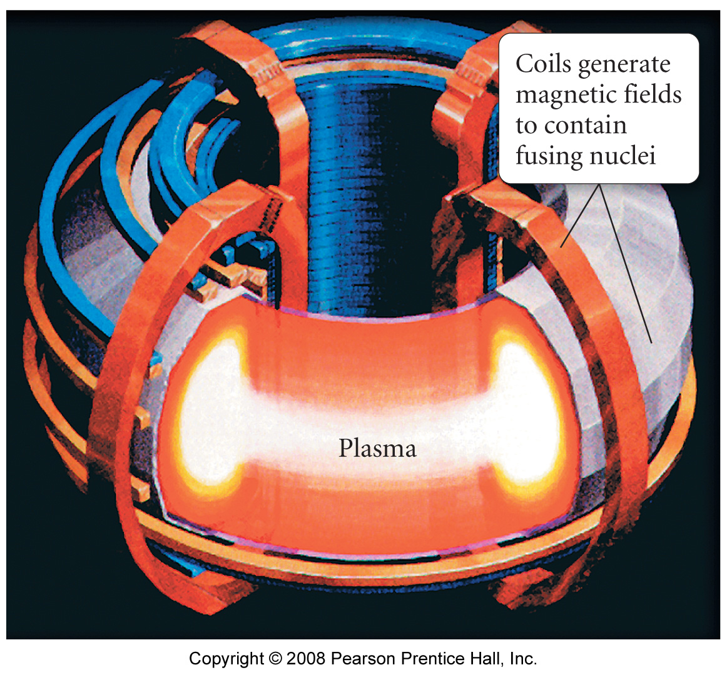
Tokamak Fusion Reactor

Slide 43
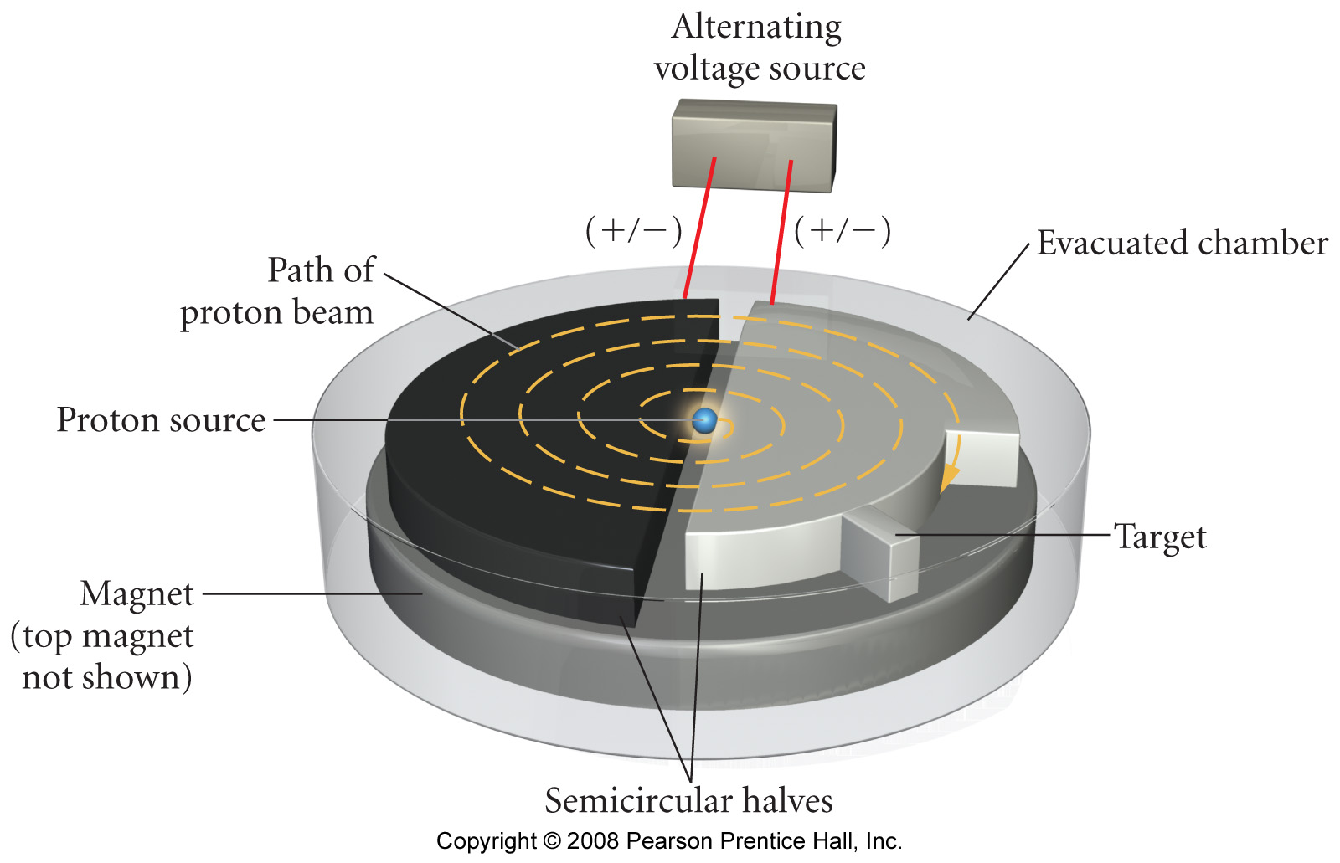
Cyclotron

Slide 44
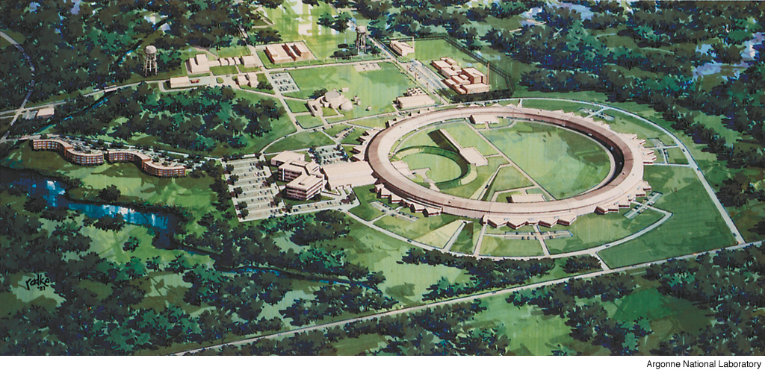
Particle Accelerator at Argonne National Laboratory near Chicago
Notes:
Page: 596
Figure 20-18 Particle accelerator at Argonne National Laboratory near Chicago. The outer ring, which is nearly the combined length of four football fields in diameter, houses experiments for as many as 300 scientists at one time.

Slide 45
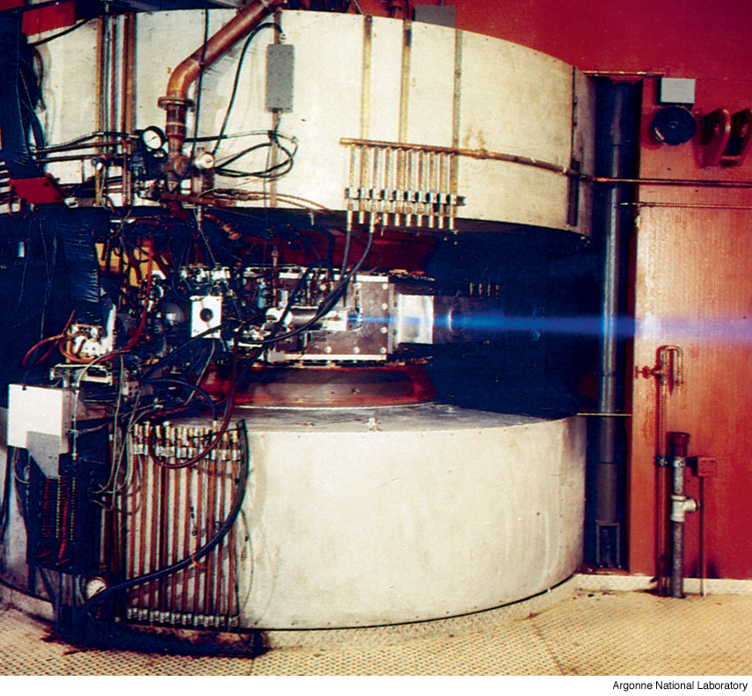
Where is the beam of protons?
Notes:
Page: 606b
A cyclotron is a particle accelerator in which particles travel in a nearly circular path. The cyclotron shown is emitting a proton beam.

Slide 46
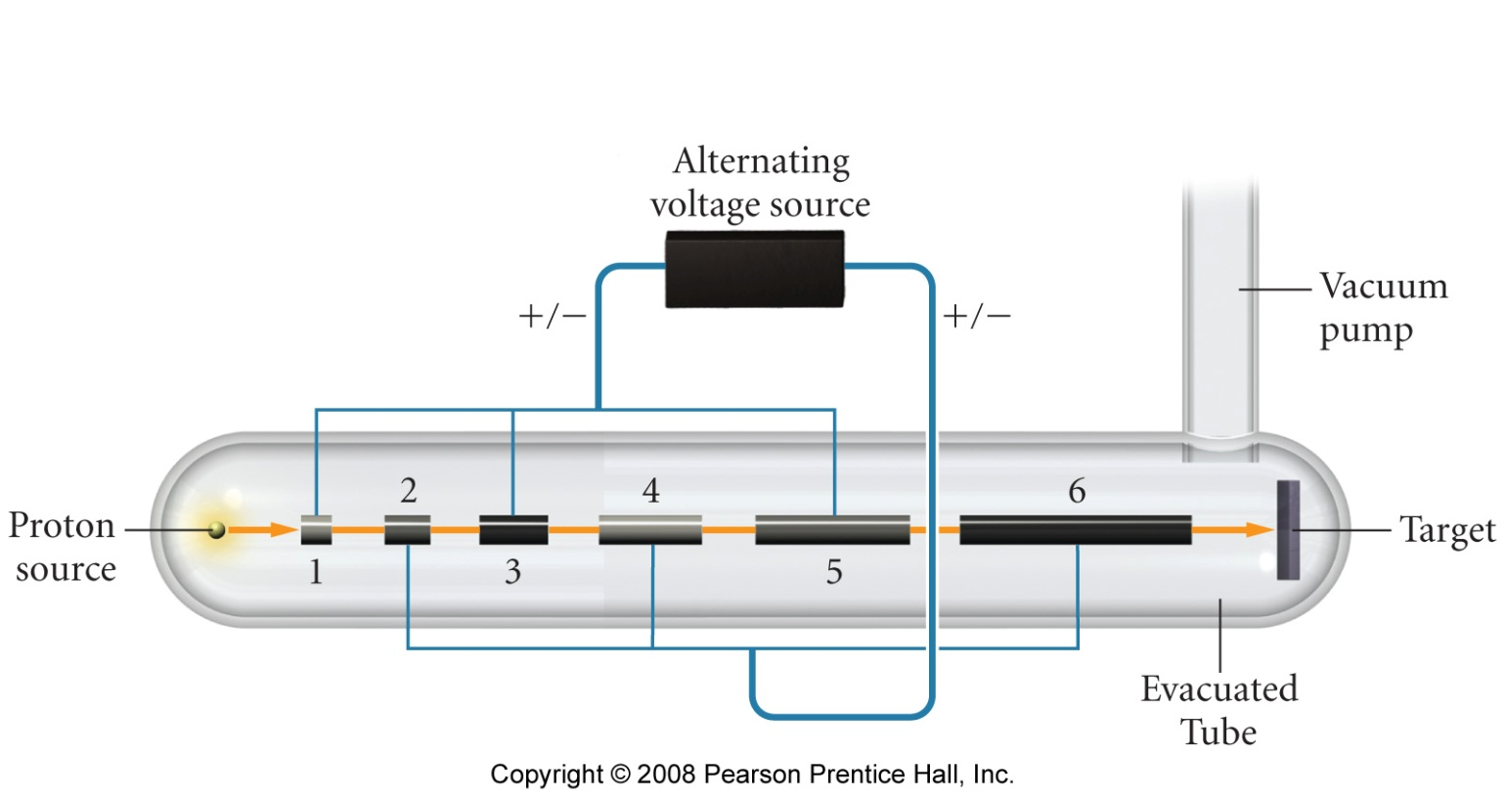
Linear Accelerator

Slide 47
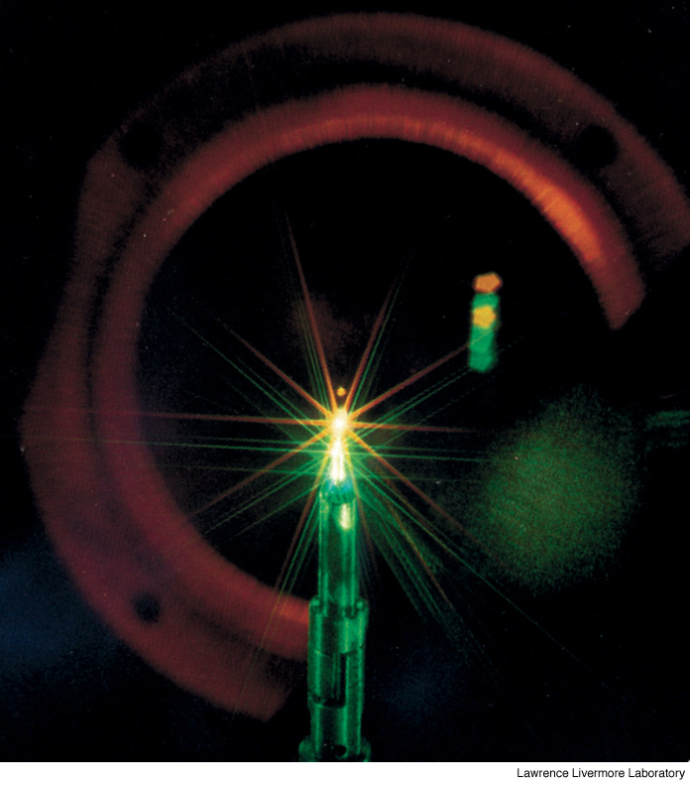
Small-scale fusion reaction: hydrogen-2 and hydrogen-3 in a 1 mm capsule
Notes:
Page: 606b
Small-scale fusion reactions are possible with today’s technology. The photo shows the reaction of hydrogen-2 and hydrogen-3 in a 1-mm capsule.

Slide 48
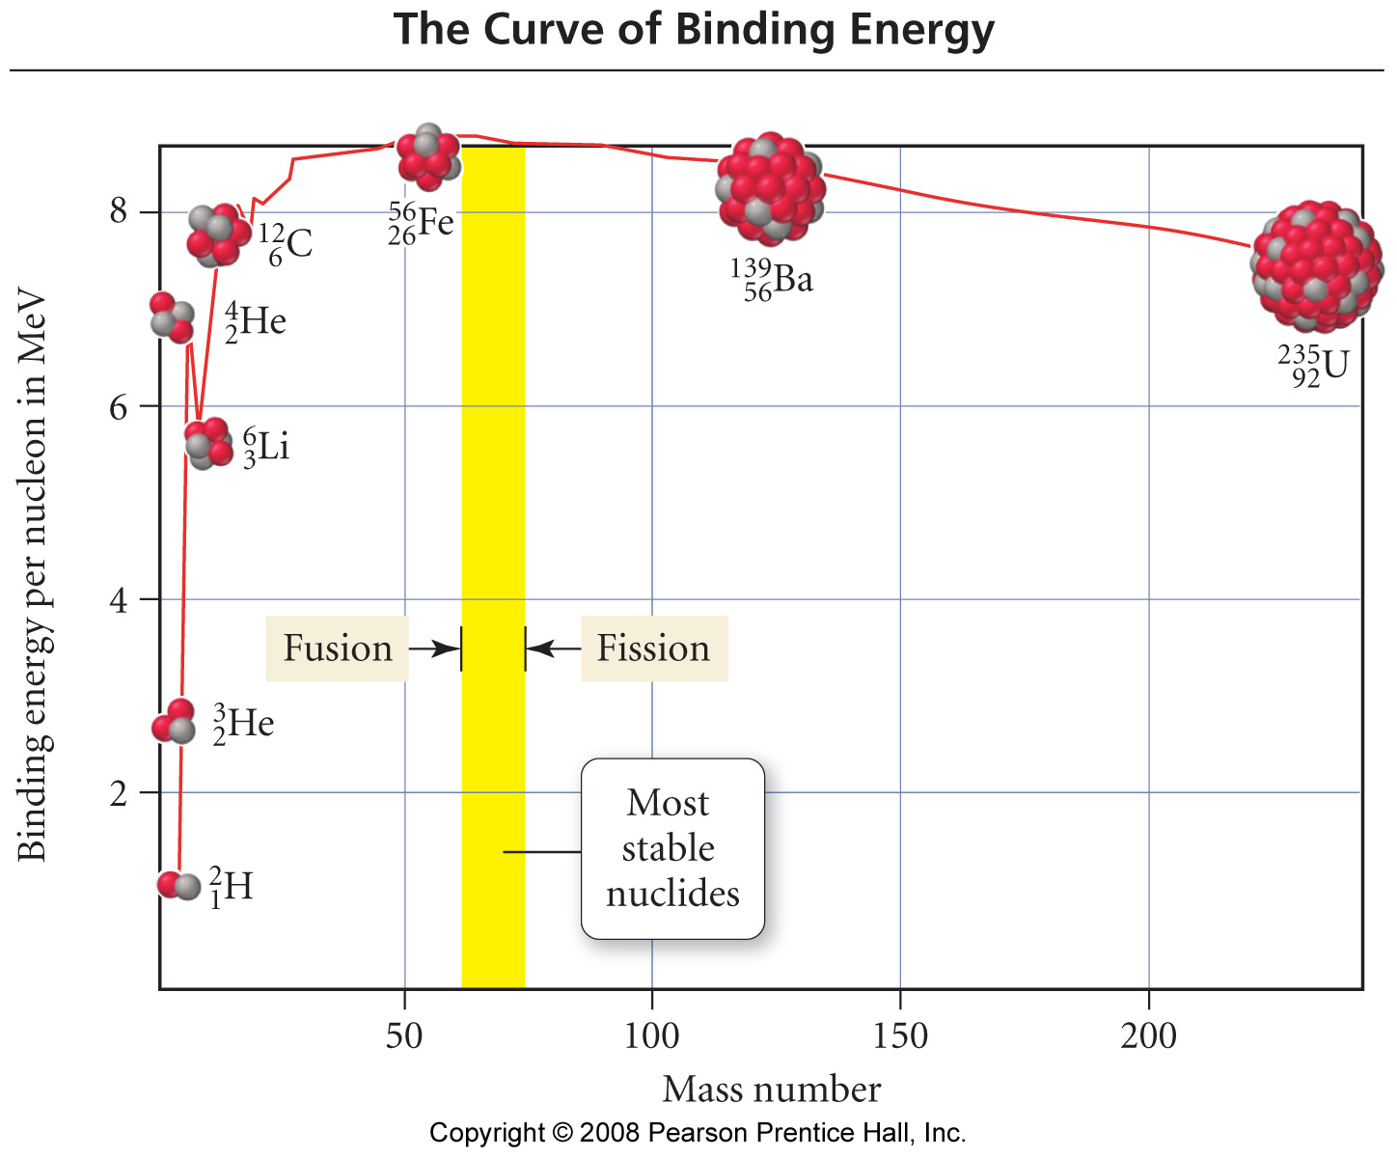

Slide 49
Nuclear Chemistry Example – Binding Energy
Calculate the binding energy per nucleon for the helium-4 nucleus. Given the atomic mass of helium-4 is 4.0026 amu, a proton is 1.67493 x 10⁻²⁴ g and a neutron is 1.67266 x 10⁻²⁴ g.
(1 amu = 1.66053873 x 10⁻²⁴ g)

Slide 50
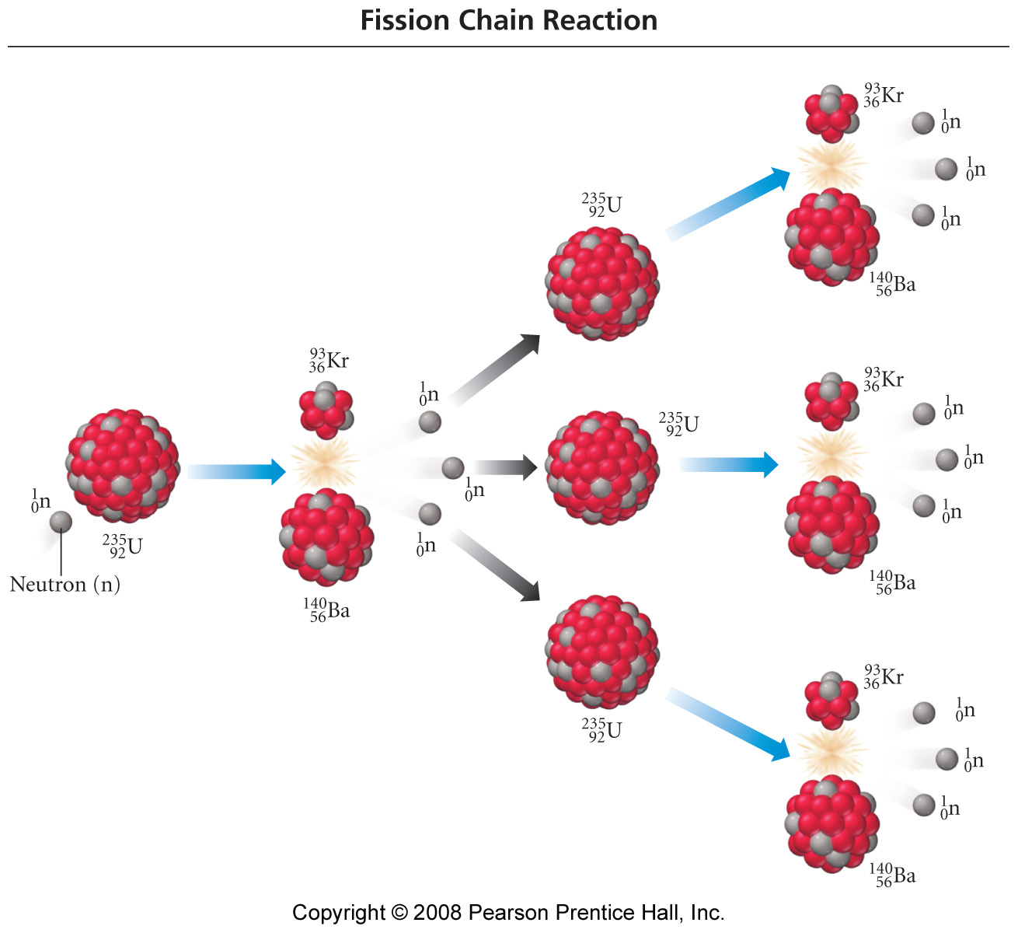

Slide 51
Fat Man and Little Boy

Slide 54
Nuclear Power Use

Slide 55
Nuclear Power Use
Notes:
Page: 602
Figure 20-28 Percentage of electricity from nuclear power by country. The United States relies on nonnuclear sources of electrical energy much more than many of the other nations of the world.

Slide 56
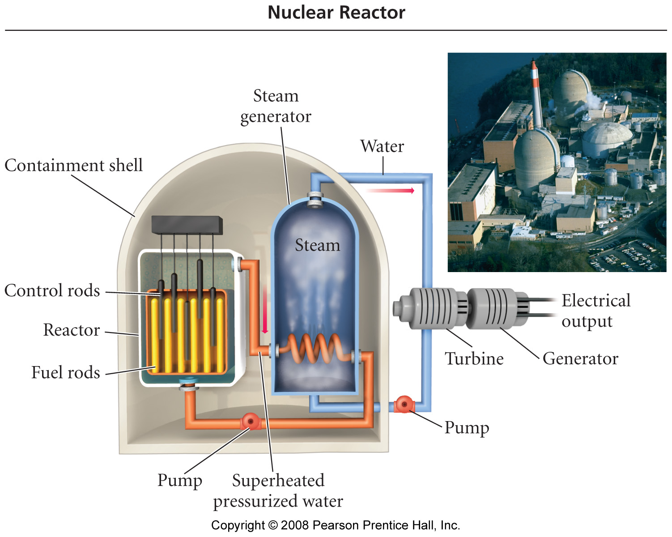

Slide 57
PLWR
Containment
Building
Turbine
Boiler
Condenser
Core
Cold
Water

Slide 58
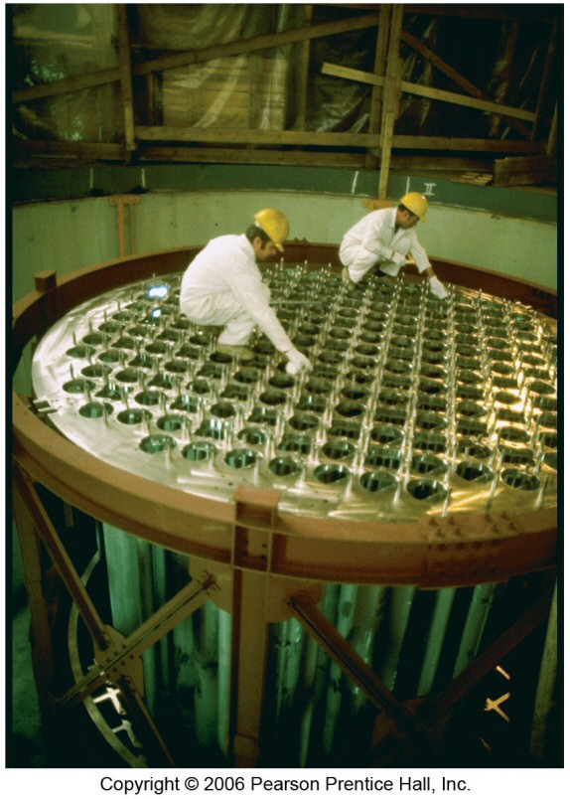
PLWR - Core
Hot
Water
Control
Rods
Fuel
Rods
Cold
Water

Slide 59
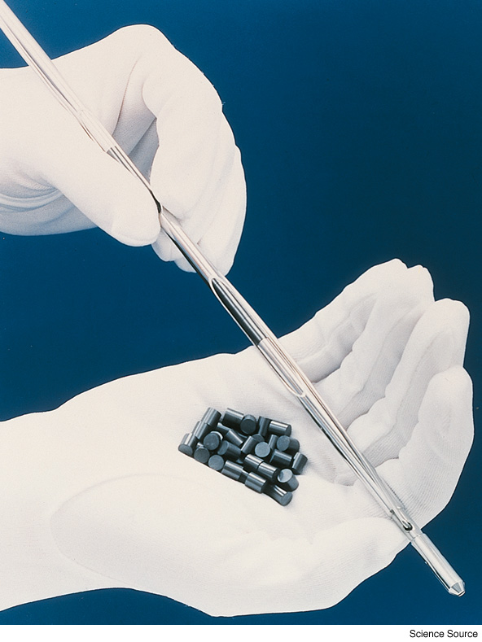
What is a fuel rod?
Notes:
Page: 601
Figure 20-25 Nuclear fuel. After mining, uranium is usually enriched to 3.5% 235 92U in the form of uranium oxide, UO2, powder. The powder is pressed into pellets, which are then inserted into tubes called fuel rods.

Slide 60
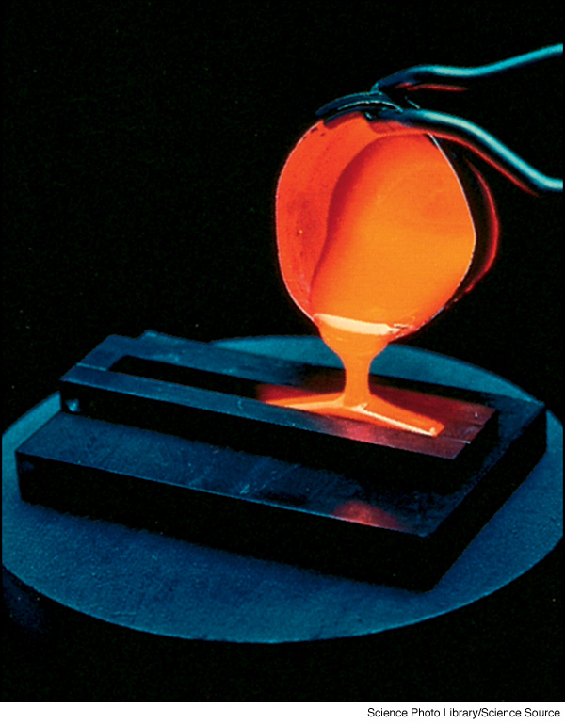
Why is vitrification used as a technique for the storage of nuclear waste?
Notes:
Page: 603
Figure 20-29 Vitrification is one technique for storing nuclear waste. The liquid waste is heated to a high temperature and mixed with substances that form a glassy solid when cooled. This prevents problems associated with storing liquids in tanks that may leak.

Slide 61
UT 10/1/03

Slide 62
UT 10/1/03

Slide 65
What are some sources of radiation?

Slide 66
Quantities of Radiation
Unit | Parameter | Description
Curie (Ci) | Level of Radioactivity | 3.7x10¹⁰ nuclear disintegrations/s
Becquerel (B)* | Level of Radioactivity | 1 disintegration/s
Gray (Gy) | Ionizing Energy Absorbed | 1 Gy = 1 J/kg of tissue mass
Sievert (Sv) | Amount of Tissue Damage | 1Sv = 1Gy x RBE**
*SI unit of radioactivity **Relative Biological Effectiveness

Slide 67
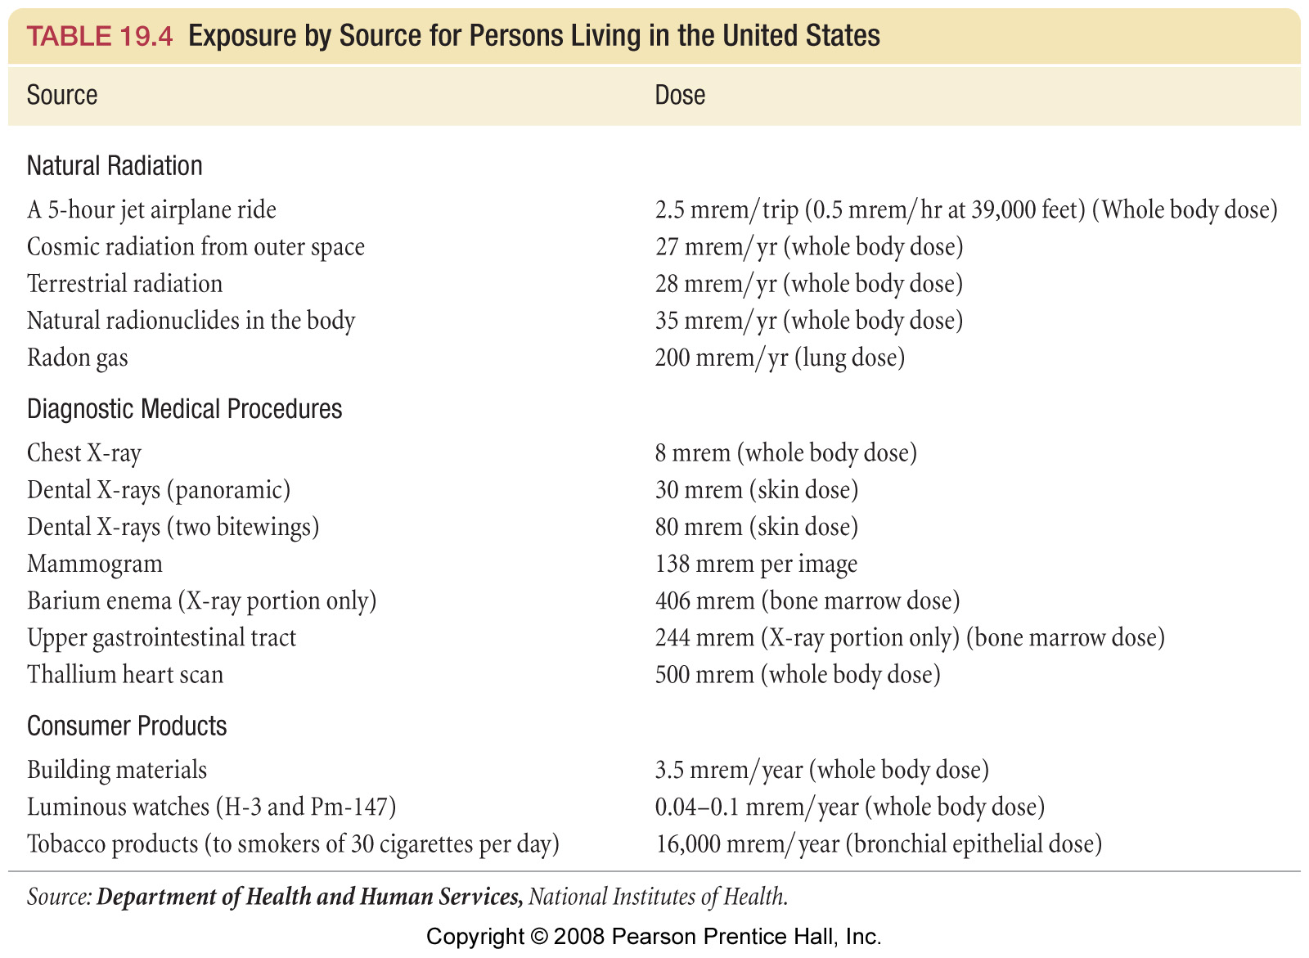

Slide 68
Physiological Effect of a Single Dose of Radiation
Dose (rem) | Dose (Sv) | Likely Effect
0-25 | 0-0.25 | No observable effect
25-50 | 0.25-0.50 | White blood cell count decreases slightly
50-100 | 0.50-1.00 | Significant drop in white blood cell count, lesions
100-200 | 1-2 | Nausea, vomiting, loss of hair
200-500 | 2-5 | Hemorrhaging, ulcers, possible death
>500 | >5 | Death

Slide 69
Isotope | Symbol | Decay | Half-Life | Use
tritium | ³H | β | 12.32 y | Biochemical tracer
carbon-14 | ¹⁴C | β | 5715 y | Archaeological Dating
phosphorus-32 | ³²P | β | 14.28 d | Leukemia Therapy
potassium-40 | ⁴⁰K | β | 1.26×10⁹ y | Geologic Dating
cobalt-60 | ⁶⁰Co | β, γ | 5.27 y | Cancer Therapy
iodine-123 | ¹²³I | γ | 13.1 h | Thyroid Therapy
uranium-235 | ²³⁵U | α, γ | 7.04×10⁸ y | Nuclear Reactors

Slide 70
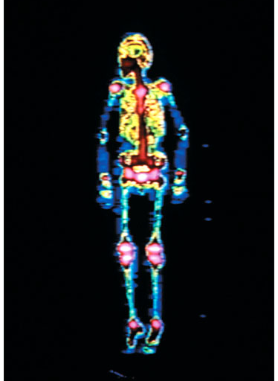
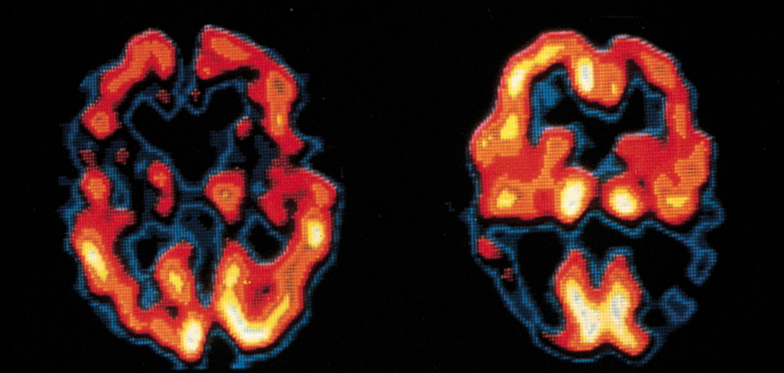
Medical Applications of Radioisotopes
Bone Scan with ^{99m}Tc
Brain images with ¹²³I-labeled compound

Slide 71
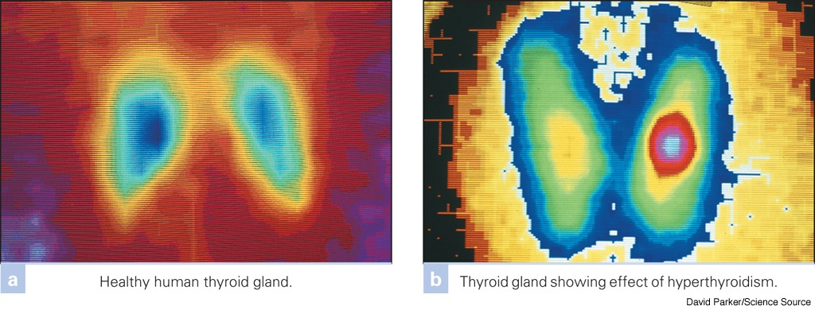
Thyroid scan using Tc-99m
Notes:
Page: 599
Figure 20-22 Radioisotope generator. The most widely used radioisotope generator converts molybdenum-99 to technetium-99m, in which the m indicates that the isotope is metastable, which means that the nucleus is in a temporary high-energy state. The excess energy is given off in the form of gamma radiation, which is used for diagnostic procedures.

Slide 72
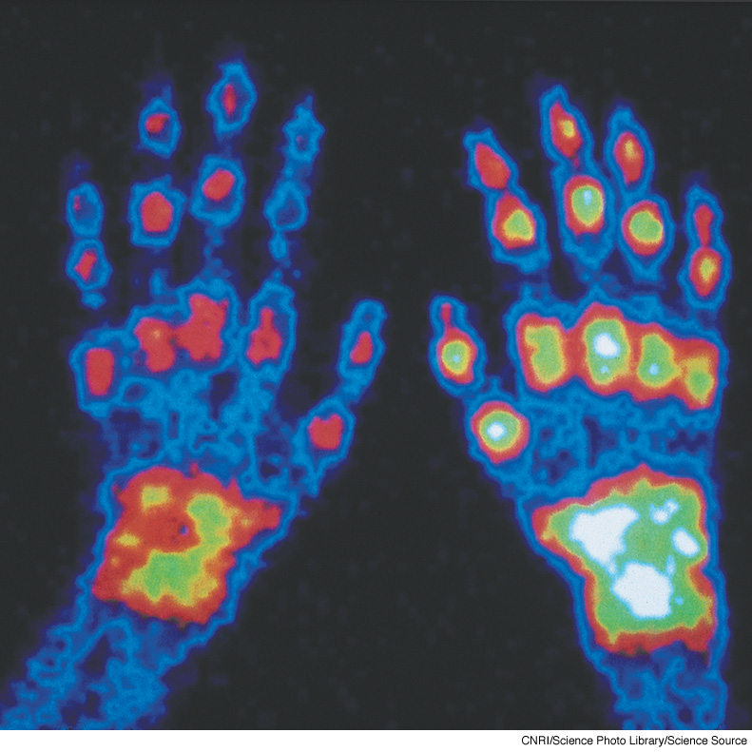
What is the difference between the left and right hand?
Gamma camera scan of a person with arthritis.
Notes:
Page: 581
Nuclear chemistry has many medicinal applications. This is a gamma camera scan of the hands of a person with extensive arthritis. A radioactive substance was injected into the hands before the scan. This substance concentrates in inflamed tissue. The brighter areas indicate greater radiation emission. Notice how the right hand is more severely affected than the left.

Slide 73
Radiation Therapy
Notes:
Page: 586
Figure 20-9 Radiation therapy. A cobalt-60 radiation source emits gamma radiation, which is directed at a cancerous tumor. The beam is rotated to minimize the destruction of healthy tissue and concentrate the radiation at the tumor.

Slide 74
How does a smoke detector work?
Notes:
Page: 597
Figure 20-19 Smoke detector. The radioactive source in a smoke detector is americium-241 oxide, embedded in a gold foil matrix. Americium is an alpha and gamma emitter. The radiation ionizes the air in the ionization chamber, producing an electric current. When smoke particles interact with the ions, the current is reduced, and the alarm is triggered.

Slide 75
Chemistry In Action: Food Irradiation
Dosage | Effect
Up to 100 kilorad | Inhibits sprouting of potatoes, onions, garlics. Inactivates trichinae in pork. Kills or prevents insects from reproducing in grains, fruits, and vegetables.
100 – 1000 kilorads | Delays spoilage of meat poultry and fish. Reduces salmonella. Extends shelf life of some fruit.
1000 to 10,000 kilorads | Sterilizes meat, poultry and fish. Kills insects and microorganisms in spices and seasoning.

Slide 76
Applications – Chemical Analysis
Radioactive tracer – used to follow fate of a chemical using radio labeling
Isotopic dilution – used to determine quantity of a substance when you can’t measure it conveniently
Neutron Activation Analysis – used to determine concentration of trace elements

Slide 77
Applications
Medicine
Diagnostic tracers
PET – Positron Emission Tomography
Patient fed radio-labeled glucose and it goes to where there is lots of metabolic activity. This often indicates a region of tumor activity.
Chemotherapy
Power pacemakers

Slide 78
Notes:
Page: 606
The United States Environmental Protection Agency estimates that radon exposure causes over 20,000 cancer deaths per year. All homes should be tested for radon.

Slide 79
Notes:
Page: 606c
The energy released by burning huge quantities of coal is equal to the energy released by the fission of a relatively tiny quantity of uranium.

