Slide 1
Beating the Forgetting Curve

Slide 2
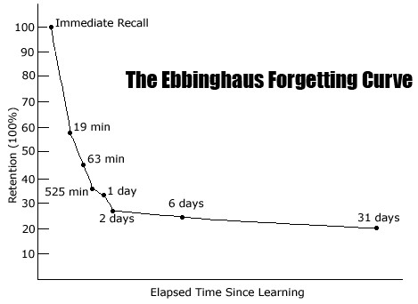

Slide 3
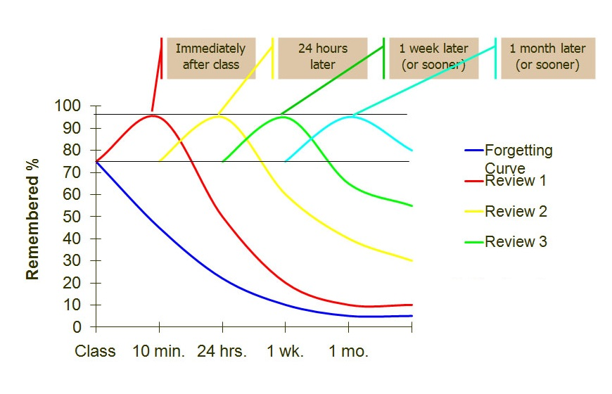
How do you beat the forgetting curve?

Slide 4
What is Memory?
Declarative—memory of words and concepts (semantic) or events and where/when they happened (episodic)
Procedural—types of memory involving skills and actions
Explicit—conscious or intentional recall
Implicit—memory influences on behavior without conscious awareness
Autobiographical--recollection of personally experienced events (often associated with emotions)
Notes:
Memory is the process of encoding, storing and retrieving experiences and information and it happens via connections between neurons in the brain

Slide 5
Encoding is Critical to Forming Long-Term Memories
There are several basic types:
Image
Sound
Meaning
Movement/Touch
Memory is enhanced if more than one type is activated at once

Slide 6
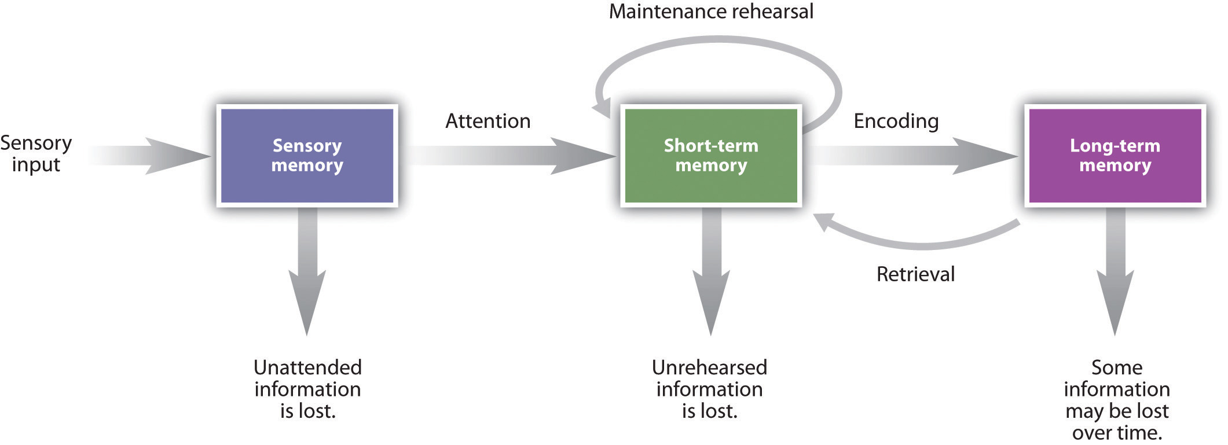
Elaborative Rehearsal
Notes:
Short-term memory (working) can only hold 5-9 items for 20 seconds unless translated into a neural code and transferred to long-term memory

Slide 7
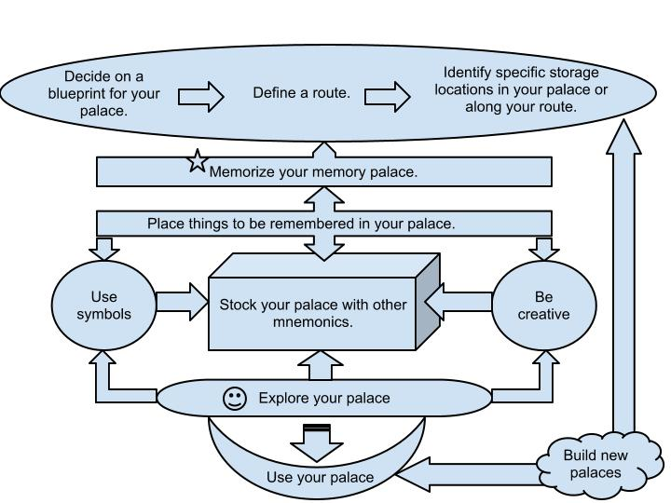

Slide 8
Summary of Mnemonic Devices
Acronyms—uses first letters of a list of words to remember the order of the words (e.g. ROYGBIV)
Visual Imagery—associate an image with the words or information
Rhyming—associating words/images based on sound similarities
Hierarchies—organize the information into sets and subsets (outlining)
Chunking—decrease # of items by increasing size of each item, or recognizing patterns rather than individual items (e.g PAO system)
Method of Loci—associates images of items with physical locations (e.g. memory palace)
Notes:
Techniques for reinterpreting information into the framework of what is already known and/or easier to remember

Slide 9
Want to learn more techniques?
"How to Get the Most Out of Studying." Each video is less than ten minutes in length.
https://www.youtube.com/watch?v=RH95h36NChI&list=PL85708E6EA236E3DB

