Slide 1
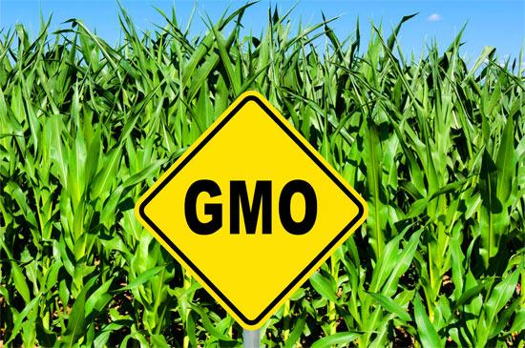
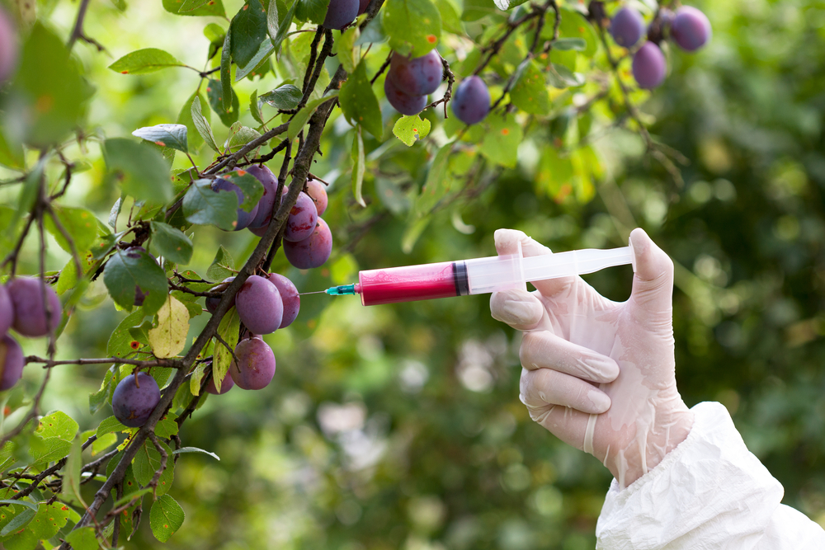
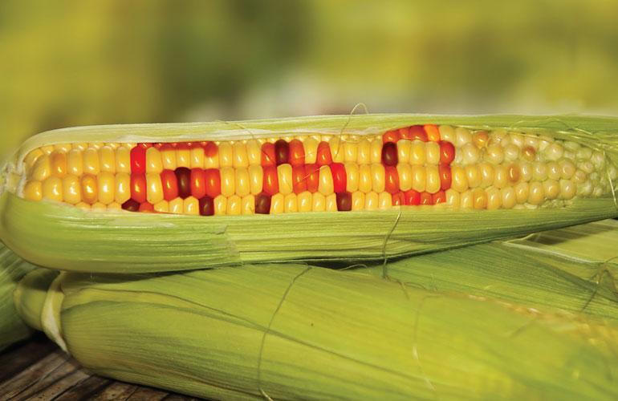
Ethics & GMC’s
Isaiah, Noah, and Kate

Slide 2
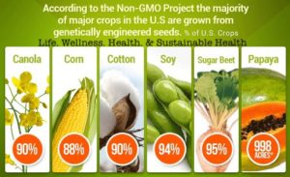
What are GMC’s?
-Plants whose genes have been altered using methods of gene technology
-92% of all foods in the U.S.
-Only closely related species

Slide 3
Quote
“Humans are directly or indirectly dependent upon plants for their survival so they always have been inclined to modify and improve plants to serve as a reliable source of food. The process of all such modifications starting from the time of early domestication of plants to the development of improved cultivars of modern agriculture is Plant Breeding, which essentially is a progression of Darwinian evolution under the forceful influence of human selection. The mendelian principles of inheritance established the scientific base of plant breeding that not only provided the logic of intuitive practices of its pre-mendelian era but also generated amazing expectations to produce plants to match human imagination.”
-G.S. Chahal

Slide 4
The Evolution of GMC’s
1982 – FDA Approves First GMO, Humulin =insulin produced by genetically engineered E. coli bacteria
1994 - FDA approves the Flavr Savr tomato, a delayed-ripening tomato that has a longer shelf life
1999 – GMO Crops Dominate Over 100 million acres worldwide are planted with genetically engineered seeds. The marketplace begins embracing GMO technology at an alarming rate.

Slide 5
Methods of Modifying Plant Genes
CROSS BREEDING
All genes of both parental lines are combined in random order, then backcrossed several times
- Long process Ex. Apples=15 years
- Examples: Corn started as tropical grass called Teosinte thousands of years ago
- Only works between closely related species

Slide 6
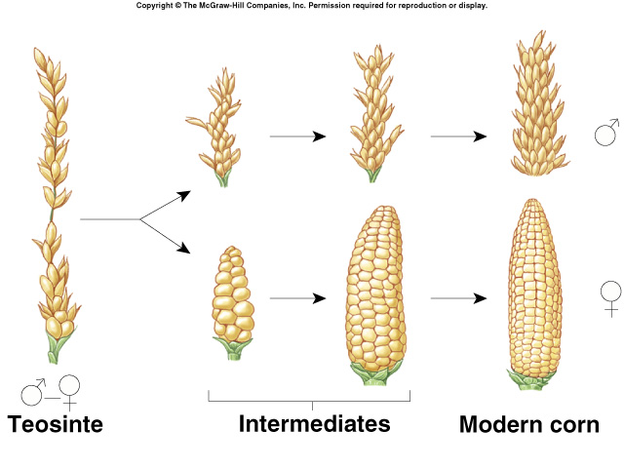

Slide 7
Methods of Modifying Plant Genes Cont.
INSERTING GENES DIRECTLY INTO PLANT GENOME
This method is done using either agrobacterium or a Gene gun
Single genes can be isolated from related plant species or even completely different organisms
Can be designed on a computer and synthesised in a test tube
Agrobacterium is a soil microorganism that can naturally transfers some of its DNA into plant cells
Desired traits inserted into agrobacterium, who shoots it into the nucleus of the new plant cells
Gene gun =DNA loaded on microscopic gold particles and shot into cells of plants
Ex. Tomatoes that make the antifreeze proteins from fish

Slide 8
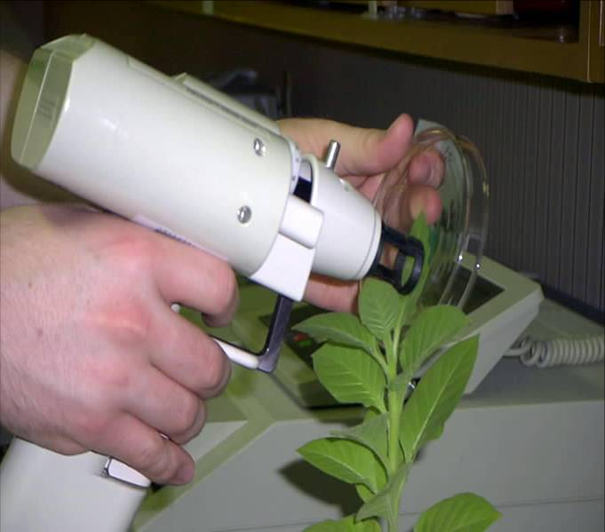

Slide 9
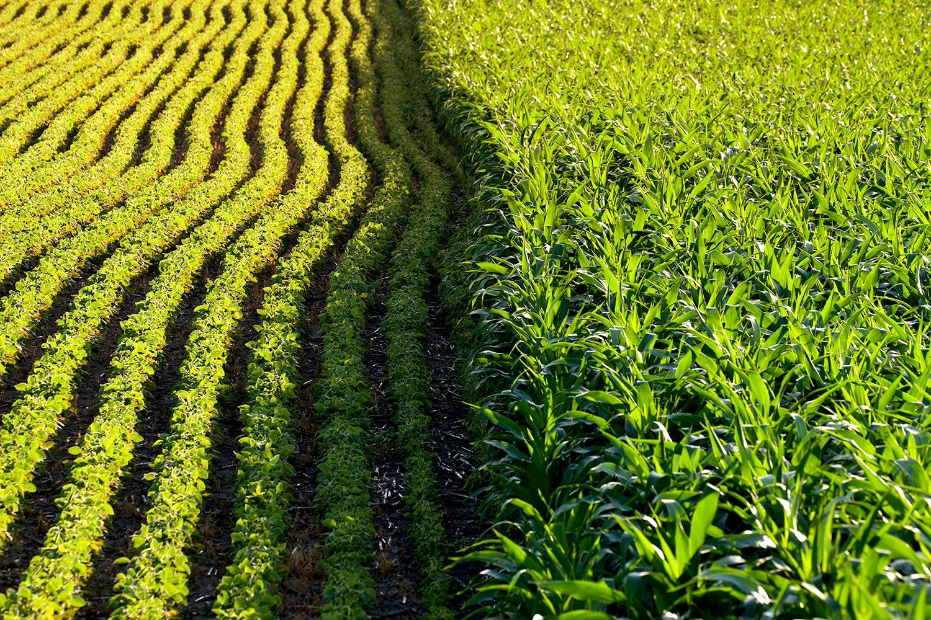
Benefits of GMCs
Higher Crop Yields
GM traits such as insect and disease resistance and drought tolerance help maximize yield by decreasing crop loss to pests, diseases, and bad weather conditions
Increased Farm Profit
Farmers who use GMO crops use 37% less of pesticides to grow more food. The farmers saw a 68% larger profit because of it.
Researchers found that insecticide resistance crops had a 25% greater profit than herbicide resistant crops which only had 8%.

Slide 10
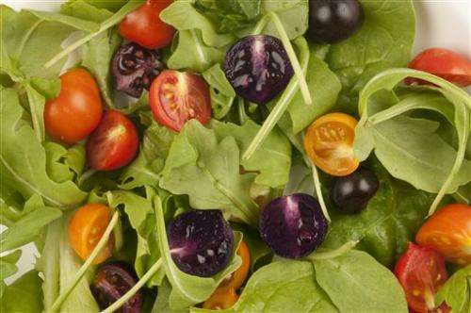
Benefits of GMCs cont’d
Safer environment
Tests GM products before putting it out on the market
GM crops have reduced the amount of greenhouse gas emissions from agricultural practice. This is equivalent to removing 27 billion kg of carbon dioxide from the atmosphere.
More nutritious foods and prevention of diseases
GMOs are used to make some of our most essential vitamins
For example, vitamin A, vitamin B-2, vitamin B-12, vitamin C, and even vitamin D.
A British company is looking for permission to produce and sell purple tomatoes that have high levels of anthocyanins which are found in blueberries and reduce cardiovascular diseases and even cancer.

Slide 11
Cons of GMC’s
“The intensive cultivation of GM crops has raised a wide range of concerns with respect to food safety, environmental effects and socioeconomic issues. The major cons are explored for cross-pollination, pest resistance, human health, the environment, the economy, and productivity. (environmentalscience.com).
Through studies, it has been shown that rats who were fed genetically modified corn had developed health problems in the kidneys and liver.
Children’s food allergies went up from 3.4% to 5.1% within the last decade which makes people believe its due to the GMOS

Slide 12
Cons of GMC’s cont.
Modifying the crops genetics create types of organisms that normally would not mix with each other.
GMOS transfer the elements of one crop to another can cause people to get allergic reactions due to the crop being mixed with something they are allergic to.
Pesticides on the crops are meant to keep them safe from bugs, weather, etc., but puts toxins on the crop itself are harmful and carry bacteria that human stomachs do not take well.

Slide 13
Works Cited
http://www.gmoinside.org/gmo-timeline-a-history-genetically-modified-foods/
https://books.google.com/books?hl=en&lr=&id=SmEdA8bYEB0C&oi=fnd&pg=PR5&dq=plant+breeding+procedures&ots=hBW3Y_DdYB&sig=bcIgDmVc-5KWX3uNgWj37TUzJ4I#v=onepage&q=plant%20breeding%20procedures&f=false
https://m.phys.org/news/2015-04-next-generation-gmos-pink-pineapples-purple.html
https://www.google.com/amp/s/geneticliteracyproject.org/2015/04/07/gmos-have-health-benefits-not-health-risks/amp/
https://gmoanswers.com/gmos-environment?gclid=EAIaIQobChMIkOKlzab32gIVzVqGCh3-CAt-EAAYASAAEgIaOvD_BwE

