Slide 1
Eugenics
By Enrique Sanchez, Justin Wiltz, and Mirna Garcia

Slide 2
What is Eugenics?
It is a term coined by Francis Gattan in 1883. It is the science of improving a human population by CONTROLLED breeding.

Slide 3
The History of Eugenics

Slide 4
Developed largely by Francis Gattan - A way to improve the human race
It was a set of beliefs and practices in the US before WWI
Wanted to replicate what the UK was doing - Superior genetics = higher social position

Slide 5
We should direct our own evolution
Brave New World like - Test Tube Babies
People who were unfit and weighing down society were poor and had bad backgrounds should not reproduce.
Discrimination - Screen immigrants with literacy testing so the US only gets the best of the best

Slide 6
How is it different/used now?

Slide 7
Consumer driven and market based
The misuse of it by the Nazis still casts a negative shadow over it
Prenatal screening - Parents chose to abort based on the health of their baby

Slide 8
“In October 2015, the United Nations' International Bioethics Committee wrote that the ethical problems of human genetic engineering should not be confused with the ethical problems of the 20th century eugenics movements. However, it is still problematic because it challenges the idea of human equality and opens up new forms of discrimination and stigmatization for those who do not want, or cannot afford, the technology.”

Slide 9
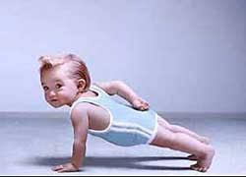
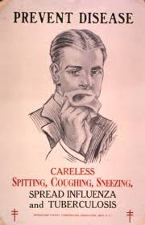
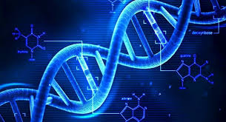
What are the pros of eugenics?

Slide 10
You get to pick your own baby
Just like in the film Gattaca, the parents are shown the possibilities of their baby’s outcome. This can lead to showing parents what to expect if, for example, their only choices are babies with medical needs. This will give them a heads up or they can also refuse having a baby before it is too late.

Slide 11
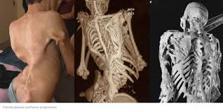
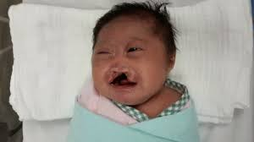
Exterminates bad genes
Eugenics can also diminish the chances of bad genes such as mental and physical disorders which means they don’t have to worry about their future offspring to carry those genes.

Slide 12
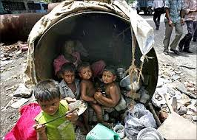
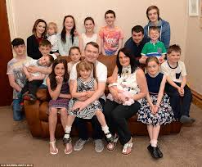
Able to decrease human population
There are some cultures that prefer males so they will keep reproducing until they get one. If they were able to choose a male for their first newborn, most likely they would have stopped reproducing which in turn will stop the population from increasing.

Slide 13
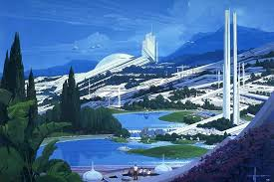
Create a better future
With eugenics, we can alter the DNA of babies (this is includes the brain) and make them more smart. This will birth geniuses that can advance mankind and other things.

Slide 14
Save more money
If we can eliminate, for example, schizophrenia then we don’t have to donate so much money into a program to find a cure for it since it’s no longer needed. This can be applied to other disorders.

Slide 15
What are the cons of eugenics?

Slide 16
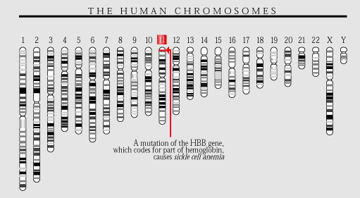
Are all “bad” genes really bad?
Some bad genes such as the sickle cell gene offer benefits to the host when they have a heterozygous presence. The presence of this trait prevents the infection of Malaria to the host which is arguably one of the deadliest diseases to humans.

Slide 17
Who decides what genes are desirable
The process of eugenics could be very expensive. This means that only those who can afford it will have children with “desirable” and “good” traits. This also leads to the question that are those born “naturally”, or without engineered traits, any less valuable or desirable than those who were born using eugenics.

Slide 18
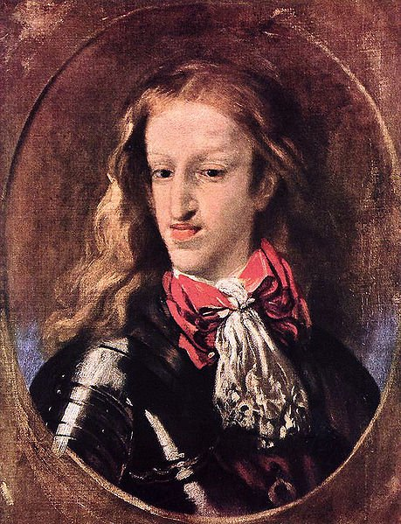
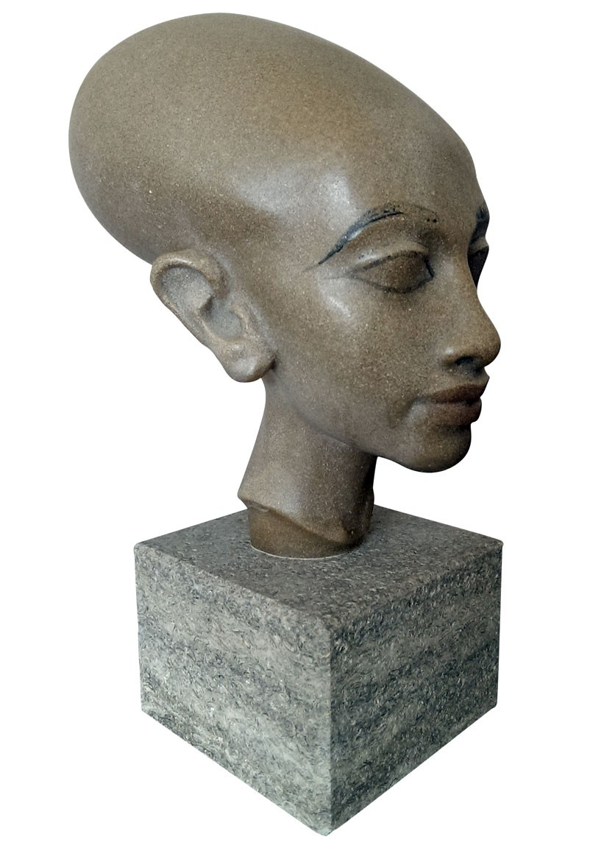
Biodiversity is important to the future
Biodiversity is important to a species’ survival and future. By creating an idealized genome we are created a gene pool that is shallow which could lead to ailments and further gene mutations.

Slide 19
Citations
https://www.cdc.gov/malaria/about/biology/sickle_cell.html
https://connectusfund.org/10-fundamental-pros-and-cons-of-eugenics
https://ghr.nlm.nih.gov/condition/trisomy-13#genes
https://en.wikipedia.org/wiki/Eugenics
http://time.com/4626571/crispr-gene-modification-evolution/

