Slide 1
Eugenics
By: Nathan, Grace, Ryan, and Caitlynn

Slide 2
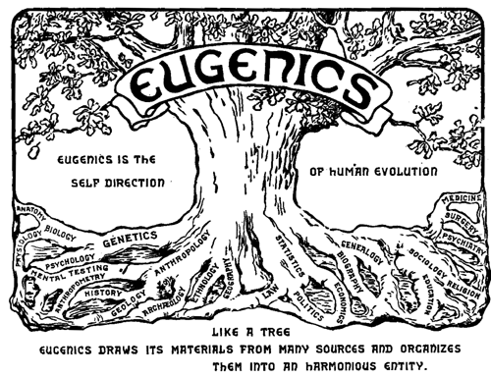

Slide 3
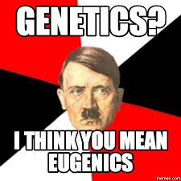
Background
Eugenics is the science aiming towards improving the genetic quality of the human population. In 1833, Sir Francis Galton, a respected British scholar and cousin of Charles Darwin, first used the term eugenics, meaning “well-born.” Galton believed selectively breeding individuals who have “desired” traits in hopes of bettering the human race in the future. The eugenics movement in the U.S. began in the 19th century and unlike in Britain, eugenicists in the U.S. focused mainly on stopping the transmission of negative or “undesirable” traits from generation to generation. Some US leaders, private citizens, corporations began to start funding eugenical studies in response to these ideas. This lead to the 1911 establishment of the Eugenics Records Office in Cold Spring Harbor, New York. The ERO tracked family histories and concluded the people who deemed to be unfit. The eugenics movement in the U.S. slowly began to decline during the start of World War II. Eugenics lost all credibility as a field of study or even an ideal that should be pursued because of the horrors of Nazi Germany and Hitler’s use of eugenic principles to justify the atrocities.

Slide 4
Technology
In theory, eugenics are used to decrease the reproduction rate of undesired traits and increase the rate for positive traits. There are many different techniques for eugenics.
Genetic engineering is what is more commonly thought of when a person hears eugenics. Scientists are able to manipulate the genetic makeup of by replacing nuclei, making the offspring a mixture of both the original cell and the new cell. In vitro fertilization also opens the door to “gene therapy”. This allows for undesirable traits to be “disabled” and desired traits to be implanted.
However, that is not all eugenics consists of...

Slide 5
More Common Examples
Genocide - genetic cleansing
Prenatal diagnosis and abortion
Sperm banks
Natural selection
Forced Sterilization

Slide 6
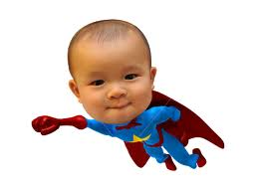
Pro’s
There are many medical benefits to Eugenics. Parents could know about their unborn child’s health needs before it is born. Also, parents could precisely select their kids gender. Parents could also genetically alter disorders in the baby’s DNA to prevent hereditary diseases. Ideally, by mutating babies, parents can have the “perfect” offspring. Ones that are kinder, more generous, stronger, smarter, etc. A really useful forward movement for science.

Slide 7
Con’s
The idea of eugenics is vulnerable to abuse because the criteria of selection is determined by the beliefs of those deciding the desirable and undesirable genes and traits. It could also lead to a loss of genetic diversity and serious ailments caused by shallow gene pools, like in cases with purebred dogs. It creates the possibility of diminishing diversity amongst human traits and increases the likelihood of there being what is considered a “superior race”. This could cause discrimination against natural born babies because they will be considered inferior to the designed babies. Since eugenics is not perfected or known to be completely safe, it is possible that it will cost human lives in either the long term or the experimental stages.

Slide 8
Predicted Consequences
The ultimate goal for eugenics is that hopefully one day, humans can live out to their maximum potential. It is a scientific movement claiming to improve genetic features of the human race. But, as time goes on and eugenics continue to develop further and further, society will be able to distinguish and attack inferior traits. This was a particularly big issue especially in the United States with segregation. Thus creating a social conformity for those who can to adapt to do so. And for the rest of society who cannot; creating an unequal class conflict .

Slide 9
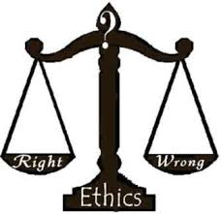
Ethics
This is a very controversial topic. People argue that this is inhumane, on the contrary this could be a leap for humanity to develop a better human and live out the lifestyle of future generations to the fullest. The following are where each of the students stand on this topic:
Nathan: For eugenics
Ryan: For eugenics
Grace: Neutral
Caitlynn: Neutral

