Slide 1
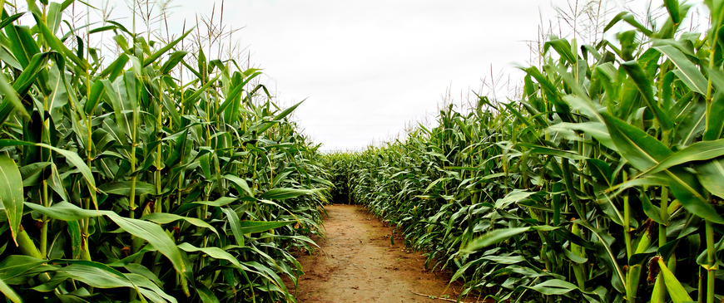
Genetically Modified Crops

Slide 2
What is a Genetically Modified Crop?
GMC’s are plants used in agriculture, the DNA of which has been modified using genetic engineering techniques. In most cases, the aim is to introduce a new trait to the plant which does not occur naturally in the species.
Genetically modified organisms (GMOs) can be defined as organisms (i.e. plants, animals or microorganisms) in which the genetic material (DNA) has been altered in a way that does not occur naturally by mating and/or natural recombination. The technology is often called “modern biotechnology” or “gene technology”, sometimes also “recombinant DNA technology” or “genetic engineering”. It allows selected individual genes to be transferred from one organism into another, also between nonrelated species. Foods produced from or using GM organisms are often referred to as GM food

Slide 3
History on GMC’s and GMO’s
The first GMO was established in grocery stores in 1982. They were genetically modified tomatoes that had a longer shelf life and did not soften as fast after ripening as non GMO tomatoes.
The first GMC was an antibiotic resistant tobacco plant that was also developed in the 1980s and by 1996, 35 approvals had been granted to grow 8 transgenic crops and one flower crop with 8 different traits in a total of 6 countries in addition to Europe.
GMO ingredients are found in 80% of packaged foods in the U.S.
Percentage of each genetically grown crops in the U.S.:
Soy- 93%
Cotton- 93%
Corn- 86%
Canola- 90%

Slide 4
Pros of GMCs/GMOs
More Nutritious Foods:
Engineered foods have more vitamin content and minerals. This helps battle malnutrition and vitamin deficiencies in the developing world.
One example is Golden Rice, which has been modified to have enhanced levels of ß-carotene, in order to help to prevent vitamin A deficiency. 14 million children under five suffer clinically from this deficiency, which can cause childhood blindness.
Better Food Quality & Production:
Longer shelf life which helps reduce food waste.
Better taste as it can make foods more sweet or spicy.
More food is also produced because it takes less time to grow by helping farmers skip steps, which also cut down on costs and can make food cheaper.
Crop tolerance to drought and temperatures.

Slide 5
Pros of GMC’s/GMO’s
Environmental Protection:
The increase in GMO crops and animals often require less chemicals, time and tools which may help reduce soil erosion, greenhouse gases, and pollution. This can lead to better air and water quality.
Bacterium can be added to the crops to make them insect resistance yet safe for humans, which is also less chemicals used on crops.
Healthier Animals
The genetic modification process can lead to animals with higher immunities and resistances which allow them to tolerate the usual farm and facility conditions.

Slide 6
Pros of GMC’s/GMO’s
Biopharmaceuticals
Plants could be genetically modified to produce vaccines or other medicines.
Potatoes have already been modified to produce an edible vaccine to E. coli.
Research is in very early stages.

Slide 7
Cons of GMCs/ GMOs
Allergic reactions
Modification often mixes or adds proteins that aren’t native to the plant or animal which may lead to possible new allergic reactions.
Decreased Antibiotic Efficiency
Some GMO’s have antibiotic features which make them immune or resistant to diseases or viruses, however when eaten they continue in the body making hospital antibiotics less effective.
Gene Transfer
GMO’s may cross into the wild and make super organisms such as “super weeds”.
Bacteria and other organisms will become much harder to kill.
Possibility of negative effects on other species and natural animal species may face extinction.

Slide 8
Is It an Ethical Issue?
In some areas, having access to GMO foods may make sense because resources are thin and people are dying from hunger. In other areas, the risks may outweigh the rewards
Such risks include the safety of the people unknowingly eating it which may lead to possible health issues of allergic reactions and antibiotic strength issues.

Slide 9
Cites:
http://www.livestrong.com/article/213053-pros-cons-of-gmo-foods/
http://geneticallyengineeredfoodnews.com/the-pros-and-cons-of-gmo
http://www.wisegeek.org/what-are-the-pros-and-cons-of-genetically-engineered-food.htm

