Slide 1
Chemistry 115
Chapter 1: An Introduction to Chemistry
Outline
Introduction to Chemistry
Scientific Method
Matter
  Classification
  State

Slide 2
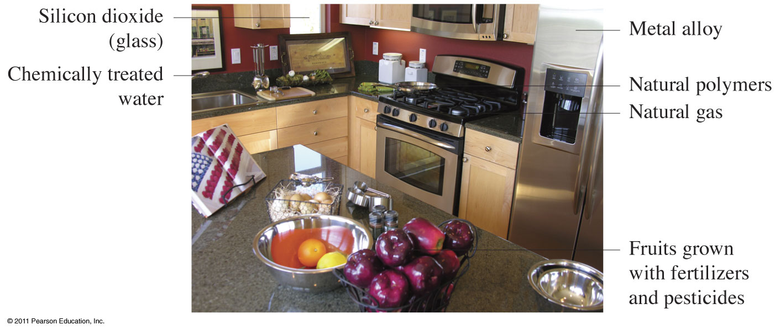
Where are chemicals found?

Slide 3
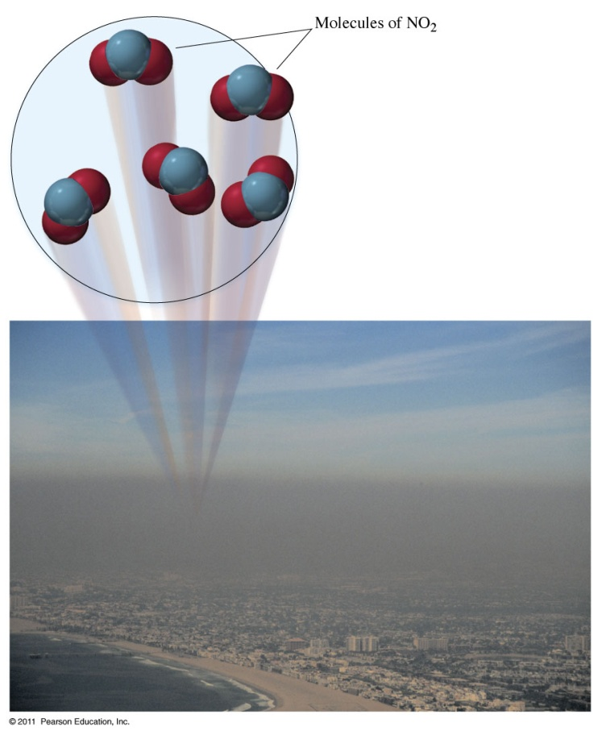
What is Chemistry?

Slide 4
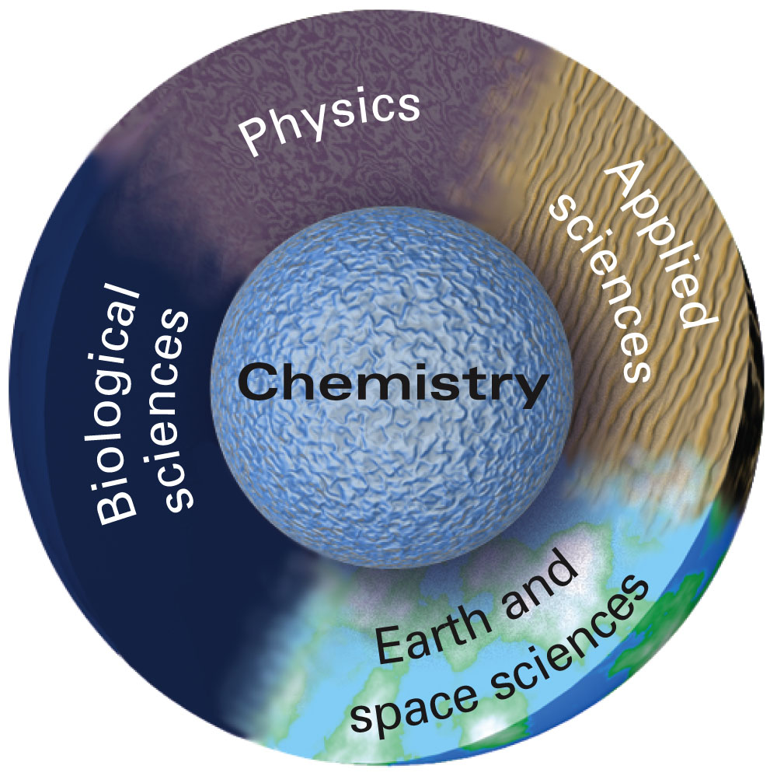
Why is chemistry called the central science?

Slide 5
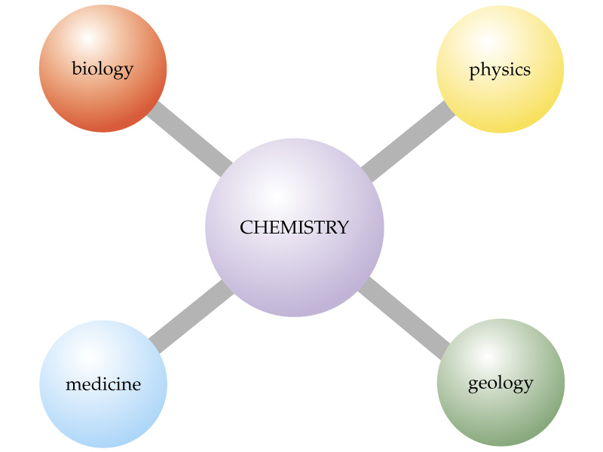
Why is chemical called the central science?

Slide 6
What is the chemistry of today?
The Five Traditional Subdivisions of Chemistry
Analytical - what and how much are in a sample
Biochemistry - chemistry of living systems
Organic - chemistry of carbon compounds
Inorganic - chemistry of compounds of all elements but carbon
Physical - physics of chemical change

Slide 7
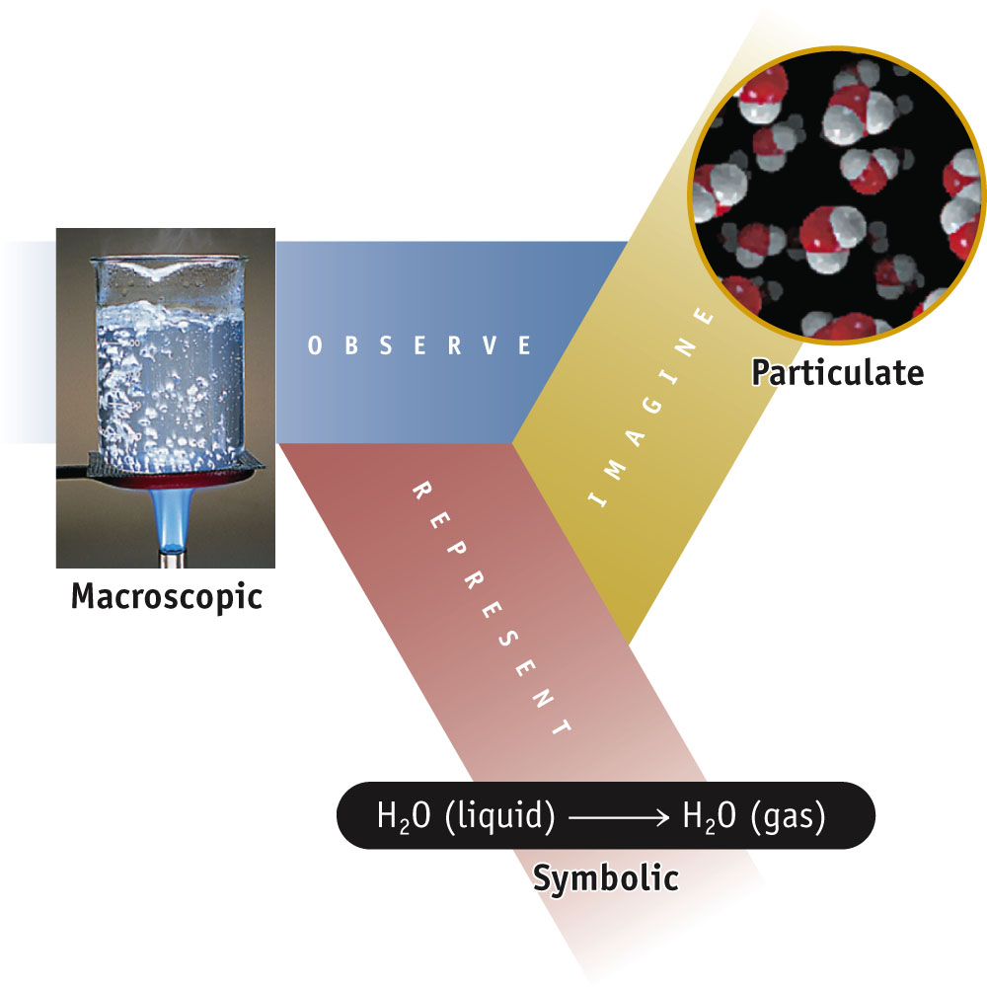
How to Learn Chemistry
How to Think Like a Chemist:

Slide 8
From Scientific Method
Empirical facts
  (observations, data)
Scientific laws
  (tested generalizations, consistent observations)
Hypothesis
  (tentative explanation)
Theory or Models
  (tested explanation, unifying explanation for a set of observations, facts and laws)

Slide 9
Scientific Method
The bicycle tire is flat. Represents
an observation.
an hypothesis.
an experiment.
a theory.

Slide 10
Scientific Method
If I add air to the bicycle tire, it will expand to the proper size. Represents
an observation.
an hypothesis.
an experiment.
a theory.

Slide 11
Scientific Method
When I added air to the bicycle tire, it was still flat. Represents
an observation.
an hypothesis.
an experiment.
a theory.

Slide 12
Scientific Method
The bicycle tire must have a leak in it. Represents
an observation.
an hypothesis.
an experiment.
a theory.

Slide 13
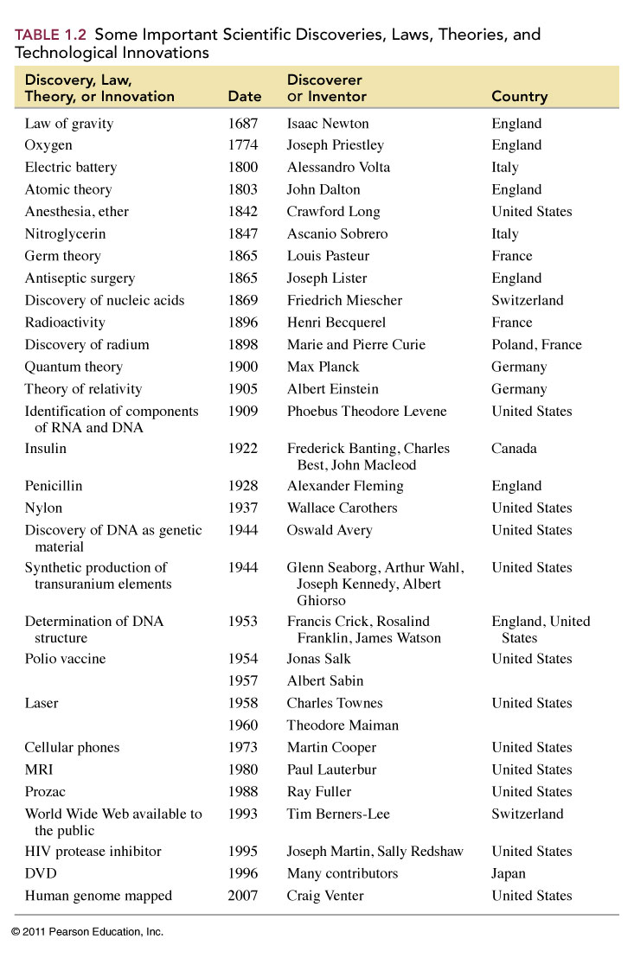

Slide 14
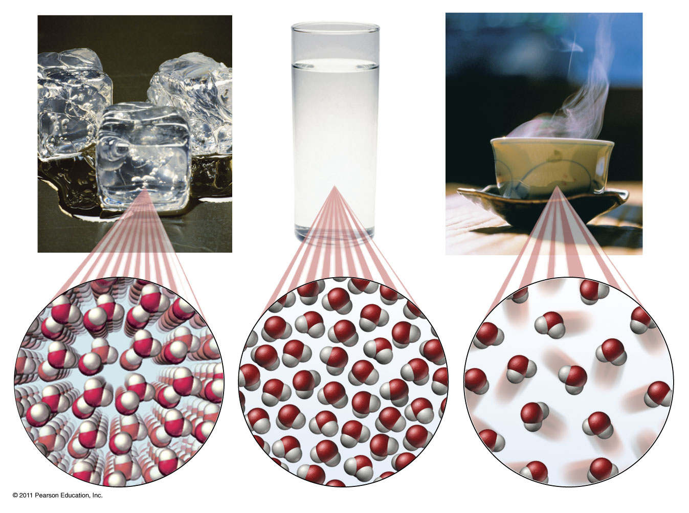
How do these states of matter differ?

Slide 15
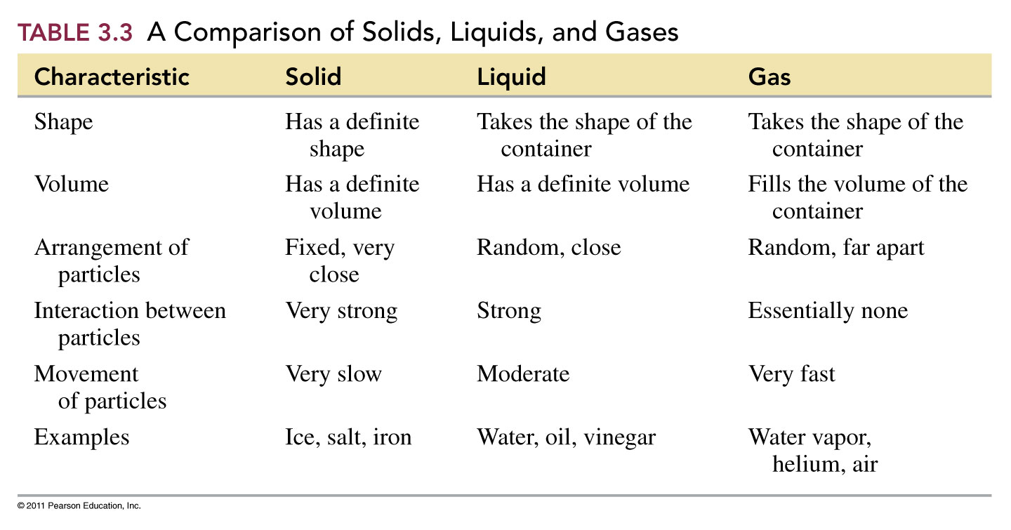
What are the states of matter?

Slide 16
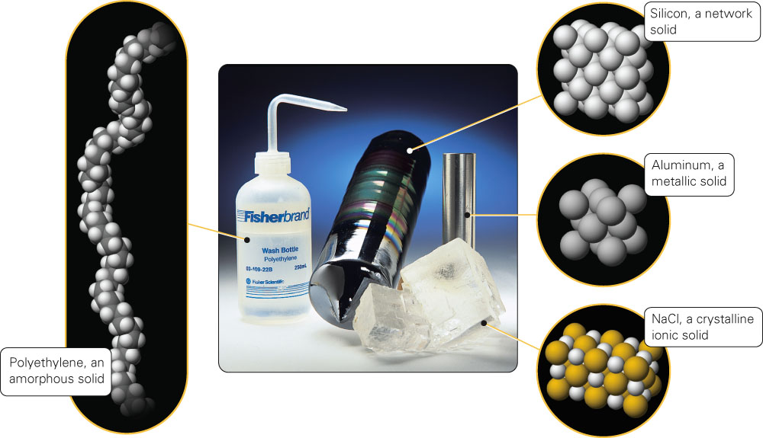
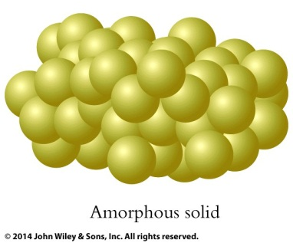
How do amorphous and crystalline solids differ?
crystalline solids:
Fig. 15-21, p. 447

Slide 17
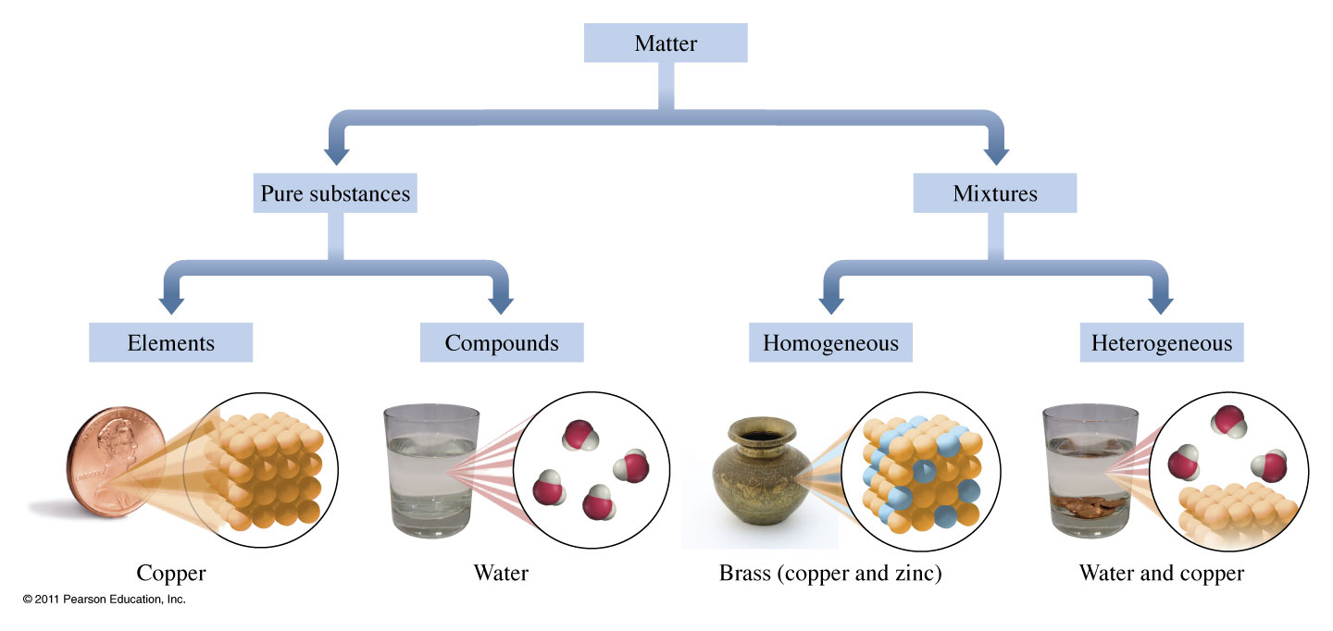
How is matter classified?
Pure Substance
One substance only.
Definite Composition.
Definite properties.
Mixture
Two or more substances.
Variable composition.
Properties depend on composition.

Slide 18
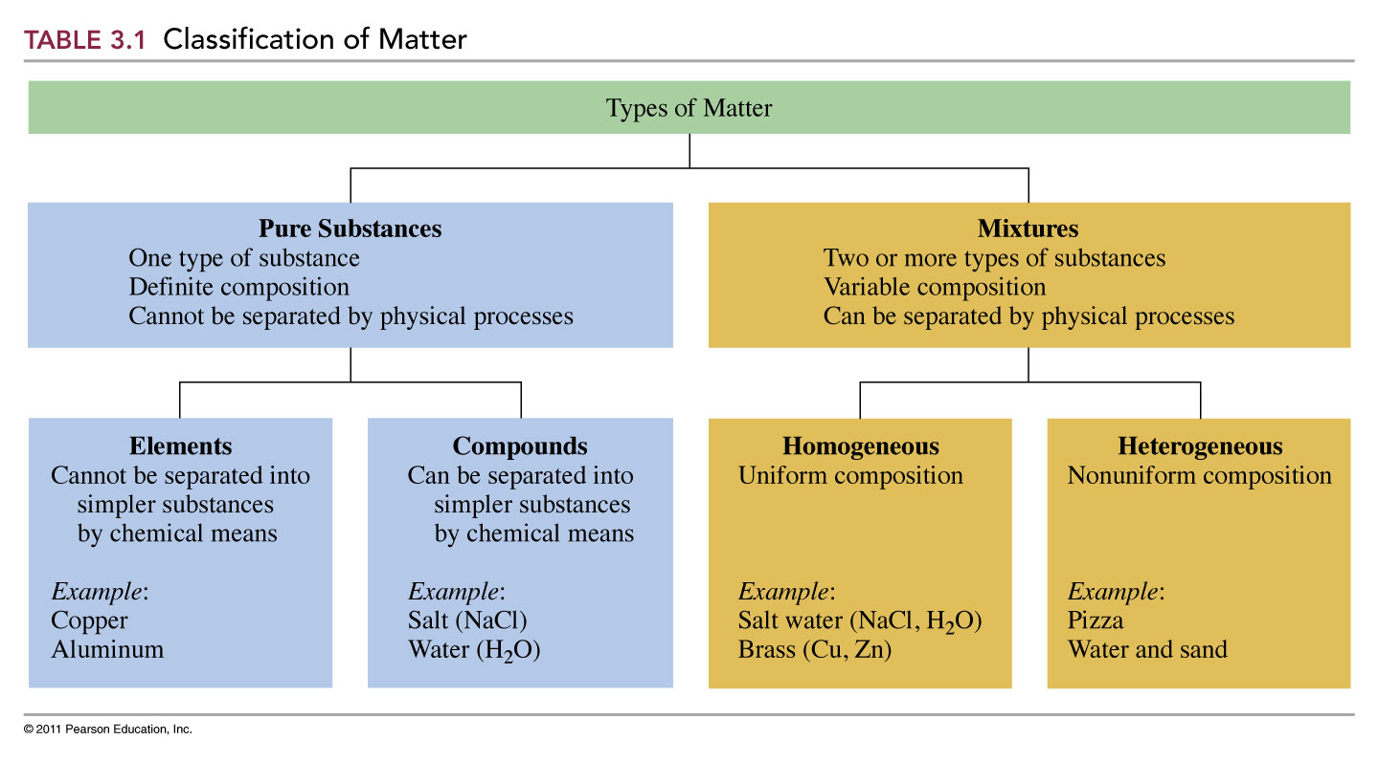
How is matter classified?

Slide 19
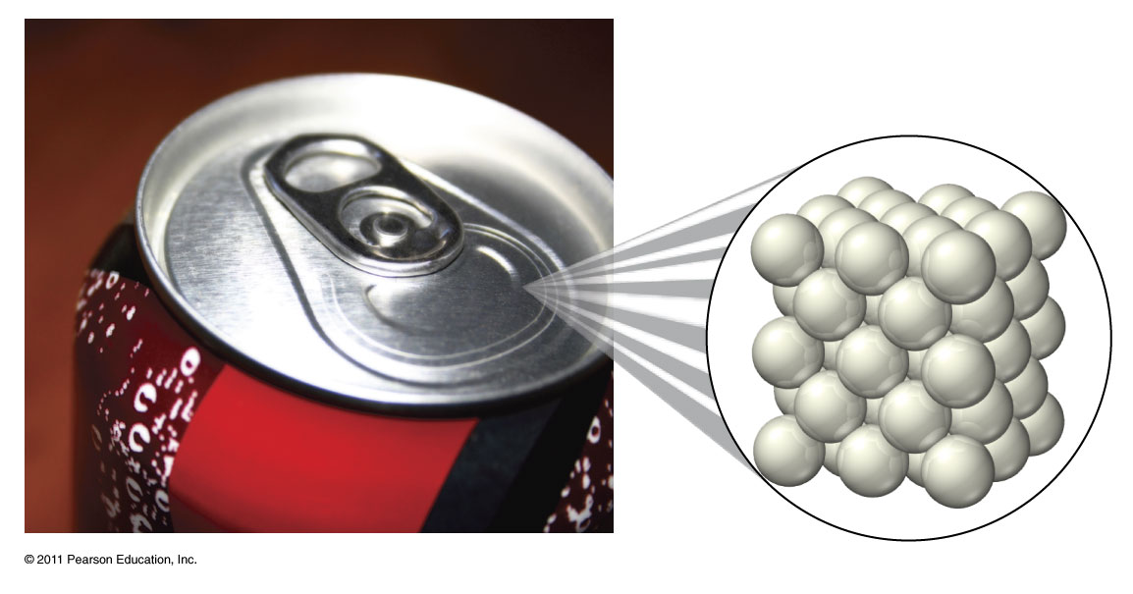
What is an element?
Cannot be separated chemically into simpler substances.
Aluminum metal

Slide 20
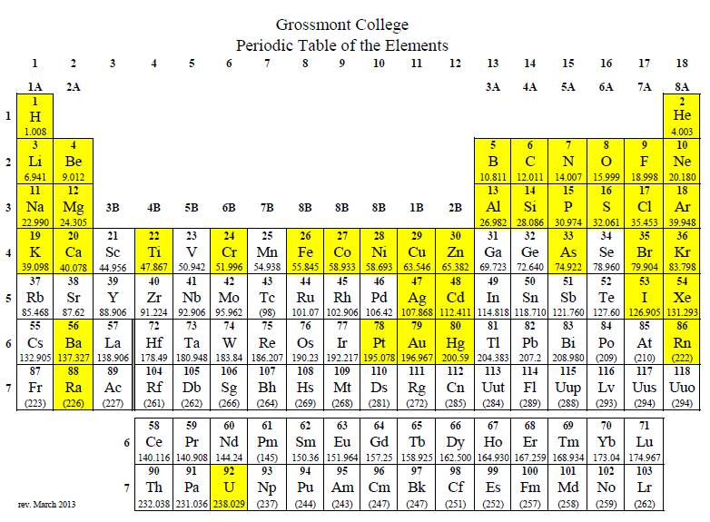
What elements do you need to know?

Slide 21
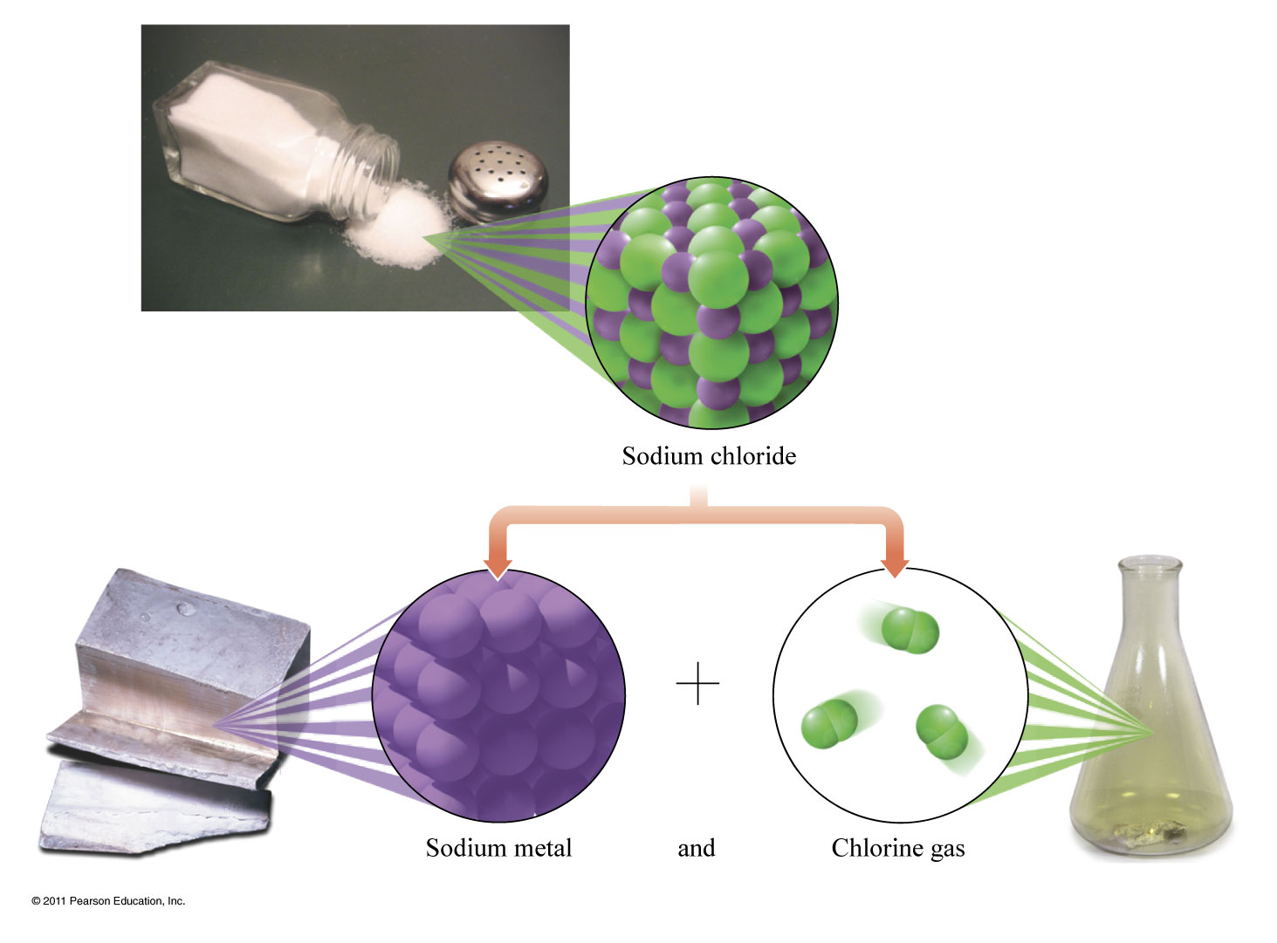
What is a compound?
Can be separated chemically into simpler substances.

Slide 22
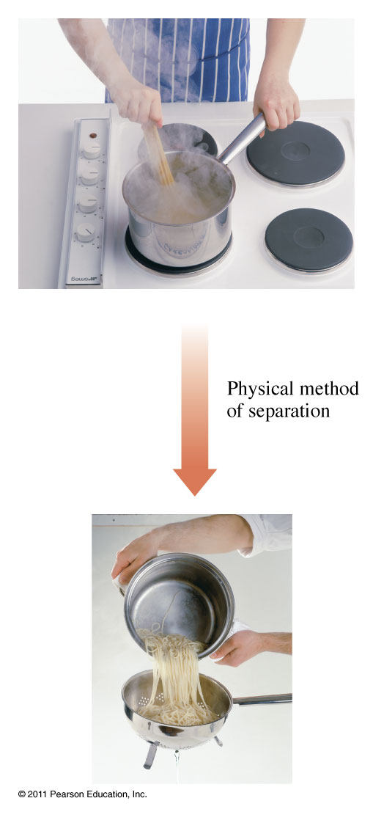
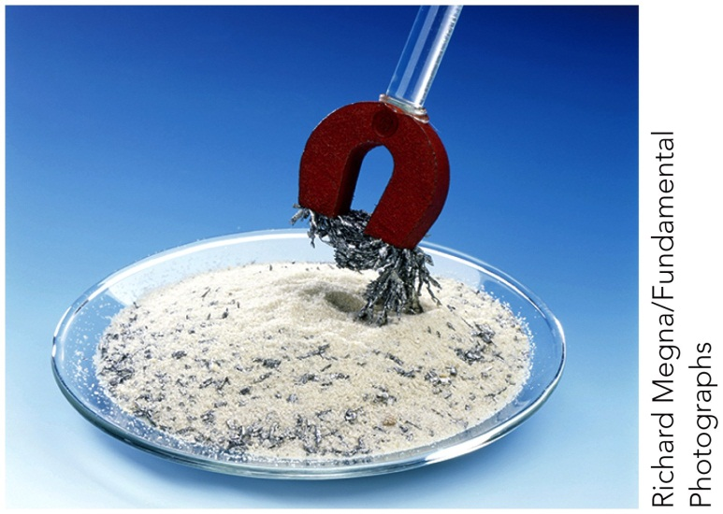
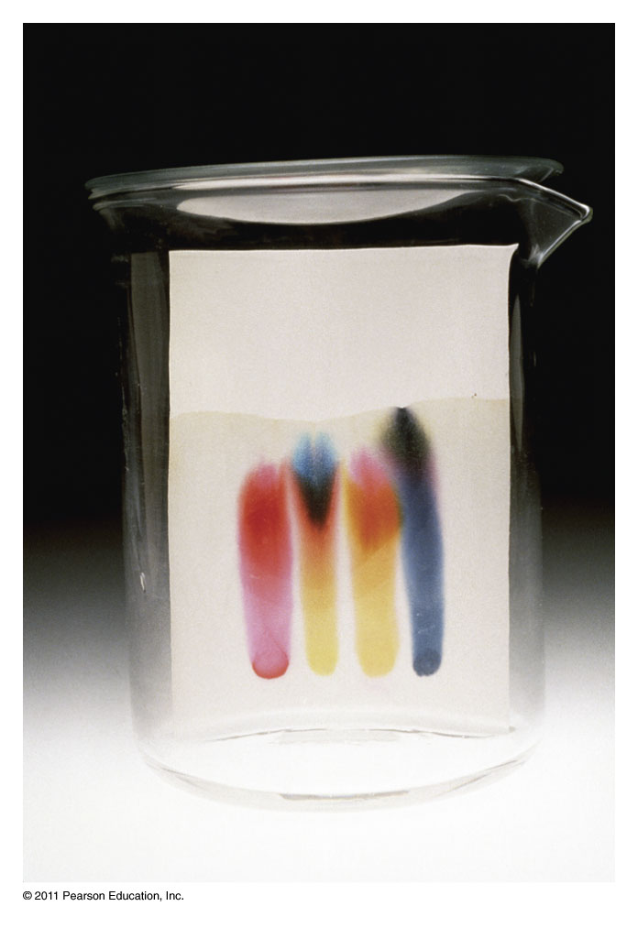
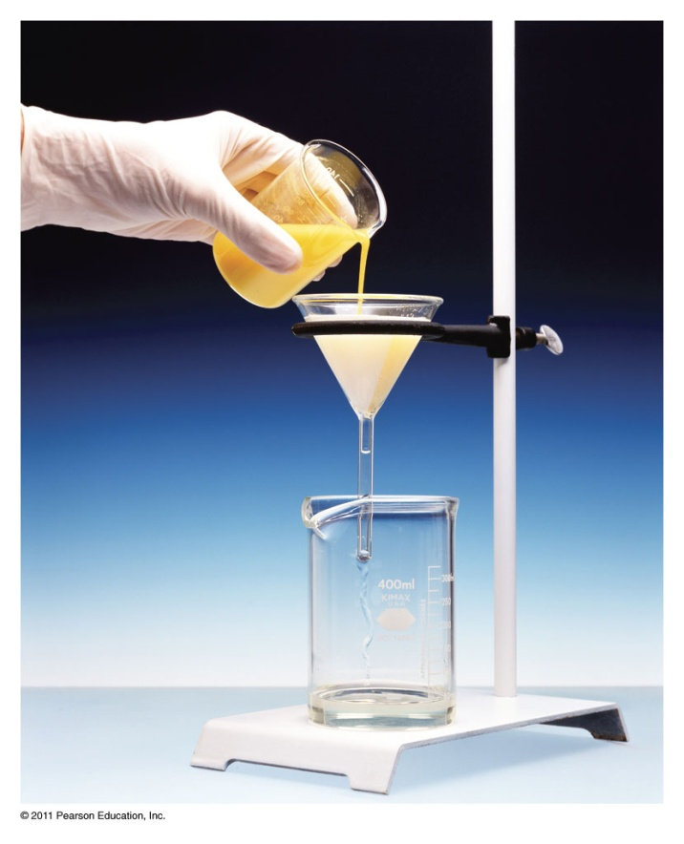
What techniques can be used to separate mixtures?
Chromatography
Filtration

Slide 23
Example – Classification of Matter
Classify an egg as a(n)
A. element
B. compound
C. heterogeneous mixture
D. homogeneous mixture

Slide 24
Example – Classification of Matter
Classify copper wire as a(n)
A. element
B. compound
C. heterogeneous mixture
D. homogeneous mixture

