Slide 1
The Gaseous State of Matter
Chapter 12
Outline
Kinetic Molecular Theory
Properties of Gases
Gas Pressure
Gas Laws
Boyle’s Law
Charles’ Law
Combined Gas Law
Avogadro’s Law
Ideal Gas Law
Dalton’s Law
Reactions Involving Gases

Slide 2
Kinetic Molecular Theory
Gases consist of molecular particles moving in straight lines at any given instant.
Gas molecules are widely spaced, the actual volume of molecules is negligible compared to the space they occupy.
Gas molecules demonstrate rapid motion, move in straight lines and travel in random directions. When they collide with each other they do so with no net loss of energy.
Gas molecules behave independently -- attractive/repulsive forces between them are negligible.
The average kinetic energy of the gas particles is proportional to the temperature.

Slide 3
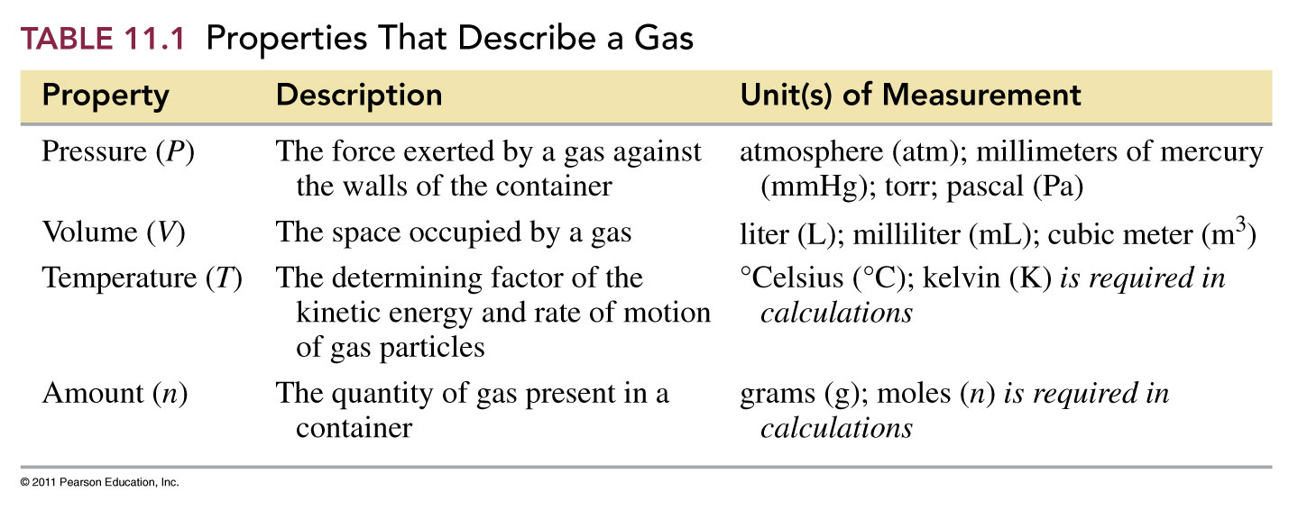
What properties describe a gas?

Slide 4
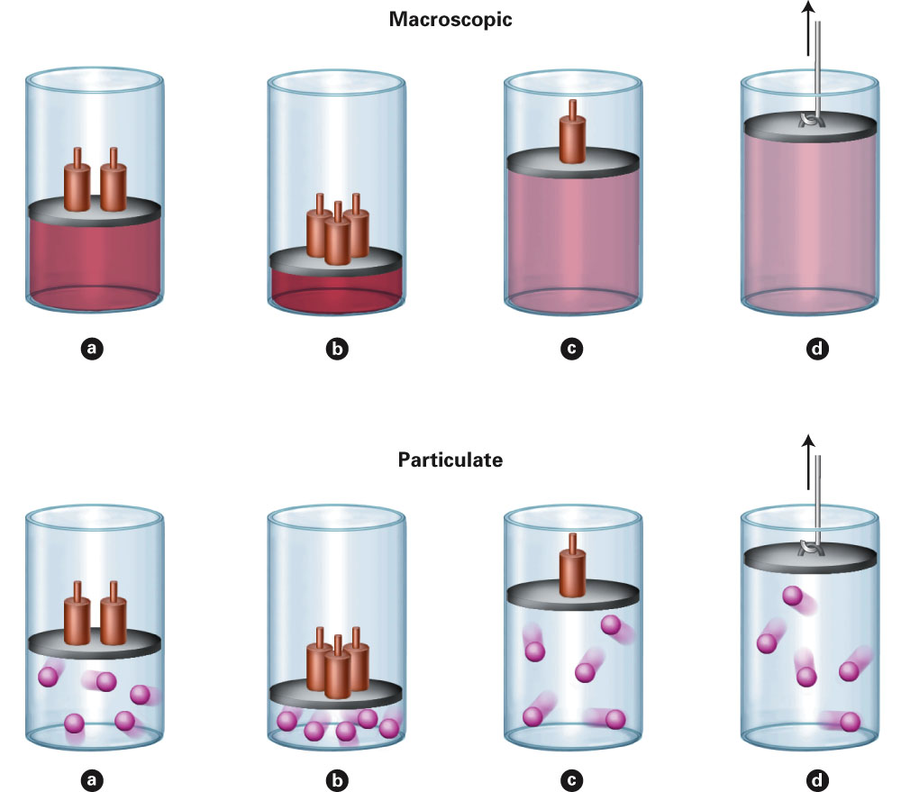
Fig. 4-1, p. 100

Slide 5
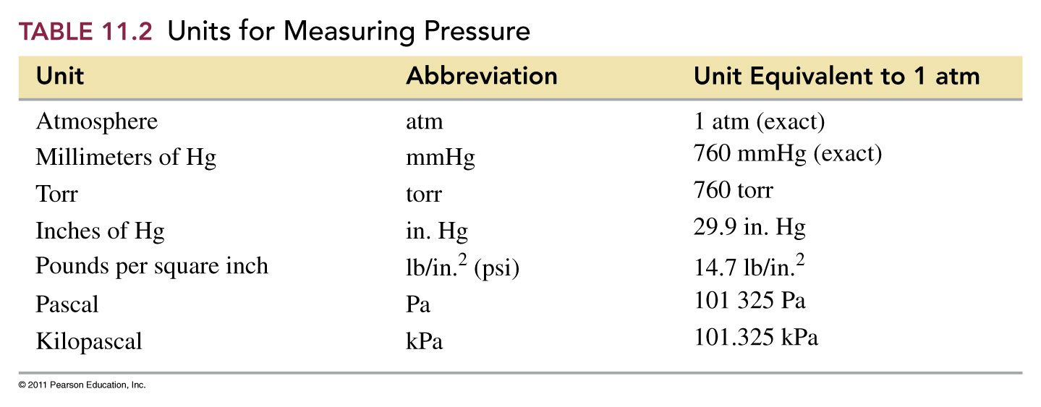
What are the units of pressure?
101.325 kPa = 760 mm Hg ≡ 760 torr ≡ 1 atm = 14.7 psi = 29.9 in Hg

Slide 6
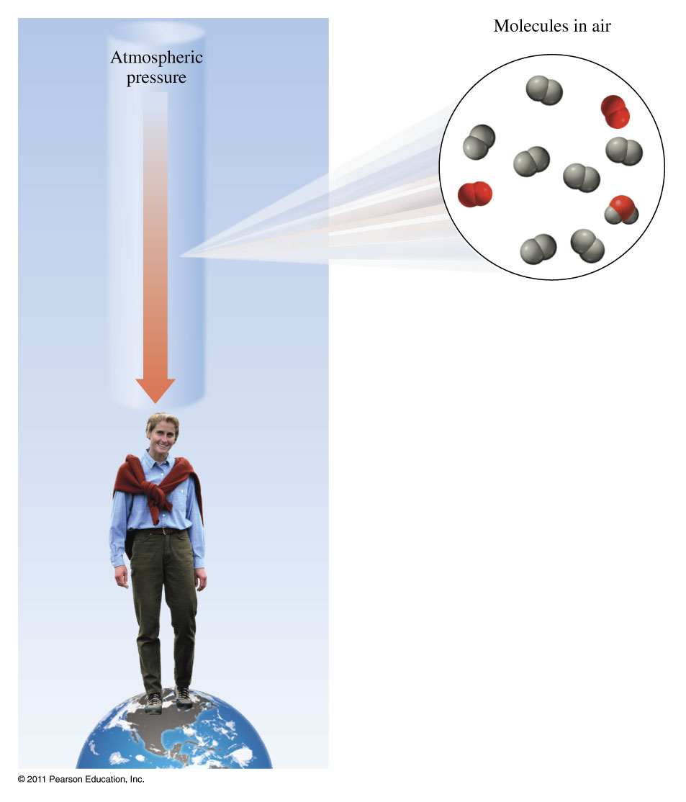
What is atmospheric pressure?

Slide 7
How far could the atmospheric pressure cause a column of water to go?

Slide 8
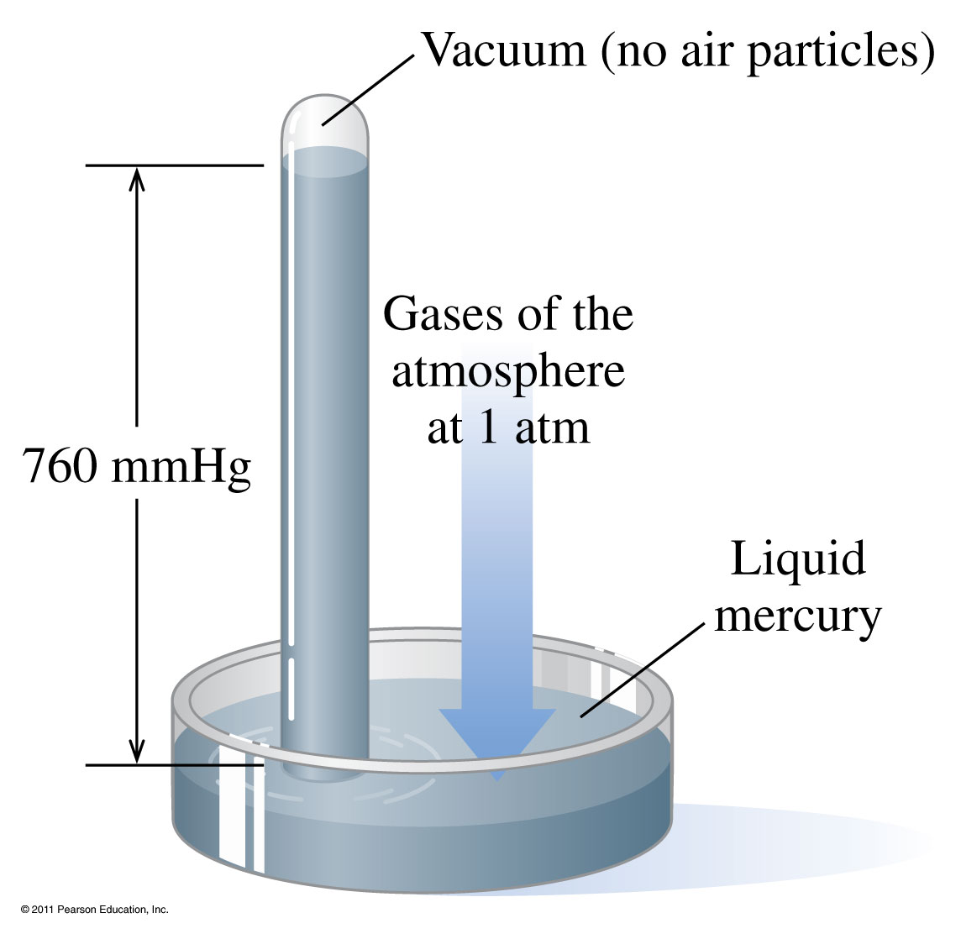
How does the atmospheric pressure change the height of the mercury column?

Slide 9
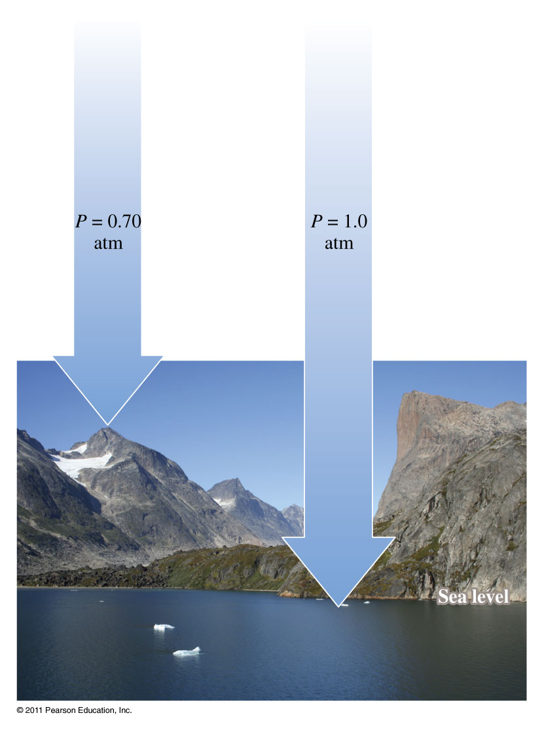
Example – Dimensional Analysis
The atmospheric pressure at the summit of Mt. McKinley (Denali) is 606 mm Hg on a certain day. What is the pressure in atmospheres?

Slide 10
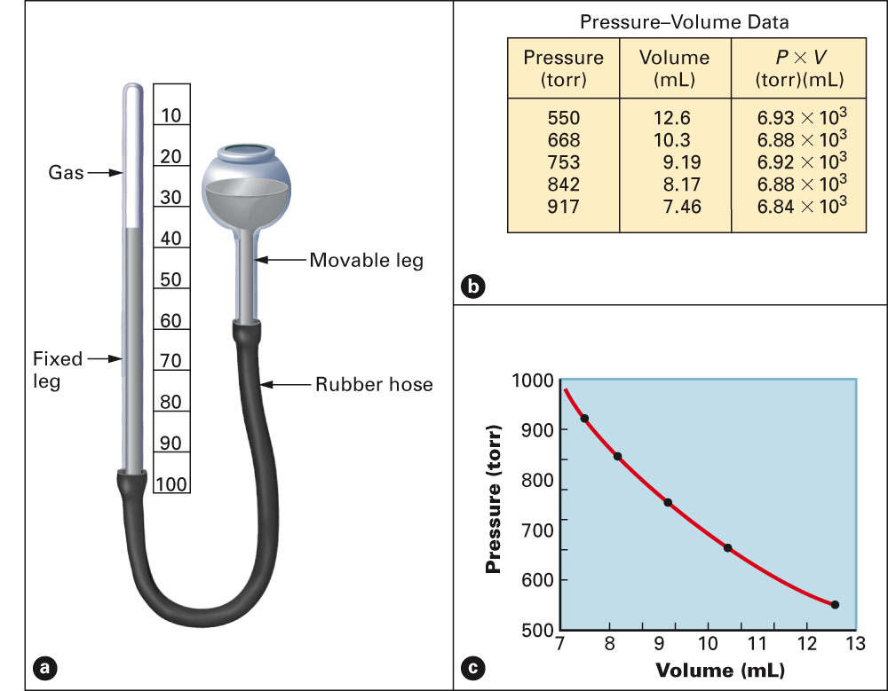
What properties of a gas does Boyle’s Law describe?
Fig. 4-14, p. 112

Slide 11
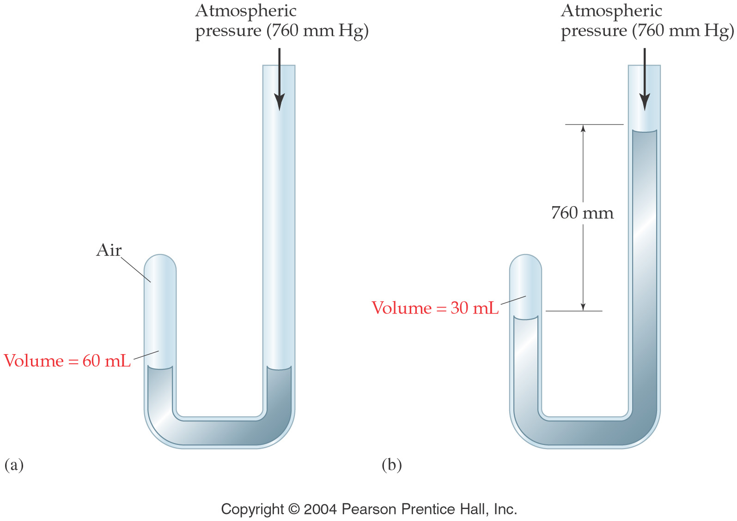
How are volume and pressure related?
Volume is inversely proportional to pressure

Slide 12
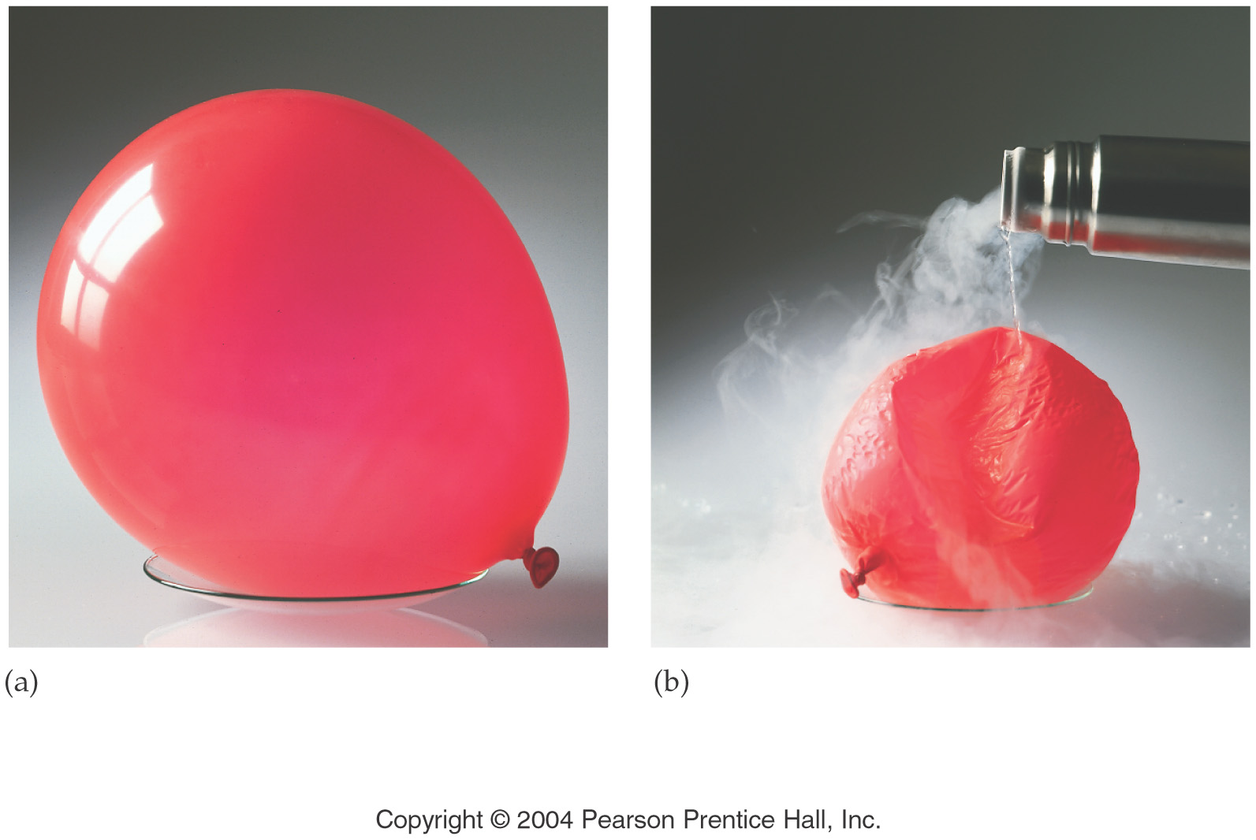
What properties of a gas does Charles’ Law describe?
Volume is proportional to temperature

Slide 13
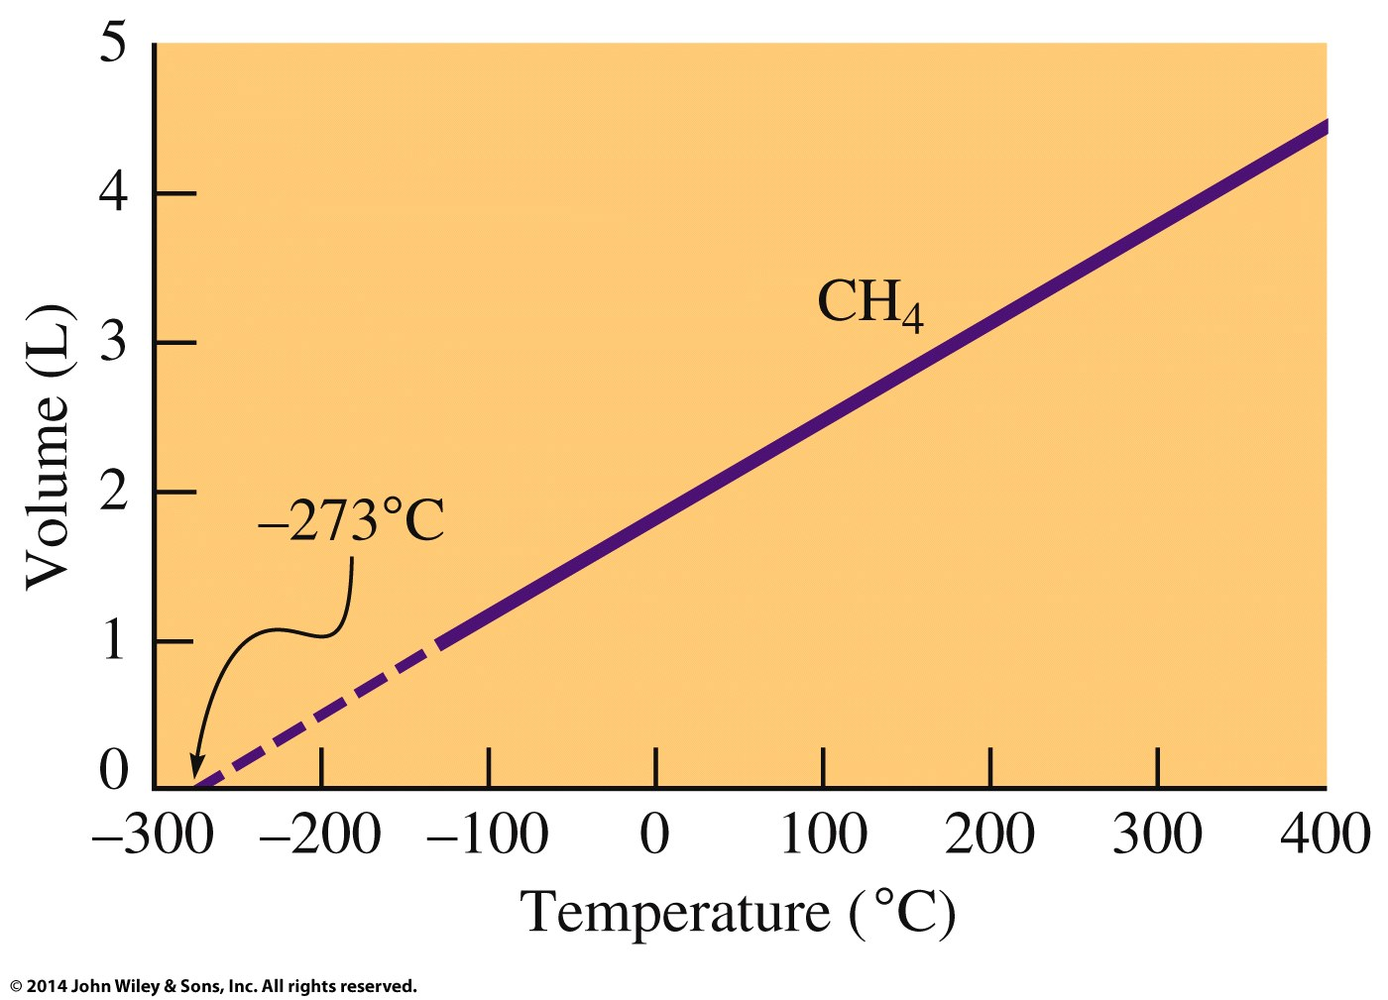
What is the relationship between volume and temperature?

Slide 14
How do gas volume’s combine?

Slide 15
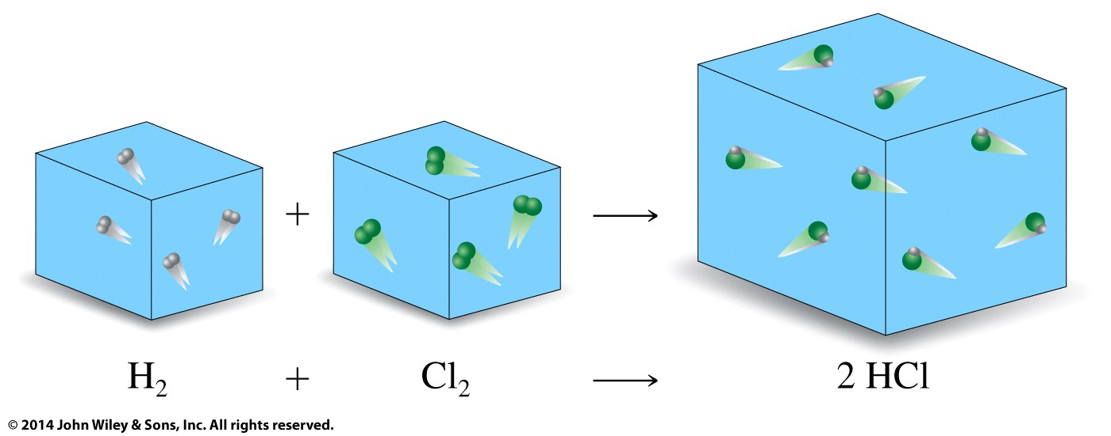

Slide 16
What properties of a gas does Gay-Lussac’s Law describe?
Temperature is proportional to pressure

Slide 17
What is vapor pressure?

Slide 18
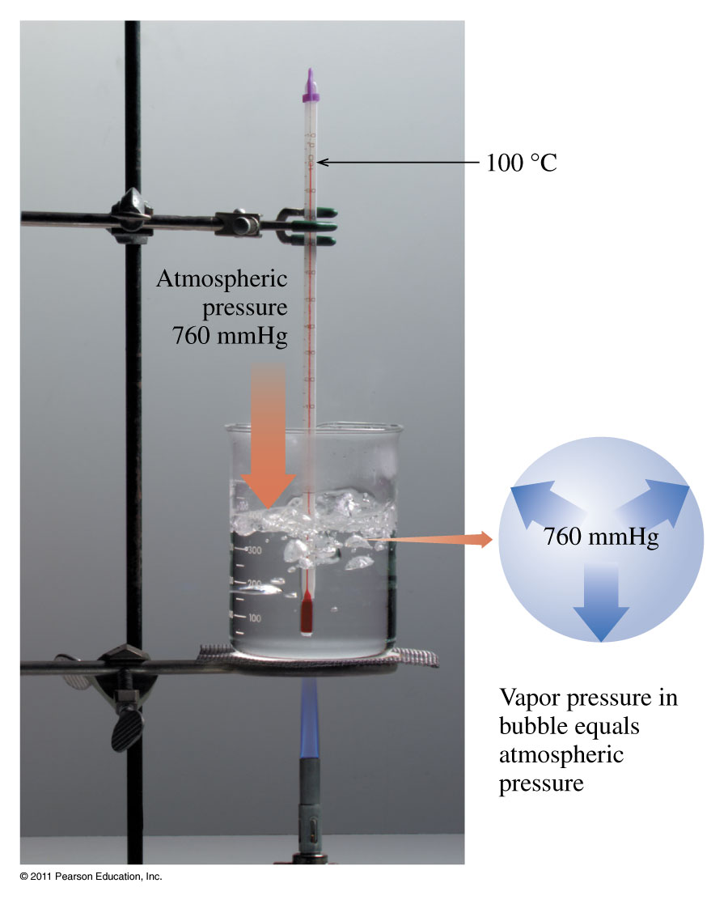
How are vapor pressure and the boiling point of water related?

Slide 19
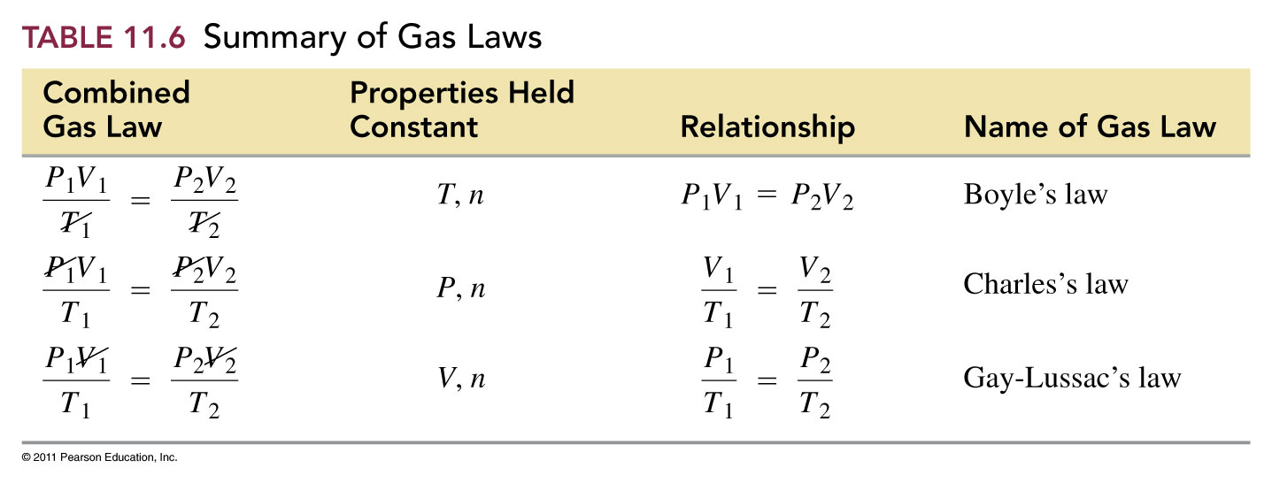
How can we use the combined gas law to determine the other gas laws?

Slide 20
What properties of a gas does Avogadro’s Law describe?
1 volume
1 molecule
1 mol
1 volume
1 molecule
1 mol
2 volumes
2 molecules
2 mol
Volume is proportional to moles

Slide 21
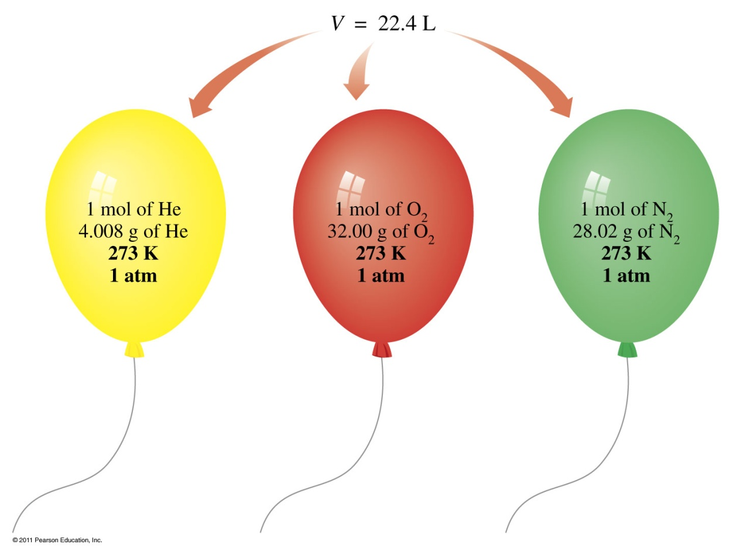
What is standard temperature and pressure (STP)?
The molar volume of a gas is about the same as the volume of three basketballs.

Slide 22
What are the Gas Laws?
Boyles Law pressure ⇑ -- volume ⇓
P ∝ 1/V
Charles Law temperature ⇑ -- volume ⇑
V ∝ T
Avogadros Law moles ⇑ -- volume ⇑
V ∝ n
Gay Lussac Law temperature ⇑ -- pressure ⇑
P ∝ T

Slide 23
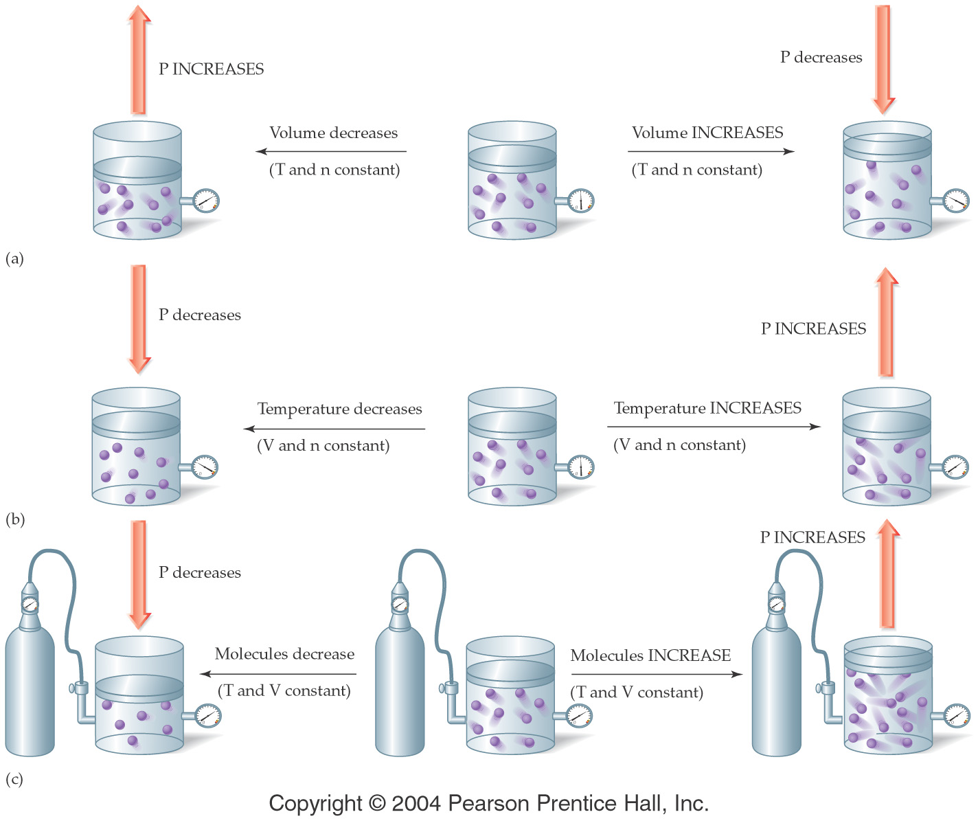

Slide 24
What is the Ideal Gas Law?
PV = nRT
P = pressure
(typical units are atm or torr or mm Hg)
V = volume (typical units are L)
n = number of moles
T = temperature (must be in K)
R = gas constant
= 0.0821 L atm/mol K
= 62.4 L torr/mol K

Slide 25
Example – Gas Laws
An inflated balloon has a volume of 0.55 L at sea level (1.0 atm) and is allowed to rise to a height of 6.4 km, where the pressure is about 0.40 atm. Assuming that the temperature and number of moles of gas remains constant, what is the final volume of the balloon?

Slide 26
Example – Gas Laws
A bicycle tire has a pressure of 2000. torr in Death Valley when the temperature is 38 °C. What would the pressure be if you took the bike to Lake Tahoe where the temperature was 0 °C?

Slide 27
Example – Gas Laws
A small bubble rises from the bottom of a lake, where the temperature and pressure are 8 °C and 6.4 atm, to the surface, where the temperature and pressure are 25 °C and 1.0 atm. Calculate the final volume of the bubble if its initial volume was 21 mL.

Slide 28
Example – Gas Laws
Sulfur hexafluoride (SF₆) is a colorless, odorless, very unreactive gas. Calculate the pressure (in atm) exerted by 1.82 moles of the gas in a steel vessel of volume 5.43 L at 69.5 °C.

Slide 29
Example – Gas Laws
Calculate the volume in liters occupied by 7.40 g of CO₂ at 735 torr and 25 °C.

Slide 30
Example – STP
Standard Temperature and Pressure (STP):
T = 0 °C = 273 K, P = 1 atm ≡ 760 torr
Calculate the volume of 1.00 mole of a gas at STP.
What volume will 3.21 moles of Ne occupy at STP?

Slide 31
Example – Gas Laws
Find the molar mass of an unknown gas that has a density of 1.45 g/L at 44 °C and 0.331 atm.

Slide 32
Example – Gas Laws
Calculate the density of Argon at STP.

Slide 33
Example - Gas Stoichiometry
C₃H_{8 (g)} + 5 O_{2 (g)} → 3 CO_{2 (g)} + 4 H₂O _{(g)}
How many mL of CO₂ can be generated from the reaction of 5.00 g C₃H₈ with excess oxygen at STP?
How many L of O₂ are required to react with 4.22 L of C₃H₈ at constant T and P?

Slide 34
Example – Gas Stoichiometry
Oxygen gas can be generated by heating potassium chlorate to a high temperature:
2 KClO_{3 (s)} → 2 KCl _{(s)} + 3 O_{2 (g)}
How much potassium chlorate, in grams, is needed to generate 7.50 L of oxygen gas at a pressure of 1.00 atm and a temperature of 37 °C?

Slide 35
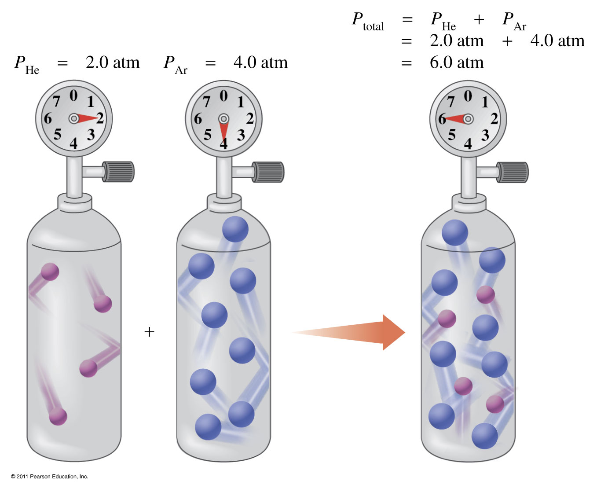
What is Dalton’s Law of Partial Pressure?
The total pressure of two gases is the sum of their partial pressures.

Slide 36
Example – Dalton’s Law
The atmosphere of Venus contains the following gases:
CO₂ 392 torr,
N₂ 834 torr
Ar 302 torr
What is the atmospheric pressure on Venus?

Slide 37
How are gases collected over water?

Slide 38
Graham's Law
Allows us to calculate relative rates of effusion for various gases.
Effusion - The escape of a gas through a small hole in its container.
Diffusion - The process by which two or more gases begin to mix together.
Graham's law says that the heavier a particle is (higher MW) the more slowly it will effuse or diffuse under the same conditions.

Slide 39
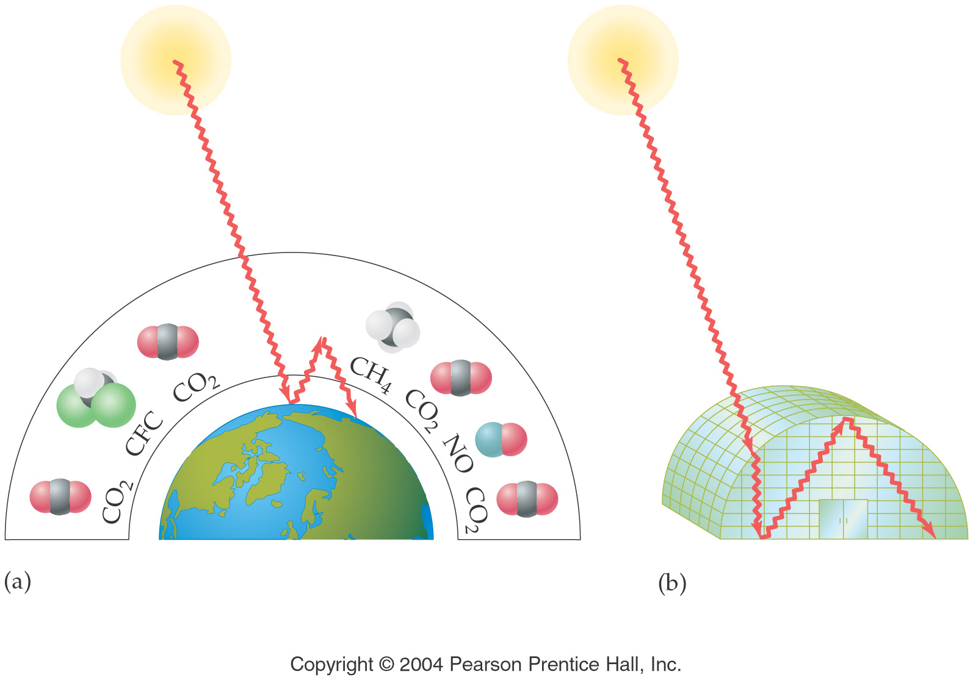
How do the gases in the Earth’s atmosphere affect the temperature?

Slide 40
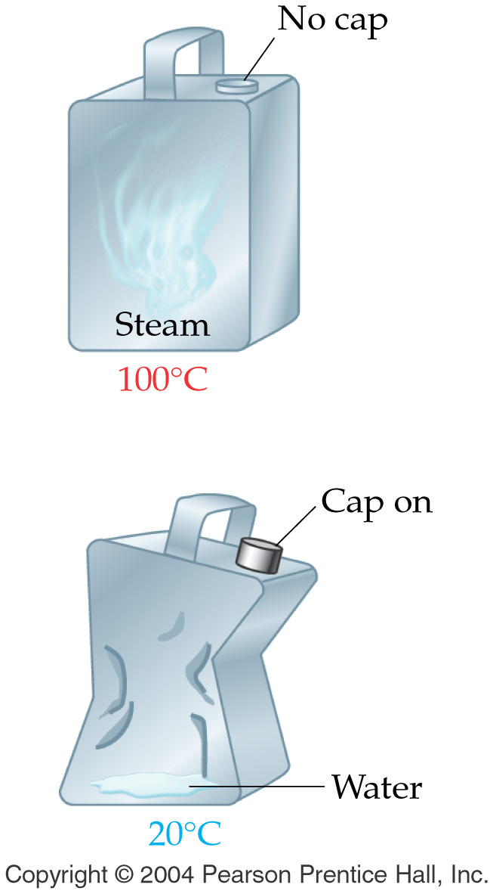
Example – Gas Laws
A few drops of water in a metal can are heated to steam and the can is promptly sealed. As the steam cools from 100 °C to 20 °C, the can is crushed as shown in the diagram. Explain the observation.

Slide 41
Example – Gas Laws
A container of 452 mL of argon is heated from 22 °C to 187 °C at constant pressure and number of moles of gas. What is its final volume?

Slide 42
Example – Gas Laws
Helium-filled balloons are used to carry scientific instruments high into the atmosphere. Suppose that a balloon is launched when the temperature is 22.5 °C and the barometric pressure is 754 mm Hg. If the balloon’s volume is 4.19 x 10³ L, what will it be at a height of 20 miles, where the pressure is 70.0 mm Hg and the temperature is −33.0 °C?

Slide 43
Example – Gas Laws
A sample of nitrogen gas kept at 32 °C in a 2.3 L container exerts a pressure of 4.7 atm. Calculate the number of moles of gas present.

Slide 44
Example – Gas Laws
Chlorine is widely used to purify municipal water supplies and to treat swimming pool waters. Chlorine is stored in stainless steel cylinders of 30.0 L capacity at a pressure of 160 lb/in² at 26 °C.
To what temperature may the cylinder be raised if it is rated to a maximum pressure of 5.35 atm? (14.7 psi = 1 atm)

Slide 45
Example – Gas Laws
A ¾ full propane tank has a pressure of 3.2 atm at a temperature of 25 °C. If you put the tank in the back of your car for a barbecue at the beach and the temperature reaches 43 °C, what is the new pressure of the propane in the tank?

Slide 46
Example – Gas Laws
What volume will 4.83 moles of a gas occupy at 35 °C and 1.15 atm pressure?

Slide 47
Example – Gas Laws
The nitrogen gas in an air bag with a volume of 35 L, exerts a pressure of 850 mm Hg at 25 °C. How many grams of N₂ are in the bag?

