Slide 1
Nuclear Chemistry
Chapter 18
Outline
Types of Radiation
Nuclear Equations
Radiation Measurements
Half-Life
Applications
Nuclear Fission and Fusion

Slide 2
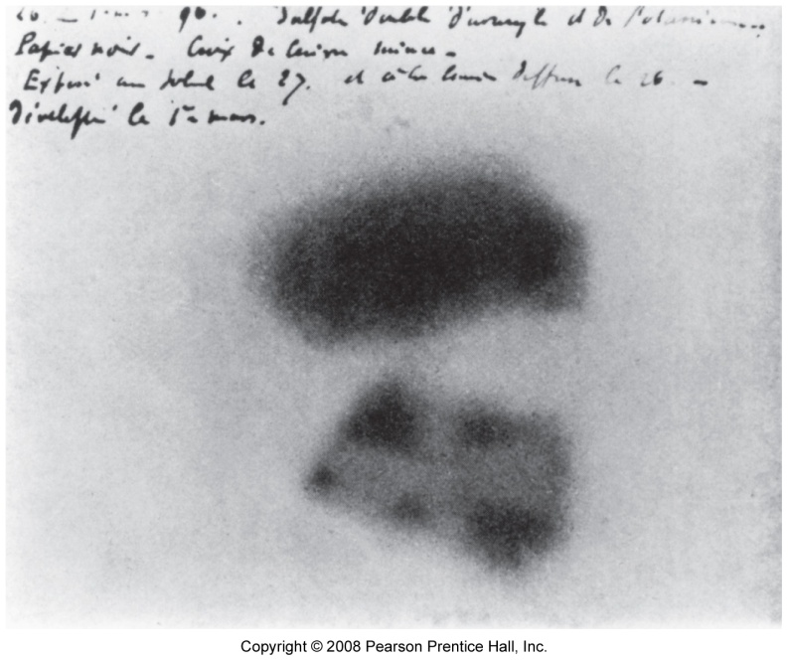
Image left by uranic rays

Slide 3
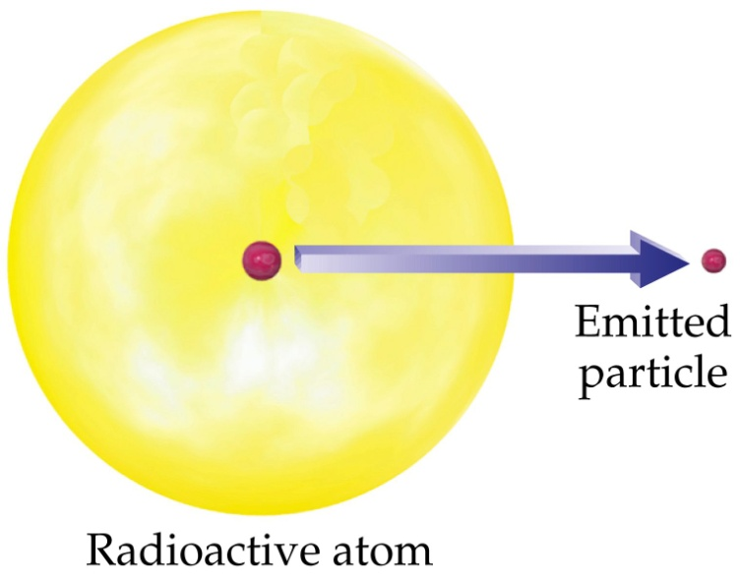
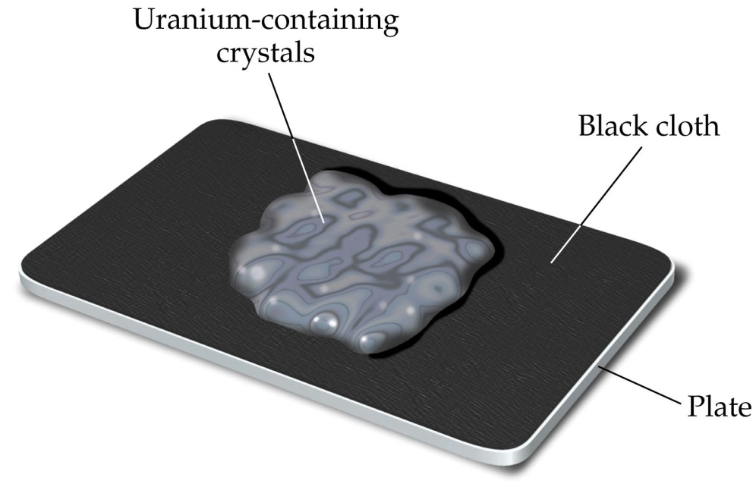
Radioactive Decay

Slide 4
Types of Radiation and Their Penetrating Abilities
α
γ
β
0.01 mm 1 mm 100 mm
Pieces of Lead
Notes:
Alpha Particle – Identical to He nucleus. Contain 2 protons and 2 neutrons. Travels at 10% of the speed of light. Stopped by paper and clothing.
Beta Particle – Identical to an electron. Travels at approximately 90% of the speed of light. Stopped by aluminum foil, several cm of wood, or ~1 cm of flesh.
Gamma Ray – Similar to X-rays, but more powerful. Travels at the speed of light. Can be stopped by 10 cm of lead or 30 cm of concrete.
Positron Particle – This particle is similar to a beta particle, it is positively charged.

Slide 5
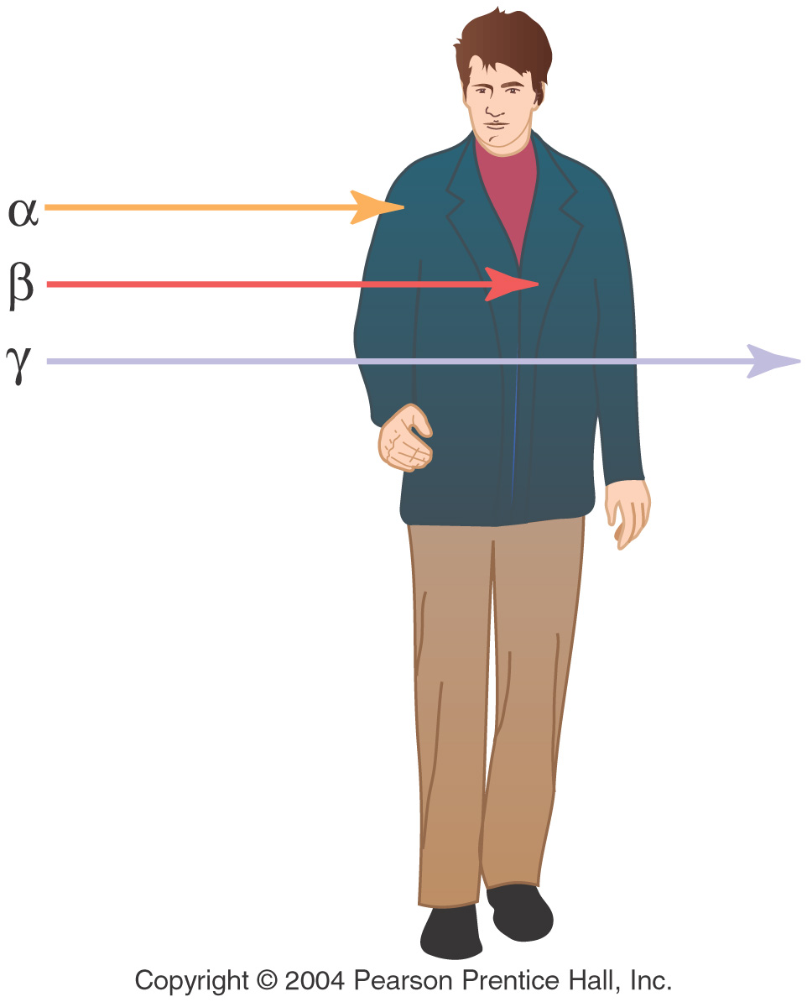

Slide 6
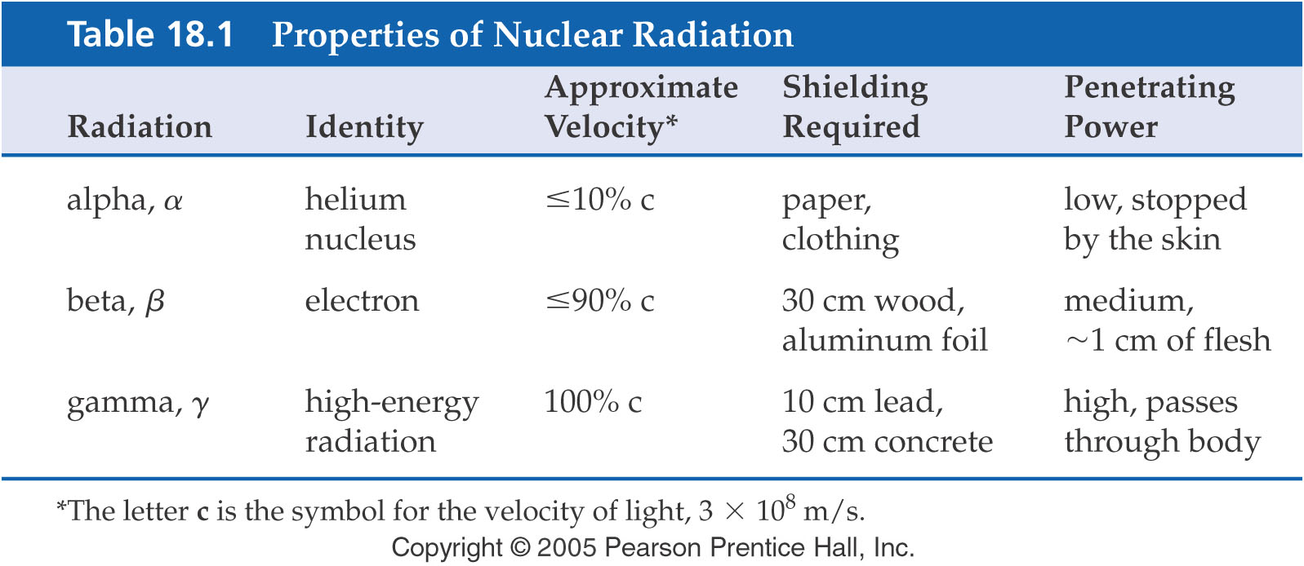

Slide 7
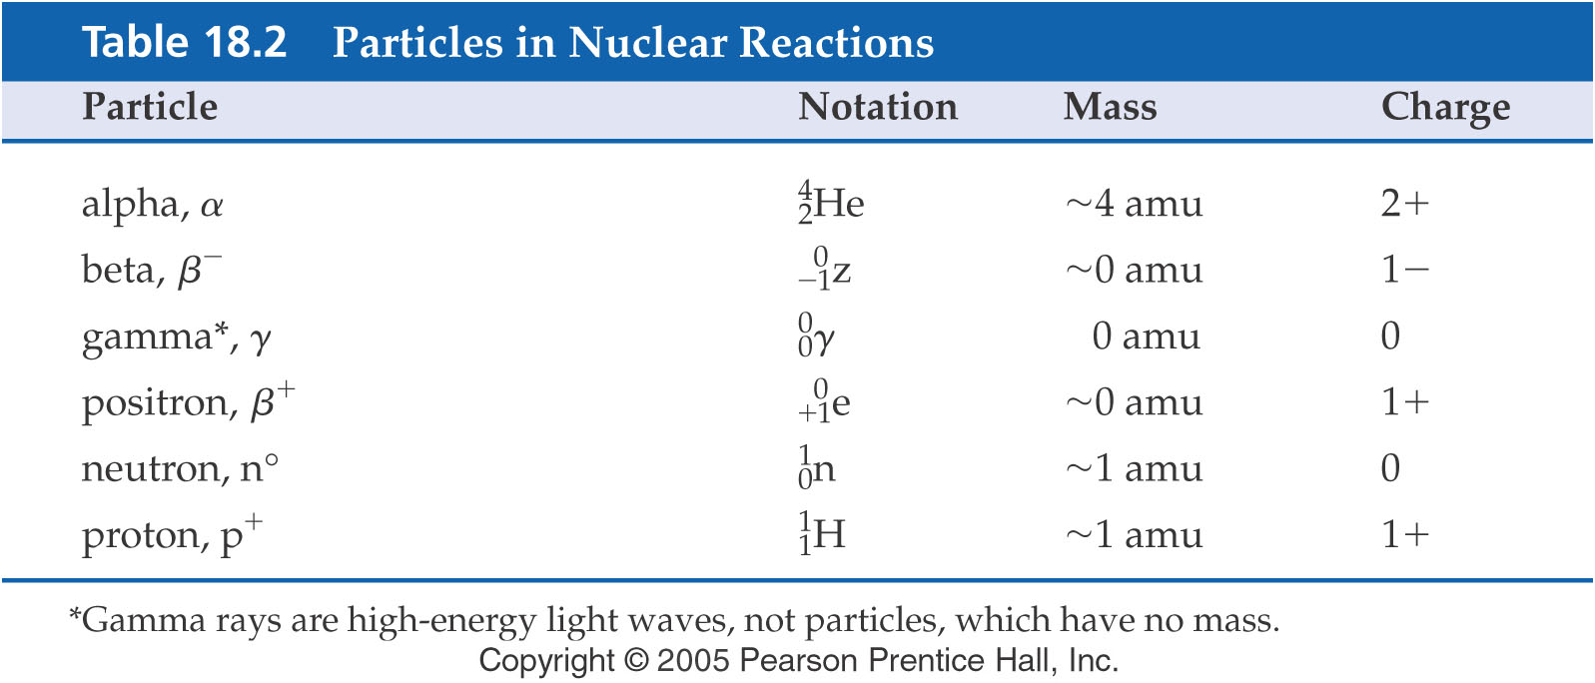
Types of radioactive decay
alpha particle emission
beta emission
positron emission
electron capture
gamma emission

Slide 8
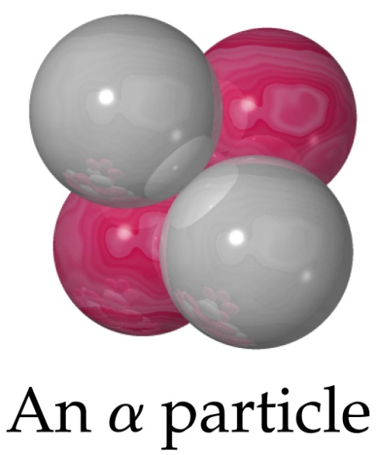
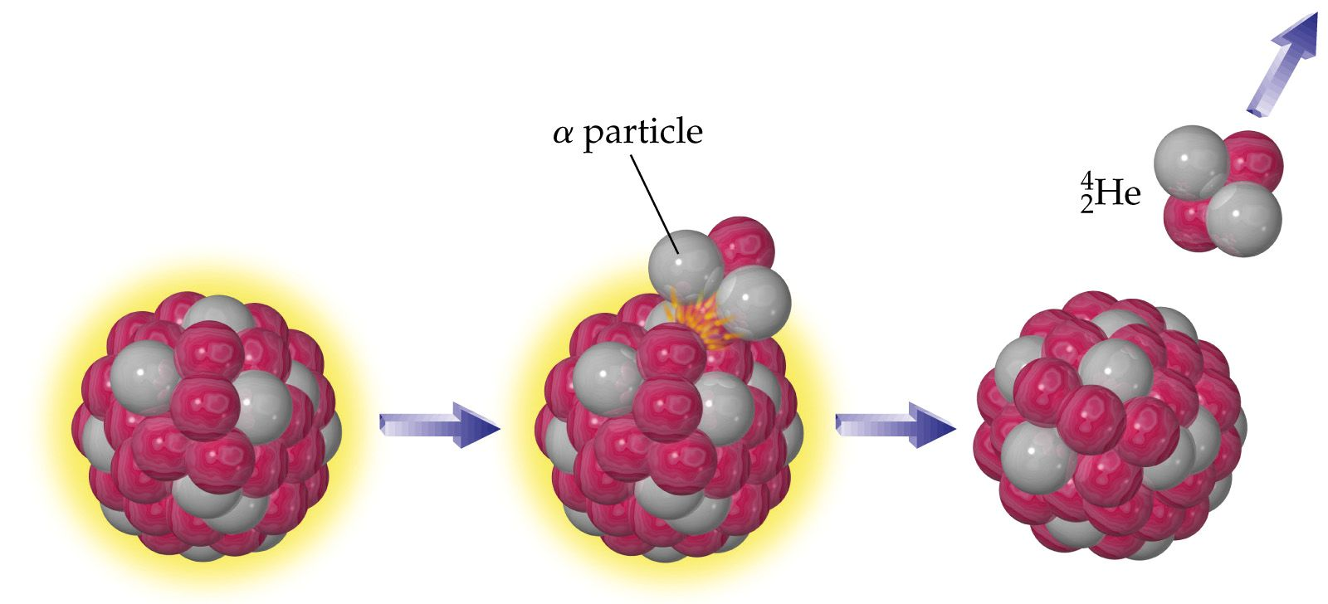
Types of radioactive decay
alpha particle emission

Slide 10
Example – Radioactive Decay
Write the nuclear reaction when Pu-239 (plutonium-239) loses an alpha particle (He nucleus).

Slide 11
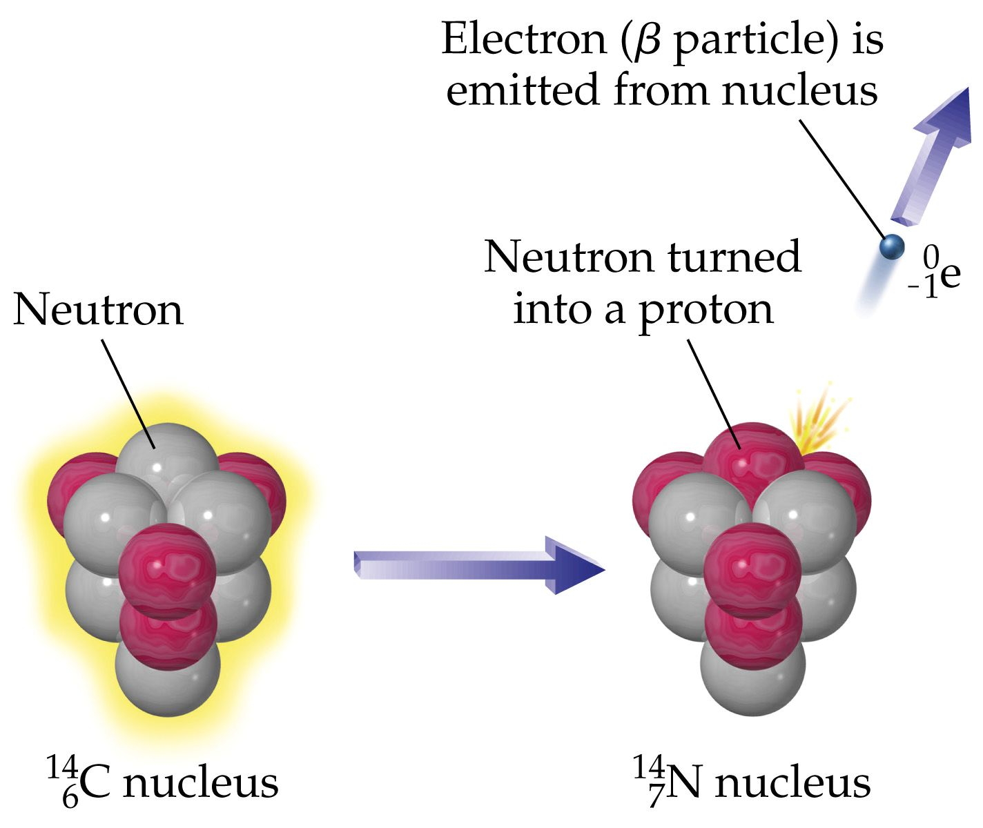
Types of radioactive decay
beta emission

Slide 12
β particle emission

Slide 13
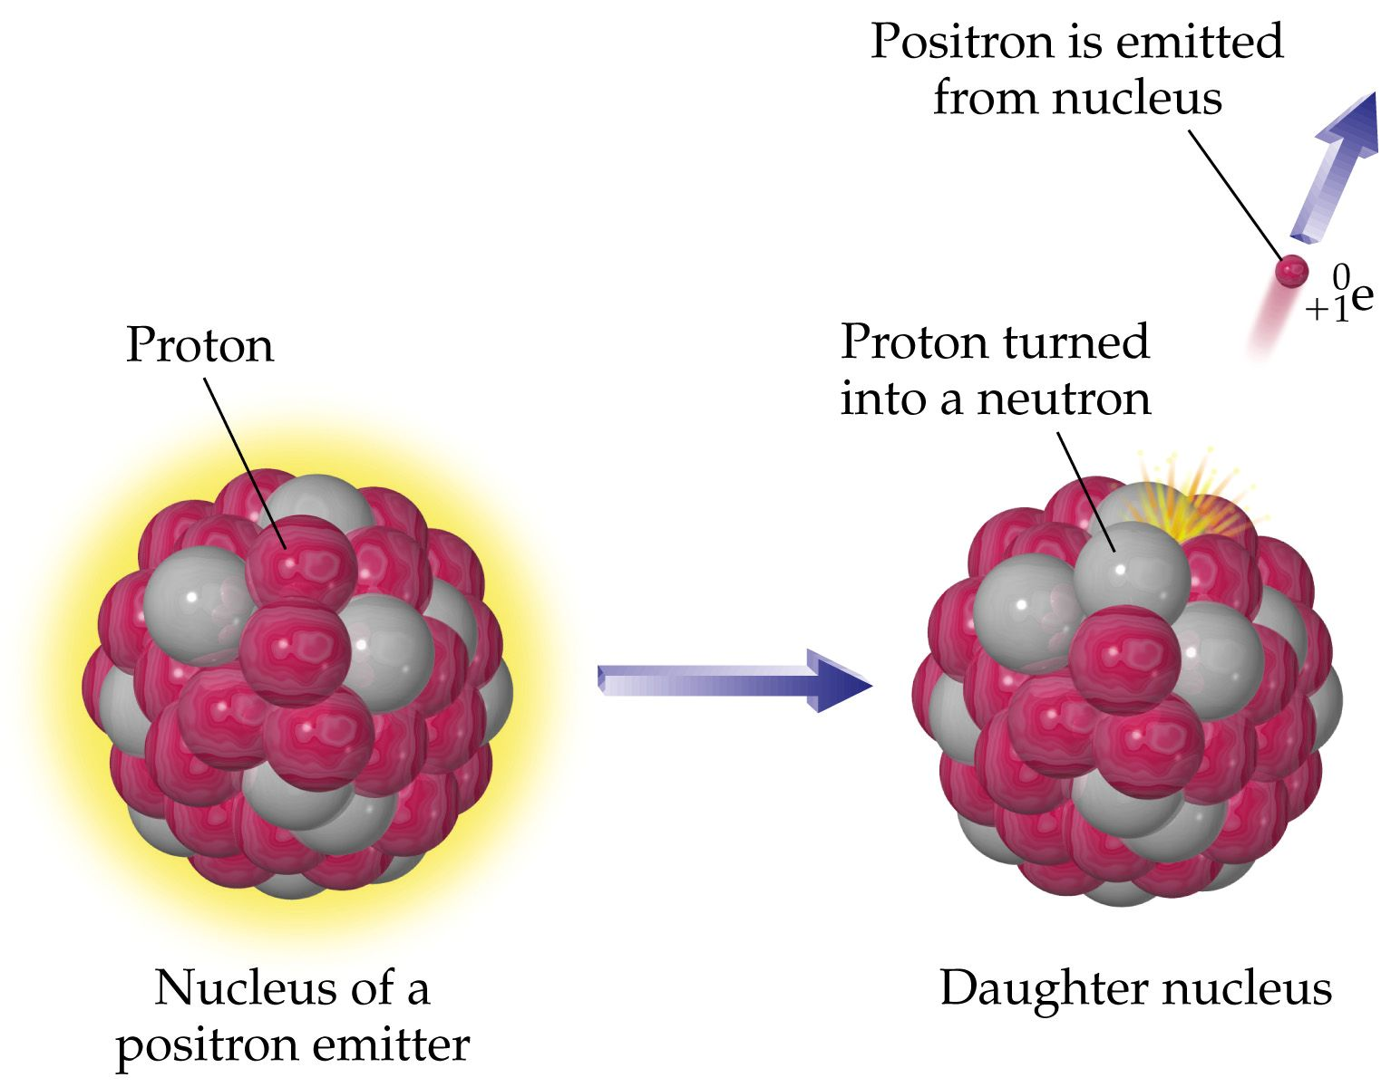
Types of radioactive decay
positron emission

Slide 14
Types of radioactive decay
electron capture (EC)
gamma emission

Slide 15
Stability
Notes:
Stability means measurable half-life
Nonradioactive = indefinitely stable
When 3000 known are plotted, fall within “band”
Within “band” all but 264 disintegrate spontaneously
Every element has at least 1 radioactive isotope
H is only element whose most abundant isotope contains more protons than neutrons
Ratio of neutrons to protons gradually increases for elements heavier than Ca (curved band)
All isotopes heavier than Bi-209 are radioactive
Of 264 nonradioactive 207 have even number of neutrons. Most have even protons & neutrons (156), 51 have an even number of neutrons but odd number of protons, and only 4 have odd both protons & neutrons

Slide 16
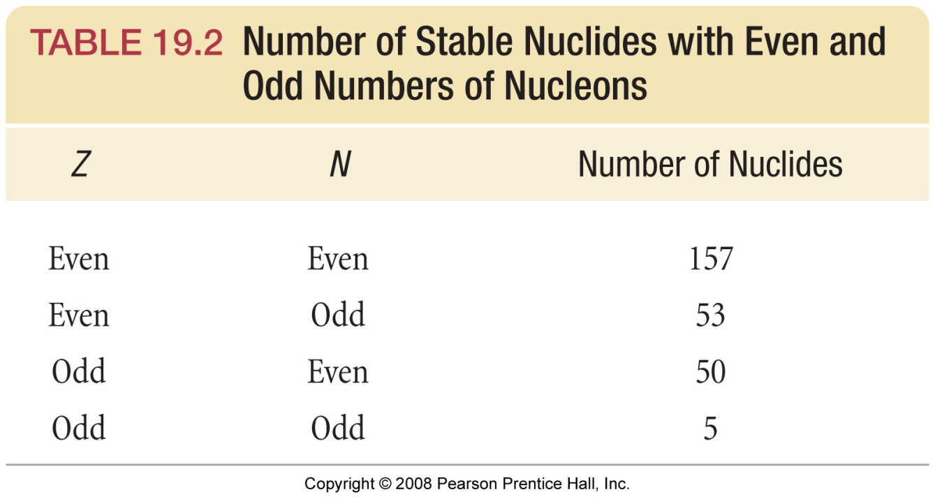

Slide 17
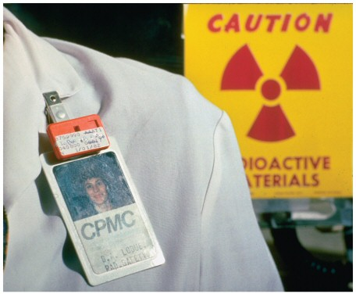
Detecting Radioactivity Film Badge Electroscope
+++
+++
Notes:
When charged, the metal foils spread apart due to like charge repulsion
When exposed to ionizing radiation, the radiation knocks electrons off the air molecules, which jump onto the foils and discharge them, causing them to drop down.

Slide 18
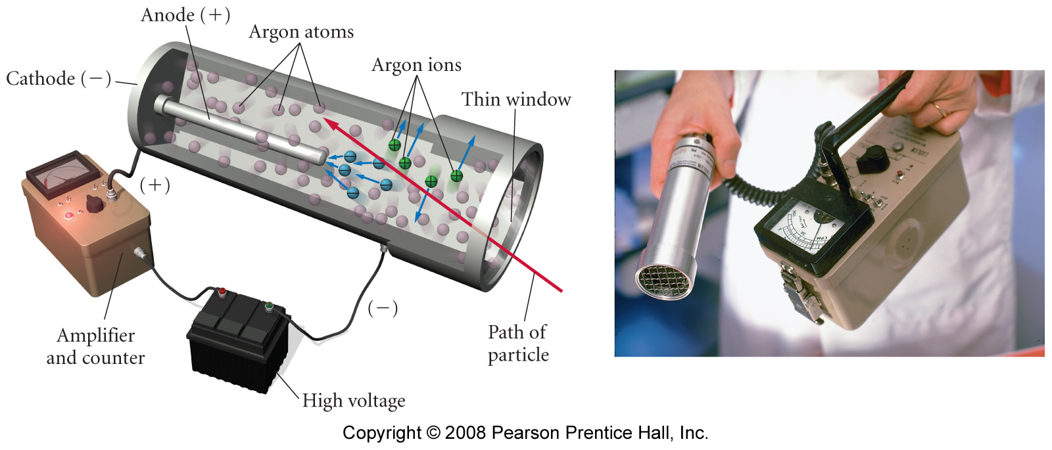
Detecting Radioactivity Geiger-Müller Counter (Geiger Counter)

Slide 19
Radiation Detection – Geiger Counter

Slide 20
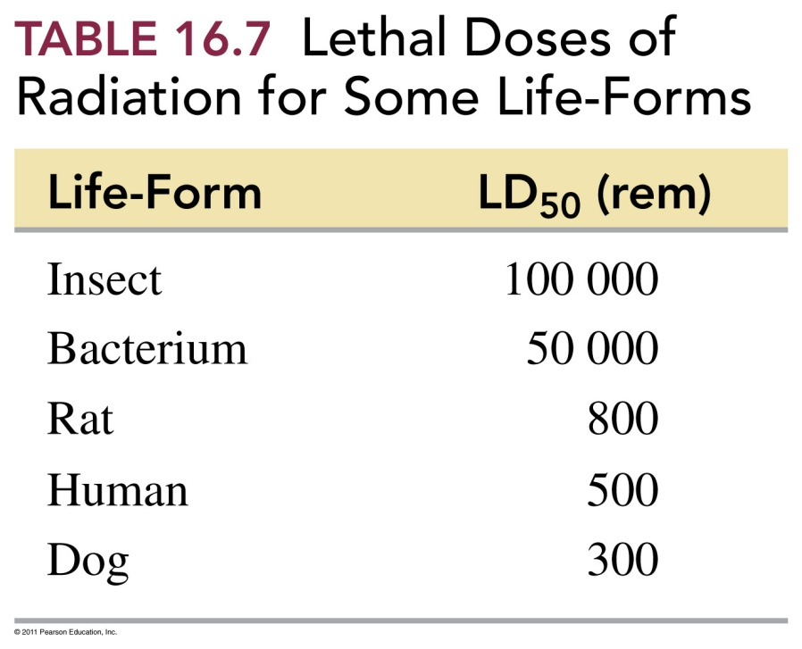

Slide 21
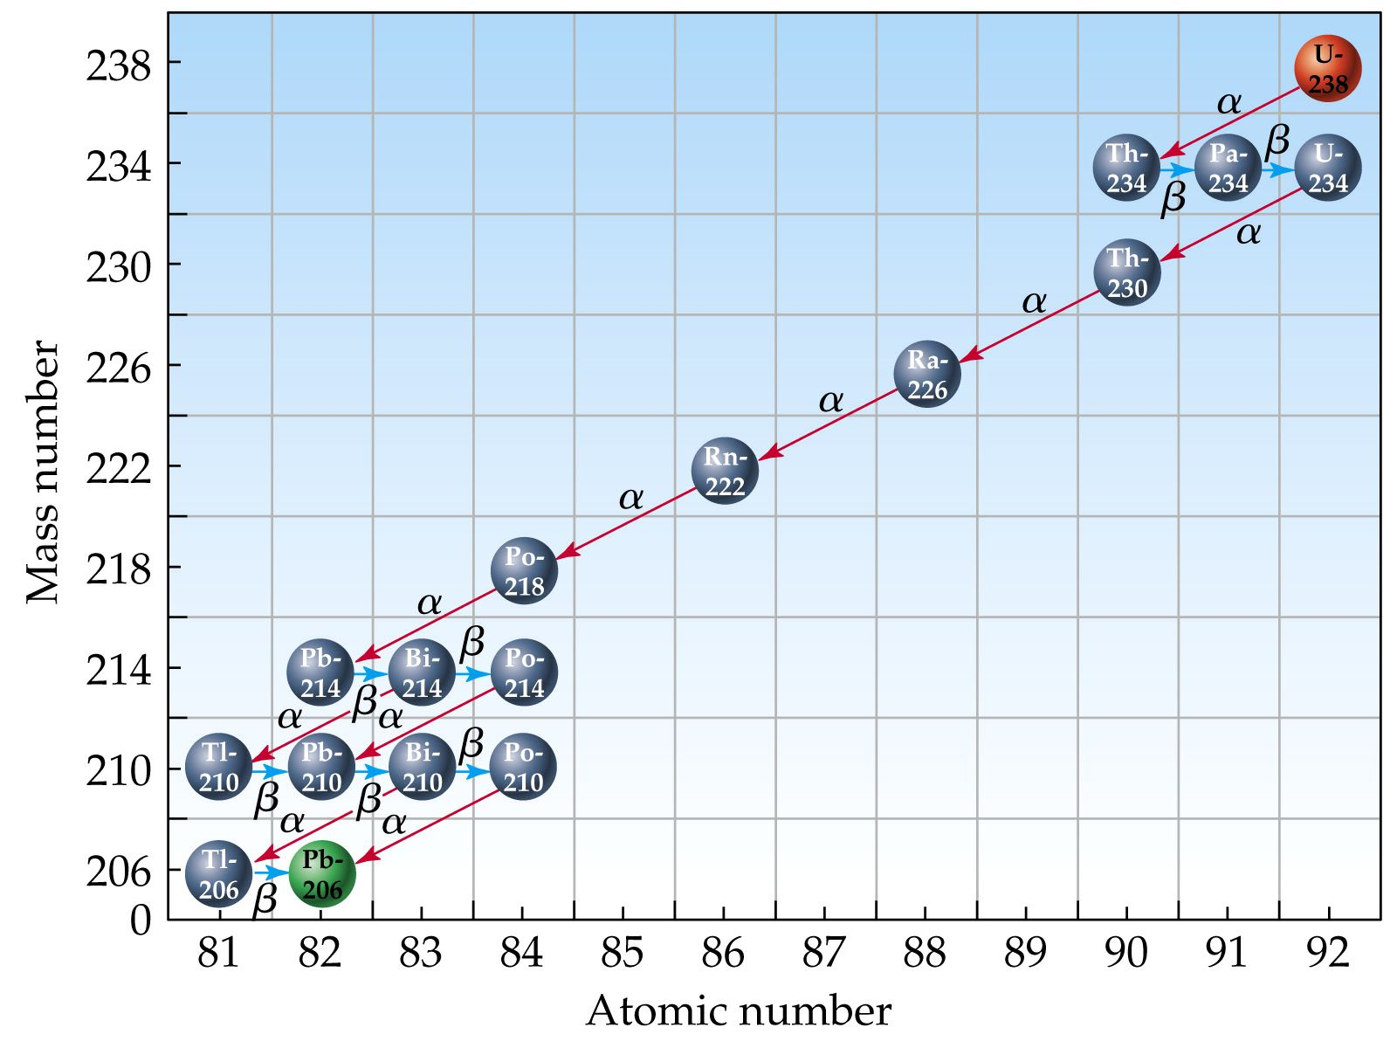
Radioactive Decay Series

Slide 22
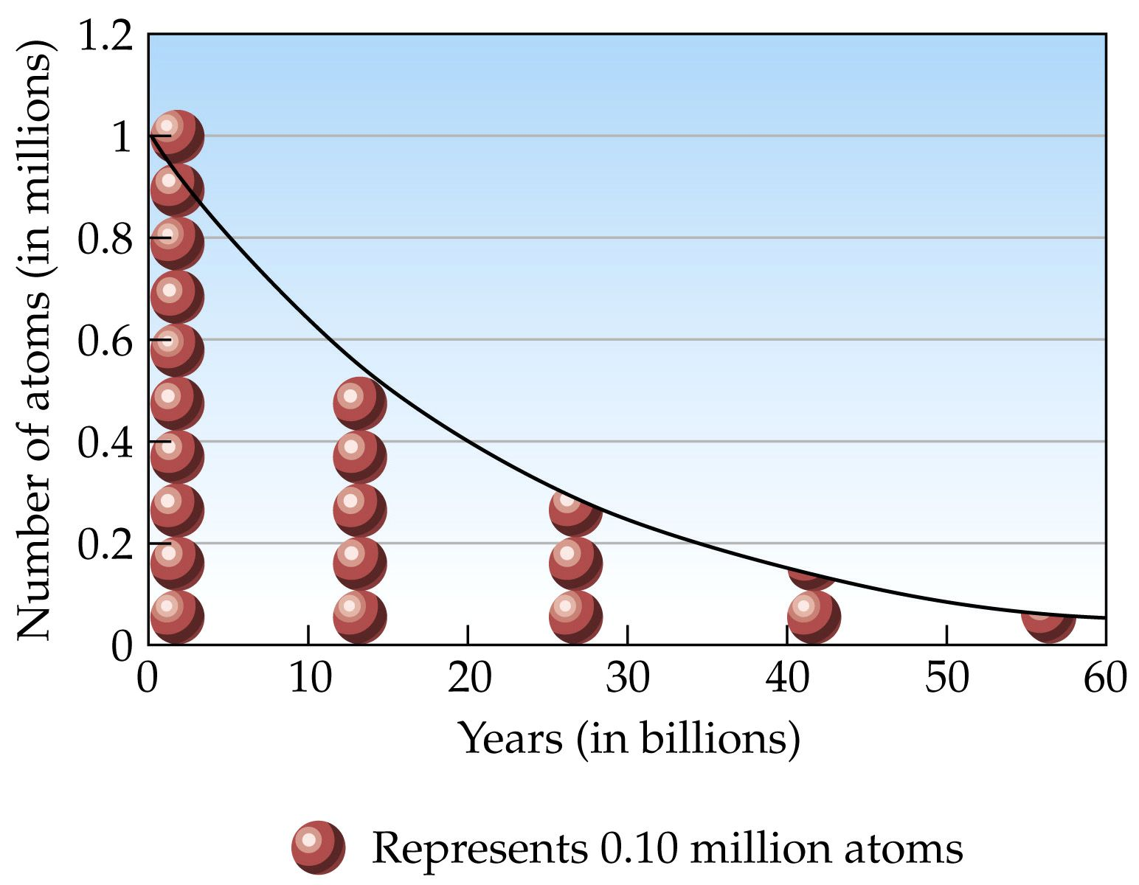
Radioactive Decay Curve

Slide 24
Example – Half-Life
If a radioactive isotope has a half-life of 20 minutes, what percent of the sample will remain after 1 hour?

Slide 25
Example – Half-Life
Hydrogen-3 is used as a chemical tracer. If 2400 µg of hydrogen-3 decays to 600 µg after 24.8 years, what is the half-life of this radionuclide?

Slide 26
Example – Half-Life
If an iridium-192 sample has an initial activity of 560 dpm (disintegrations per minute), how much time is required for the activity to drop to 35 dpm, if the half-life of Ir-192 is 74 days?

Slide 27
Energy of Nuclear Reactions
6.01512 u + 1.00782 u ≠ 3.01603 u + 4.00260 u
7.02294 u ≠ 7.01863 u violate

Slide 28
What is fusion?

Slide 29
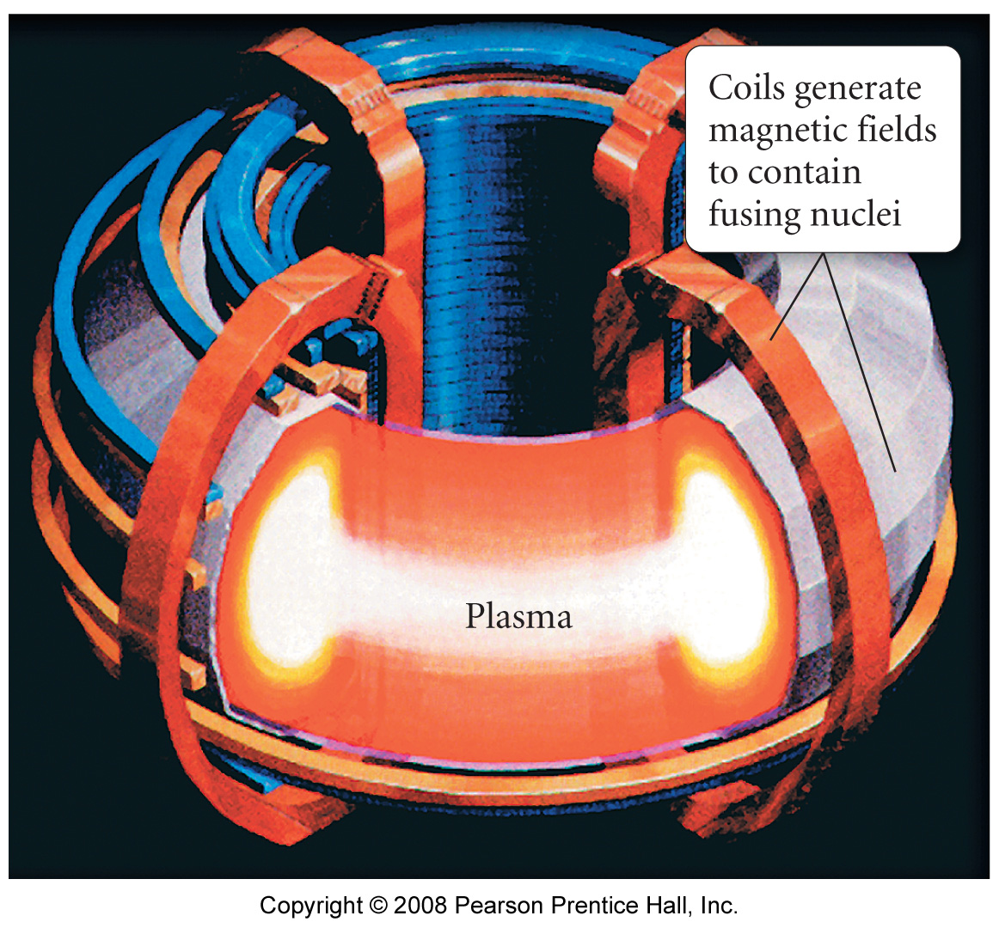
Tokamak Fusion Reactor

Slide 30
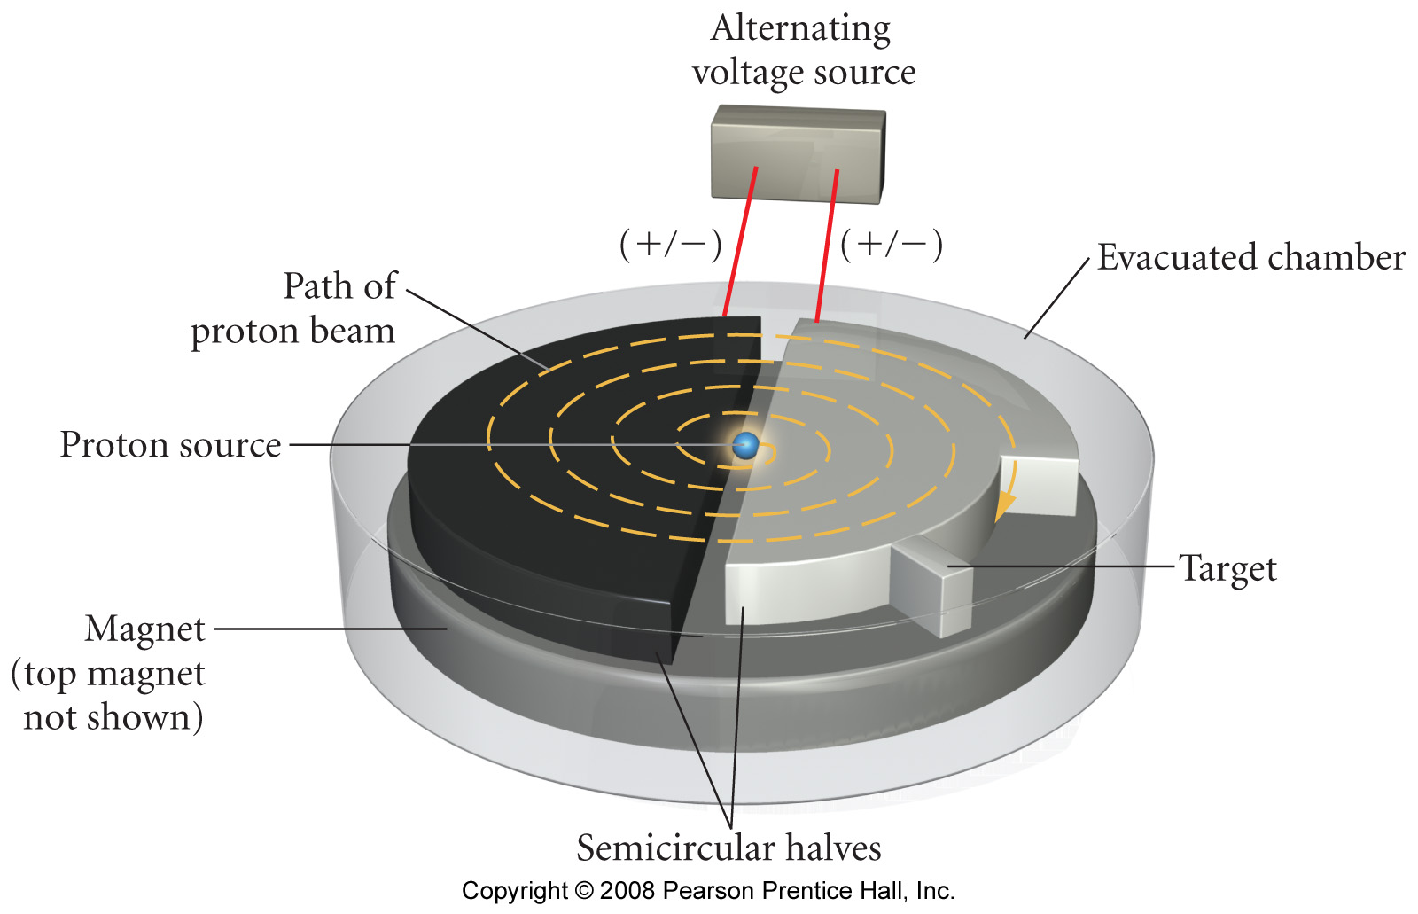
Cyclotron

Slide 31
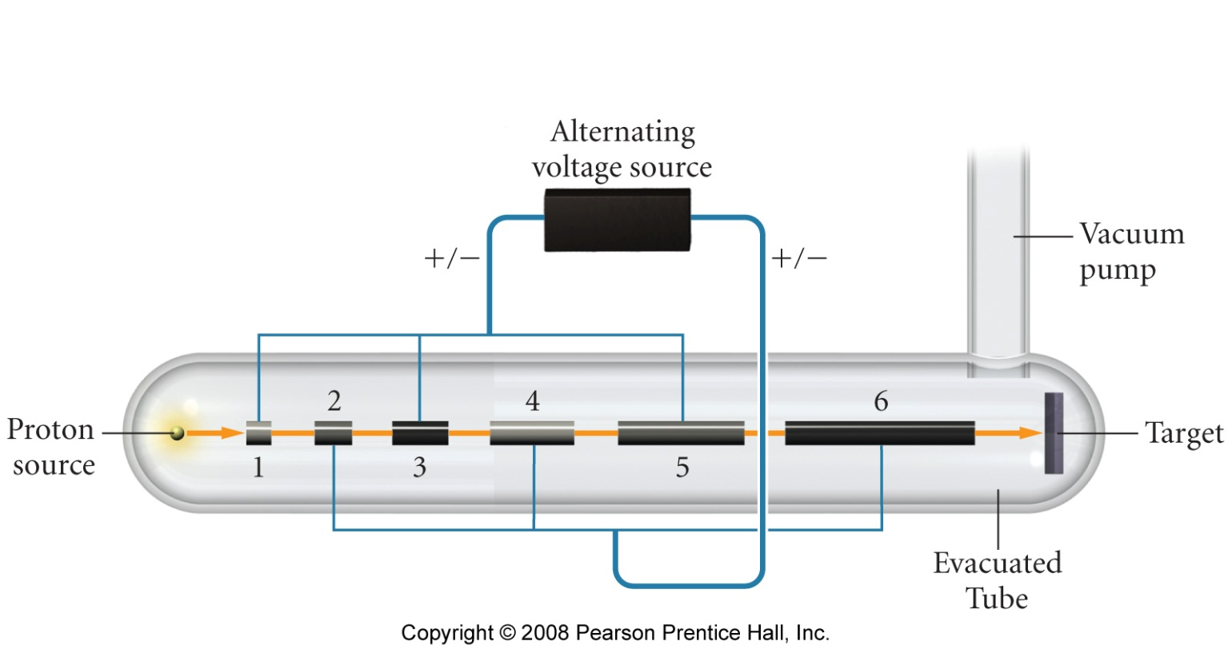
Linear Accelerator

Slide 32
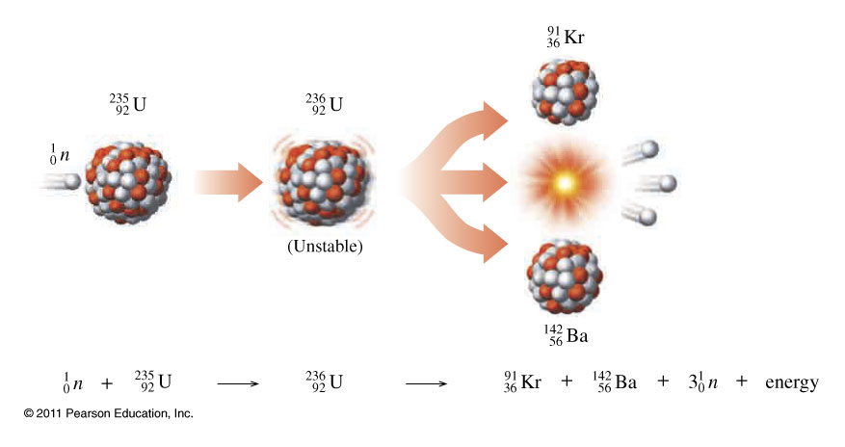
What is fission?

Slide 33
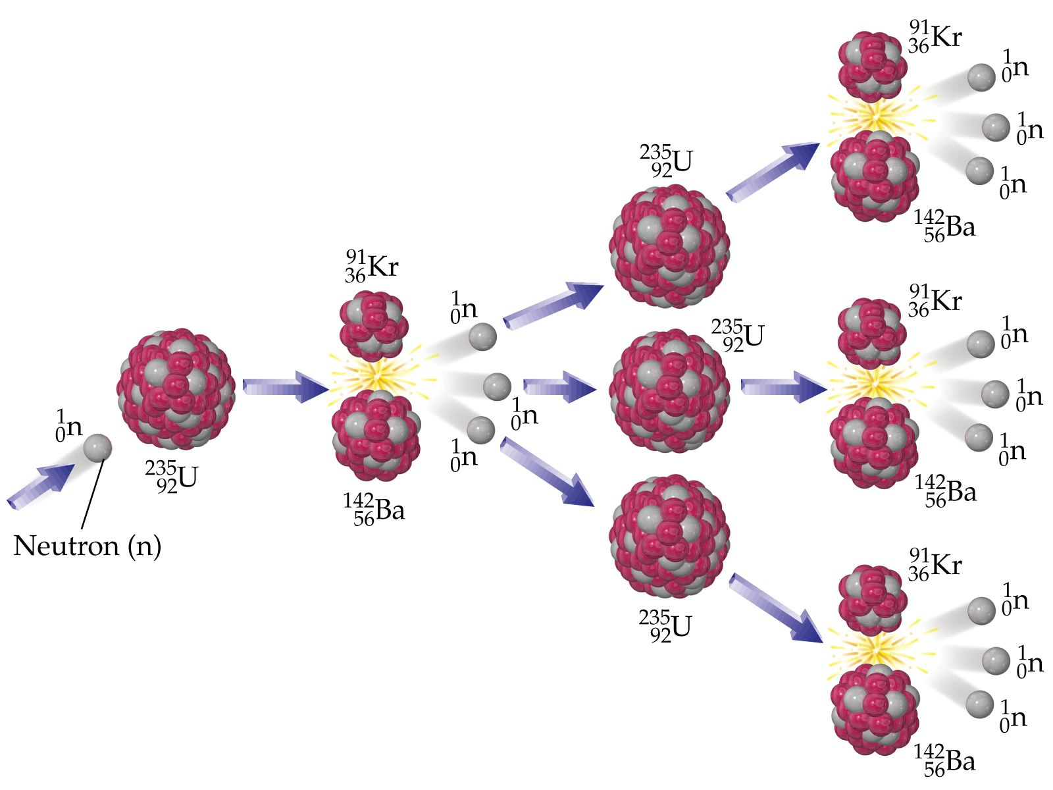
How does a chain reaction occur?

Slide 34
Fat Man and Little Boy

Slide 37
Sources of Radiation

Slide 38
Physiological Effect of a Single Dose of Radiation
Dose (rem) | Dose (Sv) | Likely Effect
0-25 | 0-0.25 | No observable effect
25-50 | 0.25-0.50 | White blood cell count decreases slightly
50-100 | 0.50-1.00 | Significant drop in white blood cell count, lesions
100-200 | 1-2 | Nausea, vomiting, loss of hair
200-500 | 2-5 | Hemorrhaging, ulcers, possible death
>500 | >5 | Death

Slide 39
Isotope | Symbol | Decay | Half-Life | Use
tritium | ³H | β | 12.32 y | Biochemical tracer
carbon-14 | ¹⁴C | β | 5715 y | Archaeological Dating
phosphorus-32 | ³²P | β | 14.28 d | Leukemia Therapy
potassium-40 | ⁴⁰K | β | 1.26×10⁹ y | Geologic Dating
cobalt-60 | ⁶⁰Co | β, γ | 5.27 y | Cancer Therapy
iodine-123 | ¹²³I | γ | 13.1 h | Thyroid Therapy
uranium-235 | ²³⁵U | α, γ | 7.04×10⁸ y | Nuclear Reactors

Slide 40
Applications – Carbon Dating
nitrogen in the atmosphere is bombarded by neutrons to form ¹⁴C
This carbon is integrated into CO₂ which then enters the food chain

Slide 41
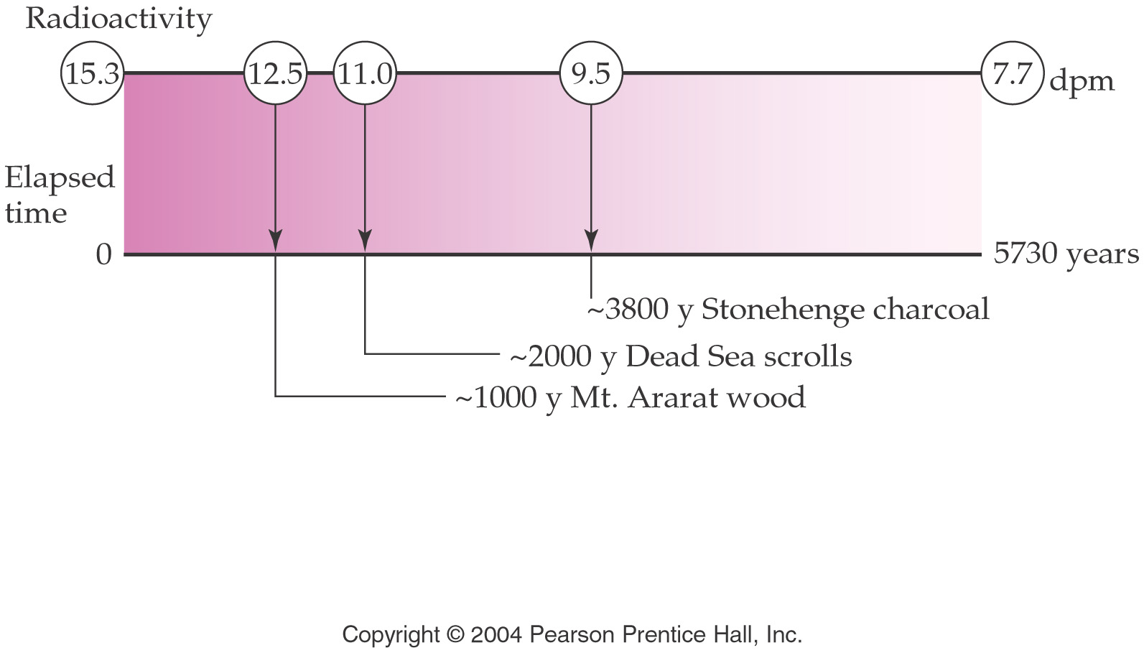
Applications – Carbon Dating

Slide 42
Radiocarbon Dating of Artifacts

Slide 43
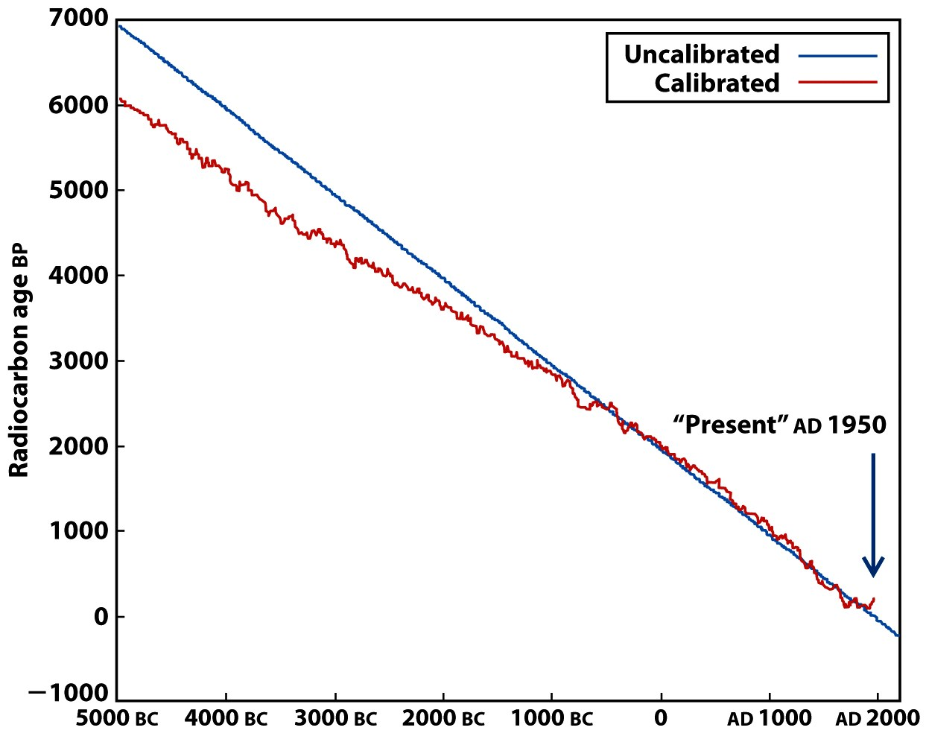
Calibration Curves for Radiocarbon Dating

Slide 44
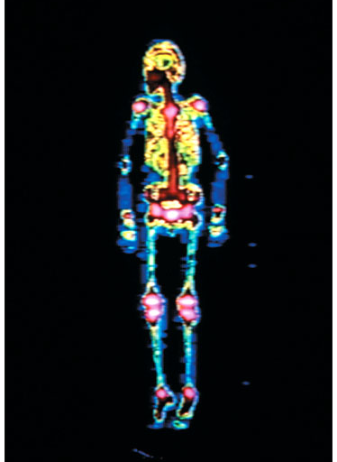
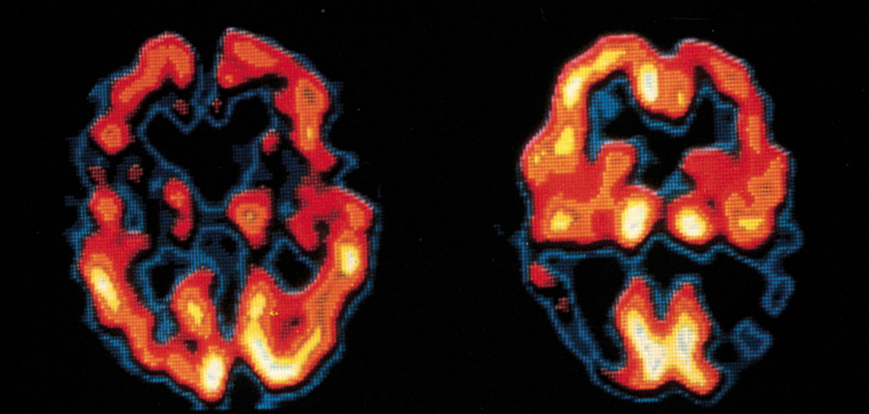
Medical Applications of Radioisotopes
Bone Scan with ^{99m}Tc
Brain images with ¹²³I-labeled compound

Slide 45
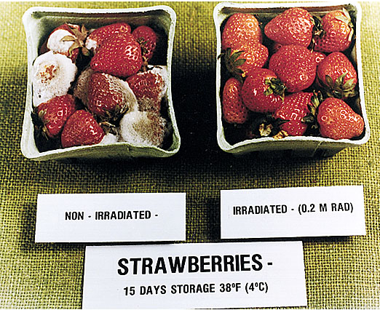
Chemistry In Action: Food Irradiation
Dosage | Effect
Up to 100 kilorad | Inhibits sprouting of potatoes, onions, garlics. Inactivates trichinae in pork. Kills or prevents insects from reproducing in grains, fruits, and vegetables.
100 – 1000 kilorads | Delays spoilage of meat poultry and fish. Reduces salmonella. Extends shelf life of some fruit.
1000 to 10,000 kilorads | Sterilizes meat, poultry and fish. Kills insects and microorganisms in spices and seasoning.

Slide 46
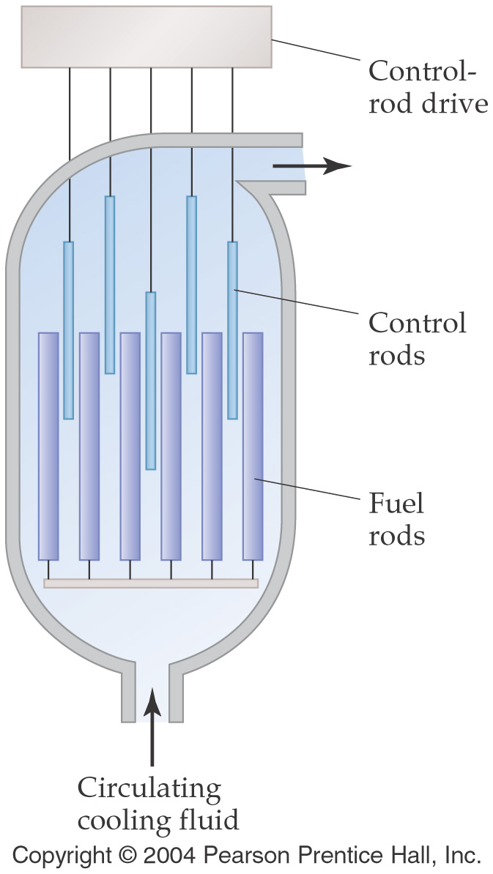

Slide 47
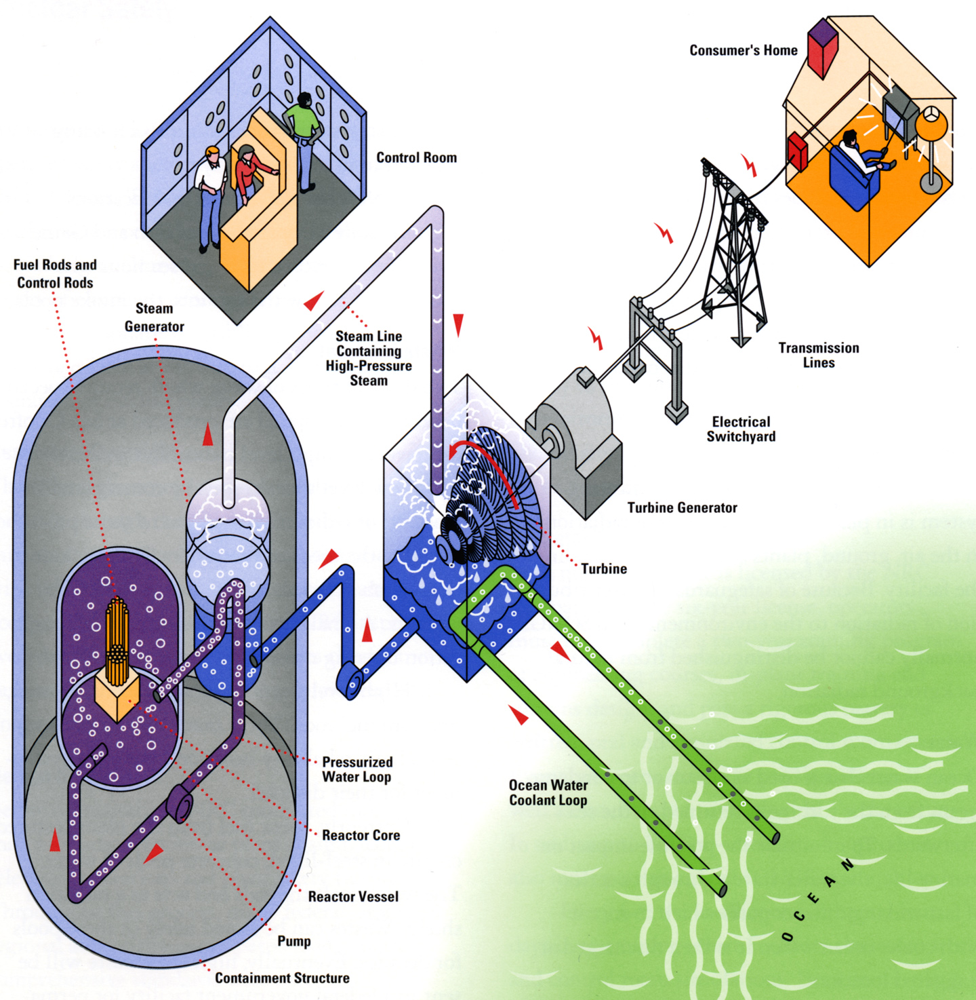
http://www.sce.com/NR/rdonlyres/A050B788-F86C-448A-9A66-8FABD9F302B4/0/NuclearEnergy_process.jpg

Slide 48
Applications – Chemical Analysis
Radioactive tracer – used to follow fate of a chemical using radio labeling
Isotopic dilution – used to determine quantity of a substance when you can’t measure it conveniently
Neutron Activation Analysis – used to determine concentration of trace elements

Slide 49
Applications
Medicine
Diagnostic tracers
PET – Positron Emission Tomography
Patient fed radio-labeled glucose and it goes to where there is lots of metabolic activity. This often indicates a region of tumor activity.
Chemotherapy
Power pacemakers

Slide 50
What Is PET
Positron Emission Tomography (PET) is a major diagnostic imaging modality used predominantly in determining the presence and severity of cancers, neurological conditions, and cardiovascular disease. It is currently the most effective way to check for cancer recurrences, and it offers significant advantages over other forms of imaging such as CT or MRI scans in detecting disease in many patients. In 2005, an estimated 1,129,900 clinical PET patient studies were performed at 1,725 sites around the country. If you're interested in learning how a PET scan can benefit you and need additional information, talk with your local health care provider or referring physician. At the end of this page are links to other sites with PET information too.
PET images demonstrate the chemistry of organs and other tissues such as tumors. A radiopharmaceutical, such as FDG (fluorodeoxyglucose), which includes both sugar (glucose) and a radionuclide (a radioactive element) that gives off signals, is injected into the patient, and its emissions are measured by a PET scanner.
A PET scanner consists of an array of detectors that surround the patient. Using the gamma ray signals given off by the injected radionuclide, PET measures the amount of metabolic activity at a site in the body and a computer reassembles the signals into images. Cancer cells have higher metabolic rates than normal cells, so they show up as denser areas on a PET scan. PET is useful in diagnosing certain cardiovascular and neurological diseases because it highlights areas with increased, diminished or no metabolic activity, thereby pinpointing problems.
Cancer and PET
PET is considered particularly effective in identifying whether cancer is present or not, if it has spread, if it is responding to treatment, and if a person is cancer free after treatment. Cancers for which PET is considered particularly effective include lung, head and neck, colorectal, esophageal, lymphoma, melanoma, breast, thyroid, cervical, pancreatic, and brain as well as other less-frequently occurring cancers.
Early Detection: Because PET images biochemical activity, it can accurately characterize a tumor as benign or malignant, thereby avoiding surgical biopsy when the PET scan is negative. Conversely, because a PET scan images the entire body, confirmation of distant metastasis can alter treatment plans in certain cases from surgical intervention to chemotherapy.
Staging of Cancer: PET is extremely sensitive in determining the full extent of disease, especially in lymphoma, malignant melanoma, breast, lung, colon and cervical cancers. Confirmation of metastatic disease allows the physician and patient to more accurately decide how to proceed with the patient's management.
Checking for recurrences: PET is currently considered to be the most accurate diagnostic procedure to differentiate tumor recurrences from radiation necrosis or post-surgical changes. Such an approach allows for the development of a more rational treatment plan for the patient.
Assessing the Effectiveness of Chemotherapy: The level of tumor metabolism is compared on PET scans taken before and after a chemotherapy cycle. A successful response seen on a PET scan frequently precedes alterations in anatomy and would therefore be an earlier indicator of tumor response than that seen with other diagnostic modalities.
From http://interactive.snm.org/index.cfm?PageID=972

Slide 51
http://www.cancer.gov/cancertopics/factsheet/Therapy/radiation
What is radiation therapy?
Radiation therapy (also called radiotherapy, x-ray therapy, or irradiation) is the use of a certain type of energy (called ionizing radiation) to kill cancer cells and shrink tumors. Radiation therapy injures or destroys cells in the area being treated (the “target tissue”) by damaging their genetic material, making it impossible for these cells to continue to grow and divide. Although radiation damages both cancer cells and normal cells, most normal cells can recover from the effects of radiation and function properly. The goal of radiation therapy is to damage as many cancer cells as possible, while limiting harm to nearby healthy tissue.
There are different types of radiation and different ways to deliver the radiation. For example, certain types of radiation can penetrate more deeply into the body than can others. In addition, some types of radiation can be very finely controlled to treat only a small area (an inch of tissue, for example) without damaging nearby tissues and organs. Other types of radiation are better for treating larger areas.

Slide 52
http://www.orau.org/PTP/collection/Miscellaneous/pacemaker.htm
Nuclear-Powered Cardiac Pacemakers
Pacemakers are used to stimulate a regular heartbeat when the body's natural electrical pacing system is irregular or not transmitting properly. Over the years, various power sources have been used for pacemakers, including thermoelectric batteries containing 2 to 4 curies of plutonium-238 (88 year half-life). As the term "thermoelectric" implies, the heat from the decaying plutonium is used to generate the electricity that stimulates the heart. At present (2003), there are between 50 and 100 people in the US who have nuclear powered pacemakers. When one of these individuals dies, the pacemaker is supposed to be removed and shipped to Los Alamos where the plutonium will be recovered.
Nuclear powered pacemakers were discontinued in the 1970s.

Slide 53
More Applications
Agriculture
Irradiate food
Pesticide
Energy
Fission
Fusion

Slide 54
Irradiation of food
How will I know if meat and poultry products are irradiated? The international symbol for irradiation, the radura, must be on packages if the entire product was irradiated, as well as the phrase, "treated by irradiation" (or "with irradiation"). The radura, pictured here, can be any color. This required labeling gives consumers the option to choose between irradiated and non-irradiated meat and poultry.
What foods are irradiated? Fresh meat and poultry including whole or cut up birds, skinless poultry, pork chops, roasts, stew meat, liver, hamburgers, ground meat, and ground poultry are approved for irradiation. U.S. food regulations also allow the irradiation of wheat and wheat powder, white potatoes, many spices, dry vegetable seasonings, fresh shell eggs, and fresh produce.
What is food irradiation? Food irradiation is a process in which approved foods are exposed to radiant energy, including gamma rays, electron beams, and x-rays. In 1963, the Food and Drug Administration (FDA) found the irradiation of food to be safe. Irradiation of meat and poultry is done in a government-approved irradiation facility. Irradiation is not a substitute for good sanitation and process control in meat and poultry plants. It is an added layer of safety.
Are irradiated foods safe to eat? Yes. Just as pasteurization makes milk safer, irradiation makes meat and poultry safer by reducing the numbers of harmful bacteria and parasites. Irradiation is an important food safety tool in fighting foodborne illness.
http://www.fsis.usda.gov/Fact_Sheets/Irradiation_and_Food_Safety/index.asp

Slide 55
