Slide 1
Chemistry 120
Chapter 11: Atomic Theory:
The Quantum Model of the Atom
Outline
Electromagnetic Radiation
Atomic Spectra
Bohr Model of the Atom
Quantum Mechanical Model of the Atom
  Energy Levels
  Sublevels and Orbitals
  Orbital Diagrams
  Electron Configurations
Periodic Trends

Slide 2
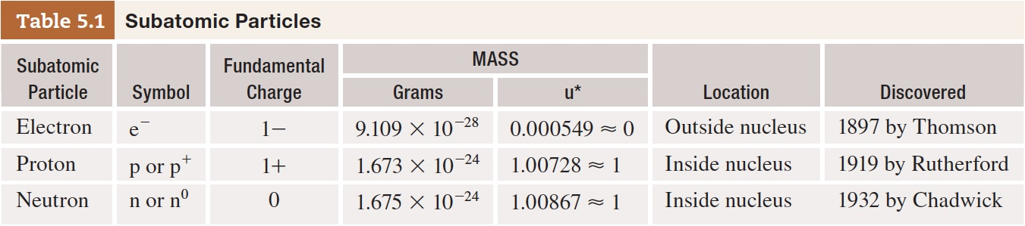
What do we know about atoms so far?
Table 5-1 p126

Slide 3
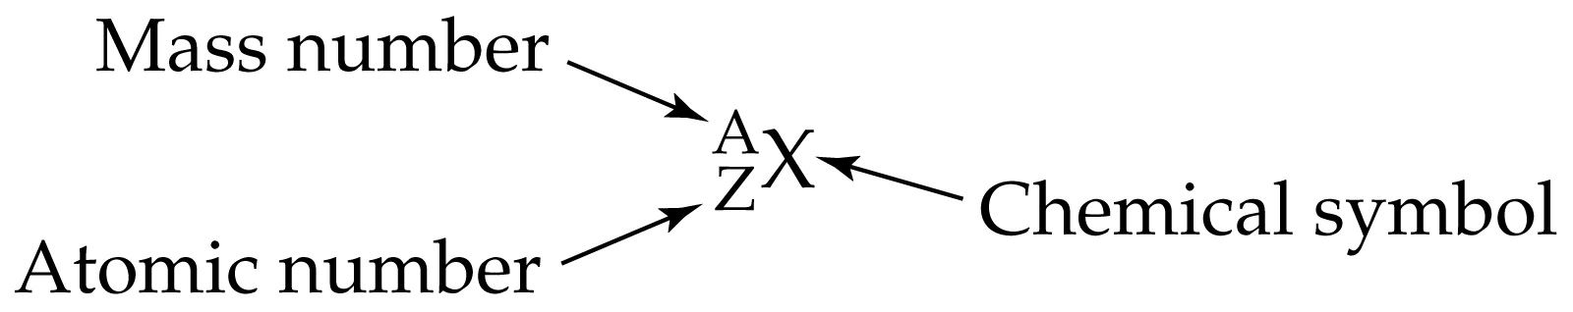

Atomic Number = Z
= number of protons in an atom.
= number of electrons in a neutral atom.
Mass Number = number protons + number neutrons in an atom
How do we keep track of the subatomic particles?

Slide 4
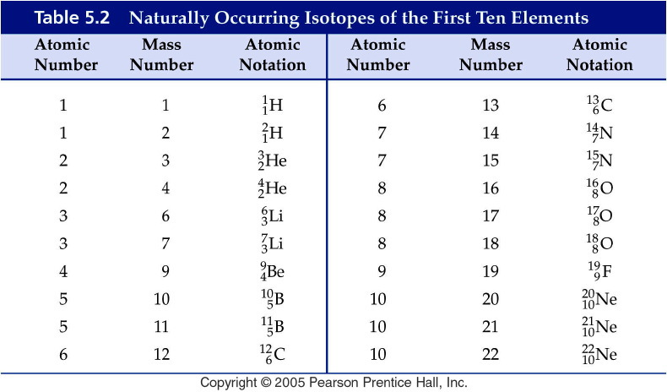
Notes:
Figure: 05-T02
Title:
Table 5.2
Caption:
Naturally Occurring Isotopes of the First Ten Elements
Notes:
Each element may have a different number of naturally occurring isotopes. Note that there are 3 isotopes of oxygen but only one of fluorine.

Slide 5
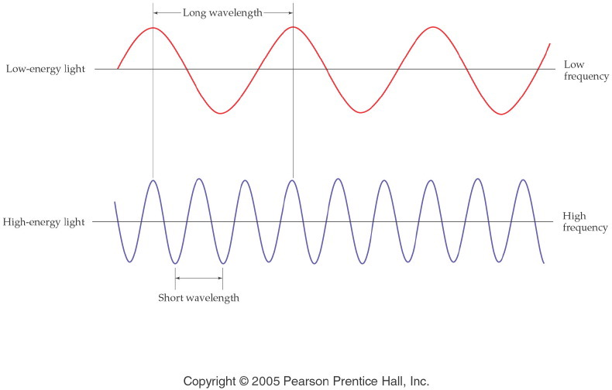
How do waves travel? How are energy, frequency and wavelength related?
Notes:
Figure: 05-07
Title:
Wavelength and Frequency
Caption:
Notice that the wavelength is longer for low-energy light than for high-energy light. Frequency is opposite.
Notes:
Wavelength and frequency are inversely related to each other through the speed of light. A small wavelength means that more waves (i.e., more energy) pass through a point per second.

Slide 6
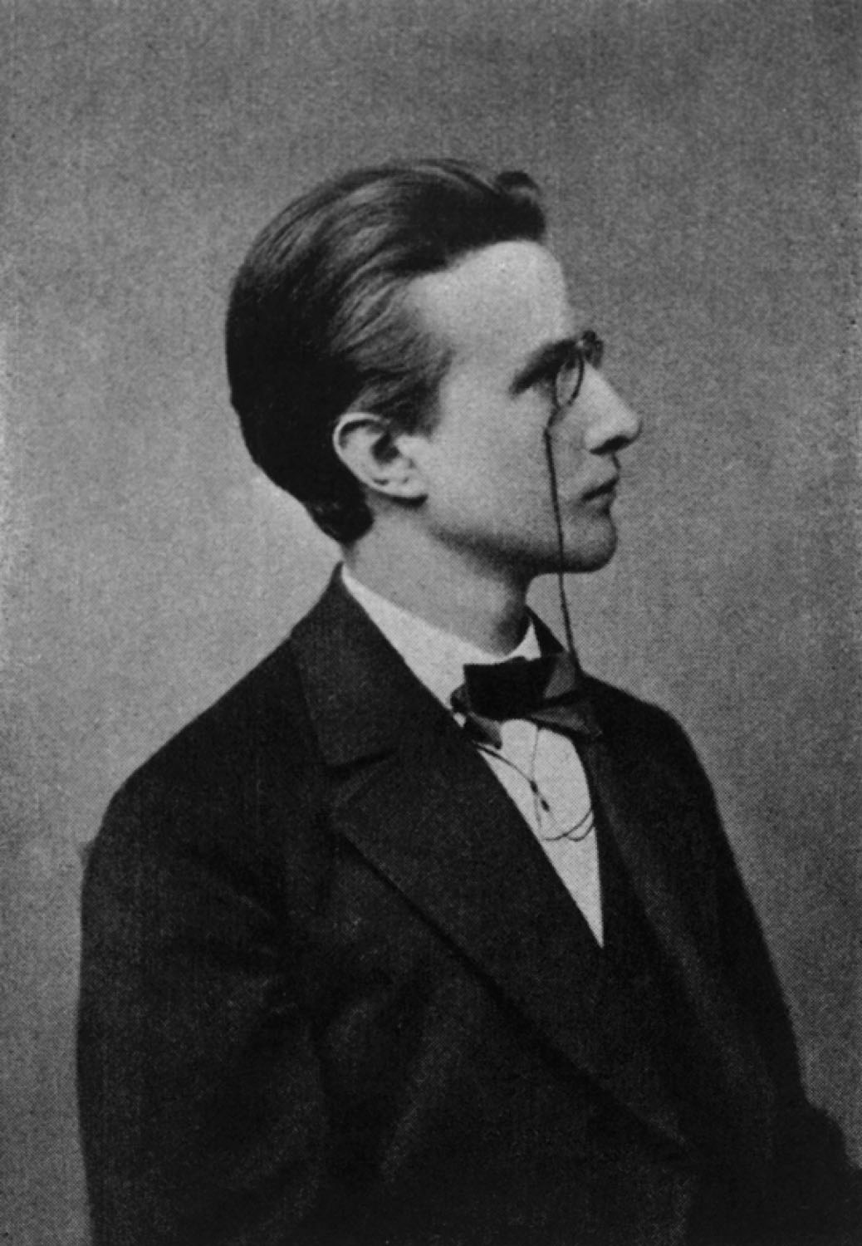
Max Planck
p318
Notes:
Max Planck (1858–1947). Planck was awarded the 1918 Nobel Prize in Physics for his discovery of the quantization of energy.

Slide 7
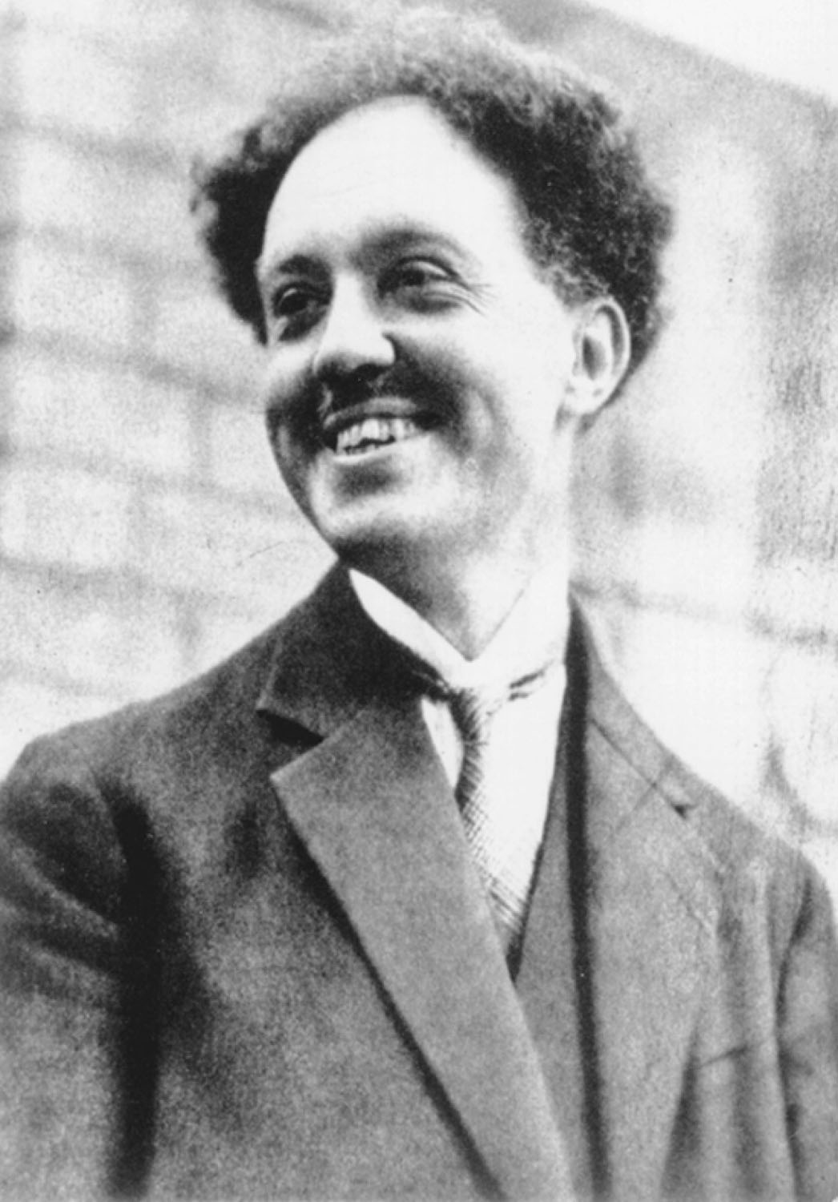
Louis de Broglie
p321
Notes:
Louis de Broglie (1892–1987) earned the 1929 Nobel Prize in Physics for his discovery of the wave characteristics of electrons.

Slide 8
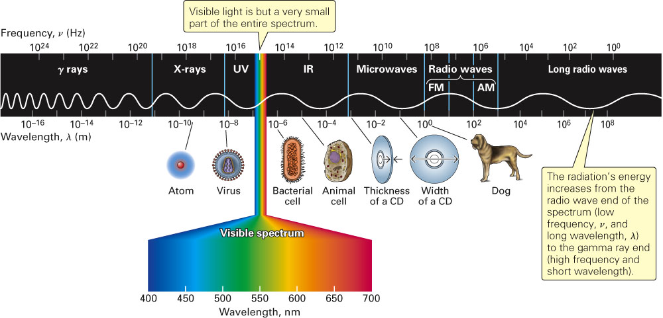
What are the relative sizes of the waves in the electromagnetic spectrum?
Fig. 11-1, p. 310

Slide 9
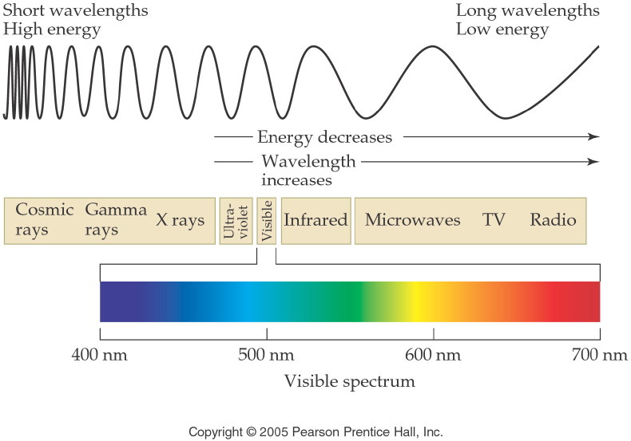
Notes:
Figure: 05-09
Title:
The Radiant Energy Spectrum
Caption:
The complete spectrum includes short-wavelength gamma rays to long-wavelength microwaves.
Notes:
The visible spectrum of light is just a narrow portion of the entire radiant energy spectrum.

Slide 10
Example – Electromagnetic Spectrum
Using violet, green, and orange, which one is the most energetic?
Violet
Green
Orange
All of the above
None of the above

Slide 11
Example – Electromagnetic Spectrum
Using violet, green, and orange, which one is the most energetic?
Violet
Green
Orange
All of the above
None of the above

Slide 12
Example – Electromagnetic Spectrum
Order the following in increasing wavelength: x-rays, ultraviolet light, FM radiowaves, and microwaves
X-rays < UV light < FM radiowaves < microwaves
X-rays < UV light < microwaves < FM radiowaves
FM radiowaves < microwaves < X-rays < UV light
FM radiowaves < microwaves < UV light < X-rays
None of the above

Slide 13
Example – Electromagnetic Spectrum
Order the following in increasing wavelength: x-rays, ultraviolet light, FM radiowaves, and microwaves
X-rays < UV light < FM radiowaves < microwaves
X-rays < UV light < microwaves < FM radiowaves
FM radiowaves < microwaves < X-rays < UV light
FM radiowaves < microwaves < UV light < X-rays
None of the above

Slide 14
Experiment 1
What happens when an elemental gas in a cathode ray tube is exposed to electricity?
  Hydrogen (H₂) purple-blue
  Neon (Ne) red-orange
  Helium (He) yellow-pink
  Argon (Ar) lavender
  Xenon (Xe) blue

Slide 15
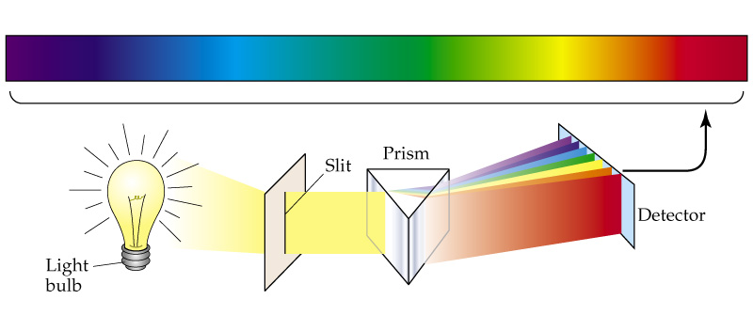
Experiment 2
What happens when a white light is shown through a prism? -- rainbow
A prism separates light of different wavelength, each color represents a different wavelength.

Slide 16
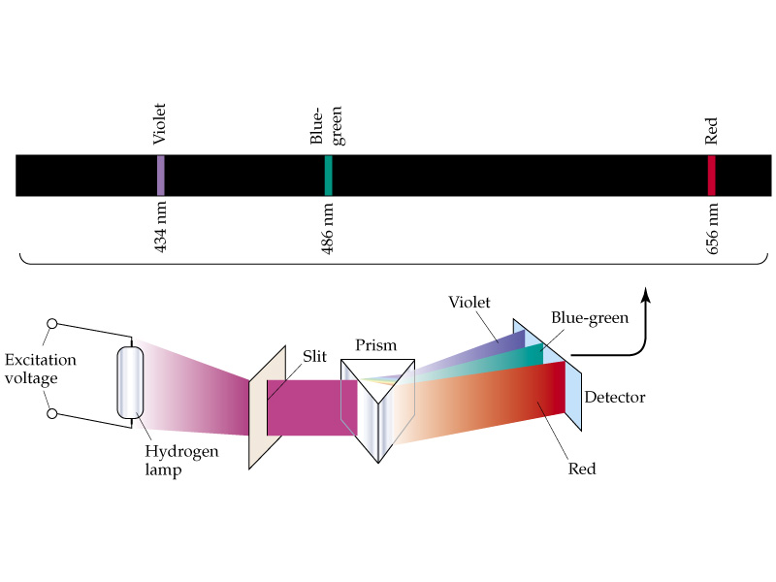
Experiment 3
What happens when colored light from a gas discharge tube is shown through a prism? -----distinct bands of color (light).
http://jersey.uoregon.edu/vlab/elements/Elements.html

Slide 17
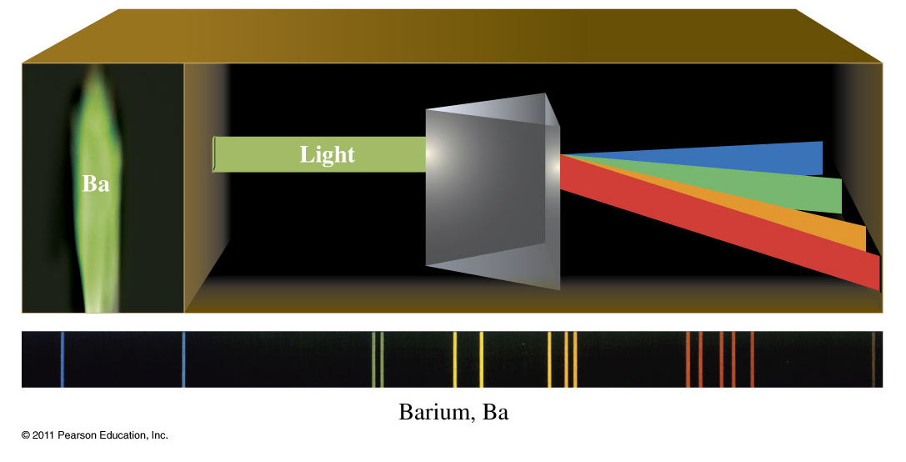
What is the atomic spectrum of Barium?

Slide 18
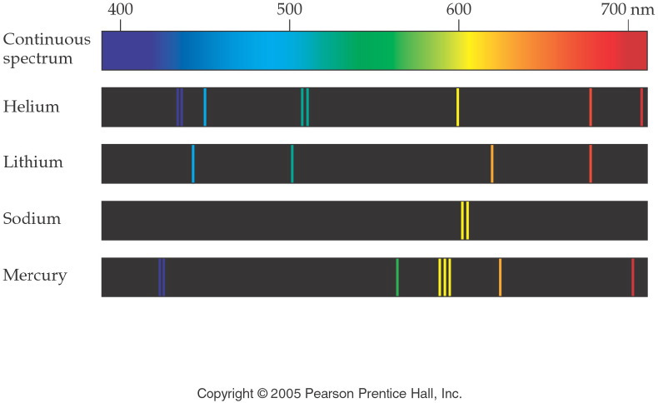
Notes:
Figure: 05-14
Title:
Continuous Spectrum versus Line Spectra
Caption:
The emission line spectra are produced by excited atoms of elements in the gaseous state.
Notes:
Each element provides its own distinct emission spectrum. This spectrum is often called an "atomic fingerprint."

Slide 19
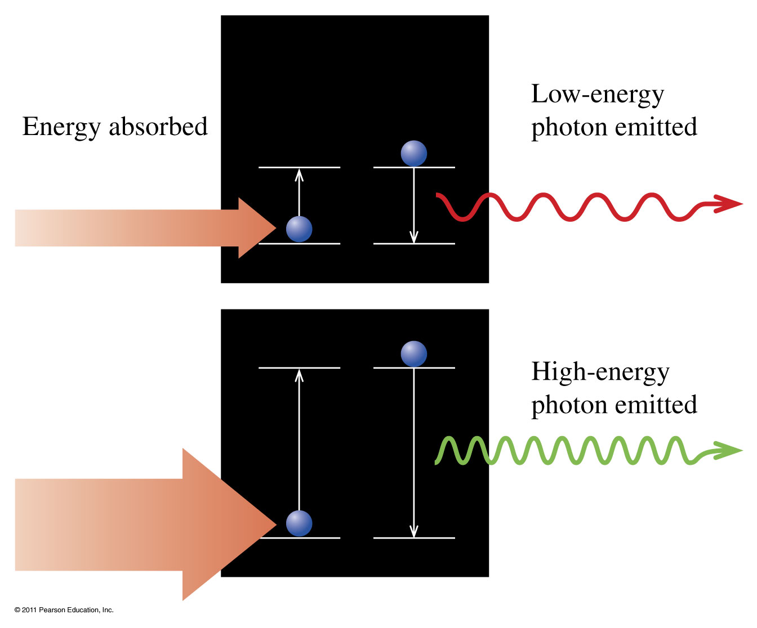
Does the amount of energy absorbed matter?

Slide 20
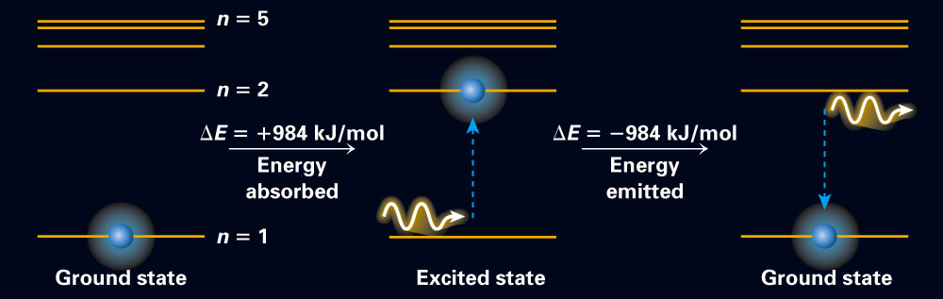
Fig. 11-8, p. 314

Slide 21
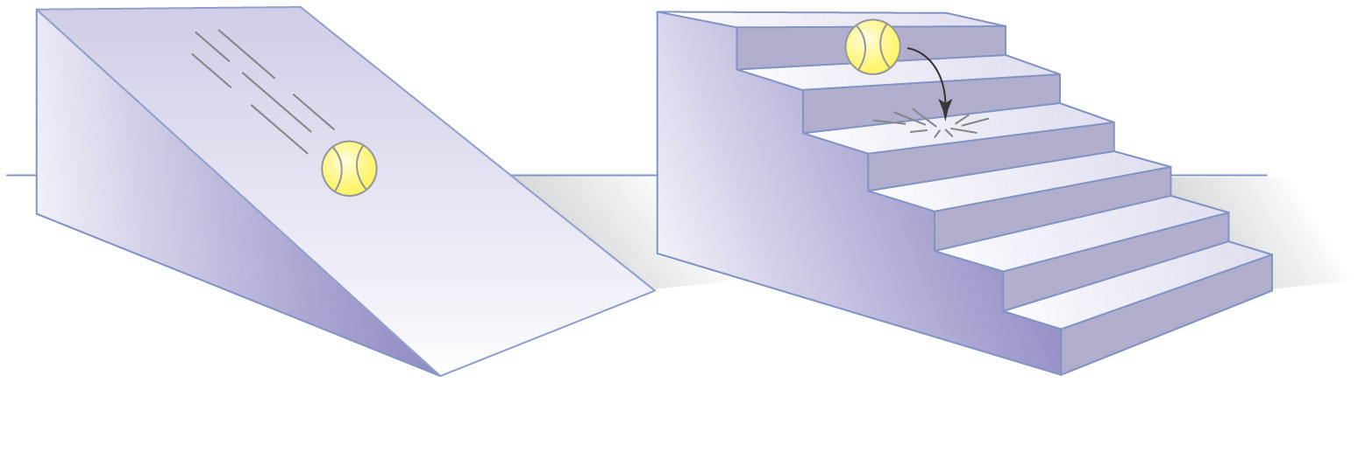
What is does it mean to be quantized?

Slide 22

Niels Bohr
p319
Notes:
Niels Bohr (1885–1962). Bohr won the 1922 Nobel Prize in Physics for his work in investigating the struc-ture of the atom.

Slide 23
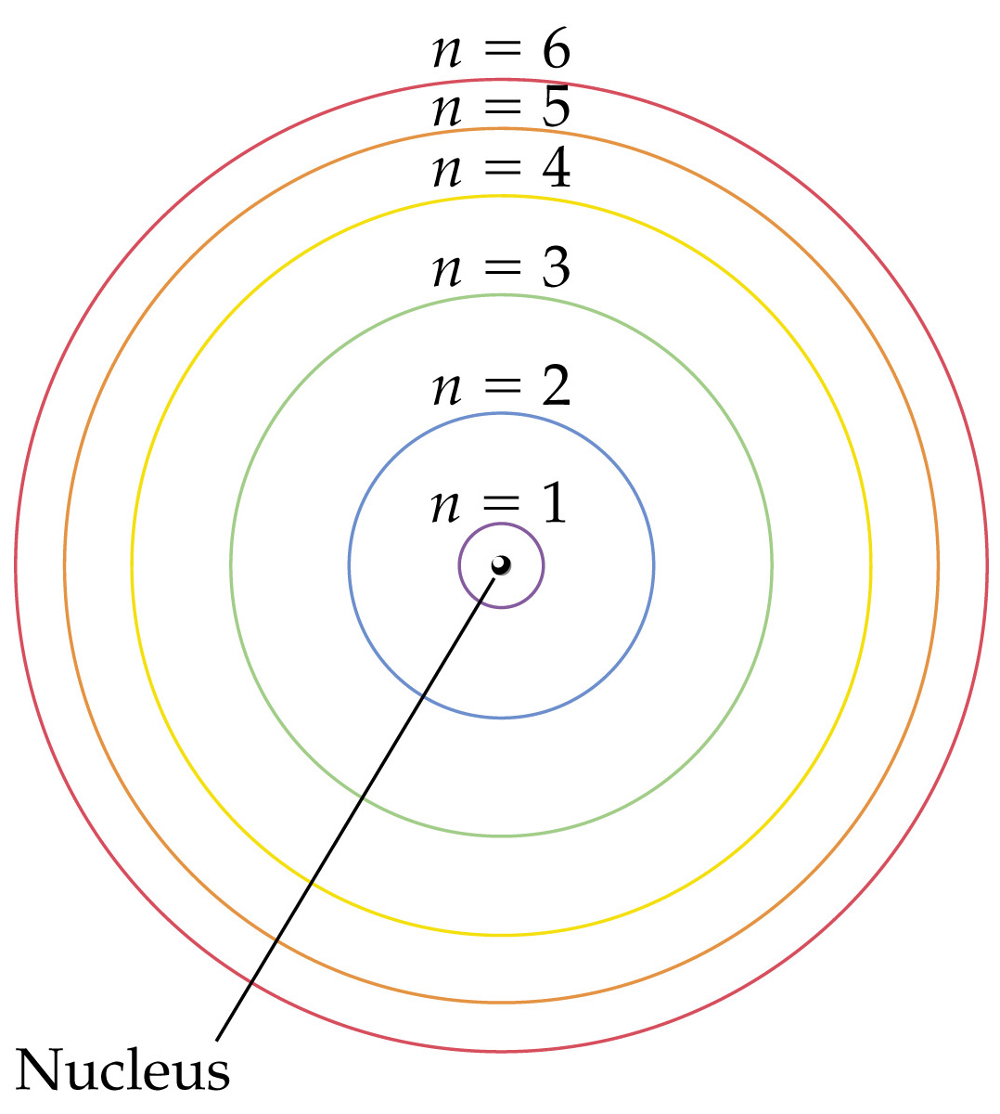
How are the electrons distributed in the Bohr model of the atom?
Notes:
Figure: 09-09
Title:
The Bohr model of the atom, showing electron orbits

Slide 24
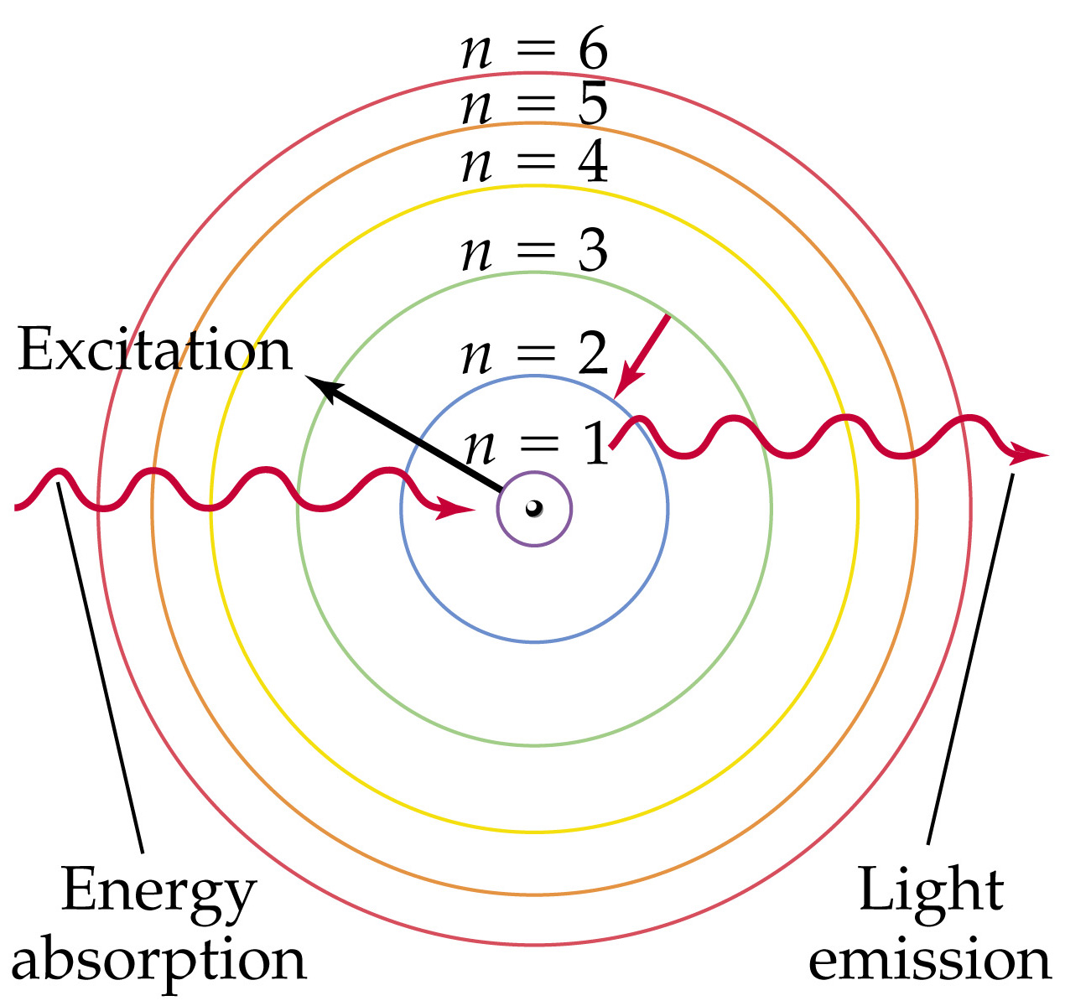
How are the spectra produced?
Notes:
Figure: 09-11
Title:
Energy absorption and light emission in a Bohr hydrogen atom

Slide 25
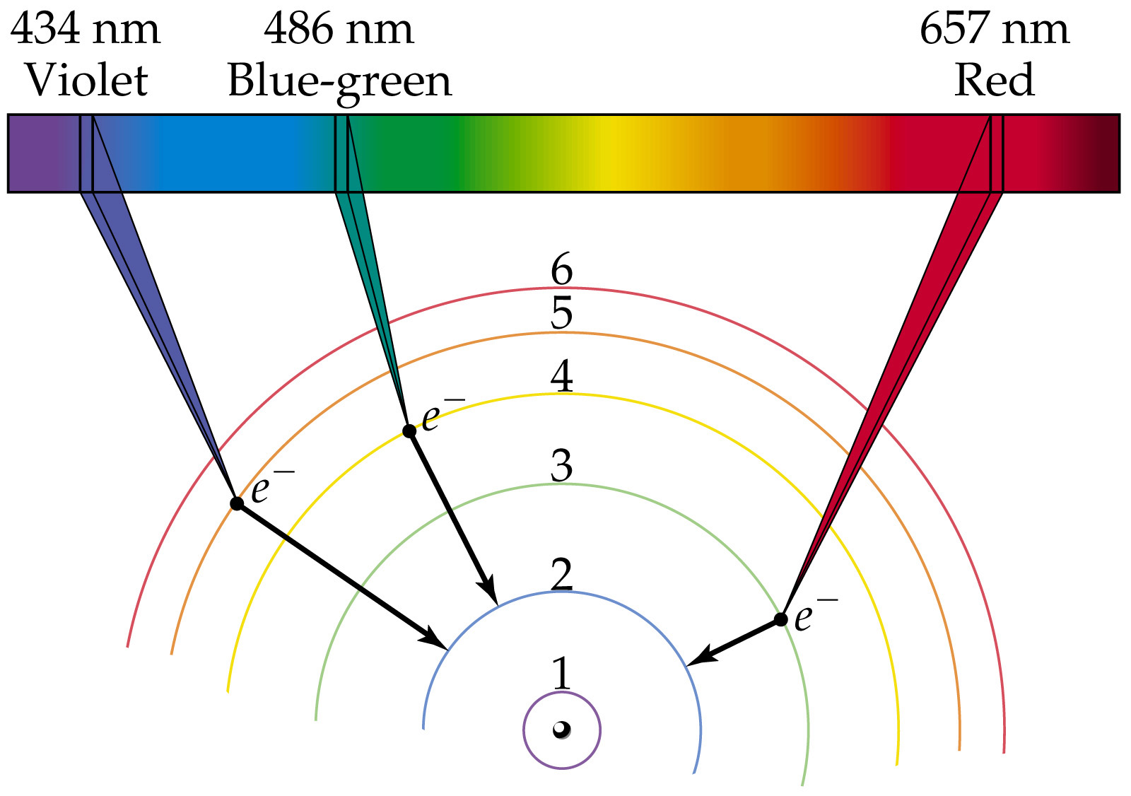
What happens in the hydrogen spectrum?
Notes:
Figure: 09-12
Title:
Visible lines in emission spectrum of a Bohr hydrogen atom

Slide 26
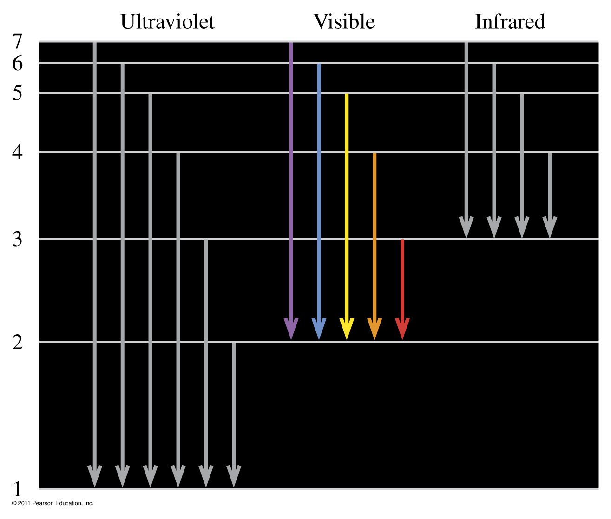
When electrons drop from a higher level to the first level, second level, and third level, photons of ultraviolet light, visible light, and infrared are emitted (not to scale).

Slide 27
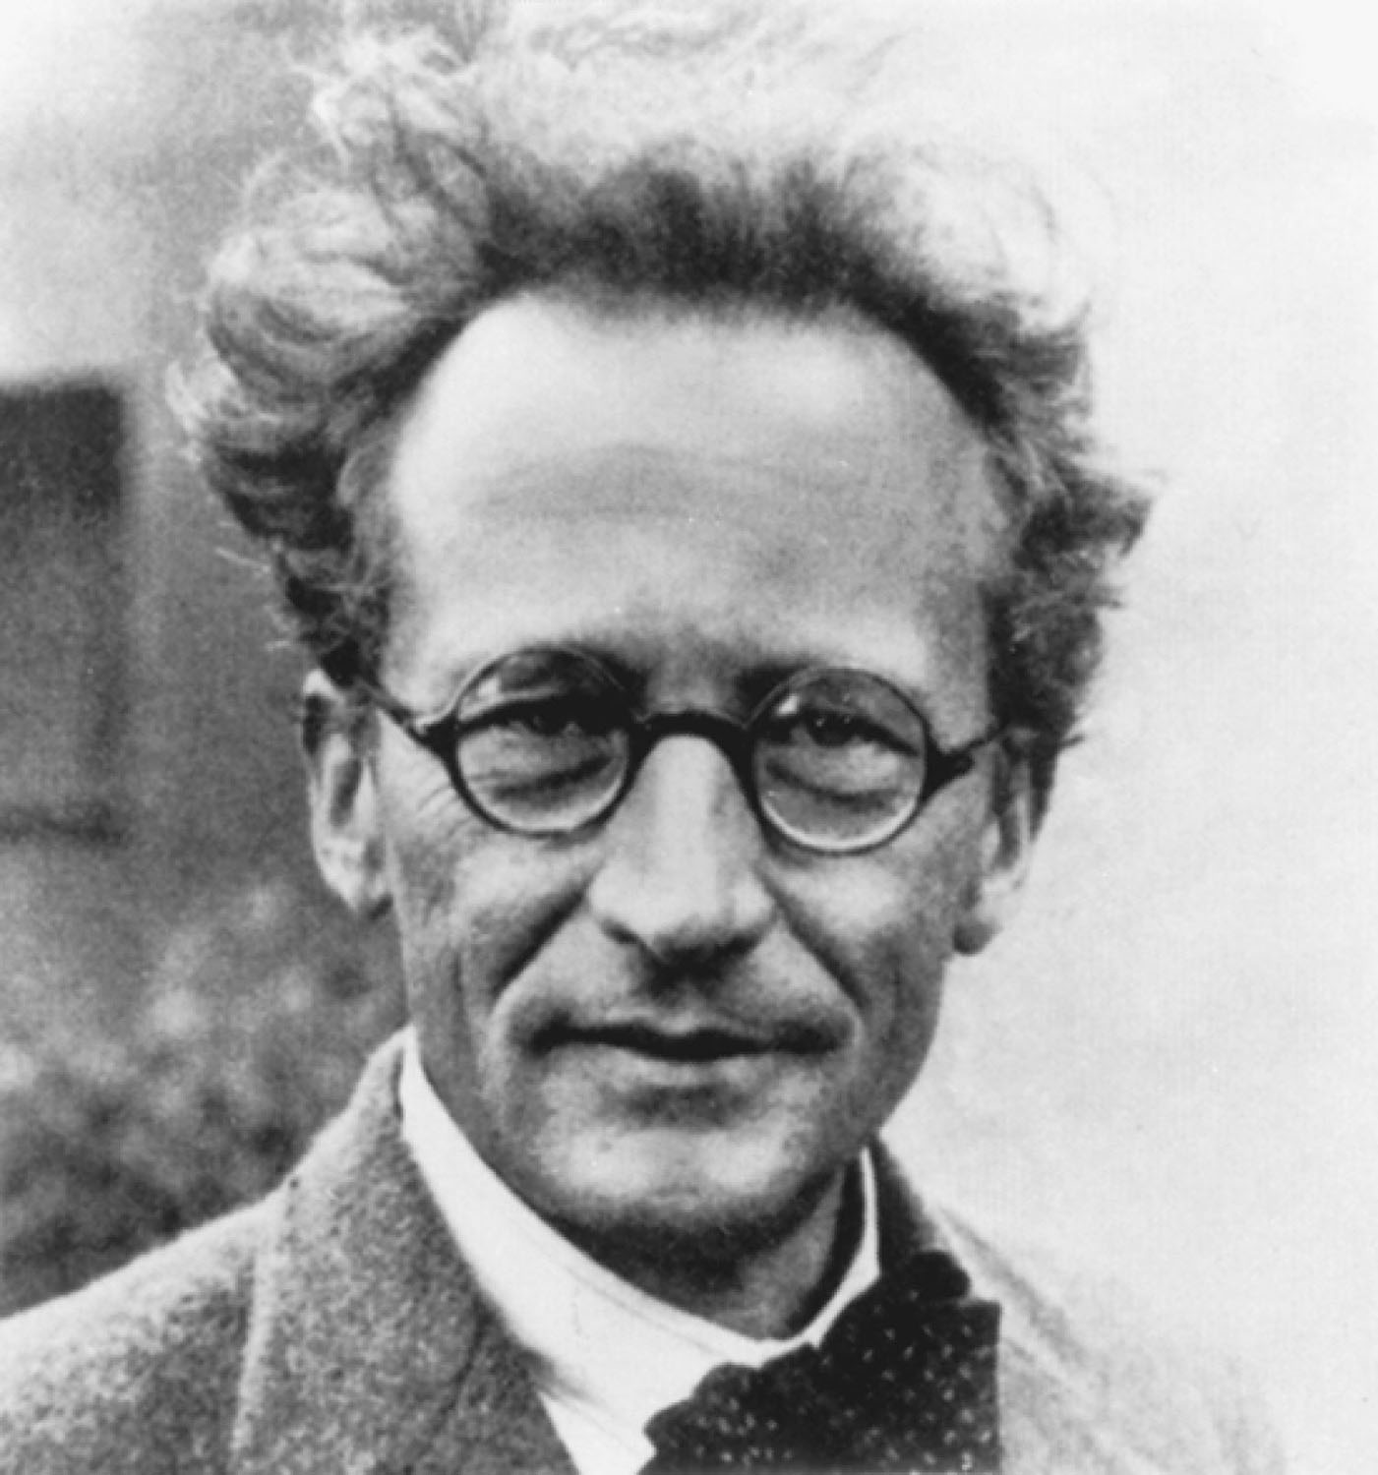
Erwin Schrödinger
p321
Notes:
Erwin Schrödinger (1887–1961) shared the 1933 Nobel Prize in Physics for his contributions to atomic theory.

Slide 28
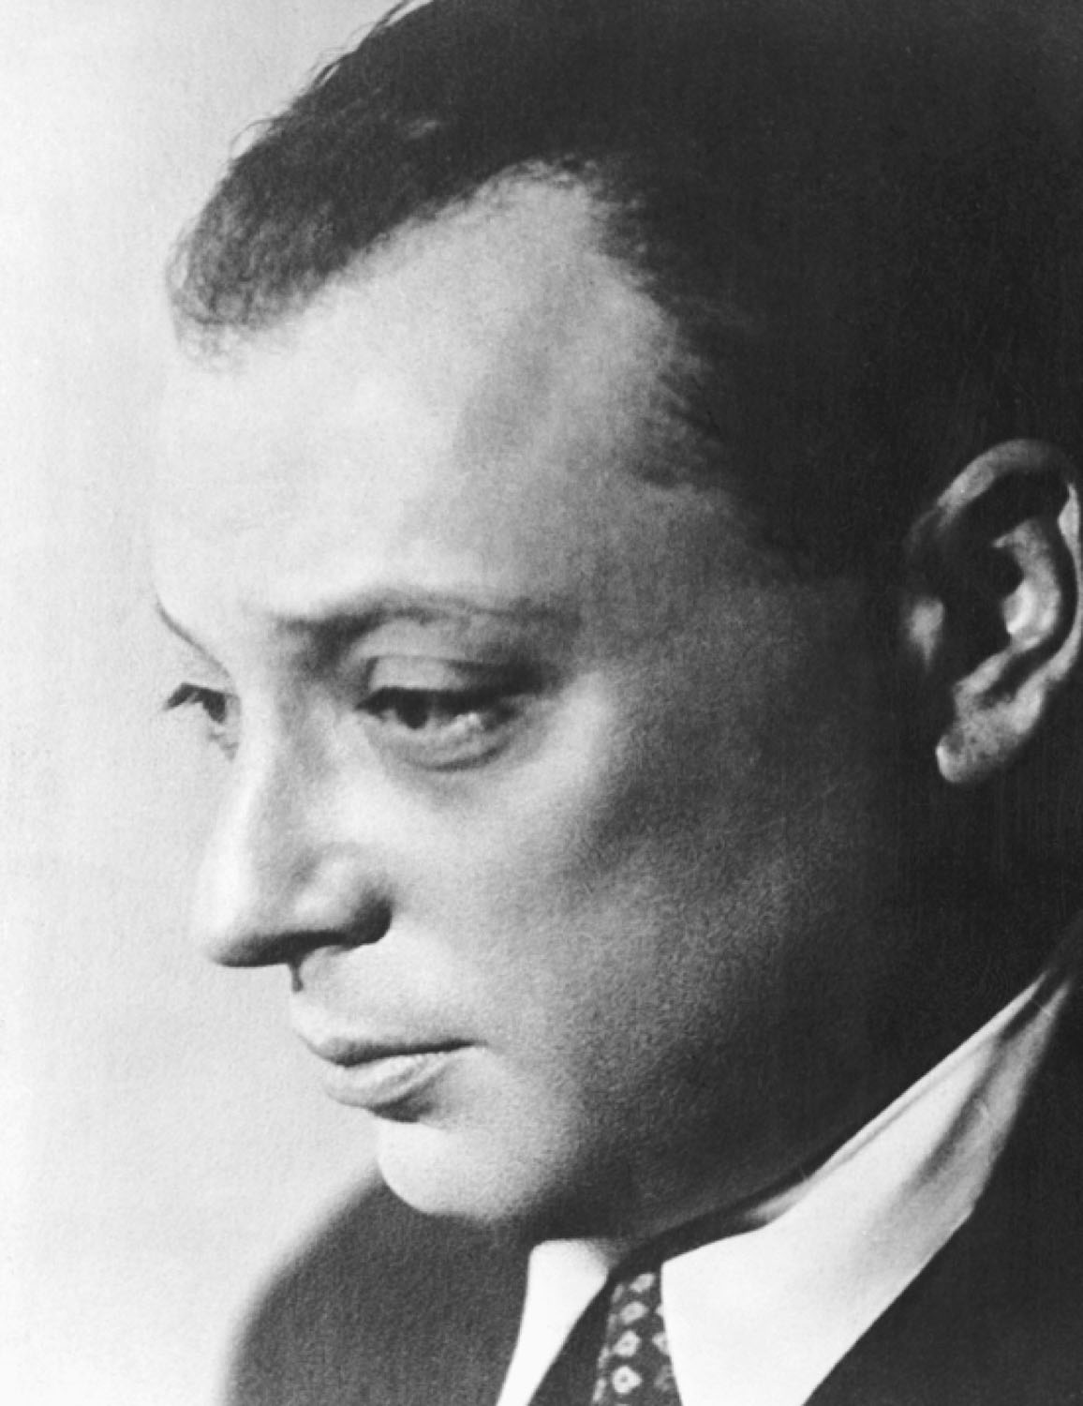
Wolfgang Pauli
p324
Notes:
Wolfgang Pauli (1900–1958) discov-ered the exclusion principle and was awarded the 1945 Nobel Prize in Physics for his work.

Slide 29
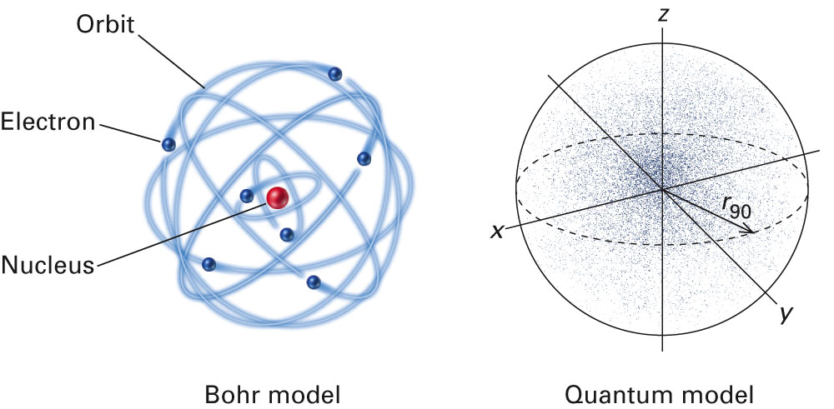
How are the Bohr model and the Quantum model different?
Fig. 11-10, p. 316

Slide 30
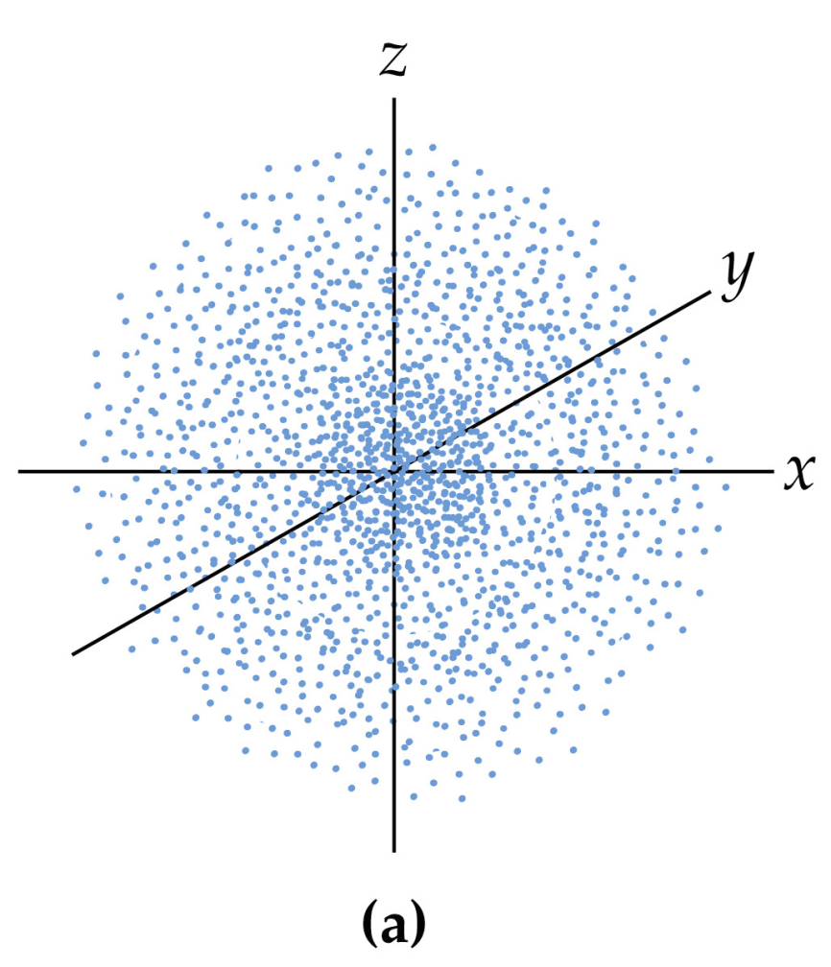
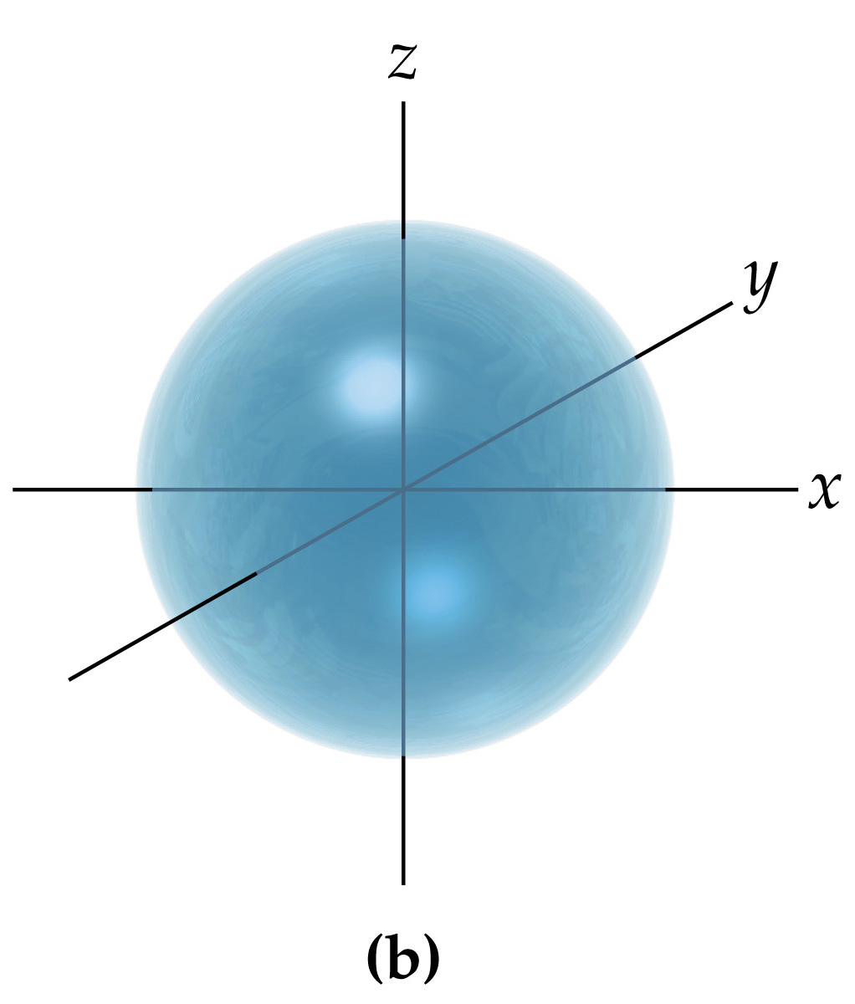
What is an s orbitals?
• spherical in shape
Electron density map
Representation of volume of orbital

Slide 31
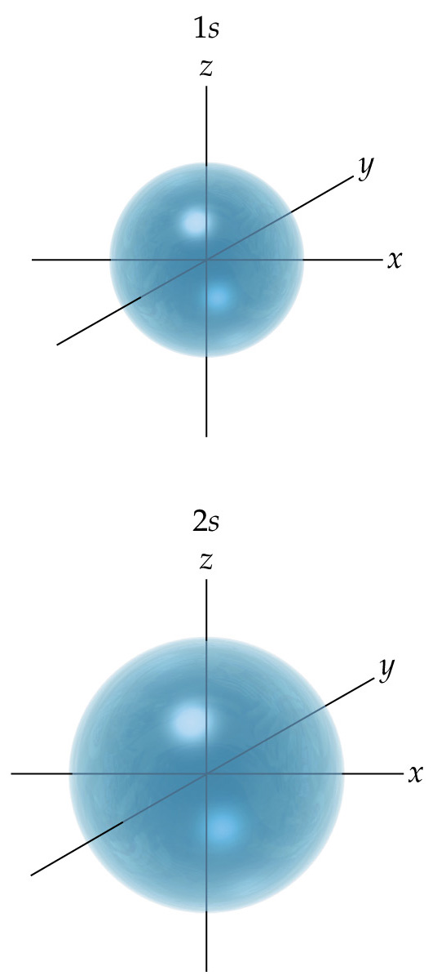
How does the size of an s orbital change as the energy level increases?
Notes:
Figure: 09-20
Title:
Comparison of 1s and 2s orbitals

Slide 32
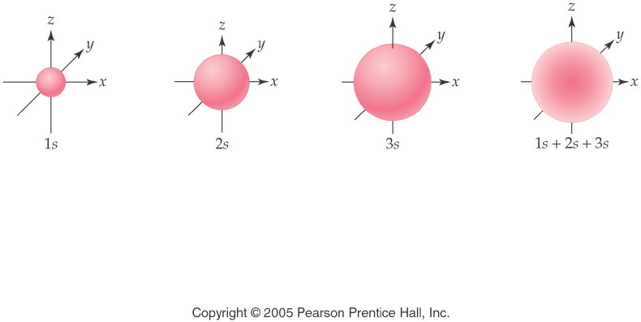
Notes:
Figure: 05-17
Title:
Relative Sizes of s Orbitals
Caption:
The relative sizes of 1s, 2s, and 3s orbitals are shown. As the main level increases, the size increases.
Notes:
The s orbitals have the same spherical shape, regardless of energy level. The spherical shape designates the area where the electrons are most likely to exist.

Slide 33
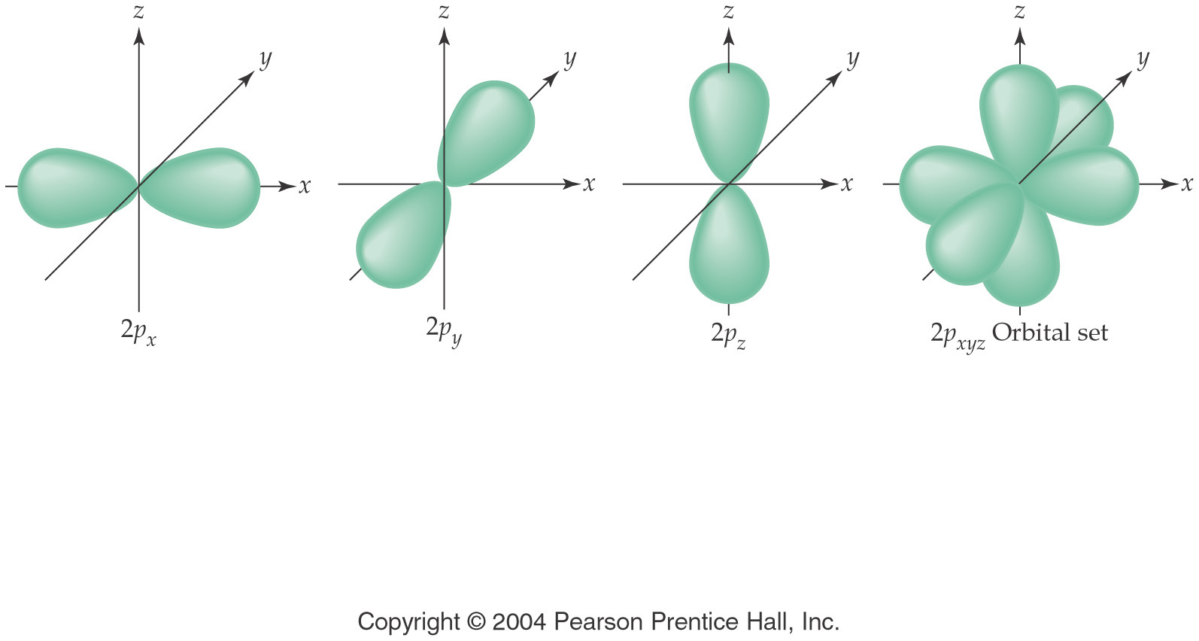
What is a p orbital?
• dumbbell shaped
• three different spatial orientations

Slide 34
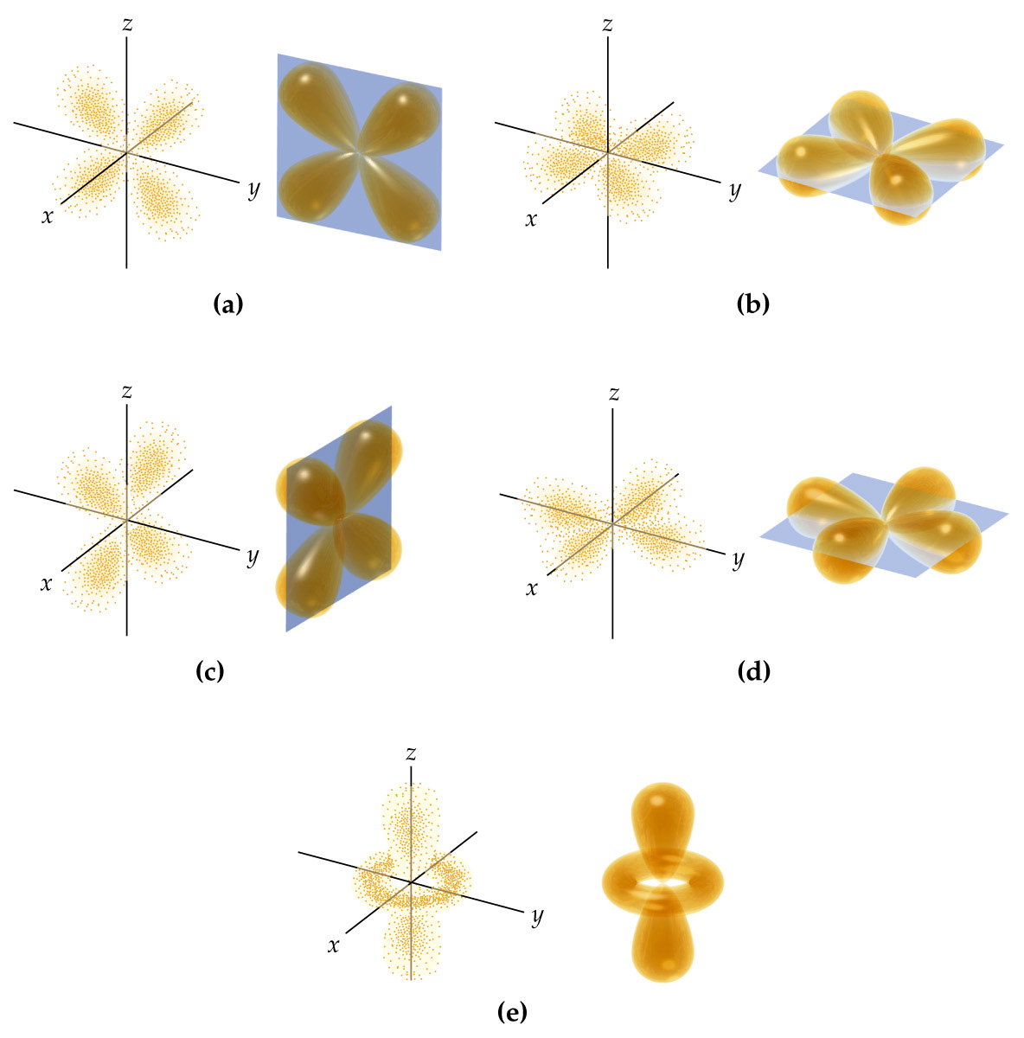
What is a d orbital?
4 leaf clover shape and a dumbbell with a doughnut
5 different orientations

Slide 35
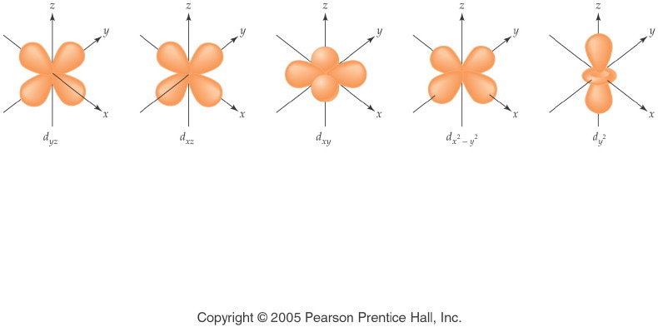
Notes:
Figure: 05-20
Title:
Shapes of 3d Orbitals
Caption:
The shapes of the five 3d orbitals are not the same, although four of the orbitals are similar.
Notes:
The five 3d orbitals mathematically represent a way that 10 electrons can all exist with the same average distance from the nucleus of the atom.

Slide 36
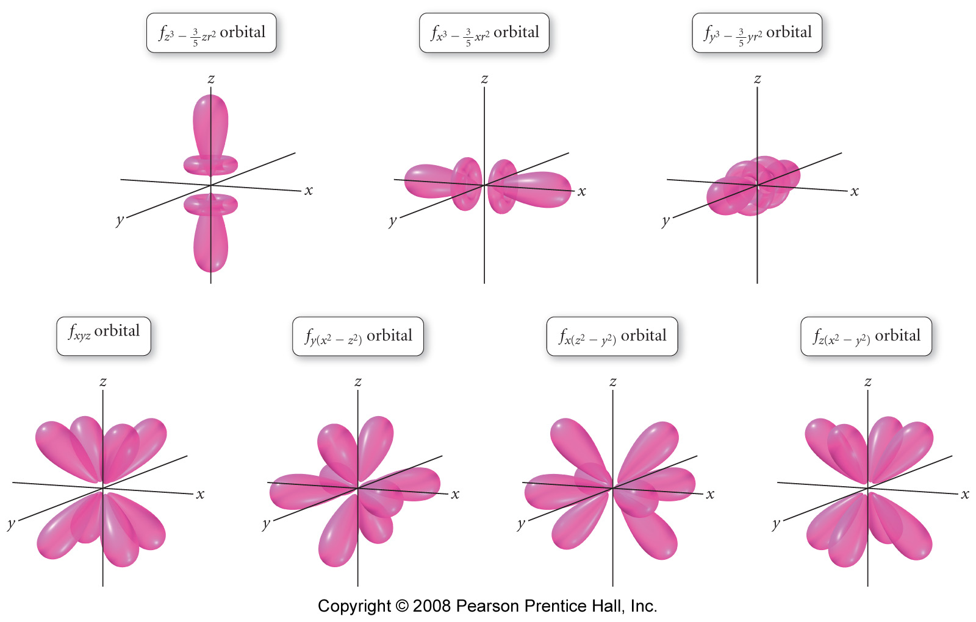
What is an f orbital?
Complex shapes
7 different orientations

Slide 37
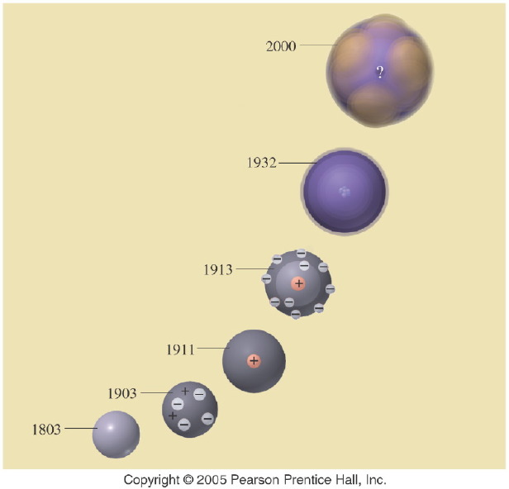
How has the model of the atom changed over time?
Notes:
Figure: 05-20-02UN
Title:
Atomic Models
Caption:
In the evolving model of the atom, what does the question mark (?) represent in the 2000 model?
Notes:
Atomic theory is one scientific theory that has been adjusted over the years as new evidence has come to light. It is still changing today.

Slide 38
Quantum Mechanical Model
Overview of the Four Quantum Numbers
General Principal Energy Levels, n
Sublevels
Electron Orbitals
Specific Orbital Occupancy

Slide 39
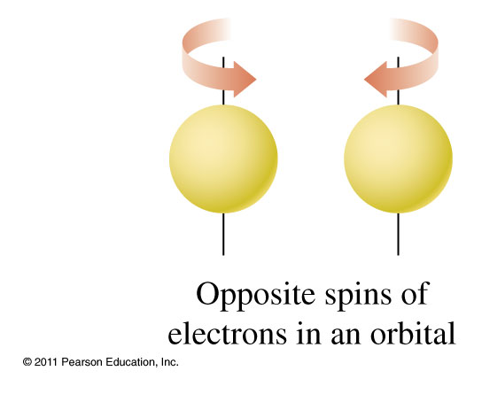

How do electrons go into orbitals?

Slide 40
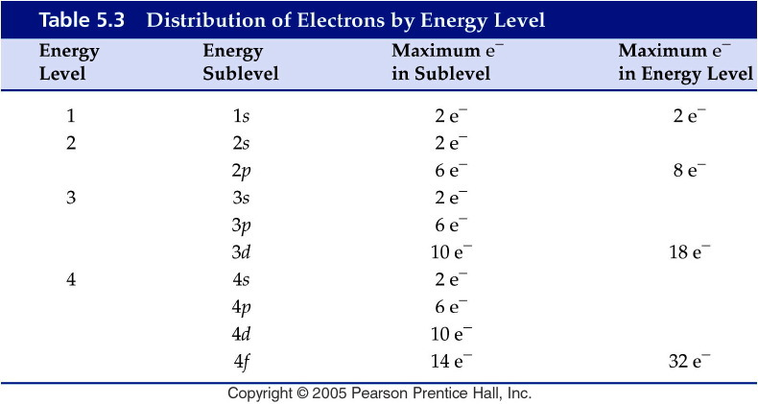
Notes:
Figure: 05-T03
Title:
Table 5.3
Caption:
Distribution of Electrons by Energy Level
Notes:
The higher the energy level, the more possible sublevels there are.

Slide 41
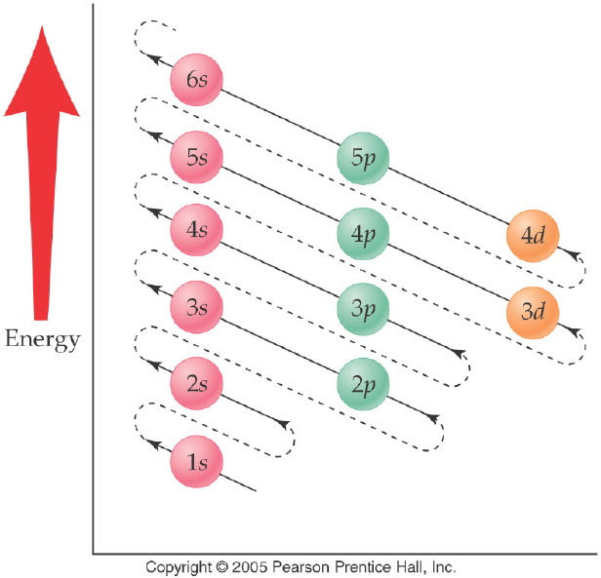
Notes:
Figure: 05-16
Title:
Filling Diagram for Sublevels
Caption:
The order of sublevel filling is arranged according to increasing energy.
Notes:
This diagonal filling diagram shows how the sublevels from different energy levels start to overlap.

Slide 42
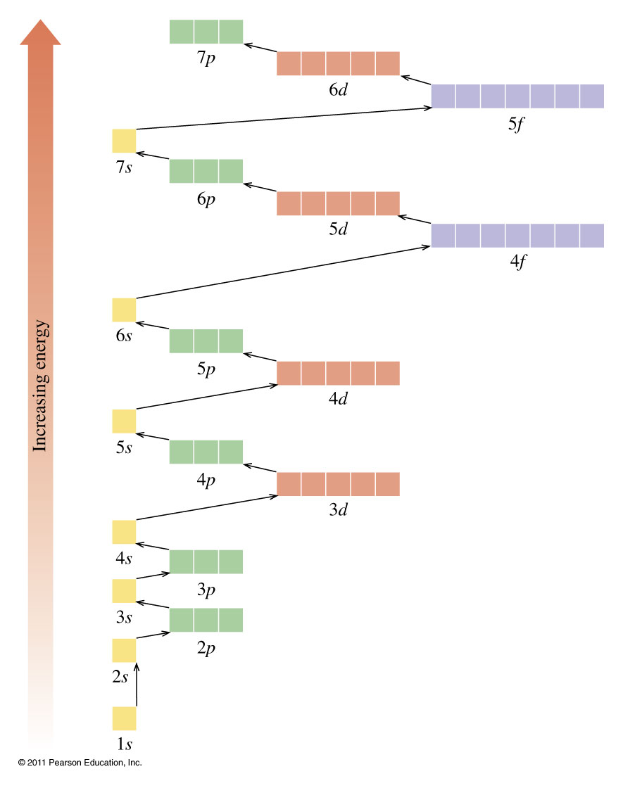

Slide 43
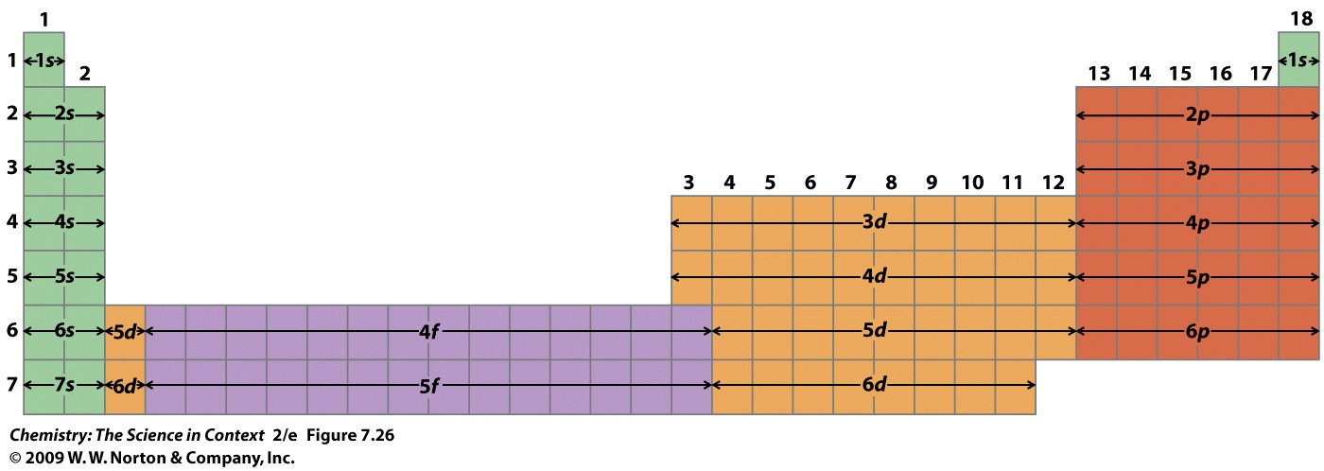

Slide 44
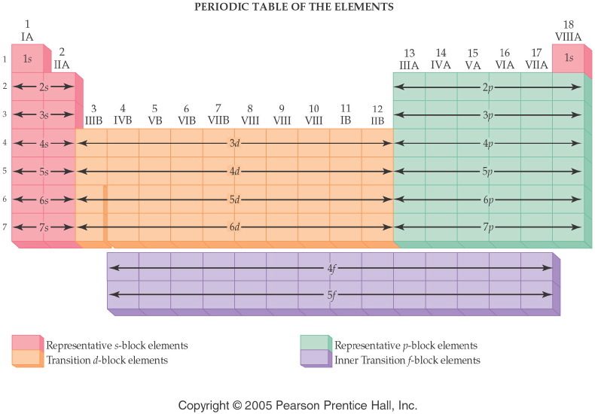
Notes:
Figure: 06-06
Title:
Blocks of Elements
Caption:
The relationship between energy sublevels and the s, p, d, and f blocks of elements is shown.
Notes:
Each block of elements represents a specific set of sublevels and is designated by a distinct color. THe indicated sublevel is the highest energy subshell in the atom.

Slide 45
Example – Electron Configuration
What is the electron configuration of C?
1s² 2s² 2p²
1s² 1p⁴
2s² 2p²
1s⁶
None of the above

Slide 46
Example – Electron Configuration
What is the electron configuration of C?
1s² 2s² 2p²
1s² 1p⁴
2s² 2p²
1s⁶
None of the above

Slide 47
Example – Electron Configuration
What element has an electron configuration of 1s² 2s² 2p⁶ 3s¹?

Slide 48
Example – Electron Configuration
What element has an electron configuration of 1s² 2s² 2p⁶ 3s¹?
Sodium, Na

Slide 49
Expanded Periodic Table

Slide 50
Example – Electron Configuration
What is the electron configuration of vanadium, V?
1s² 2s² 2p⁶ 3s² 3p⁶ 4s² 4d³
1s² 2s² 2p⁶ 3s2 3p⁶ 4s⁵
1s² 2s² 2p⁶ 3s³ 3p⁶ 4s² 3d²
1s² 2s² 2p⁶ 3s² 3p⁶ 4s² 3d³
None of the above

Slide 51
Example – Electron Configuration
What is the electron configuration of vanadium, V?
1s² 2s² 2p⁶ 3s² 3p⁶ 4s² 4d³
1s² 2s² 2p⁶ 3s2 3p⁶ 4s⁵
1s² 2s² 2p⁶ 3s³ 3p⁶ 4s² 3d²
1s² 2s² 2p⁶ 3s² 3p⁶ 4s² 3d³
None of the above

Slide 52
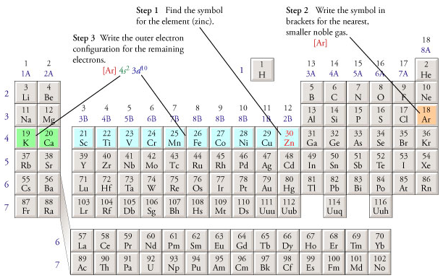
How would you write the condensed electron configuration for zinc?

Slide 53
Example – Electron Configuration
How many core electrons does aluminum have?
2
3
4
6
10

Slide 54
Example – Electron Configuration
How many core electrons does aluminum have?
2
3
4
6
10

Slide 55
Example – Electron Configuration
How many valence electrons does aluminum have?
2
3
4
6
10

Slide 56
Example – Electron Configuration
How many valence electrons does aluminum have?
2
3
4
6
10

Slide 57
Example – Electron Configuration
Write the core notation for Pb.
[Xe] 6s² 6p²
6s² 5d¹⁰ 4f¹⁴ 6p²
1s² 2s² 2p⁶ 3s² 3p⁶ 4s² 3d¹⁰ 4p⁶ 5s2 4d¹⁰ 5p⁶ 6s² 5d¹⁰ 4f¹⁴ 6p²
[Xe] 6s² 5d¹⁰ 4f¹⁴ 6p²
[Hg] 6p²

Slide 58
Example – Electron Configuration
Write the core notation for Pb.
[Xe] 6s² 6p²
6s² 5d¹⁰ 4f¹⁴ 6p²
1s² 2s² 2p⁶ 3s² 3p⁶ 4s² 3d¹⁰ 4p⁶ 5s2 4d¹⁰ 5p⁶ 6s² 5d¹⁰ 4f¹⁴ 6p²
[Xe] 6s² 5d¹⁰ 4f¹⁴ 6p²
[Hg] 6p²

Slide 59
Example – Electron Configuration
Write the core notation for Pb²⁺.
[Xe] 5d¹⁰ 4f¹⁴ 6p²
[Xe] 6s²
6s² 5d¹⁰ 4f¹⁴
1s² 2s² 2p⁶ 3s² 3p⁶ 4s² 3d¹⁰ 4p⁶ 5s2 4d¹⁰ 5p⁶ 6s² 5d¹⁰ 4f¹⁴ 6p²
[Xe] 6s² 5d¹⁰ 4f¹⁴ 6p²

Slide 60
Example – Electron Configuration
Write the core notation for Pb²⁺.
[Xe] 5d¹⁰ 4f¹⁴ 6p²
[Xe] 6s²
6s² 5d¹⁰ 4f¹⁴
1s² 2s² 2p⁶ 3s² 3p⁶ 4s² 3d¹⁰ 4p⁶ 5s2 4d¹⁰ 5p⁶ 6s² 5d¹⁰ 4f¹⁴ 6p²
[Xe] 6s² 5d¹⁰ 4f¹⁴ 6p²

Slide 61
Example – Electron Configuration
Write the core notation for the oxide ion.
[Ne]
1s² 2s² 2p⁶ 3s² 3p⁶
[He] 3s² 3p⁶
[He] 3s² 3p⁴
A and C

Slide 62
Example – Electron Configuration
Write the core notation for the oxide ion.
[Ne]
1s² 2s² 2p⁶ 3s² 3p⁶
[He] 3s² 3p⁶
[He] 3s² 3p⁴
A and C

Slide 63
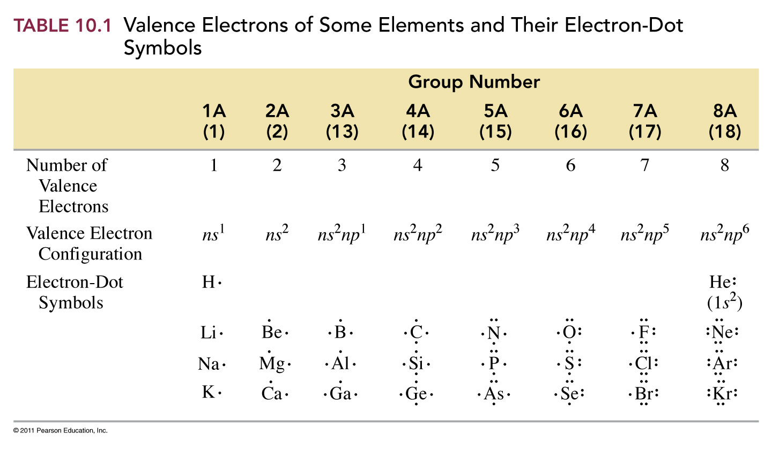

Slide 64
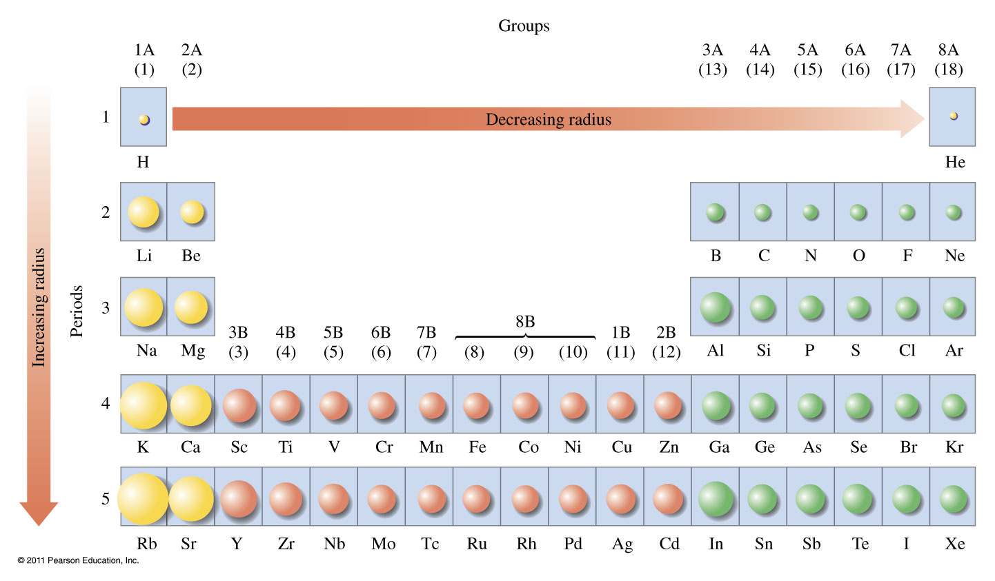
What are the trends for atomic size?

Slide 65
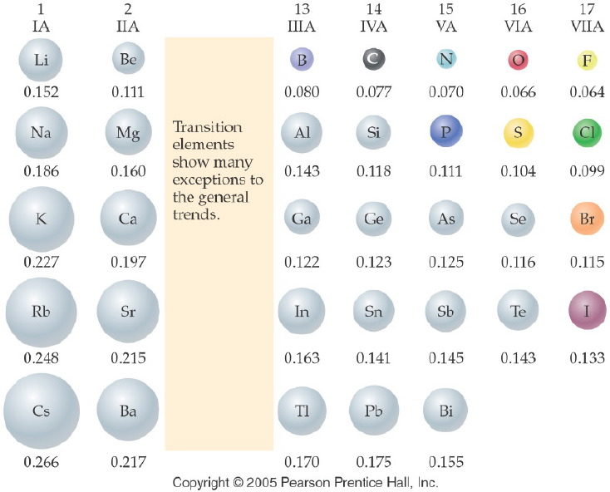
What are the trends for atomic size?
Notes:
Figure: 06-04
Title:
Atomic Radii of Elements
Caption:
Atomic radii decrease up a group and across a period. The values for radii are given in nanometers.
Notes:
Atomic size (radius) decreases as fewer energy levels are needed (up the table) and as the nucleus adds protons, pulling the electrons closer to the nucleus (to the right in the table).

Slide 66
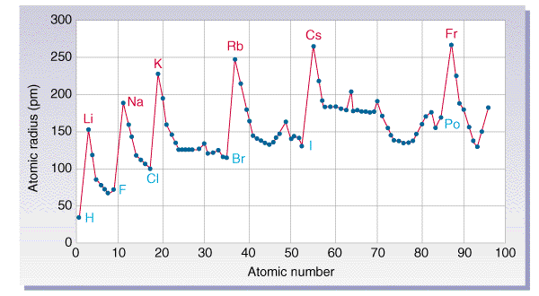
Periodic Properties
Atomic Size – determined by how far the outermost electrons are from the nucleus

Slide 67
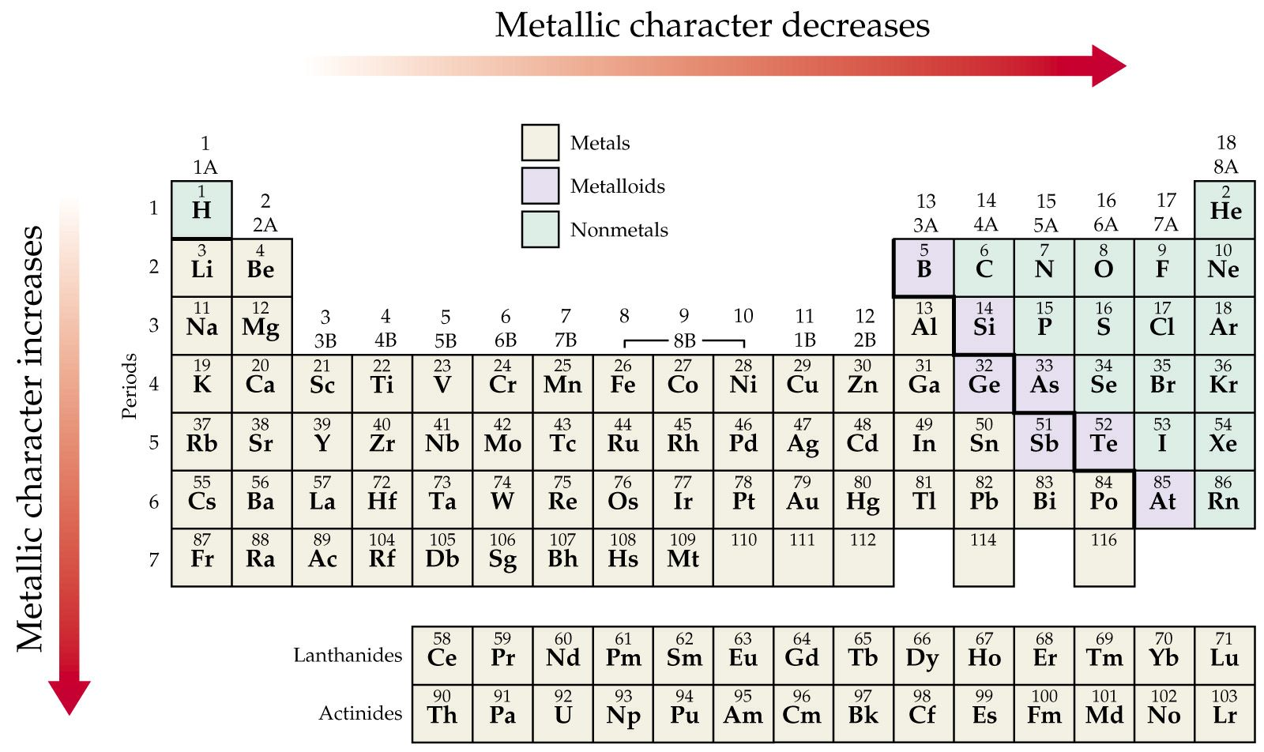
What are the trends for metallic character?

Slide 68
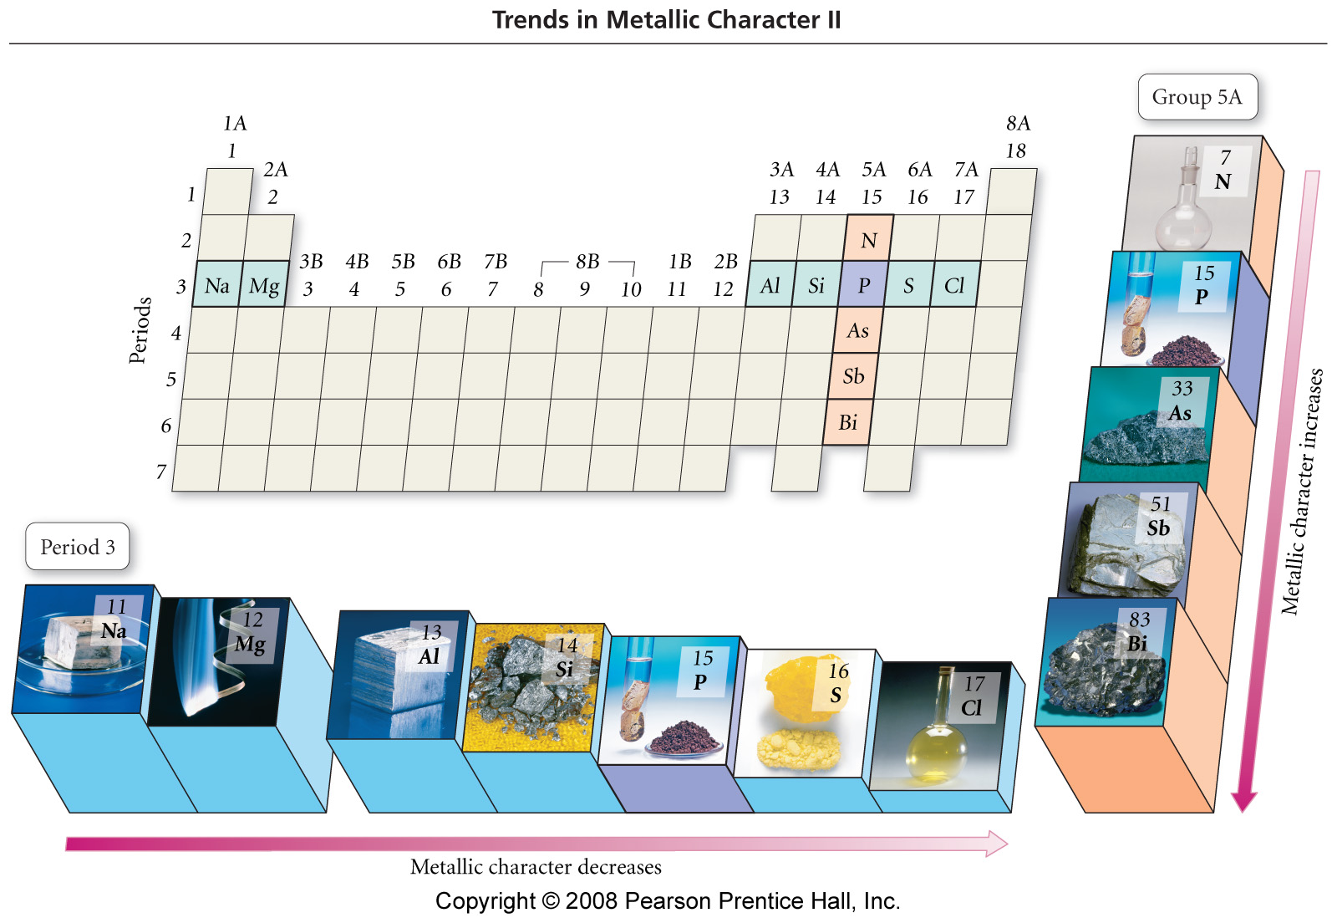
Notes:
Figure: 08-18
Title:
Trends in Metallic Character II
Caption:
As you move down group 5A in the periodic table, metallic character increases. As you move across period 3 in the periodic table, metallic character decreases.

Slide 69
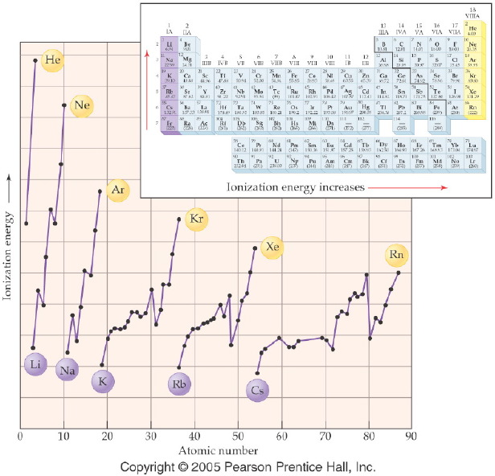
What are the trends for ionization energy?
Notes:
Figure: 06-08
Title:
Ionization Energy
Caption:
This diagram shows the energy required to remove a single electron from a neutral atom.
Notes:
In general, the greater the number of protons in the nucleus in each period, the harder it is to remove an electron. Moving the electrons further from the nucleus decreases the energy required. The ionization energy generally increases as atomic radius decreases.

Slide 70
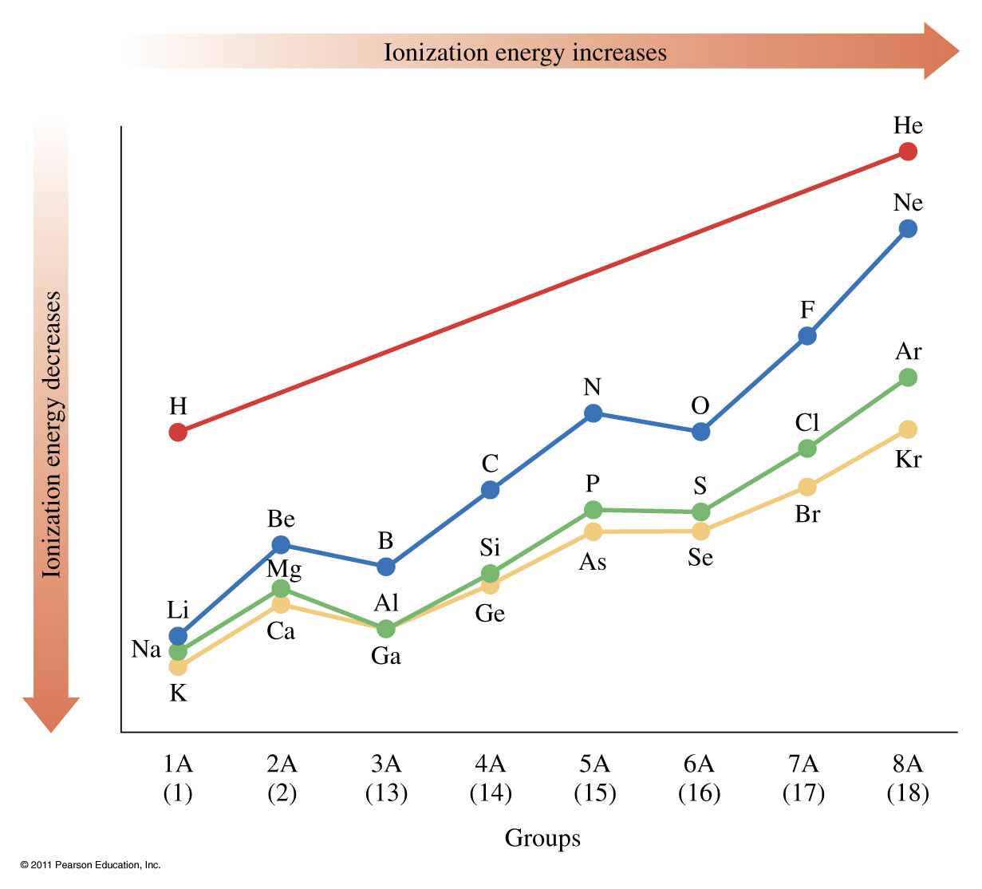

Slide 71
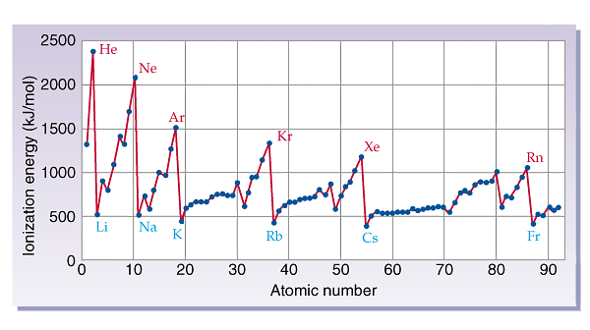
Periodic Properties – Ionization Energy

Slide 72
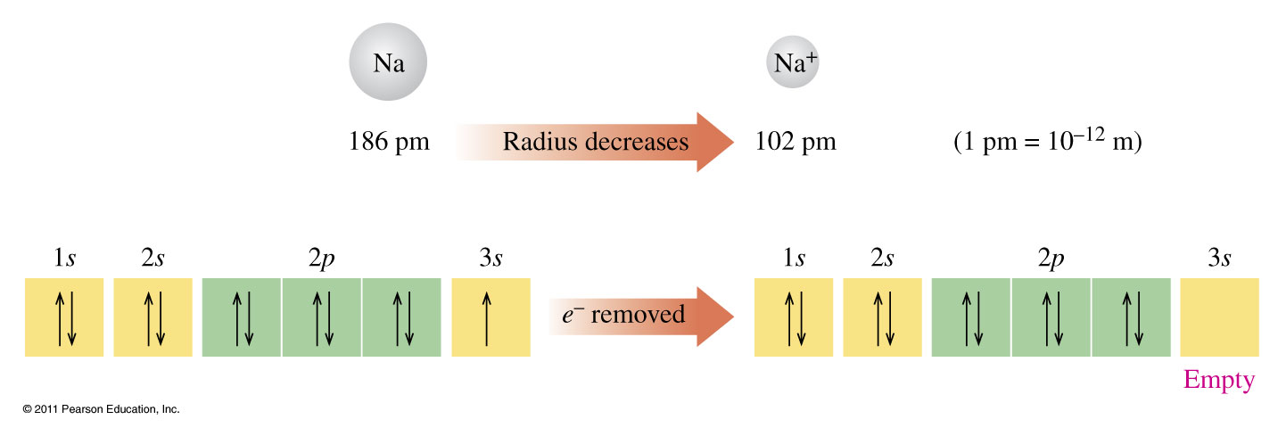
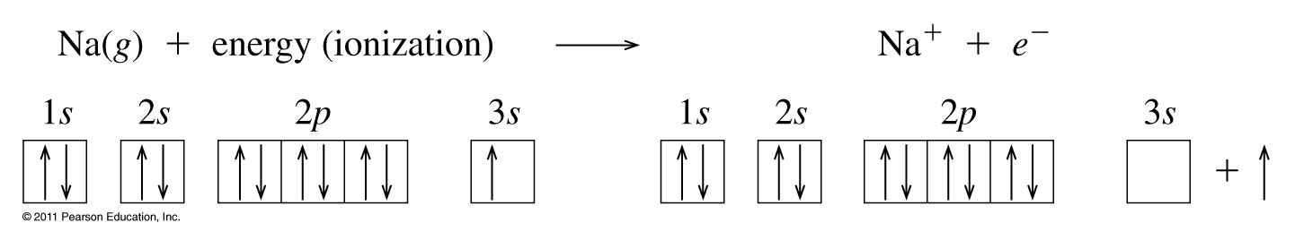
What happens when an atom loses an electron?

Slide 73
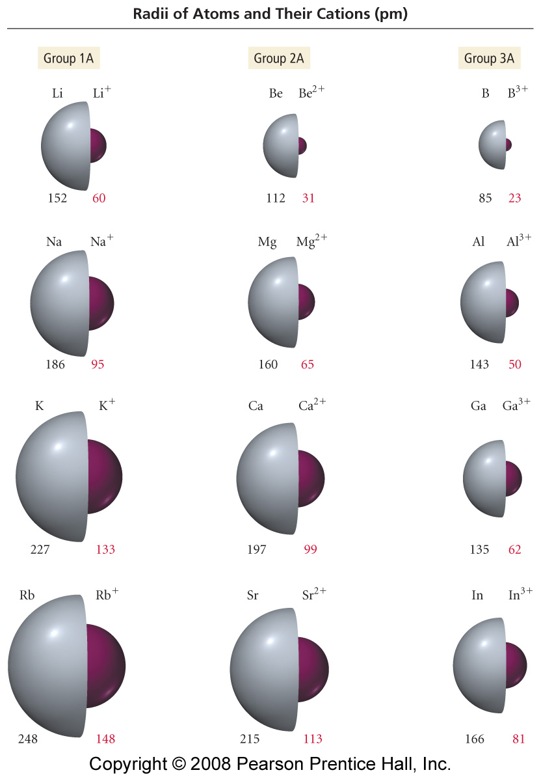

How does the radius of a cation differ from an atom?
Notes:
Figure: 08-12
Title:
Sizes of Atoms and Their Cations
Caption:
Atomic and ionic radii (pm) for the first three columns of main-group elements.

Slide 74

What happens when an atom gains an electron?

Slide 75


How does the radius of an anion differ from an atom?
Notes:
Figure: 08-13
Title:
Sizes of Atoms and Their Anions
Caption:
Atomic and ionic radii for groups 6A and 7A in the periodic table.

Slide 76

How are the sizes of species related?
Notes:
Figure: 12-07
Title:
Formation of Na+ and Cl- Ions
Caption:
The radius of the sodium atom decreases, while the chloride atom increases when ionized.
Notes:
Losing an electron means that the positive nucleus can pull the other electrons in more strongly. Gaining an electron means that the positive nucleus is less effective in pulling the electrons in.

Slide 77
Example – Atomic Size
Which has the larger atomic size?
Li or Na and N or P
Li, N
Na, N
Li, P
Na, P
Not enough information

Slide 78
Example – Atomic Size
Which has the larger atomic size?
Li or Na and N or P
Li, N
Na, N
Li, P
Na, P
Not enough information

Slide 79
Example – Metallic Character
Which has more metallic character:
S or Na?

Slide 80
Example – Metallic Character
Which has more metallic character:
S or Na?
Na

Slide 81
Example – Ionization Energy
Which has the higher ionization energy:
Mg or Ca?

Slide 82
Example – Ionization Energy
Which has the higher ionization energy:
Mg or Ca?
Mg

Slide 83
Example – Ionization Energy
Which has the higher ionization energy:
Sn or Pb?

Slide 84
Example – Ionization Energy
Which has the higher ionization energy:
Sn or Pb?
Sn

Slide 85
Example – Ionization Energy
Which has the higher ionization energy:
Se or S?

Slide 86
Example – Ionization Energy
Which has the higher ionization energy:
Se or S?
S

Slide 87

Notes:
Figure: 06-03
Title:
Names of Groups and Periods
Caption:
The common names of groups and periods are shown for selected families and series.
Notes:
These names are still commonly used, and it's important to remember them.

Slide 88

Fig. 11-21, p. 333

Slide 89

Fig. 11-22, p. 334

