Slide 1
Chemistry 120
Outline
Chemical Reactions
Evidence
Balancing
Electrolytes
Types of Chemical Equations
Conventional
Total Ionic
Net Ionic
Types of Reactions
Combination/Synthesis
Combustion
Decomposition
Single Replacement
Double Replacement
Chapter 8: Chemical Reactions
Chapter 9: Chemical Change

Slide 2
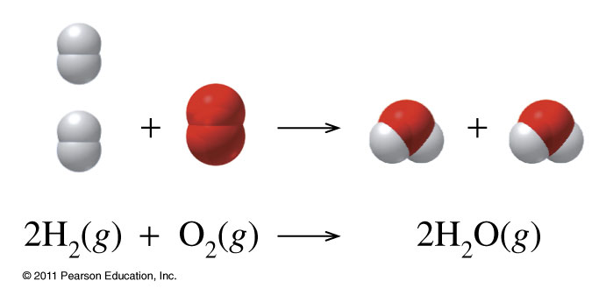
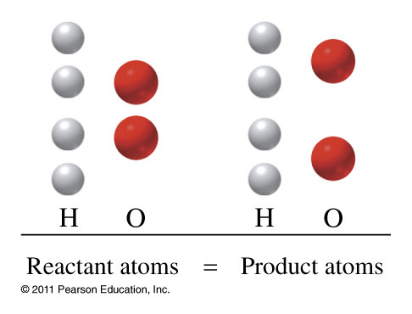
Chemical Equations
Must be balanced to satisfy Law of conservation of mass
State Designations
(g) gas
(l) liquid
(s) solid
(aq) aqueous

Slide 3
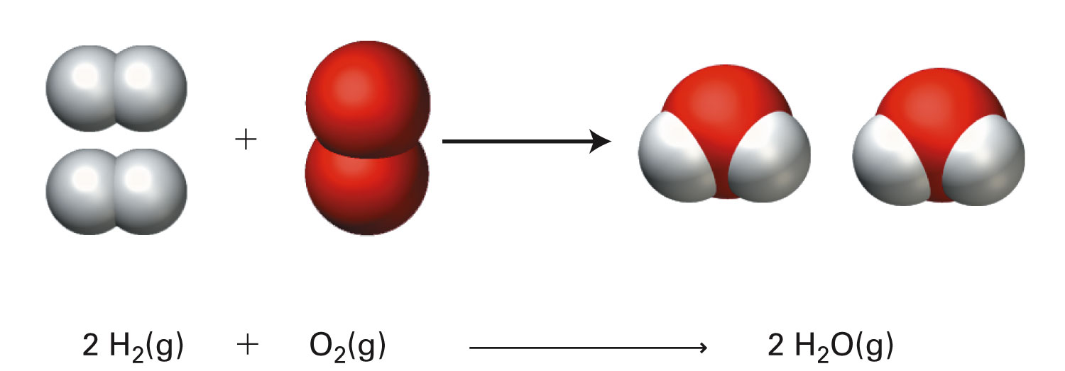
Particulate level interpretation and Molar-level interpretation
spark
spark
p218

Slide 4
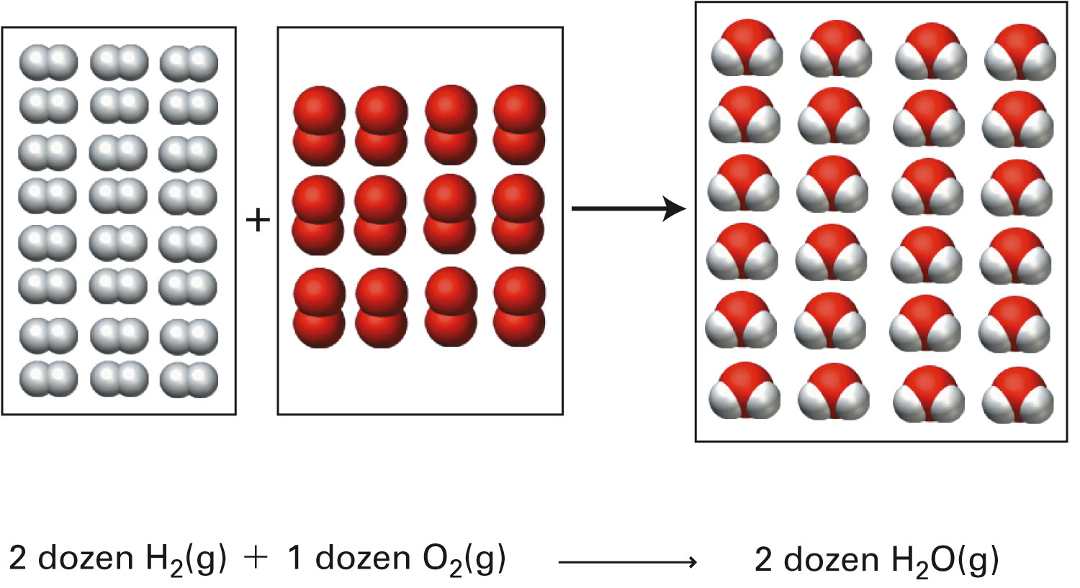
Grouping-unit level interpretation
spark
spark
p219

Slide 5
What information is shown in a balanced chemical equation?
Zn _{(s)} | + | 2 HCl _{(aq)} | → | ZnCl_{2 (aq)} | + | H_{2 (g)}
1 atom Zn |  | 2 molecules HCl |  | 1 formula unit ZnCl₂ |  | 1 molecule H₂
1 atom Zn |  | 2 atoms H 2 atoms Cl |  | 1 atom Zn 2 atoms Cl |  | 2 atoms H
1 mole |  | 2 moles |  | 1 mole |  | 1 mole
65.38 g |  | 2(36.46 g) |  | 136.28 g |  | 2.02 g
138.30 g |  |  | = | 138.30 g

Slide 6
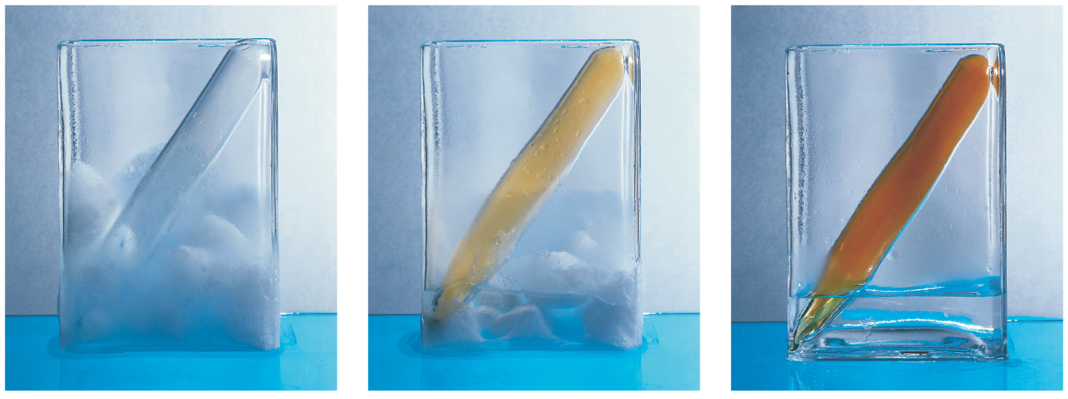
How do we know a reaction is taking place?

Slide 7
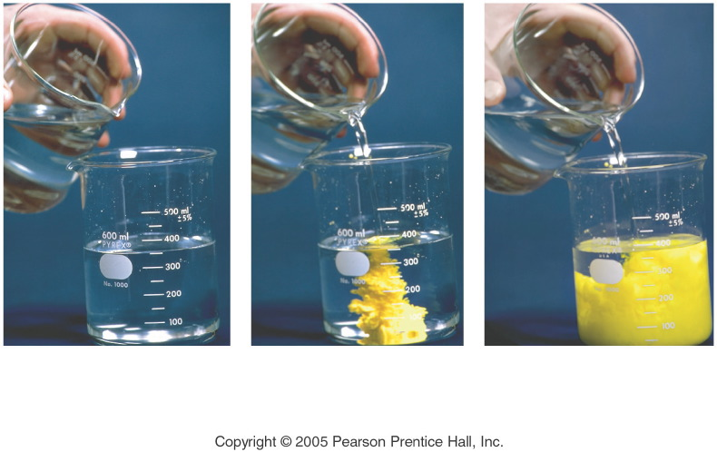
How do we know a reaction is taking place?
Notes:
Figure: 08-01-21CREx14
Title:
precipitation reaction
Caption:
Composite of 3 photos: 1) 2 clear solutions; 2) yellow precipitate starts; 3) clear solution turns to yellow.
Notes:
This is a double-replacement reaction. One of the products is insoluble in water.

Slide 8
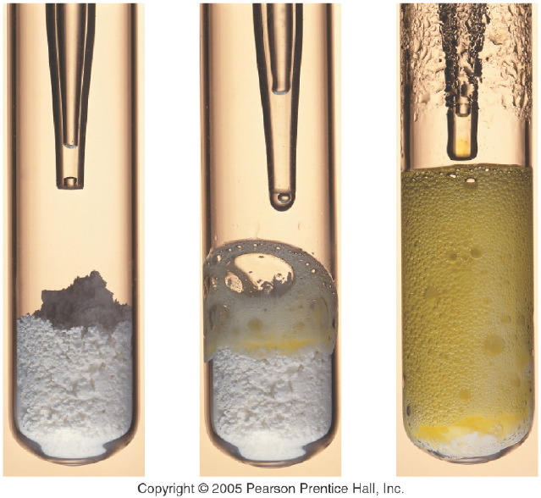
How do we know a reaction is taking place?
Notes:
Figure: 08-01-20CRKC10
Title:
Hydrochloric acid and baking soda
Caption:
Composite of 3 photos: In test tube 1) dropper over white powder; 2) white powder starting to become yellow foam; 3) yellow foam.
Notes:
This reaction produces a gas as well as an aqueous solution.

Slide 9
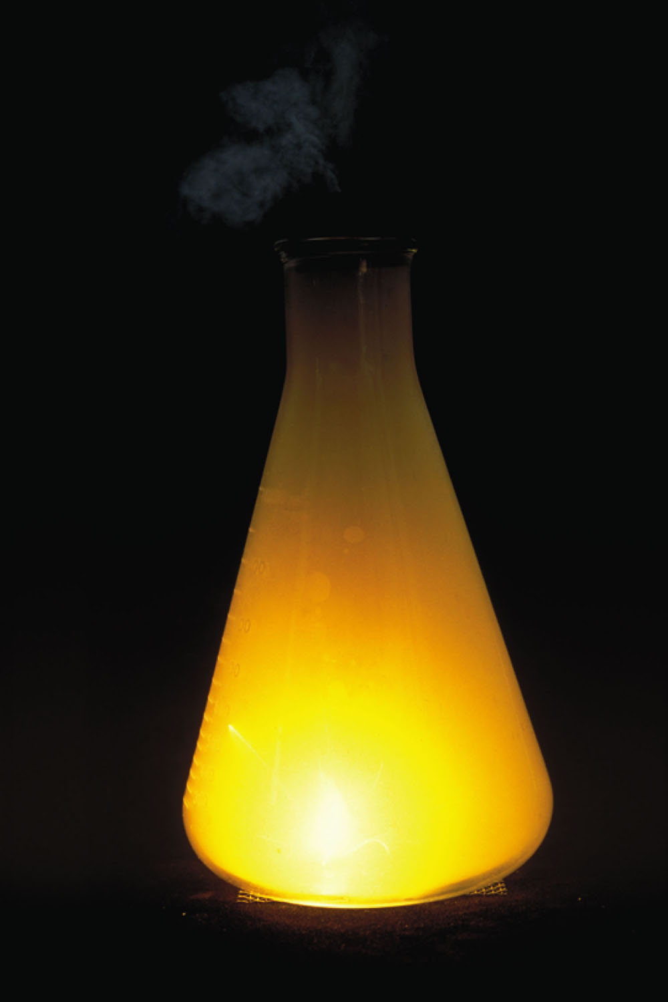
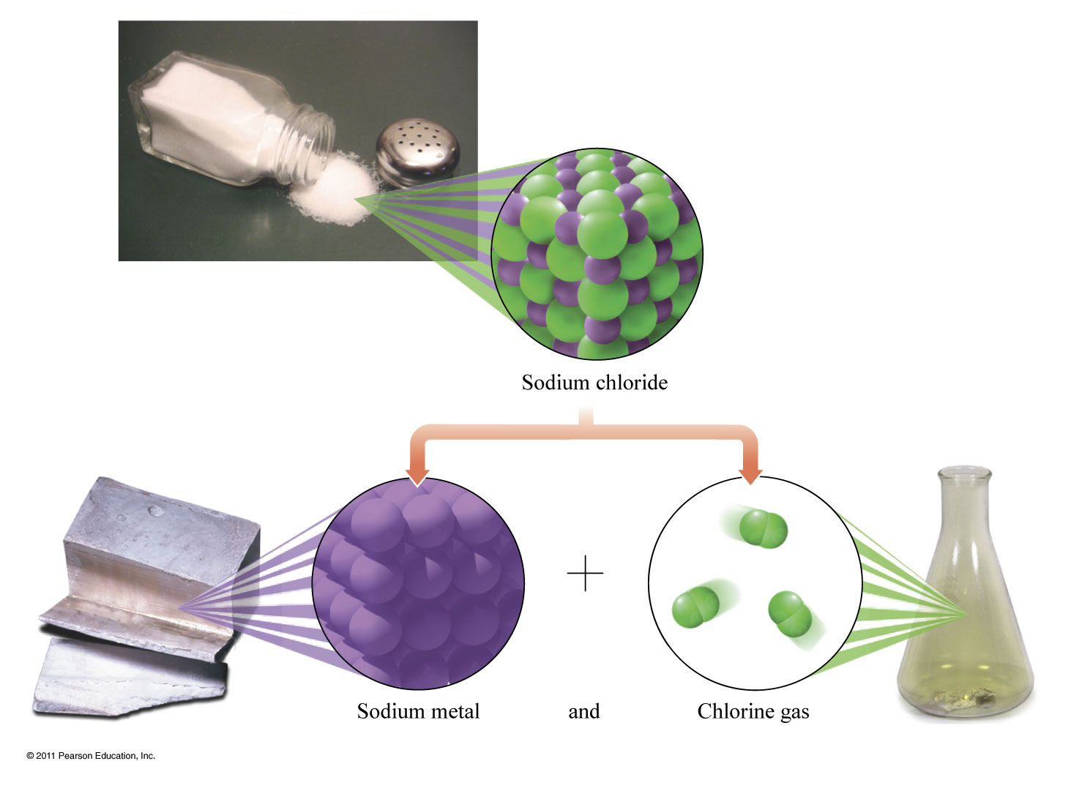
Is this an exothermic or endothermic reaction?
Figure 12-2 p353
Notes:
Figure 12.2 The reaction of sodium and chlorine. Sodium metal reacts violently with chlorine gas to form sodium chloride.

Slide 10
Notes:
Figure: 08-T01
Title:
Table 8.1
Caption:
Chemical Equation Symbols
Notes:
These symbols are used to describe the details of the conditions in a chemical reaction and to describe the products and reactants.

Slide 11
When does the light bulb light up?
Figure 9-1 p242
Notes:
Figure 9.1 A lightbulb conduc-tivity apparatus.

Slide 12
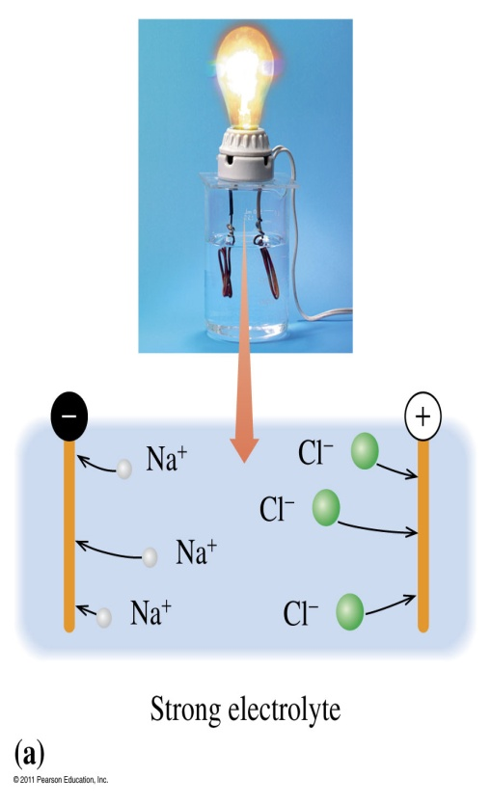
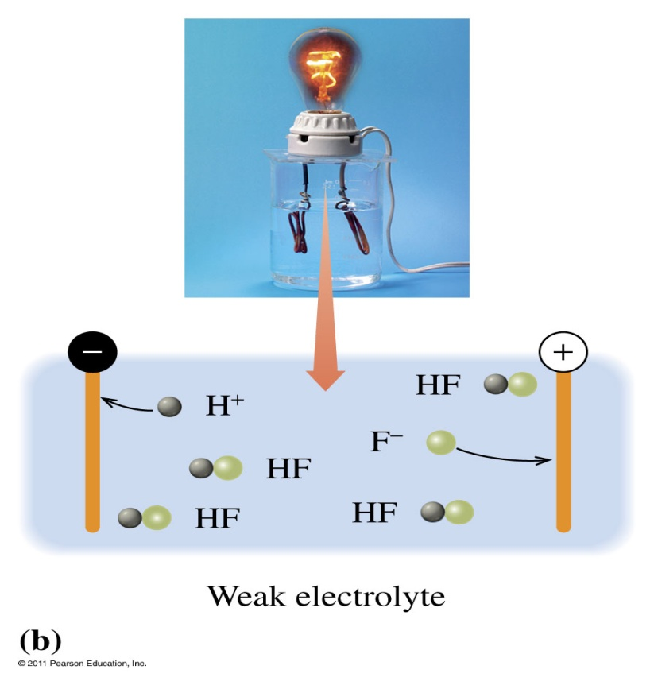
Are ionic compounds conductive?
A strong electrolyte in an aqueous solution completely dissociates into ions.
The weak electrolyte in an aqueous solution forms mostly molecules and a few ions.

Slide 13
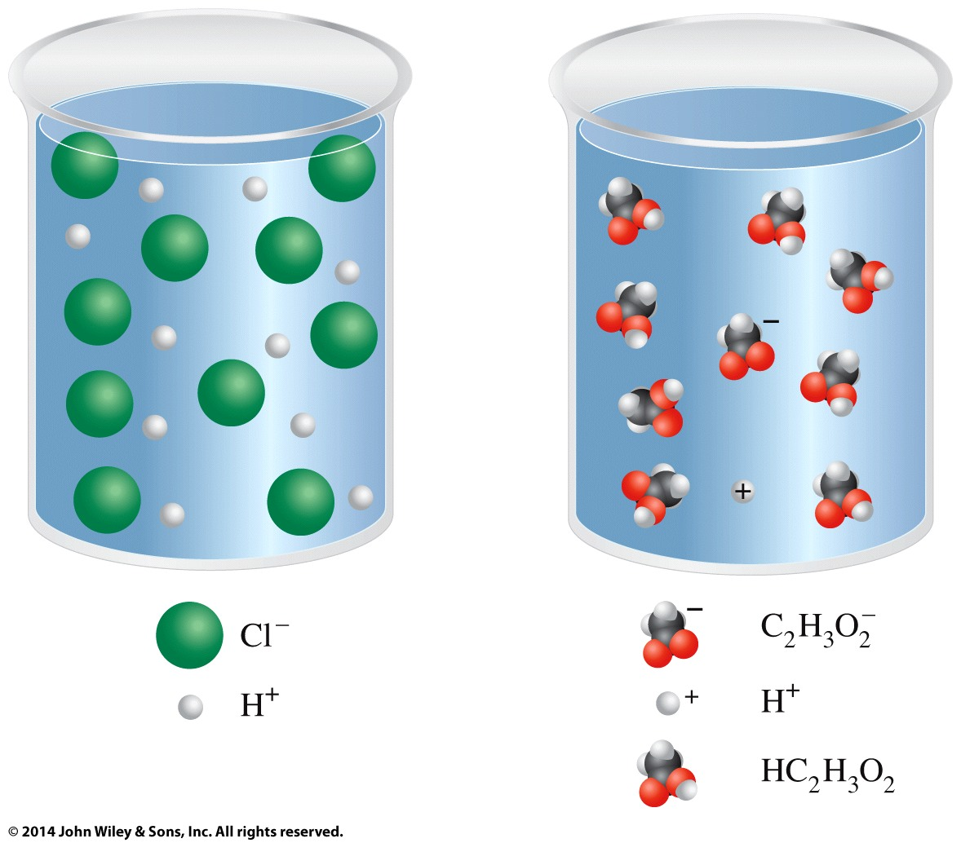
What is different about these solutions?

Slide 15
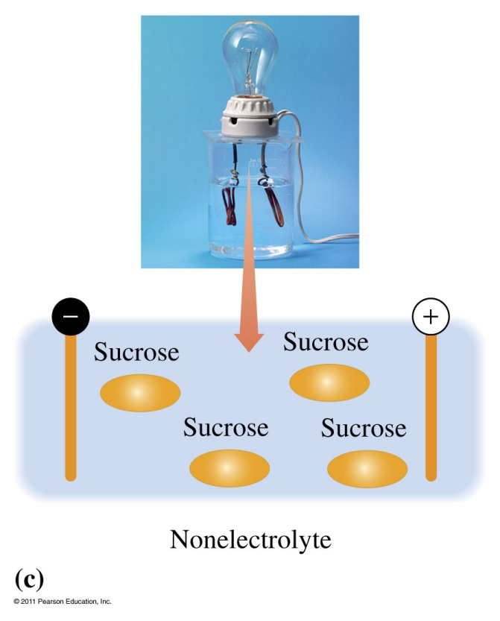
Are covalent compounds conductive?
A nonelectrolyte in an aqueous solution produces only molecules.

Slide 16
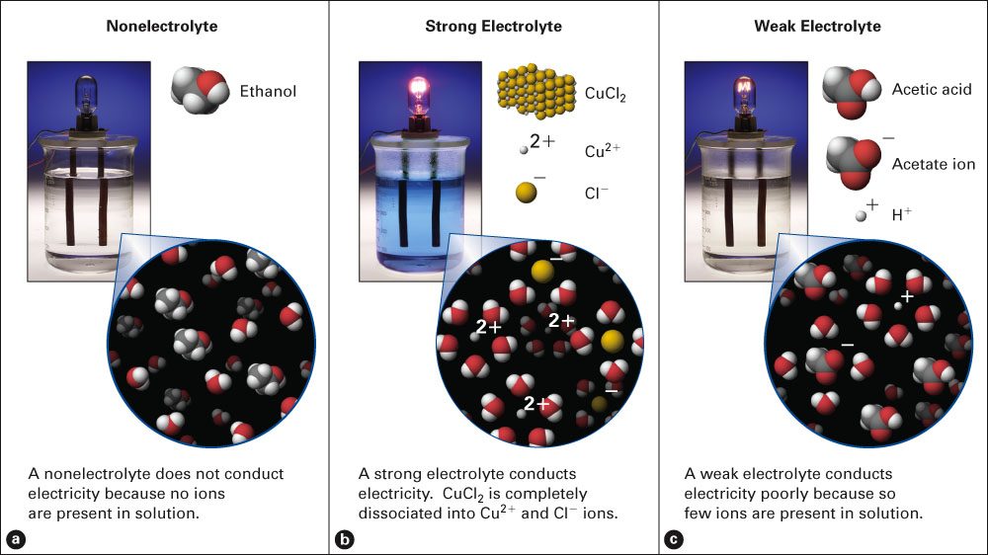
When does the light bulb light up?
Fig. 9-2, p. 237
Notes:
Figure 9.2 Nonelectrolytes, strong electrolytes, and weak electrolytes. The liquid in the beaker is used to “close” the electri-cal circuit. (a) If the liquid is pure water or a solution of molecular compounds, the bulb does not light. Solutes whose solutions do not conduct electricity are nonelectrolytes. (b) A soluble ionic salt is a strong electrolyte because its solution makes the bulb burn brightly. (c) Some solutes are called weak electrolytes because their solutions conduct poorly, and the bulb glows dimly.

Slide 17
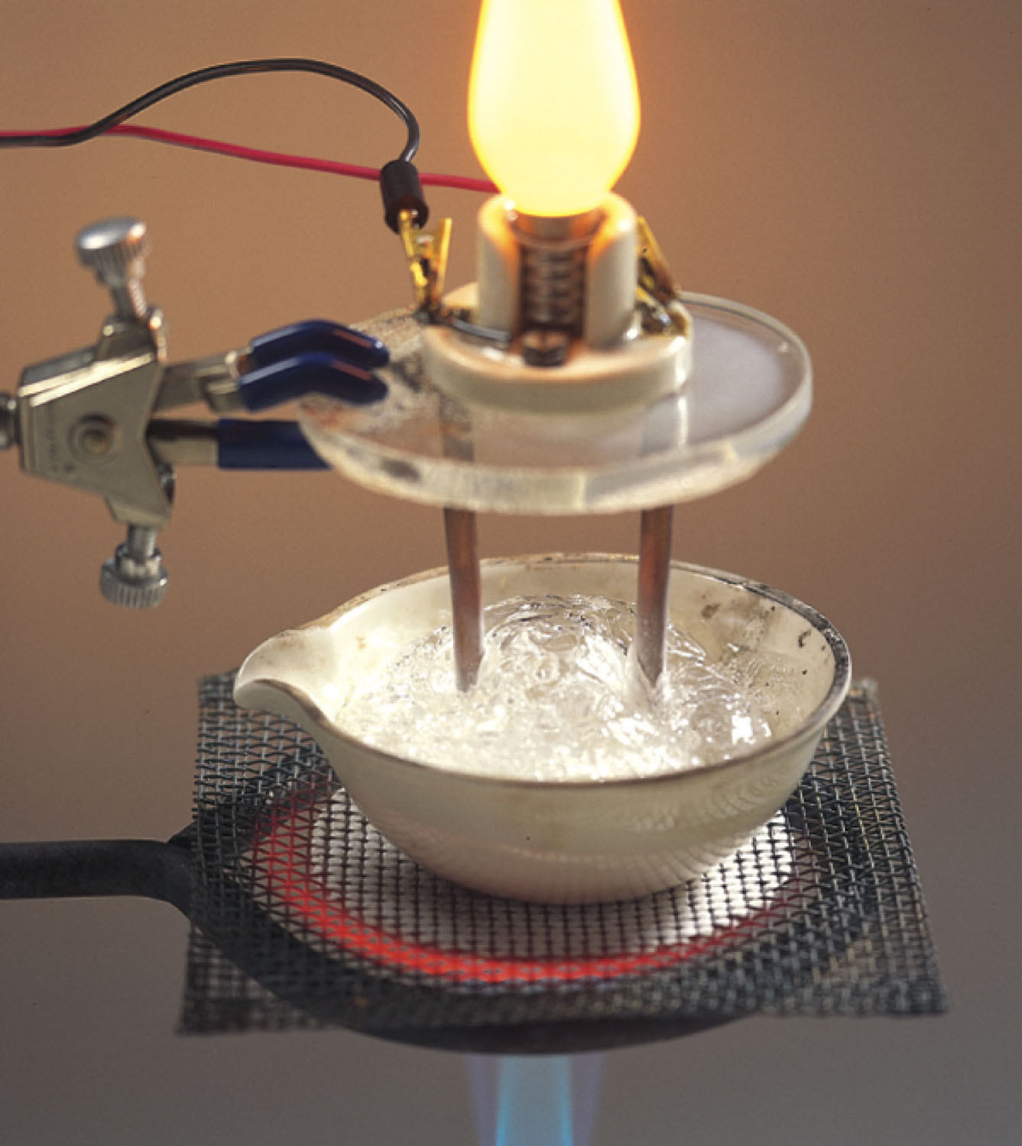
Why does a molten liquid conduct electricity?
Figure 12-6 p355
Notes:
Figure 12.6 Electrical conduc-tivity of a liquid ionic compound. A light bulb conductivity apparatus (review Figure 9.3 if necessary) shows that when an ionic compound is heated until the solid changes to the liquid state, it conducts electric current. We interpret this observation at the particulate level by concluding that the ions must be free to move relative to one another when in the liquid state, allowing them to carry current between the electrodes.

Slide 18
Common Strong Acids and Bases
Common Strong Bases
Lithium hydroxide LiOH _{(aq)}
Sodium hydroxide NaOH _{(aq)}
Potassium hydroxide KOH _{(aq)}
Strontium hydroxide Sr(OH)₂ _{(aq)}
Barium hydroxide Ba(OH)₂ _{(aq)}
Calcium hydroxide Ca(OH)_{2 (aq)}
Common Strong Acids
Hydrochloric acid HCl _{(aq)}
Hydrobromic acid HBr _{(aq)}
Hydroiodic acid HI _{(aq)}
Perchloric acid HClO_{4 (aq)}
Chloric acid HClO_{3 (aq)}
Nitric acid HNO_{3 (aq)}
Sulfuric acid H₂SO_{4 (aq)}

Slide 19
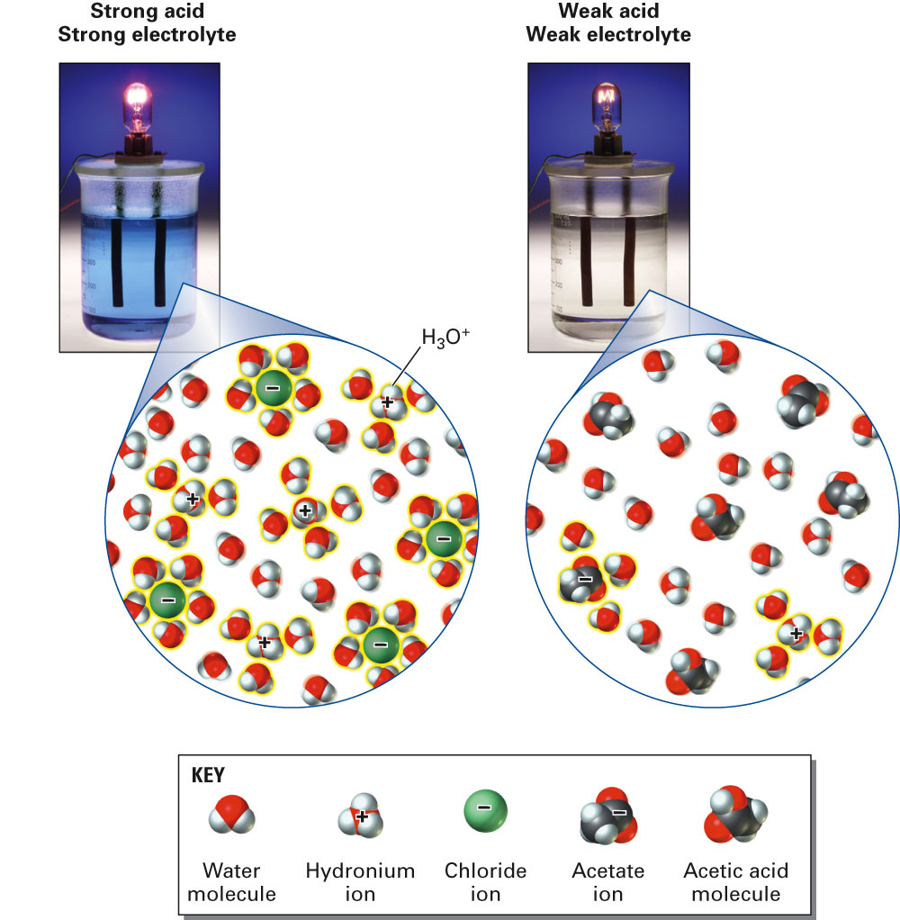
What is the difference between these two solutions?
Fig. 9-6, p. 241

Slide 20
Figure 9-3 p243
Notes:
Figure 9.3 Conductivity in an ionic solution. (a) The illuminated bulb shows that this solution, made by dissolving the solid ionic compound potassium chloride in water, is indeed a conductor. If a solution conducts electricity, it is tangible evidence that mobile ions are present. At the particulate level, we model the solution showing potassium ions and chloride ions free to move among the water molecules. (b) A simplified model of the electrical circuit. Positively charged ions are attracted to the negatively charged metal strip. Similarly, negatively charged ions move to the positively charged metal strip. Note how electrons flow through the system.

Slide 21
Example – Conventional, Total Ionic and Net Ionic Equations
Zinc metal reacts with aqueous copper(II) chloride to produce copper solid and aqueous zinc chloride.
What is the net ionic equation?
Zn _{(s)} + CuCl_{2 (aq)} → Cu _{(s)} + ZnCl_{2 (aq)}
Zn _{(s)} + Cu²⁺ _{(aq)} + 2 Cl⁻ _{(aq)} → Cu _{(s)} + Zn²⁺ _{(aq)} + 2 Cl⁻ _{(aq)}
Zn _{(s)} + Cu²⁺ _{(aq)} → Cu _{(s)} + Zn²⁺ _{(aq)}
Zn _{(s)} + Cu²⁺ _{(aq)} + 2 Cl⁻ _{(aq)} → Cu _{(s)} + ZnCl₂ _{(aq)}
All spectator ions

Slide 22
Example – Conventional, Total Ionic and Net Ionic Equations
When cadmium bromide reacts with potassium arsenate the products are:
CdK₂ and AsO₄Br₃
Cd₂(AsO₄)₃ and K₃Br₂
Cd₃(AsO₄)₂ and K₃Br₂
Cd₃(AsO₄)₂ and KBr
KCd and BrAsO₄

Slide 23
Example – Conventional, Total Ionic and Net Ionic Equations
What are the spectator ions in the total ionic equation?
Cd²⁺, Br⁻, K⁺, AsO₄³⁻
Br⁻, K⁺
Cd²⁺, AsO₄³⁻
Cd²⁺, Br⁻, K⁺, As³⁻, O²⁻
No spectator ions

Slide 24
Example – Conventional, Total Ionic and Net Ionic Equations
Aqueous ammonium nitrate reacts with aqueous sodium hydroxide to produce aqueous sodium nitrate and ammonia gas and water.
What is the total ionic equation?
NH₄NO_{3 (aq)} + NaOH _{(aq)} → NaNO_{3 (aq)} + NH_{3 (g)} + H₂O _{(l)}
NH₄ ⁺ _{(aq)} + NO₃⁻ _{(aq)} + Na⁺ _{(aq)} + OH- _{(aq)} → Na⁺ _{(aq)} + NO₃⁻ _{(aq)} + NH_{3 (g)} + H₂O _{(l)}
NH₄ ⁺ _{(aq)} + OH- _{(aq)} → NH_{3 (g)} + H₂O _{(l)}
All spectator ions

Slide 25
Classifying Reactions by what Atoms Do

Slide 26
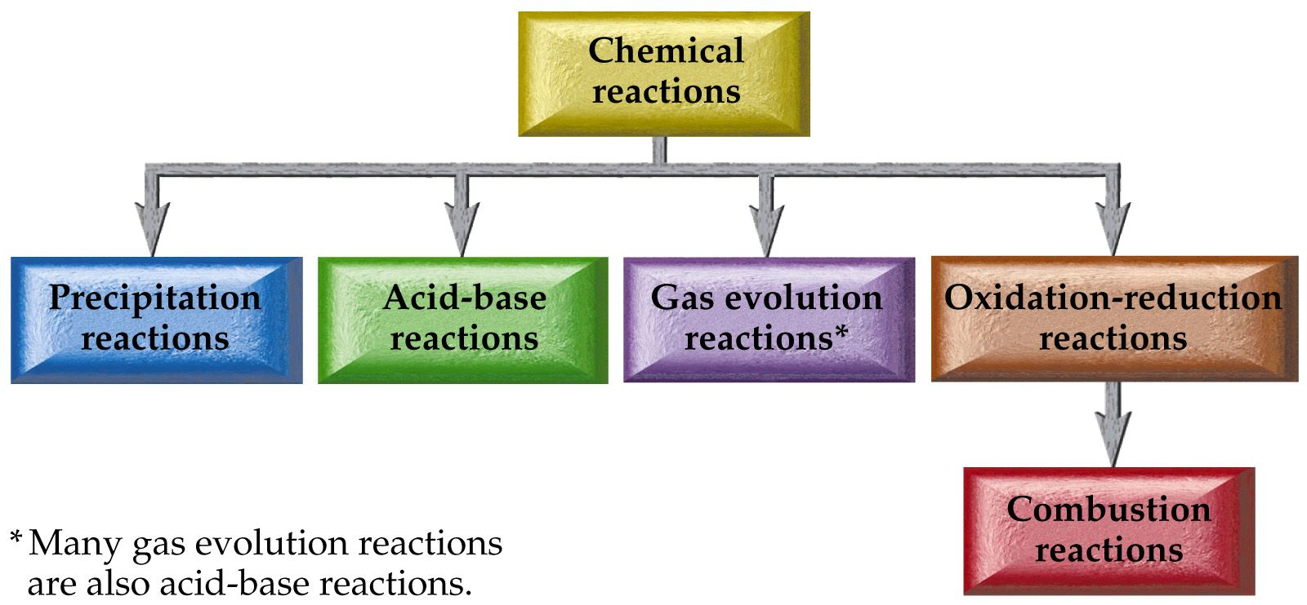
Classifying Reactions by Type of Chemistry

Slide 28
Notes:
Figure: 08-T03
Title:
Table 8.3
Caption:
Basic Types of Chemical Reactions
Notes:
These are the basic types of chemical reactions.

Slide 29
Classifying Reactions by what Atoms Do
Combination/Synthesis
A + Z ⎯→ AZ

Slide 30
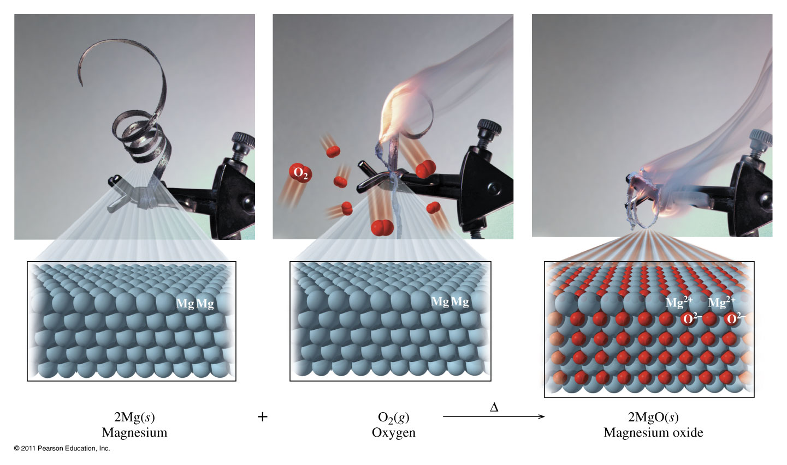
What does a combustion reaction looks like?

Slide 31
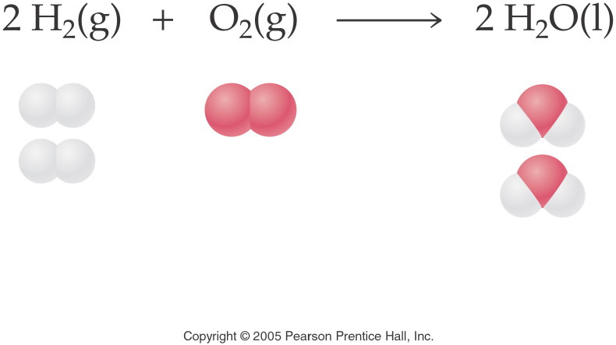
Notes:
Figure: 08-01-01EQ7-UN
Title:
Water
Caption:
Chemical equation of two water and its molecular atoms
Notes:
We should clear fractions by multiplying all coefficients by a number that will make all the coefficients whole numbers. Here we multiplied all the coefficients by 2 to make whole-number coefficients.

Slide 32
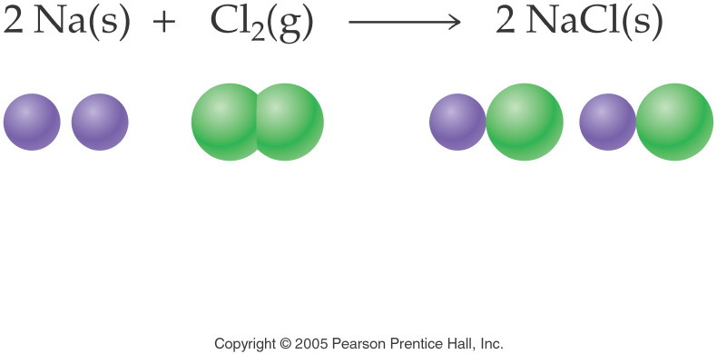
Potassium metal and bromine liquid are combined, what is the product(s)?
Notes:
Figure: 08-01-04EQ10-UN
Title:
sodium chloride
Caption:
Chemical equation of two sodium chloride and its molecular models
Notes:
This is a combination reaction. One product is produced from the two reactants. Note that the equation is balanced.

Slide 33
Example – Redox Reactions Synthesis/Combination Reactions
Lead filings are heated with phosphorus powder to yield lead(IV) phosphide solid.

Slide 34
Example – Redox Reactions Synthesis/Combination Reactions
Lithium metal is heated in the presence of oxygen gas.

Slide 35
Example – Redox reactions Synthesis/Combination Reactions
What is the coefficient of oxygen gas, when methane, CH₄, gas undergoes combustion with oxygen gas to produce carbon dioxide gas and water vapor?

Slide 36
Example – Synthesis Reactions
Sodium oxide and water are mixed. What is the balanced chemical equation?
Na₂O _{(s)} + H₂O _{(l)} → 2 NaOH _{(aq)}
Na₂O _{(s)} + H₂O _{(l)} → NaH₂O _{(aq)}
2 Na₂O _{(s)} + H₂O _{(l)} → 2 NaH _{(aq)} + O_{2 (g)}
Na₂O _{(s)} + H₂O _{(l)} → NaOH _{(aq)}
No reaction

Slide 37
Example – Synthesis Reactions
Calcium oxide and water are mixed. What is the product(s)?
CaO _{(s)}
Ca₂OH _{(s)}
CaOH_{2 (aq)}
Ca(OH)₂ _{(s)}
No reaction

Slide 38
Example – Synthesis Reactions
Sulfur trioxide and water are mixed, what is the sum of the coefficients?

Slide 39
Example – Synthesis Reactions
Dinitrogen pentaoxide and water are mixed. What is the coefficient of the product?

Slide 40
Example – Redox Reactions Synthesis/Combination Reactions
Chromium metal is heated with nitrogen gas to give solid chromium(III) nitride. What is the coefficient of the chromium metal?

Slide 41
Example – Redox Reactions Synthesis/Combination Reactions
Solid magnesium oxide combines with carbon dioxide to produce magnesium carbonate powder. What is the coefficient of the product?

Slide 42
Example – Redox Reactions Combustion Reactions
Chlorine gas and oxygen gas react to produce dichlorine trioxide gas. What is the coefficient in front of oxygen gas?

Slide 43
Classifying Reactions by what Atoms Do
Decomposition
AZ ⎯→ A + Z

Slide 44
What does a decomposition look like?

Slide 45
Example – Redox Reactions Decomposition Reactions
Hydrogen peroxide decomposes into oxygen gas and water. Write the balanced reaction.

Slide 46
Example – Redox Reactions Decomposition Reactions
Water decomposes into its element’s using electricity. Write the balanced reaction.

Slide 47
Example – Redox Reactions Decomposition Reactions
Stannous chlorate decomposes upon heating to yield stannous chloride and oxygen gas. What is the balanced chemical equation?
Sn(ClO₃)_{2 (s)} → SnCl_{2 (s)} + 3 O_{2 (g)}
Sn(ClO₂)_{2 (s)} → SnCl_{2 (s)} + 4 O_{2 (g)}
Sn(ClO₂)_{2 (s)} → no rxn
SnCl_{2 (s)} + 3 O_{2 (g)} → Sn(ClO₃)_{2 (s)}

Slide 48
Example – Redox Reactions Decomposition Reactions
Silver bicarbonate decomposes by heating to silver carbonate powder, water, and carbon dioxide gas. What is the sum of the coefficients?

Slide 49
Example – Redox Reactions Decomposition Reactions
Silver carbonate further decomposes upon heating to silver oxide and carbon dioxide. What is the sum of the coefficients now?

Slide 50
Classifying Reactions by what Atoms Do
Single Displacement
A + BZ ⎯→ AZ + B

Slide 51
What does a single replacement look like?

Slide 52
Activity Series
Metals
Li ← most reactive
K
active Ba Will replace H₂ from
metals Sr liquid water, steam or
Ca acid
Na
Mg
Al
Mn Will replace H₂ from
Zn steam or acid
Cr
Fe
Cd
Co
Ni Will replace H₂ from
Sn acid
Pb
(H)
Sb
Cu
Ag Will not replace H₂
Pd from liquid water,
Pt steam or acid
Hg
Au ← least reactive
Nonmetals: Halogens
F ← most reactive
Cl
Br
I ← least reactive

Slide 54
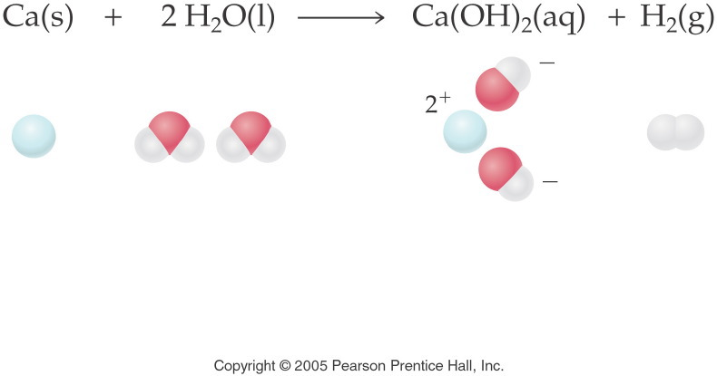
Notes:
Figure: 08-01-10EQ13-UN
Title:
Calcium and water
Caption:
Chemical equation of calcium hydroxide and its molecular models
Notes:
This is a single-replacement reaction. Two products are produced from the two reactants. One element replaces another. Note that the equation is balanced.

Slide 55
Example – Redox Reactions Single Replacement Reactions
Activity
Series of
Metals
Li
K
Ba
Sr
Ca
Na
Mg
Al
Mn
Zn
Cr
Fe
Cd
Co
Ni
Sn
Pb
(H)
Sb
Cu
Ag
Pd
Pt
Hg
Au
Aluminum wire is placed in a cupric nitrate solution. What is the sum of the coefficients?

Slide 56
Example – Redox Reactions Single Replacement Reactions
Metals
Li
K
Ba
Sr
Ca
Na
Mg
Al
Mn
Zn
Cr
Fe
Cd
Co
Ni
Sn
Pb
(H)
Sb
Cu
Ag
Pd
Pt
Hg
Au
Copper wire is placed in a solution of magnesium nitrate. What is the net ionic equation?
Cu _{(s)} + Mg(NO₃)_{2 (aq)} → Mg _{(s)} + Cu(NO₃)_{2 (aq)}
Cu _{(s)} + Mg(NO₃)_{2 (aq)} → MgCu _{(s)} + NO_{2 (g)}
Cu _{(s)} + Mg²⁺ _{(aq)} + 2 NO₃⁻ _{(aq)} → Mg _{(s)} + Cu²⁺ _{(aq)} + 2 NO₃⁻ _{(aq)}
Cu _{(s)} + Mg²⁺ _{(aq)} → Mg _{(s)} + Cu²⁺ _{(aq)}
No reaction

Slide 57
Example – Redox Reactions Single Replacement Reactions
Metals
Li
K
Ba
Sr
Ca
Na
Mg
Al
Mn
Zn
Cr
Fe
Cd
Co
Ni
Sn
Pb
(H)
Sb
Cu
Ag
Pd
Pt
Hg
Au
Magnesium ribbon is placed in a hydrochloric acid solution. What is the balanced chemical equation?
Mg _{(s)} + 2 HCl _{(aq)} → MgCl_{2 (aq)} + H_{2 (g)}
Mg _{(s)} + 2 HCl _{(aq)} → MgCl_{2 (aq)} + 2 H _{(g)}
Mg _{(s)} + 2 H⁺ _{(aq)} + 2 Cl- _{(aq)} → Mg²⁺ _{(aq)} + 2 Cl⁻ _{(aq)} + H_{2 (g)}
Mg _{(s)} + 2 H⁺ _{(aq)} → Mg²⁺ _{(aq)} + H_{2 (g)}
No reaction

Slide 58
Example – Redox Reactions Single Replacement Reactions
Metals
Li
K
Ba
Sr
Ca
Na
Mg
Al
Mn
Zn
Cr
Fe
Cd
Co
Ni
Sn
Pb
(H)
Sb
Cu
Ag
Pd
Pt
Hg
Au
Sodium metal is put in water. What gas is formed?

Slide 59
Classifying Reactions by what Atoms Do
Double displacement
AX + BZ ⎯→ AZ + BX
Precipitation (solubility rules)
Gas formation (H₂S, CO₂, NH₃, SO₂)
Slightly ionizable substance (weak acid/weak base)
Neutralization (special type of double displacement reaction)
HX _{(aq)} +BOH _{(aq)} ⎯→ BX +H₂O _{(l)}

Slide 60
What does a double displacement look like?

Slide 61
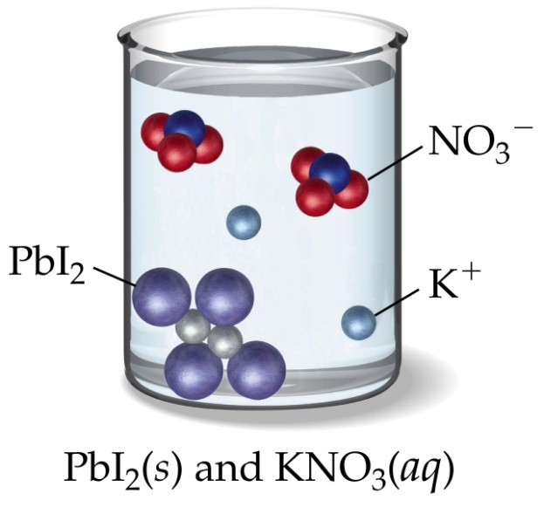
Predicting Reactions Double Displacement

Slide 62
Solubility Rules
All common compounds of Group 1 and ammonium ions (NH₄⁺) are soluble.
All nitrates (NO₃⁻), acetates (C₂H₃O₂⁻), and chlorates (ClO₃⁻ ) are soluble. Except acetates of aluminum (Al³⁺), and silver (Ag⁺).
All binary compounds of the halogens (other than F) with metals are soluble, except those of silver (Ag⁺), mercury(I) (Hg₂²⁺), and lead(II) (Pb²⁺) (lead halides are soluble in hot water).
4. Compounds containing fluoride ions (F⁻) are soluble except for calcium (Ca²⁺), barium (Ba²⁺), strontium (Sr²⁺), magnesium (Mg²⁺), and lead(II) (Pb²⁺).
5. All sulfates (SO₄²⁻) are soluble, except those of barium (Ba²⁺), strontium (Sr²⁺), calcium (Ca²⁺), lead(II) (Pb²⁺), silver (Ag⁺), and mercury (I) (Hg₂²⁺), which are insoluble. The latter three are slightly soluble.
6. Except for rule 1, carbonates (CO₃²⁻), hydroxides (OH⁻), oxides (O²⁻), silicates (SiO₄²⁻), and phosphates (PO₄³⁻) are insoluble.
7. Sulfides (S²⁻) are insoluble except when paired with calcium (Ca²⁺), barium (Ba²⁺), strontium (Sr²⁺), magnesium (Mg²⁺), sodium (Na⁺), potassium (K⁺), and ammonium (NH₄⁺) .

Slide 63
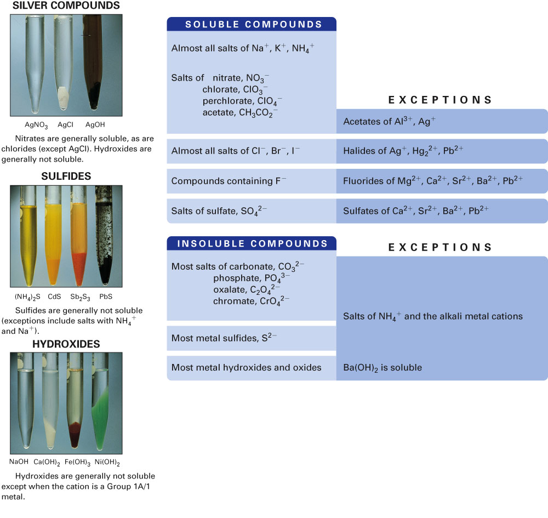
Fig. 9-13, p. 256

Slide 64
Notes:
Figure: 08-T02
Title:
Table 8.2
Caption:
Solubility Rules for Ionic Compounds
Notes:
Note that Rule 1 "trumps" other rules, i.e., compounds of Group IA (1) metals and ammonium ion are always soluble.

Slide 65
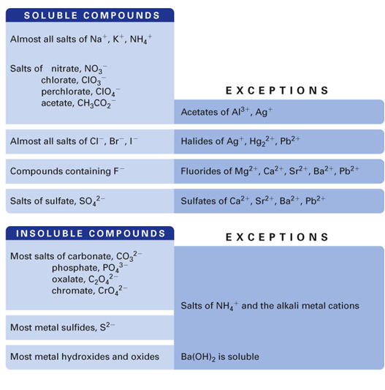
Example – Ion Exchange Reactions
What is the precipitate when lead(II) nitrate reacts with lithium chloride?

Slide 66
Example – Ion Exchange Reactions
What gas is formed when sodium sulfite reacts with hydrobromic acid?

Slide 67
Example – Ion Exchange Reactions
When aqueous solutions of sodium sulfite and potassium bromide are mixed the products are:
NaBr and K₂SO₃
K₂SO₃ and Na₂Br
NaK and SO₃Br
No reaction

Slide 68
Example – Ion Exchange Reactions
Aqueous sodium acetate is mixed with hydrochloric acid. What is formed?
Precipitate
Gas
Slightly ionizable substance
No reaction

Slide 69
Example – Ion Exchange Reactions
Sulfuric acid and lithium hydroxide react. Write the balanced chemical equation.

Slide 70
Example – Ion Exchange Reactions
Sodium iodide and nitric acid are mixed. What is the sum of the coefficient of the product(s)?

Slide 71
Example – Ion Exchange Reactions
Potassium sulfide and perchloric acid are mixed. What gas is formed?

Slide 72
Example – Ion Exchange Reactions
Potassium hydroxide and ammonium bromide are mixed. How many products are formed?

Slide 73
