Slide 1
Chemistry 142 Chapter 14: Chemical Kinetics
Outline
Kinetics
Rate
Integrated Rate Law
Reaction Rate and Temperature
Reaction Mechanisms
Catalysis

Slide 2
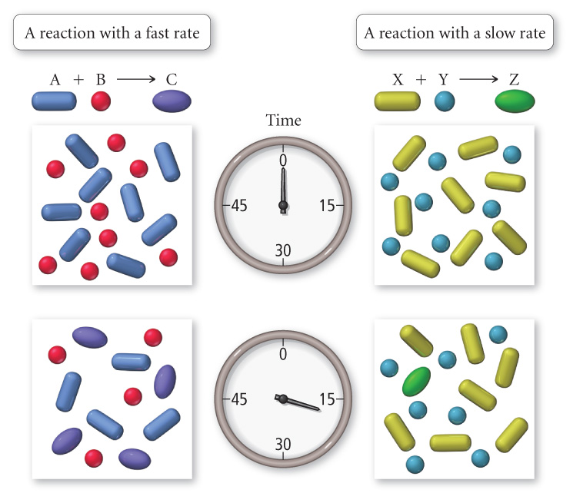
Examples – Rate
at t = 0 s
[A] = 8 M
[B] = 8 M
[C] = 0 M
at t = 0 s
[X] = 8 M
[Y] = 8 M
[Z] = 0 M
at t = 16 s
[X] = 7 M
[Y] = 7 M
[Z] = 1 M
at t = 16 s
[A] = 4 M
[B] = 4 M
[C] = 4 M

Slide 4
Concentration as a function of time 2 N₂O_{5 (g)} → 4 NO_{2 (g)} + O_{2 (g)}
Notes:
Rate of formation of NO₂
Rate of decomposition of N₂O₅

Slide 5
Examples: Rate
Time (s) | [N₂O₅] (M)
0 | 0.0200
100 | 0.0169
200 | 0.0142
300 | 0.0120
400 | 0.0101
500 | 0.0086
600 | 0.0072
700 | 0.0061
2 N₂O_{5 (g)} → 4 NO_{2 (g)} + O_{2 (g)}
Calculate the average rate of decomposition of dinitrogen pentaoxide during the time interval 200-300 s.
Calculate the average rate of formation of oxygen gas during the same interval.
What is the instantaneous rate of nitrogen dioxide formation at 250 s?

Slide 6
Examples: Rate
Time (s) | [N₂O₅] (M)
0 | 0.0200
100 | 0.0169
200 | 0.0142
300 | 0.0120
400 | 0.0101
500 | 0.0086
600 | 0.0072
700 | 0.0061
2 N₂O_{5 (g)} → 4 NO_{2 (g)} + O_{2 (g)}
Calculate the average rate of decomposition of dinitrogen pentaoxide during the time interval 200-300 s.
Calculate the average rate of formation of oxygen gas during the same interval.
What is the instantaneous rate of nitrogen dioxide formation at 250 s?

Slide 7
Examples - Rate Law
For the reaction:
BrO₃⁻ _{(aq)} + 5 Br⁻ _{(aq)} + 6 H⁺ _{(aq)} → 3 Br_{2 (aq)} + 3 H₂O _{(l)}
What is the generic rate law and over all order if the reaction is first order with respect to bromate and bromide and second order with respect to the hydrogen ion?

Slide 8
Examples - Rate Law
For the reaction:
CH₃CN _{(aq)} → CH₃NC _{(aq)}
The generic rate law is rate = k[CH₃CN]. What is the overall order of the reaction?

Slide 9
Examples - Rate Law
For the reaction:
CH₃CHO _{(l)} → CH_{4 (g)} + CO _{(g)}
What is the generic rate law if the reaction is one and a half order with respect to ethanal?

Slide 10
Examples - Rate Law
Ammonia gas decomposes to nitrogen and hydrogen gases in the presence of platinum catalyst. Write the decomposition reaction and the generic rate law if the order with respect to ammonia is zero.

Slide 11
Examples - Rate Law
The following reaction is autocatalytic because a product affects the rate.
Tl³⁺ _{(aq)} + Hg₂²⁺ _{(aq)}→ Tl⁺ _{(aq)} + 2 Hg²⁺ _{(aq)}
As the concentration of mercury(II) increases the reaction rate slows down. So mercury(II) is acting as a negative catalyst. The generic rate law is
rate = k[Tl³⁺][Hg₂²⁺][Hg²⁺]⁻¹
What is the overall order of the reaction?

Slide 12
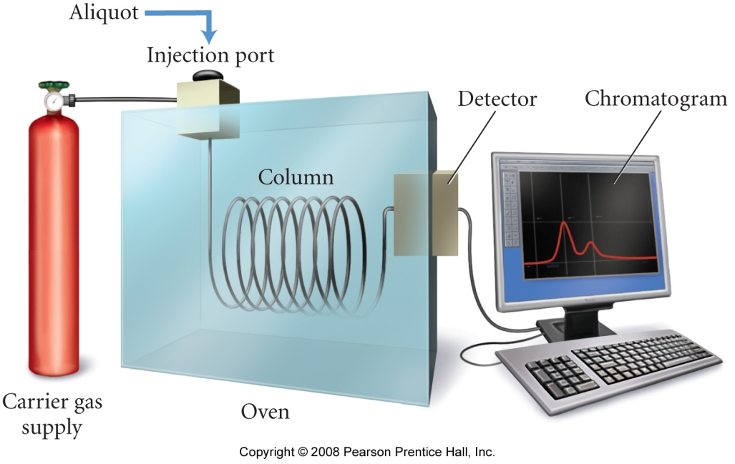
Continuous Monitoring
What methods can be used to measure the rate of reaction?
Sampling

Slide 13
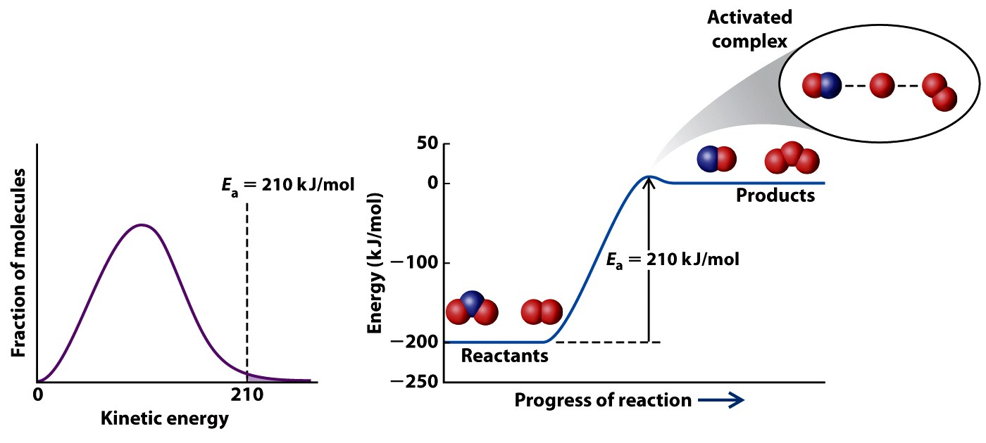
How does activation energy affect reaction rate?

Slide 14
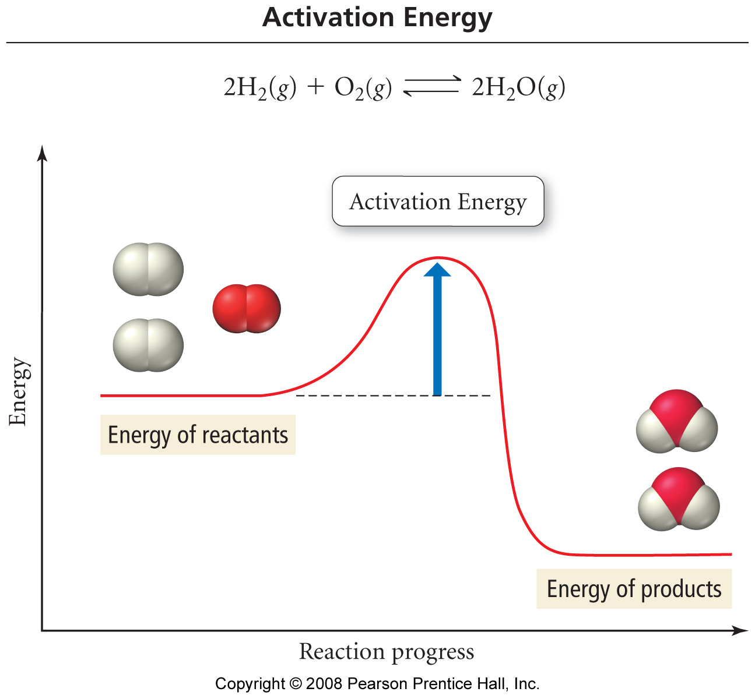

Slide 15
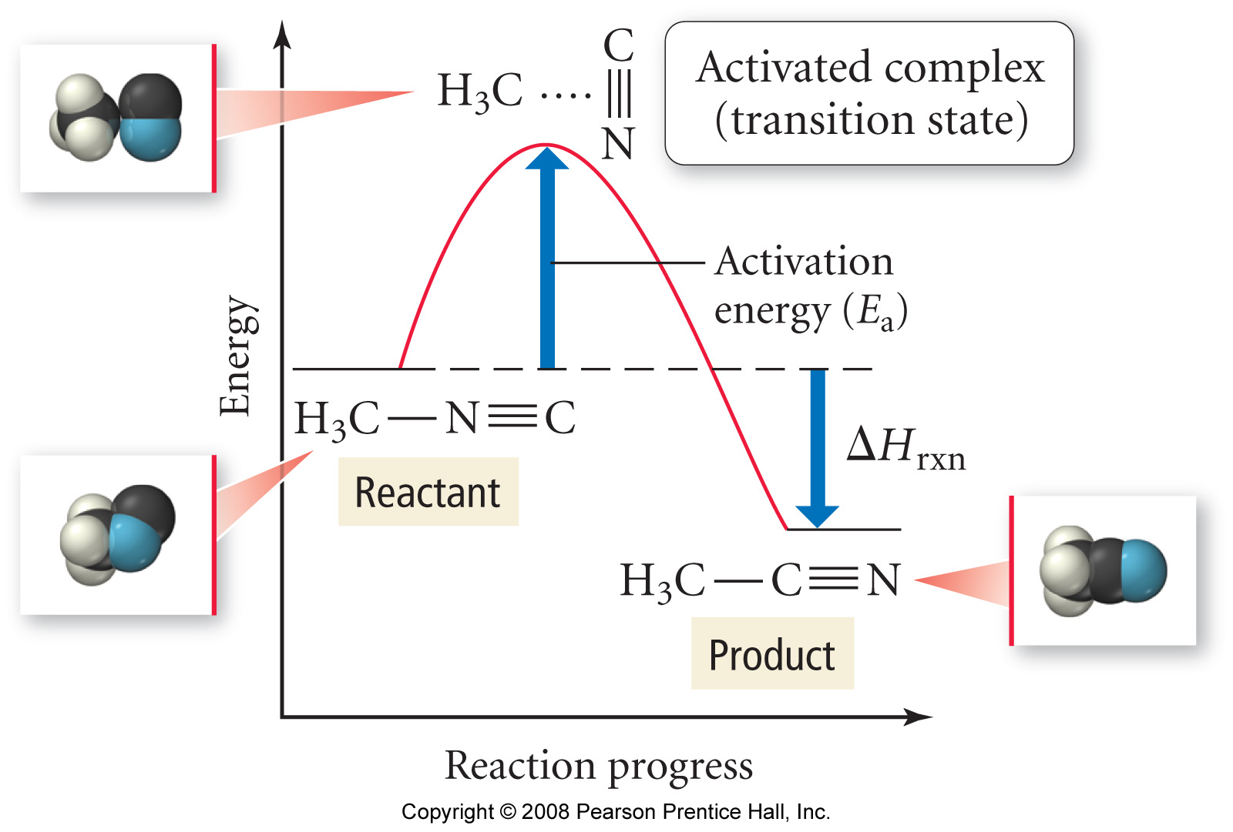
Energy Profile for the Isomerization of Methyl Isonitrile

Slide 16
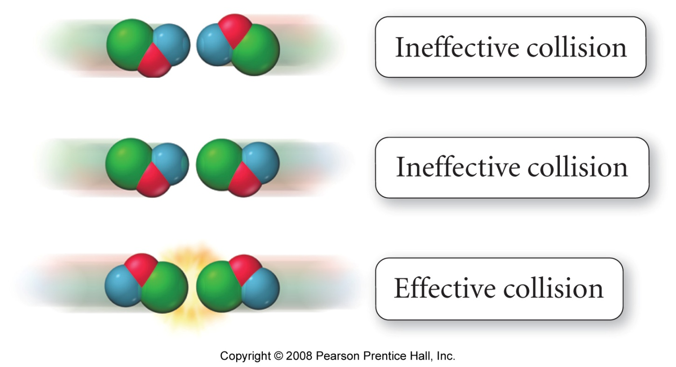
Effective Collisions Orientation Effect

Slide 17
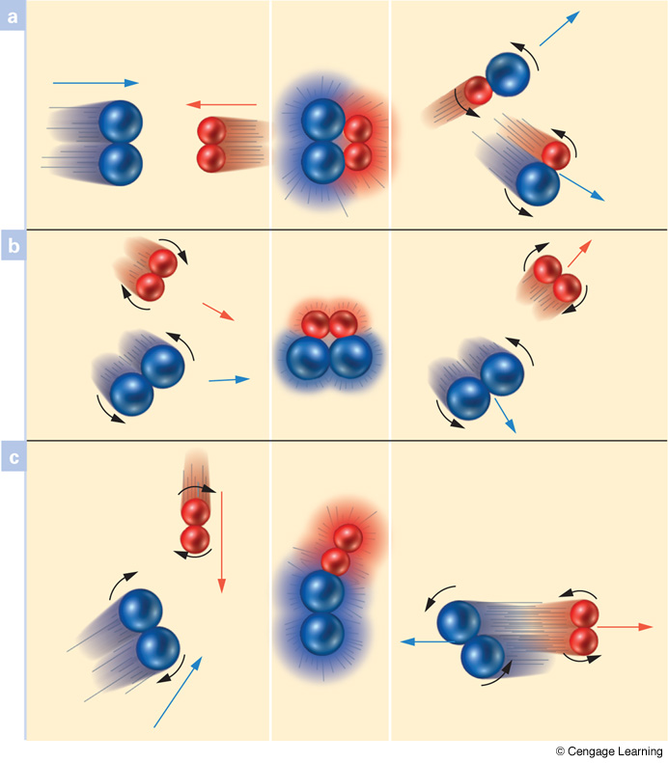
Which reactions result in products?
Effective collision
Proper orientation
Sufficient energy
Ineffective collision
Proper orientation
Insufficient energy
Ineffective collision
Improper orientation
Sufficient energy
Notes:
Page: 517
Figure 18-2 Molecular collisions and chemical reactions. (a) Reactionproducing collision between molecules A2 and B2, which have sufficient energy and proper orientation. (b) Collision has proper orientation but not enough kinetic energy. There is no reaction. (c) Glancing collision has enough kinetic energy, but poor orientation. There is no reaction.

Slide 18
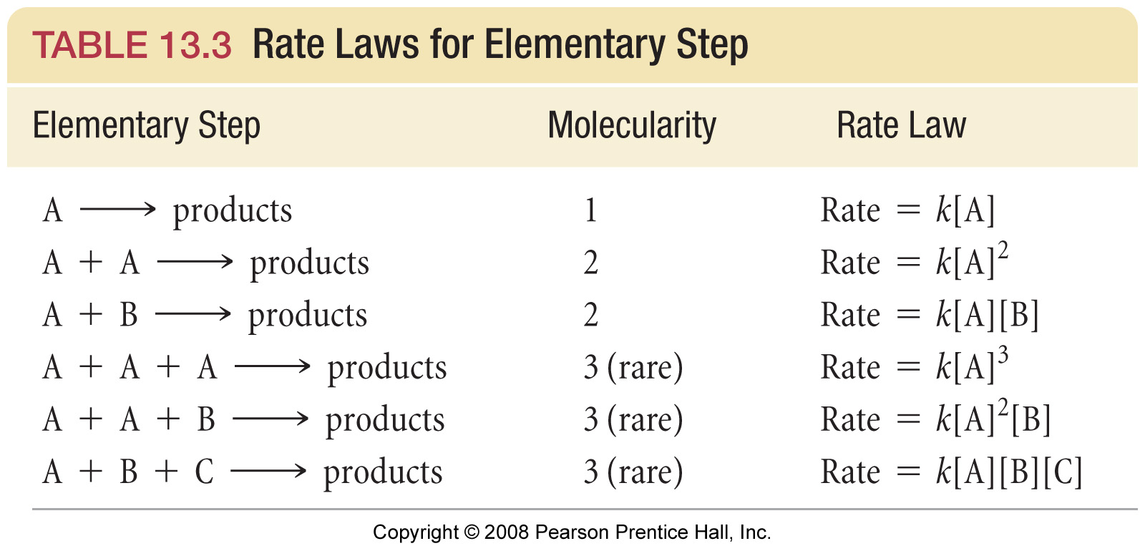
What are rate laws of elementary steps?

Slide 20
Examples Mechanism Validation
The balanced equation for the reaction of nitrogen dioxide and fluorine gases is:
2 NO_{2 (g)} + F_{2 (g)} → 2 NO₂F _{(g)}
the experimentally determined rate law is
rate = k[NO₂][F₂]
A suggested mechanism is
k₁
NO_{2 (g)} + F_{2 (g)} → NO₂F _{(g)} + F _{(g)} slow
k₂
F _{(g)} + NO_{2 (g)} → NO₂F _{(g)} fast
Is this an acceptable mechanism?

Slide 21
Examples Mechanism Validation
The balanced equation for the reaction of nitrogen dioxide and fluorine gases is:
2 NO_{2 (g)} + F_{2 (g)} → 2 NO₂F _{(g)}
the experimentally determined rate law is
rate = k[NO₂][F₂]
Another suggested mechanism is
NO_{2 (g)} + F_{2 (g)} → NOF₂ _{(g)} + O _{(g)} slow
NO_{2 (g)} + O _{(g)} → NO₃ _{(g)} fast
NOF₂ _{(g)} + NO_{2 (g)} → NO₂F _{(g)} + NOF _{(g)} fast
NO_{3 (g)} + NOF _{(g)} → NO₂F _{(g)} + NO_{2 (g)} fast
Is this an acceptable mechanism?

Slide 22
Examples Mechanism Validation
The balanced equation for the reaction of nitrogen monoxide and chlorine gases is:
2 NO _{(g)} + Cl_{2 (g)} → 2 NOCl _{(g)}
the experimentally determined rate law is
rate = k[NO]²[Cl₂]
A suggested mechanism is
k₁
NO _{(g)} + Cl_{2 (g)}  NOCl₂ _{(g)} fast
k₋₁
k₂
NOCl₂ _{(g)} + NO _{(g)} → 2 NOCl _{(g)} slow
Is this an acceptable mechanism?

Slide 23
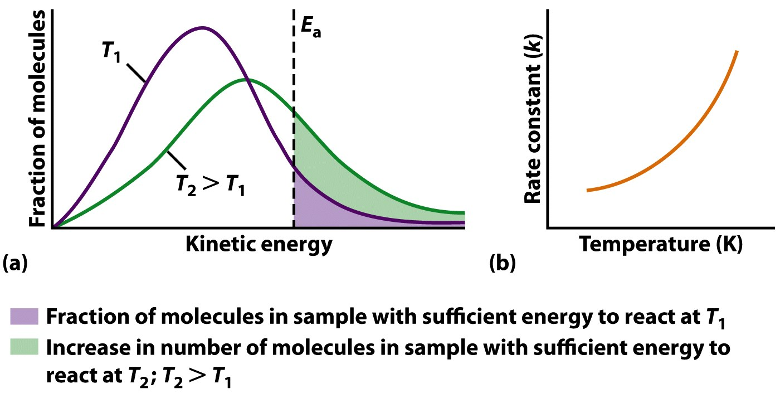
How does temperature effect reaction rates?

Slide 24
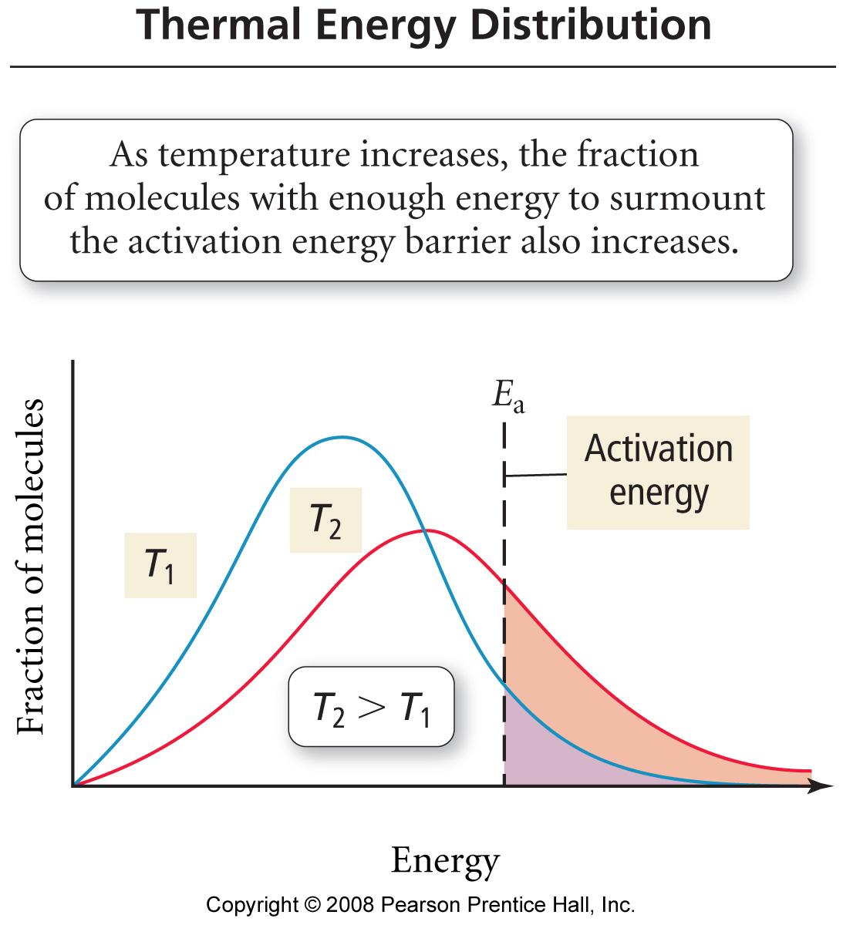

Slide 25
Arrhenius Plot

Slide 26
How do these two point equations compare?
Claussius-Claperyon Equation
$$\ln\left(\frac{P_{2}}{P_{1}}\right)=−\frac{∆H}{R}\left(\frac{1}{T_{2}}−\frac{1}{T_{1}}\right)$$
Arrhenius Equation
$$\ln\left(\frac{k_{2}}{k_{1}}\right)=−\frac{E_{a}}{R}\left(\frac{1}{T_{2}}−\frac{1}{T_{1}}\right)$$

Slide 27
Examples Arrhenius Plot
For the reaction: 2 N₂O_{5 (g)} → 4 NO_{2 (g)} + O_{2 (g)}
Several values of k were obtained at different temperatures. Calculate the activation energy for the reaction.
T (°C) | k (s⁻¹)
20 | 2.0 x 10⁻⁵
30 | 7.3 x 10⁻⁵
40 | 2.7 x 10⁻⁴
50 | 9.1 x 10⁻⁴
60 | 2.9 x 10⁻³

Slide 28
Examples Arrhenius Plot
2 N₂O_{5 (g)} → 4 NO_{2 (g)} + O_{2 (g)}
T (°C) | T (K) | 1/T (1/K) | k (s⁻¹) | ln k
20 | 293 | 3.41 x 10⁻³ | 2.0 x 10⁻⁵ | -10.82
30 | 303 | 3.30 x 10⁻³ | 7.3 x 10⁻⁵ | -9.53
40 | 313 | 3.19 x 10⁻³ | 2.7 x 10⁻⁴ | -8.22
50 | 323 | 3.10 x 10⁻³ | 9.1 x 10⁻⁴ | -7.00
60 | 333 | 3.00 x10⁻³ | 2.9 x 10⁻³ | -5.84
Calculate the activation energy for the reaction.

Slide 29
Examples Arrhenius Plot
2 N₂O_{5 (g)} → 4 NO_{2 (g)} + O_{2 (g)}
T (°C) | T (K) | 1/T (1/K) | k (s⁻¹) | ln k
20 | 293 | 3.41 x 10⁻³ | 2.0 x 10⁻⁵ | -10.82
30 | 303 | 3.30 x 10⁻³ | 7.3 x 10⁻⁵ | -9.53
40 | 313 | 3.19 x 10⁻³ | 2.7 x 10⁻⁴ | -8.22
50 | 323 | 3.10 x 10⁻³ | 9.1 x 10⁻⁴ | -7.00
60 | 333 | 3.00 x10⁻³ | 2.9 x 10⁻³ | -5.84
Calculate the activation energy for the reaction.

Slide 30
Examples Arrhenius Equation
For the gas phase reaction:
CH_{4 (g)} + 2 S_{2 (g)} → CS_{2 (g)} + 2 H₂S _{(g)}
The rate constant at 550 °C is 1.1 L/mol s and at 625 °C the value of k is 6.4 L/mol s. Calculate the activation energy for the reaction.

Slide 31
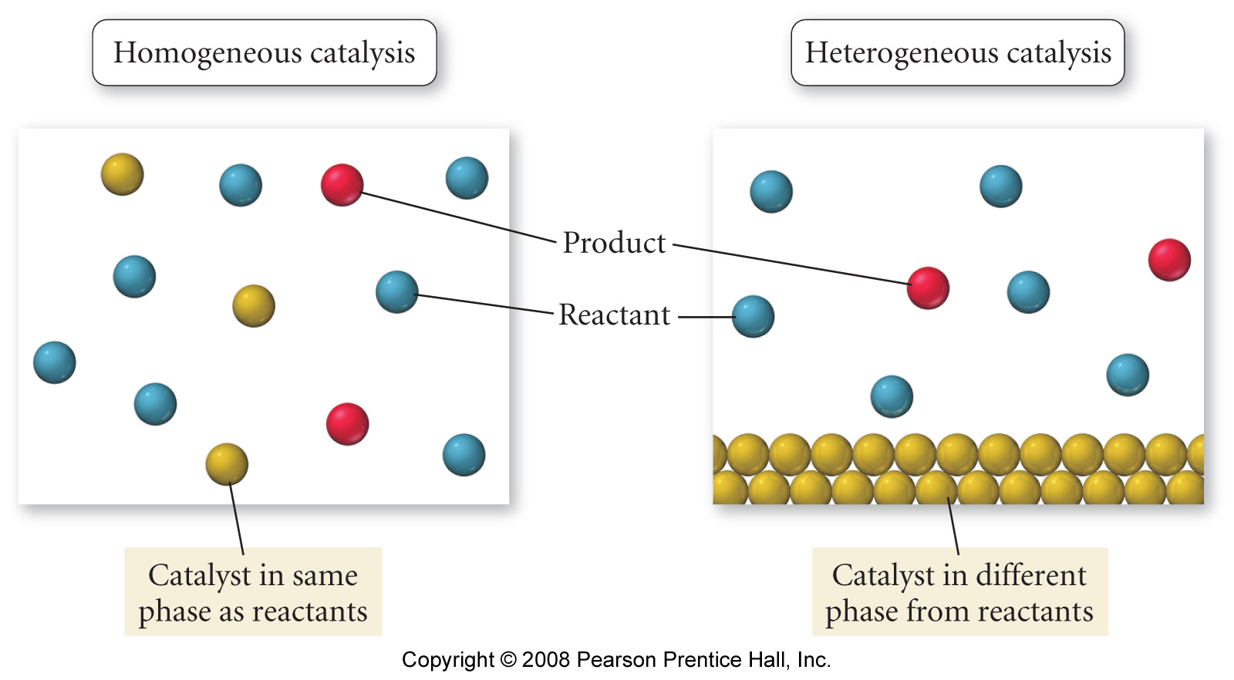
What are the types of catalysts?

Slide 32
How does a catalysis change the activation energy?

Slide 33
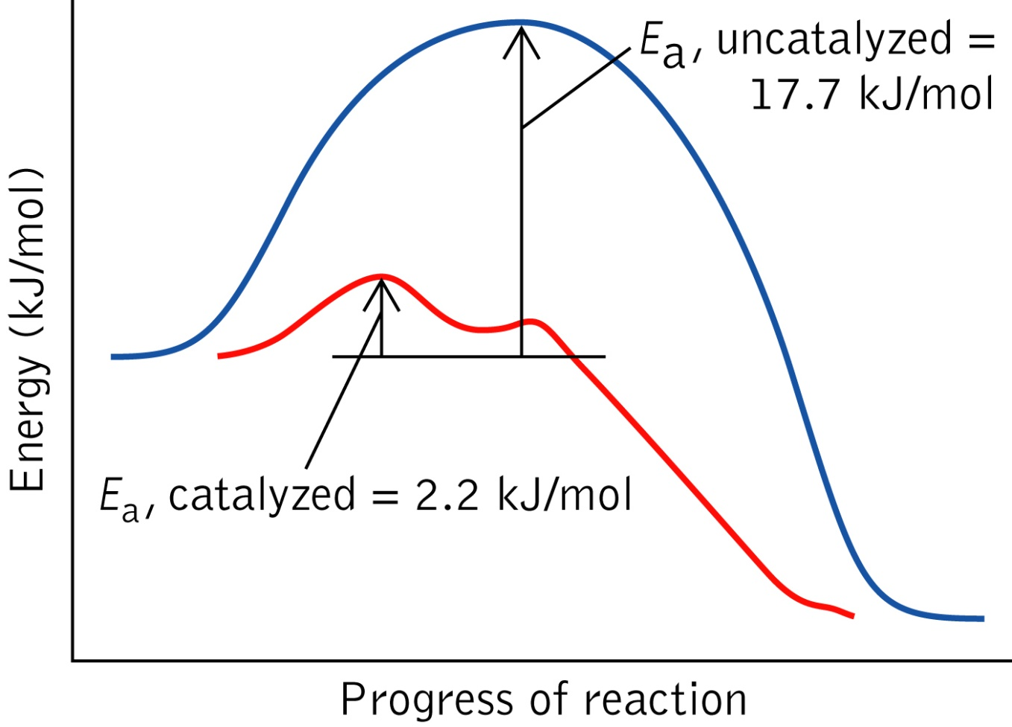
How does the presence of a catalyst change reaction energetics?
The catalyst, a chlorine atom, is not consumed during the chemical reaction.

Slide 34
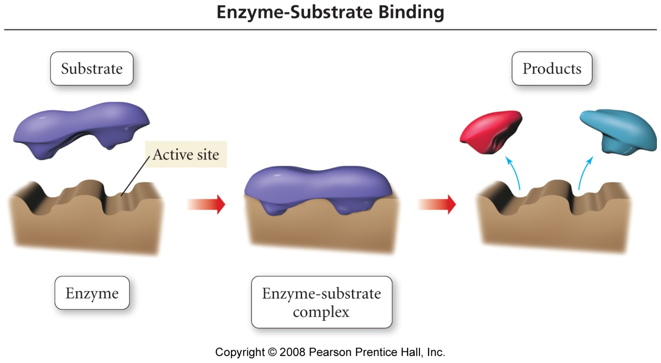
What is a lock and key mechanism?

Slide 35
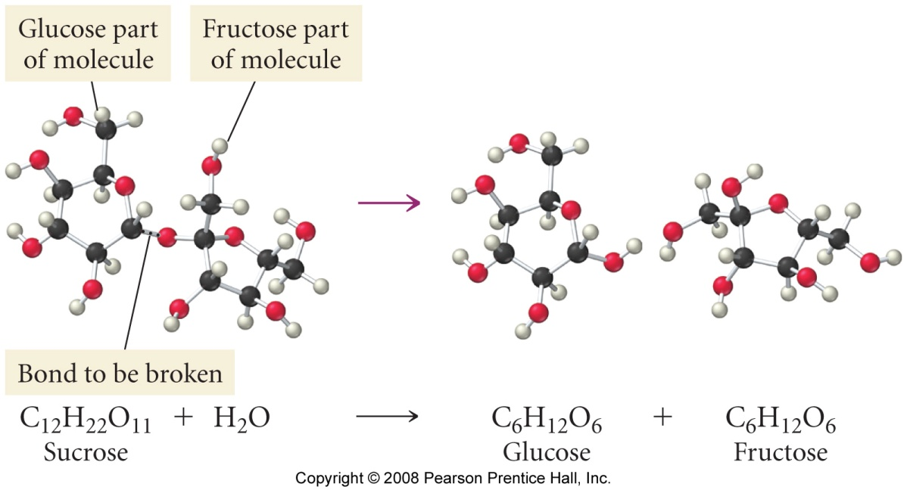
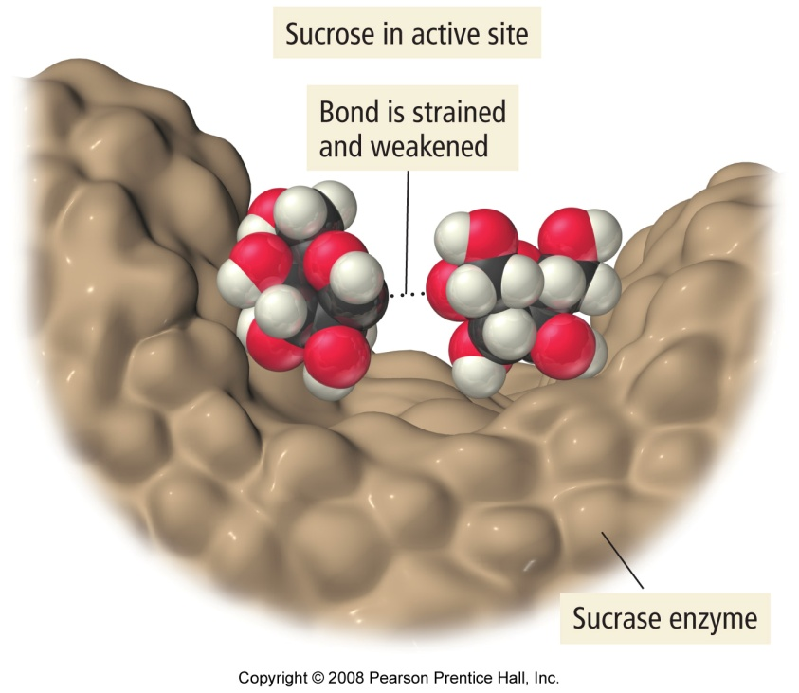
What is the enzymatic hydrolysis of sucrose?

Slide 36
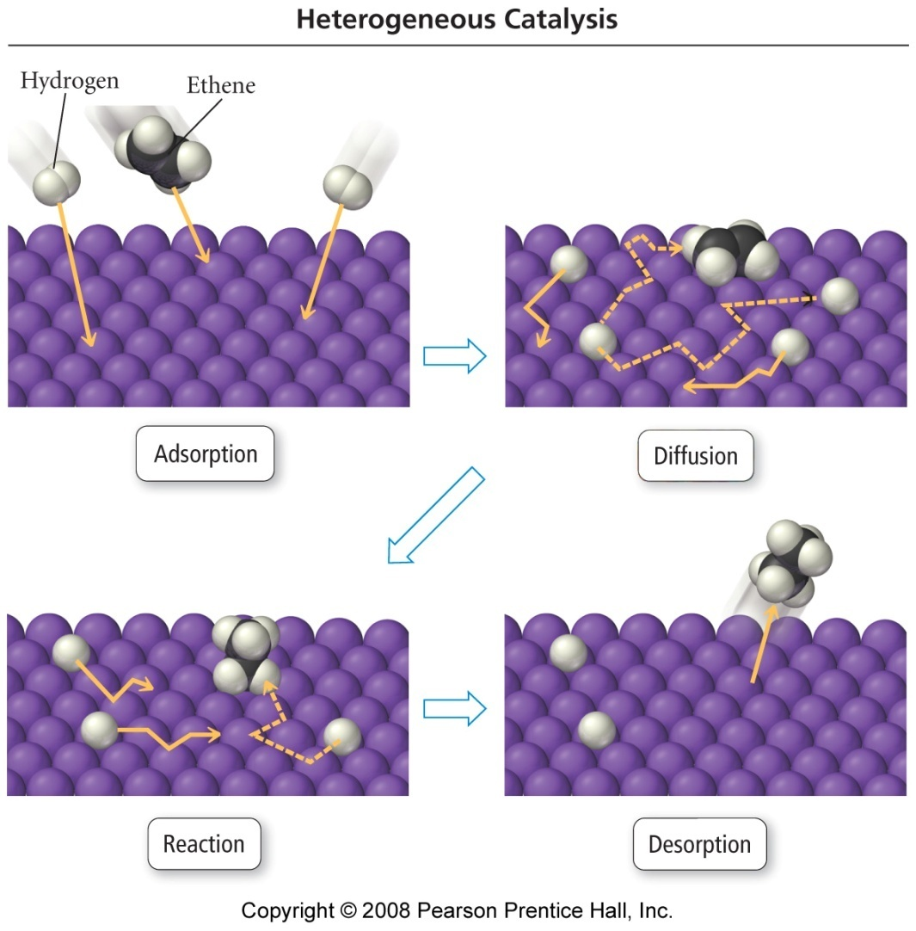
What are the steps of catalytic hydrogenation? H₂C=CH_{2 (g)} + H_{2 (g)} → CH₃CH_{3 (g)}

Slide 37
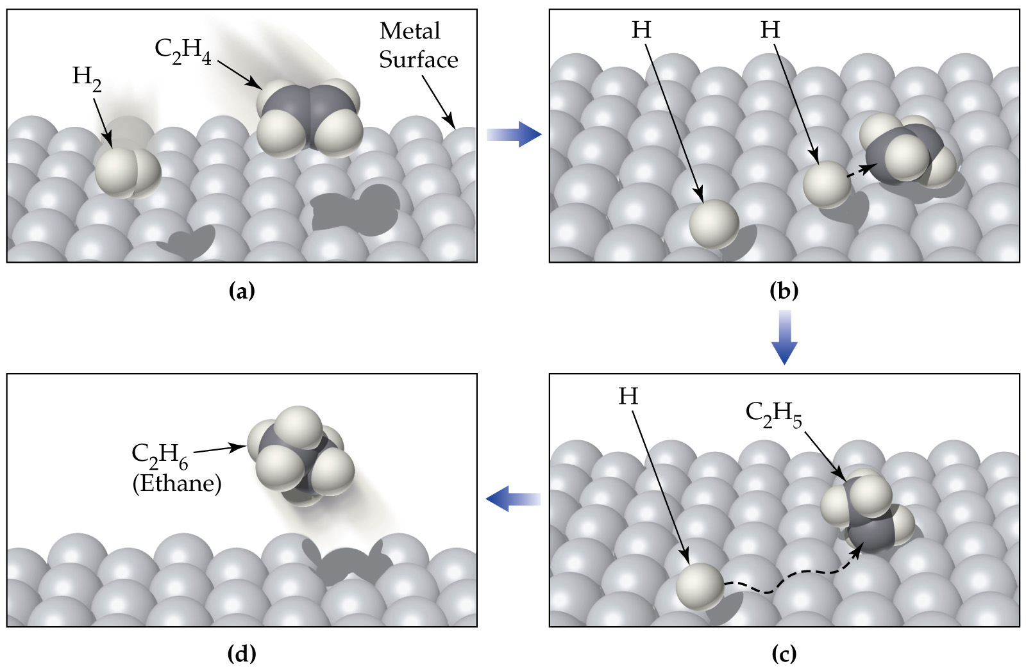
Notes:
Figure: 12-18
Title:
Heterogeneous Catalysis
Caption:
Figure 12.18 Proposed mechanism for the catalytic hydrogenation of ethylene (C2H4) on a metal surface. (a) H2 and C2H4 are adsorbed on the metal surface. (b) The H–H bond breaks as H–metal bonds form, and the H atoms move about on the surface. (c) One H atom forms a bond to a C atom of the adsorbed C2H4 to give a metal-bonded C2H5 group. (d) A second H atom bonds to the C2H5 group, and the resulting C2H6 molecule is desorbed from the surface.

Slide 38
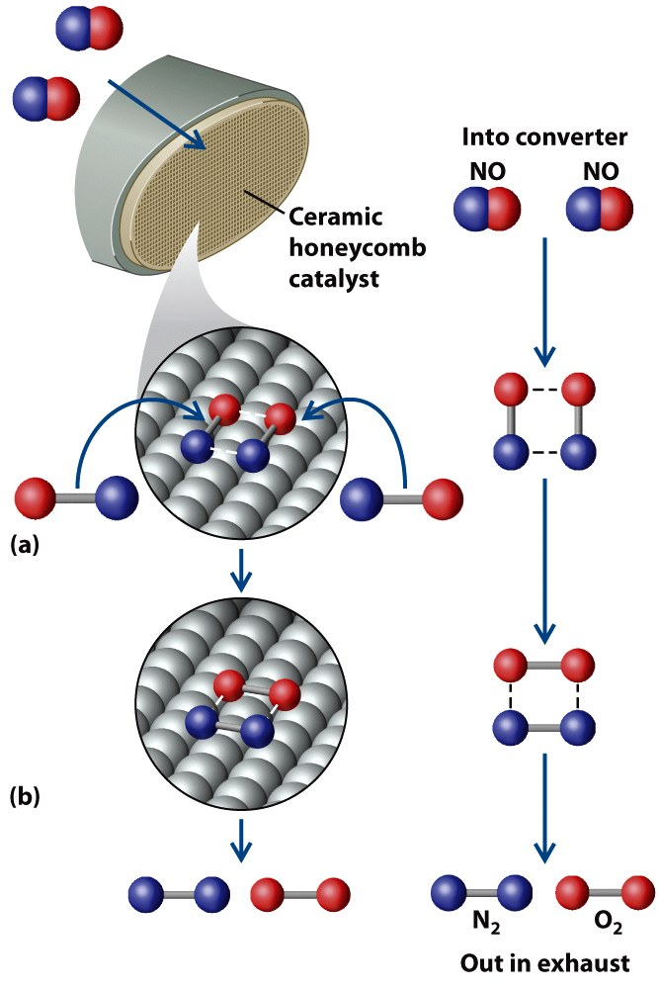
Molecular View of Catalytic Converters
2 NO _{(g)} → N_{2 (g)} + O_{2 (g)}

Slide 40
What is a first order reaction?
ln[A]₀
slope = −k
ln[A]
time

Slide 41
Rate Data for C₄H₉Cl _{(aq)} + H₂O _{(l)} → C₄H₉OH _{(aq)} + HCl _{(aq)}
Time (sec) | [C₄H₉Cl], M
0.0 | 0.1000
50.0 | 0.0905
100.0 | 0.0820
150.0 | 0.0741
200.0 | 0.0671
300.0 | 0.0549
400.0 | 0.0448
500.0 | 0.0368
800.0 | 0.0200
10000.0 | 0.0000

Slide 42
C₄H₉Cl _{(aq)} + H₂O _{(l)} → C₄H₉OH _{(aq)} + 2 HCl _{(aq)}

Slide 43
C₄H₉Cl _{(aq)} + H₂O _{(l)} → C₄H₉OH _{(aq)} + 2 HCl _{(aq)}

Slide 44
C₄H₉Cl _{(aq)} + H₂O _{(l)} → C₄H₉OH _{(aq)} + 2 HCl _{(aq)}

Slide 45
C₄H₉Cl _{(aq)} + H₂O _{(l)} → C₄H₉OH _{(aq)} + 2 HCl _{(aq)}
slope = -2.01 x 10⁻³ s⁻¹
k =2.01 x 10⁻³ s⁻¹

Slide 46
Examples Reaction Order
Using the data below verify that the decomposition of dinitrogen pentaoxide is first order and calculate the value of the rate constant, where rate = -Δ[N₂O₅]/Δt
2 N₂O_{5 (g)} → 4 NO_{2 (g)} + O_{2 (g)}
Time (s) | [N₂O₅] (mol/L)
0 | 0.100
50 | 0.0707
100 | 0.0500
200 | 0.0250
300 | 0.0125
400 | 0.00625

Slide 47
Examples Reaction Order
Using the data below verify that the decomposition of dinitrogen pentaoxide is first order and calculate the value of the rate constant, where rate = -Δ[N₂O₅]/Δt
2 N₂O_{5 (g)} → 4 NO_{2 (g)} + O_{2 (g)}
Time (s) | [N₂O₅] (mol/L)
0 | 0.100
50 | 0.0707
100 | 0.0500
200 | 0.0250
300 | 0.0125
400 | 0.00625

Slide 48
Examples Reaction Order
Using the data below verify that the decomposition of dinitrogen pentaoxide is first order and calculate the value of the rate constant, where rate = -Δ[N₂O₅]/Δt
2 N₂O_{5 (g)} → 4 NO_{2 (g)} + O_{2 (g)}
Time (s) | [N₂O₅] (mol/L) | ln[N₂O₅]
0 | 0.100 | -2.303
50 | 0.0707 | -2.649
100 | 0.0500 | -2.996
200 | 0.0250 | -3.689
300 | 0.0125 | -4.382
400 | 0.00625 | -5.075

Slide 49
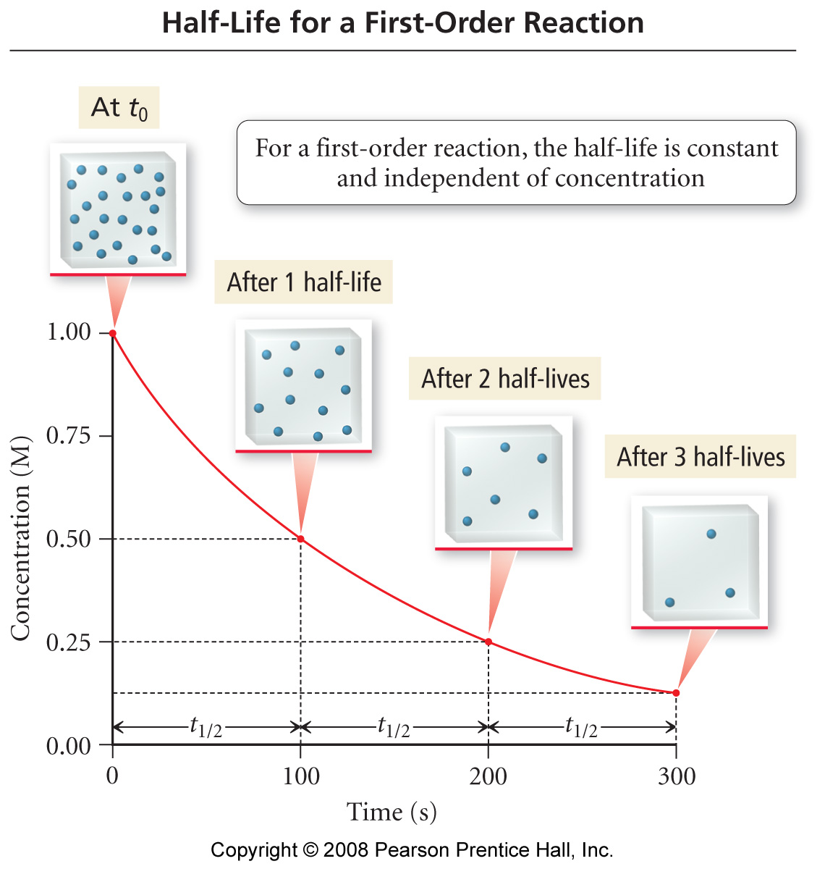
Half-Life of a First-Order Reaction Is Constant

Slide 50
Examples Half-life
A certain first order reaction has a half-life of
20.0 minutes.
a. Calculate the rate constant.
b. How much time is required for this reaction to be
75% complete?

Slide 51
What is a second order reaction?
1/[A]
slope = k
l/[A]₀
time

Slide 52
Examples Rate Laws
Butadiene reacts to form its dimer according to:
2 C₄H_{6 (g)} → C₈H_{12 (g)}
Is this reaction first order or second order?
What is the value of the rate constant function of the reaction?
What is the half-life for the reaction under the conditions of this experiment?
time (s) | [C₄H₆] (mol/L)
0 | 0.0100
1000 | 0.00625
1800 | 0.00476
2800 | 0.00370
3600 | 0.00313
4400 | 0.00270
5200 | 0.00241
6200 | 0.00208

Slide 53
Examples Rate Laws
Butadiene reacts to form its dimer according to:
2 C₄H_{6 (g)} → C₈H_{12 (g)}
Is this reaction first order or second order?
What is the value of the rate constant function of the reaction?
What is the half-life for the reaction under the conditions of this experiment?

Slide 54
Half-life for a second order reaction

Slide 55
What is a zero order reaction?
[A]₀
slope = - k
[A]
time

Slide 56
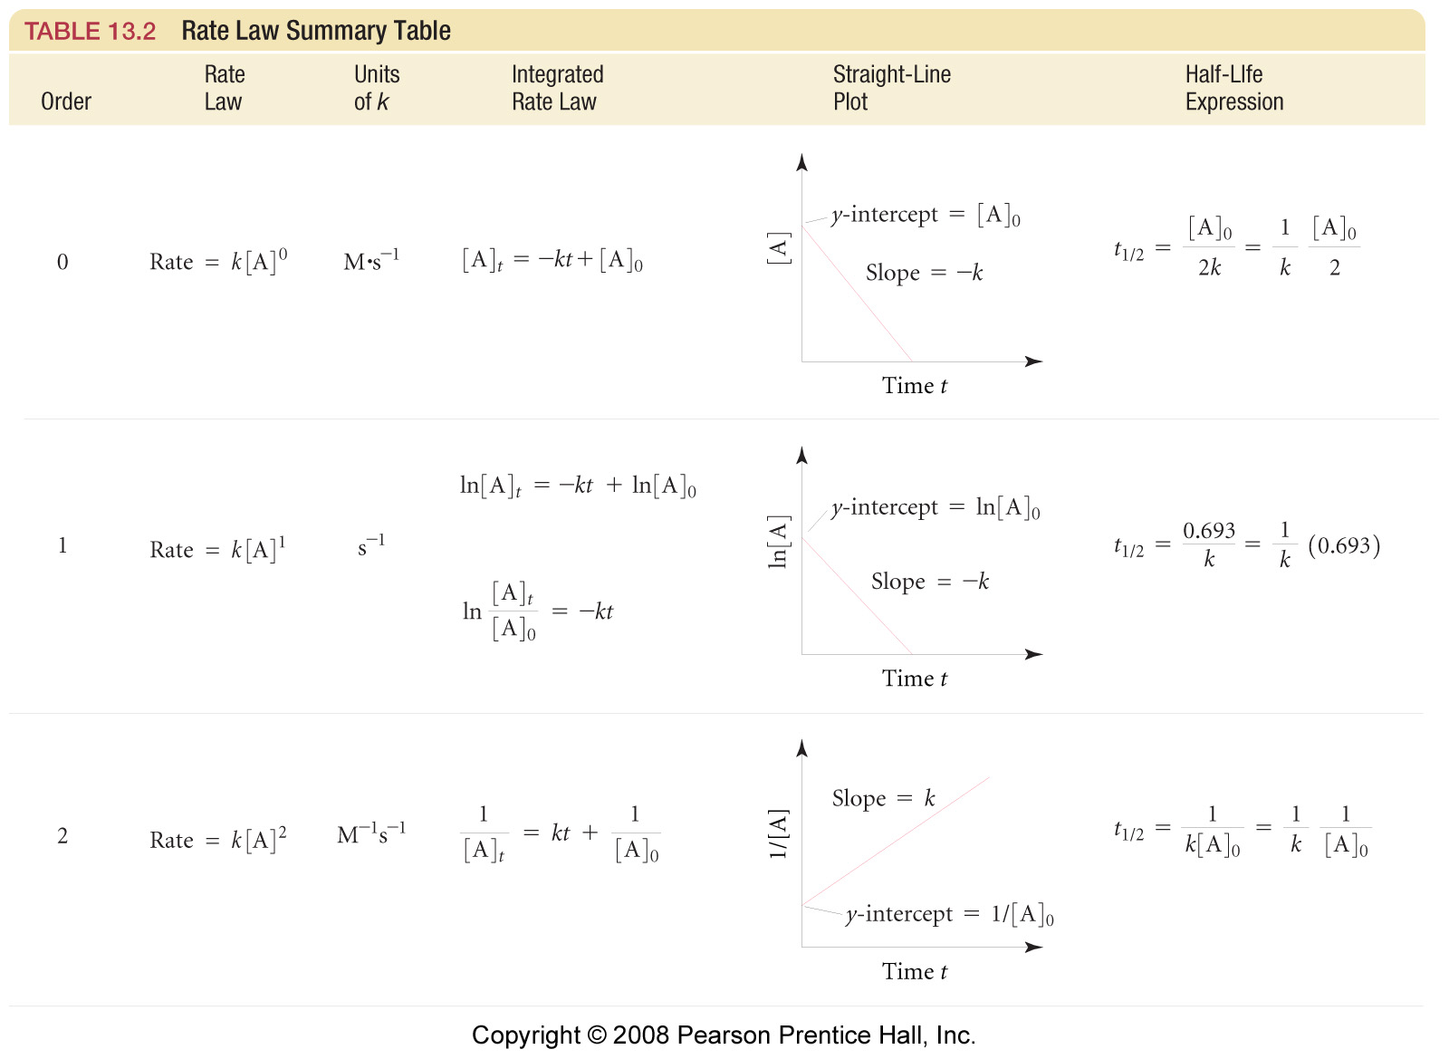

Slide 57
Examples: Rate
Time (s) | [N₂O₅] (M)
0 | 0.0200
100 | 0.0169
200 | 0.0142
300 | 0.0120
400 | 0.0101
500 | 0.0086
600 | 0.0072
700 | 0.0061
2 N₂O_{5 (g)} → 4 NO_{2 (g)} + O_{2 (g)}
Calculate the average rate of decomposition of dinitrogen pentaoxide during the time interval 200-300 s.
Calculate the average rate of formation of oxygen gas during the same interval.
What is the instantaneous rate of nitrogen dioxide formation at 250 s?
Is this reaction first order, second order, or zero order?

Slide 58
Examples: Rate
2 N₂O_{5 (g)} → 4 NO_{2 (g)} + O_{2 (g)}
d) Is this reaction first order,
second order, or zero
order?
Time (s) | [N₂O₅] (M) | ln[N₂O₅] | 1/[N₂O₅]
0 | 0.0200 | -3.912 | 50.0
100 | 0.0169 | -4.080 | 59.2
200 | 0.0142 | -4.255 | 70.4
300 | 0.0120 | -4.423 | 83.3
400 | 0.0101 | -4.595 | 99.0
500 | 0.0086 | -4.76 | 116
600 | 0.0072 | -4.93 | 139
700 | 0.0061 | -5.10 | 164

Slide 59
Examples Initial rate method
Describe the general form of the rate law for the reaction given the results of four experiments below:
NH₄⁺ _{(aq)} + NO₂⁻ _{(aq)} → N_{2 (g)} + 2 H₂O _{(l)}
Experiment | [NH₄⁺ ]₀ | [NO₂⁻ ]₀ | Initial rate (mol/L s)
1 | 0.100 M | 0.0050 M | 1.35 x 10⁻⁷
2 | 0.100 M | 0.010 M | 2.70 x 10⁻⁷
3 | 0.200 M | 0.010 M | 5.40 x 10⁻⁷

Slide 60
Examples Initial rate method
Describe the general form of the rate law for the reaction given the results of three experiments below:
CH₃COOCH₃ _{(aq)} + OH⁻ _{(aq)} → CH₃COO⁻ _{(aq)} + CH₃OH _{(aq)}
Experiment | [CH₃COOCH₃ ]₀ | [OH⁻ ]₀ | Initial rate (mol/L s)
1 | 0.040 M | 0.040 M | 0.00022
2 | 0.040 M | 0.080 M | 0.00045
3 | 0.080 M | 0.080 M | 0.00090

Slide 61
Examples Initial rate method
Describe the general form of the rate law for the reaction given the results of three experiments below:
CH₃COOH _{(aq)} + OH⁻ _{(aq)} → CH₃COO⁻ _{(aq)} + CH₃OH _{(aq)}
Experiment | [CH₃COOH ]₀ | [OH⁻ ]₀ | Initial rate (mol/L s) | k (L/mol s)
1 | 0.040 M | 0.040 M | 0.00022 | 0.0138
2 | 0.040 M | 0.080 M | 0.00045 | 0.0141
3 | 0.080 M | 0.080 M | 0.00090 | 0.0141

Slide 62
Examples Initial Rate Method
The reaction between bromate ions and bromide ions in an acidic solution is given by the equation:
BrO₃⁻ _{(aq)} + 5 Br⁻ _{(aq)} + 6 H⁺ _{(aq)} → 3 Br_{2 (l)} + 3 H₂O _{(l)}
Describe the general form of the rate law for this reaction given the results of four experiments below.
Experiment | [BrO₃⁻ ]₀ | [Br⁻ ]₀ | [H⁺ ]₀ | Initial rate (mol/L s)
1 | 0.10 M | 0.10 M | 0.10 M | 8.0 x 10⁻⁴
2 | 0.20 M | 0.10 M | 0.10 M | 1.6 x 10⁻³
3 | 0.20 M | 0.20 M | 0.10 M | 3.2 x 10⁻³
4 | 0.10 M | 0.10 M | 0.20 M | 3.2 x 10⁻³

Slide 63
