Slide 1
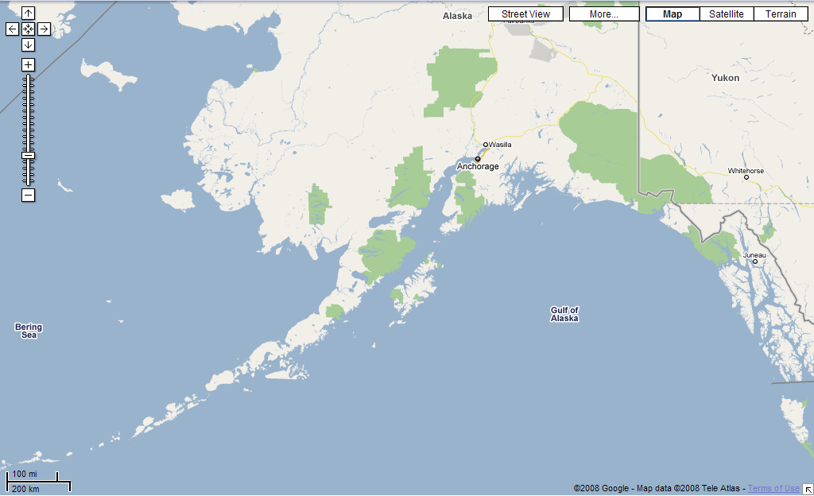
Katmai N.P.
Alaska Peninsula
Notes:
Located at the base of the Alaska Peninsula, Katmai National Park …

Slide 2
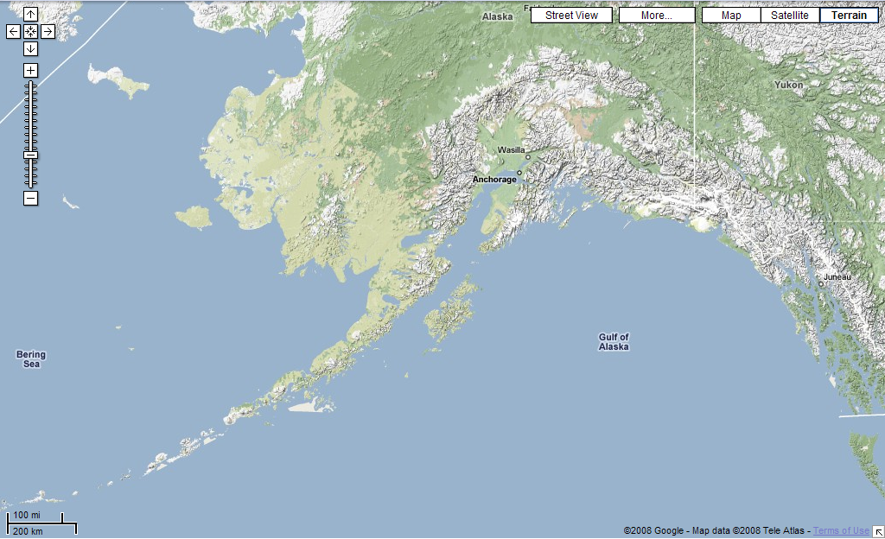
Alaska Range
Volcanic Arc
Aleutian Islands
Notes:
… lies along the great volcanic arc that stretches from the Aleutian Islands towards Mt. McKinley in the Alaska Range. The classic surface expressions of a subduction zone are all here including …

Slide 3
Alaska Range
Forearc Basin
Notes:
… a forearc basin …

Slide 4
Alaska Range
Accretionary Wedge
Notes:
… and an accretionary wedge. Kenai Fjords National Park is part of that vast accretionary wedge.

Slide 5
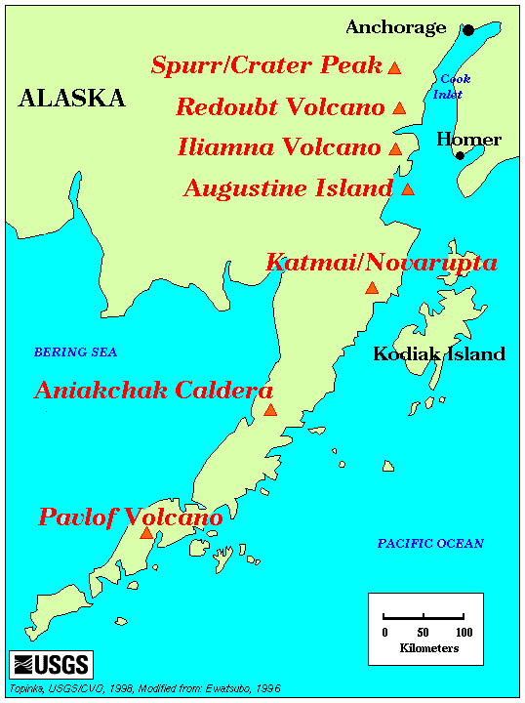
Notes:
Katmai National Park is famous for two things: The Katmai/Novarupta volcano and …

Slide 6
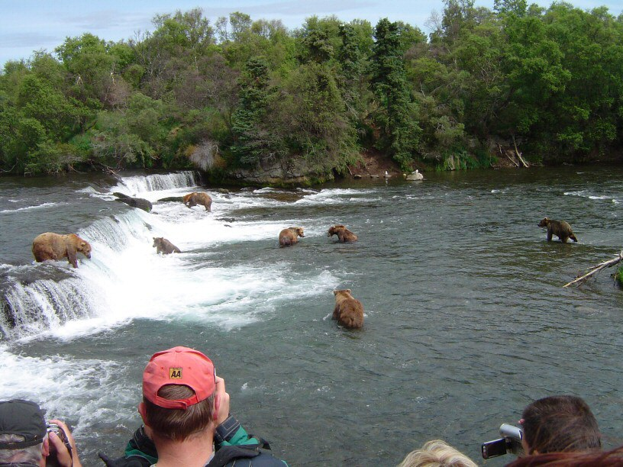
Notes:
… bears fishing. Although that waterfall no doubt has a geologic story behind it probably related to volcanism, it would be difficult to make bears the unifying theme for this lesson.

Slide 7
Notes:
So considering that the 1912 eruption of Katmai / Novarupta is rated a 6 on the volcanic explosivity index - making it the largest since Tambora in 1815, …

Slide 8
KATMAI / NOVARUPTA
1912 eruption was largest of the entire 20th century
Notes:
… it should be pretty obvious which of Katmai’s top two attractions will be the focus of this lesson.

Slide 9
KATMAI / NOVARUPTA
1912 eruption was largest of the entire 20th century
Notes:
Sorry bears, but we have bigger fish to fry.

Slide 10
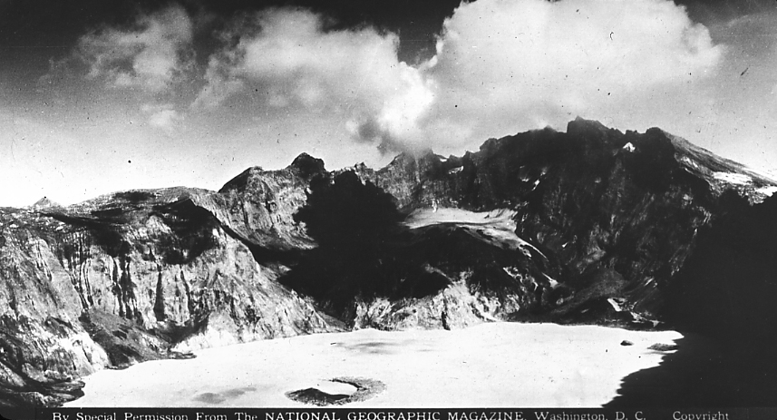
Katmai Caldera 1915
Burj-Dubai 2,684 ft
Notes:
As is typical of extremely large eruptions, the eruption was followed by the formation of a huge caldera. This picture, taken by a National Geographic Expedition 3 years after the eruption and before much of caldera had filled with water, shows the caldera rim towering some 3700 feet above lake surface. The world’s tallest building, the half-mile-high, Burj-Dubai has been added for scale.

Slide 11
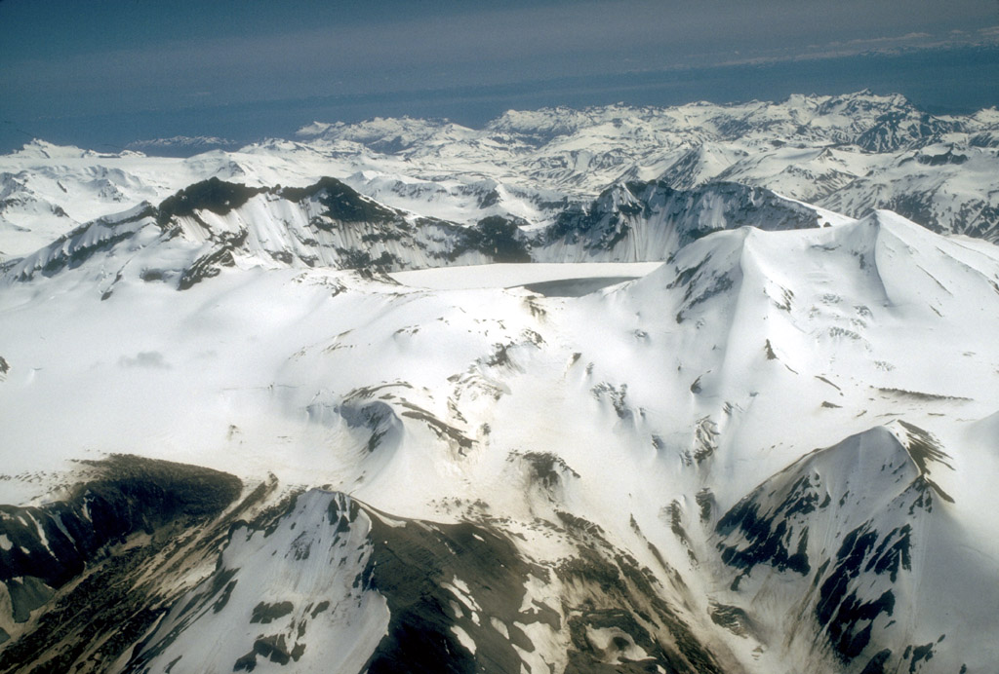
Katmai Caldera, 1990
1.5 km
Notes:
Since that 1915 expedition, the caldera has filled with a lot more water. The blue-green lake is about a thousand feet deep now and still rising, because unlike the much older Crater Lake, Katmai Lake has yet to reach equilibrium. Now here’s the really weird thing about this caldera: The eruption that caused Katmai to collapse didn’t happen here!

Slide 12
KATMAI / NOVARUPTA
1912 eruption was largest of the entire 20th century
From Novarupta vent 10 km away!
Notes:
The eruption occurred some 10 km away from a vent called Novarupta!

Slide 13
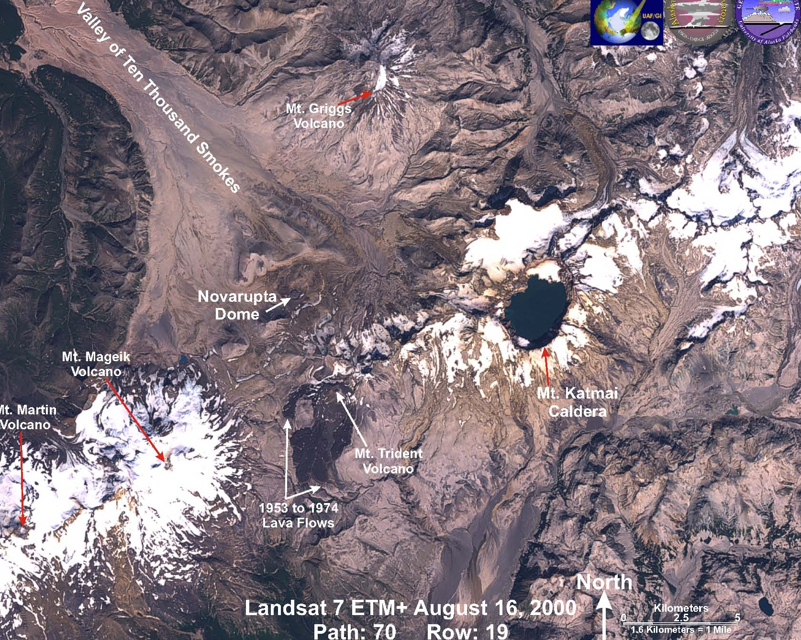
10 km
Notes:
The Novarupta vent is left of center in this satellite image of the area. Since the Katmai Caldera formed at the same time as the great eruption from the Novarupta vent, the two must be fed by the same magma chamber.

Slide 14
Inferred size of magma chamber
10 km
Notes:
This gives us a rough idea of just how big island arc magma chambers are. They must be on the order of several kilometers wide. The 12-15 km³ of magma that was erupted from Novarupta produced about 30 km³ of tephra, because pumice and ash are very porous.

Slide 15
KATMAI / NOVARUPTA
1912 eruption was largest of the entire 20th century
From Novarupta vent 10 km away!
Tephra fall caused flooding
Stream aggradation
Notes:
The accumulation of all that tephra caused considerable flooding in nearby streams, especially Katmai River. Although snow melt no doubt contributed to the initial flooding, most flooding happened in the weeks and months following the eruption because of a process known as stream aggredation, which refers to the accumulation of sediment in stream channels.

Slide 16
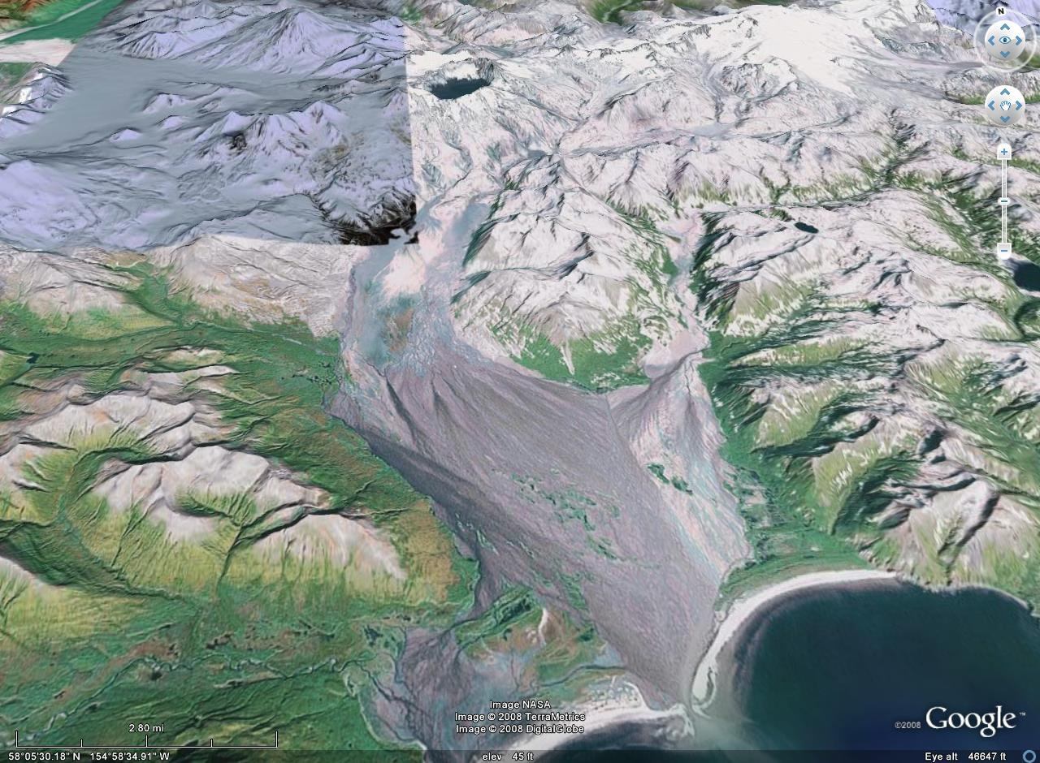
Soluka Creek
Katmai River
Notes:
Much of that tephra ended up on the Katmai River floodplain and in Soluka Creek.

Slide 17
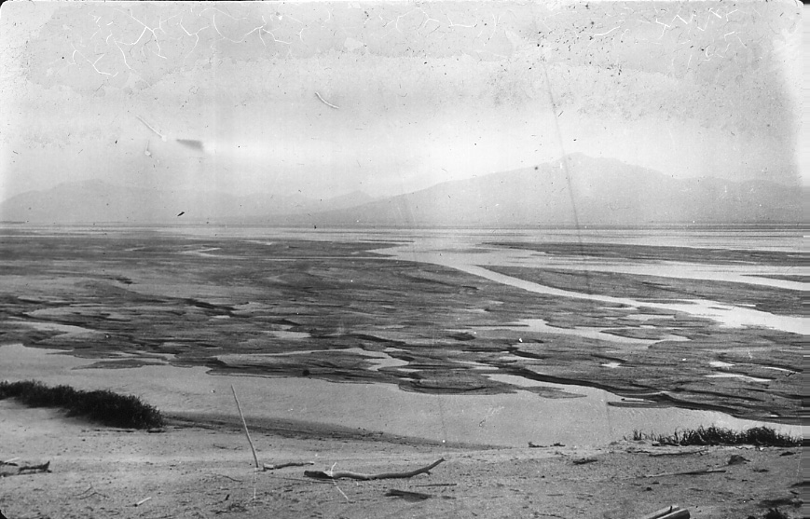
Ash-laden and aggrading Katmai River, 1915
Notes:
Although only about 1-2m of tephra fell on the Katmai floodplain, the vast amount of tephra produced in the eruption (30 to 50 times as much as Mt. Saint Helens!) covered the Katmai’s drainage basin, and so by erosion quickly ended-up accumulating in the river.

Slide 18
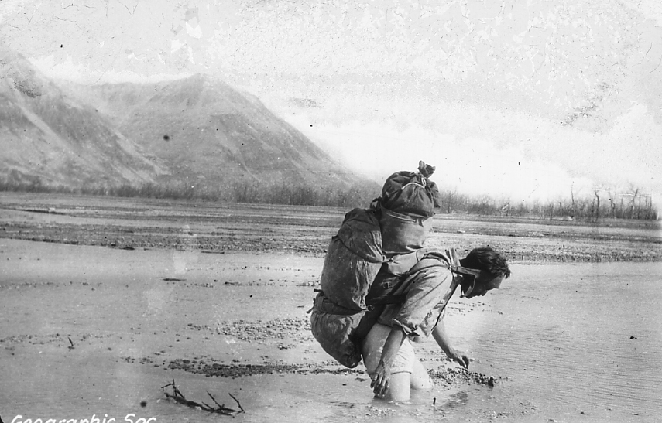
I’m glad I put on clean underwear today.
Notes:
Here we see National Geographic expedition member Robert Griggs slogging across the ash-loaded Katmai River in 1915. Judging from the exposed gravel deposits in the stream, the channel looks to be no more than a few inches deep, yet Griggs is at least knee deep here. Either the wet ash is extremely soft or Griggs is standing in a hole dug by the expedition. That the channel is shallow is important, because it had little capacity to hold water and that’s what caused the flooding.

Slide 19
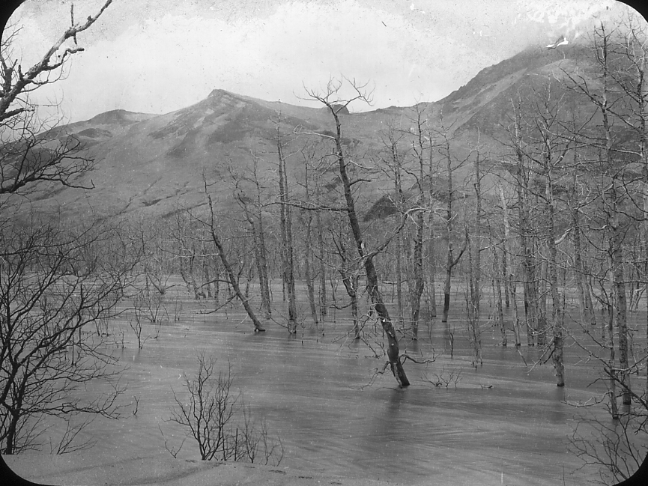
Ash-laden and aggrading Soluka Creek, 1915
Notes:
Over-loaded with sediment, the streams were forced to spread far outside their original channels. Aggredation and flooding above the former flood-plain killed the flood-plain vegetation.

Slide 20
KATMAI / NOVARUPTA
1912 eruption was largest of the entire 20th century
From Novarupta vent 10 km away!
Tephra fall caused flooding
Stream aggradation
Failure of landslide-created dams
Notes:
A much more violent type of flooding occurred when landslide-created tephra dams failed along the rivers.

Slide 21
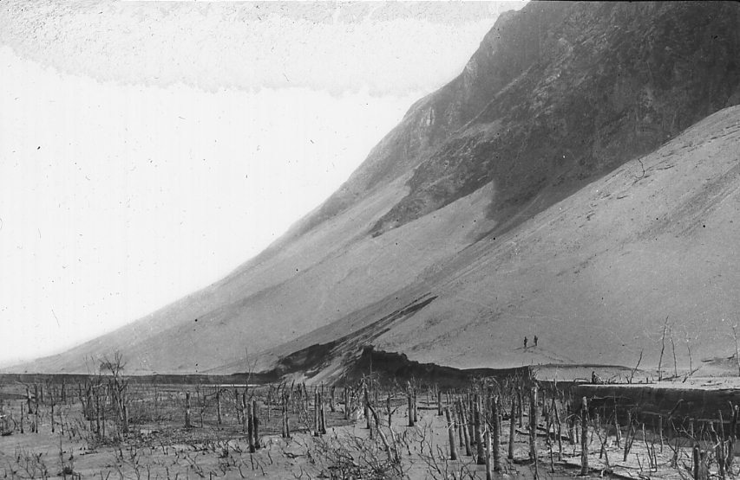
Trees beheaded by flood due to landslide dam failure
Notes:
This picture of the upper Katmai Valley gives one a pretty good idea of how this type of flooding occurs. First note the massive talus deposits of tephra at the base of the slopes here. Now picture such deposits sliding across the valley and blocking the river. The lakes that would form behind such dams would be rapidly released when the unstable landslide dam failed. Note that the flood beheaded the trees and did so about a meter or so above their base.

Slide 22
Trees beheaded by flood due to landslide dam failure
AGGRADED SEDIMENT
Notes:
That’s because the base of the trees were buried under previously aggraded sediment. The height of the stumps indicates how much sediment was eroded after the flood neatly trimmed the trees to the former ground level. Beheaded trees are cool, I know, …

Slide 23
KATMAI / NOVARUPTA
1912 eruption was largest of the entire 20th century
From Novarupta vent 10 km away!
Tephra fall caused flooding
Stream aggradation
Failure of landslide-created dams
Pyroclastic flows create “Valley of 10,000 Smokes”
30 – 200m thick
Notes:
… but the main event of the Novarupta eruption was a spectacular pyroclastic flow, which deposited between 30 and 200 meters of pyroclastic debris in the Valley of 10,000 Smokes.

Slide 24
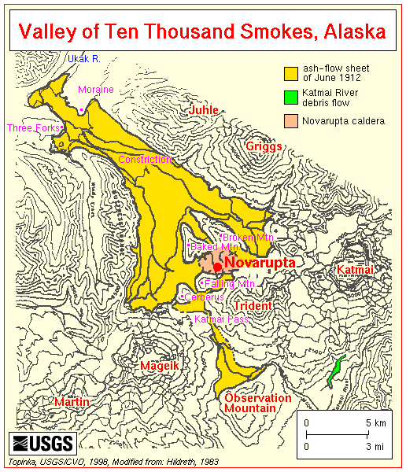
99% of ash
1% of ash
Notes:
This map shows in yellow the extent of the 120-square-kilometer ash-flow sheet from the 1912 eruption. Although one ash flow penetrated Katmai Pass and ponded up to 25 meters of ash in Mageik Creek on the Pacific slope, 99 percent of the ash-flow volume moved northwestward to form the Valley of Ten Thousand Smokes.

Slide 25
30 m thick
200 m thick?
Notes:
Its thickness is not known in the upper valley, but may be as great as 200 meters; it thins to around 30 meters just before the moraine that partially blocked its path near Three Forks. Although there were no eyewitnesses to the eruption, thickness variations clearly point toward Novarupta as the source.

Slide 26
Pyroclastic flow
Notes:
Here’s a relatively small pyroclastic flow raging down Mt. Merapi, a large composite volcano in Java. The one that formed the Valley of 10,000 Smokes was easily 100 times this size.

Slide 27
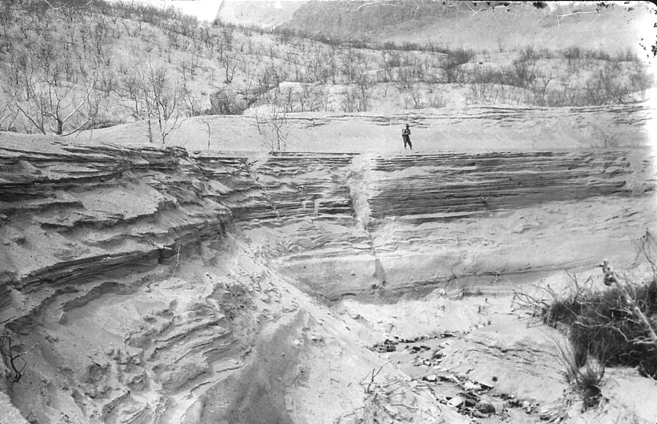
Notes:
Here are the ash deposits on a tributary to Soluka Creek. These were deposited by stream aggradation and thus are distinctly layered. They became eroded shortly after deposition when the streams stopped receiving vast quantities of sediment from upstream. Without that load to carry, the streams became overpowered, down cut through the soft ash deposits and readjusted their profiles to pre-eruption levels.

Slide 28
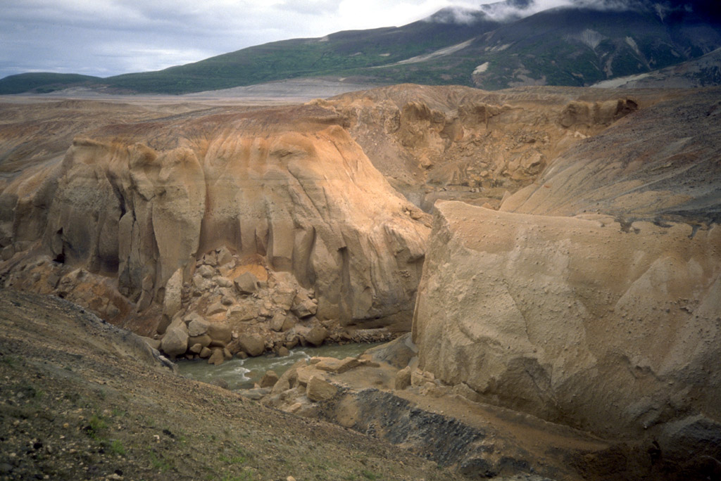
Notes:
Similar adjustments occurred on rivers flowing across The Valley of 10,000 Smokes, although here the exposed strata is far less layered, …

Slide 29
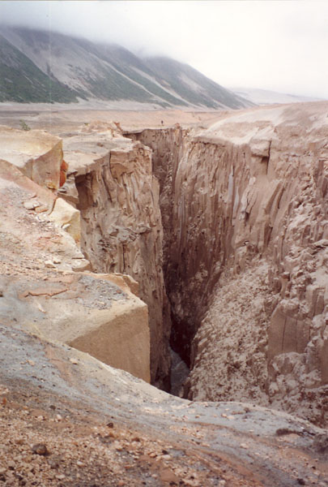
Notes:
… because these deposits were formed by pyroclastic flows – not stream aggradation.

Slide 30
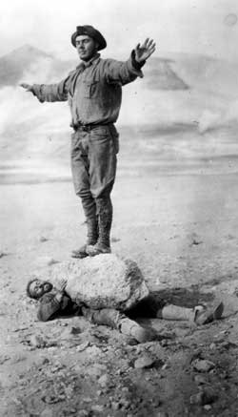
Katmai chakra adjustment
Notes:
Much of the pyroclastic material is pumice, although not typically this large.

Slide 31
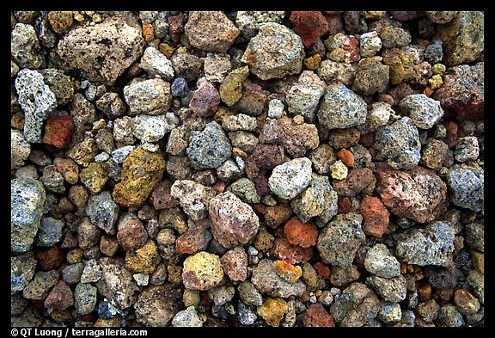
Pumice lapilli colored by hydrothermal alteration
Notes:
More commonly the pumice is lapilli-size, which is about that of a pea to a marble. Here the highly permeable lapilli show signs of hydrothermal alteration from the flow of groundwater through the hot, porous, pyroclastic deposits.

Slide 32
KATMAI / NOVARUPTA
1912 eruption was largest of the entire 20th century
From Novarupta vent 10 km away!
Tephra fall caused flooding
Stream aggradation
Failure of landslide-created dams
Pyroclastic flows create “Valley of 10,000 Smokes”
30 – 250m thick
“Smoke” = groundwater steam
Notes:
It is precisely that groundwater flowing through hot pyroclastics that created the steam that formed the “10,000 smokes”.

Slide 33
Notes:
Robert Griggs (remember the guy in the underwear?) coined the name Valley of Ten Thousand Smokes as he stared awe struck from Katmai Pass across the valley's roaring landscape riddled by thousands of steam vents. He later described the scene writing: "The whole valley as far as the eye could reach was full of hundreds, no thousands -- literally, tens of thousands -- of smokes curling up from its fissured floor.”

Slide 34
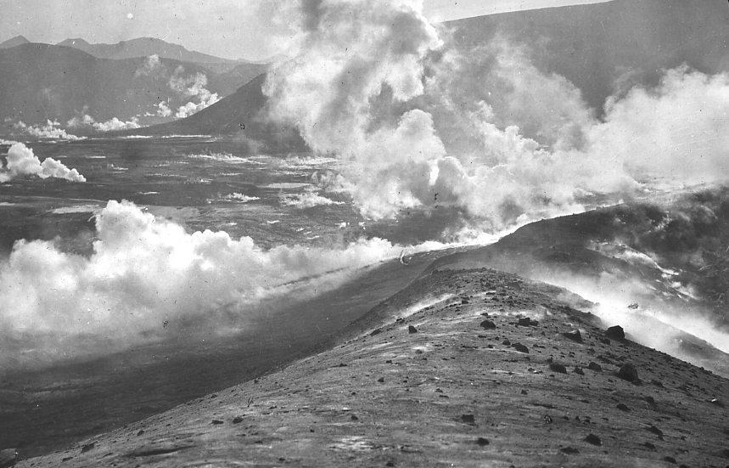
Notes:
The expedition’s surveyor was decidedly less impressed with the place as the incessant swirl of steam often made visibility difficult …

Slide 35
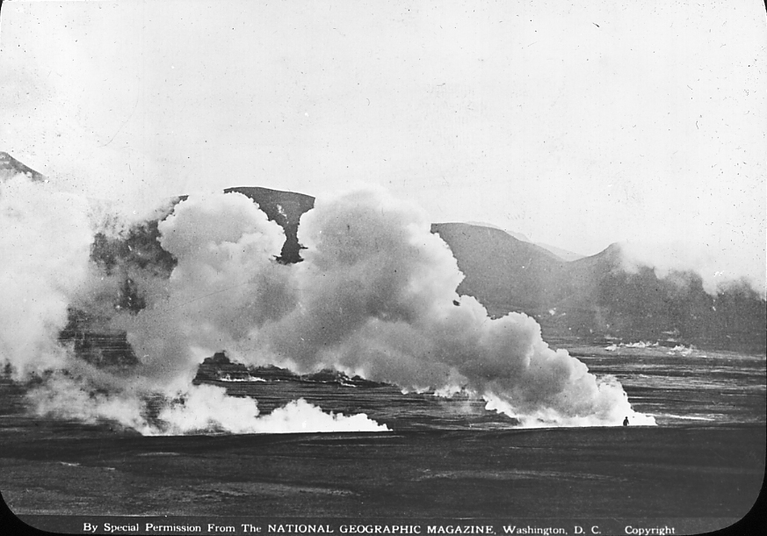
Notes:
… and surveying next to impossible.

Slide 36
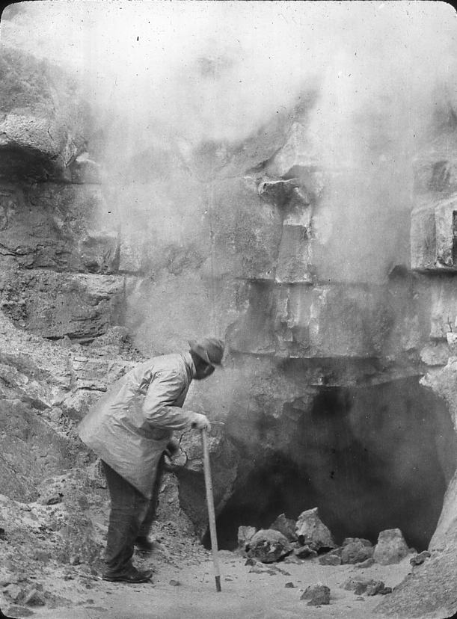
Notes:
Here we see a vent pouring out steam which is transparent because the water vapor has yet to condense.

Slide 37
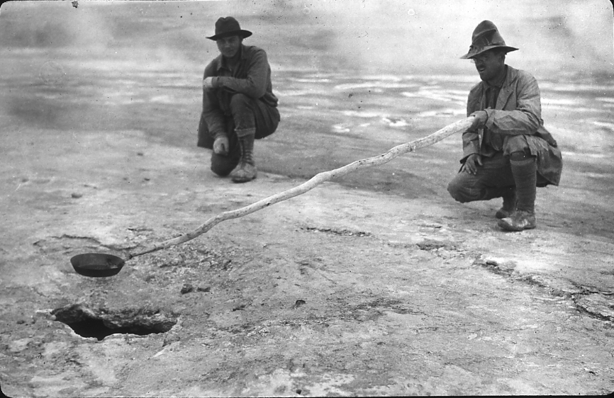
Notes:
Similarly, the steam emanating from this fumarole is invisible, but it must be venting with enough force to support the frying pan. That’s Griggs supposedly frying bacon, which unless the photo is staged, indicates that the steam must be superheated well above the boiling point for water. Steam venting is a very efficient way to cool a pyroclastic flow, …

Slide 38
KATMAI / NOVARUPTA
1912 eruption was largest of the entire 20th century
From Novarupta vent 10 km away!
Tephra fall caused flooding
Stream aggradation
Failure of landslide-created dams
Pyroclastic flows create “Valley of 10,000 Smokes”
30 – 250m thick
“Smoke” = groundwater steam
Active for 15 years
Katmai Caldera = ½ scale Crater Lake
Novarupta Dome is the most silicic dome on earth
Notes:
… so after about 15 years, the steam fumaroles became inactive.

Slide 39
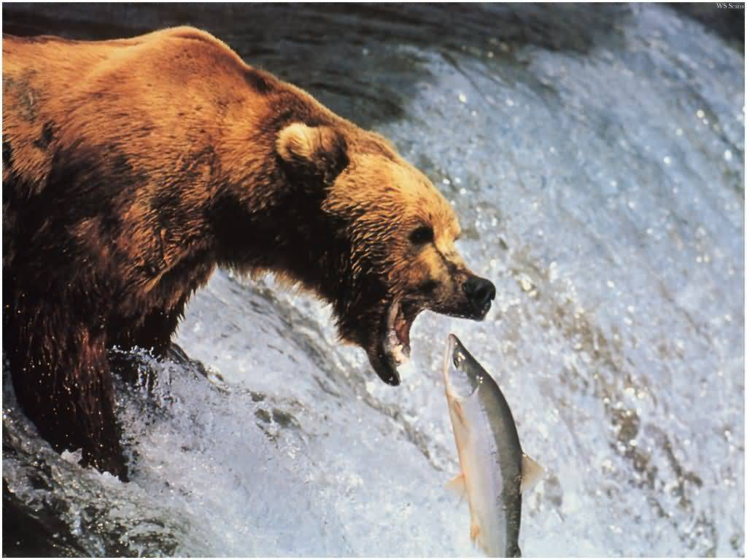
Notes:
Does this mean we’re going to talk about bears now?

Slide 40
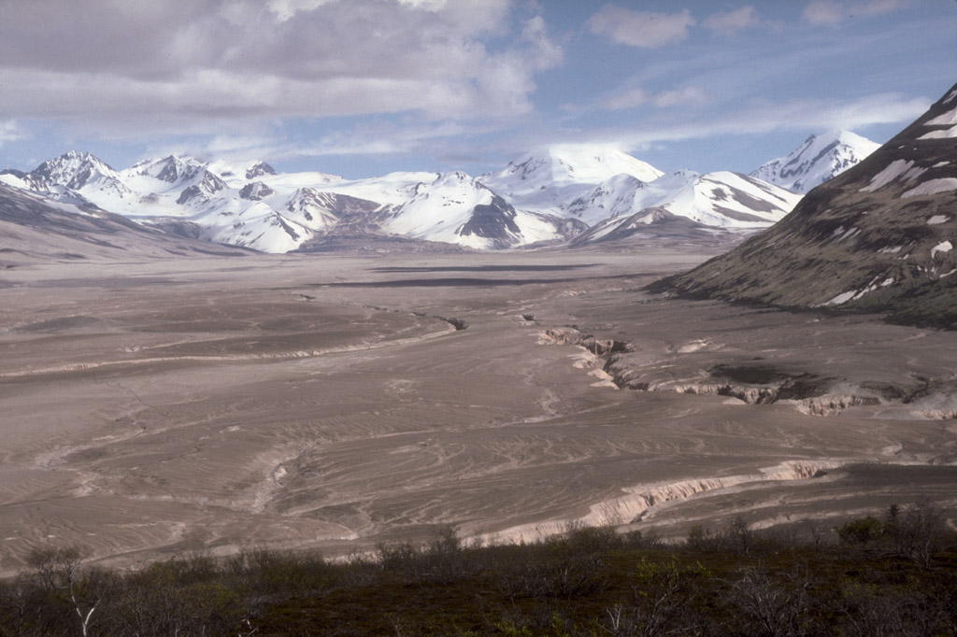
Notes:
Fat chance! Even though it’s been The Valley of Zero Smokes for a long time now, the massive pyroclastic flow is still an impressive sight that warns us of the devastating potential of high silica volcanism. Sometime during or shortly after the deposition of the pyroclastic flow, …

Slide 41
KATMAI / NOVARUPTA
1912 eruption was largest of the entire 20th century
From Novarupta vent 10 km away!
Tephra fall caused flooding
Stream aggradation
Failure of landslide-created dams
Pyroclastic flows create “Valley of 10,000 Smokes”
30 – 250m thick
“Smoke” = groundwater steam
Active for 15 years
Katmai Caldera
Notes:
… Katmai Caldera formed.

Slide 42
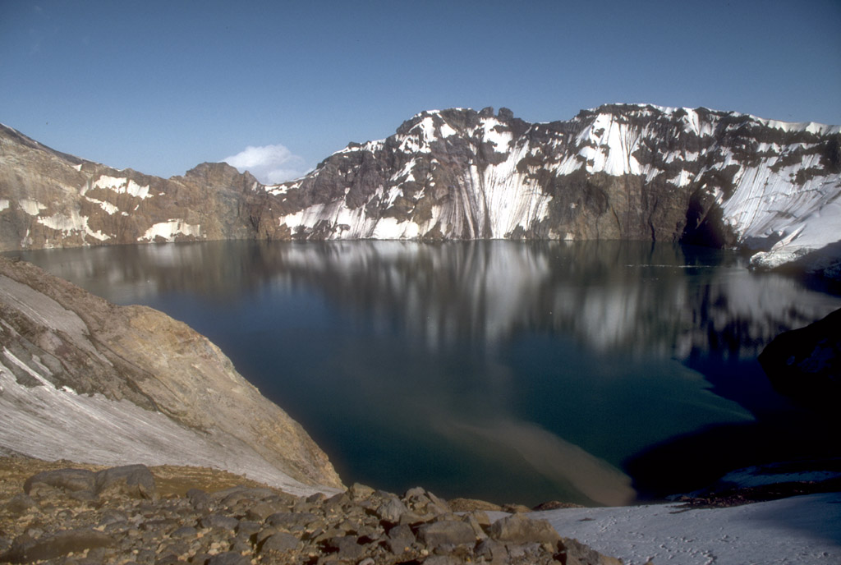
Katmai Caldera Today
Notes:
It’s been described as a scaled-down model of Crater Lake, …

Slide 43
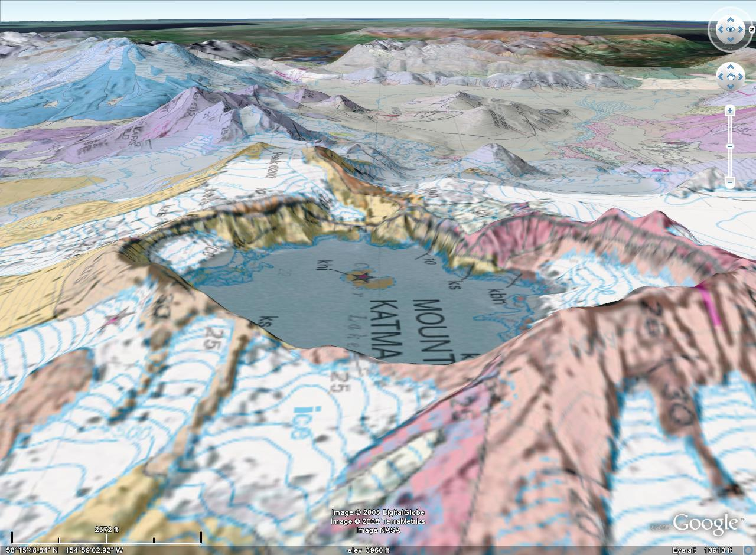
Cinder cone
Notes:
… complete with it’s own version of Wizard Island. This small dacitic cinder cone was emplaced on the floor of the caldera following the collapse.

Slide 44
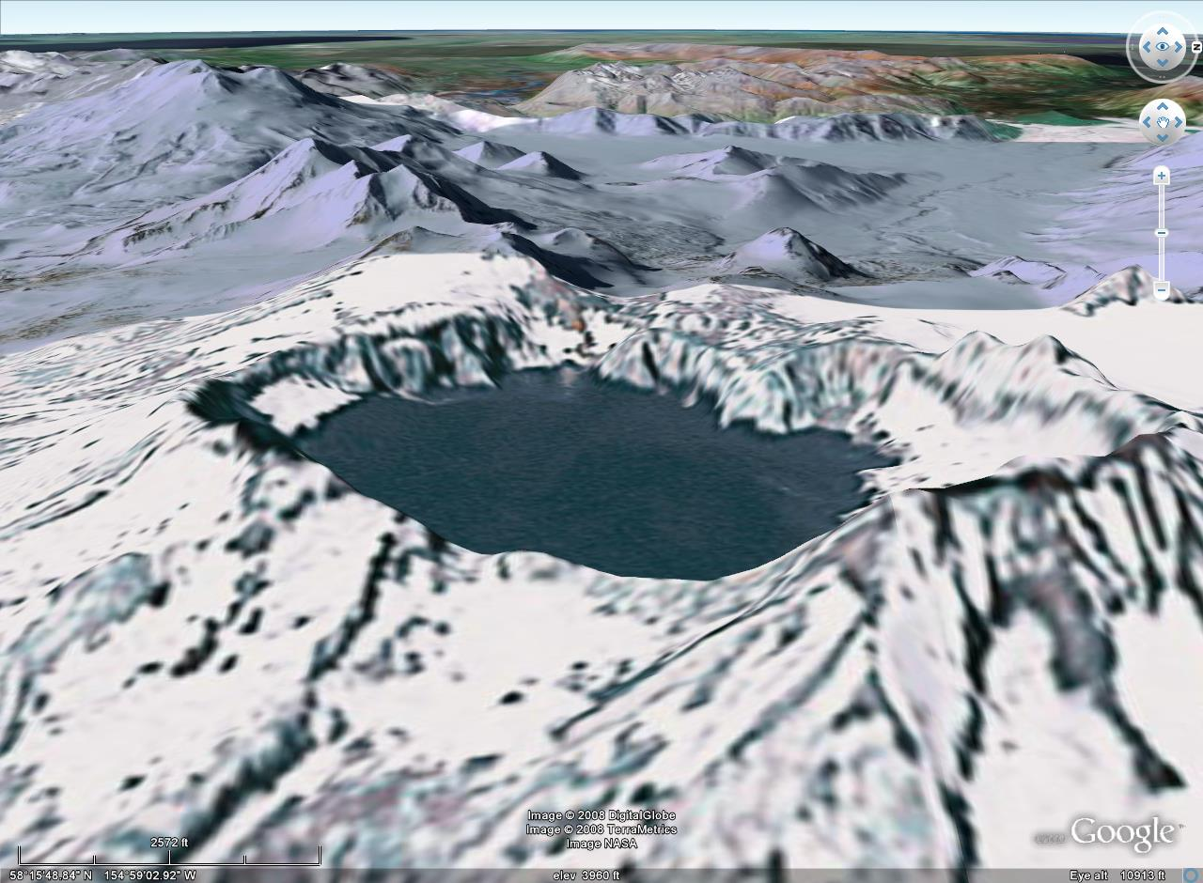
Submerged cinder cone
Notes:
Now submerged, the cinder cone was the only juvenile material erupted from Katmai Caldera during the eruption of Novarupta.

Slide 45
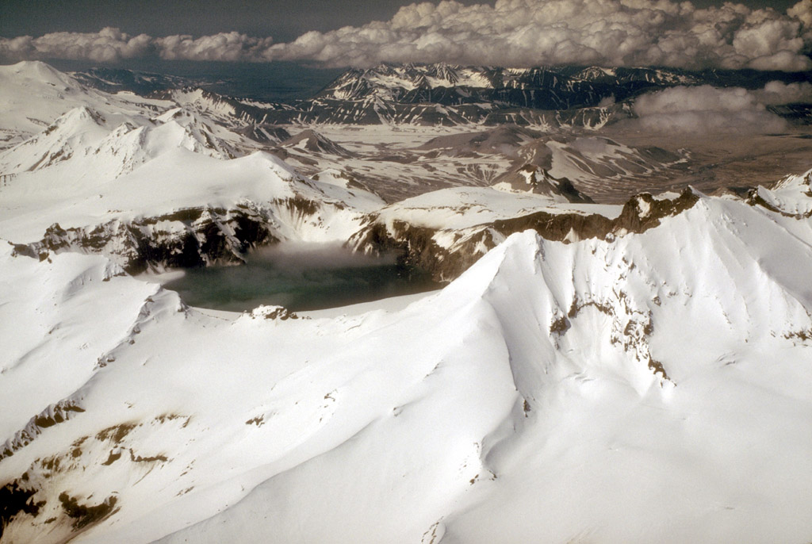
Trident volcano
Novarupta
Notes:
There is evidence that the 30-or-so km³ of tephra ejected from Novarupta was more likely derived from the plumbing system of nearby Trident volcano than that of Katmai. Trident is one of several composite volcanoes intermittently active in the park. Since the collapse of Katmai Caldera happened during the eruption of Novarupta, somehow it’s pluming must be tied into Trident’s too. I think the lesson to take away from all this is that volcanic …

Slide 46
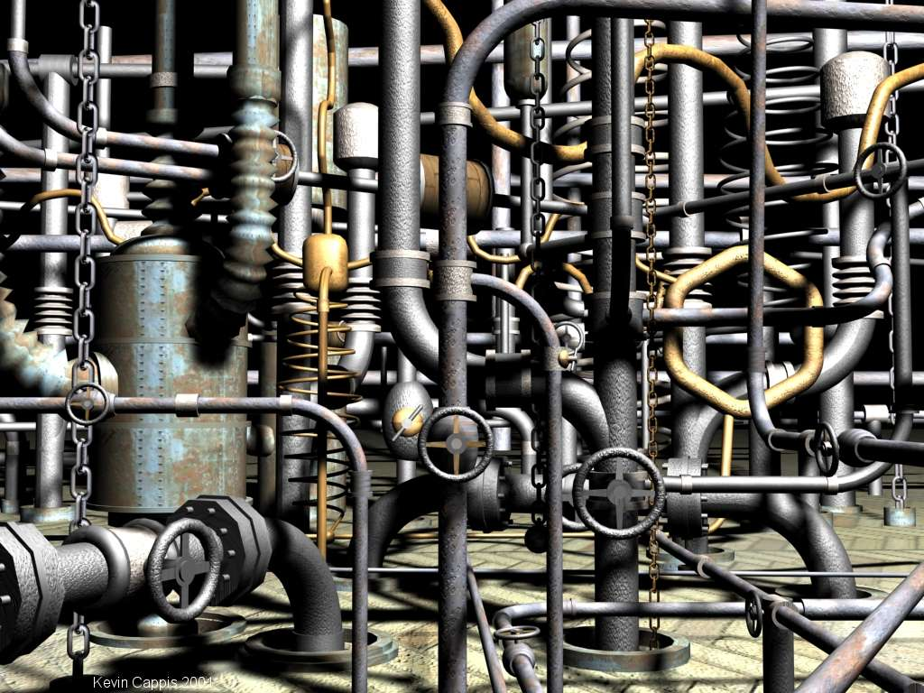
Notes:
…plumbing is probably more complex than we imagine.

Slide 47
KATMAI / NOVARUPTA
1912 eruption was largest of the entire 20th century
From Novarupta vent 10 km away!
Tephra fall caused flooding
Stream aggradation
Failure of landslide-created dams
Pyroclastic flows create “Valley of 10,000 Smokes”
30 – 250m thick
“Smoke” = groundwater steam
Active for 15 years
Katmai Caldera = scaled down Crater Lake
Novarupta Dome is the most silicic dome on earth
Notes:
The great pyroclastic flow from Novarupta released virtually all the gas in the magma, because following the eruption, an extremely silicic dome extruded from the vent.

Slide 48
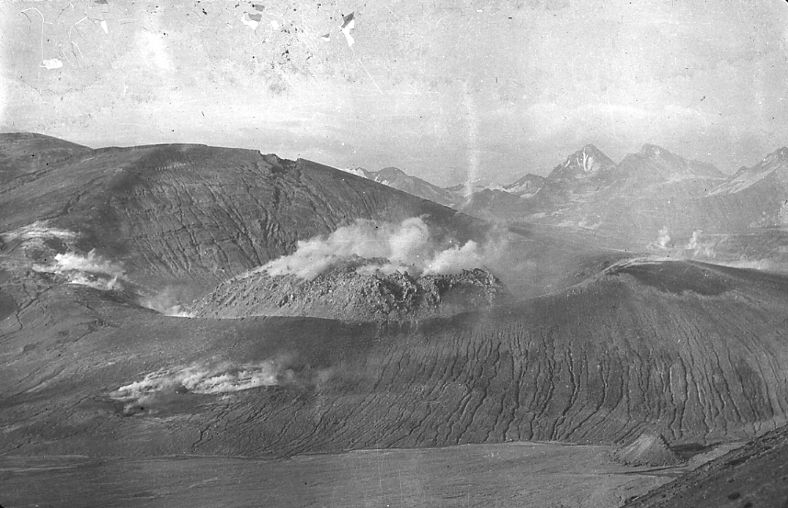
Novarupta Dome in 1915
Notes:
The dome that plugged the vent was still smoking hot when National Geographic arrived on the scene in 1915.

Slide 49
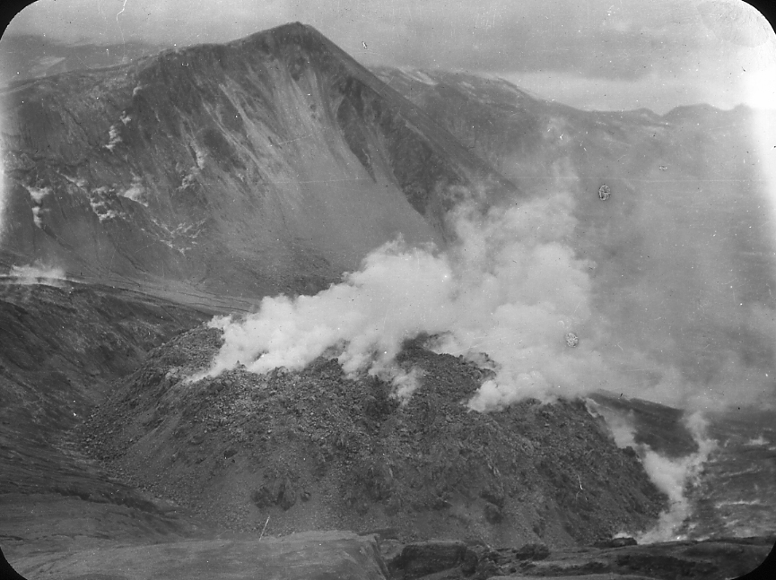
Notes:
This shot gives you a good idea of how viscous the lava is and how the dome’s extremities disintegrate as new magma is added to the interior.

Slide 50
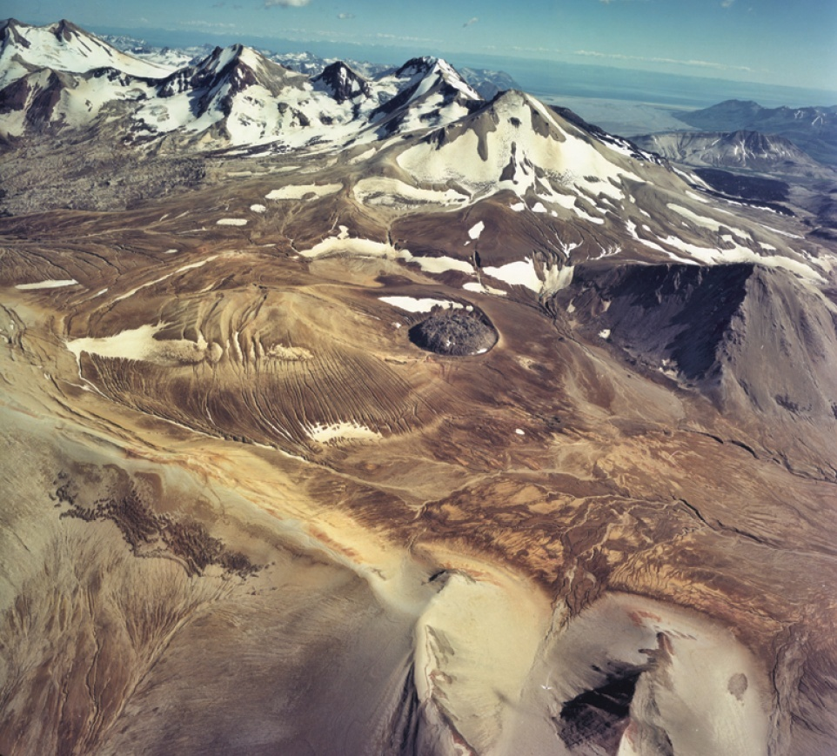
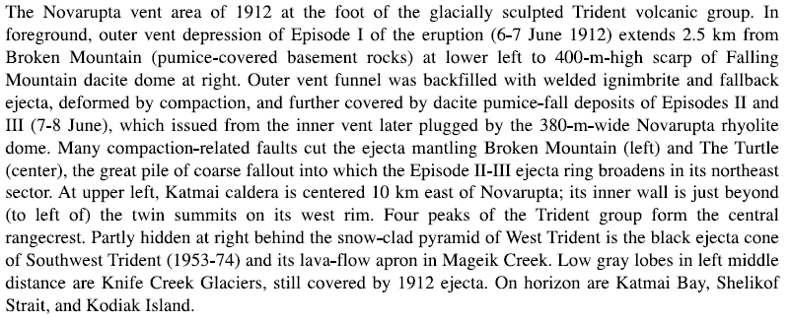
Falling Mountain
Novarupta Dome
Broken Mountain
Notes:
The original vent from which the pyroclastic flow erupted was much larger than the dome. The blast-truncated scarps of Broken Mountain and Falling Mountain show were the edges of the vent were, ….

Slide 51
400 m
2500 m
Notes:
… and indicate a diameter of about 2500 meters, while projecting the 400m scarp of Broken Mountain downward …

Slide 52
Falling Mountain
Novarupta
400 m
2500 m
Notes:
… indicates the gaping crater was about 1000m deep.

Slide 53
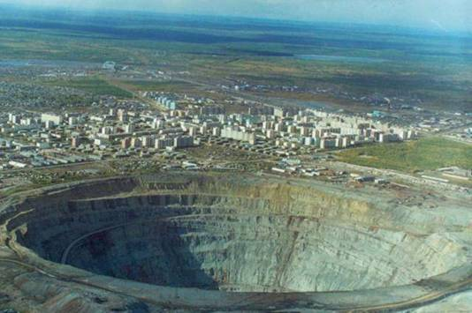
1,250 m
Notes:
That would make it almost exactly twice as deep and wide as this ridiculously huge diamond mine in Siberia.

Slide 54
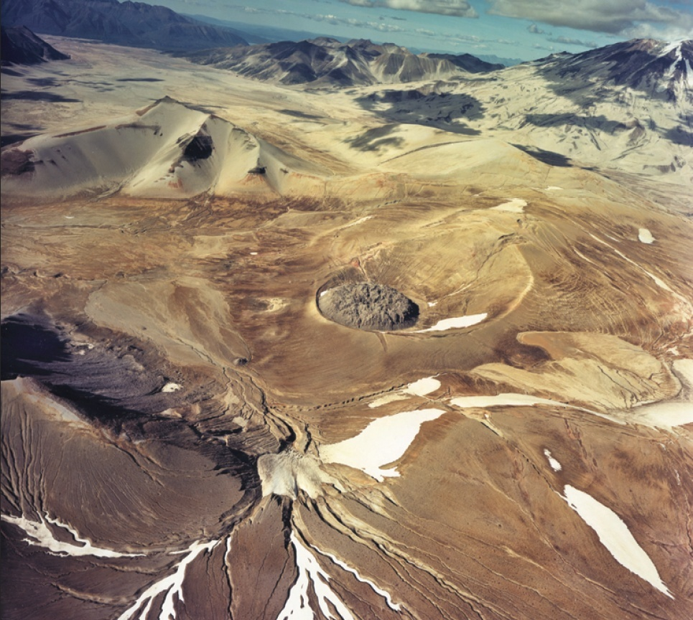
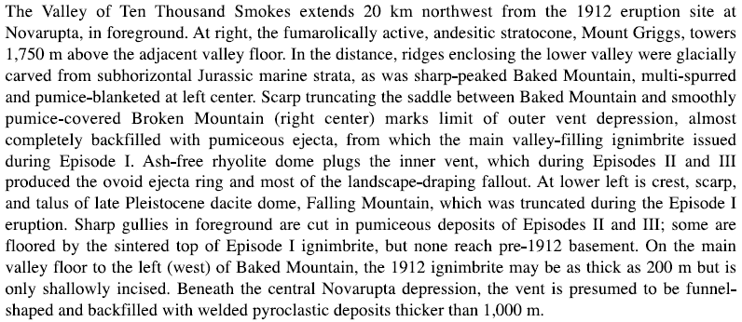
Notes:
As the eruption subsided, more and more ejected debris fell back into the cone and eventually filled it. Tephra continued to be ejected during the waning phases of the eruption, …

Slide 55
Notes:
… but from a much smaller crater.

Slide 56
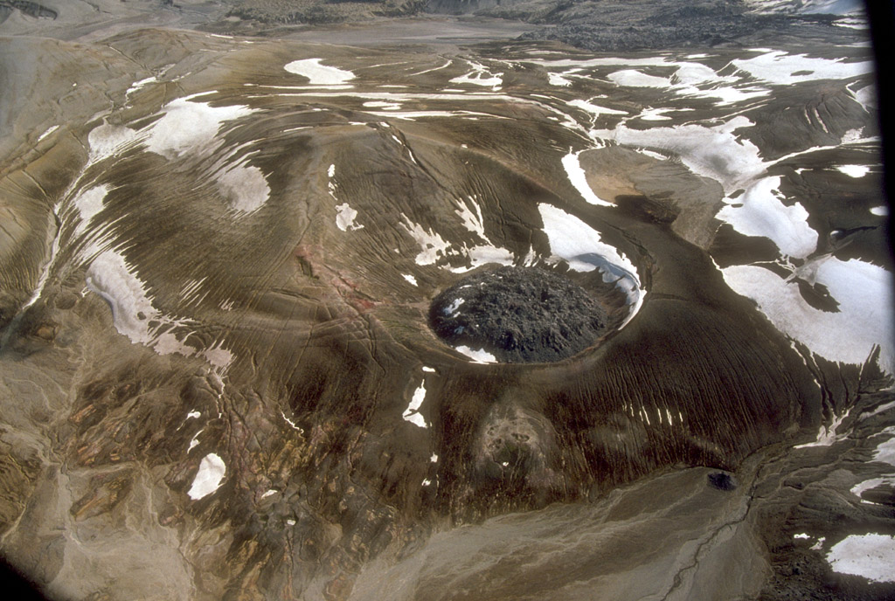
Notes:
An oval-shaped ring of coarse tephra accumulated around the vent as the last bit of gas escaped from the source magma. The great eruption ended with an anticlimactic whimper as the magma, lacking the gas pressure to create pyroclastics and greatly thickened by its high silica content, just barely squeezed out of the vent to form the most silicic dome on earth.

Slide 57
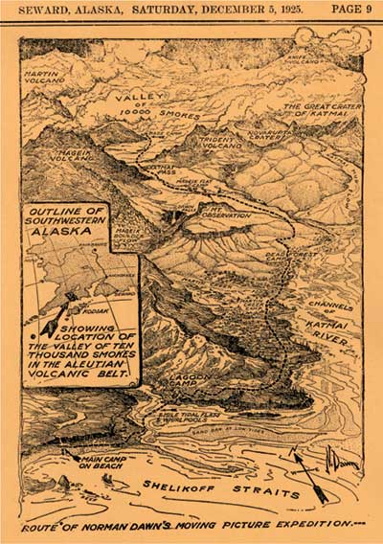

Slide 58
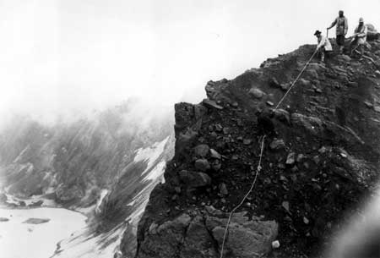
Notes:
Nat geog in katmai crater 1919

Slide 59
Notes:
Mount Cerberus and Falling Mountain are Holocene dacite domes adjacent to the 1912 vent at Novarupta. Baked Mountain and Broken Mountain consist of Jurassic sedimentary rocks, which, like Falling Mountain, were truncated by the eruption and subsidence in the Novarupta caldera. The Katmai River debris flow is a deposit of remobilized ejecta that debouched from a single narrow gorge fed from the glaciated south slope of Mount Katmai, which was in the sector of heaviest tephra fall. The Valley of Ten Thousand Smokes constriction is where the ash flows left marginal veneers and constructional hills of tuff. Part of the Mageik Creek ash-flow lobe is now covered by the 1953-1960 lava flows from Trident. -- From: Hildreth, 1983, The Compositionally Zoned Eruption of 1912 in the Valley of Ten Thousand Smokes, Katmai National Park, Alaska: Journal of Volcanological and Geothermal Research, v.18., p.1-56.

Slide 60
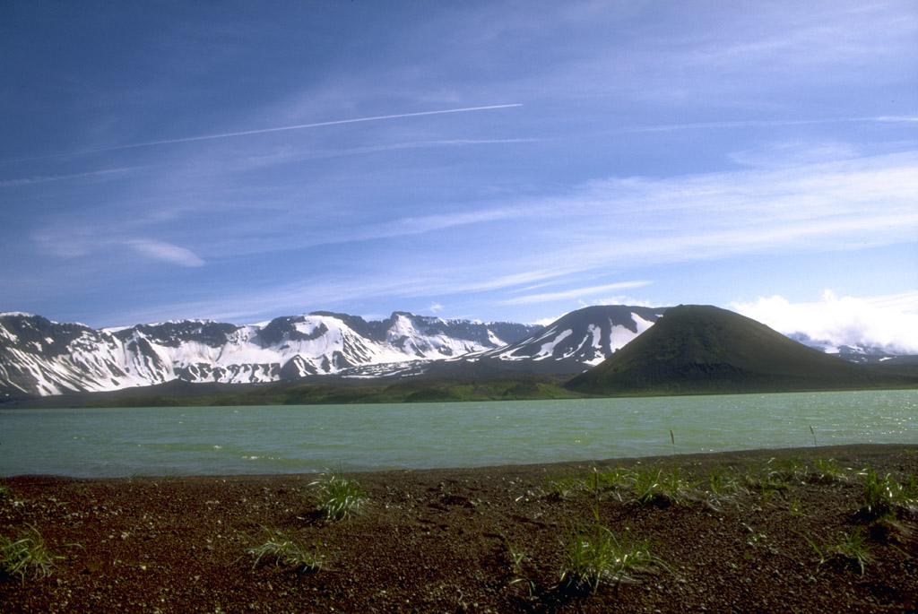
Notes:
46. Jet contrails over Aniakchak caldera. The proximity of explosive volcanoes of the Aleutian volcanic arc to North Pacific air routes is one of the principal hazards associated with volcanoes in Alaska. View is to the south. Photograph by C. Neal, U.S. Geological Survey, July 19, 1994.

Slide 61
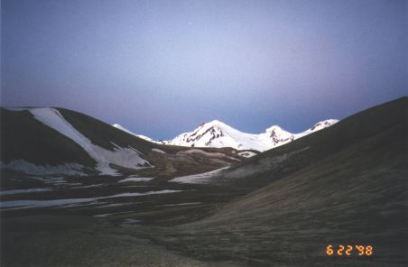
Mt. Trident (midnight, summer solstice)
Notes:
Mt Trident, Summer Solstice, Midnight

