Slide 1
Nanotechnology
Technology on the nanoscale

Slide 2
Nanotechnology By Definition
The term nanotechnology includes many different fields and sciences, including engineering, chemistry, electronics, and medicine, among others, but all are concerned with bringing existing technologies down to a very small scale, measured in nanometers.

Slide 3
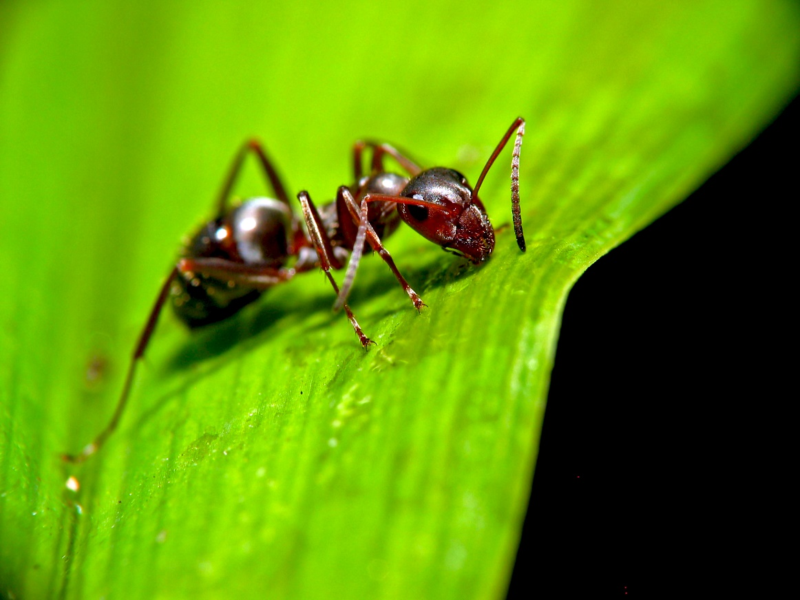
How Small is a Nanometer?
A Nanometer is one million times smaller than the common ant.
And a single stand of human hair is 100,000 times the width of a nanometer.

Slide 4
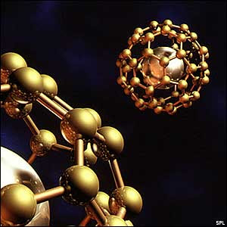
Understanding Nanotechnology
https://youtu.be/EkRBr8BOakE

Slide 5
The Generations of Nanotechnology
1st Generation (2000): Passive Nanostructures Ex. Aerosols, Coatings for Materials
2nd Generation (2005): Active Nanostructures Ex. Targeted Drugs, Biodevices
3rd Generation (2010): Systems of Nanostructures Ex. 3D Networking, Robotics
4th Generation (2015): Molecular Structures Ex. Molecular Devices ‘by design’, Atomic Design

Slide 6
Examples In Use Today
Molecule Printers
A printer that can build functional molecules piece by piece
Sports Equipment
Increases strength and durability and reduces weight as well as friction
Electricity-Generating Viruses
Paint these viruses onto the bottom of your shoes and you could power up your smart phone. Or paint a dance floor with them and power your whole club.
Stretchable Gold
With circuits made of stretchable gold, you can bend and torque your devices as much as you want, or have a squeezy computer.
Stain-repellant Fabric Coating
Fabrics made of several nano-layers of positively and negatively charged films that actively repel everything from water to acids

Slide 7
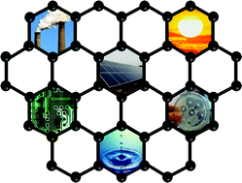
Potential Benefits of Nanotechnology
Manufacturing
Packaging that protects food from food borne illnesses
Environmental
Ozone rebuilding
Toxin Cleanup
Alternative resources
Medical
Early Detection of cancer
as well as new treatments

Slide 8
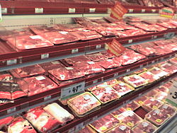
Manufacturing That Saves
Plastic packaging made from polymer-based nanomaterials that can detect and in some cases eliminate salmonella, pesticides, and other contaminants.
The plastic storage bins used to transport food are often lined with silver nanoparticles that kill bacteria from the previously stored food. And some types of packaging contain nanoparticles that keep oxygen out so the food doesn’t spoil as quickly.

Slide 9
Nanotechnology benefits the environment
Nano robots could be programmed to rebuild ozone layer.
Oil Spills could be cleaned instantly by automatically removing contaminants.
Resources can be constructed by Nano machines instead of cutting down trees, mining for coal, or drilling for oil.

Slide 10
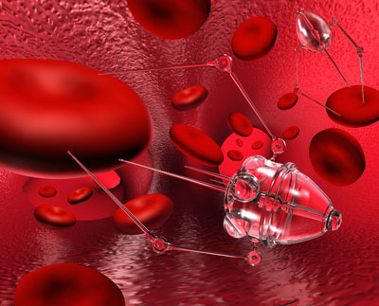
The Fight Against Cancer
Cancer is known to be incurable as we have all encountered a family member, friend, or heard of someone with cancer. According to National Cancer Institute, Nanotechnology can assist by…
Monitoring, studying, and manipulating the process of cells
Early detection of cancer with an advanced imaging system, healthy vs bad cells
“Nanobots” to deliver drug to proper location or “destroy” cancer cells vs standard medicine, without damaging healthy cells

Slide 11
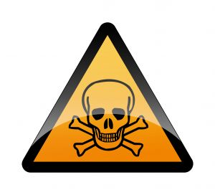
Potential Dangers of Nanotechnology
Weapons
Miniature and undetectable weapons and explosives
Dissemblers for Military use
Rampant Nanomachines
The Gray Goo Scenario. In this scenario self replicating Nanomachines could begin an infinite chain reaction that could eventually consume entire solar systems and continue to spread
Substance Abuse
Nanofactories being created to produce dangerous and illegal drugs that can be sold in the black market

Slide 12
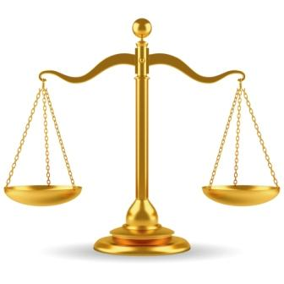
Ethical Issues in Nanotechnology
Surveillance and jeopardized Right to privacy
Nanotoxicity
Bodily autonomy
Regulation and Environmental Concerns

Slide 13
Surveillance and Right to Privacy
Nanotechnology could lead to undetectable surveillance, which could jeopardize the right to privacy
Any new Surveillance developed must comply with the Fourth Amendment
I.e. Kyllo vs United States
New nanotechnology developed could violate the privacy laws without people being aware

Slide 14
Nanotoxicity
Particles at nanoscopic scales are subject to quantum mechanics
They cause different biological reactions than at larger scales
Negative effects include DNA breakage, mutations, accelerated cell death and induced cell death
Differs based on type of particle, i.e. metals

Slide 15
Bodily Autonomy
“Bodily Autonomy”: Each person’s right to control what happens to their own body
Because of small scale of nanotechnology this autonomy could easily be breached
Particles suspended in air, in fluid, etc. are absorbed within the body without the host’s consent or knowledge

Slide 16
Regulation and Environmental Concerns
Similar to nuclear power, there is risk of environmental contamination by the nanotechnological components
Example: Carbon nanotubes released into ocean and filtered through gills of fish
Debate over government regulation of nanotechnology/science in general: suppressing scientific inquiry and experimentation
Risk vs. Reward

Slide 17
Sources
http://io9.gizmodo.com/5967198/8-incredible-nanotechnologies-that-actually-exist-in-the-real-world
Dictionary.com
http://www.nanowerk.com/spotlight/spotid=30661.php
http://theinstitute.ieee.org/technology-focus/technology-topic/everyday-nanotechnology
https://en.wikipedia.org/wiki/Nanotoxicology#Genotoxicity
https://www.scu.edu/ethics/focus-areas/more/technology-ethics/resources/the-ethics-of-nanotechnology/
https://epic.org/privacy/nano/

