Slide 1
Institutions, Policies, & Cross-Country Differences in Income and Growth

Slide 2
How Large are Income Differences Across Countries?

Slide 3
Measuring Cross-Country Differences in Income
Countries use different currencies. Thus, the purchasing power of different currencies must be converted to a common denominator in order to compare incomes in different countries.
This could be done with exchange rates.
But, exchange rates are influenced by capital movements and will fail to reflect the prices of goods not traded in international markets.
They may be an inaccurate indicator of the purchasing power of different currencies.
Economists favor the purchasing power parity (PPP) method of income comparisons.

Slide 4
Measuring Cross-Country Differences in Income
Economists favor the purchasing power parity (PPP) method of income comparisons.
This method uses the cost of purchasing a common bundle of goods consumed in each country and uses this cost to estimate the purchasing power of each currency.
The purchasing power of each currency is then used to convert the income levels of each country to a common currency, typically the U.S. dollar.

Slide 5
Cross-Country Differences in Income
The following slide highlights the 2007 per person income for various high, middle and low-income countries.
The incomes in Norway, the US, and Hong Kong are the highest in the world, in excess of $39,000.
The per-person income in high-income countries is about 50 times the figure for the countries with the lowest incomes.
The incomes of less-developed countries will be understated because GDP figures generally omit household production.
Even after making some allowance for this, it is clear that the income differences between the high and low-income countries are huge.

Slide 6
Cross-Country Differences in Income
The 2009 Per Person Income Levels for high-, Middle-, and Low-Income Countries
(measured in 2005 PPP U.S. dollars)
High-Income Countries
Middle-Income Countries
Low-Income Countries
Norway
$47,676
South Korea
$25,493
China
$6,200
United States
41,761
Hungary
16,896
Ukraine
5,737
Hong Kong
39,255
Poland
16,705
Bolivia
4,013
Switzerland
36,954
Russian Federation
13,611
Indonesia
3,813
The Netherlands
36,358
Argentina
13,202
Honduras
3,488
Ireland
36,278
Chile
13,057
Philippines
3,216
Canada
34,567
Malaysia
12,724
India
2,993
Germany
32,255
Mexico
12,429
Nigeria
2,001
United Kingdom
32,147
Turkey
11,209
Bangladesh
1,286
Japan
29,692
Brazil
9,414
Sierra Leone
734
France
29,578
South Africa
9,333
Malawi
721
Italy
26,578
Thailand
7,260
Niger
626

Slide 7
How Do Growth Rates Vary Across Countries?

Slide 8
Cross-Country Differences in Growth
The following slide shows the growth of per person GDP during 1990-2007 for the countries with the best and worst growth records, along with the figures for high-income countries.
Except for Ireland, the ten fastest growing economies were LDCs at the beginning of the 1980s. The two most populace countries, China and India, are on the high-growth list.
The high-growth economies grew at an annual rate of 4.1% or more (twice that of most high-income countries). This has closed the gap relative to their richer counterparts since 1990.
While LDCs dominate the high-growth list, those with the worst growth records were also LDCs. Countries on the right side of the table are not only poor, they are falling further and further behind.

Slide 9
Economic Growth: 1990-2009
The Average Annual Growth Rate Per-Person GDP for High-Growth,
High-Income Industrial, and Low-Growth Countries (1990–2009)
High-Growth
High-Income Industrial
Low-Growth
China
9.5%
Norway
2.1%
Kyrgyz Repulic
-1.0%
Vietnam
5.9%
Australia
1.9%
Cote d’Ivoire
-1.1%
Taiwan
4.9%
The Netherlands
1.7%
Guinea-Bissau
-1.3%
India
4.7%
United Kingdom
1.6%
Georgia
-1.4%
Korea, Rep.
4.3%
United States
1.4%
Liberia
-1.6%
Trinidad and Tobago
4.1%
Canada
1.3%
Burundi
-1.6%
Sri Lanka
4.1%
Germany
1.2%
Ukraine
-1.8%
Uganda
4.0%
France
1.0%
Tajikistan
-2.8%
Lebanon
3.9%
Japan
0.7%
Moldova
-3.0%
Ireland
3.9%
Italy
0.6%
Congo, Dem. Rep.
-3.9%

Slide 10
Economic Freedom as a Measure of Sound Institutions

Slide 11
Economic Freedom as a Measure of Institutional Quality
Gains from trade, entrepreneurial discovery, and investment are largely dependent on institutions and policies supportive of voluntary exchange, market allocation, freedom to compete, and protection of people and their property from aggressors.
These ingredients comprise the foundation of economic freedom.

Slide 12
Measuring Economic Freedom
The Economic Freedom of the World (EFW) index is designed to measure the consistency of a nation’s institutions and policies with economic freedom.
Leading scholars, including Nobel laureates Milton Friedman, Gary Becker, and Douglass North, helped to develop the EFW index.
The EFW index uses 42 separate components to measure the consistency of a nation’s institutions and policies with personal choice, voluntary exchange, open markets, and protection of private property.

Slide 13
Measuring Economic Freedom
To achieve a high economic freedom (EFW) rating, a country must:
provide secure protection of privately owned property,
provide evenhanded enforcement of contracts,
provide a stable monetary environment,
keep taxes low,
refrain from creating barriers to both domestic and international trade, and,
rely more fully on markets rather than governments to allocate goods and resources.
The EFW index reflects the institutional and policy factors that theory indicates are key sources of economic growth.

Slide 14
The Most and Least Free Economies of the World
Economic freedom (EFW) ratings are available for 122 countries during the 1990-2007 period.
The following slide indicates the ten highest and lowest rated economies, as well as the ratings of ten other large countries.
Hong Kong, Singapore, New Zealand, the United States, and Switzerland headed the list of the most persistently free economies.
Myanmar, the Democratic Republic of Congo, Guinea-Bissau, Zimbabwe, and Burundi had the least free economies.

Slide 15
EFW Ratings: 1990-2009
The Economic Freedom Rating for Top-, Middle-, and High-Rated Countries
EFW Index, Average 1990–2009
Top-Rated Countries
Middle-Rated Countries
Low-Rated Countries
Hong Kong
8.9
Germany
7.6
Algeria
4.9
Singapore
8.7
Chile
7.5
Sierra Leone
4.9
New Zealand
8.3
Japan
7.4
Congo, Republic of
4.9
United States
8.2
France
7.0
Venezuela
4.9
Switzerland
8.1
South Korea
6.8
Syrian Arab Republic
4.8
United Kingdom
8.0
Mexico
6.6
Burundi
4.7
Canada
8.0
Indonesia
6.4
Zimbabwe
4.6
Australia
7.8
Argentina
6.2
Guinea-Bissau
4.3
Ireland
7.8
China
5.7
Congo, Dem. Rep.
4.1
The Netherlands
7.7
Brazil
5.5
Myanmar
3.8

Slide 16
Questions for Thought:
Why do economists believe the purchasing power parity (PPP) method is a more accurate way to compare cross-country incomes than comparisons based on exchange rates?
How large are the income differences across countries? Why are the per capita GDP figures likely to overstate the size of the income difference between high and low-income countries?
How do growth rates vary across countries? Are the rich countries getting richer while the poor are getting poorer?

Slide 17
Questions for Thought:
4. What is the Economic Freedom of the World (EFW) index designed to measure? What determines whether the rating of a country will be high or low on this index?
5. “Economic freedom is present if a country is a political democracy.” – Is this statement true?

Slide 18
Institutions, Policies, and Economic Performance

Slide 19
Economic Freedom and Performance
If institutions and policies are important, then countries that are economically free should outperform those that are less free.
When considering the impact of institutions, it is important to focus on income and long-term growth rather than short-term growth, which may reflect mostly the ups and downs of business cycle conditions.

Slide 20
Economic Freedom and Income
2009 GDP Per Capita, PPP (in constant 2005 dollars)
The real per-person income (using a PPP adjustment) for countries ordered by economic freedom rating is shown here by quartiles.
Note the strong positive linkage. Income per person in the freest quartile of countries was about eight times the figure for the least free.
$35,501
$14,961
$4,545
$6,464
Least-Free Quartile
Third Quartile
Second Quartile
Most-Free Quartile

Slide 21
Economic Freedom and Growth
Growth of GDP Per Capita 1990-2009 (Annual %)
The relationship between the economic freedom of a country and its growth rate (of GDP per capita) during the 1990-2007 period is shown here.
Countries in the most free quartile grew at an annual rate of 3.1% compared to the 1.2% growth for the least-free quartile.
3.1%
2.3%
2.4%
1.2%
Least-Free Quartile
Third Quartile
Second Quartile
Most-Free Quartile

Slide 22
Economic Freedom and Poverty
The extreme poverty rate in the most free quartile of countries was 2.7% compared to 41.5% in the least free quartile.
The pattern in the data for the moderate poverty rate is the same.
Clearly the countries with more economic freedom have lower poverty rates.
Extreme Poverty Rate (2000-2005)
Moderate Poverty Rate (2000-2005)
41.5%
57.4%
36.3%
21.3%
7.8%
14.0%
2.7%
3.6%
Least-Free Quartile
Third Quartile
Second Quartile
Most-Free Quartile
Least-Free Quartile
Third Quartile
Second Quartile
Most-Free Quartile

Slide 23
The Importance of Economic Growth
Here countries are divided into 3 groups, based upon their average EFW rating during 1980-2005.
Investment is positively linked to economic freedom.
Private investment was 18.7% of GDP in the freest group, while only 11.2% of GDP for the least free group.
Economic Freedom & Private Investment
as a Share of GDP (Groups are Average EFW Ratings for 1980-2005).
18.7%
15.6%
11.2%
< 5.0
5.0 – 7.0
> 7.0

Slide 24
The Importance of Economic Growth
Change in Growth Rate Per Percentage-Point Change in Investment (1980 – 2005)
The estimated impact of a 1% increase in investment/GDP ratio on the annual growth rate during 1980-2005 is shown.
In the most free group, a 1% increase in private investment enhanced long-term growth by 0.25%, compared to 0.07% for the least free group.
0.25%
0.16%
0.07%
EFW < 5
EFW 5-7
EFW > 7

Slide 25
Economic Freedom – A Summary
Countries with institutions and policies more consistent with economic freedom (as measured by the EFW index) have achieved …
higher incomes per person,
more rapid growth rates,
lower poverty rates
higher investment rates, and,
greater productivity per unit of investment.

Slide 26
Is Institutional Change Possible?

Slide 27
The Influence of History
Research indicates that history matters.
Countries with colonial settlers who planned on staying tended to develop institutions and policies that protected individual property rights and limited the power of government.
The United States, Canada, Australia, and New Zealand provide examples.

Slide 28
The Influence of History
In contrast, colonizers settling in harsh climates or with short-term interests in the extraction of mineral resources were more likely to choose institutions that provided few limitations on the power of government and failed to provide for protection of ownership rights and unbiased enforcement of the law.
Even after independence, protective institutions have been largely absent in Africa and Latin America, where the European colonizers were primarily interested in resource extraction.

Slide 29
Three Factors That Now Make Institutional Change More Possible
While no country can entirely escape its past, at least three factors have increased the likelihood of institutional change.
The colonial era is over – countries that were previously colonized by European powers are now in a position to make their own institutional and policy choices.
The collapse of communism has also expanded the opportunity for institutional change.
Substantial reductions in transportation & communication costs have increased the potential gains from the adoption of sound institutions and policies.

Slide 30
Recent Institutional Change and Economic Performance

Slide 31
Major Reformers During the 1960s
In the 1960s, Hong Kong and Singapore both began to liberalize their economies and by the 1970s they were among the world’s freest economies.
In 1960, Hong Kong & Singapore were poor; their income per capita was less than countries like Brazil, Argentina, and Venezuela.
Impressive growth has led to dramatic change.
The per capita incomes of Hong Kong and Singapore are now much greater than Latin American countries and greater than many high-income economies of Western Europe.

Slide 32
Major Reformers During the 1970s
In the 1970s, China and Chile each began instituting key reforms. At the time, both were among the least free economies in the world. The reform process has increased their EFW ratings substantially.
The growth of each has been impressive.
China has been the world’s fastest growing economy during the 1980-2009 period.
Chile had an annual growth rate of 3.1% during the same period and now has the highest per capita income in Latin America.

Slide 33
The Reformers of the 1980s
Data for the 8 major reformers of the 1980s is shown here.
Since 1990, per capita income for the 1980s reformers has grown at an average annual rate of 2.6%.
The growth rates of Ireland, Botswana, and Mauritius have been particularly impressive.
Countries Beginning Reform During the 1980s
Beginning Year of Change
2005 EFW Rating
Growth 1990-2009
Growth
1995-2009
Per Capita GDP, 2009
Bangladesh
1987
6.0
3.4%
3.8%
$1,286
Botswana
1985
7.2
2.9%
3.4%
$12,154
Ghana
1985
6.2
2.4%
2.8%
$1,410
Iceland
1988
7.8
1.5%
2.3%
$33,980
Ireland
1987
7.9
3.9%
3.8%
$36,278
Mauritius
1985
7.5
3.5%
3.4%
$11,658
New Zealand
1985
8.5
1.4%
1.3%
$24,706
United Kingdom
1980
8.1
1.6%
1.7%
$32,147
Average
7.4
2.6%
2.8%
$19,202

Slide 34
Major Reformers of the Early 1990s
The following slide presents data for the diverse countries adopting major reforms in the early 1990s.
The average growth rate of these 12 countries was 3.2% during the 1995-2009 period.
The growth of Estonia, Hungary, India, and Poland have been particularly impressive.
It will be interesting to see if these countries will be able to sustain the economic reforms and follow their growth record in the years immediately ahead.

Slide 35
The Reformers of the 1990s
Countries Beginning Reform During the 1990s
Beginning Year of Change
2005 EFW Rating
Growth 1990-2009
Growth
1995-2009
Per Capita GDP, 2009
Costa Rica
1991
7.4
2.4%
$10,085
El Salvador
1994
7.6
1.9%
$6,020
Estonia
1995
8.0
5.4%
$16,133
Hungary
1995
7.5
3.2%
$16,896
India
1990
6.6
5.3%
$2,993
Israel
1991
7.1
1.5%
$25,474
Nicaragua
1994
6.5
2.0%
$2,398
Peru
1993
7.2
2.8%
$7,836
Poland
1990
6.9
4.5%
$16,705
Tanzania
1995
6.3
3.2%
$1,237
Uganda
1995
6.5
4.1%
$1,005
Zambia
1996
6.7
1.9%
$1,299
Average
7.0
3.2%
$9,015

Slide 36
Countries That Regressed
Countries That Have Regressed Since 1990
Beginning Year of Change
2005 EFW Rating
Growth
1995-2009
Per Capita GDP, 2009
Congo, Rep.
1995
4.0
-1.4%
$290
Venezuela
2000
4.9
0.7%
$11,190
Zimbabwe
1998
2.9
-3.4%
$1,813
Average
3.9
-1.4%
$4,431
Here we show the record of the Republic of Congo, Venezuela and Zimbabwe – the only three countries with a substantial reduction in economic freedom during the 1990s.
All three of these economies experienced low growth rates during 1995-2009 with the Democratic Republic of Congo and Zimbabwe exhibiting negative growth.

Slide 37
The Declining Economic Freedom of the United States

Slide 38
The Economic Freedom of the United States
United States EFW index Rating
During the 1980-2000 period the U.S. had the 3rd highest economic freedom rating, ranking behind only Hong Kong and Singapore.
The Economic Freedom of the World rating of the US has declined from 8.45 in 2000 to 7.58 in 2009.
The U.S. ranking has slipped from 3rd to 10th.
9.0
8.5
8.0
7.5
7.0
1980
1985
1990
1995
2000
2001
2002
2003
2004
2005
2006
2007
2008
2009

Slide 39
The Economic Freedom of the United States
Between 2000 and 2009 the U.S. rating fell by almost a full point. While a one unit change may sound small, research indicates that it is associated with a 1% decline in the long-term, annual growth rate of real GDP.
The following elements contributed to the decline in the US EFW rating: higher levels of government spending, a reduction in the quality of the legal environment, higher non-tariff trade barriers, a smaller share of credit allocated to the private sector, and more restrictive regulation of business activity.

Slide 40
Rich and Poor Nations Revisited

Slide 41
Rich and Poor Nations Revisited
Countries with low per capital income in 1990 dominate the list of both (1) those that have grown most rapidly and (2) those that have regressed and experience falling incomes since 1990.
When low-income economies have sound institutions, they can grow rapidly because:
they can merely copy or emulate technologies and business practices that have been successful in high-income countries
the rate of return on investment in these low-income countries will generally be higher than in capital-rich, more advanced economies

Slide 42
Rich and Poor Nations Revisited
In order for a low-income country to benefit from the borrowing of technologies and inflow of investment capital, it must have sound institutions.
Many low-income economies continue to perform poorly and even regress because their institutions and policies stifle gains from trade, entrepreneurship, and investment.

Slide 43
Economic Rules and Political Decision Making

Slide 44
Politics and Sound Institutions
Economics provides direction with regard to institutions and policies that will lead to wealth creation, growth, & prosperity.
But, these institutions are an outgrowth of the political process and there is no assurance that political decision-making will lead to sound economic institutions.

Slide 45
Politics and Sound Institutions
Democratic political decision-making will often lead to rules that encourage unproductive and counterproductive actions because of:
shortsightedness: bias toward adoption of unproductive programs providing immediate, highly visible benefits at the expense of difficult-to-identify future costs
special-interest politics: political incentives that lead politicians to “trade” favors to interest groups for political contributions to help them win the next election
rent-seeking and favoritism: activities that provide favors to some at the expense of others, that encourage people to divert resources away from productive activities and toward lobbying, campaign contributions, & other forms of political favor seeking

Slide 46
Politics and Economics
Achievement and maintenance of political power often conflict with sound economics.
In recent decades, a wide variety of political processes have generated moves toward economic institutions more consistent with prosperity.
Economists do not fully understand the linkage between political decision-making and the adoption of economic reforms consistent with growth and prosperity.
This is a subject of current research that will enrich the future study of economics.

Slide 47
Questions for Thought:
How do the income levels and growth rates of countries with institutions and policies more consistent with economic freedom compare with those that are less free? Is this surprising? Why or why not?
From the viewpoint of economic growth, why is the legal structure of a country important? What are some of the key attributes of a legal system that will encourage economic growth.
The fastest growing economies during the past quarter of a century were generally poor in 1990. Is this surprising? Why or why not?

Slide 48
Questions for Thought:
4. (a) When property rights are well defined and enforced, what determines if an exchange will take place in a market economy? (b) When political decisions are made democratically, what determines whether a political action will be undertaken?
5. Is the difference in the structure of incentives accompanying markets and that of democratic political decision making important? Explain.

Slide 49
Questions for Thought:
6. (a) Do we count on majority rule to protect civil liberties such as the right to free speech, freedom of the press, the right to assembly, and religious freedom? (b) Should we count on majority rule to defend economic rights like protection of one’s property, freedom to trade, and the freedom to compete? Discuss each of these questions.

Slide 50
Questions for Thought:
7. Compared to countries with low levels of economic freedom, countries with a larger degree of economic freedom tend to have:
a. higher per capita income levels, but slower rates of growth.
b. lower per capita income levels, but more rapid rates of growth.
c. both higher per capita income levels and more rapid growth.
d. both lower income levels and slower rates of growth.

Slide 51
Addendum to Chapter 17: Economic Freedom

Slide 52
Economic Freedom of the World: 2009
Intuitions and policies generally change slowly.
Thus, we have generally focused on the quality of institutions and policies over a lengthy time frame such as 1980-2009.
However, the recent data are also of interest.
The following map indicates the Economic Freedom of the World (EFW) ratings for 2009.

Slide 53
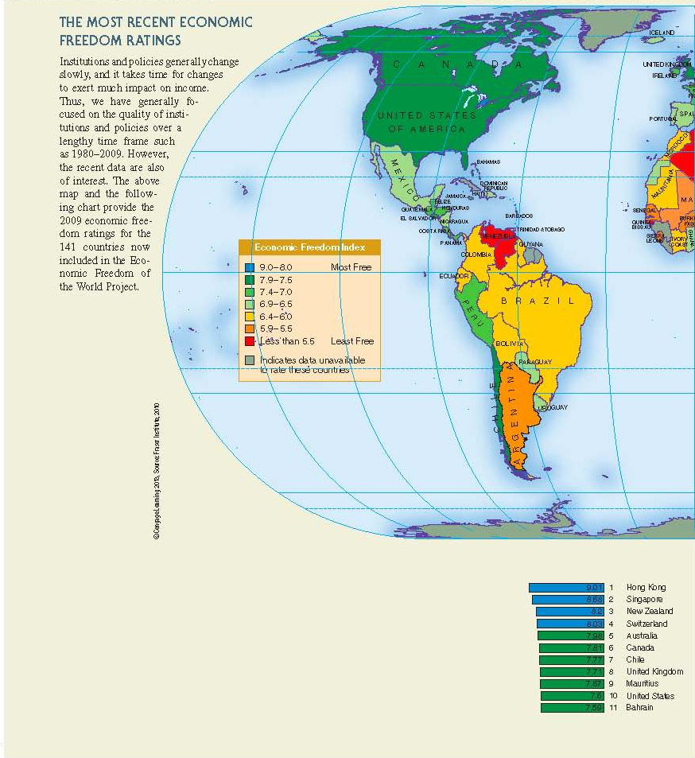
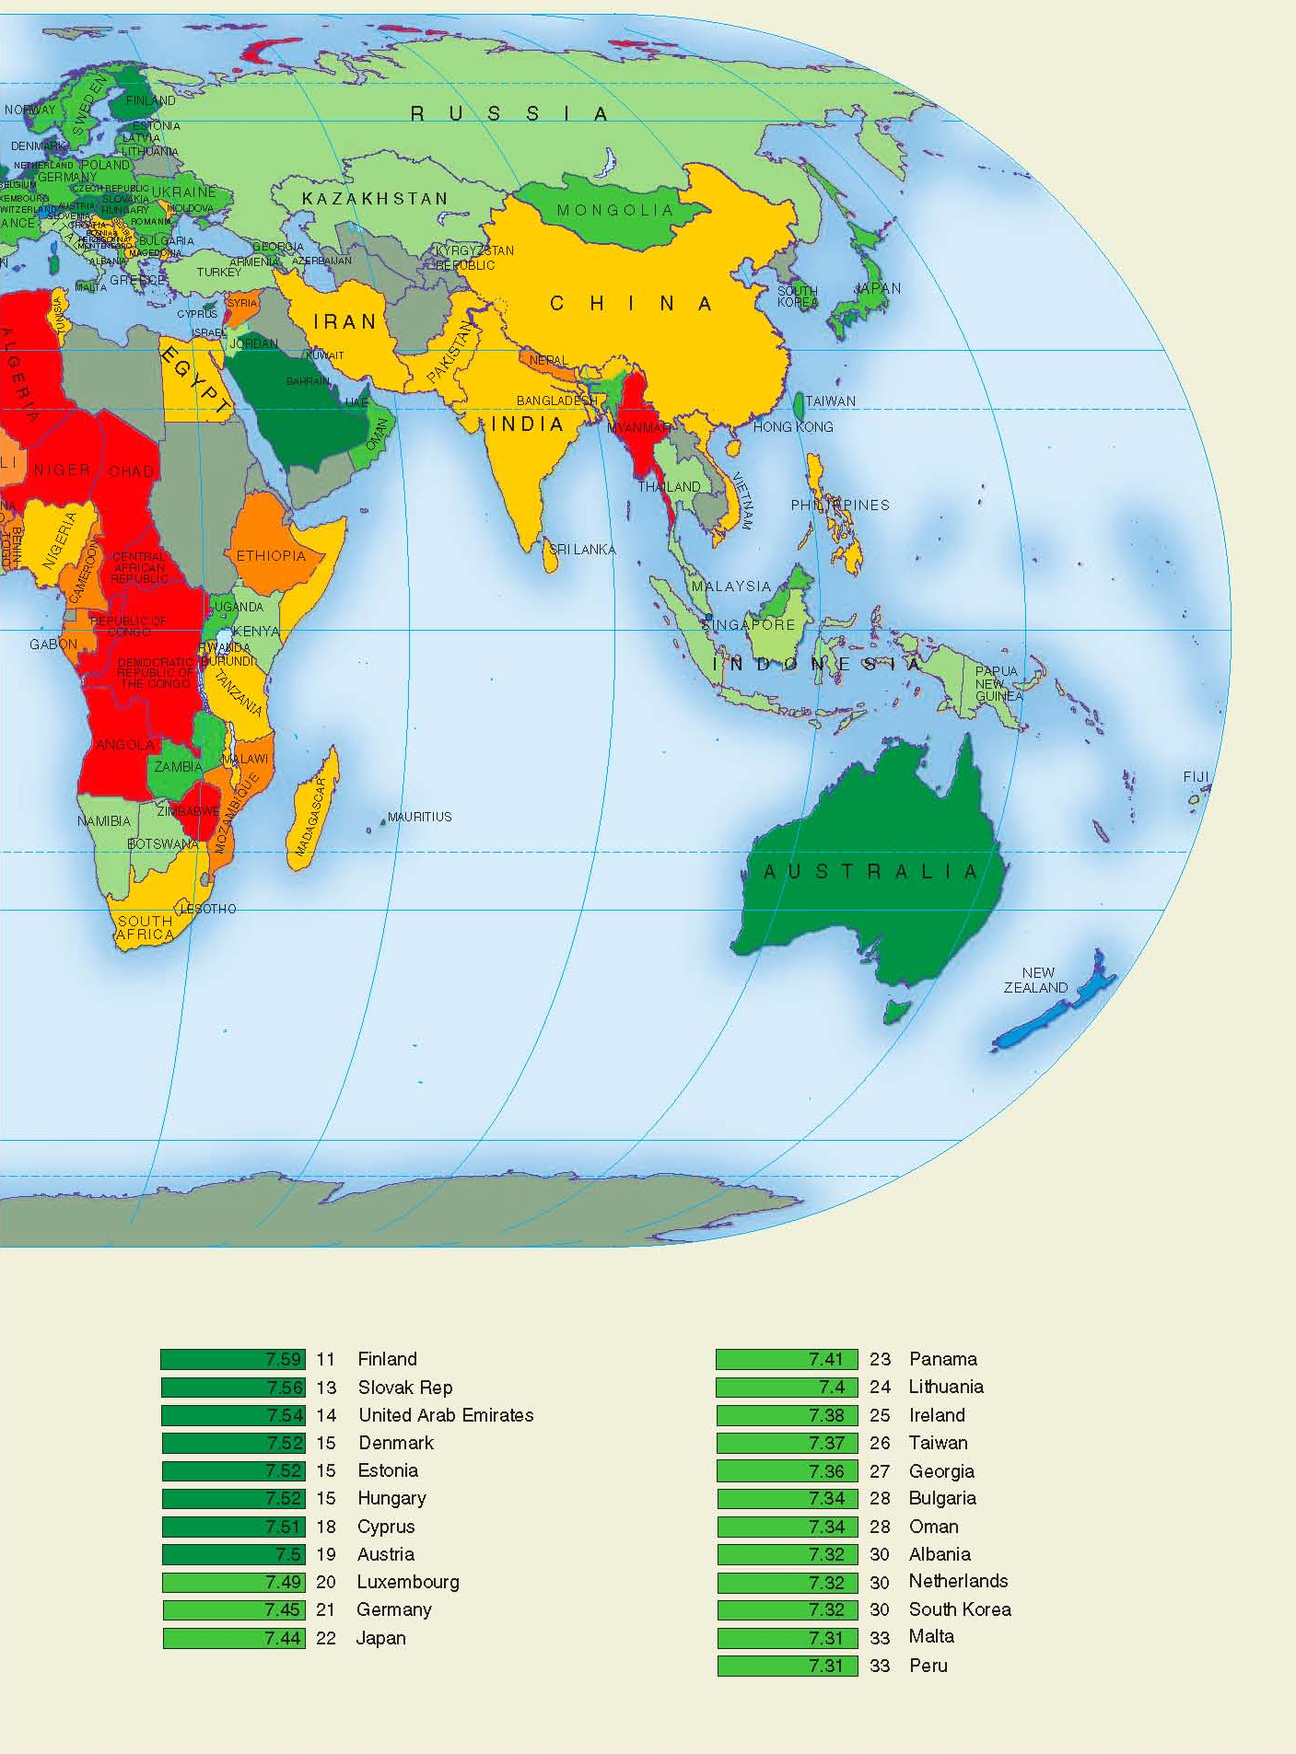

Slide 54
End of
Chapter 17

