Slide 1
China
The Party-State System

Slide 2
The Party State System
State Structures
Party Structures
Party State Interpenetration

Slide 3
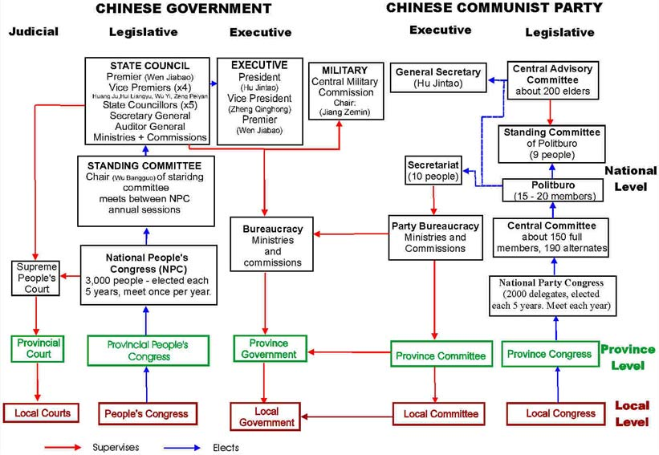
State/Party Structures

Slide 4
The Leading Role of the Party
The Leninist Party
Vanguard of the Proletariat
Discipline
Propaganda – Rectify
People’s Democratic Dictatorship
Marxism-Leninism and Mao Zedong Thought
Crystallized, collective wisdom of the Chinese Communist Party tested in practice
In 1981 Mao was acknowledged to have made gross mistakes but in the end, he was a great Marxist and a great revolutionary, strategist and theorist

Slide 5
The Evolution of Party State Relations
Restoring Order and Implementing Reform – 1949 – 1957 – 5 year plan – Agrarian Reform – Marriage Law – Hundred Flowers Bloom – Anti- Rightist Campaign
Reviving Revolution – 1957 – 1965 – Great Leap Forward – Mao’s domination of politics loosened because of catastrophe
The Great Proletariat Cultural Revolution – 1965 – 1976 – Factional politics with rightist such as Liu Shaoqi and Deng Xiaoping demoted and humiliated – War against four olds – PLA intervenes to establish order – Lin Biao established as Mao’s heir in 1969 constitution
Succession Politics: The Transition to Reform Period – Lin Biao incident – Party authority over military reestablished – Zhou Enlai rehabilitates Deng Xiaoping, Zhou dies and Deng purged – Mao dies and Gang of Four tried and purged – Hua Guofeng outmaneuvered by Deng
The Reform Period – Modernization campaign reintroduced in 1978 – 1982 constitution drawn up to support reforms – Deng is declared architect of China’s second revolution – Tiananmen events of 1989 controlled by force and establish China’s commitment to party state structure

Slide 6
Assessing the Party State System
Top leaders have held both party and state positions but ultimate source of influence comes from position in Communist party
With exception of the end of the Cultural Revolution and Lin Biao period, China has been under civilian rule, but civilian leaders have held the chairmanship of the Central Military Commission
Personalism and factionalism have played important roles in Chinese succession politics
Technical expertise has played an important role in the selection of the post Long March generation of leadership
The Tiananmen incident was the last major convulsion surrounding leadership transitions with the transition from Jiang Zemin to Hu Jintao moving smoothly
The Chinese system, along with most other political systems, tends to under represent women and politicians

